Slide 1
Employer Advisory Group
July 2024

Slide 2
Agenda
Director’s Office update
Legislative update
Modernization update
Actuarial update
Employer Service Center update
Communications update
Open discussion

Slide 3
Director’s Office update
Kevin Olineck, Director

Slide 4
Director’s Office update
PERS Board updates
July 26 board meeting
CEM Benchmarking results.
Actuarial valuation report for period ending December 31, 2023.
2025-27 Agency Request Budget board approval.
Board member updates
Board Member Scanlan reappointed for a second three-year term.
Member representative.
Board Member Scanlan represents public employees and retirees.

Slide 5
Legislative update
Heather Case, Senior Policy Advisor

Slide 6
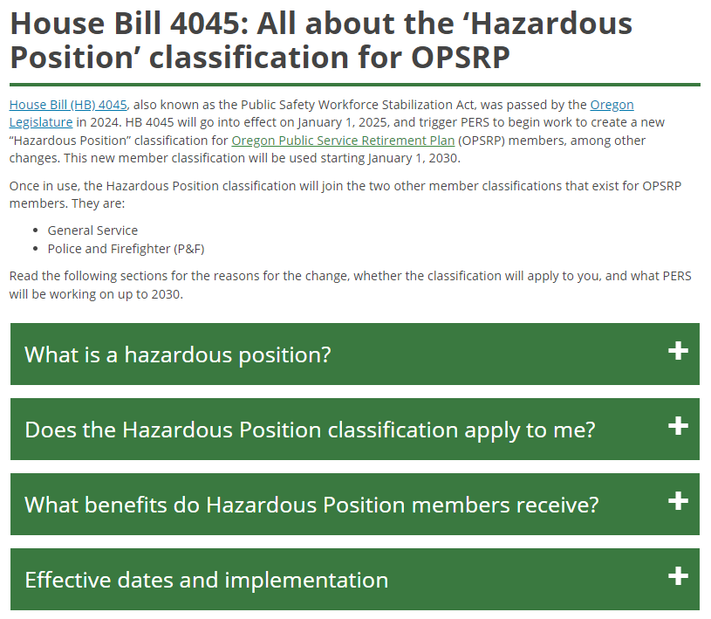
Legislative update
Member webpage for Hazardous Position
Hazardous Position webpage
In anticipation of implementation beginning in 2026, new webpage for frequently asked questions about Hazardous Position job classification.
House Bill 4045: All about the ‘Hazardous Position’ classification for OPSRP
We will update page with any legislative changes that occur between now and the operative date of new member classification on January 1, 2030.
Webpage serves as a resource for employers also so that we have a single source of information for this upcoming legislation.

Slide 7
Legislative update
PERS 2025 legislative concepts
PERS’ 2025 legislative concepts are continuing forward as introduced.
They were sent out to legislative counsel for drafting at the end of June. We will be working with legislative counsel throughout the summer and fall to edit draft language.
Four potential bills (see April 2024 EAG meeting for more details):
Alignment/clean up of death benefits.
Alignment/clean up of employer reporting.
PERS Health Insurance Program (PHIP) concepts.
Treatment of School District Unfunded Liability Fund (SDULF).
Government affairs staff for your various membership groups are aware of the upcoming legislative concepts. They remain a resource for you about potential impacts and lobbying plans as the 2025 session approaches.

Slide 8
Modernization update
Yvette Elledge-Rhodes, PERS Deputy Director

Slide 9
Modernization update
Staffing, planning, and budgeting
Staffing
May: Program Director Rebecca Craven submitted her resignation from PERS effective May 28, 2024. Deputy Director Yvette Elledge-Rhodes will oversee the PERS Modernization Program until a new director is hired.
Project planning
March: Request to reallocate Policy Option Package (POP) 103 subcategories was approved by the 2024 Legislature. Adjustments reflect changes in work plans based on resource impacts of Senate Bill 1049 Implementation Program schedule delays and procurement delays.
May: Final updates to 2023-25 Program Roadmap accepted by Modernization Steering Committee.
May: Data Cleaning Implementation Project approved and prioritized in PERS Project Portfolio.
Continued

Slide 10
Modernization update
Staffing, planning, and budgeting
Telephony Modernization Project
Reviewing high-level requirements with the state preferred vendor Kyndryl.
2025-27 budget
Preparing 2025-27 budget business cases for next biennium needs for program administration and future projects.

Slide 11
Roadmap 2023–2025
Modernization update
2023 | 2024 | 2025
Note that this timeline is an estimation and should not be considered a project schedule. A project schedule is developed after projects and resources are approved and prioritized in PERS Enterprise Portfolio and then will be formally baselined.
Jul | Sep | Nov | Jan | Mar | May | Jul | Sep | Nov | Jan | Mar | May
Modernization Program Administration and Delivery
BPM/EA, Data & Analytics, DevOps, OCM & Communication, and Security Workstreams
EA Consultant
DevOps Modernization Readiness
iQMS Initial Risk Assessment
System Assessment
CRM Needs Assessment
Document Current and Future State Enterprise Architecture
iServer 365 Upgrade
Current State Process Maps
Data Clean Up Project
Telephony Modernization Project
Hybrid Integration Platform Project
25/27 Budget Draft to
PERS Board
Architecture Alternative
Analysis
MIAM Decision
Roadmap approved 5/14/24
Workstream Activities
Project
Key decision point

Slide 12
Modernization update
2021-2023 | 2023-2025 | 2025-2027 | 2027-2029 | 2029-2031
2022 | 2023 | 2024 | 2025 | 2026 | 2027 | 2028 | 2029 | 2030 | 2031
Note that this timeline is an estimation and should not be considered a project schedule. A project schedule is developed after projects and resources are approved and prioritized in PERS Enterprise Portfolio and then will be formally baselined.
Initiation/Definition
Modernization Program Delivery (includes OCM & Communications)
Program Closure
Enterprise Architecture & Process Mapping Support Workstream
Data & Analytics Workstream
Development & Operations Workstream
Security Workstream
Telephony Project
Training Workstream
HIP
Project
Future State Visioning
Client Relationship Management (CRM)
Future State Visioning
Online Member Services Modernization
Future State Visioning
Pension Admin System Modernization
Future State Visioning
IAP Modernization
Future State Visioning
Employer Data Modernization
Stabilization
Notes:
12
As you know, the Work After Retirement section of Senate Bill 1049 was effective January 1, 2020.
Full information for employers can be found on our SB 1049 Employer website – www.oregon.gov/PERS/EMP/Pages/SB1049.aspx (linked from employer homepage)
From that page, you’ll see we regularly update when we have new information to share. That page also includes a link to our member-focused information if you are helping any retirees understand the limitations in returning to work.

Slide 13
Actuarial update
Troy Phillips, PERS Actuarial Business Specialist
Notes:
Thank you, Sam.
Good morning, everyone.
Today, I am going to provide information on the employer incentive fund – its history, what it is, what it does, data from the previous funding cycle, and information on a proposed new funding cycle.
I will also provide an update on our plans to manage those side accounts that are due to expire on December 31, 2027.
Next slide please Sam

Slide 14
Actuarial update
Employer Incentive Fund (EIF)
Background
Established by 2018 Oregon Legislature — Senate Bill 1566.
Additional PERS funding to match side account contributions.
Employers receive up to 25% match for new or certain existing side account deposits.
Minimum deposit amount: $25,000.
Maximum match: 5% of UAL or $300,000, whichever is greater.
Program is scheduled to sunset on July 1, 2042.
Notes:
The Employer Incentive Fund was established by the Oregon Legislature in 2018 with the passage of Senate Bill 1566.
It created additional funding for PERS that is used to encourage employers to create side accounts by offering match amounts. The idea is to assist employers with managing their unfunded actuarial liability.
Employers receive a 25% match for new side account deposits or deposits into existing side accounts.
The minimum match is $6,250, which is 25% of the minimum deposit amount of $25,000.
The maximum match is 5% of unfunded actuarial liability or $300,000, whichever is greater. This would equate to an employer with a six million dollar UAL.
The EIF program is currently scheduled to sunset on July 1, 2042.
Next slide please.

Slide 15
Actuarial update
Employer Incentive Fund (EIF)
Criteria for EIF match
Deposit is at least $25,000 from cash on hand — not borrowed funds.
Employer has no transition liability.
Must research other ways to reduce their contribution rate by participating in the Unfunded Actuarial Liability Resolution Program.
Notes:
The minimum required deposit is twenty-five thousand dollars, which must be from cash on hand– it cannot be from borrowed funds, which includes proceeds from a pension obligation bond.
For those employers belonging to the State and Local Government Rate Pool, if the employer has a current transition liability, it can directly pay down the liability, but that payment is not eligible for a match.
Lastly, the employer must commit to participating in the Unfunded Actuarial Liability Resolution Program, which provides tools to assist employers with different methods of reducing their contribution rates.
Next slide please.

Slide 16
Actuarial update
Employer Incentive Fund (EIF)
Cycle 1
Notes:
This table shows the amount of funds matched from two thousand nineteen to two thousand twenty-three. There were no matches in two thousand twenty-one due to a temporary reallocation of state funds.
Next slide please.

Slide 17
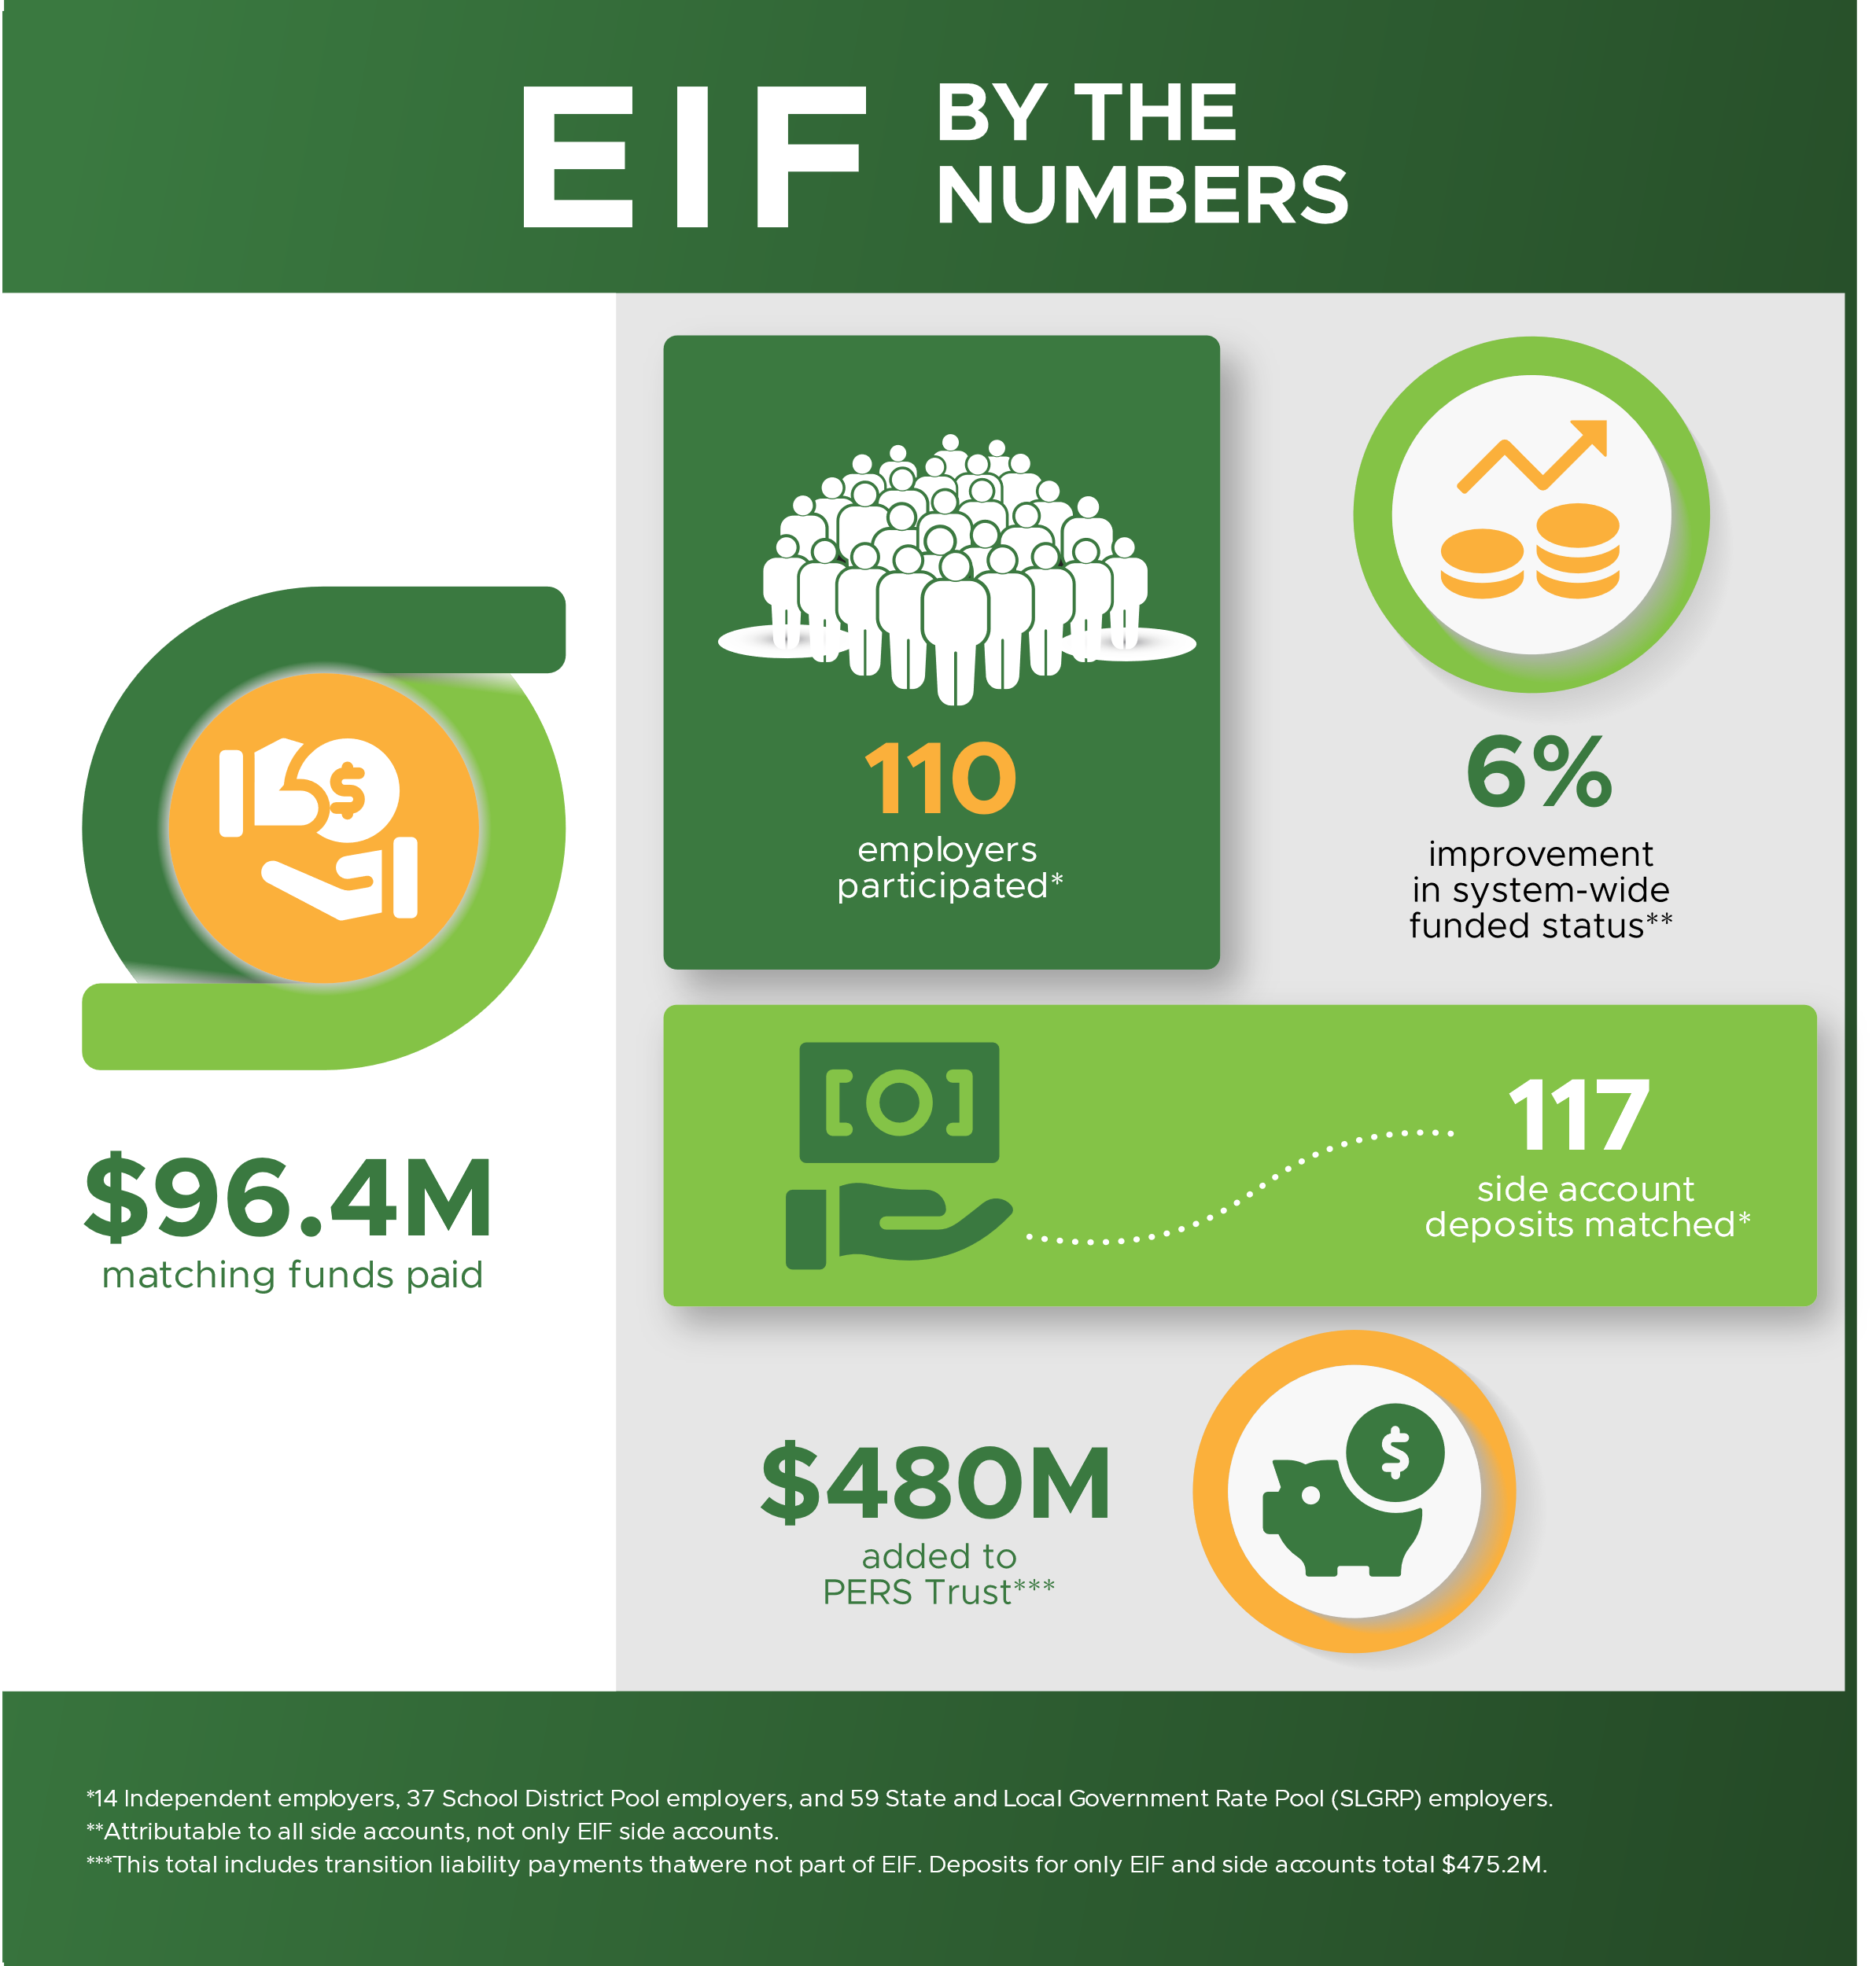
Actuarial update
EIF
Cycle 1
Information through November 30, 2023.
Notes:
As you can see from this slide, the program has been extremely successful, having paid out over ninety-six million dollars in matching funds, matching one hundred and seventeen side account deposits for one hundred and ten employers. This contributed to a system-wide funding status improvement of six percent.
Next slide please.

Slide 18
Actuarial update
Employer Incentive Fund (EIF)
2025 funding
New round of funding in 2025.
Amount of available funds will be approximately $40,000,000.
Employers with UAL > 200% given priority — first 90 days of application period.
Employer survey will be conducted later this summer to gauge interest and solicit input on preferred application dates.
Notes:
We are excited to announce that we anticipate opening a new round of EIF funding next year.
There will be approximately forty million dollars available in matching funds.
Employers with an unfunded actuarial liability greater than 200% will be given priority for the first ninety days of the application period. After ninety days, the program will be open to all qualifying employers.
We will be conducting a survey later this summer to gauge interest in the program and to solicit input on preferred application dates that may work best for employers’ budget cycles. More information will be forthcoming.
Next slide please.

Slide 19
Actuarial update Expiration of side accounts
Amortization
Most side accounts are scheduled to fully amortize on 12/31/2027:
183 out of 349 (52%).
Only 15 other side accounts are currently set to amortize before 2037.
Key items to consider when planning actions to resolve:
Cash-flow concerns for employers using pension obligation bonds.
Challenges implementing mid-biennium rate changes.
Desire to not “over withdraw” side account balances.
Notes:
I wanted to take the opportunity to provide an update on our plans to manage those side accounts that will be expiring in two thousand twenty-seven.
As we’ve mentioned before, we have been proactively discussing methods of handling those accounts in a way that prevents account balances from being overdrawn and addressing the challenges of mid-biennium rate changes, while being mindful of potential cash flow concerns for those employers that are servicing pension obligation bonds.
Next slide please.

Slide 20
Actuarial update
Expiration of side accounts
Proposed method to expire side accounts – Part 1
For the 2025 valuation, consulting actuary will determine the 2027-29 biennium contribution rate for each employer.
Contribution rate will not reflect any offset for side accounts expiring 12/31/2027.
Side account balance as of 12/31/2026 (+ earnings) will be calculated in April 2027.
Employer will have option to convert residual balance into new side account if:
12/31/2026 side account balance is at least $500,000.
Employer notifies PERS on or before 5/31/2027.
New side account deposit amount and offset rate will be shared on 11/1/2027.
Offset rate will apply effective 1/1/2028.

Slide 21
Actuarial update
Expiration of side accounts
Proposed method to expire side accounts – Part 2
If no new side account is selected, 30% of the 12/31/2026 side account balance will be credited to employer’s account.
Credit will be available to employer on 6/30/2027 and will remain until extinguished by subsequent contributions due.
On 7/1/2027, new contribution rates based on 2025 valuation will apply.
Rates will include no side account rate offset for accounts expiring on 12/31/2027.
In October 2027, final side account balance effective 6/30/2027 will be calculated.
Balance will reflect credit made available 6/30/2027.
A credit reflecting this final balance will be available no later than 11/1/2027.

Slide 22
Employer Service Center update
Laurel Galego, Employer Service Center Manager

Slide 23
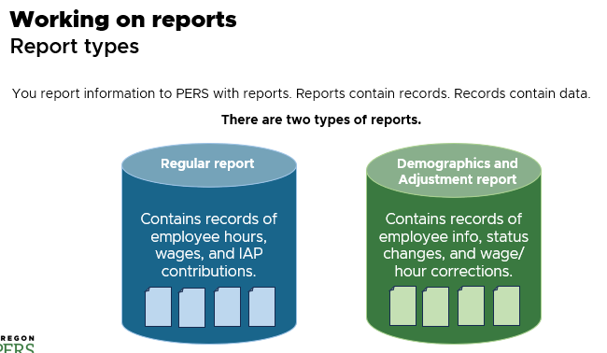
Employer Service Center (ESC) update
Beginner EDX Training course
About the course
First official ESC training offered in two years.
Content updated, expanded, more thorough.
Includes hands-on practice in EDX test environment, necessitating small classes.
Sample slide from beginner training.

Slide 24
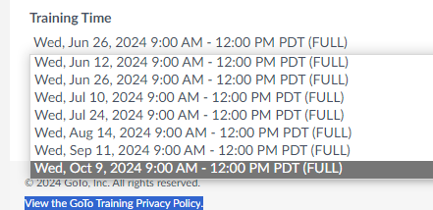
Employer Service Center (ESC) update
Beginner EDX Training course
High demand for training
Training announced by email on April 14 at 9:30 a.m.
All monthly classes (May through October) filled in three hours.
ESC quickly doubled number of classes.
The additional classes filled by end of day.

Slide 25
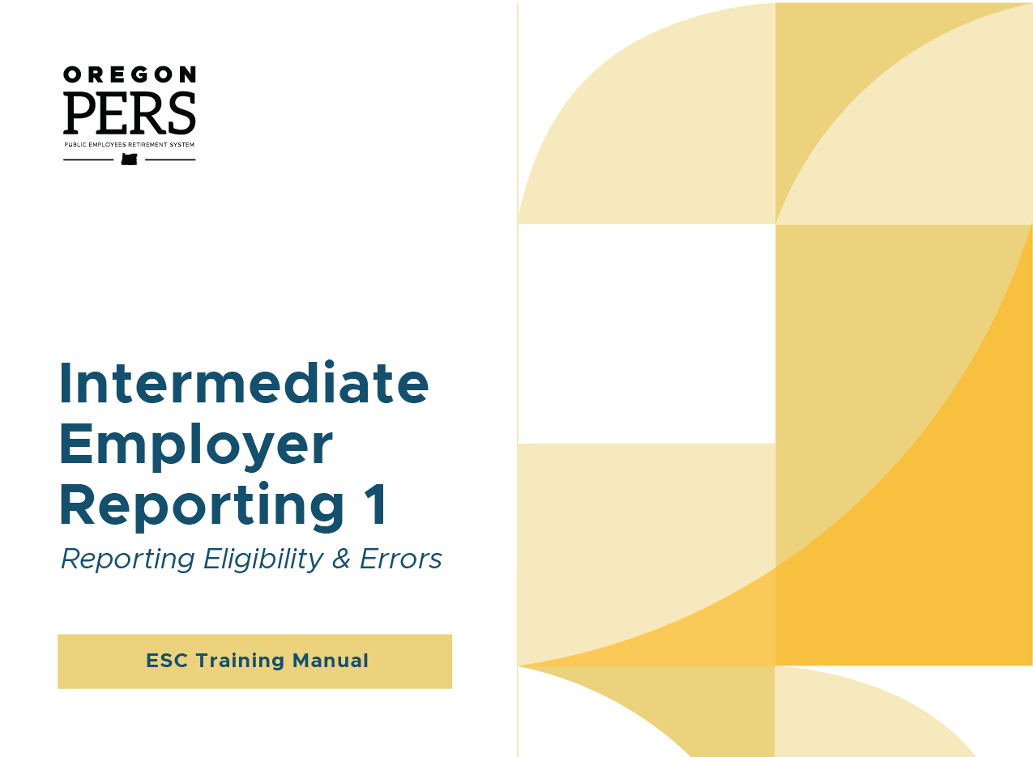
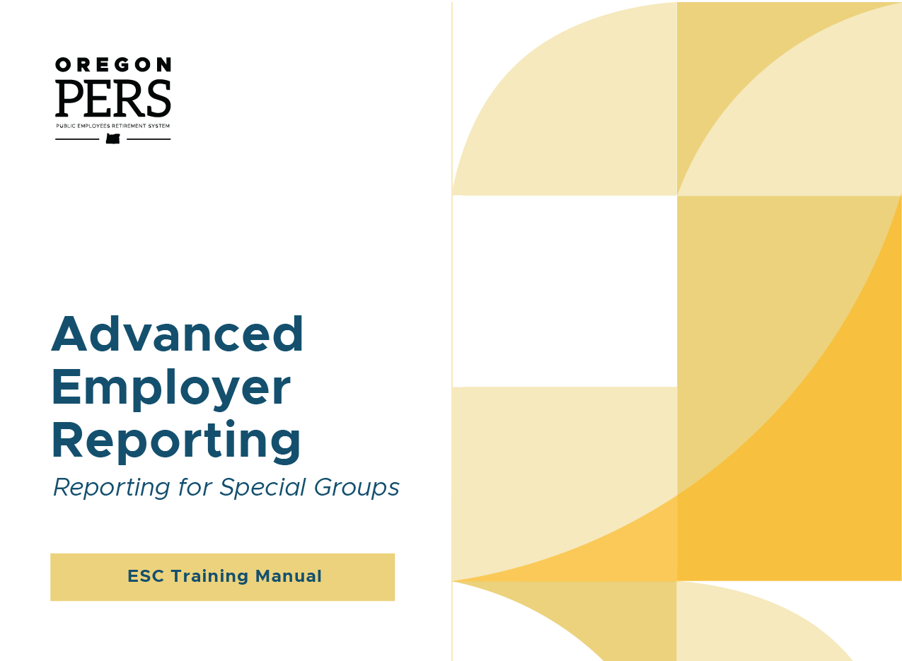
Employer Service Center (ESC) update
Beginner EDX Training course
Next steps
To help meet demand, ESC will offer a recording of the course employers can take on their own.
It will not include practice in the EDX test environment, but it will allow many more employers to access the main presentation.
ESC and Communications will continue to work on the Intermediate and Advanced classes as quickly as schedules allow.

Slide 26
Communications update
Shawn Harper, Employer Communications Specialist

Slide 27
Communications update
PERS Employer Satisfaction Survey
May 1 – 30
Duration
8,848 No. of employer contacts emailed
479
No. of people who took it
5.2% Response rate
Conducted by PERS via SurveyMonkey.
Anonymous unless they choose to include contact information.
Marketing campaign:
Weekly emails.
Newsletter articles.
ESC signature line link.
Improvement over last year’s 4.5% response rate.
Increase of 131 over last year.

Slide 28
Communications update
PERS Employer Satisfaction Survey
Results
Tune in to the October 4, 2024, board meeting for survey results.

Slide 29
Communications update
Expanding focus
Employer News
More than EDX reporting and legislative news.
Expanding to cover benefits information and processes for Human Resources (HR) roles and agency heads.
APRIL
Retirement theme
PERS retirement package.
How PERS calculates pensions.
Four steps of retirement process.
JULY
Partial HR theme
Preretirement beneficiary process.
Service time purchases: cost, instructions, how wait-time purchase affects school employees’ service credit.
AUGUST
Hiring & onboarding theme
Hiring employees in special situations.
Teaching your new employee about PERS.
Doing status checks.

Slide 30
Communications update
New resources
Employer website
New information, never-before published. Previously only available by calling.
Find any time using search bar.
Designating a Preretirement Beneficiary
How pension beneficiary works.
How IAP beneficiary works.
What beneficiaries Tier One/Tier Two and OPSRP can choose, by law.
Beneficiary benefits.
LINK
Filling out a Tier One/Tier Two Written Benefit Estimate Form
Preretirement beneficiary process.
Service time purchases, cost, instructions, and how wait-time purchase affects school employees.
LINK
Special Classifications and Statuses (in work)
Information specifically for certain job classes and statuses, such as:
Schools, colleges, and universities.
Police and firefighters.
Sick or injured employees.
Members of US military.
Legislators, elected officials.

Slide 31
Open discussion

Slide 32
Open discussion
Any questions or comments for PERS?
Questions for each other?
Notes:
32
As you know, the Work After Retirement section of Senate Bill 1049 was effective January 1, 2020.
Full information for employers can be found on our SB 1049 Employer website – www.oregon.gov/PERS/EMP/Pages/SB1049.aspx (linked from employer homepage)
From that page, you’ll see we regularly update when we have new information to share. That page also includes a link to our member-focused information if you are helping any retirees understand the limitations in returning to work.

Slide 33
Thank you!

