Slide 1
UPCS Changes, Updates & Reminders

Slide 2
UPCS Changes, Updates & Reminders
GENERAL Changes To The UPCS Protocol
“Industry Standard” Repairs Rephrasing of the rule to include the wording “reasonably compatible with design and quality of the original”. Additionally, HUD urges the REAC inspectors to understand that new materials will not be an exact match to the original color and to use their “best judgment and professional common sense” when determining this possible NIS issue (HUD used tuck-pointing as an example of a correct repair that won’t match existing materials).
1. Completed in a “workmanlike manner”.
2. Don’t introduce a material that is not consistent with the original.
3. New material shade variation is allowed as long as the material is correct.
Panel Boxes Caulking (or any “foreign” material) is not allowed to cover/fill 1/4” gaps in electrical boxes. HUD gave minimal feedback other than to say; “introduction of a foreign material into this type of device is NOT an acceptable repair.” 1/4” gaps covered/filled with caulking will now be recorded as a “Health and Safety - Electrical Hazard”. Additionally, screws that penetrate into the box (where the wires are located) is also considered an “Electrical Hazard”
Cause and Effect If one deficiency creates another deficiency, only one of the defects (the higher level) should be recorded (unless the secondary defect is a Health and Safety – at which point both defects would be cited).
New Responsibilities
Garbage Disposal Property rep is allowed to “reset” the disposal if needed so long as that can be accomplished without the use of any tools. Additionally, if any missing electrical covers are noted on the disposal, this will continue being recorded as a LT defect.
Tripped Breaker The property rep can reset a tripped breaker as long as the breaker does not affect a life safety item (call-for-aid or smoke detector), and no defect will be recorded.
Window AC The inspector is required to allow the property rep to plug in an installed but unplugged window AC unit to check for proper operation.
Shut Off Valves If the water shutoffs at the sinks or toilets are turned off at time of inspection, the REAC inspector CAN allow the property rep to turn on the valves to allow for proper inspection.
Door Hardware Property reps are allowed to remove door sweeps, wreath hangers, clothes, etc. from a door to allow for proper closing.

Slide 3
UPCS Changes, Updates & Reminders, Continued
SITE Changes To The UPCS Protocol
Trip and Sharp Hazards If found on non-owned walks/roads, will be recorded as Site/Hazards/Other (non-scoring issue).
Perimeter Fencing All perimeter fencing (48” or taller) will be fully inspected regardless of actual ownership – get your appeals ready.
Overgrown Vegetation If growing on the roof or in gutters, this is considered Site/Grounds/Overgrown Vegetation. So, moss on shingles or small saplings in the gutters will be cited.
Overgrown Vegetation Small amount of vegetation touching a fence and causing NO damage, is NOT to be considered “Overgrown Vegetation”. If the questionable vegetation is dense (even without causing damage), a defect will be cited.
Graffiti Regardless of medium used (paint, chalk, etc.) to create inscriptions, gang signs, symbols, drawings, etc. will be cited as defective. But, if chalk is used only for game boards, drawings, etc. on flat ground surfaces (walks and roads), this should NOT be cited.
Steps In the past, any steps not under roof was considered “Site” steps. The new protocol dictates that any steps directly connected to the building will be evaluated not as “Site” but as “Unit” or “Common Area” depending on its actual purpose. This is an awesome adjustment as the point deduction will be much less as a unit or common area issue.

Slide 4
UPCS Changes, Updates & Reminders, Continued
EXTERIOR Changes To The UPCS Protocol
Cracks When inspecting repairs, inspectors are reminded that the new material must be appropriate (no latex or silicone caulking), but is not required to match perfectly in color. New and old mortar are NOT required to match in color/shade but must be completed in a “workmanlike manner”.
Foundation Vents Not within scope of UPCS.
Brick Chipping Minor chipping of brick wall corners will no longer be recorded as deficient.
Vents Any missing or damaged exhaust vents (range hood, dryer, etc.) resulting in gaps/holes will be cited as Building Exterior/Hole/Level 3.
Concrete Slabs Basement, garage and all other interior slabs on grade are inspected as though they are part of the “Exterior Foundation”.
Zip Ties Inspectors are allowed to test the integrity of zip ties used to lock disconnect boxes. If the zip ties are sunbaked/old and break during inspection, the inspector will inspect the interior of the previously locked box for defects.
Exterior Stains Stains (mildew, hard water, etc.) on brick, vinyl or aluminum building is no longer a defect. The “stain” defect on the building exterior only applies now to painted surfaces.

Slide 5
UPCS Changes, Updates & Reminders, Continued
UNIT/COMMON AREA Changes To The UPCS Protocol
Call-For-Aid Regardless of all other documents HUD has produced over the past 20 years explaining there is no length requirement – that has now changed! All call-for-aid pull cords MUST BE baseboard length.
Bed Bugs These units are no longer be off-limits to the REAC inspector. If units with bed bugs show up in the inspector’s sample, they will be fully inspected. If the inspector actually observes bed bugs, they will now cite these as “H&S / Infestation”.
Door Hardware If multiple lock types (chain latch, slide bolt, etc.) are installed by property staff, ALL locks will be inspected for proper operation. If resident installed, they are not within the scope of this inspection.
Water Heater Pressure relief valve discharge piping that is crimped, bent or otherwise restricted will be recorded as defective.
Elevator Room While the elevator room is often off-limits to the inspector, REAC now expects the inspector to review the door (surface, hardware, etc.) without entering the room.
Sprinklers If the sprinkler and escutcheon are entirely intact but the hole behind the escutcheon is too large to be covered, a “hole” in the ceiling will be recorded. If the escutcheon has fallen loose (no longer secured against the ceiling or wall), a Level 3 Sprinkler defect will be cited.
Oven HUD/REAC now expects the inspectors to check both elements in the oven (broil and bake).
Refrigerator 1” split or tear in the gasket can be repaired (in a ‘workmanlike manner’). Any damage larger than 1” requires a full replacement of the seal.
Windows All locks must function. If the window was designed with 2 locks, both must work (if one lock is missing or inoperable, a Level 3 defect will be assigned). Additionally, sash pins are NO LONGER an acceptable alternative for defective balance(s) or locks.

Slide 6
UPCS Changes, Updates & Reminders, Continued
UNIT/COMMON AREA Changes To The UPCS Protocol (continued)
Installed Air Conditioners Windows with A/C’s installed will be inspected for fogging and physical damage, but NOT operation of window hardware.
Access Panels REAC now requires their inspectors to verify a “sampling” of the access panels to ensure they are truly access panels and not drywall patches. Additionally, access panels must be painted to match the existing wall color.
Flammable Material According to these new standards, nail polish remover, hairspray, paint thinner or other types of combustible items cannot be stored near a heat or electrical source/plug/light. Yes, with the wording on page 94, an inspector has the obligation to cite
hairspray sitting on the vanity if near the outlet.
Fire Hoses/Cabinets If fire hoses AND hanger hardware has been removed, no defect will be recorded. If hanging device remains in the cabinet, a defect will be assigned.
Sink/Tub Stopper If rubber stoppers are being used, the original mechanical stopper along with the pull rod must be removed AND the small hole plugged (solid overflow cover installed at tub).
Range Hood Filter Although counter to recent guidelines, a missing range hood filter is now to be recorded as a "Level 3 - Inoperable Hood".
Foil on Stove Foil on the stove or in the oven is no longer a defect.
Items Stored in Oven Flammable items stored in the oven are no longer to be recorded as “Improperly Stored Flammable Material” but only as “Hazards - Other” (non-scoring).
Sink Sprayers Sink sprayers are now only inspected for leaks. The actual operation is no longer within the scope of the UPCS.

Slide 7
UPCS Changes, Updates & Reminders, Continued
UNIT/COMMON AREA Changes To The UPCS Protocol (Continued)
Self-Closing Doors The inspector is to make only 2 attempts. If the door doesn’t self-latch with no assistance after the 2nd attempt, a Level 3 defect is to be recorded. Additionally, property reps are NOT allowed to open windows to aid in the doors closing.
Door Hardware Missing strike plates, even if the door still operates correctly, is to be cited as a defect. The level of deficiency will depend on the type of door.
Damaged Outlets and Switches (not the covers) This applies to outlets and switches that are so damaged that electrical connections are exposed. If the switch is inoperable or damaged with no exposed connections, evaluate this condition under “lighting”. (Again, reading between the lines, a damaged outlet that doesn’t expose connectors/wiring would NOT be recorded as a defect…this, of course, doesn’t apply to the covers but the outlet itself).
Regardless of Ownership Generally speaking, the only 3 resident owned items that REAC requires the inspectors to fully inspect (and deduct points) are; resident owned fridge, range and window AC units.
Resident Owned Items Most resident owned items found defective within the apartment are not scored. Items such as; resident owned fire extinguishers, broken glass, fans without covers, open slices, missing covers on dryers, etc. are recorded as “Hazards/Other” (non-scoring).

Slide 8
Oregon Supplemental Inspection Standards of Practice
The Uniform Physical Condition Standards (UPCS) are the Minimum Property Standards as set by HUD to ensure housing that is decent, safe, sanitary and in good repair (REAC utilizes UPCS standards).
UPCS violations are categorized in three levels*:
Example of a Level 1 violation include:
In one room in a dwelling unit, a permanent lighting fixture is missing or not
functioning, and no other switched light source is functioning in the room
Example of a Level 2 violation include:
In two rooms in a dwelling unit, a permanent lighting fixture is missing or not
functioning, and no other switched light source is functioning in the rooms.
Example of a Level 3 violation include:
A permanent light fixture in more than two rooms is missing or not functioning,
and no other switched light sources are functioning in the rooms.
*When filing an 8823 for the tax credit program all levels of UPCS findings must be reported

Slide 9
UPCS – vs – Supplemental
OHCS considers and monitors each property as an asset and determines the property rating based on agency liability for non-compliance; as a result the minimum REAC/UPCS standards are not enough to determine the true property condition/liability/rating for the agency and State of Oregon.
Examples: UPCS – Damaged window in a building not part of sample no deficiency noted.
OHCS Supplemental – All buildings are inspected for deficiencies.
UPCS – Kitchen cabinet deficiencies are based on a minimum percentage of 10% before being noted as deficiency.
OHCS Supplemental – Any cabinet damaged noted as deficiency.
* Certain supplemental findings that are not UPCS findings may not be reported to the IRS on form 8823 if they do not meet the level 1, 2 or 3 criteria. However, the deficiency noted must be corrected regardless.
_______________________________________________________________ Streamlining Supplemental Inspection Standards of Practice
    LISTS ITEMS AND SYSTEMS TO BE EVALUATED IN ADDITION TO THOSE DEFECTS DEFINED BY THE UNIFORM PHYSICAL CONDITIONS STANDARDS (UPCS)
    http://www.oregon.gov/ohcs/APMD/Streamlining/supplemental_inspection_standards.pdf.

Slide 10

REAC Inspection

Slide 11

OHCS Inspection

Slide 12
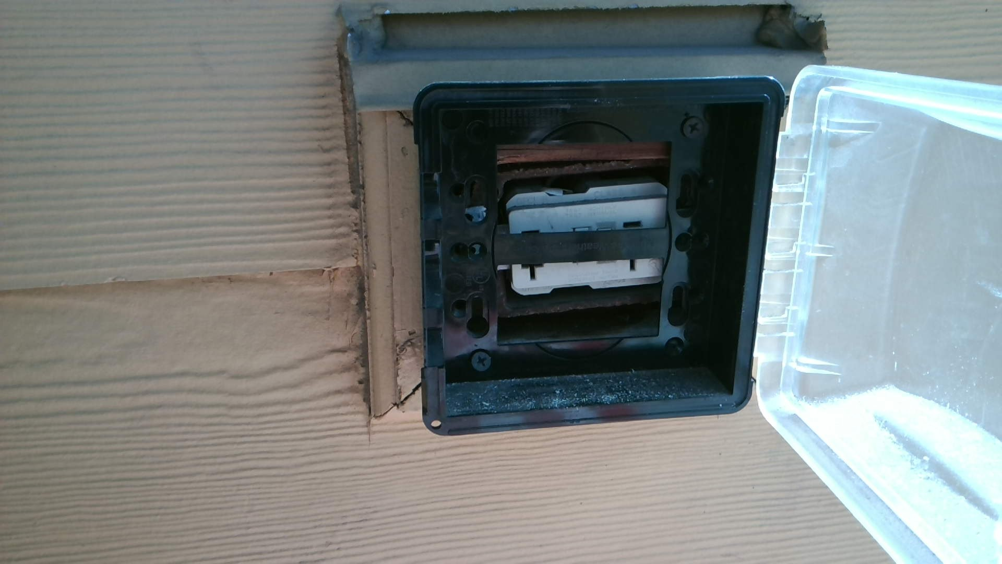
“Industry Standard” Repair?

Slide 13
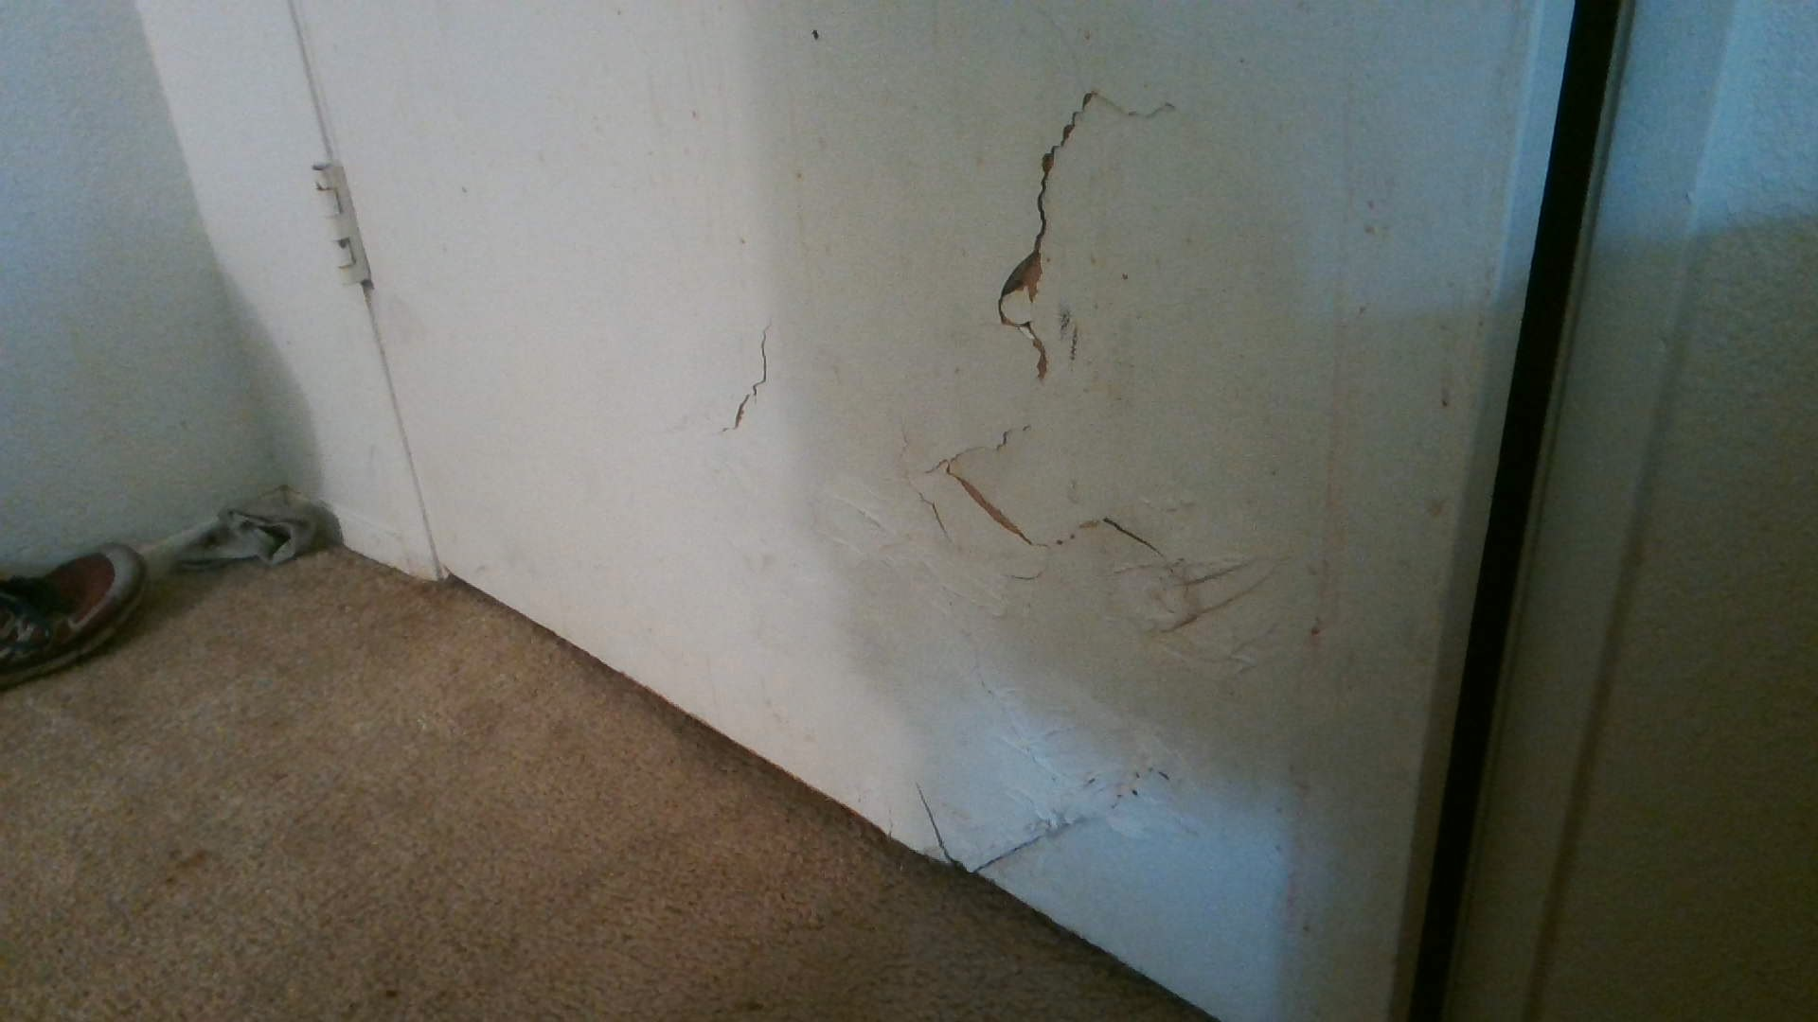
“Industry Standard” Repair?

Slide 14
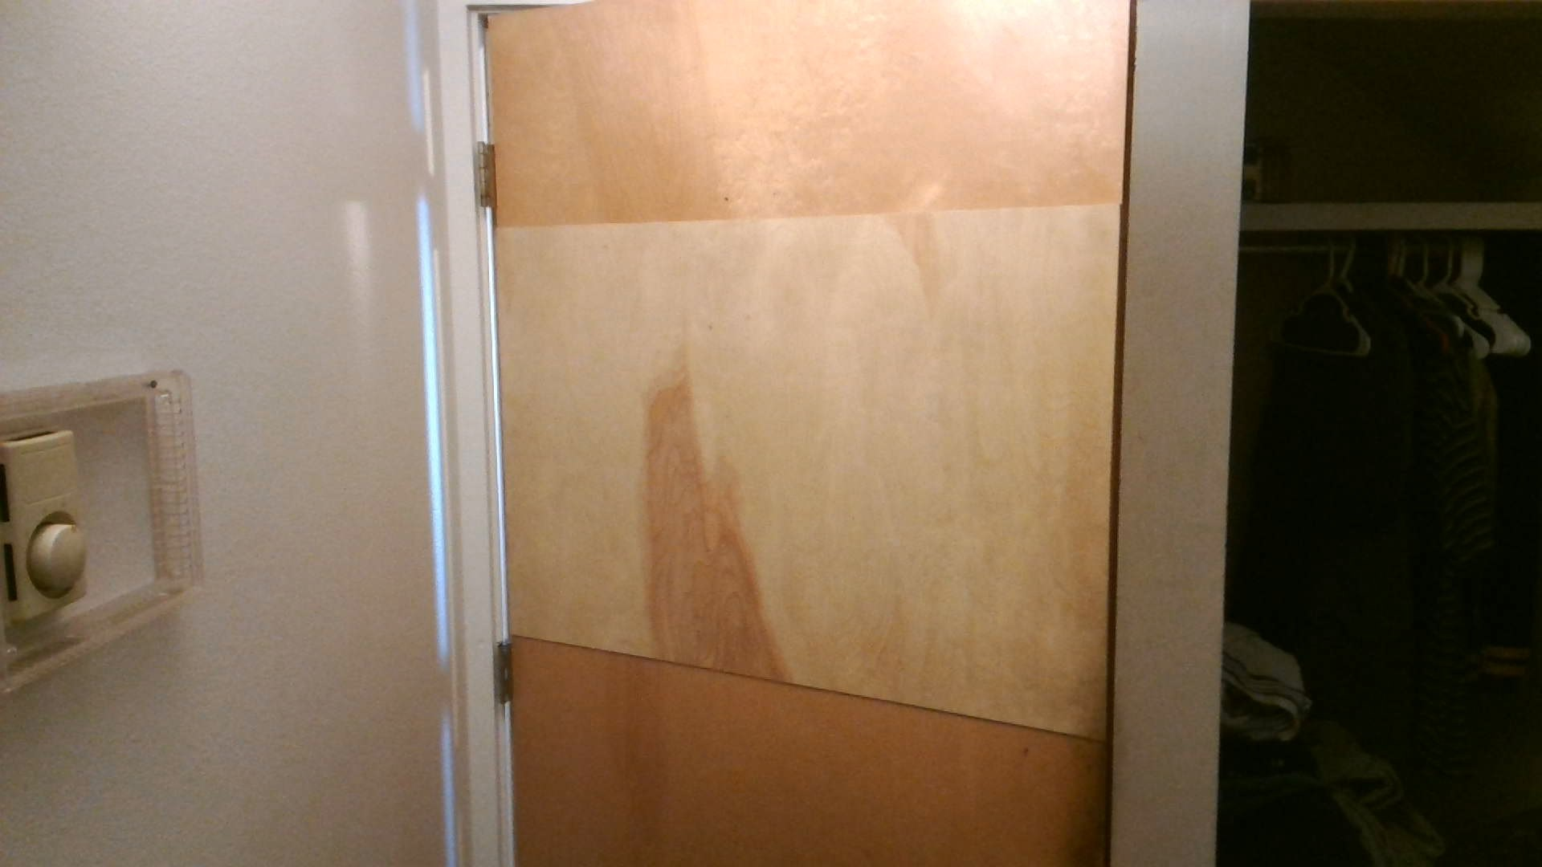
“Industry Standard” Repair?

Slide 15
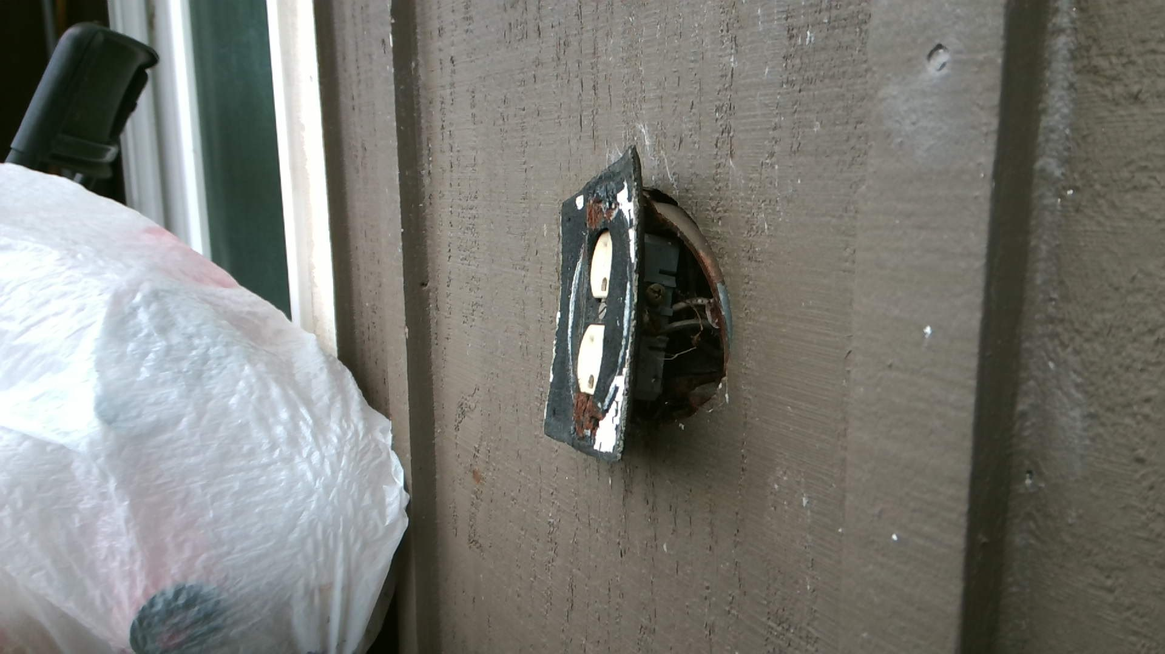
“Industry Standard” Repair?

Slide 16
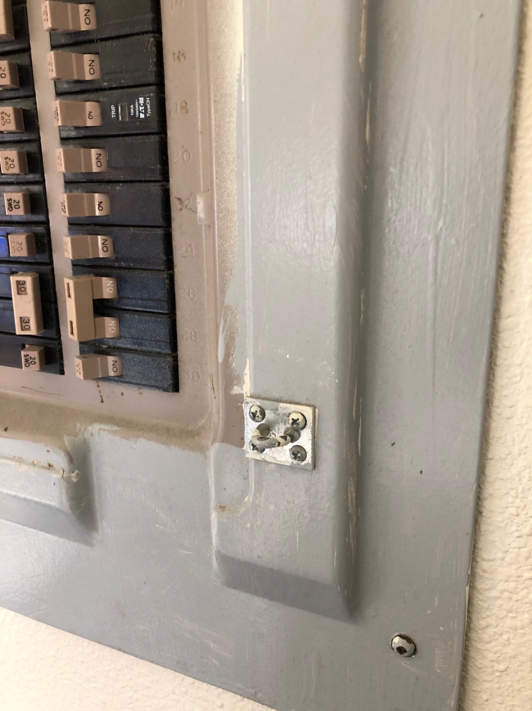
“Industry Standard” Repair?

Slide 17
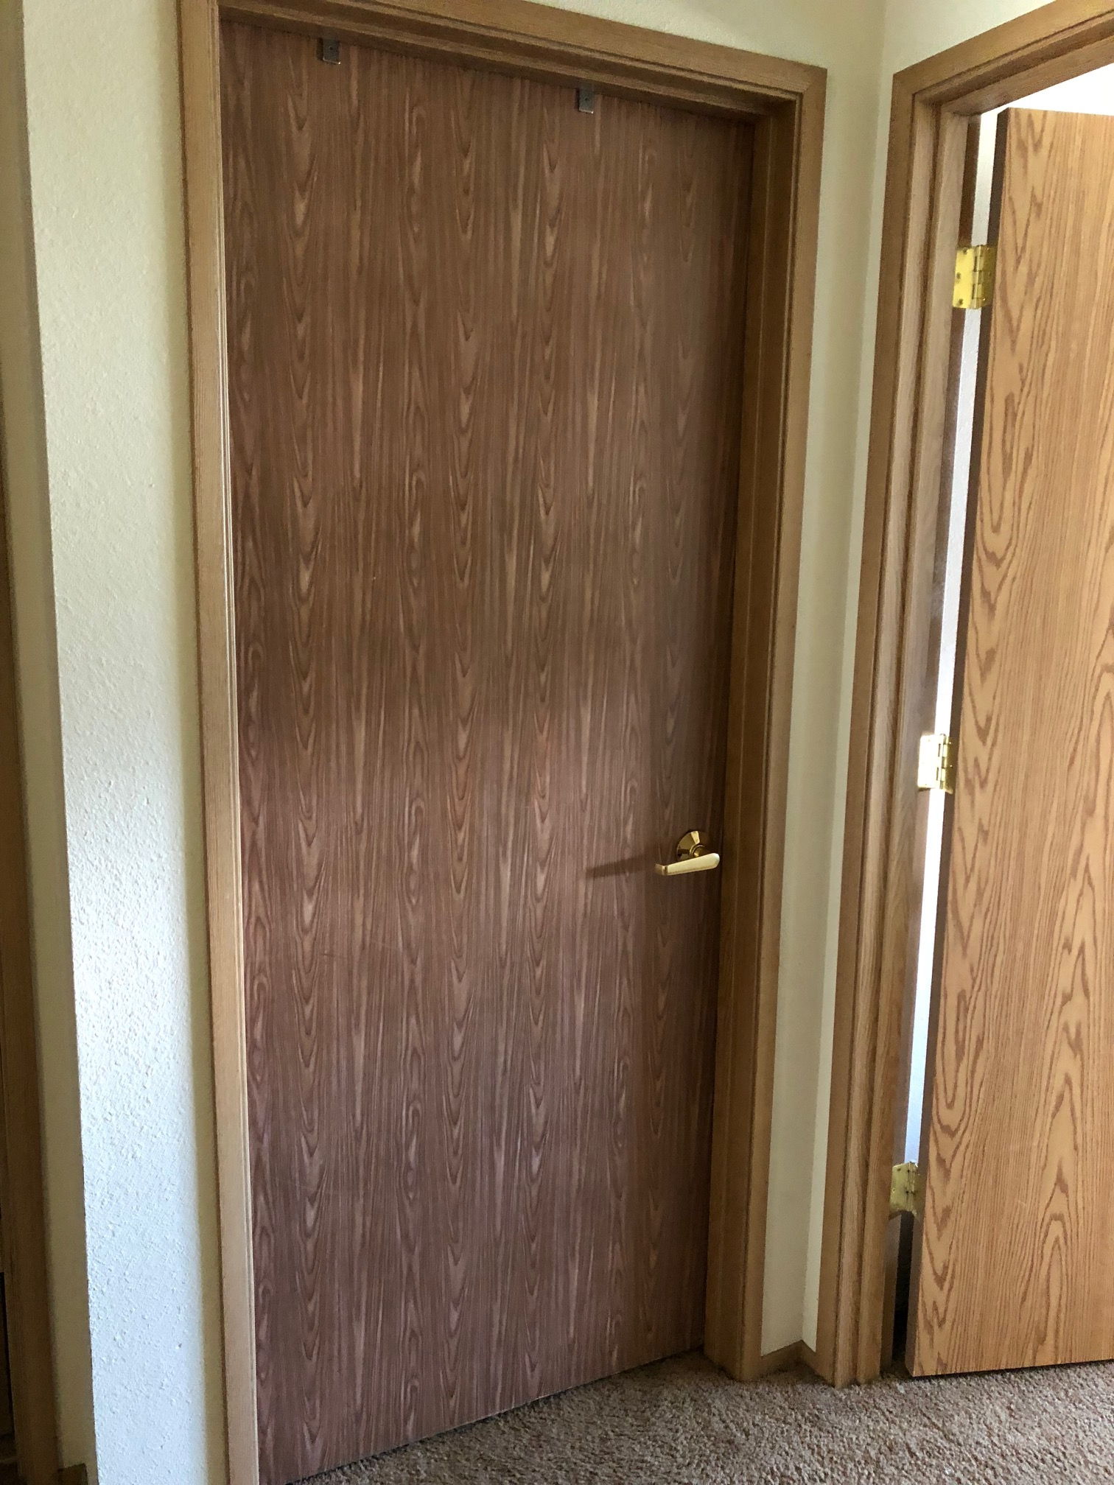
“Industry Standard” Repair?

Slide 18
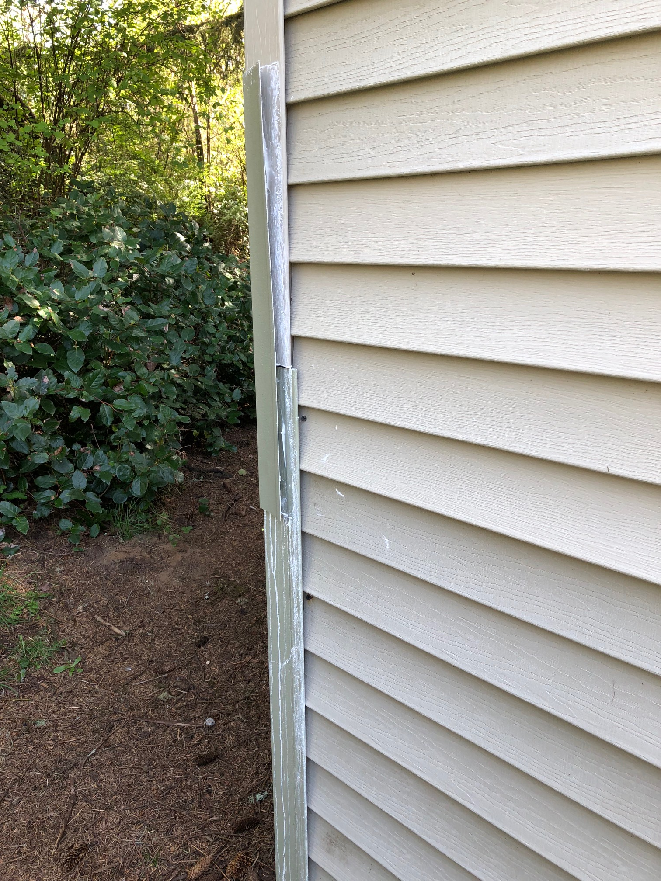
“Industry Standard Repair”?

Slide 19
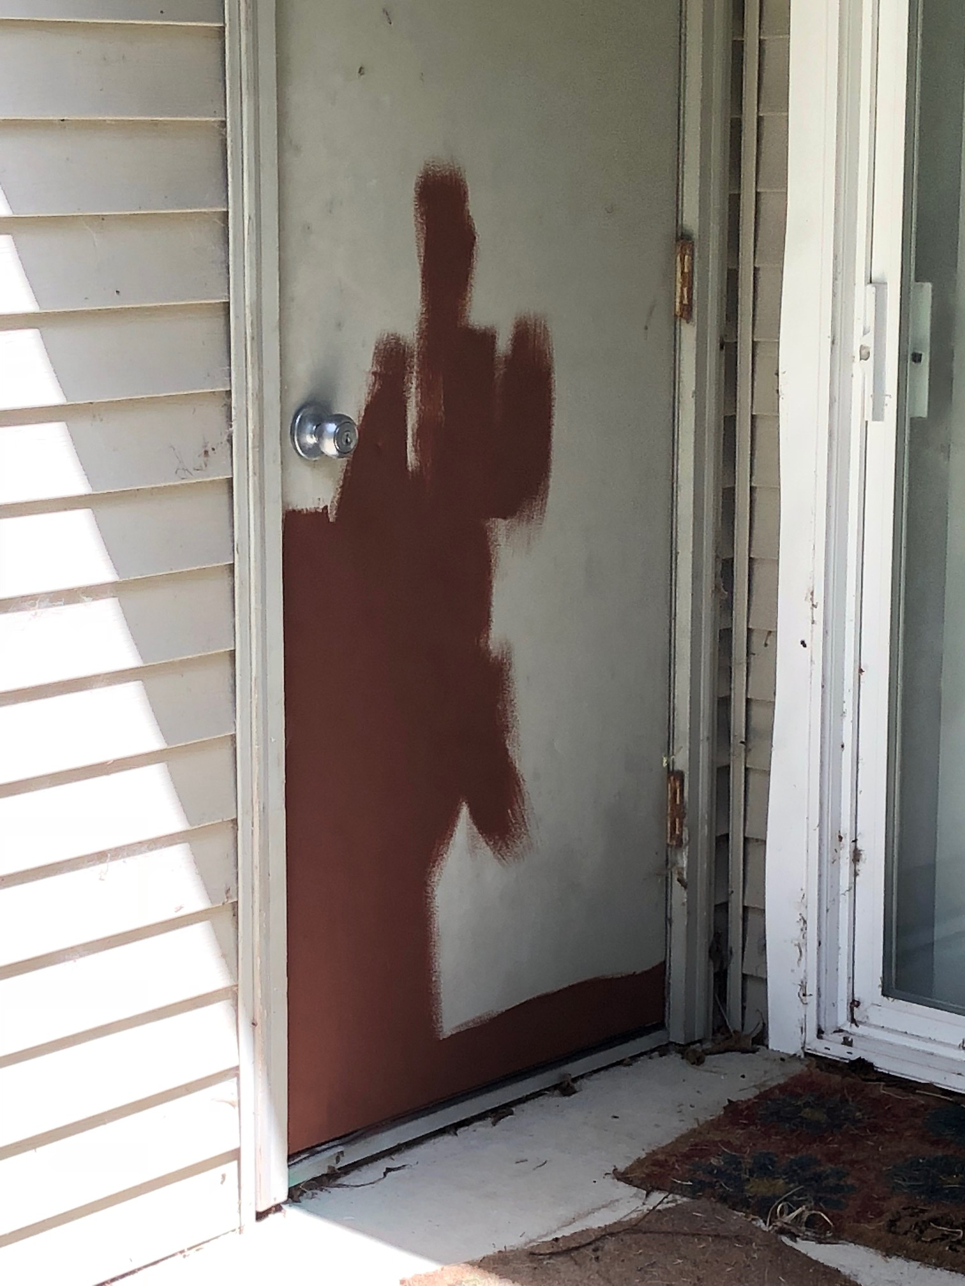
“Industry Standard” Repair?

Slide 20
Top 10 OHCS Inspection findings

Slide 21
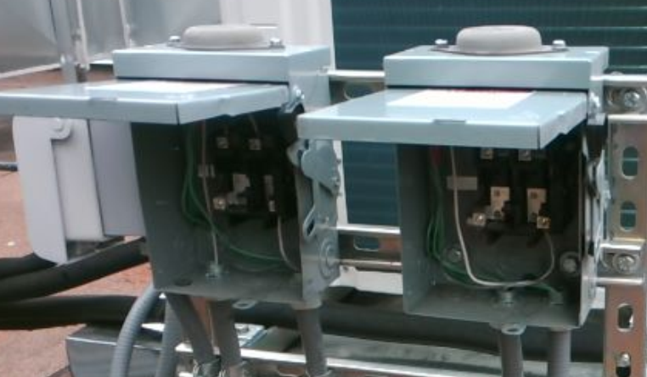
#10

Slide 22
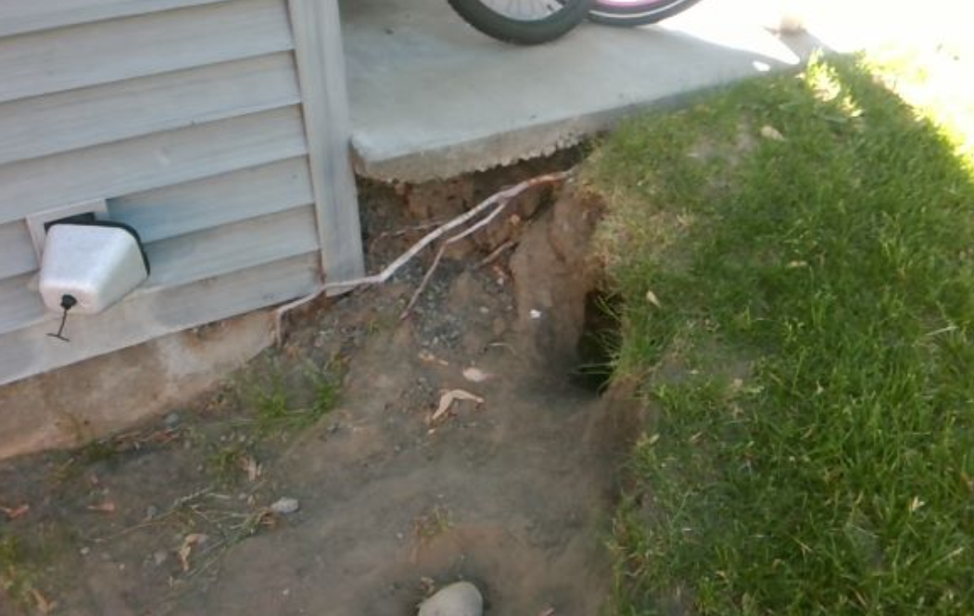
#9

Slide 23
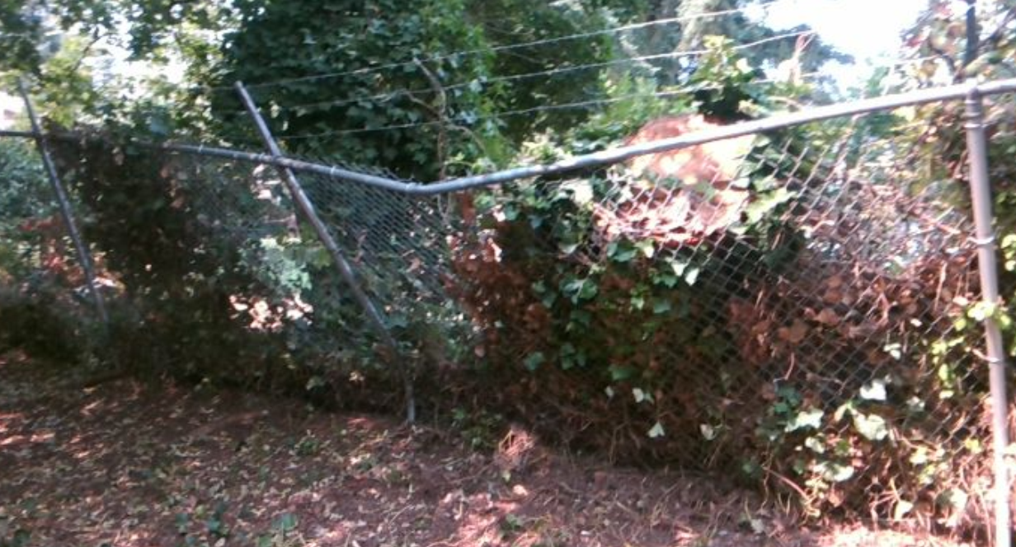
#8

Slide 24
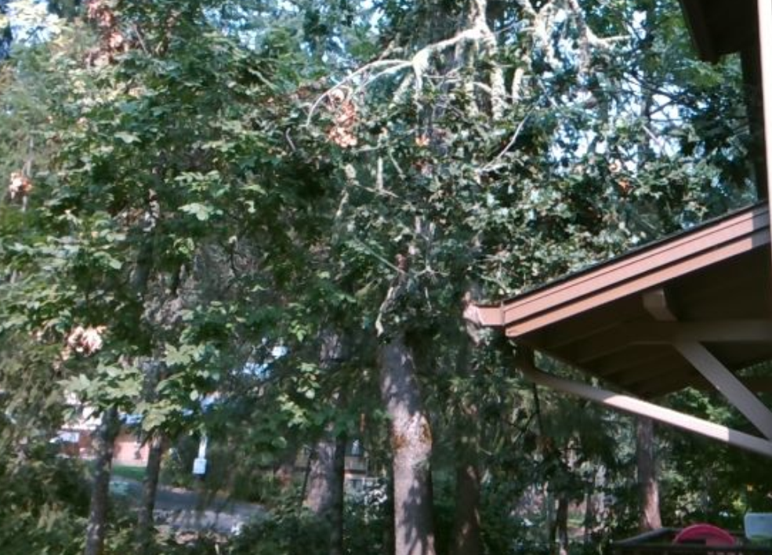
#7

Slide 25
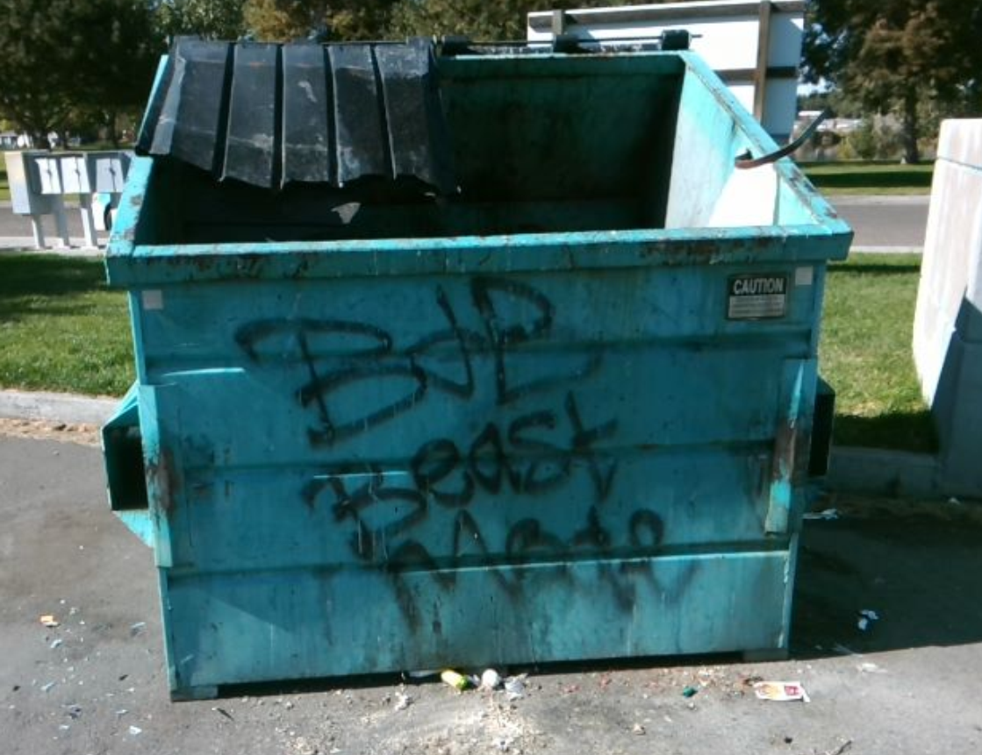
#6

Slide 26
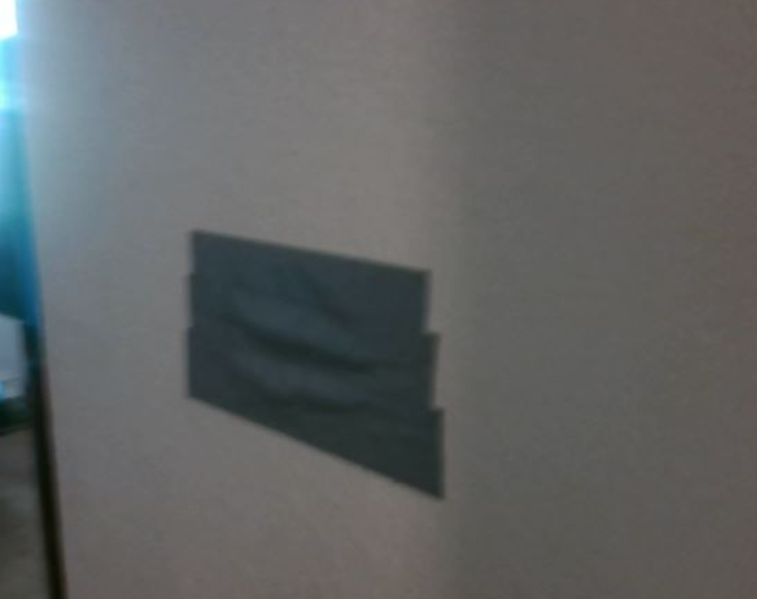
#5

Slide 27
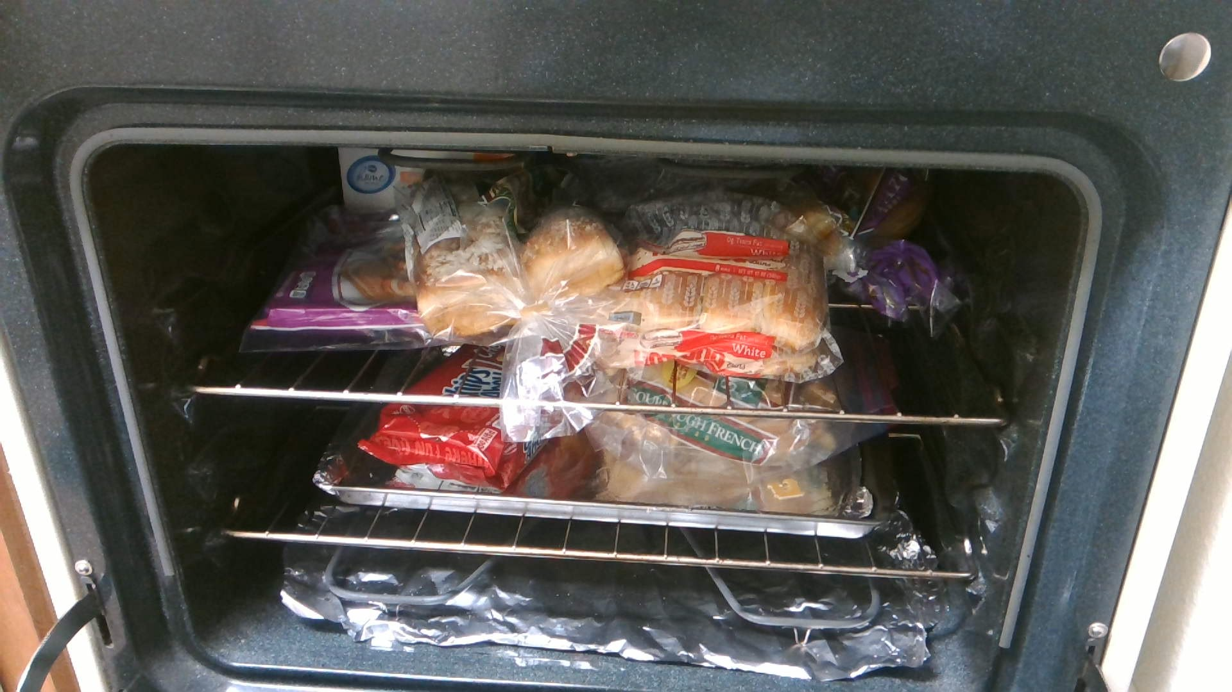
#4

Slide 28
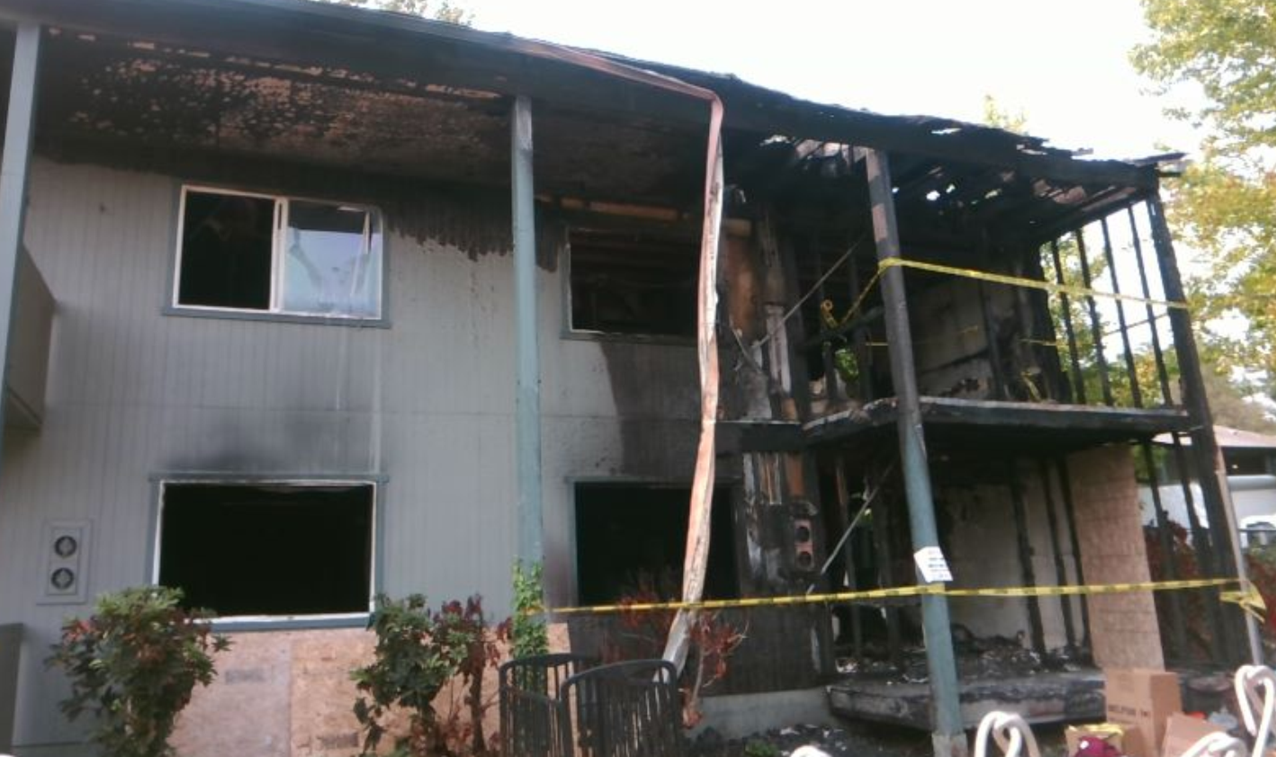
#3

Slide 29
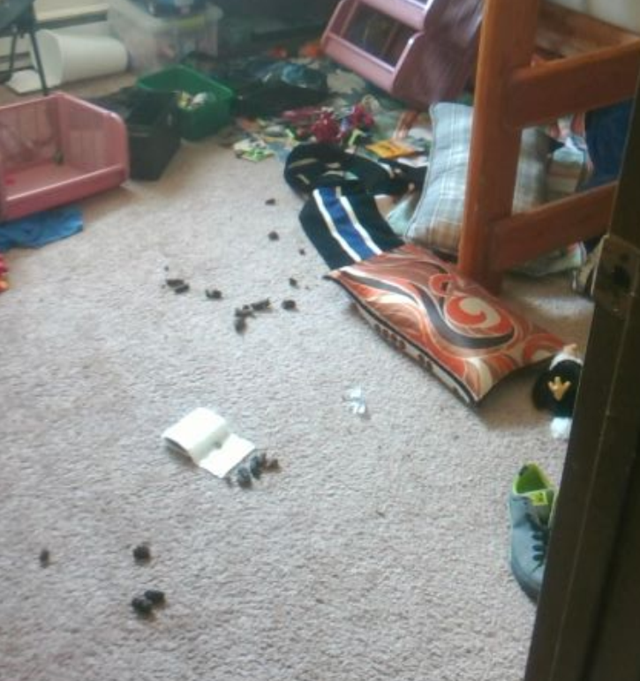
#2

Slide 30
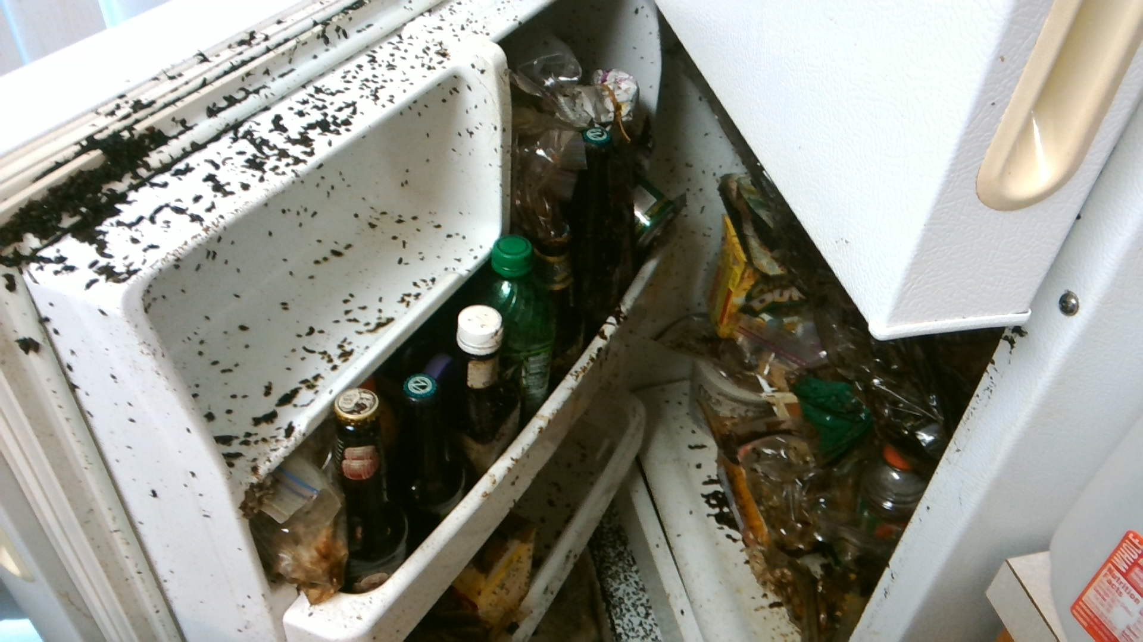
#1

Slide 31
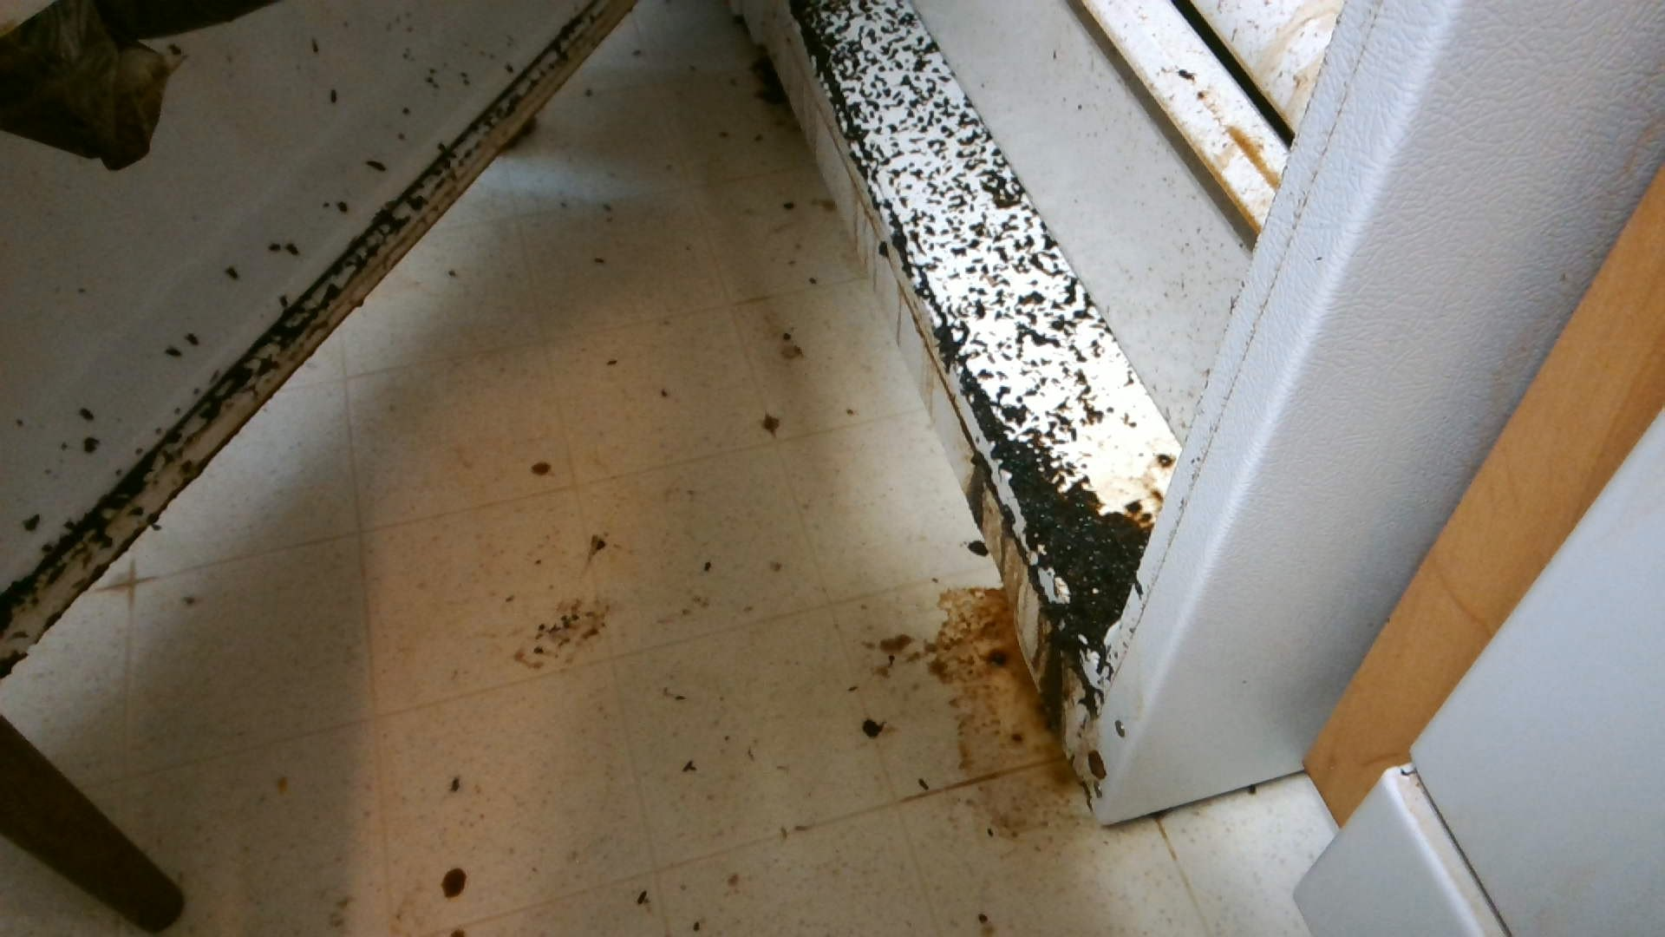

Slide 32

The End

