Slide 1
OREGON OVERDOSE PREVENTION COORDINATION in funded regions Annual Report | Sept 2022 to Aug 2023

Slide 2
Sections
Background
Data Collection
State Accomplishments
Regional Priority Projects
Recommendations

Slide 3
Background

Slide 4
Overdose Prevention Funding Timeline
Since 2015, the Oregon Health Authority has been investing in specific counties and regions to implement overdose prevention initiatives.
2015 to 2019: CDC Prevention for States (PfS)
2017 to 2019: SAMHSA State Targeted Response (STR)
2019 to 2023: SAMHSA State Opioid Response (SOR)
2020 to 2023: CDC Overdose Data to Action (OD2A)
Looking Forward -- 2023 to 2028: CDC Overdose Data to Action in States (OD2A-S)
Notes:
Since 2015, the Oregon Health Authority (OHA) has been investing in specific counties and regions to execute overdose prevention initiatives. OHA has strategically combined funding from both the Centers for Disease Control and Prevention (CDC) and the Substance Abuse and Mental Health Services Administration (SAMHSA) to strengthen local overdose prevention endeavors. This segment offers insight into the evolution of overdose prevention funding for Local Public Health Authorities (LPHAs), along with specifics regarding the regions currently receiving funding. This slides shows a comprehensive timeline illustrating the distribution of overdose prevention funding among LPHAs.

Slide 5
Funded Regions
Topic 3 (option 1)
Notes:
Interdisciplinary Approach: The overdose crisis underscores the necessity of an interdisciplinary, comprehensive, and cohesive public health approach.
Role of Local Public Health Authorities: Local public health authorities, backed by funding, play a crucial role in overdose prevention and addressing drug-related harms.
Purpose of Funding: Funds allocated to regions aim to support the development and implementation of strategies to prevent substance use disorders, overdoses, and related harms.
Encouragement from OHA: OHA encourages regions to complement existing initiatives, leverage resources, and build sustainable overdose prevention strategies.

Slide 6
Identifying Funded Regions
High-burden regions were identified by a combination of indicators, including:
Rate of overdose deaths across drugs type
Rate of overdose hospitalizations across all drugs
Rates of risky opioid prescribing (e.g., rate of prescription fills > 90 MED)
Identified High Intensity Drug Tracking Areas (HIDTA) county
Notes:
Regions were identified consisting of one to three independent LPHAs or regional neighboring counties, with an LPHA serving as lead and receiving funding. At the start of the funding opportunity, funded regions were tasked with building or strengthening a community network within the high-burden region that contributes to reducing problematic prescribing, improving coordination of patient care for patients with opioid use disorder, and increasing the use of non-opioid treatment for chronic non-cancer pain.

Slide 7
September 2022 – August 2023 Funding
Funded Region | Annual Award Amount
Central Oregon - Deschutes, Crook, Jefferson | $112,080
Clackamas County | $151,008
North Coast - Clatsop, Tillamook, Columbia | $100,104
Douglas and Coos Counties | $144,984
Klamath and Lake Counties | $86,664
Lane County | $163,380
Linn, Lincoln, and Benton Counties | $133,524
Multnomah County | $209,916
North Central – Wasco, Sherman | $91,296
Umatilla and Union Counties | $94,428
Mid-Willamette Valley - Yamhill, Polk, Marion | $143,496
Total | $1,430,880
Notes:
The total amount of CDC and SAMHSA funding awarded to funded regions for these efforts from September 2022 to August 2023 was $1,430,880.

Slide 8
Regional Overdose Prevention Strategies
Funded regions implement strategies and objectives related to:
Developing or sustaining a multisector stakeholder group
Developing, expanding, and implementing an overdose emergency response plan
Coordinating with partners to distribute naloxone and improve naloxone access
Developing, expanding, and implementing one or more local prevention project related to the Overdose Data to Action (OD2A) or State Opioid Response (SOR) strategies.
Notes:
Funded regions are expected to collaborate with multi-disciplinary partners and collaborators to develop, plan, implement, and evaluate culturally relevant interventions using tailored prevention strategies that emphasize reaching groups disproportionately affected by substance use disorder and overdose.

Slide 9
OD2A and SOR Strategies
OD2A Strategies | OD2A and SOR* | SOR Strategies
Establish linkages to care Partner with public safely and first responders Support providers and health systems | Empower individuals to make safer choices and prevention messaging | Support outreach in underserved and diverse populations Support school-based prevention programs
*One OD2A strategy and one SOR strategy aligned, so combined into one strategy to streamline the data collection process and decrease data entry burden.

Slide 10
Data Collection

Slide 11
Data Collection
Quarterly Process Online Forms
Monthly Meeting Notes
Technical Assistance Notes
Weekly Emails

Slide 12
Statewide Accomplishments

Slide 13
Multisector Stakeholder Partnerships
Sectors Involved | N | %
Clinics and hospitals | 9 | 82%
Local SUD treatment agencies | 6 | 55%
Local harm reduction agencies/organizations | 6 | 55%
Law enforcement agencies | 5 | 45%
Behavioral health agencies | 5 | 45%
Recovery community organizations | 4 | 36%
Courts/jails/community corrections | 4 | 36%
Fire departments | 2 | 18%
School / youth-serving organizations | 2 | 18%
Emergency Medical Services (EMS) | 1 | 9%
Tribal partners | 1 | 9%
Emergency departments | 1 | 9%
N = 11 funded regions
Notes:
From September 2022 – August 2023, funded regions held 310 meetings with multisector stakeholder groups.
Funded regions engaged continuously with the following sectors as part of the multisector stakeholder partnerships:

Slide 14
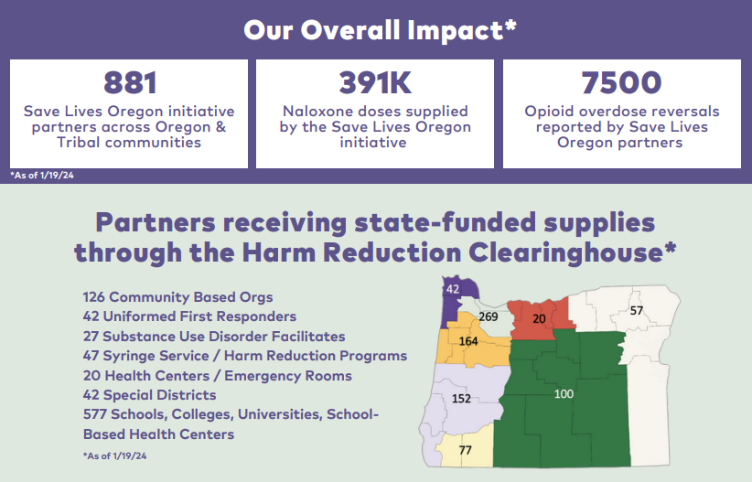
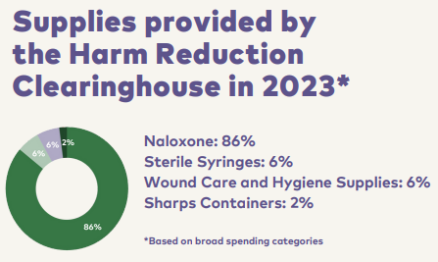
Naloxone Efforts
https://www.savelivesoregon.org/
Notes:
In the funded regions, collaborative efforts with partners were directed towards enhancing access to and awareness of naloxone. Throughout this funding period, the focus transitioned from directly conducting training sessions and distributing naloxone to offering technical support to empower other organizations to spearhead training and distribution initiatives.
The SLO Clearinghouse has had significant impacts on the overdose prevention efforts in the funded region, facilitating increased naloxone distribution, bolstering community partnerships, and enabling access to harm reduction supplies.
Images from:
https://www.savelivesoregon.org/wp-content/uploads/2024/02/SLO_Impact_Report_Jan_2024.pdf

Slide 15
Naloxone Trainings and Technical Assistance
Providing education/training to organization staff to encourage naloxone distribution, dispensing, or prescribing
100%
Linking community partners to one another
100%
100%
Connecting organizations with available resources and funding (e.g., SLO Clearinghouse)
91%
Supplying naloxone
100%
Disseminating naloxone educational and promotional advertising material
91%
Conducting outreach to track and determine naloxone supply
100%
Providing information about local overdose prevention data and statistics
Technical assistance related to policy development
18%
N = 11 funded regions
Notes:
Funded regions implemented a breadth of strategies to improve naloxone supply access and distribution. Funded regions worked with or provided support to organizations by:

Slide 16
Naloxone Trainings Overview
348
3,653
3,026
# of trainings held
# of individuals trained
# of naloxone doses distributed at trainings
N = 11 funded regions

Slide 17
Naloxone Trainings Overview
Sectors Trained | N | %
Schools / youth-service organizations | 10 | 91%
Local SUD treatment agencies | 9 | 82%
Local harm reduction agencies/organizations | 8 | 73%
Behavioral health agencies | 8 | 73%
Fire departments | 7 | 64%
Law enforcement agencies | 6 | 55%
Clinics and hospitals | 6 | 55%
Advocacy groups | 6 | 55%
Recovery community organizations | 6 | 55%
Courts/jails/community corrections | 5 | 45%
Tribal partners | 4 | 36%
Emergency Medical Services (EMS) | 3 | 27%
Pharmacies | 1 | 9%
N = 11 funded regions

Slide 18
Overdose Emergency Response Planning
100%
55%
All regions are in the finalizing, implementing, or revising stages of their overdose emergency response plan
Six regions activated their overdose emergency response plan
Notes:
This is the implementation of regional overdose emergency response plans

Slide 19
Regional Priority Projects

Slide 20
Funded Regions Submit Data For Selected Strategies
Establish linkages to care (N = 4)
Partner with public safety and first responders (N = 5)
Empower individuals to make safer choices and prevention messaging (N = 5)
Support providers and health systems (N = 1)
Expand local infrastructure for outreach in underserved and diverse populations (N = 1)
Expand local infrastructure for school-based prevention programs (N = 4)

Slide 21
Establish linkages to care
Ensure people are connected to the care they need by leveraging systems and upstream prevention efforts.
Conducted 50 coordinator meetings and engaged 169 key partners
Completed 58 dissemination activities to announce referral system and share data and resources
Provided support in developing 4 policies and procedures to ensure sustainability of programming
Peers engaged 614 clients and referred 310 clients to treatment and recovery
Provided 24 training events to 327 people
N=4 funded regions

Slide 22
Partner with public safety and first responders
Develop new and/or enhance existing partnerships with public safety partners to improve data sharing and advance prevention efforts.
Conducted 73 coordination meetings and engaged 78 key partners
Completed 65 dissemination activities to share resources with key partners
Supported 47 first responder agencies through ODMAP sign up or workflow policy development
Engaged 72 first responder agency partnerships
N=5 funded regions

Slide 23
Empower individuals to make safer choices and prevention messaging
Increase awareness about drug-related harms, treatment, and risk reduction strategies to help individuals make informed decisions.
Conducted 66 coordination meetings and engaged 97 key partners
Completed 21 dissemination activities and engaged over 11,000 people via social media
Provided 45 education events to 1,579 participants
N=5 funded regions

Slide 24
Support providers and health systems
Support healthcare providers and health systems with drug overdose prevention and response, including expanding the use of evidence-based prescribing and treatment practices.
Conducted 21 coordination meetings and engaged 55 key partners
Completed 20 dissemination activities including education and promotional material
Provided 27 clinical skill-building trainings to 35 providers and clinic staff
N=1 funded regions

Slide 25
Expand local infrastructure for outreach in underserved and diverse populations
Increase access to substance use and overdose prevention resources.
Conducted 16 coordination meetings and engaged 31 key partners
Completed 3 dissemination activities
Provided 4 overdose prevention trainings to 120 participants
N=1 funded regions

Slide 26
Expand local infrastructure for school-based prevention programs
Support the expansion of local infrastructure for school-based prevention programs in schools, school districts, or education service districts.
Conducted 49 coordination meetings and engaged 95 key partners
Completed 28 dissemination activities
Engaged 73 schools/school districts and 27 youth organizations
Provided 72 education events to 821 participants
N=4 funded regions

Slide 27
Technical Assistance Provide to Funded Regions
Monthly Overdose Prevention Coordinator Meetings
Facilitated discussions and guest speaker presentations on various topics
Encouraged sharing of regional updates across topic areas to identify needed supports
Funded Region Technical Assistance Meetings
Monthly or bi-monthly meetings with individual overdose prevention coordinators
Provided technical assistance and resources to support local project implementation
Weekly Technical Assistance Email
Covered updates on state programs, upcoming conferences/training events, current overdose data, and funding opportunities
Notes:
The funded regions with their overdose prevention initiatives and strategic planning, OHA consistently furnished them with technical guidance, training sessions, and essential resources. OHA personnel engaged in both one-on-one and group sessions with overdose prevention coordinators to pinpoint and tackle any obstacles and hurdles hindering implementation and long-term viability. Moreover, OHA regularly circulated weekly emails to these coordinators, spotlighting accessible resources, pertinent data insights, and potential avenues for securing additional funding.
Monthly Overdose Prevention Coordinator Meetings:
Topics:
Overdose fatality review and OHA’s upcoming pilot project
Save Lives Oregon Clearinghouse
Xylazine trends in Oregon
Klamath County’s Substance Use Resource Map
Special Districts eligibility for Save Lives Oregon Clearinghouse for leave-behinds
Lane County Fentanyl Aware Campaign
Linking the State Unintentional Drug Overdose Reporting System (SUDORS) and Prescription Drug Monitoring Program (PDMP) Data in Oregon
Oregon Opioids Settlement & HB 4098
Funded Region Technical Assistance Meetings:
Discussions on:
Naloxone assessment and distribution
Overdose emergency response planning
Regional program plans and budgets
Ongoing successes, challenges, and barriers
Assistance including:
Connecting coordinators to state contacts
Sharing data sources and state priorities/initiatives
Sharing strategies and lessons learned
Responding to reporting questions for quarterly progress forms.
Weekly Technical Assistance Emails:
Included information from various sources such as CDC’s Overdose Data to Action Technical Assistance Program, U.S. Department of Justice’s Comprehensive Opioid, Stimulant, and Substance Abuse Program, National Association of County and City Health Officials, and other regional/national partners.

Slide 28
Recommendations

Slide 29
Recommendations for Next Funding Year
Continue to support cross-region resource and funding sharing
Strengthen capacity for overdose emergency response plan implementation
Continue providing consistent funding to avoid program and service disruptions and expand funding and resource opportunities beyond currently funded regions
Encourage cross-region connections between schools to support updated policies
Continue to prioritize naloxone distribution
Develop resources and discuss strategies to support local collaboration efforts

Slide 30
questions, comments, thoughts

Slide 31
Thank you!
Presenter 1 Photo
Presenter 2 Photo
Presenter 3 Photo
Presenter 1
Email address
Presenter 2
Email address
Presenter 3
Email address
Event | Date
Notes:
Update depending on event*

