Slide 1
Healthier Together Oregon in Partnership with Benton LPHA CHW Core Training Informational Session
April 24, 2024
This presentation is being recorded.
Notes:
CINTIA

Slide 2
Accessibility Tools
This session has closed captioning available. Click the link available in the chat box.

Slide 3
Agenda
Frequently Used Language
Who is eligible to apply?
Benton CHW Core Training
Healthier Together Oregon 101
Q&A
Notes:
Add questions to the chat – We will answer at the end during the Q&A time

Slide 4
Frequently Used Language
HTO – Healthier Together Oregon
SHIP – State Health Improvement Plan
SHA – State Health Assessment
CHW – Community Health Worker

Slide 5
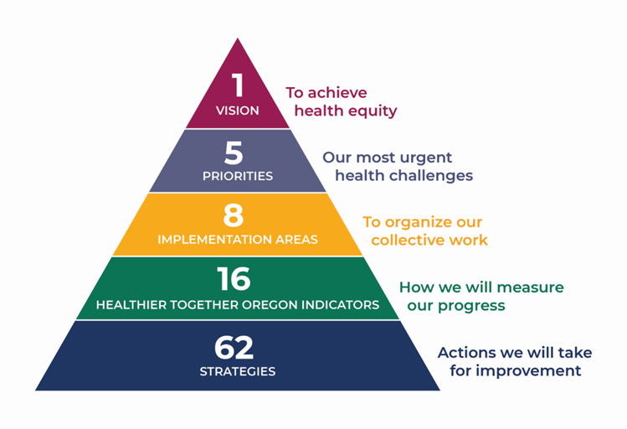
Healthier Together Oregon 101
State Health Improvement Plan created with community
Designed to align health equity efforts across state, local, and community-level work
Notes:
Identified 5 priority areas
Institutional Bias
Adversity, trauma and toxic stress
Behavioral health
Access to equitable preventive health care
Economic drivers of health

Slide 6
Priority Populations
Notes:
CINTIA
Priority populations for HTO. Identified in the 2018 State Health Assessment and amended by the PartnerSHIP
Please note that the PartnerSHIP had determined the language for priority populations, and these are the terms they selected after discussion- it is not the terminology we use at OHA. This is the language from the 2020 plan/2020 PartnerSHIP.

Slide 7
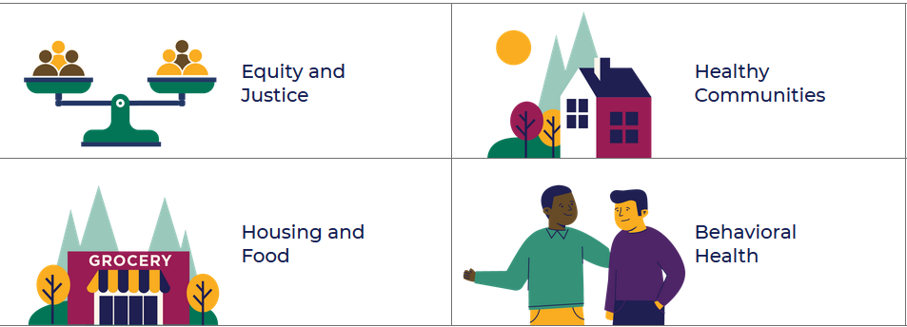
Implementation Areas
Notes:
CINTIA
8 implementation areas organize the 62 strategies. Please check our website for more details
Equity and justice – directs state agencies to center priority populations, esp BIPOC and tribal communities in planning, policy and investments
Housing and food – to achieve housing stability and food security
Behavioral health - HTO is focused on mental health, addressing stigma and ensuring continuum of mental health services, from prevention through treatment and recovery. – Strategies specific to substance use are found in the Alcohol Drug and Policy Commission’s Strategic Plan that was developed at the same time.
Healthy families – strategies related to shoring up family resilience through preventive services, early childhood education, home visiting programs, and support for caregivers
Workforce development – strategies to ensure a diverse, culturally responsive workforce, especially in health and social services. through standards, trainings and hiring practices
Healthy communities – strategies that address the built environment, social resilience and economic development
Healthy youth- addressing bias and disparities, as well as preventive services in health care and education.
Technology – EHRs, telehealth and community information exchange.

Slide 8
CORE CHW Training
July 9th-August 15th
Time: 8:30 AM- 5:00 PM
Training is virtual
Core Curriculum
23 Modules
13 Foundational Competencies
Popular Education Based
Core Practicum
Case Studies
In-class skill building (roleplays)
Resource Practicum
Scavenger Hunt

Slide 9
CORE CHW Training Expectations for Participants
Must attend 90% of the training to receive a certificate of training completion
If miss more than 10% of the training (one full day, or two half day sessions), they are responsible for contacting the Training HUB Coordinators for next steps
Reliable and regular internet access with a microphone and camera on are required
Attendance will not be counted if camera is off or pointed in a direction other than their face for an extended period of time
If working on house projects, driving, or are otherwise occupied, they will be asked to leave for the day and return when they can provide their undivided attention
Participation to your comfort level is expected
Must complete required homework for the course within 2 weeks of the last day of training

Slide 10
Application
Limited seats at no cost for eligible (20) applications will be awarded on a first-come, first-served basis until the number of allocated seats (3 - 4) per region gets filled.
Oregon regions: Eastern Oregon, Central Oregon, Southern Oregon, Oregon Coast, Willamette Valley, Portland Metro
In addition, we are also considering the applicant’s financial needs, experience working with the HTO populations, and representation that reflects the diversity of the communities in Oregon.

Slide 11
Who is eligible to apply?
Individuals who are 18 years old or older
Reading and writing proficiency in the English language (We encourage bilingual folks to apply)
Individuals who can commit to attending the entire training series
July 9 until August 11 from 8:30 am to 4:30 pm
You have reliable and regular internet
Having access to a computer/laptop with a microphone and camera is required to attend this training

Slide 12
Important to Know
OHA Requires a background check after completion of approved training and submission of a complete Traditional Health Worker (THW) application
Please check the website for more information
https://www.oregon.gov/oha/ei/pages/thw-become-certified.aspx

Slide 13
Timeline
Applications open
Information sessions
April 24, 2024 @ 2pm
Applications close
Decisions
April 24, 2024
May 8, 2024
Mid – June 2024
Training Dates
July 9 - August 15, 2024

Slide 14
Q&A

Slide 15
Contact Information
HTO Team
Cintia Vimieiro, Nicholas Sievers
SHIP.Grants@oha.oregon.gov
HTO CHW Core Training Application link
https://app.smartsheet.com/b/form/45c65cda13044e18a449cb84ece9e121
HTO website and link to the application
https://www.oregon.gov/oha/PH/ABOUT/Pages/HealthImprovement.aspx
Notes:
CINTIA

