Slide 1
LPHA Provider Education Session on Lead Investigation Reimbursements
10/23/2024
Notes:
Hello, and thank you for taking the time to view this webinar.
My name is Ryan Barker, and I work in the Childhood Lead Poisoning Prevention Program at the Public Health Division of the Oregon Health Authority.
This webinar will cover the process for local public health authorities, or LPHAs, to bill for reimbursements for home lead poisoning investigations for children who are enrolled in Medicaid, also known as the Oregon Health Plan.
The webinar will also give additional context as to when and why LPHAs perform lead poisoning investigations and case management, the rules that govern blood lead testing and investigation reimbursements, the process for identifying if a child is on Medicaid, and how LPHAs can enroll as Medicaid providers.

Slide 2
Discussion Topics
Review of Childhood Lead Poisoning Prevention Program
Early and Periodic Screening, Diagnostic and Treatment program and Oregon Administrative Rule (OAR) updates, lead screening requirements, and lead investigation reimbursement in OAR 410-151-0040
LPHA enrollment as a Medicaid provider
Steps to bill for lead investigation claim using the MMIS portal and CCO guidance
Identifying OHP Eligibility in Orpheus
Closing
Notes:
In addition to myself, we also have experts from Oregon Health Authority’s Health Systems Division that will cover important aspects of the Early and Periodic Screening, Diagnostic and Treatment program, Medicaid provider enrollment, and billing for claims using the Oregon Medicaid Management Information System.
With that, I will go ahead and cover my section first.

Slide 3

National Lead Poisoning Prevention Week
Notes:
I would like to recognize that the week that this webinar was recorded was during National Lead Poisoning Prevention Week. During this week we hope to highlight the ongoing work to reduce and prevent exposure to lead and promote awareness of the topic for the general public, the medical community, and public health agencies. https://www.cdc.gov/lead-prevention/php/nlppw/index.html

Slide 4
Childhood Lead Poisoning Prevention Program (OHA)

Slide 5
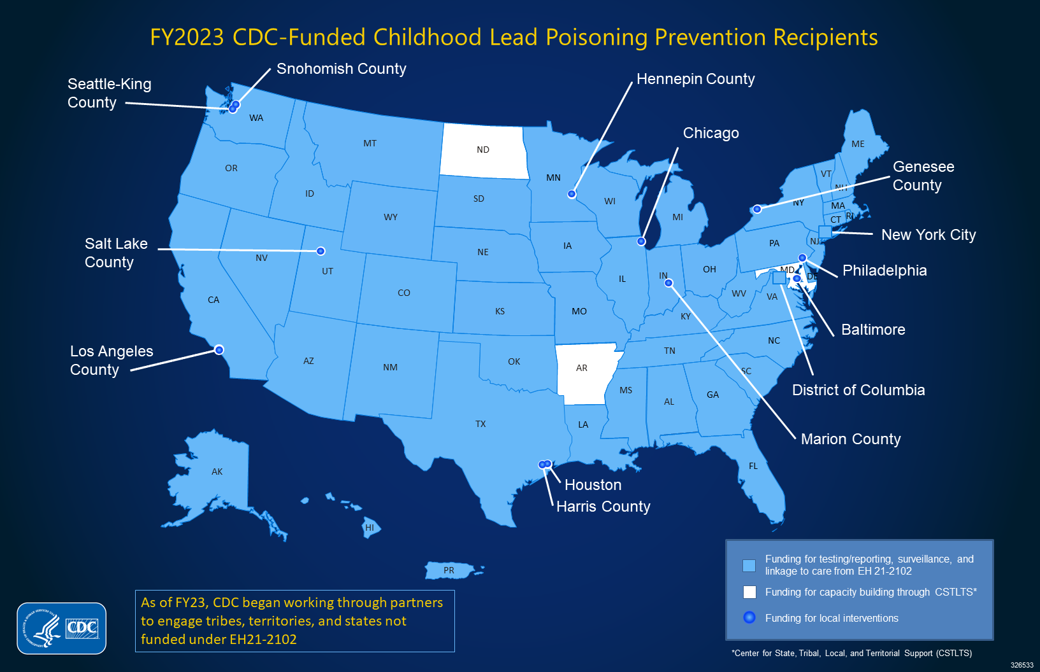
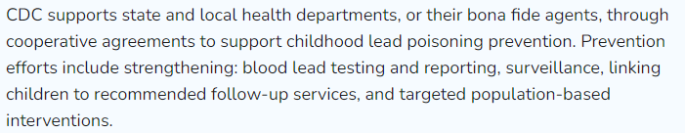
Oregon Childhood Lead Poisoning Prevention Program (CLPPP)
Notes:
Oregon’s CLPPP is a CDC-funded program that works to strengthen blood lead testing and reporting, surveillance, and linking children to recommended follow-up services. Nearly all 50 states and several cities and counties in the US have similar programs.

Slide 6
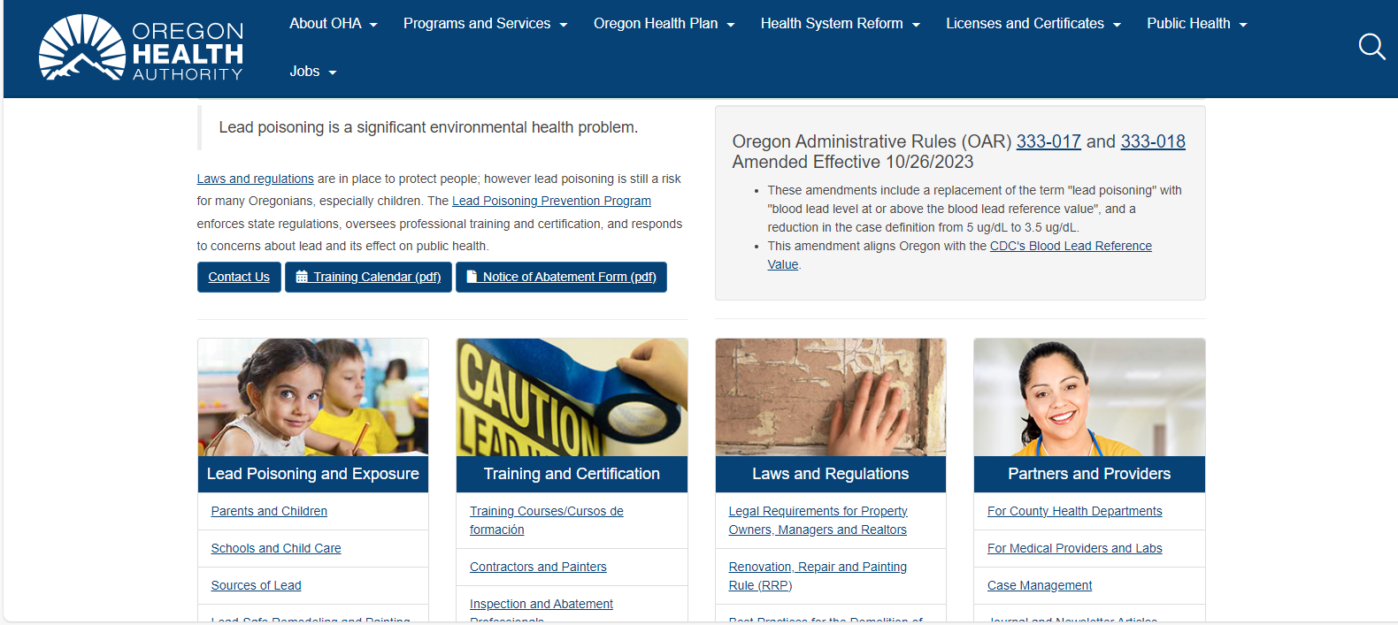
Oregon Childhood Lead Poisoning Prevention Program (CLPPP)
healthoregon.org/lead
Notes:
For more information about our specific program, and information relevant to case management and the topics we will be discussing today, refer to our website and the links highlighted on the bottom right of the page.

Slide 7
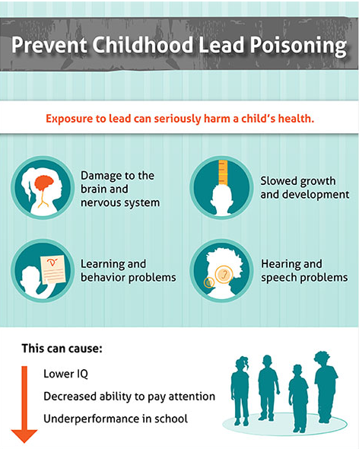
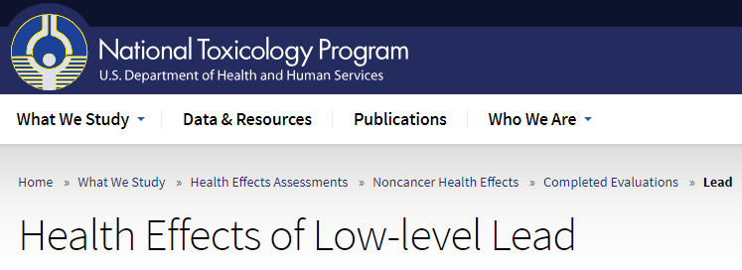

No Safe Level of Lead
“Although reductions in lead exposure for the U.S. population have resulted in lower blood lead levels over time, epidemiological studies continue to provide evidence of health effects at lower and lower blood lead levels. The NTP Monograph on Health Effects of Low-level Lead was developed to summarize the evidence for lead- associated health effects in children and adults at these low exposure levels. The evidence provides support for adverse health effects in both children and adults at blood lead levels below 10 µg/dL, and, for some effects, below 5 µg/dL.”
Notes:
As a continued reminder, there is no safe level of lead identified for children, and even low levels of lead in blood can cause harm. This fact has been identified by decades of research and epidemiological studies.

Slide 8
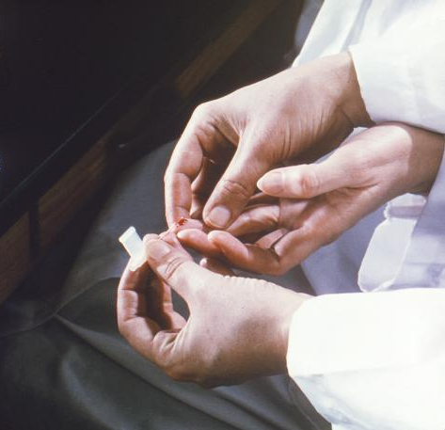
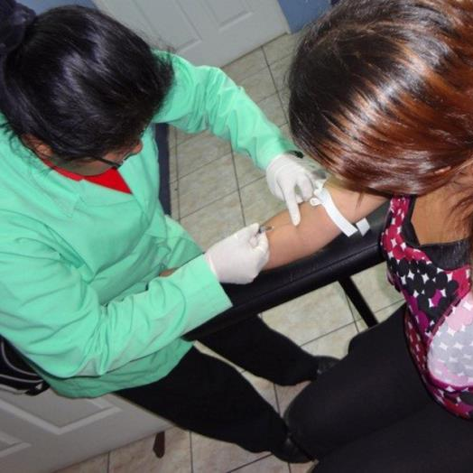
Testing Children for Lead
Capillary test (Presumptive)
Venous test (Confirmatory)
Notes:
The only way to know if a child has been exposed to lead is through a blood lead test. Most children are tested through a capillary sample, usually a finger poke. If this results in a blood lead level of 3.5 ug/dL or higher, we recommend a venous draw to confirm that level. Capillary samples are very sensitive to skin contamination, and if the fingertip is not properly cleaned, the result could be inaccurate.

Slide 9
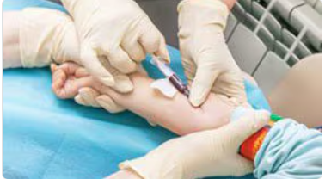
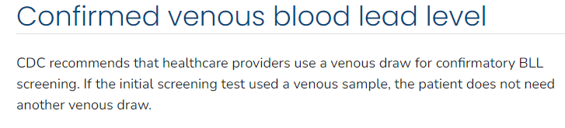
Confirmed Blood Lead Tests
Venous test (Confirmatory)
Recommended before continuing with case management and investigation
Notes:
Confirmed blood lead levels of 3.5 ug/dL or greater initiate public health case management. This is usually confirmed through a venous draw. However, follow-up capillary samples could also be used if they are the only option for children that cannot get a venous draw.

Slide 10
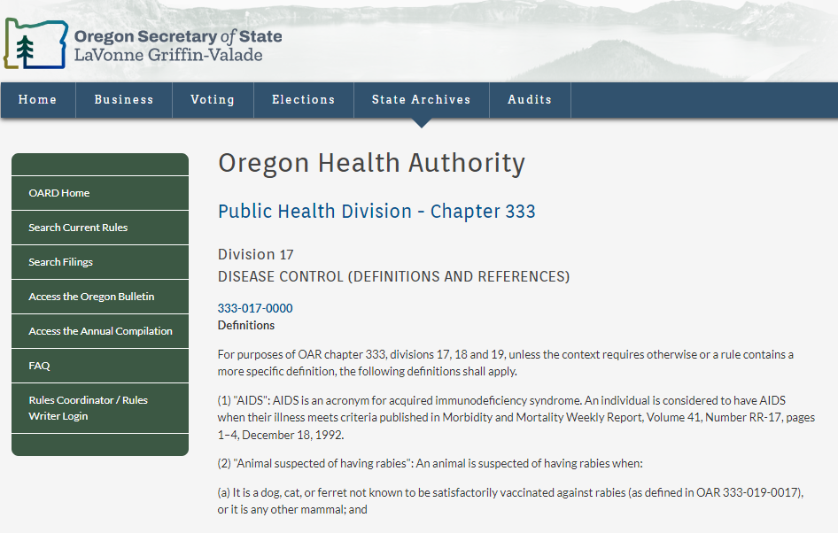
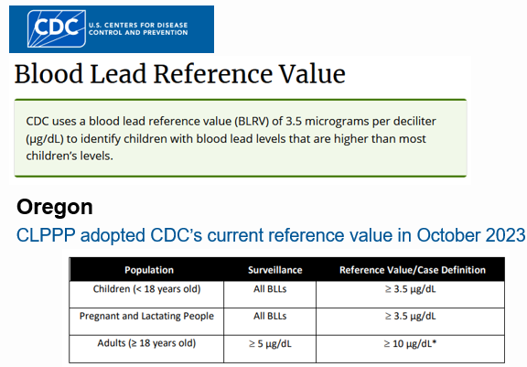
Oregon Lead Case Definition
Notes:
On October 26th, 2023, Oregon adopted in rule the current case definition of 3.5 ug/dL for lead. This aligns with CDC’s blood lead reference value which was adopted in late 2021.

Slide 11
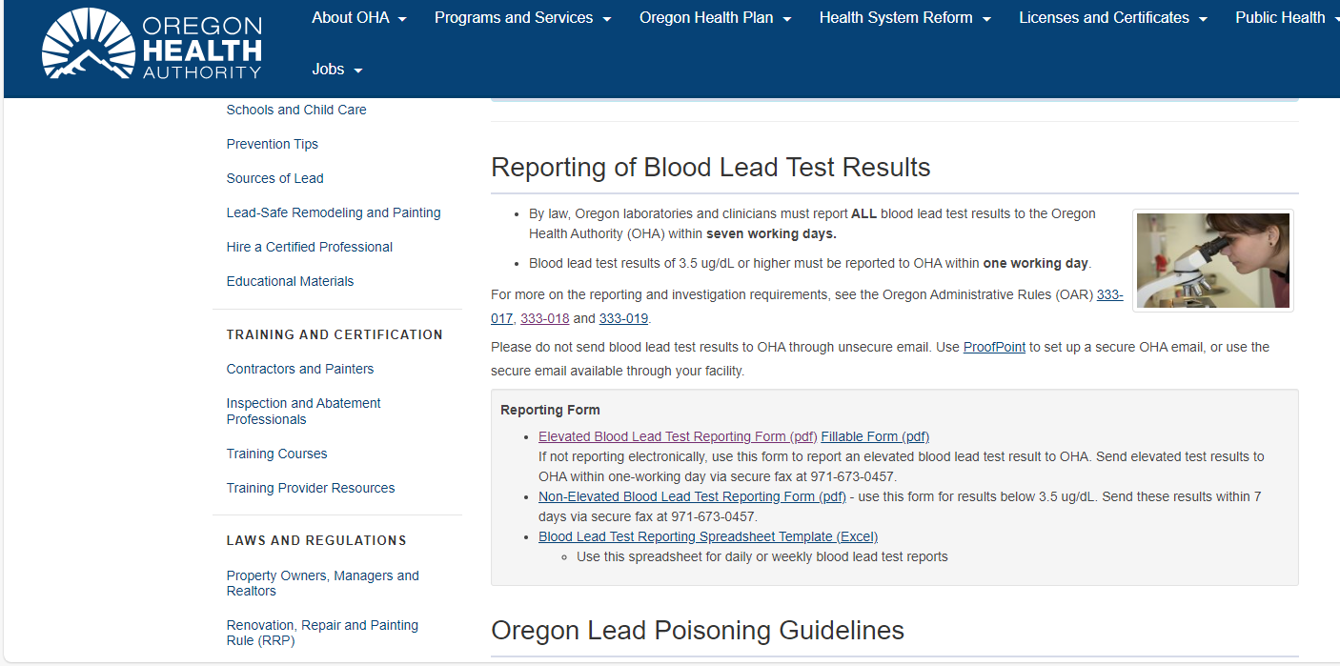
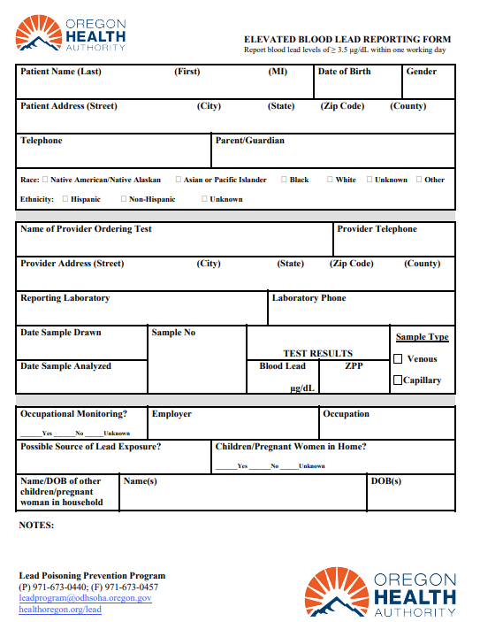
Oregon Blood Lead Test Reporting
Notes:
All blood lead tests for Oregon residents must be reported to OHA, with results at or above 3.5 ug/dL reportable in one working day. Once OHA or the LPHA receives this report, case management and investigation activities should begin.

Slide 12
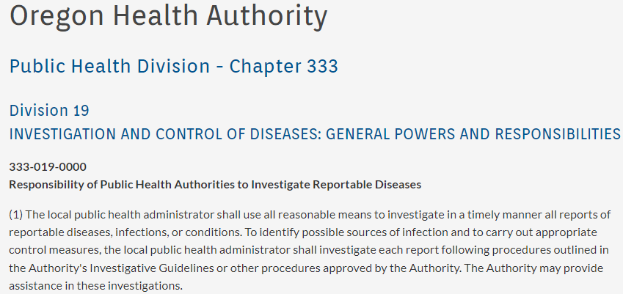
Investigations
Notes:
The local public health authority must investigate each report for a child under 18 years of age. Rules regarding this are found in OAR 333-019 “Investigation and Control of Diseases”. Please note that OHA is always here to provide support for LPHAs in this work.

Slide 13
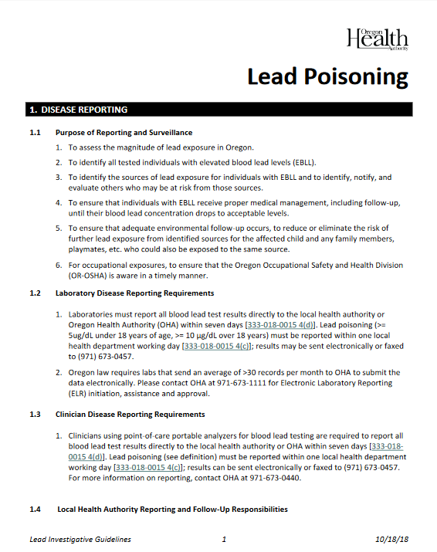
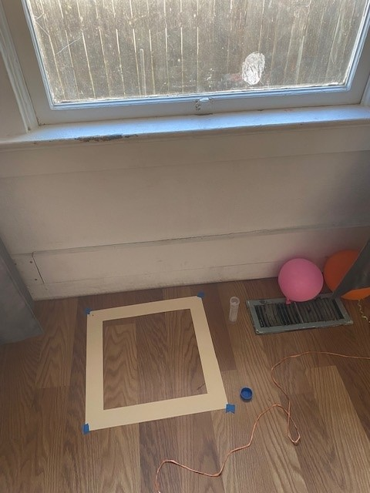
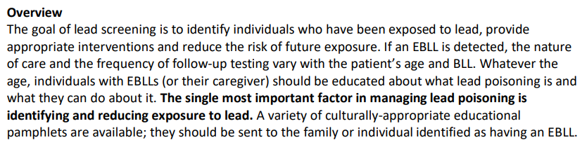
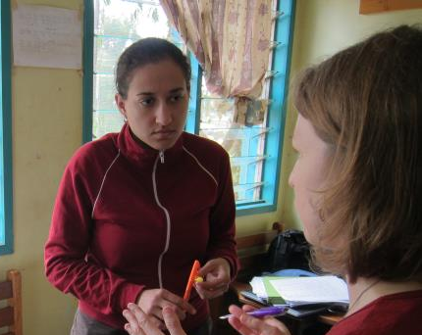
Investigations
CDC
Notes:
Specific details on the investigation and case management protocols can be found in the Lead Poisoning Investigative Guidelines, which are available for download on our program website. The most important factor in managing lead poisoning cases is identifying and reducing exposure to all sources of lead.

Slide 14
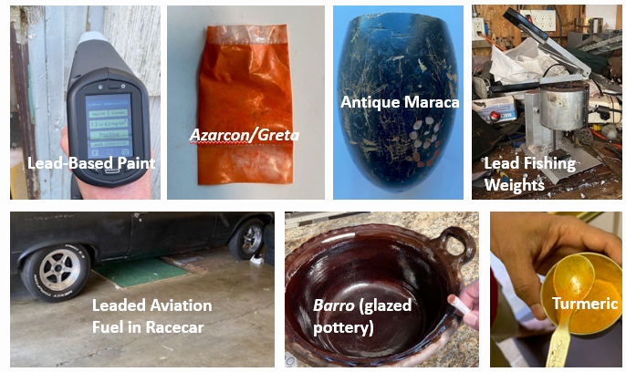
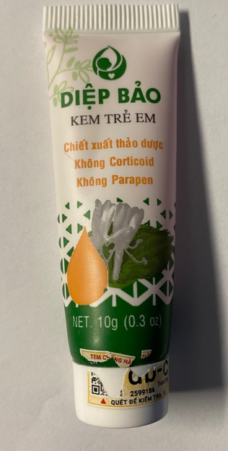
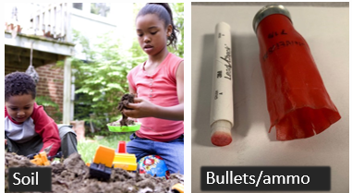
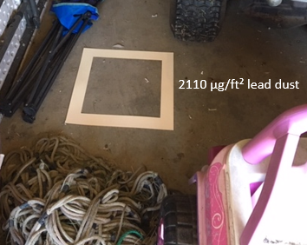
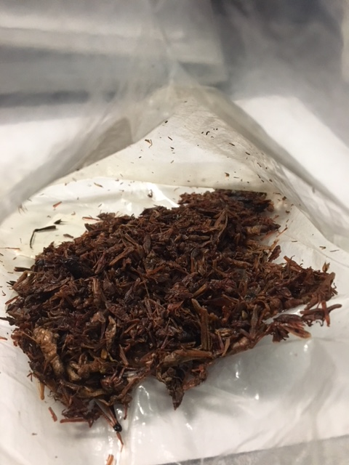
Investigations
Fishing equipment
chapulines
Notes:
Investigations over the years have identified a variety of lead exposure sources. While lead-based paint continues to be the most common source, many other sources have been identified and include consumer products, hobbies, contaminated soil, spices and imported cosmetics.

Slide 15






Follow-up Services
Notes:
Once the most probable sources of lead have been identified, it’s important to share important services and referrals with the family whenever possible. Additional details about these services are found in the Lead Poisoning Investigative Guidelines.

Slide 16
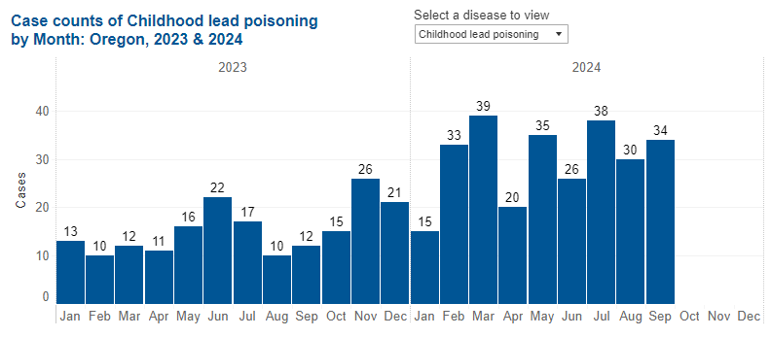


Childhood Lead Poisoning Cases (2023-24)
Case definition changes from 5 µg/dL to 3.5 µg/dL (10/26/2023)
Notes:
This screenshot shows total confirmed child cases (<18 years) in 2023 and through Sept. 2024. On the date of this presentation (10/23/2024), there have actually been 289 confirmed child lead cases of which 56% were on Medicaid/OHP.

Slide 17
EPSDT Program

Slide 18
First…what is EPSDT?
Early and Periodic Screening, Diagnostic and Treatment (EPSDT) is a federally required benefit that provides comprehensive health care services for children and youth under age 21 who are enrolled in Medicaid (the Oregon Health Plan).
EPSDT covers all medically necessary and medically appropriate services, based on the member’s individual needs.
Anyone under age 21 and enrolled in OHP, will receive EPSDT coverage. No need to enroll in a separate program.
Oregon.gov/EPSDT

Slide 19
Early and Periodic Screening for Lead
EPSDT requires the Bright Futures Periodicity Schedule for preventive screening for children.
The current lead screening rule requires screenings for all OHP children ages 12 months and 24 months
Any child between ages 24 and 72 months with no record of a blood lead test must receive one.
In Oregon, blood lead testing for children is low, only 21% of OHP children younger between 1-3 years got this testing in 2023.

Slide 20
EPSDT OAR – Lead Rule Updates
EPSDT administrative rules (OAR) went into effect January 1, 2024
The lead screening rule moved to OHA’s Early and Periodic Screening, Diagnostic and Treatment (EPSDT) rules effective July 11, 2024 (OAR 410-151-0040).
The update specifies that LPHAs can bill for lead investigations:
  “The local public health authorities are eligible for investigation reimbursements”

Slide 21
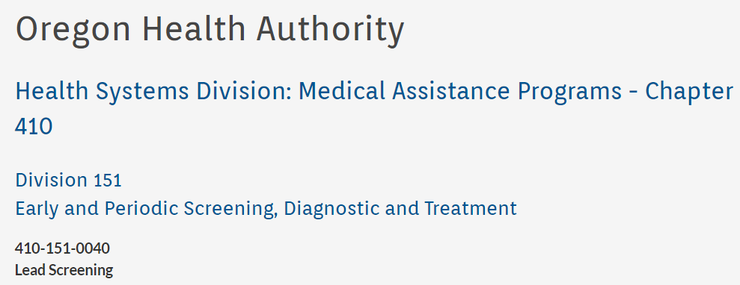
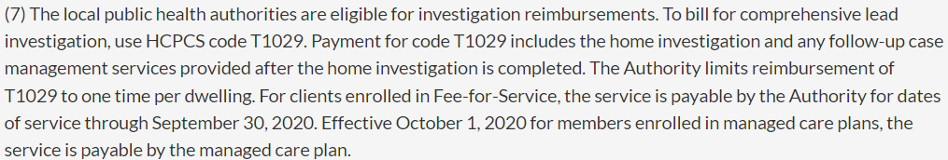
EPSDT OAR – Lead Rule Updates
Notes:
To bill for a home lead investigation, be sure to include the Healthcare Common Procedure Coding System, or HCPCS, code T1029 as the Procedure Code.

Slide 22
Where to find more information about EPSDT
OHA has developed the following materials to share information about EPSDT:
EPSDT Fact Sheet for OHP members (available in 13 languages)
EPSDT Frequently Asked Questions (available in English & Spanish, additional languages upon request)
All EPSDT materials, including guidance documents for CCOs and OHP providers, are available at Oregon.gov/EPSDT

Slide 23
Provider Enrollment

Slide 24

Provider Enrollment
For step-by-step instructions for using the MMIS Provider Enrollment, reference the MMIS Provider Web Portal Provider Enrollment Guide.
https://www.oregon.gov/oha/HSD/OHP/Tools/Provider-Enrollment-Guide.pdf
To access the MMIS Provider Enrollment application, utilize the link below.
https://www.or-medicaid.gov/
Complete and save the enrollment forms to your computer or desktop.

Slide 25
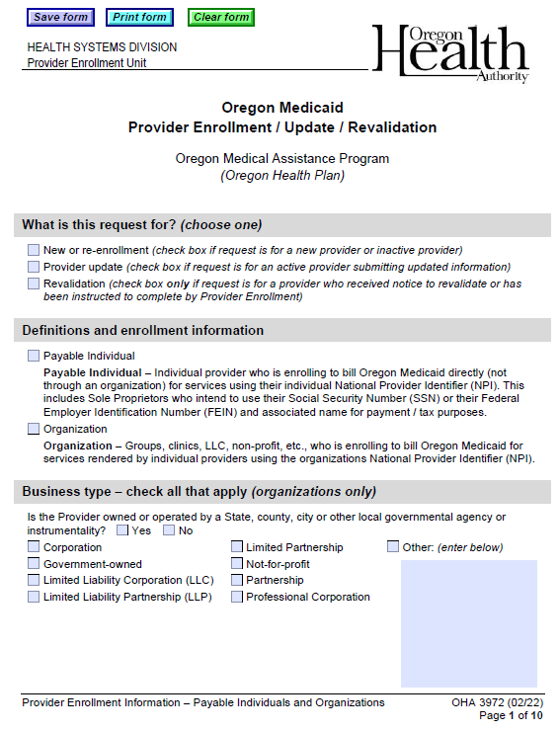
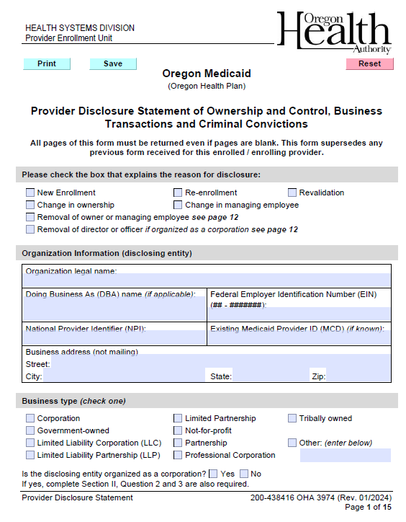
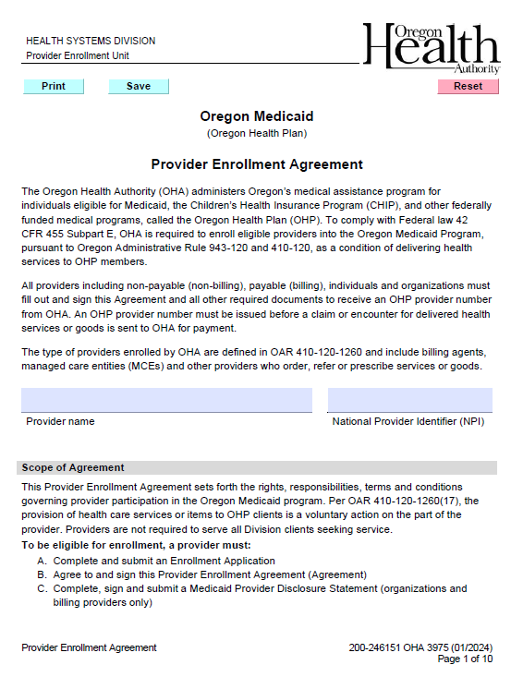
Required Forms for Organizations Enrolling as Providers
OHA 3972
OHA 3974
OHA 3975

Slide 26
Enrollment Next Steps
Once enrolled, you will be emailed a Medicaid Welcome letter containing your Medicaid provider number with helpful links and information.
You will be mailed a PIN letter, which will give you instructions on how to set up your provider web portal access so you can check OHP Member eligibility. This is not a requirement.
If you cannot apply on the web page, you can fax your application to Provider Enrollment to (503) 378-3074, utilizing the instructions on the EDMS Coversheet.

Slide 27
Provider Assistance
For enrollment questions, call OHA’s Provider Enrollment Team​ at 800-336-6016, option 6, or email Provider.Enrollment@odhsoha.oregon.gov.
For assistance with provider web portal setup and password assistance, you can call Provider Services at 800-336-6016, option 5 or email DMAP.ProviderServices@odhsoha.oregon.gov.
The email for Provider Services MMIS Password unlock/resets request for access is TEAM.Provider-access@odhsoha.oregon.gov

Slide 28
Billing Professional Claims in the
MMIS Provider Portal

Slide 29

Need to setup access to the MMIS Provider Portal?
To access the MMIS Provider Portal, visit www.or-medicaid.gov.
To setup Provider Portal access, you will need a PIN letter. New providers get a PIN letter within 5 or 6 business days of enrolling with Oregon Health Authority (OHA).
If you need a new PIN letter, email team.provider-access@oha.oregon.gov with the following:
  Your name.
  The NPI or MCD number.
  The “Mail To” address on the account for the NPI or MCD number.
You will get an automated response; but a representative will reach out within 3 business days.​

Slide 30
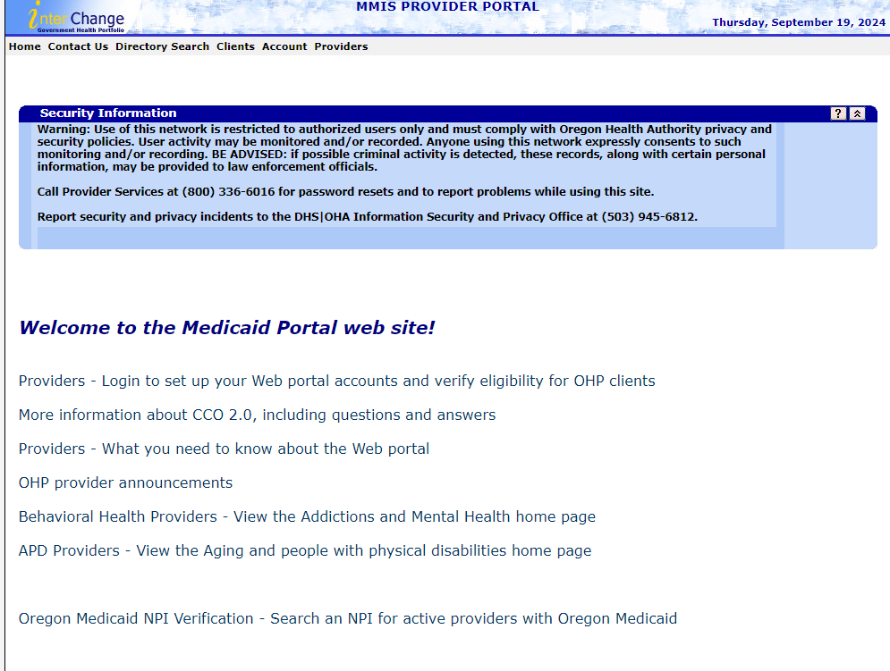
Click on Provider Login to set up web portal link.
www.or-medicaid.gov

Slide 31
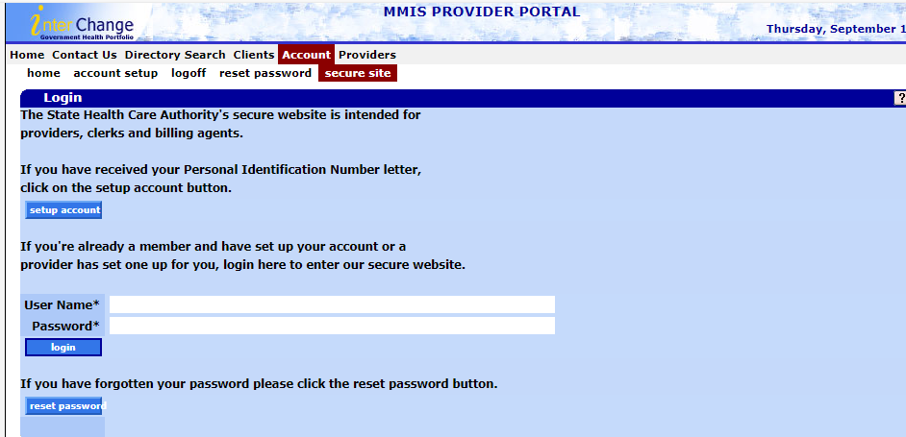
Type in your Username and Password and click on the Login button.

Slide 32
Before you start billing your claims:
Make sure you are logged in under the correct Provider ID. If you need to switch the Provider ID you are logged in under, go to Account menu and select “switch provider”.
The provider ID you are logging in under should have the correct provider type of 47 as well as specialty of 079. Please ensure of this before moving forward with billing the LPHA claims.

Slide 33
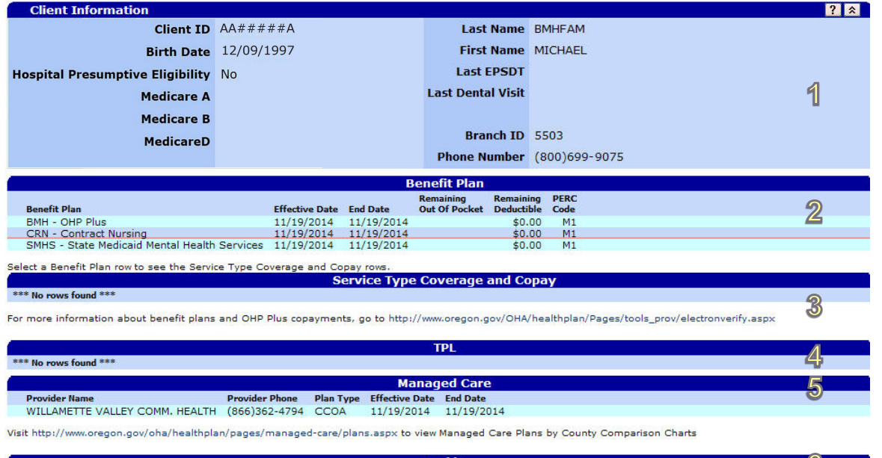
Did you know contracted providers must check eligibility?
All contracted providers must check eligibility of every person they see.
If the member is with the FFS, then use the MMIS Provider Portal for billing.
If the member is with a CCO or Managed Care Group, please contact the Managed Care Group directly.
The Eligibility Manual can be found at:
www.oregon.gov/oha/HSD/OHP/tools/Portal-Eligibility-Enrollment.pdf

Slide 34
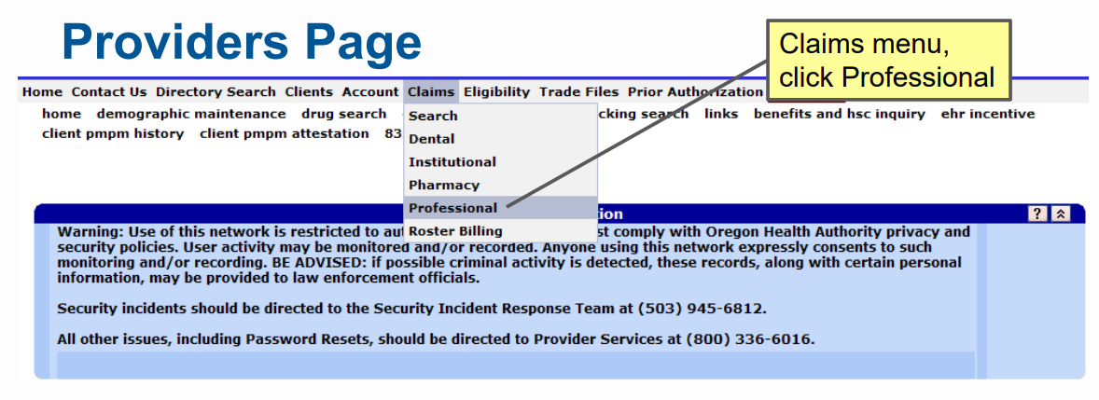
Click on Claims, then Professional and this will open the claim.

Slide 35
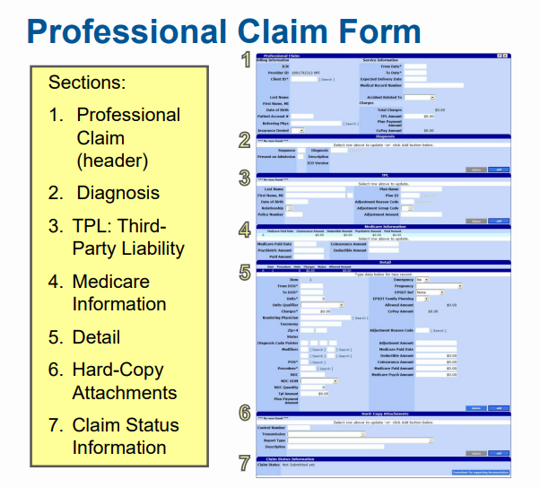

Slide 36
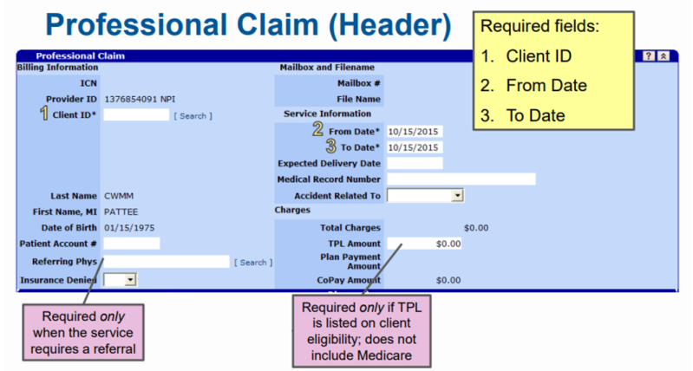
NPI OR MCD WILL POPULATE HERE

Slide 37
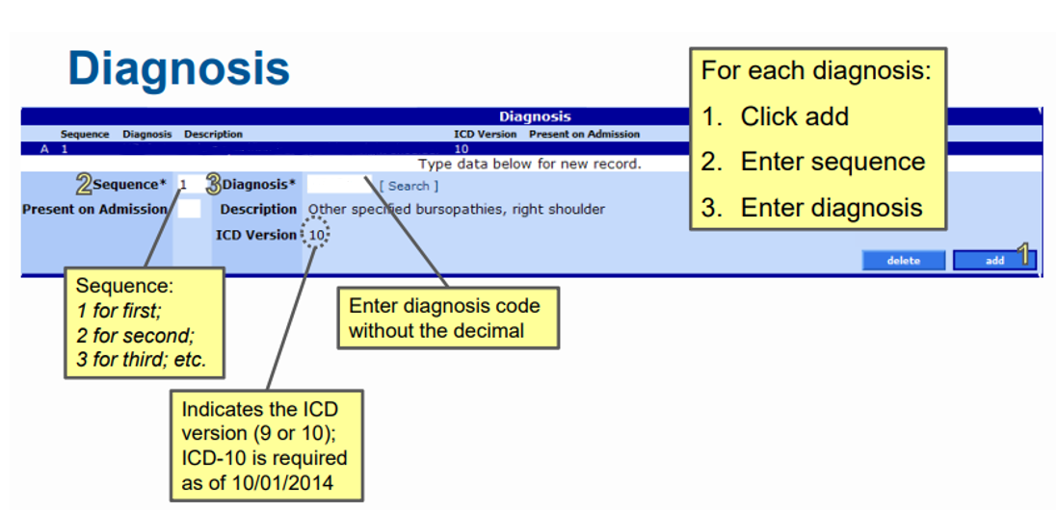
Once you add in the diagnosis, please do not click add. You only click add if you need to add another diagnosis code.

Slide 38
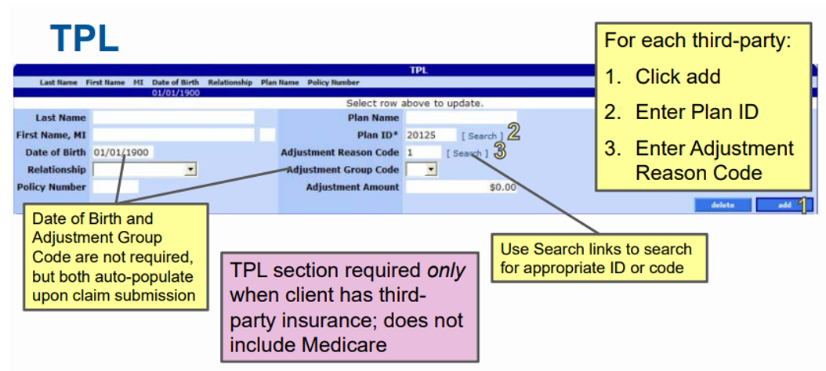
If the member has TPL, add it here and if they do not have TPL, then skip this panel.

Slide 39
Adjustment Reason Codes for Provider Portal
Adjustment reason codes for TPL, and Medicare are:
Web Portal
1 | Deductible
2 | Co-Insurance
119 | Max Benefits
96 | Not Covered

Slide 40
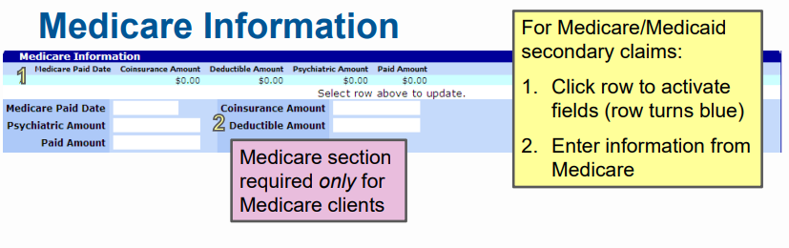

Slide 41
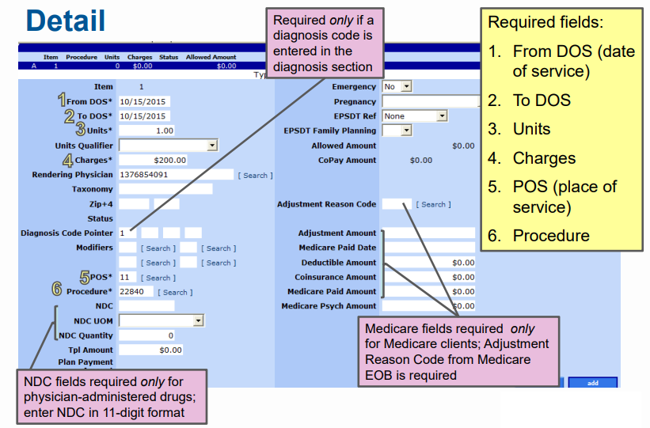

Slide 42
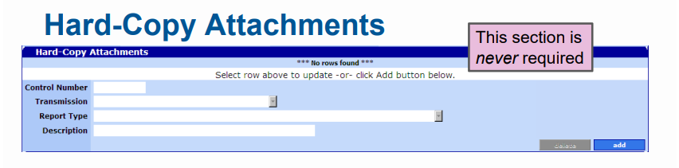
MMIS does not use information entered in this section. If you need to submit hardcopy attachments, please submit a paper claim.

Slide 43
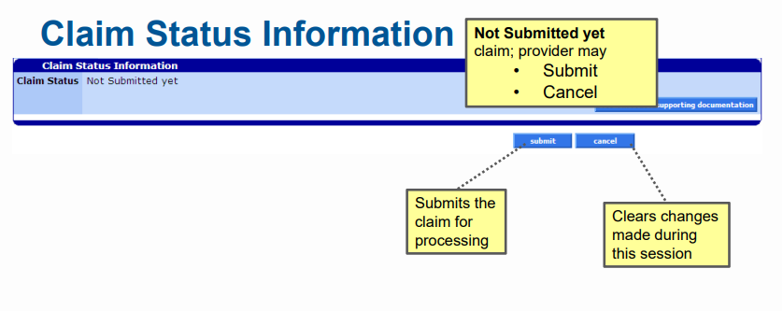
If the status states “Not Submitted”, please go back and check for errors.

Slide 44
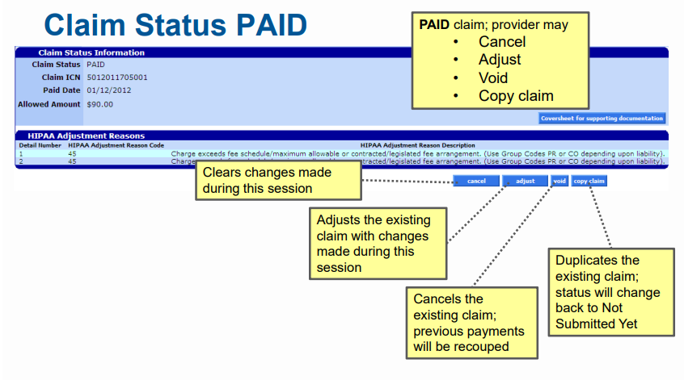
XXXXXXXXXX
If the Claim Status shows “Paid” then the claim will be in a paid status.

Slide 45
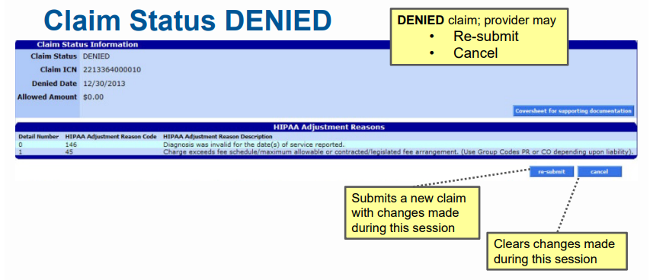
XXXXXXXXXXX
XX/XX/XXXX

Slide 46
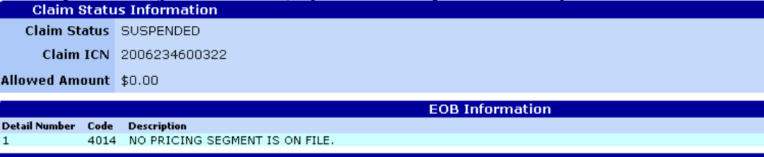
Claim Status: SUSPENDED
• You cannot take any action on a suspended claim.
• OHA staff will give the claim a Paid or Denied status after internal review.
• The review should not take longer than 30 days.
XXXXXXXXXX

Slide 47
Need Further Assistance?
Provider Services Unit:
800-336-6016, option 5
MMIS Provider Portal Link:
www.or-medicaid.gov
Claims Billing Slides Link:
www.oregon.gov/oha/HSD/OHP/Tools/Submit-Professional-Claims.pdf
Eligibility Manual Link:
www.oregon.gov/oha/HSD/OHP/tools/Portal-Eligibility-Enrollment.pdf
Resources for Providers:
www.OHP.Oregon.gov/Providers

Slide 48
What if the member has a CCO and not Open Card/FFS?
The provider will need to contact the CCO directly for guidance.
For more information on how to contact the CCOs, click here.

Slide 49
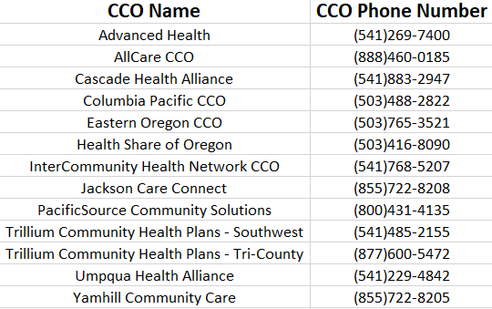
How to contact the different CCOS

Slide 50
Need Help with a CCO?
Contact the Innovator Agent for your region if you:
  Have questions or concerns as a local CCO member or partner.
  Want to work with your local CCO to improve health care access, quality and equity.
  Have community engagement opportunities to share with CCOs or their Community Advisory Councils.
  For more information about Innovator Agents, click here.

Slide 51
OHP Eligibility in Orpheus
Notes:
This last section will help LPHAs to understand how to determine if a home investigation for a child with lead poisoning is eligible for a reimbursement. Remember, only children enrolled in the Oregon Health Plan, or OHP, are eligible for reimbursements. However, this should not be used to deny other cases on private insurance from also receiving case management services, including a home investigation if warranted.

Slide 52
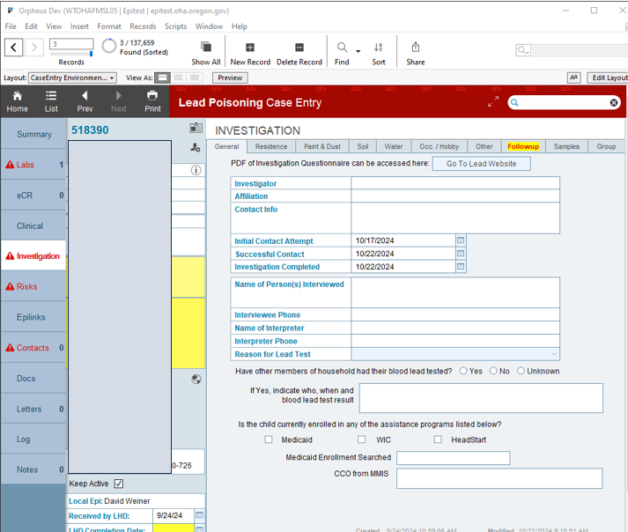

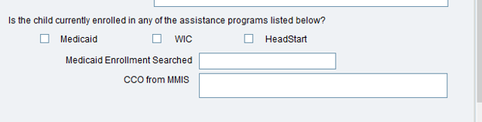
Finding Medicaid Enrollment in Orpheus
Notes:
In Orpheus, check in the Investigation tab, under General, to find out if the child is enrolled in Medicaid/OHP. The Medicaid box should be checked. If it’s not, you can check to see if the MMIS scan was performed during case creation. Do this by clicking the Person Entry icon.

Slide 53

Finding Medicaid Enrollment in Orpheus
Person Entry
Notes:
Once you click the Person Entry icon, and new page will open up with details about that Person.

Slide 54
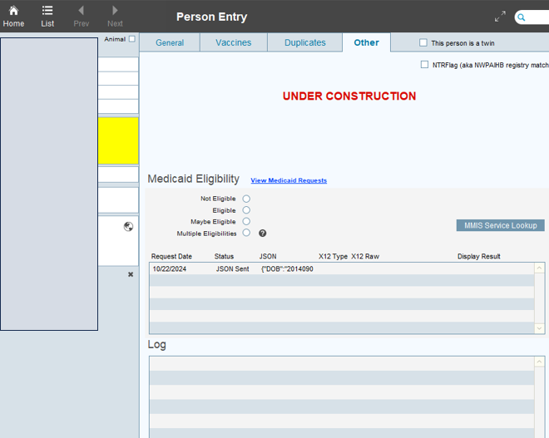
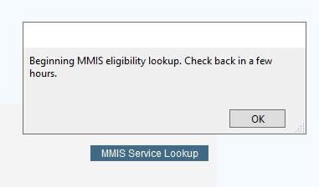
Finding Medicaid Enrollment in Orpheus
If none of the radio buttons are filled in, then the Lookup was not performed.
Click the “MMIS Service Lookup” button and come back to the case in a few hours to check.
Notes:
Under the “Other” tab, check to see if the Medicaid Eligibility section has been completed. You’ll know that the scan was completed if a radio button is clicked. If not, click the “MMIS Service Lookup” button to initiate this scan. Come back to the case in a few hours to see if the scan was completed.

Slide 55
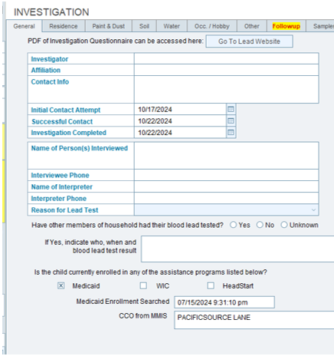

Finding Medicaid Enrollment in Orpheus
Notes:
Once the scan is complete, the Medicaid Eligibility page will be updated with the result. Also, the case record should be updated as well and will include both the scanned date/time as well as the Coordinated Care Organization name. If it is determined that the child is Not Eligible for Medicaid, the home investigation is not reimbursable. If you or any LPHA staff have questions about this, please contact me.

Slide 56
Resources
OHA Lead Poisoning Prevention Program website
  Local Public Health Authorities website
  Case Management website
  OHA Lead Poisoning Investigative Guidelines
Oregon Administrative Rule (OAR) 333-018: Disease Reporting
Oregon Administrative Rule (OAR) 333-019: Investigation and Control of Diseases
OHA Early and Periodic Screening, Diagnostic and Treatment (EPSDT) Program
OHA Monthly Communicable Disease Surveillance Report
CDC Recommended Actions Based on Blood Lead Level
Centers for Medicare and Medicaid Services (CMS): Lead Screening
National Lead Poisoning Prevention Week (CDC)
Notes:
Here are some links to additional resources beyond those that were included in the previous slides.

Slide 57
Thank you
You can get this document in other languages, large print, braille or a format you prefer free of charge. Contact Ryan Barker at ryan.s.barker@oha.oregon.gov or 503-953-5432 (voice/text). We accept all relay calls.
Public Health Division
Childhood Lead Poisoning Prevention Program
800 NE Oregon St. Suite 640
Portland, OR 97232
971-673-0440
leadprogram@odhsoha.oregon.gov
healthoregon.org/lead
Notes:
Again, thank you for taking the time to view this webinar. If you have any questions about this process, please use the contact information available on the relevant slides. If you have specific questions about lead poisoning cases, please contact me directly.
Thank you!

