Slide 1
REALD & SOGI and APAC discussion group
Session 3
Building and transferring files to APAC
May 21, 2024

Slide 2
Acronyms
APAC – All Payer All Claims program; within Health Policy & Analysis in OHA
CMS – Centers for Medicare & Medicaid Services
E & I – Equity and Inclusion Division in OHA
HSRI – Human Services Research Institute (APAC’s vendor)
OHA – Oregon Health Authority
OMB – Office of Management and Budget; determines federal standards on race, ethnicity, language and other items
REALD – Race Ethnicity (and) Language and Disability
SOGI – Sexual Orientation and Gender Identity
TAG – (APAC’s) Technical Advisory Group

Slide 3
What are the goals of these discussions?
Enhanced planning for reporters from deeper consideration of laws, rules, collection devices and reporting
REALD and SOGI questions and potential answers
Data collection, storage and possibly use
Files sent to APAC

Slide 4
Data in should be data out - mostly
Information asked =
Information stored =
Information transferred
There may be minimal data cleaning or ‘organizing’ depending on collection and storage method
No value-add, no interpretation, no recoding
Notes:
Because OHA is specifying the specific questions and potential responses, it is important data submitted are the direct responses of members

Slide 5
Data in should be data out – mostly continued 1
Data cleaning to remove special characters other than tilde
As a comma delimited file, commas within responses should be removed
What do you need from OHA to help that happen?
Reminder - Work with E & I on any edits, including skip patterns, that occur at data intake
Notes:
Hop to next screen as example, then back to this for any questions
When come back to this screen – so other than a final file layout and reference tables, what do you need from OHA to help this happen

Slide 6
Data in should be data out – mostly continued 2
After data has been received from members, how will storage method and capacity manage the data submitted? For example, if machine readable form used, multiple selections under Race and Ethnicity are reported in a single field, separated by tildes (~)
What do you need from OHA to help that happen?
Notes:
Hop to next screen as example, then back to this for any questions
When come back to this screen – so other than a final file layout and reference tables, what do you need from OHA to help this happen

Slide 7
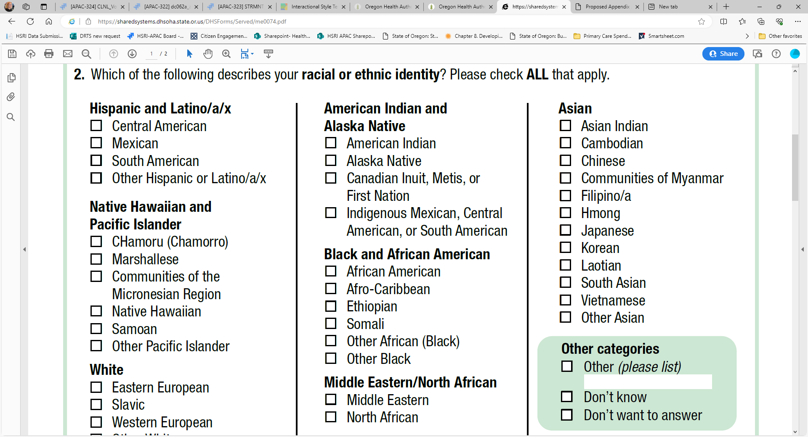
Example: Data in to data out
Notes:
As you can see, multiple check boxes need to be reported within a field with one option – Other please list – having a separate field as a text literal
Each checkbox is recorded, prior to transfer, as the numeric field value in the appendix look up table
This modification can occur at intake if programming a web site or after receipt, but will be needed prior to data transfer

Slide 8
Data transfer to APAC same as usual
Files will be submitted through HSRI data submission portal
HSRI will run basic validations to ensure files can be loaded
Right number of fields (commas between)
Numeric fields have only numbers, etc.
Any file problems will be reported as file failure and replacements required
APAC is not expecting any exemption activity on REALD & SOGI data files
Any early questions for APAC or Equity & Inclusion?

Slide 9
Resources – more to be developed
APAC REALD & SOGI Implementation page is active
Implementation plan
Draft Appendix J
Discussion schedule and recordings of meetings
REALD and SOGI page for E & I
Presentation by E & I for January 2024 TAG meeting
Draft Appendix J presented to March 2024 TAG meeting
Fields and values still under review in E & I rulemaking; updates will be required
Basic structure, length, reference lists useful in planning now
APAC and E & I plan on more meetings to discuss technical elements after file layout and APAC rules (and E & I rules) are known

Slide 10
Questions, comments or concerns to share today? Ideas for technical assistance (discussions) after rules and layout final?
Comments, etc. at any time to APAC.admin@odhsoha.Oregon.gov

