Slide 1
All Payer All Claims (APAC) Technical Advisory Group
March 20, 2024
To provide verbal public comment send a ZOOM chat message to the meeting host
Ashley Walchli, or text 503-385-6542, and request public comment.
OHA welcomes all participants. If you have any questions about accommodations or need any assistance to participate, please ZOOM chat Ashley Walchli, or text 503-385-6542.
All relay calls are accepted.

Slide 2
Zoom features, captions and transcript
Your microphone and video controls
List of who is present
Chat feature will open in new window
Click the small arrow next to “CC Live Transcript” to access caption controls
You can hide the subtitles or view the full transcript
Please note this meeting is being recorded.
The recording and meeting minutes will be made available on the APAC TAG website:
https://www.oregon.gov/oha/HPA/ANALYTICS/Pages/All-Payer-All-Claims-TAG.aspx

Slide 3
Attendance
Please enter your name and organization in the Chat
We will make a verbal request for those attending by telephone only

Slide 4
Agenda
Meeting opening
Public comment
General updates
Appendix J draft file layout presentation
Coming soon

Slide 5
Meeting opening - Recap of January meeting
Data requests
1/22/24 DRC Meeting
6039 Type 1 Ketoacidosis
Discussion on Healthcare Operations

Slide 6
Meeting opening - Recap of January meeting
PAF Data Issues
Issues with 2023 submission of 2022 data
Several organizations resubmitted data, so HSRI had to reprocess PAF data with the 2023 Q4 claims data
APAC is considering changes to improve data completeness and timeliness
If you know what issues occurred in your organization that we can impact, please reach out by email or schedule a call

Slide 7
Meeting opening - Recap of January meeting
Healthcare Operations Data Release Discussion
APAC is developing an application package tailored to healthcare operations requests

Slide 8
Public comment
To provide verbal public comment send a ZOOM chat message to meeting host Ashley Walchli, or text 503-385-6542, and request public comment.
Please do not submit written public comment through the ZOOM chat; we will unmute you when it is your turn to speak.

Slide 9
General updates
APAC data use -2/26/2024 Data Review Committee (DRC)
6029 APCD DTECH DM
6218 Joint Taskforce hospital-discharge
Currently nothing posted for review in March DRC

Slide 10
HSRI Annual Validation reports refresher

Slide 11
All Payer All Claims (APAC) Proposed Appendix J File Layout
March 20, 2024

Slide 12
Background
APAC is authorized to collect data that meets ORS 413.161 (REALD & SOGI). Before submission may begin, APAC must update the APAC data file layouts through formal rulemaking.
The APAC team and the Equity and Inclusion Division have collaborated to create a file layout (Appendix J) to enable the ingestion of REALD & SOGI data into APAC.
Much of the Appendix J file layout is taken from existing REALD and SOGI reporting appendices.
Submission to APAC is currently scheduled to begin on 1/31/25
Submissions will be made every quarter, with relaxed error thresholds at the start.

Slide 13
Appendix J File Layout
Appendix J- Race, Ethnicity, Primary Language and Disability Status; Sexual Orientation and Gender Identity
70 fields detailing facility name and location information, provider first name and last name, individual’s unique member ID, member demographic information, race and ethnicity, language(s) spoken, interpreter need and type, English proficiency, disability status and needs, and sexual orientation and gender identity information.
Items highlighted in yellow in the file layout are current rulemaking activity by E&I and are subject to change
Single values only unless multiple values are separated by a tilde (~) are indicated. Tilde is the only special character accepted.

Slide 14
Appendix J
*Example image only does not contain the complete file layout table

Slide 15
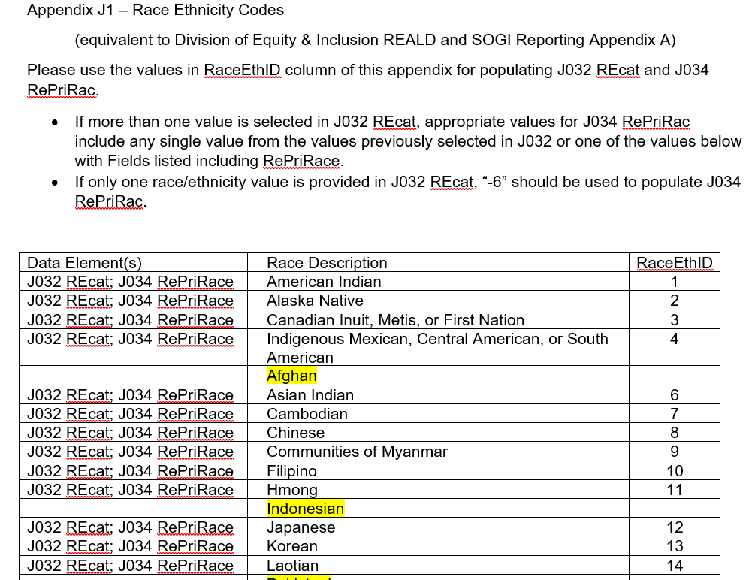
Appendix J1
*Example image only does not contain the complete lookup table

Slide 16
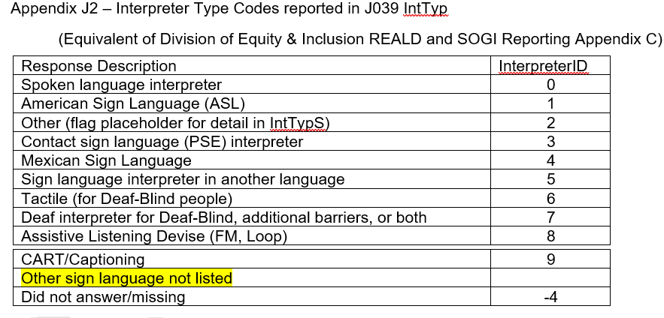
Appendix J2

Slide 17
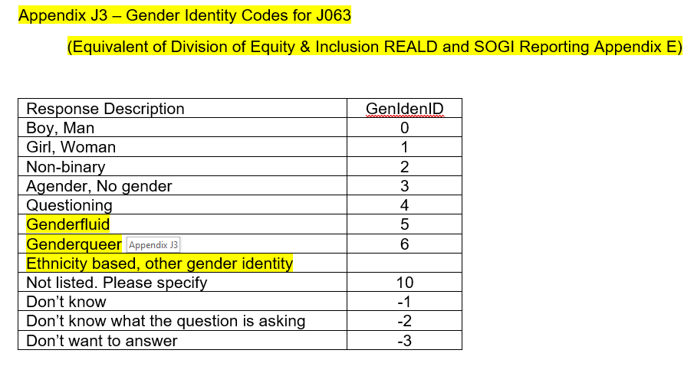
Appendix J3

Slide 18
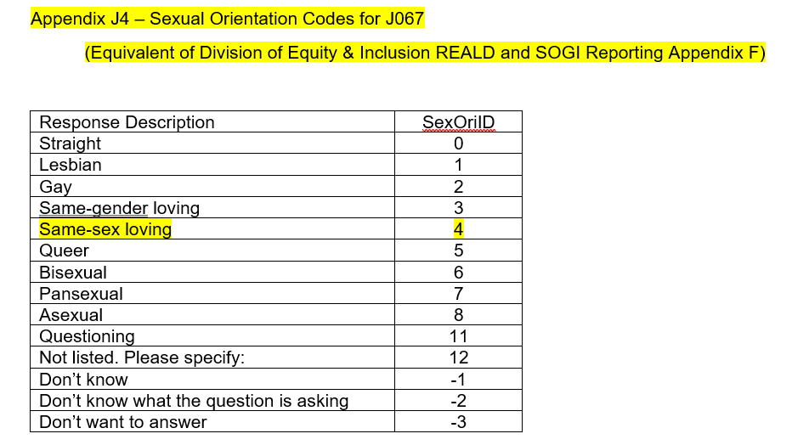
Appendix J4

Slide 19
Appendix J5

Slide 20
What’s Next?
Please share thoughts and comments with the APAC team via public comment or APAC.Admin@odhsoha.oregon.gov
The finalized proposed appendix J layout will be presented during the May 15th TAG meeting
Calendar invites for a voluntary workgroup with data submitters will be sent out soon
If you or your organization is interested in being an early data submitter, please reach out to the APAC team
A RAC Hearing will be set for summer 2024

Slide 21
Coming soon
Annual validation reports to be received in April
Work sessions on implementing REALD and SOGI data collection and submission – attendance is completely voluntary

Slide 22
Questions? Contact
APAC.Admin@odhsoha.oregon.gov

