Slide 1
Driver #3: 11-Hour Rule

Slide 2
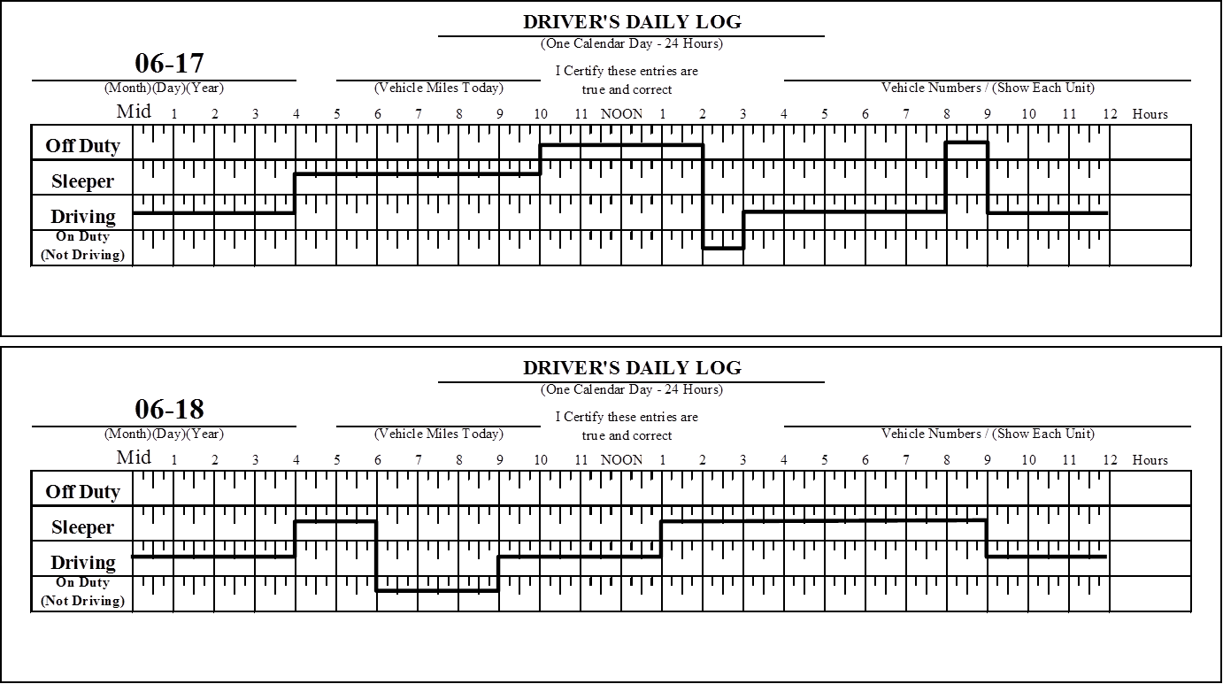
Driver #3 – 11-Hour Rule
10 Hours
1
1
2
11
3
2

Slide 3
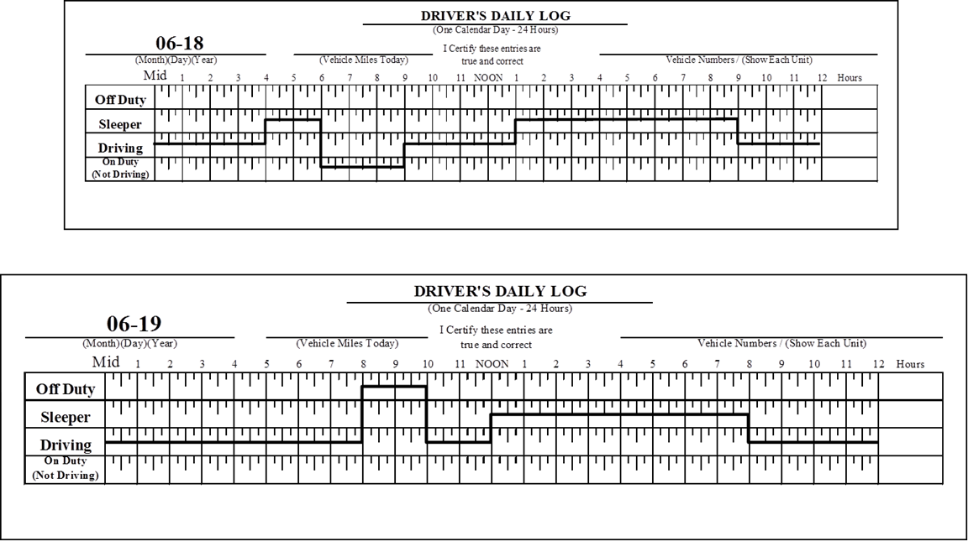
Driver #3 – 11-Hour Rule (cont.)
3
4
11
11
3
5
4

Slide 4
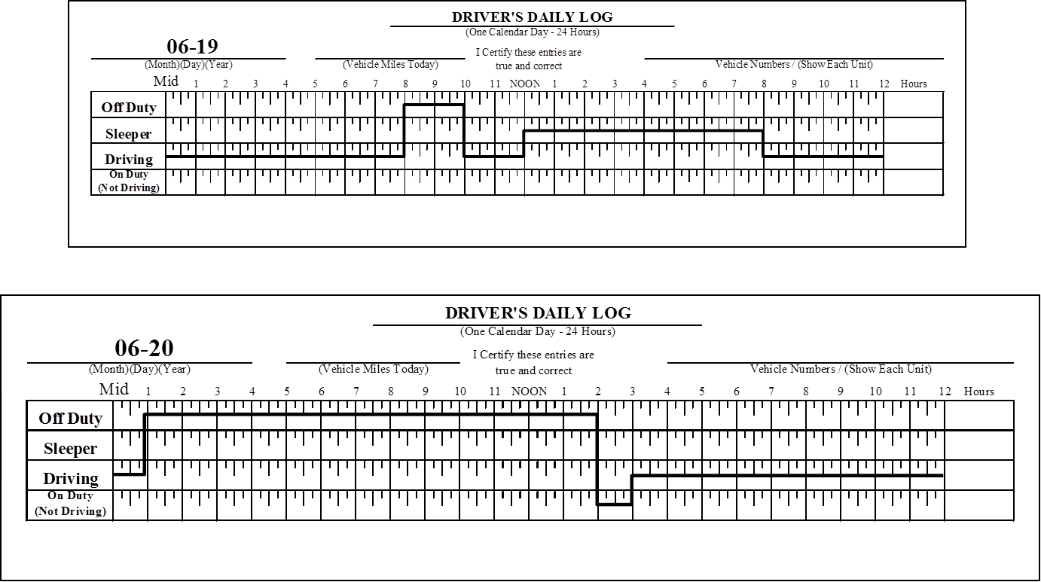
Driver #3 - 11- Hour Rule (cont.)
5
5
6

Slide 5
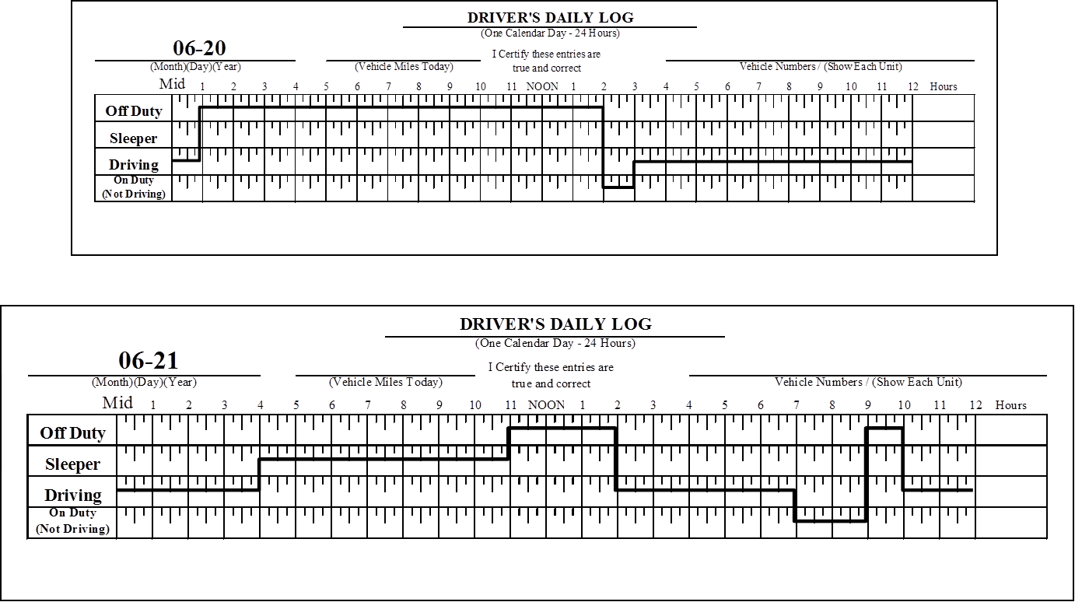
Driver #3 – 11-Hour Rule (cont.)
6
11
6
7

Slide 6
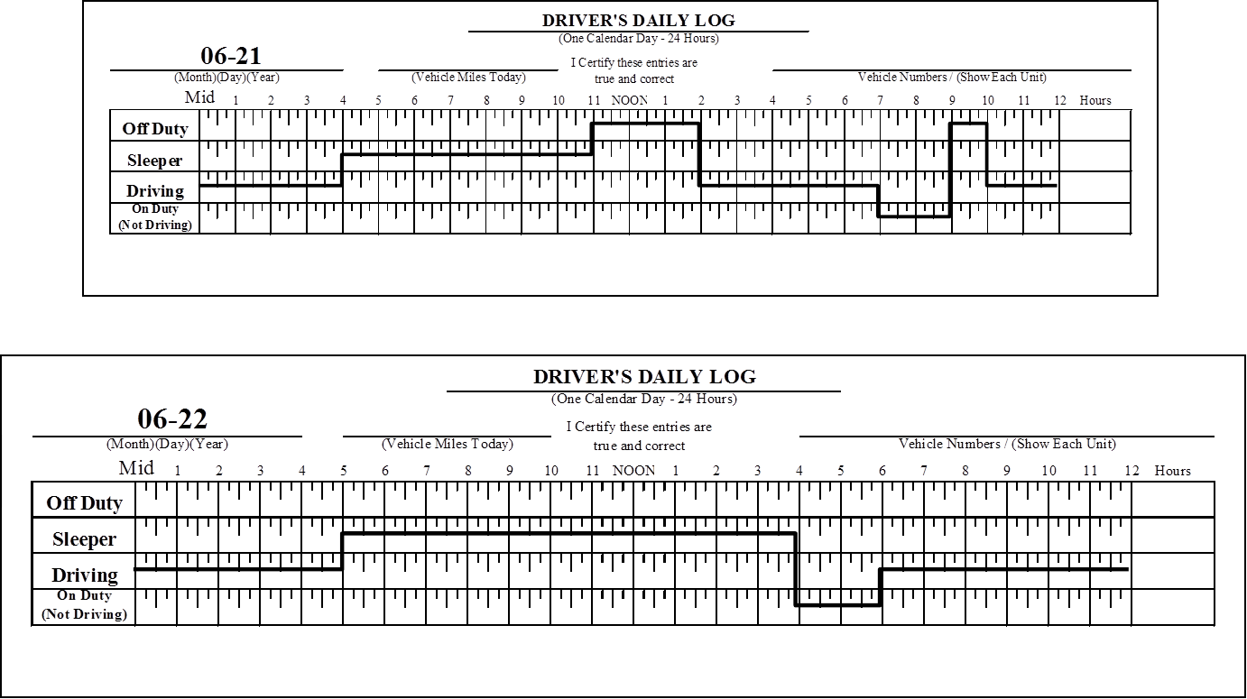
Driver #3 – 11-Hour Rule (cont.)
7
11
7
8

Slide 7
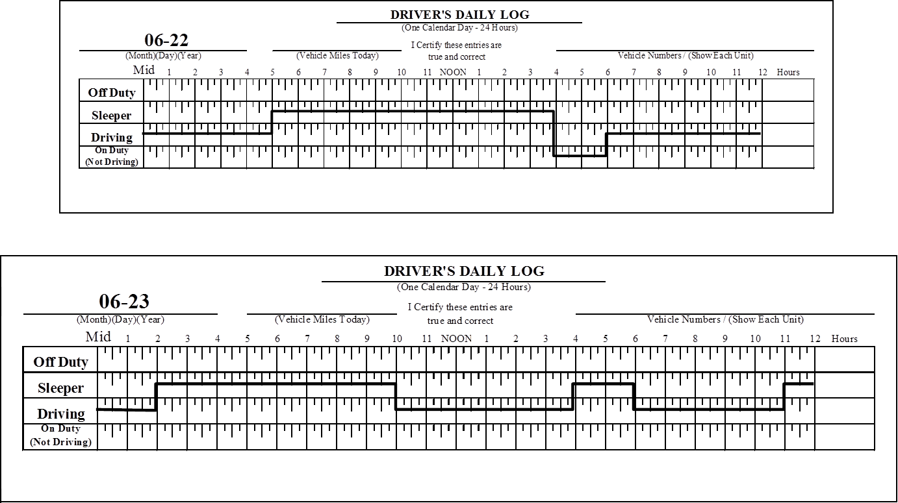
Driver #3 – 11-Hour Rule (cont.)
8
11
9
8

Slide 8
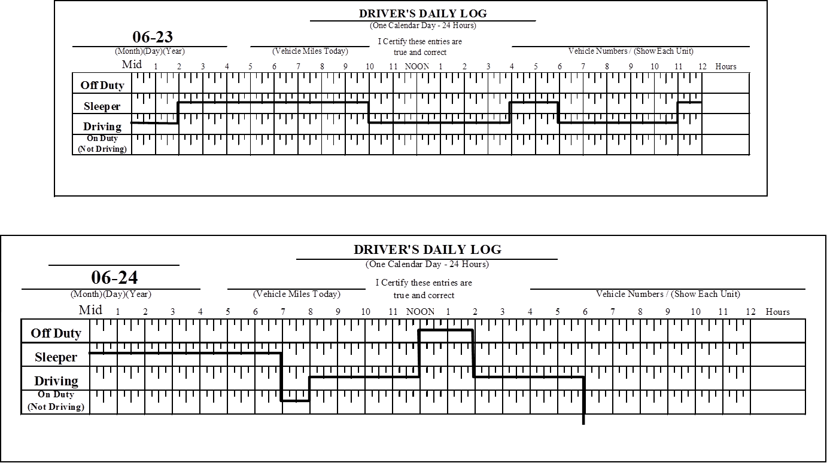
Driver #3 – 11-Hour Rule (cont.)
9
10
9
Stopped For Inspection
Stopped For Inspection

Slide 9
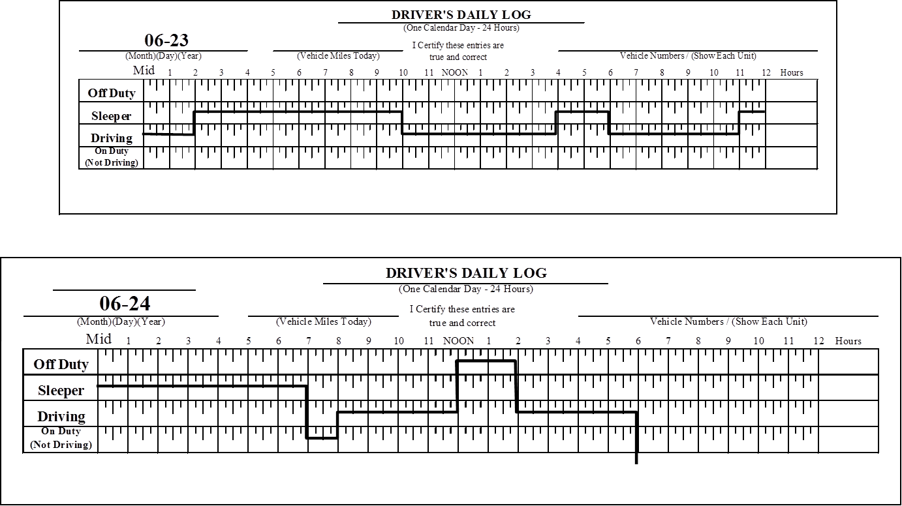
Driver #3 – 11-Hour Rule (cont.)
10
11
10
11
Stopped For Inspection
Stopped For Inspection

Slide 10
Driver #3 11-Hour Violations
The following is a summary of the violations discovered for Driver #3:
11 Hour Rule Violations Discovered
6-18: 3 A.M.-4 A.M. & 9 A.M.-1 P.M.
6-19: 4 A.M.-8 A.M. & 10 A.M. - Noon
6-21: 2 A.M.-4 A.M.
6-22: 4 A.M.-5 A.M.
6-23: 1 P.M.-4 P.M.
If there is a violation at the time of inspection, when may the driver drive again?
No Violation
Notes:
Instructor Notes:
Review the violations found for driver #1. Ask, if there is a violation at the time of the inspection, when may the driver drive again? Click to show the answer. Answer: No Violation
11-Hour Rule Violations Discovered:
6-18: 3:00 A.M.–4:00 A.M., and 9:00 A.M. –1 P.M.
6-19: 4:00 A.M.–8:00 A.M. & 10:00 A.M.–Noon
6-21: 2:00 A.M.–4:00 A.M.
6-22: 4:00 A.M.–5:00 A.M.
6-23: 1:00 P.M.–4:00 P.M.

Slide 11
Driver #3: 14-Hour Rule

Slide 12
Driver #3 – 14-Hour Rule
10 Hours
1
1
2
14
3
2

Slide 13
Driver #3 – 14-Hour Rule (cont.)
3
4
14
3
5
4

Slide 14
Driver #3 - 14- Hour Rule (cont.)
5
5
6

Slide 15
Driver #3 – 14-Hour Rule (cont.)
6
6
7

Slide 16
Driver #3 – 14-Hour Rule (cont.)
7
14
7
8

Slide 17
Driver #3 – 14-Hour Rule (cont.)
8
14
9
8

Slide 18
Driver #3 – 14-Hour Rule (cont.)
9
10
9
11
10
11
Stopped For Inspection
Stopped For Inspection

Slide 19
Driver #3 14-Hour Violations
The following is a summary of the violations discovered for Driver #3:
14-Hour Rule Violations Discovered
6-18: 9 A.M. – 2 P.M.
6-22: 4 A.M. – 5 A.M.
6-23: 2 P.M. – 4 P.M.
6-19: 3 A.M. – 7 A.M.
If there is a violation at the time of inspection, when may the driver drive again?
No Violation
Notes:
Instructor Notes:
Review the violations found for driver #1. Ask, if there is a violation at the time of the inspection, when may the driver drive again? Click to show the answer. Answer: No Violation
11-Hour Rule Violations Discovered:
6-18: 3:00 A.M.–4:00 A.M., and 9:00 A.M. –1 P.M.
6-19: 4:00 A.M.–8:00 A.M. & 10:00 A.M.–Noon
6-21: 2:00 A.M.–4:00 A.M.
6-22: 4:00 A.M.–5:00 A.M.
6-23: 1:00 P.M.–4:00 P.M.

Slide 20
Driver #3: 60/70-Hour Rule

Slide 21
Driver #3 – 60/70-Hour Rule

Slide 22
Driver #3 – 60/70-Hour Rule (cont.)

Slide 23
Driver #3 – 60/70-Hour Rule (cont.)
70

Slide 24
Driver #3 – 60/70-Hour Rule (cont.)

Slide 25
Driver #3 70-Hour Rule Results
Date | Hours
6-17 | 13
6-18 | 14
6-19 | 13
6-20 | 11
6-21 | 13
6-22 | 13
6-23 | 13
6-24 | 9
Total | 99
Violations
Reaches 70th hour on 6/22 at 4pm
6/22: 6pm to midnight
6/23: midnight to 2am, 10am to 4pm, 6pm to11pm
6/24: 8am to noon, 2pm to 6pm
Total
When may the driver drive again?
6-25 (12:01 A.M.) -13
6-26 (12:01 A.M.) -14
86
72
Notes:
Instructor Notes:
Review the violations for driver 3. Ask; If there is a violation at the time of inspection, when may the driver drive again? Click to show answer. Answer: After 8 consecutive hours in the SB. Remind the students the driver is only placed OOS until such time as eligibility to drive is re-established.
11-Hour Violations Discovered:
9-10: 4 P.M.-5 P.M.
9-11: 2 A.M.-5 A.M.
9-12 Noon-2 P.M. & 4 P.M.-10 P.M.
9-13: 7 P.M.-8 P.M.
9-14: 5 A.M.-9 A.M.
9-17: 3 A.M.-6 A.M. & 10 A.M.-1 P.M.

Slide 26
Driver #3 – 34-Hour Restart
6-25
34
6-26

