Slide 1
Rest Period Examples with Starts and Stops

Slide 2
Example #1
10 hours
1
10 hours
2
1
2

Slide 3
Example #2
10 hours
1
1
2
2
10 hours
3
3

Slide 4
Example #3
10 hours
1
1
2
2
10 hours
3
3

Slide 5
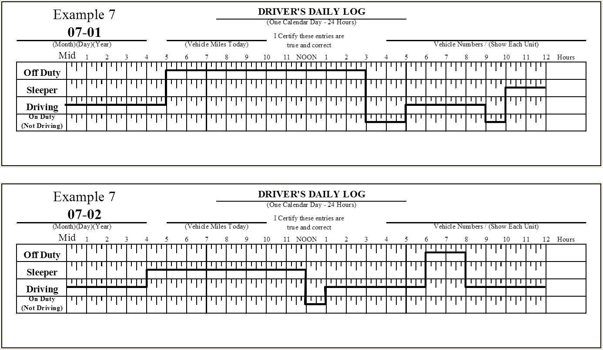
Example #4
10 hours
1
1
2
10 hours
3
2
4
3
4

Slide 6
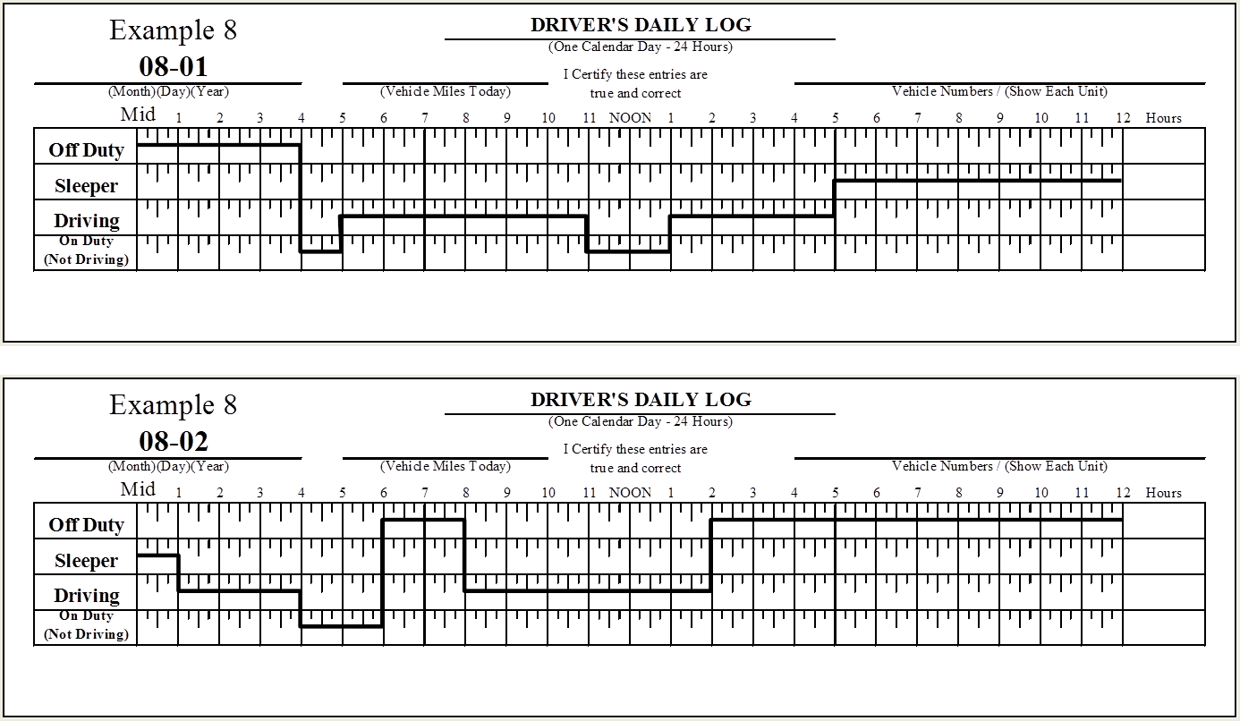
Example #5
10 hours
1
2
1
2

Slide 7
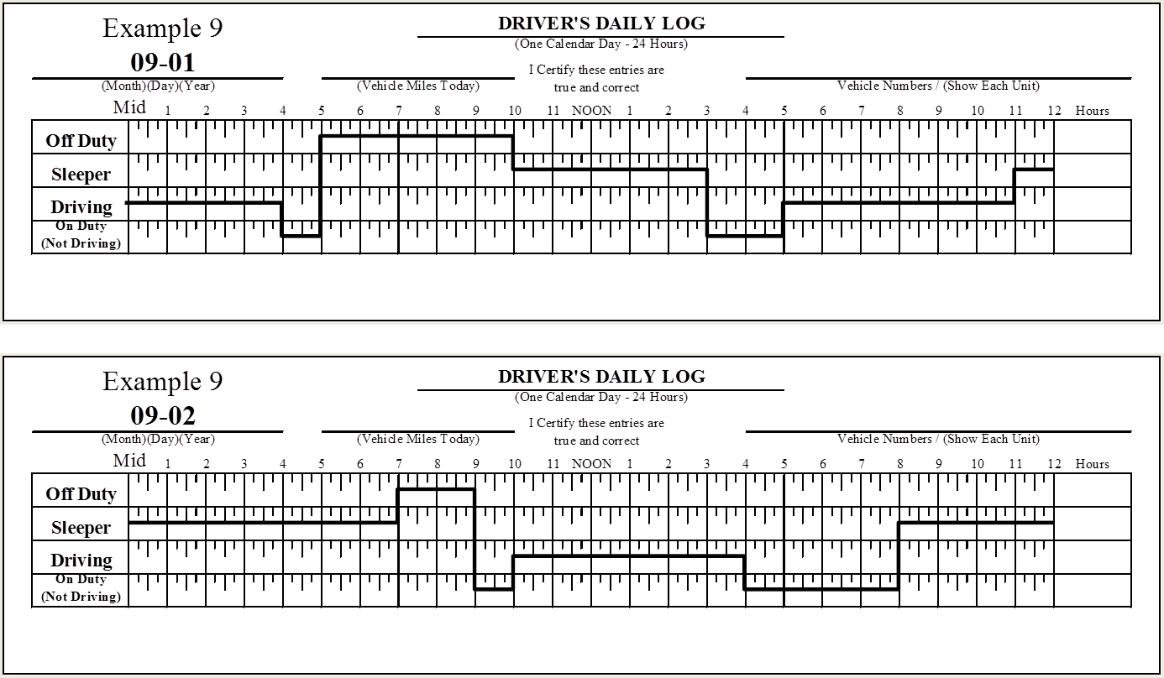
Example #6
10 hours
1
1
2
2
10 hours
3
3

