Slide 1
Oregon Title VI Community of Practice
Wednesday, November 20, 11AM-12PM
In the chat, please share
your first and last name
name of district ,ESD, or Tribe, and
official Title VI Role - Project Coordinator, Authorized Official Representative, student liaison, etc.

Slide 2
Introductions and Role
Peer Community of Practice Leaders -
Gillian Murr - Portland Public Schools
Shelby Maerz - Salem-Keizer Public Schools
[Small District CoP Leader Wanted]
[Consortium CoP Leader Wanted]
Oregon Office of Indian Education Title VI Lead -
Stacy Parrish, Education Program Specialist II, Proud Member of the Klamath Tribes (Yahooskin Paiute)
Notes:
ALL

Slide 3
A Challenge to You All –
Find ways to use your tribal language or the language of the local tribe in everyday conversation as much as you can.
Many of our ancestors only know the old language and using it – no matter our pronunciation or fluency – keeps them strong and able to hear us when we speak.

Slide 4
Today’s Agenda -
Roll Call, Updates, and the Formula Grant Timeline
Checking In as a Community - US Government’s Boarding School Apology Reflections
Teamwork Makes the Dreamwork - Throwing Your Blanket Over a Chair; Save Your Spot at the Table for Integrated Guidance
Community of Practice Shared Folder - Update it Regularly and Contact List

Slide 5
Title VI Intro and Check In with Three Awardees
In September we heard from Coquille SD, Klamath County SD, and David-Douglas. In October we heard from Willamette ESD, North Bend SD, and Lincoln County.
Let’s get to know three of you better…
If your district, consortium, or tribe has not already shared out, unmute and tell us your…
Name
Tribes you “Meaningfully Collaborate with” for Title VI
Your role with Title VI
Years in the role
Come to me if you want help with…

Slide 6
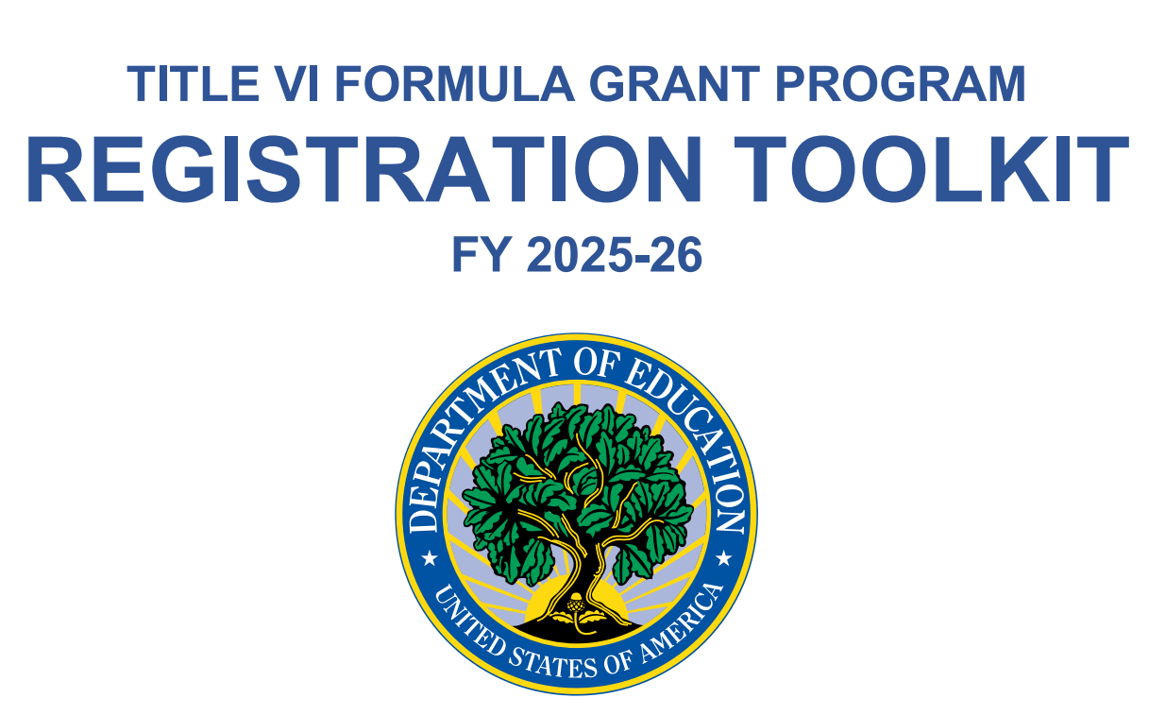
Quick Updates from the EASIE Website
The US Department of Education has a NEW registration process.
Title VI Formula Grant Program Registration Toolkit FY 2025-2026
“Registration for school year FY 2025-26 opened Monday, November 4, 2024, and will remain open until Friday, December 6, 2024, at 11:59 p.m., ET.
Each year, OIE EASIE applicants are highly encouraged to update their entity and contact information for the upcoming application cycle.
To ensure proper EASIE contact updates are collected, entities should be mindful that the individual submitting the EASIE Registration response has the authorizing authority to do so because the main Point of Contact, Project Director, and Authorized Official Representative registered will be provided EASIE access for Parts I & II.
The purpose of OIE EASIE Registration is to ensure that the correct entity information is pre populated into the EASIE Part I application. The EASIE Registration process does not serve as a grant application but gives the applicant an opportunity to update contact information.”
Wait - What?
If you were emailed a link from the US Department of Education, click on it. Then, verify and update your info.
If you have an award and didn’t get a link, ask another staff member who might have gotten the link.
If you didn’t get a link or don’t have anyone to ask, call the Partner Support Center.

Slide 7
Quick Updates
The US Department of Education Office of Indian Education released the public-facing list of FY24-25 Awardees for Title VI Indian Education. Visit the website and toggle to “Awards” to learn more about all awardees.
ODE publishes our own public-facing list, which is more comprehensive. It can be found on our Title VI website and on our Tribal Consultation website. View it here.
Have a list of technical questions?
EASIE Title VI Office Hours with the US Department of Education -
These new technical assistance sessions, which are intended to allow prospective and current grantees to receive direct support from their assigned OIE Program Officer via breakout sessions during the event.
Register for all sessions in the series or select specific sessions to attend by completing the WebEx Registration Form.

Slide 8
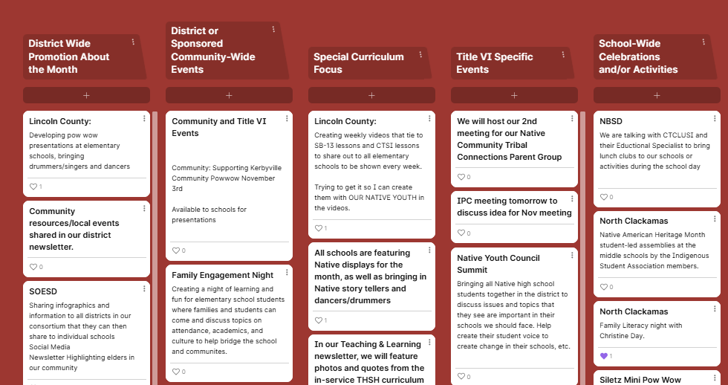
Continue contributing to this Padlet —
Open the Padlet and click on the + to add events and initiatives your district has planned for Native American Heritage Month.

Slide 9
General Formula Grant Timeline
To Do List -
✅ Save Your Spot - Integrated Guidance
✅ 506 Form collection process
✅ Indian Parent Committee Planning
-EASIE APR for FY 23-24 opened Sept. 9
-Indian Parent Committee Start of Year Outreach
-District and School-Wide Registration Norming - 506
Native American Heritage Month
-EASIE PART I Closes, 2nd week of month
-Tribal Consultation window for Integrated Guidance Opens
-Public Hearing must be held before Part II closes
-EASIE PART II Submission Deadline, Second week of Month Approx.
SEPTEMBER
NOVEMBER/DECEMBER
MARCH
MAY
OCTOBER
JANUARY/FEBRUARY
APRIL
-EASIE APR for FY 23-24 closed October 11
-Indigenous Peoples Day, Monday Oct 14
-EASIE Part 1 Opens, 2nd week of February Approx.
-EASIE PART II Application Available, 1st week of Month
-Tribal Consultation closes April 30th for Integrated Guidance
This is a general visual of the Title VI school year timeline. All LEAs and LEA-Cs should adhere to all published DOE timelines to plan their efforts.

Slide 10
Checking In as a Community
US Government’s Boarding School Apology Reflections

Slide 11
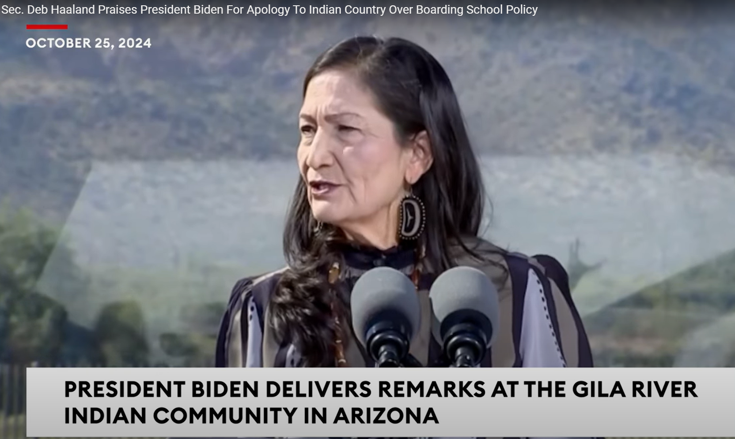
Secretary Deb Haaland - Introduction
On October 25, 2024 President Joe Biden delivered his now historic speech at the Gila Crossing Community School in Laveen Village, Arizona, formally apologizing for the role of the federal government in the mandated removal of children from their families and tribes launching one of the most horrific chapter’s in American History, the Federal Indian Boarding school era. Addressing the nation, he said, “After 150 years, the United States government eventually stopped the program, but the federal government has never — never — formally apologized for what happened until today. I formally apologize as president of the United States of America, for what we did. I formally apologize. And it’s long overdue.”
Federal Indian Boarding School Initiative
First Volume - Published May 2022
Second and Final Volume - Published July 2024
Oregon Tribal Members Reveal Painful Past from Country’s Boarding School Policy, as Biden Issues Apology - OPB

Slide 12
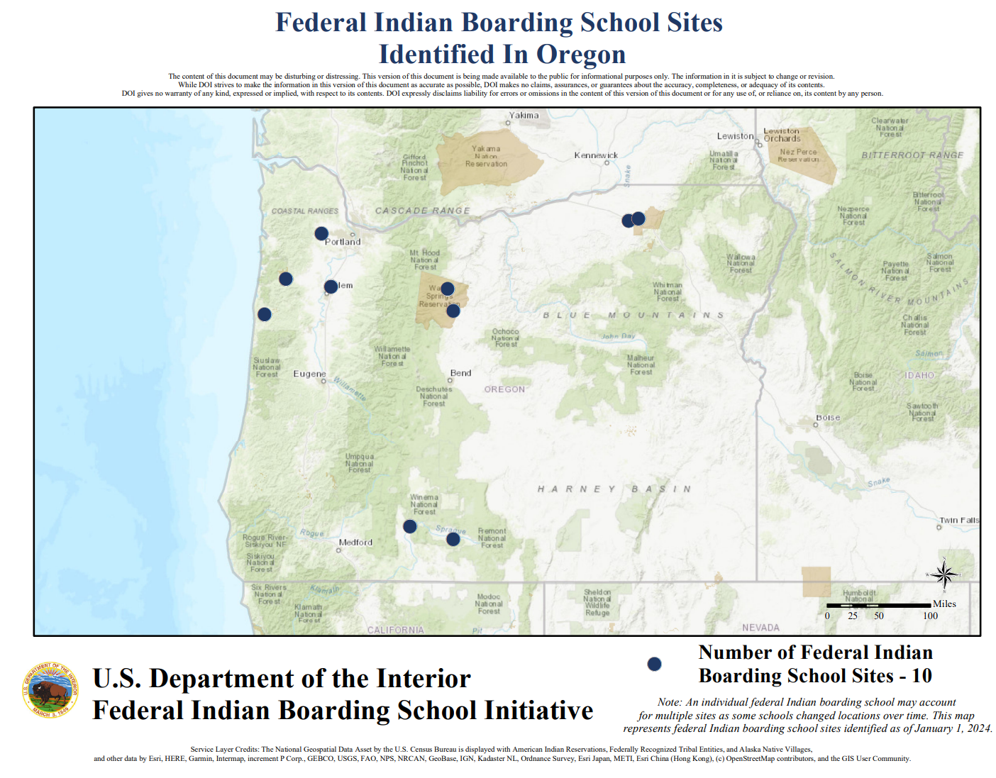
Ten Boarding Schools Identified in the Report
Chemawa Indian Training School
Forest Grove Indian Training School
Grand Ronde Boarding School
Kate Drexel Mission Boarding School
Klamath Agency Boarding School
Siletz Boarding School
Simnasho Boarding and Day School
Umatilla Boarding and Day School
Warm Springs Boarding and Day School
Yainax Indian Boarding School

Slide 13
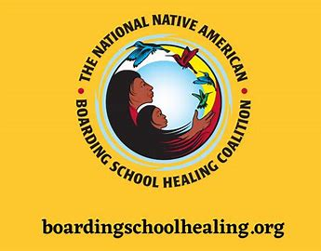
Group Reflection
The following questions have been adapted from the National Native American Boarding School Healing Coalition middle school curriculum.
What feelings are coming up for you?
What are the implications on us as a Nation to be asked to “now know” Native history?
What does it mean for us as educators to reckon with the acknowledgement that “federal policies were set out to break us, obtain our territories, and destroy our cultures and our lifeways”? (Asst. Secretary of the Interior for Indian Affairs, Bryan Newland, Ojibwe)
What should/Why should educators be taught about American Indian boarding schools moving forward?
What should/Why should students be taught about American Indian boarding schools moving forward?
What does healing look like in your District? What does it look like in your Title VI program?

Slide 14
Teamwork Makes the Dreamwork
Throw your Blanket Over a Chair; Save your Spot at the Table

Slide 15
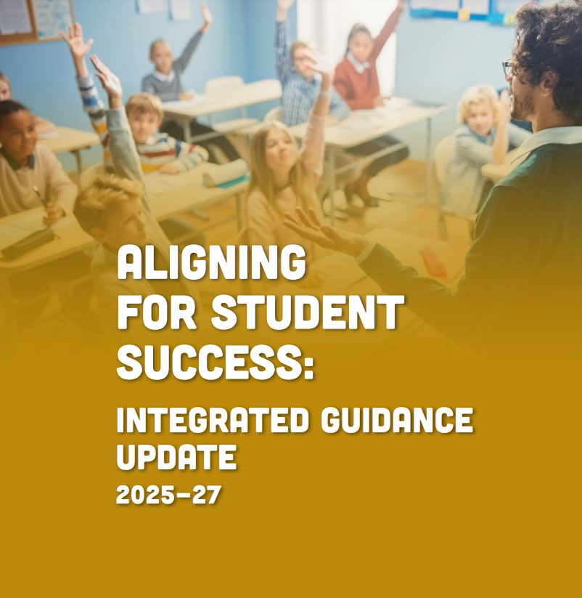
Leveraging Title VI Efforts to Impact District Improvement
Integrated Guidance Window Opens March 1 and Closes April 30
“This guidance now integrates nine programs or initiatives. Bringing these programs together operationally creates significant opportunities to improve outcomes and learning conditions for students and educators. (7)
The headline is that students, communities, educators, school leaders, and postsecondary, business, and industry partners have the opportunity and responsibility to plan and integrate these programs and funding streams in a way that improves the well-being, health, climate, quality of instruction, and outcomes for each and every student in Oregon with dedicated attention to focal student groups. (8)”

Slide 16
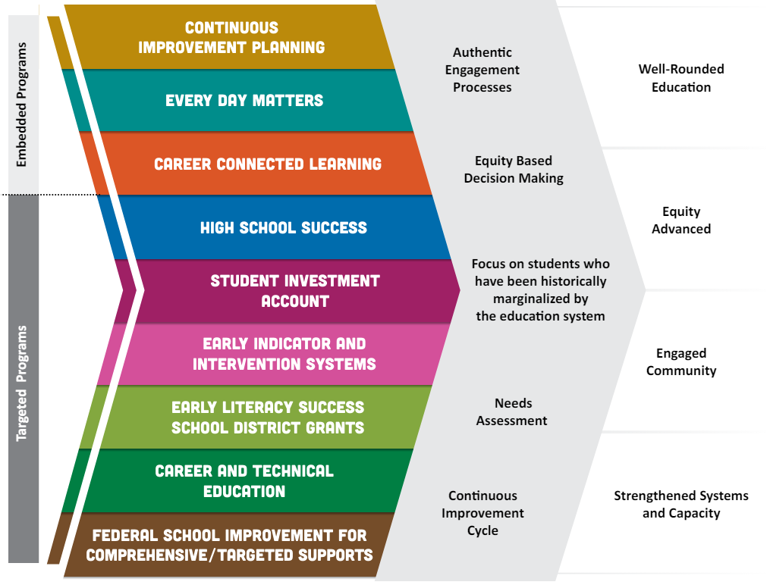
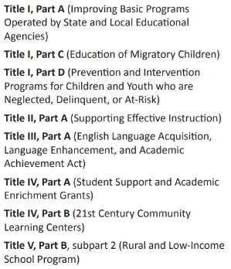
Title VI Indian Education Formula Grant Purpose
SEA-Administered Federal Title Programs:
Notes:
Time:
Script: Tim
SAY -
to help conceptualize this – This slide is an attempt at a visual which calls out how all of you, because of the funding amount you receive for Title VI, have now been brought into the Federal and State Tribal Trust Treaty responsibilities to better serve Native students through a relationship with local sovereign nations for Tribal Consultation.
Think of this visual as starting with the top – As recipients of a Title VI Indian Education formula grant, you now have received funds or the consortia has received funds on your behalf to create a comprehensive Indian Education program, which not only has three program requirements called out in the statute (see below), but awardees have also identified proposed objectives being focused on throughout the cycle of the grant based on the specific needs of your AI/AN population. These objectives are those BIG GOALS you are striving toward in the administration of the grant; those are the BIG GOALS to which you backwards plan your comprehensive program.
However, everything your district does to methodically co-create your district’s continuous improvement plan via your Integrated Guidance application - seen on the left here - also has significant impacts on your Title VI Indian Education program. It goes back to one of those three key messages above, in that AI/AN student success is not assured by merely having a Title VI program, it is done by design through thinking through where AI/AN students are represented throughout the planning process for your Integrated Plan in all of these embedded and targeted programs.
And then, by engaging in tribal consultation for how the district will utilize their SEA-Administered Federal Title funds, you are further inviting tribes into how those programs further supplement all of your District Improvement Planning efforts.
1) how they are determining which schools are getting IA funds, why, and what type of program the school(s) will run.
2) data from any needs assessments done for the school(s) and district wide.
3) Their academic / SEL / behavioral goals for the school(s) and district and how they're going to support educators and students in achieving those goals.
1. to meet the unique educational and culturally related academic needs of Indian students, so that such students can meet the challenging State academic standards;
2. to ensure that Indian students gain knowledge and understanding of Native communities, languages, tribal histories, traditions, and cultures; and
3. to ensure that teachers, principals, other school leaders, and other staff who serve Indian students have the ability to provide culturally appropriate and effective instruction and supports to such students.

Slide 17
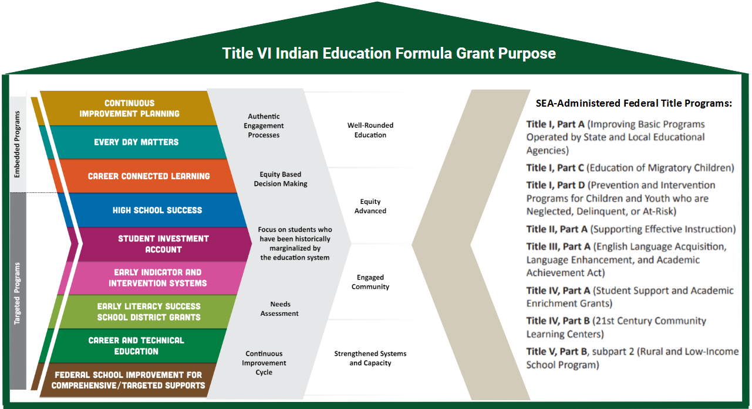
It is all connected. We are all connected.
Title VI Indian Education, SEC. 7421, PURPOSE
It is the purpose of this subpart to support the efforts of local educational agencies, Indian tribes and organizations, and other entities in developing elementary school and secondary school programs for Indian students that are designed to−
meet the unique cultural, language, and educational needs of such students; and
ensure that all students meet the challenging State academic standards.
Title VI Part A Indian Education Legislation

Slide 18
It is all connected. We are all connected.
Title VI Indian Education, SEC.7424, Assurances
(c) Assurances
Each application submitted under subsection (a) shall include assurances that—
(1) the local educational agency will use funds received under this subpart only to supplement the funds that, in the absence of the Federal funds made available under this subpart, such agency would make available for services described in this subsection, and not to supplant such funds;
(2) the local educational agency will prepare and submit to the Secretary such reports, in such form and containing such information, as the Secretary may require to—
(A) carry out the functions of the Secretary under this subpart;
(B) determine the extent to which activities carried out with funds provided to the local educational agency under this subpart are effective in improving the educational achievement of Indian students served by such agency, and meet program objectives and outcomes for activities under this subpart; and
(C) determine the extent to which such activities by the local educational agency address the unique cultural, language, and educational needs of Indian students;
(3) the program for which assistance is sought—
(A) is based on a comprehensive local assessment and prioritization of the unique educational and culturally related academic needs of the Indian students for whom the local educational agency is providing an education;
(B) will use the best available talents and resources, including individuals from the Indian community; and
(C) was developed by such agency in open consultation with parents of Indian children and teachers, representatives of Indian tribes on Indian lands located within 50 miles of any school that the agency will serve if such tribes have any children in such school, Indian organizations, and, if appropriate, Indian students from secondary schools, including through public hearings held by such agency to provide to the individuals described in this subparagraph a full opportunity to understand the program and to offer recommendations regarding the program;

Slide 19
Ensuring the Voices of Tribes, Students, and Families are Heard
Awardees $40K or More
All Title VI Awardees
As a state requirement, all affected school districts (those receiving $40K or more for their award, including those districts who are part of a consortium receiving $40K or more) must engage in Tribal Consultation with all local tribes prior to submitting their Integrated Guidance Plan.
Any district who receives a Title VI Indian Education Formula grant or any district who is a part of a consortium who receives the grant, should consider engaging in the Needs Assessment process with
the Indian Parent Committee
and/or with tribal students served by Title VI Indian Education
in order to listen intently with this high priority focal group in the district.
Reflection - In what ways does your school district include Title VI families and students intentionally in their Integrated Guidance planning? OR
What are ways you can advocate for Title VI families and students to be intentionally included in creating this plan given your District’s context and your leadership style? What additional training will your families and students need to prepare for these conversations?

Slide 20
Community of Practice Shared Drive
Please bookmark the link to the folder dropped in the Chat. We will not be posting it here, because these slides are shared publicly.

Slide 21
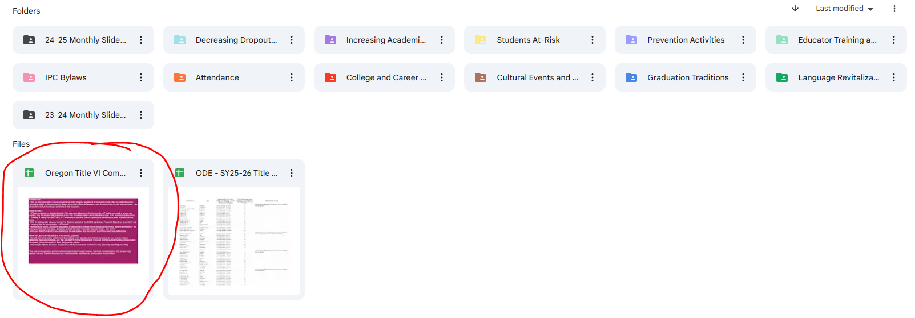
Step 1 - Open the circled document. Read the directions.
Step 2 - Fill out the Contact List first. This list is not public, but for internal use.
Step 3 - Contribute to the CoP tab as much or little as you like!

Slide 22
Contact Stacy Anytime
Stacy Parrish, Education Program Specialist II
Email - stacy.parrish@ode.oregon.gov
Book an Office Hours -
Book time with STACY PARRISH * ODE
Text/Call - 971-208-0270
I am available for things like…
Indian Parent Committee Training
“Advocating Up” Help
Data Analysis Work / Data Systems
ESD Consortium Support
Tribal Consultation and Improving Tribal Relations Help/Coaching

