Slide 1
TAPP Quarterly Webinar #2
November 21, 2024 9-11AM
✅ Welcome! Please rename yourself by clicking on the three dots by your name and typing your preferred name, school district or tribe initials, role, and pronouns.

Slide 2
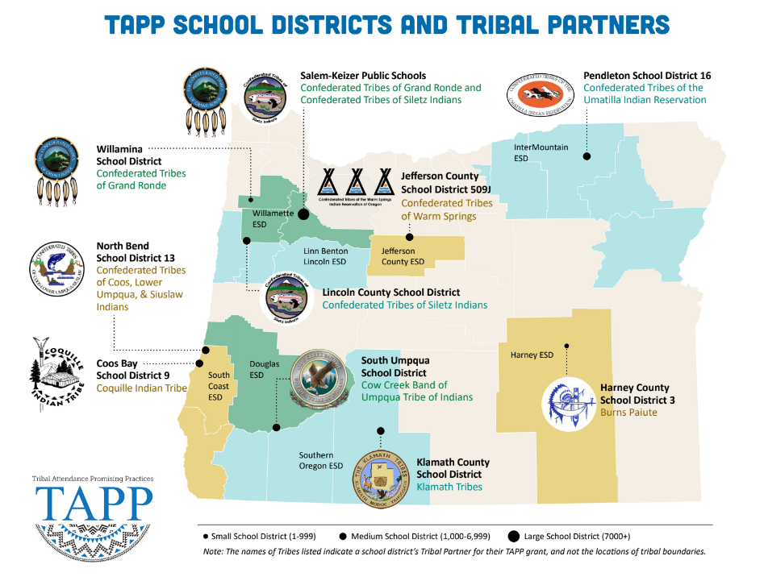
⭐ Indicates TAPP Expansion Position
Mona Smith
Stacey Jacobs
Ray Fox ⭐
Rebecca Arredondo
Mike Solem ⭐
Atcitty Begay
[TBD] ⭐
[TBD] ⭐
RuthEllen Melton
Crystal Hinds
Bre Landrum
Vacancy
Scott Smyth
Janelle Emard
[TBD] ⭐

Slide 3
TAPP Quarterly Webinar Agenda
15 min - Checking In as a Community
15 min - SY24-25 Grounding - Sensemaking
30 min - Analyzing our First Quarter Attendance
30 min - Diving Deeper into Our Root Causes for Chronic Absenteeism
30 min - Evaluating the Effectiveness of our Tiered Support Systems

Slide 4
Checking In
Reflect silently for one minute and then be prepared to share out. Please further introduce yourself to the group before sharing.
Winter is a powerful time for Native people. It is a time where the earth goes dark and snow blankets the mountain tops and valleys, bringing a quiet to powerful places. It is a time for Winter ceremonies and storytelling. It is also a time of retreat and rest.
What is a significant Winter tradition for you? Tell us about it.
🔊 Unmute (preferred) or drop your response into the Chat.

Slide 5
SY24-25 Grounding
Sensemaking

Slide 6
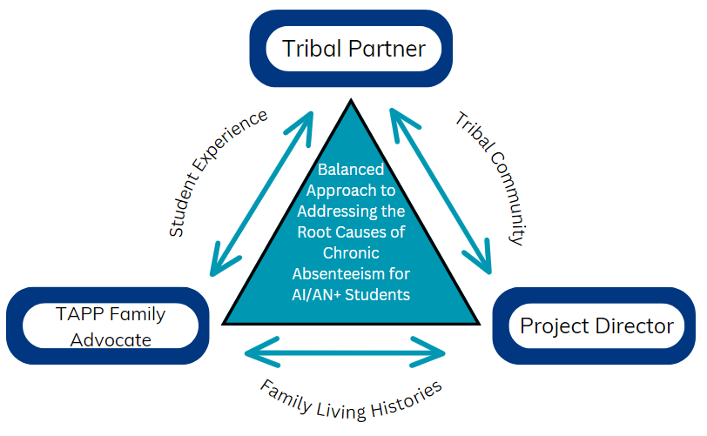
ESSENTIAL PARTNERSHIP

Slide 7
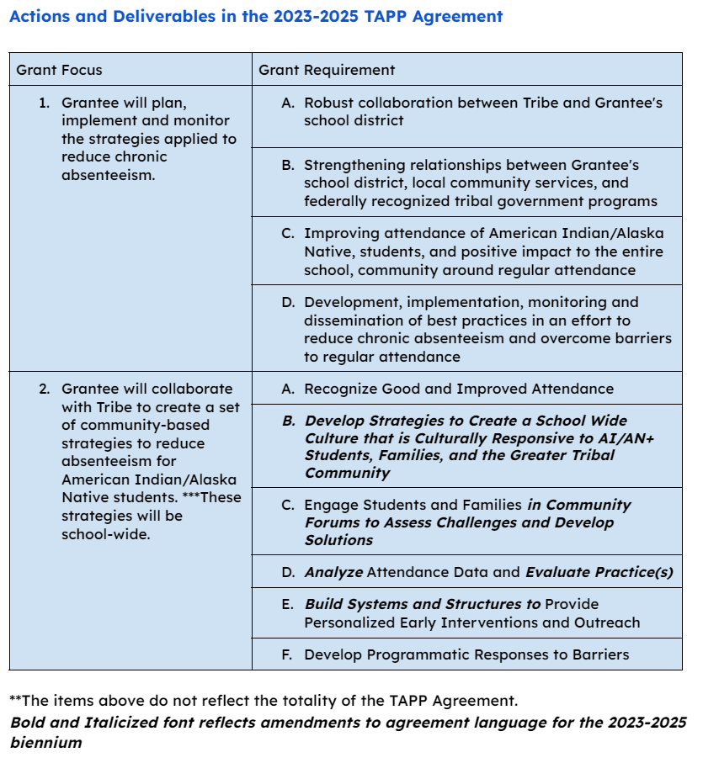
The
WHAT
The
HOW

Slide 8
What we will do…Analyzing our attendance data for the first quarter or trimester (What are we noticing? What do we see?)
What we really mean….
What we will do…Continue to dive into our root causes for chronic absenteeism
What we really mean…
What we will do…Evaluate our Tiered Support Systems in place to provide personalized interventions to students
What we really mean…
🔊 Now, try it yourself. Select a category above we are going to talk about and then share with the group what you really hope it is we talk about, uncover, and surface for this group today.

Slide 9
Analyzing our First Quarter or Trimester of Attendance
Team and Whole Group Reflections
2024-2025 TAPP Districts’ Dashboard

Slide 10
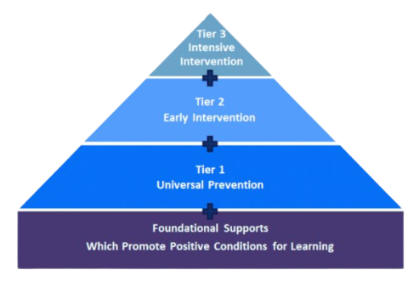
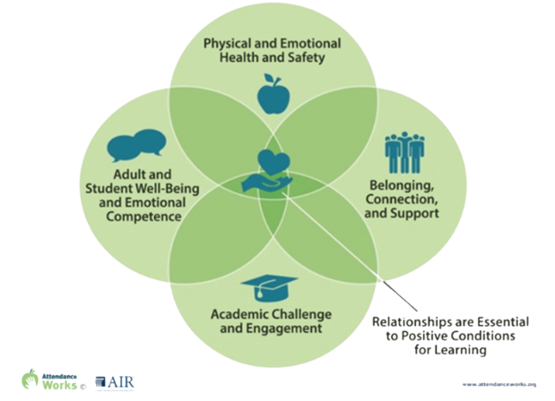
Attendance Works Foundational Supports

Slide 11
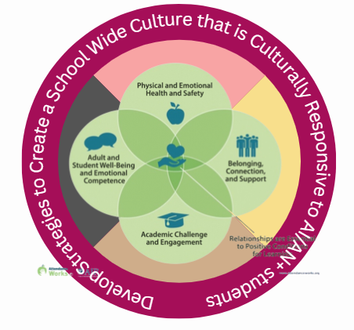
Attendance Works Foundational Supports with TAPP Promising Practices
Adapted from Attendance Works: 3 Tiers of Intervention
https://www.attendanceworks.org/chronic-absence/addressing-chronic-absence/3-tiers-of-intervention/

Slide 12
Attendance Works Foundational Supports with TAPP Promising Practices
Remember, research states high levels of absenteeism reflect an erosion in positive conditions for learning.
Attendance Works

Slide 13
What is our Data Telling Us?
You will Need:
TAPP Dashboard - Column C - Attendance Tracker Tab
School Level Tiered Historical Data
Whole Group Silent Work Time – 6 Minutes - Take Notes
WHAT DO YOU NOTICE?
WHAT DO YOU SEE? How does the data thus far compare to last school year?
What percentage of students is in Tier 2 (attending <90 - >80%)?
What percentage of students is in Tier 3? (attending <80%)?
Are there differences between schools or grade levels (elementary, middle, high)?
❗❗❗What questions do you have about any of the foundational conditions in the four quadrants at any of the TAPP schools?
If data has not been input into the Dashboard, what data can be sent via email to the team for review?

Slide 14
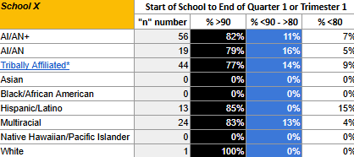
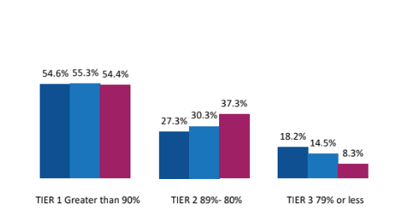
How to Review the Two Sets of Data -
TAPP Dashboard Column C, Attendance Tracker -
Tiered Attendance Data from 2023-2024 -

Slide 15
What is our Data Telling Us?
Breakout Rooms - 10 Minutes
Share your notes with one another.
When we come back together we will share out our findings from each district from the group.
Choose someone to share out.
You will have >30 seconds to share out.

Slide 16
Diving Deeper into our Root Causes
Attendance Works and TAPP

Slide 17
Attendance Works Foundational Supports with TAPP Promising Practices
Remember, research states high levels of absence reflect an erosion in positive conditions for learning.
Attendance Works

Slide 18
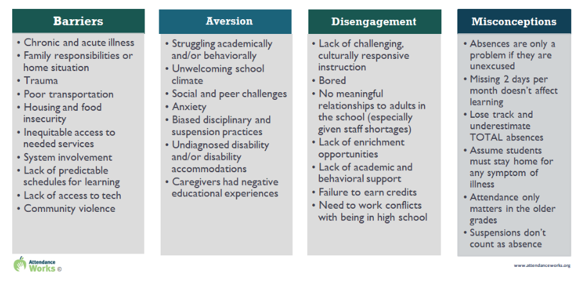
Four Common Root Causes - Published from Attendance Works

Slide 19
Three Types of Bias-Based Beliefs
Color Evasiveness
Beliefs - Color is not seen; cultural lived experiences are irrelevant (Bonilla-Silva, 2013 and Fergus, 2017)
Impact
Leads to dismissal of assertions of systemic racism and systemic inequities which reinforces deficit thinking, poverty disciplining, and systemic inequities (Fergus, 2017)
Culture, values, practices of school members not a part of the dominant culture are devalued, marginalized, ignored and/or “problematic.” (The Continuum | CCPEP.ORG, n.d.)
Deficit Thinking
Beliefs - Certain groups of students/families/cultures: do not care about their student’s academic performance and aren’t capable of high academic achievement.
Impact
“Assumes a denial of values that supports education…[which] allows for abdication of [educators’] responsibility for connecting with students and families
Pygmalion Effect - If we as educators expect certain actions from certain students, we are more likely to treat them in such a way that can lead to the anticipated actions. The students’ actions do not necessarily occur because we were right, but rather because of an internalized attitude the student adopted about themselves as a result of the ways we consciously or subconsciously treated them.
Poverty Disciplining
Beliefs - Low-income students/families, particularly those experiencing generational poverty:​
Lack morals, good manners, and/or the ability to avoid self-destructive behavior, “Cannot follow directions”; Are less motivated or less inclined to succeed; Don’t take school seriously (Soss et al., 2011)
Impact - A tendency to look at and interact with students experiencing poverty through the lens of deficit-based thinking
Assumption that low-income students will be disruptive, disobedient and disrespectful (Payne, 2003)
Hyper Focused expectation that the poor students will act in a deviant way (Payne, 2003)

Slide 20
What are we identifying as Root Causes?
You will Need:
TAPP Dashboard - Column C
Strategy Tracking Log tab
Whole Group Silent Work Time – Take Notes!
Read the Root Causes input into your Strategy Tracking Log.
To what extent are Root Causes strengths-based?
Do any reflect a bias-based belief and thus, need to be modified or revised?
Connecting it to the attendance data, do these root causes “align” to the data or the questions you had about the foundational conditions?
If there is no Root Causes data entered, use this time to review the Interim Report for Root Causes identified.

Slide 21
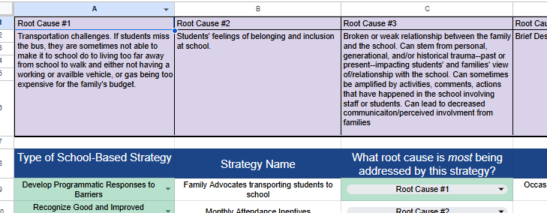
How to Find the Root Causes -
TAPP Dashboard Column C, Strategy Tracking Log -

Slide 22
What are we identifying as Root Causes?
Breakout Rooms - 10 Minutes
Share your notes with the group.
Engage in a conversation around the Root Causes of Chronic Absenteeism from the data and the insights learned during the TAPP efforts.

Slide 23
Evaluating the Effectiveness of our Tiered Support Systems
TAPP Best Practices - Always Refining

Slide 24
Attendance Works Foundational Supports with TAPP Promising Practices
Adapted from Attendance Works: 3 Tiers of Intervention
https://www.attendanceworks.org/chronic-absence/addressing-chronic-absence/3-tiers-of-intervention/

Slide 25
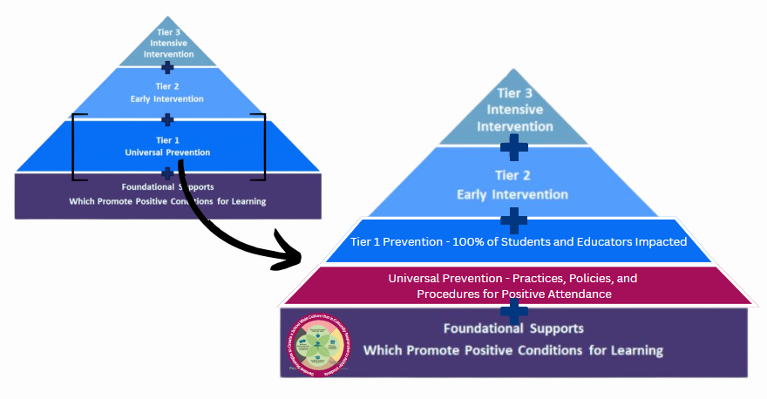

Slide 26
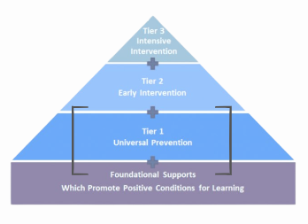
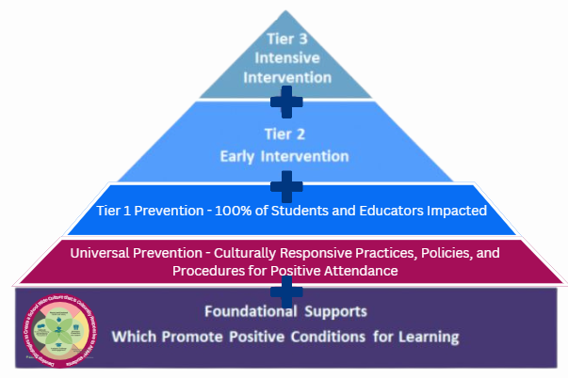
Attendance Works Foundational Supports with TAPP Promising Practices
]
Students and families attending <80%
Students and families attending 80-89%
All students, families, support staff, and educators
All students, families, support staff and educators; influenced by TAPP
All students, families, support staff, and educators; influenced by TAPP

Slide 27
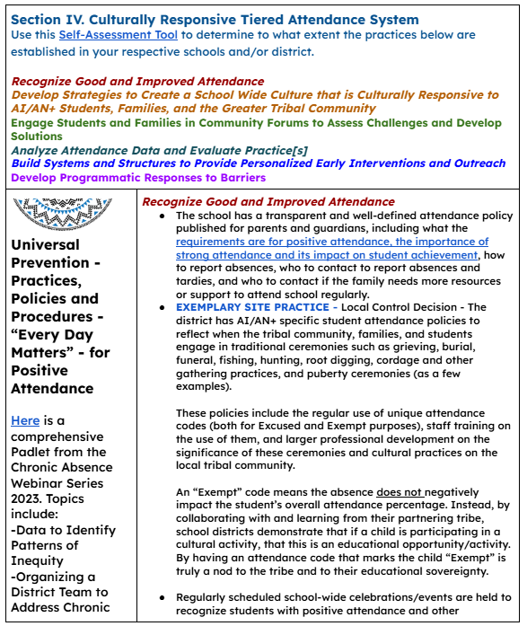
Source: TAPP Program Promising and Best Practices - Last Updated 9/13/2024

Slide 28
Attendance Works Foundational Supports with TAPP Promising Practices
Culturally Responsive Tiered Attendance Systems Self-Assessment -
This assessment is aligned to Section Four of the TAPP Promising and Best Practices Comprehensive Resource document.

Slide 29
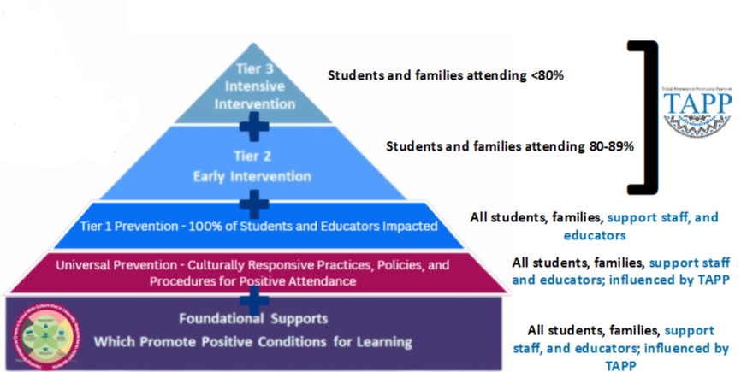
The Aim of the Self Assessment –
To what extent are we aligned to the Promising Practices learned from TAPP?
What is the relationship to our Data and the Tiered Support Systems we have in place? Where are there strengths? Gaps? Blind spots?

Slide 30
Pre-Work - Culturally Responsive Tiered Attendance Systems Self-Assessment
Culturally Responsive Tiered Attendance Systems Self-Assessment
Show of hands from the Project Directors - Have the TAPP Site Teams completed the Self-Assessment and calibrated on the results as a team?

Slide 31
To What Extent are our Tiered Support Systems for Attendance Effective?
Whole Group Silent Reflection -
Open the Self-Assessment.
Make a Copy of it.
Take 5 minutes to complete it to the best of your ability - focusing ONLY on the Universal section. If there is time remaining, go to Tier 1.

Slide 32
To What Extent are our Tiered Support Systems for Attendance Effective?
Breakout Rooms - 10 Minutes
Prioritizing the Universal and Tier 1 sections, take turns sharing out on the scores and any notes you made in the Self-Assessment.
To what extent are you calibrated as a group?
Where are their immediate, short term, and long(er) term opportunities to refine or create better systems? Who will be responsible for ensuring those shifts are made?

Slide 33
To What Extent are our Tiered Support Systems for Attendance Effective?
Whole Group Silent Reflection
In your journal –
To what extent are we aligned to the Promising Practices learned from TAPP?
What is the relationship to our Data and the Tiered Support Systems we have in place? Where are there strengths? Gaps? Blind spots?

Slide 34
To What Extent are our Tiered Support Systems for Attendance Effective?
Breakout Rooms - 10 Minutes
With your TAPP Site Team -
To what extent are we aligned to the Promising Practices learned from TAPP?
What is the relationship to our Data and the Tiered Support Systems we have in place? Where are there strengths? Gaps? Blind spots?

Slide 35
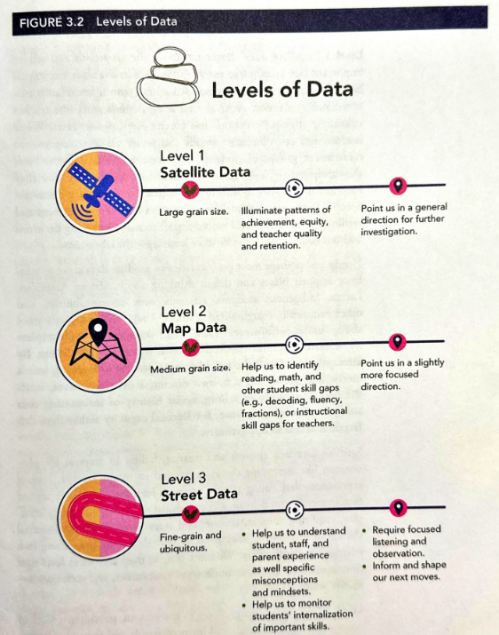
The Family Advocates read this passage from Street Data: A Next Generation Model for Equity, Pedagogy, and School Transformation by Shane Safir and Jamila Dugan in October.

Slide 36
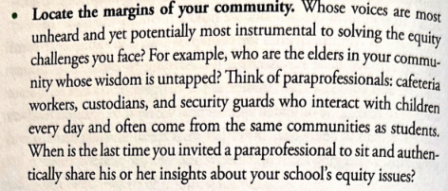
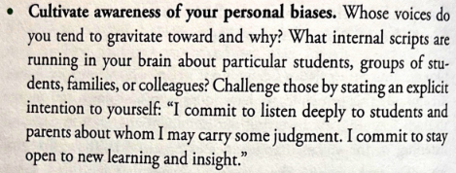
The Family Advocates read this excerpt from Street Data Chapter 5 , which introduced them to the concepts of deep listening and radical inclusion. The goal of the chapter was to “seek root causes over quick fixes.”
Remember your purpose - healing plus understanding. Street data is distinct from other forms of data-gathering in that the process itself can be healing. It is an opportunity to build trust and relational capital with people at the margins of your community. Street data is not a technical approach; rather, it is an adaptive, human-centered data dance that unfolds fluidly through caring, inclusive, and culturally sustaining interactions.
Notes:
Reactions, reflections

Slide 37
Share Out on Our Time Today…
What are you sitting with?
What are you walking away still thinking more about?
How can you make sure your TAPP Site Team completes the Self-Assessment and then reconvenes to ensure strong tiered support systems are in place in your respective schools?
How will you use today’s learning to continuously improve the TAPP efforts in your district?

Slide 38
Text Parrish anytime at 971-208-0270
Or - send me an email. Call if you must.
There is no such thing as, “I know you are busy”. I am here for you.

Slide 39
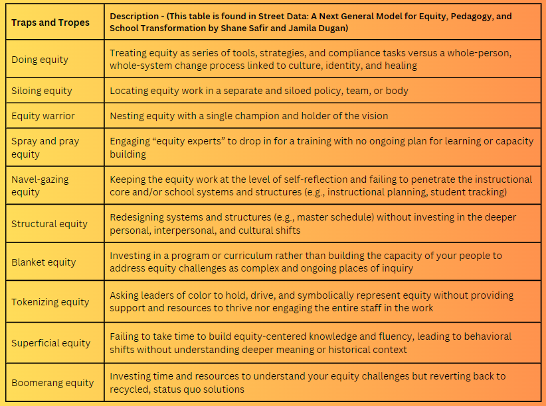
-Which traps and tropes sound or feel familiar to you?
-Where do you see a trap or trope playing out in your school or organizational context?
-What traps or tropes might students and families identify in your context? Are they the same or different from the ones you identified? Why might that be?

