Slide 1

Grade 8 Lesson
Native Nutrition

Slide 2
Essential Nutrients
Nutrient | How the Body Uses It | Food Sources | Notes
Protein | Build and repair tissue Fight infections Energy source | Seafood Lean meat and poultry Eggs Beans and peas Nuts and seeds Dairy products Soy products
Carbohydrates | Energy source Fiber source | Fruit Vegetables Dairy products Grains (whole and refined) Soda and candy | Consist of sugars, starches, and cellulose. Carbohydrates can be simple (easily digested) and complex (take longer to digest); complex are generally healthier
Fats | Energy source Help absorb vitamins | Meats Poultry Seafood Eggs Seeds and nuts Avocados Cooking oil | Fats can be saturated or unsaturated or trans fat; unsaturated is generally healthiest

Slide 3
Energy Uses
Uses | Definition | How Used
Thermic effect of food | Energy needed to digest food | Eating and digesting food
Basal metabolism | Energy used at rest | Heartbeat, breathing, thinking, cell division
Physical activity | Energy used to perform any body movement | Sitting, standing, turning your head, raising your hand, walking, running, playing a sport, exercising
Sources: U.S. Department of Health and Human Services, National Institutes of Health

Slide 4
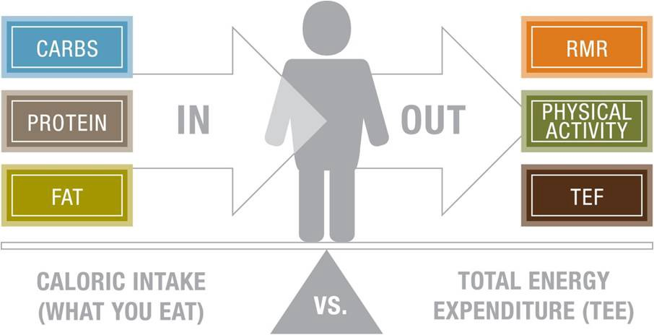
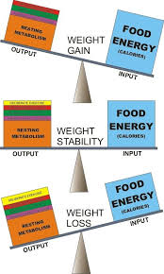
Energy Balance
Image Sources: https://medium.com/@decker_st/cico-energy-balance-68a5bda0327e,
http://www.hollandclinic.com/science-of-weight-loss/nutrition/calories/energy-balance;

Slide 5


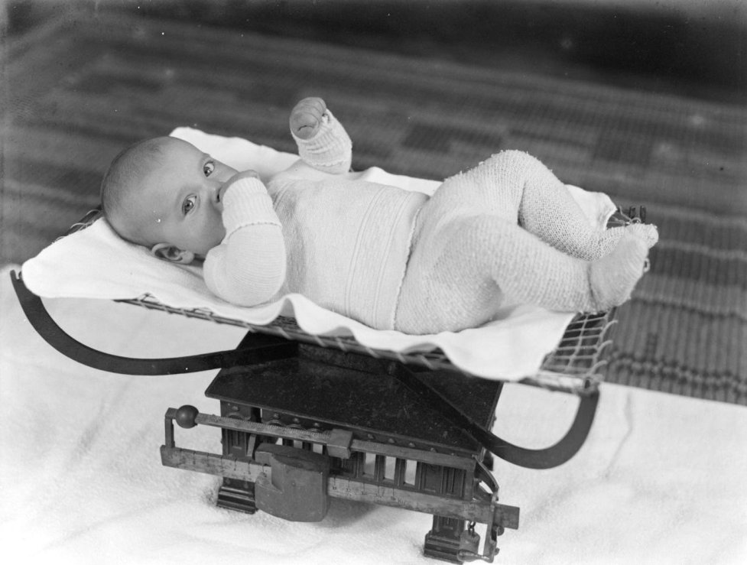

Health Risks - Not Enough Healthy Food
Fatigue/low energy
Get sick easily
Failure to thrive (children)
Diseases of malnutrition
(e.g., scurvy, rickets, beriberi)
Image Sources: Pixabay, Wikimedia Commons

Slide 6
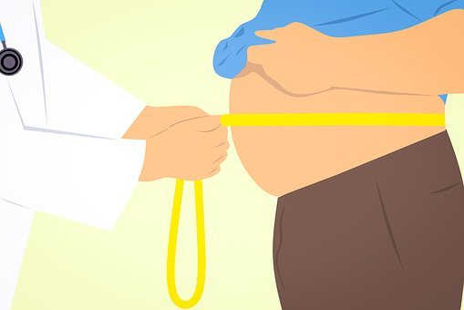
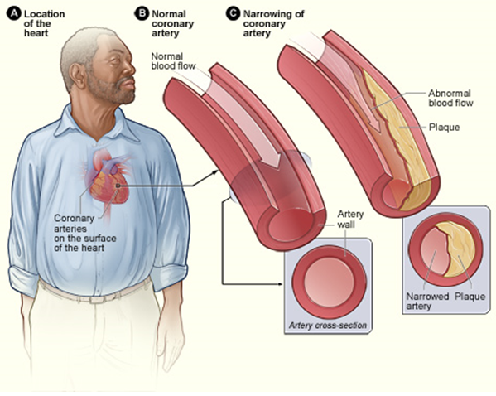
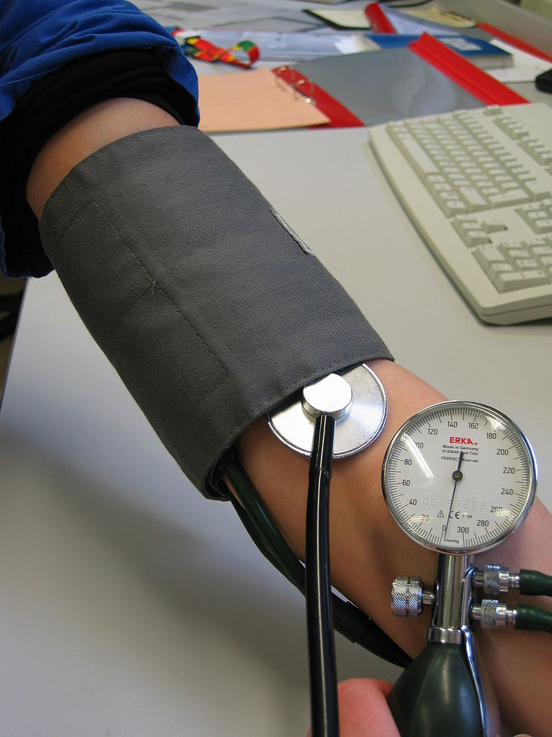
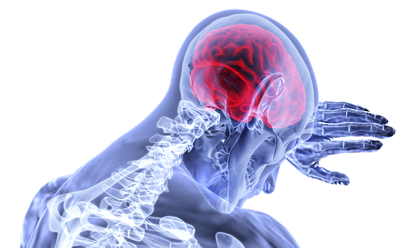


Health Risks - Not Enough Activity
Obesity
Heart Disease
High blood pressure
Stroke
Diabetes
Depression
Source: National Institutes of Health, U.S. National Library of Medicine
Image Sources: Pixabay, Wikimedia Commons

Slide 7
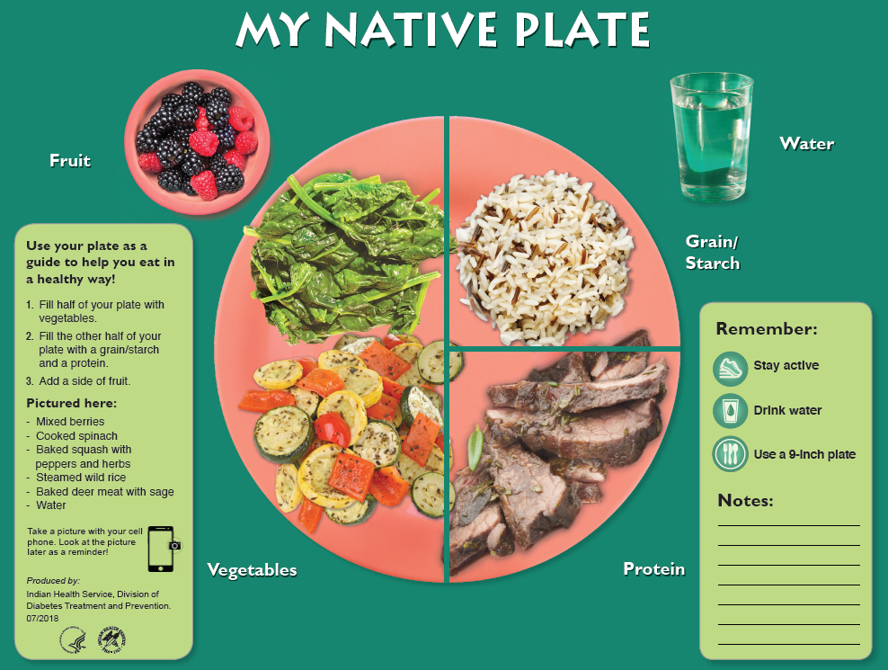
My Native Plate
Image Source: U.S. Department of Health and Human Services, Indian Health Service

Slide 8
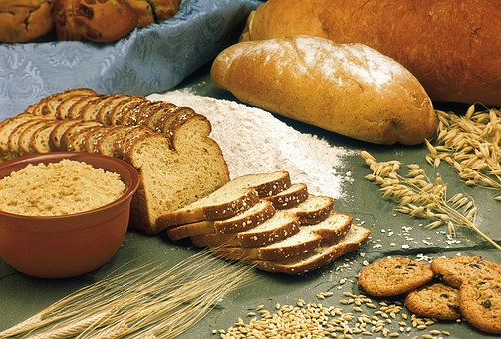
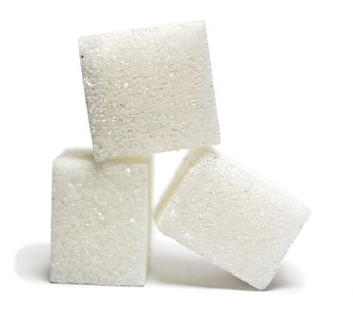
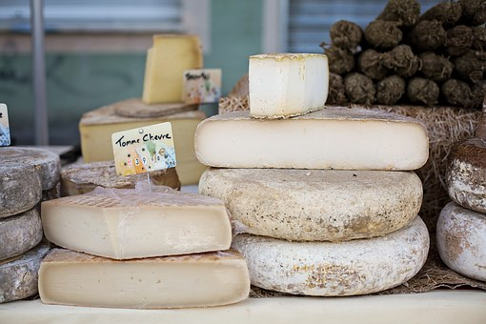
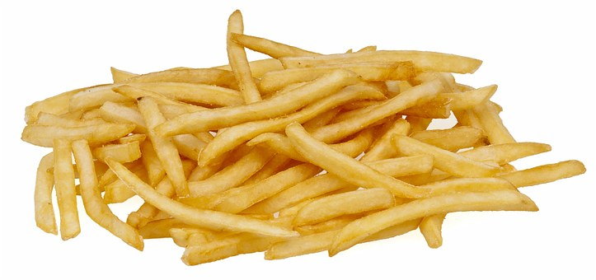
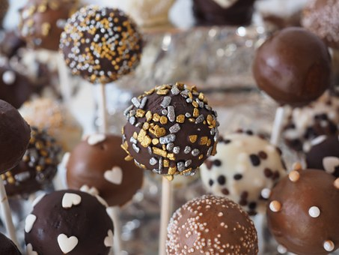
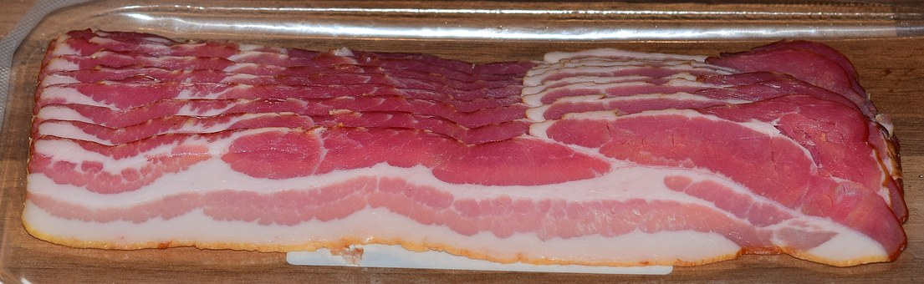
What’s Missing?
Image Source: Pixabay

Slide 9
What Are first foods”?
Foods eaten by Indigenous people prior to contact with or colonization by non-Indigenous people.

Slide 10
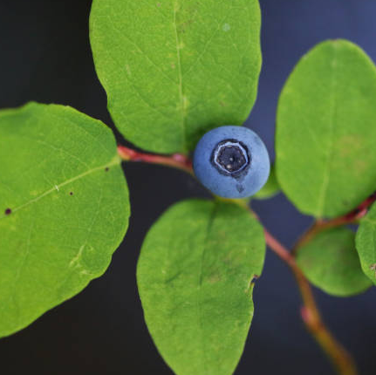
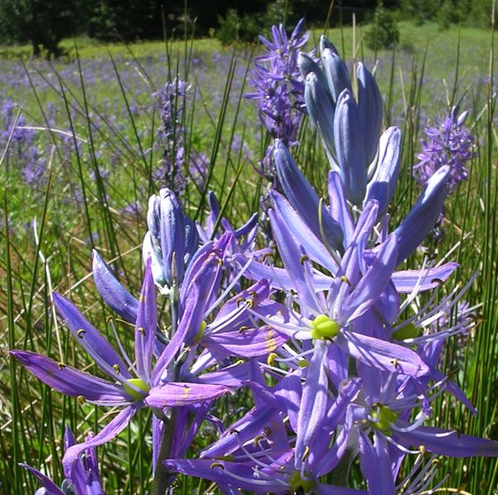
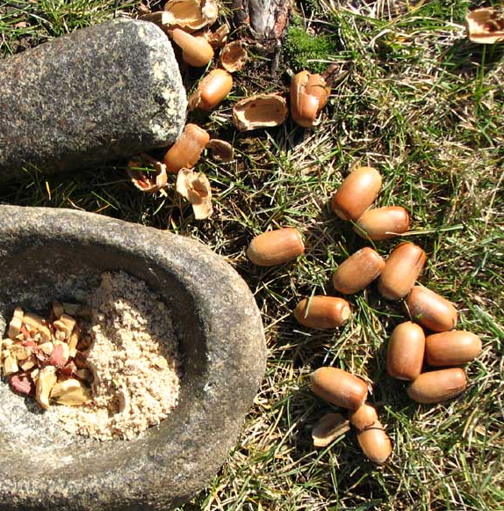
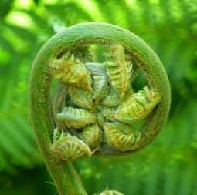
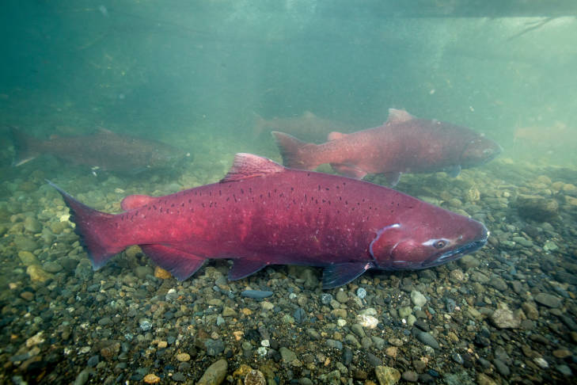
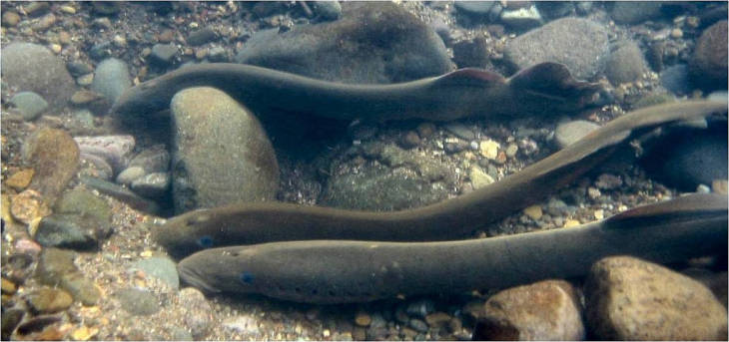
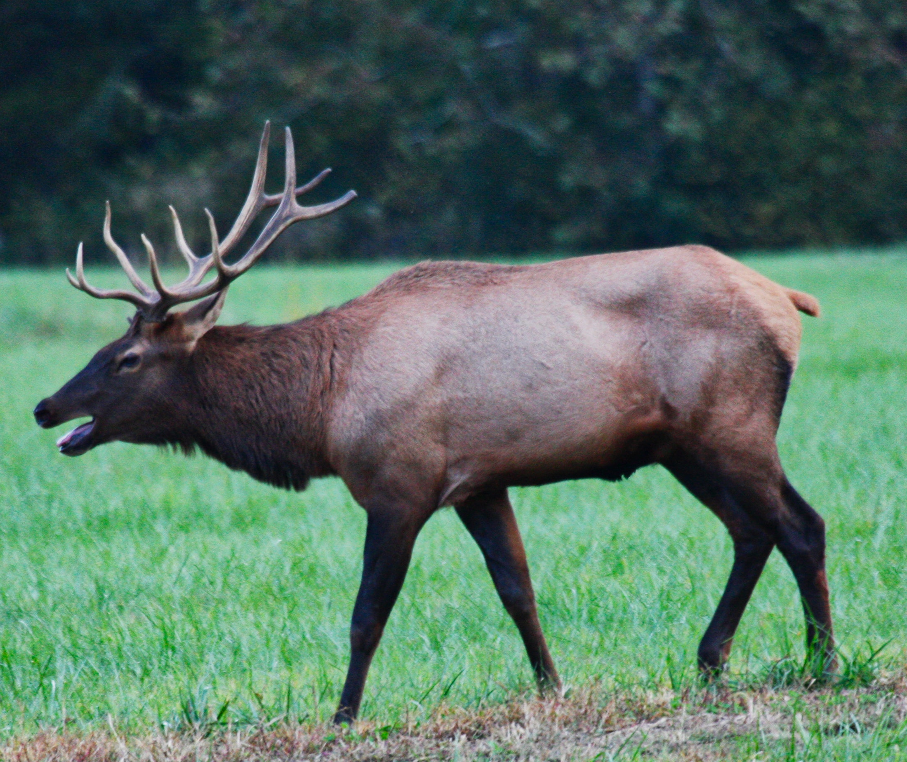
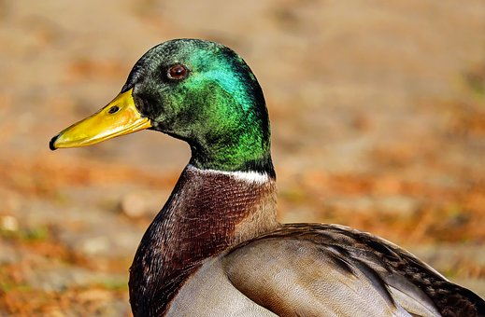
Oregon First Foods
Huckleberries
Camas bulbs
Acorns
Fiddleheads (ferns)
Salmon
Lamprey
Elk
Duck

Slide 11
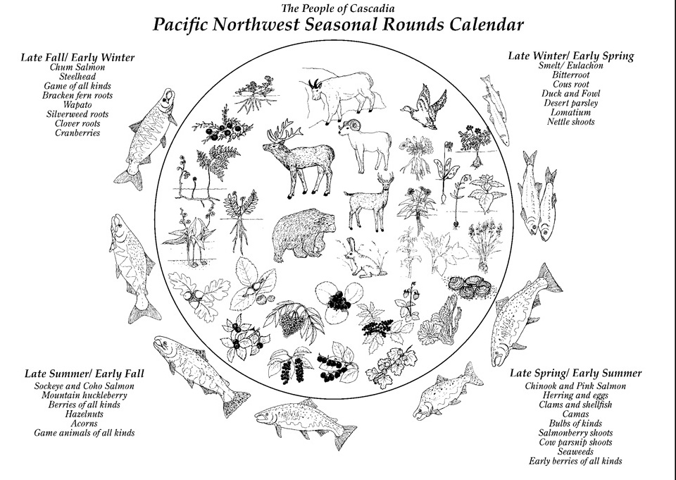
The Oregon Native Plate
Source: The People of Cascadia, http://peopleofcascadia.com

Slide 12
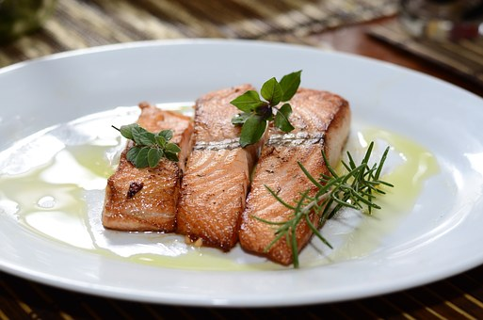
A Salmon Dinner

Slide 13
Hunter-Gatherer Fitness
Caloric Cost of Various Hunter-gatherer or Forager Activities and Recommended Equivalent Modern Activities
 |  | Caloric Expenditure (Kilocalories/Hour)
Hunter-Gather Activity | Modern Equivalent Activity | 176 lb. Man | 132 lb. Woman
Carrying logs | Carrying groceries, luggage | 893 | 670
Running (cross country) | Running (cross country) | 782 | 587
Carrying meat (20kg) back to camp | Wearing backpack while walking | 706 | 529
Carrying young child | Carrying young child | 672 | 504
Hunting, stalking animals | Interval training | 619 | 464
Digging (tubers in field) | Gardening | 605 | 454
Dancing (ceremonial) | Dancing (aerobic) | 494 | 371
Carrying, stacking rock | Lifting weights | 422 | 317
Butchering large animal | Splitting wood with axe | 408 | 306
Walking—normal pace (fields and hills) | Walking—normal pace (outside on trails, grass, etc.) | 394 | 295
Gathering plant foods | Weeding garden | 346 | 259
Shelter construction | Carpentry, general | 250 | 187
Tool construction | Vigorous housework | 216 | 162
Source: O’Keefe, J., Vogel, R., Lavie, C. & Cordain, L. (2010). Achieving Hunter-gatherer Fitness in the 21s Century: Back to the Future. The American Journal of Medicine. Retrieved June 4, 2019 from https://www.amjmed.com/article/S0002-9343(10)00463-8/fulltext

Slide 14
Key Takeaways
Oregon Indigenous people ate a diet that was high in protein, nutrient dense, and low in unhealthy fats
They ate a wide variety of native plants and animals harvested in season
Foods were minimally processed; no refined grains and sugars, no frying,
no artificial additives or preservatives
Their hunter-gatherer lifestyle required constant movement and physical activity
The combination of healthy diets and physical activity promoted a healthy energy balance and lifestyle
They had deep knowledge of first foods and took care to sustain them; people and food nourished each other

Slide 15
Image Citations
Oregon First Foods
Huckleberries: https://digitalmedia.fws.gov/digital/api/singleitem/image/natdiglib/30223/default.jpg?highlightTerms=huckleberry
Camas bulbs: https://www.nps.gov/articles/camas.htm
Acorns: https://www.blm.gov/programs/recreation/recreation-activities/oregon-washington/tablerocks/cultural-history/seasonal-rounds
Fiddleheads (ferns): Image #123533 by LoggaWiggler (Pixabay License)
Salmon: https://digitalmedia.fws.gov/digital/collection/natdiglib/id/26887/rec/8
Lamprey: https://digitalmedia.fws.gov/digital/collection/natdiglib/id/12687/rec/23
Elk: Image #436035 by werner22Brigitte (Pixabay License)
Duck: Image #1893080 by Couleur (Pixabay License)

