Slide 1
GRADE 8 LESSON Lewis and Clark: A Native American View

Slide 2
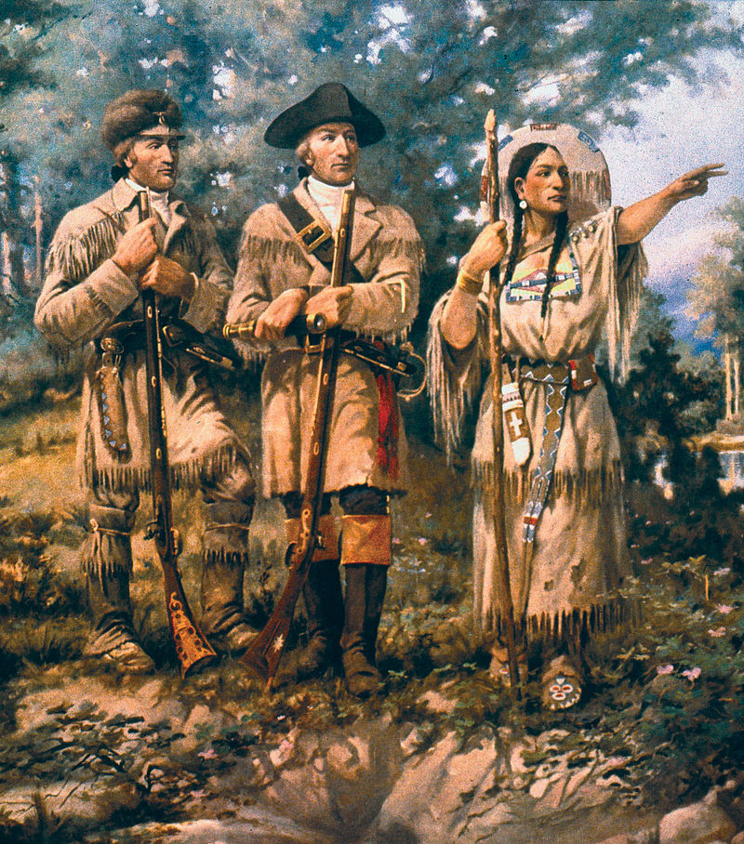
Background
In 1804, Meriwether Lewis and William Clark left St. Louis to explore land west of the Mississippi River. The U.S. had recently acquired the land as part of the Louisiana Purchase. Lewis and Clark kept journals and made maps during their journey. They returned to St. Louis on September 23, 1806. That day, Lewis wrote a letter to President Jefferson describing the journey.
Notes:
Image Source: Edgar Samuel Paxson [Public domain]

Slide 3
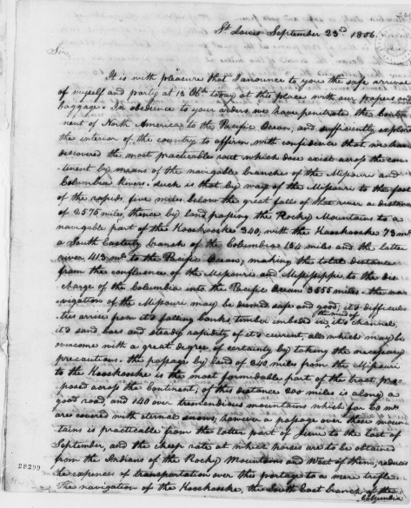
Primary Sources
The letter from Lewis to Jefferson is a primary source. A primary source is a source of information that comes from someone who was there when an event took place. Letters, journals, photographs, newspapers, interviews, oral histories, and government documents are examples of primary sources.
Notes:
Image Source: (1806) Meriwether Lewis to Thomas Jefferson. -09-23. [Manuscript/Mixed Material] Retrieved from the Library of Congress, https://www.loc.gov/item/mtjbib016499/.

Slide 4
Benefits and Challenges
This excerpt from an encyclopedia article about the expedition is a secondary source. A secondary source is a source of information that comes from someone who was not present when an event took place. They are created after an event. Textbooks, biographies, general history books, and documentary videos are examples of secondary sources.
The group crossed half the continent of North America, traveling through a largely unknown wilderness on foot, on horseback and by boat.”
– World Book Encyclopedia, 2007, Vol. 12, p.222

Slide 5
Benefits and Challenges
Primary Sources | Secondary Sources
Benefits
Evidence of what happened in the past. Bits of history that reveal how people from the time lived and what they thought about the world. | Help us interpret or make sense of primary sources. Tell how an event fits into history. Can include related facts about other events that happened at the same time or at other times.
Challenges
May be difficult to read or understand. May only tell one point of view. | May tell a story from only one point of view. May be a biased representation of the story.

Slide 6
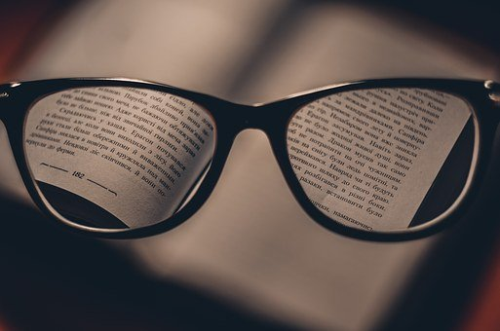
Point of View (Perspective)
The position or attitude from which something or someone is observed. Everyone has a point of view. Sometimes in history one person’s or one group’s point of view is judged to be more accurate or important than other points of view. Different points of view can be misunderstood, forgotten, or intentionally left out. History can be missing “the other side of the story.”
Notes:
Image Source: Pixabay (https://pixabay.com/photos/glasses-reading-glasses-spectacles-1246611/)

Slide 7
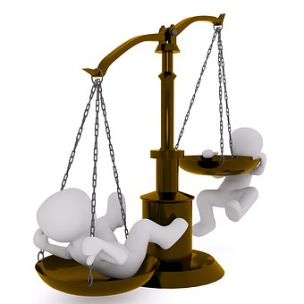
Bias
Prejudice in favor of or against one thing, person, or group compared to another. Sometimes people who observe or interpret an event in history make judgments that are based on their own biases.
Notes:
Image Source: Pixabay (https://pixabay.com/illustrations/horizontal-pan-balance-weigh-2071320/)

