Slide 1
GRADE 4 LESSON Salmon People

Slide 2
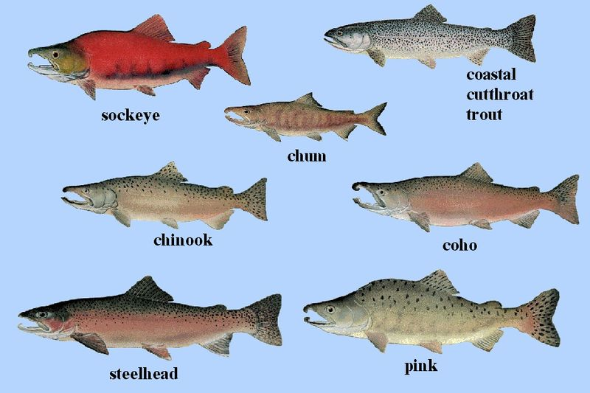
Salmon People
This Photo by Unknown Author is licensed under CC BY-SA
Notes:
This slide deck contains quotes from tribal members or short sections of text that reference tribal members and their beliefs about the importance and role of salmon.
All the tribes in Oregon have a relationship with salmon, though salmon are more prominent in the lives of some tribes compared to others.

Slide 3
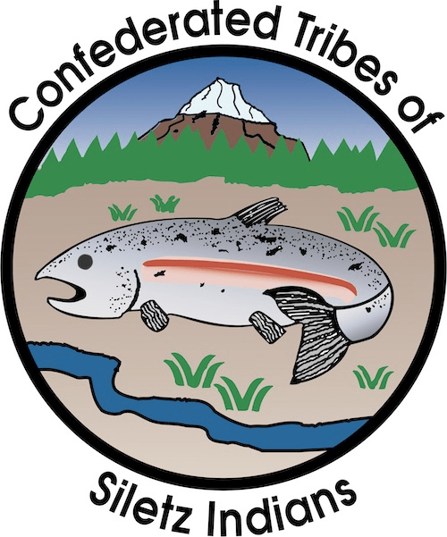
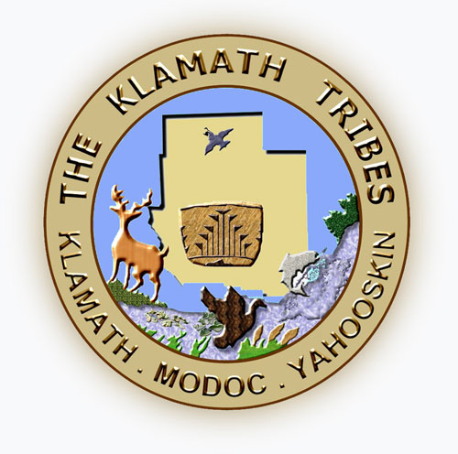
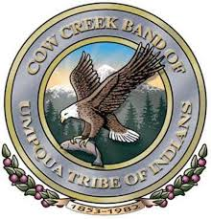
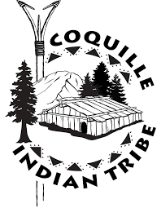
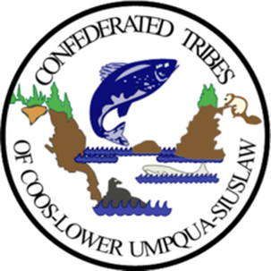
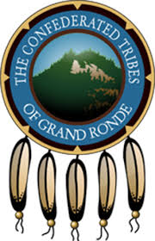
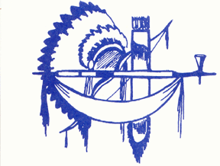
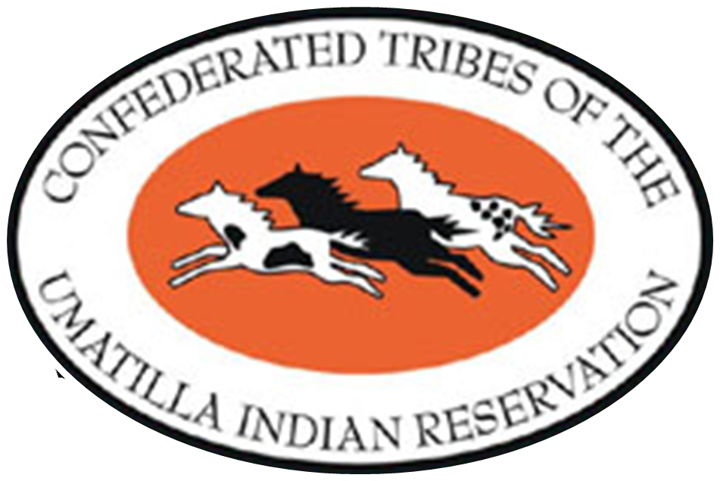
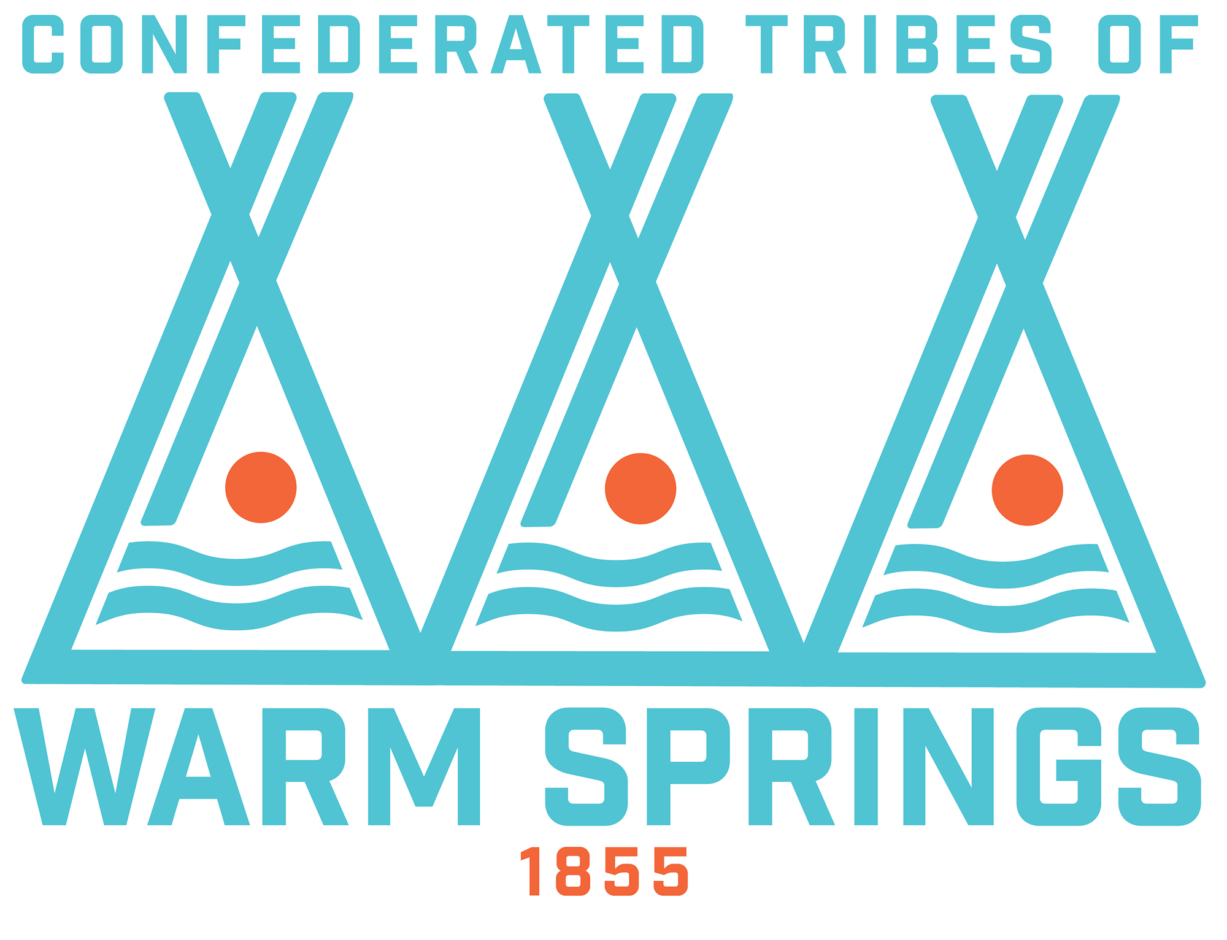
Which tribal seals reference salmon?
Burns Paiute Tribe
Notes:
Ask students:
Which tribes have a reference to salmon fishing in their tribal seal (logo)?
Confederated Tribes of Siletz Indians (prominent in center)
The Klamath Tribes (small image of salmon in lower right)
Cow Creek Band of the Umpqua Tribe of Indians (salmon in eagle’s clutch)
Coquille Indian Tribe (the fishing spear is used in the seal)
Confederated Tribes of Coos-Lower Umpqua-Siletz (prominent in upper middle)
Which ones do not?
Confederated Tribes of the Umatilla Indian Reservation (not used, but is a member of Columbia River Inter-Tribal Fish Commission)
Confederated Tribes of the Warm Springs Reservation (not used, but is a member of Columbia River Inter-Tribal Fish Commission)
Confederated Tribes of Grand Ronde (not used,
Burns Paiute

Slide 4
THE SILETZ TRIBE About Fivemile Creek Wetlands
(The tribe purchased 125 acres in 2016 that is part of their ancestral lands.)
“The Siletz Tribe is pleased to acquire this property of our ancestors and help protect coho salmon. It’s part of our cultural tradition to take care of the land and its inhabitants, and this is another opportunity to do both.”
-Tribal Chairman Delores Pigsley
Notes:
Source: https://www.mckenzieriver.org/2016/10/confederated-tribes-of-siletz-indians-regain-salmon-bearing-wetlands-in-ancestral-homeland/

Slide 5
NATIONAL GEOGRAPHIC A Small Tribe Thinks Big About Their Ocean Space
The Indigenous people living on the southern Oregon coast have always understood that the ocean and its creatures must be respected. According to the tribal lore of the Confederated Tribes of the Coos, Lower Umpqua and Siuslaw, Thunderbird was the chief of the ocean, and of all the ocean’s creatures, salmon was most beloved. When the people treated salmon carelessly, by dropping it on the ground or burning it, Thunderbird became angry and created powerful storms. The people burned tobacco in their fires and pleaded with Thunderbird to go north.
Notes:
Source: https://blog.nationalgeographic.org/2014/05/07/a-small-tribe-thinks-big-about-their-ocean-space/

Slide 6
NATIONAL GEOGRAPHIC A Small Tribe Thinks Big About Their Ocean Space
The lesson? The ocean can be perilous, but it also provides. Margaret Corvi, a tribal member and Environmental Specialist with the Confederated Tribes of Coos, Lower Umpqua and Siuslaw , knows this very well. “Resource management is embedded into tribal practices and stories,” she says, “and these traditional stories help guide our management-with-respect approach.”
Notes:
Source: https://blog.nationalgeographic.org/2014/05/07/a-small-tribe-thinks-big-about-their-ocean-space/

Slide 7
Cow Creek Tribe Salmon Fishing
During the salmon runs, the Cow Creek Tribe built weirs across the streams and placed funnel-shaped basket traps made of hazel shoots in the narrow channels. According to pioneer settler, George Riddle (1851), “The salmon in great numbers would pass up by the side of the trap and, failing to get above the dam would be carried back into the open end of the trap, and the weight of the water would hold them.”
Notes:
Source: https://www.cowcreek.com/tribal-story/

Slide 8
For many tribal members, fishing is still the preferred livelihood
“We’re thankful that as the fish come back because it means we’ve got to start getting ready for the season. But we’re also giving thanks for the fish coming back and we’re sharing it with our family and our friends. It is part of our treaty rights, it is part of our heritage and our culture.”
- Kathryn “Kat” Brigham, Confederated Tribes of the Umatilla Indian Reservation
Notes:
Source: https://www.columbiariverkeeper.org/news/2016/9/tribal-fishing-traditions

Slide 9
THE KLAMATH TRIBES Speaking about the need for dam removal and salmon restoration
“The c’iyaal’s, which means salmon in the Klamath language, were placed in these waters by our Creator and was essential in sustaining the people for centuries, but when the dams were built we have not seen salmon in the Klamath Basin for almost 100 years. We won’t be whole, and we won’t be complete as a people, until we can once again fish for our c’iyaal’s.”
-Klamath Tribal Chairman Don Gentry
Notes:
Source: http://klamathtribes.org/news/bring-home-the-salmon/

Slide 10
The Confederated Tribes of Grand Ronde
In 2018 the Confederated Tribes of Grand Ronde (CTGR) received a permit from the Oregon Department of State Lands to construct a fishing platform on state lands at Willamette Falls. The scaffold allows the CTGR to safely harvest ceremonial fish at Willamette Falls at the time of year when our ancestors historically took the first fish from the Falls. The Tribe has taken ceremonial fish at the falls for the past three years [since 2016].
Notes:
Source: https://www.grandronde.org/press-media/tribal-announcements/our-connection-to-the-falls/

Slide 11
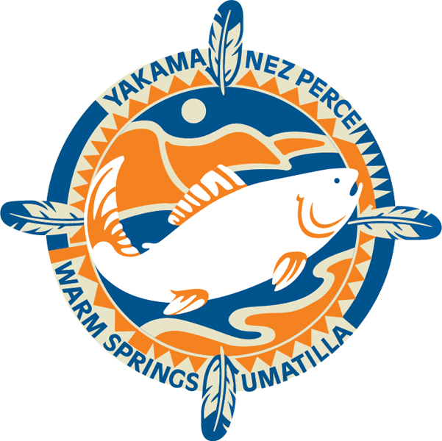
Columbia River Inter-Tribal Fish Commission
Salmon play an integral part of tribal religion, culture, and physical sustenance.
Notes:
Source: https://www.critfc.org/salmon-culture/tribal-salmon-culture/

Slide 12
Columbia River Inter-Tribal Fish Commission
Salmon are part of our spiritual and cultural identity. Over a dozen longhouses and churches on the reservations and in ceded areas still use salmon for their religious services.
Notes:
Source: https://www.critfc.org/salmon-culture/tribal-salmon-culture/

Slide 13
Columbia River Inter-Tribal Fish Commission
The annual salmon return and its celebration by the tribes assure the renewal and continuation of human and all other life.
Notes:
Source: https://www.critfc.org/salmon-culture/tribal-salmon-culture/

Slide 14
Columbia River Inter-Tribal Fish Commission
Historically, we were wealthy peoples because of a flourishing trade economy based on salmon.
Notes:
Source: https://www.critfc.org/salmon-culture/tribal-salmon-culture/

Slide 15
Columbia River Inter-Tribal Fish Commission
Salmon and the rivers they use are part of our sense of place. The Creator put us here where the salmon return. We are obliged to remain and to protect this place.
Notes:
Source: https://www.critfc.org/salmon-culture/tribal-salmon-culture/

Slide 16
Columbia River Inter-Tribal Fish Commission
The annual salmon harvest allows the transfer of traditional values from generation to generation.
Notes:
Source: https://www.critfc.org/salmon-culture/tribal-salmon-culture/

Slide 17
Columbia River Inter-Tribal Fish Commission
The importance of the first salmon ceremony has to do with the celebration of life, of the salmon as subsistence, meaning that the Indians depend upon the salmon for their living. And the annual celebration is just that—it's an appreciation that the salmon are coming back. It is again the natural law; the cycle of life. It's the way things are and if there was no water, there would be no salmon, there would be no cycle, no food. And the Indian people respect it accordingly.
—Antone Minthorn, Cayuse, Confederated Tribes of the Umatilla Indian Reservation
Notes:
Source: https://www.critfc.org/salmon-culture/tribal-salmon-culture/

Slide 18
Louie Dick, Jr., a member of the Confederated Tribes of the Umatilla Reservation (1992)
Don’t call us a minority. We come from the land. We are the earth; we are the land. The others occupy the land. When you destroy the salmon, you destroy me. The salmon made a commitment to return and to give life. He’s following his law by coming. We are violating our own law by not doing everything we can to get him back.
Notes:
Source: https://www.nwcouncil.org/reports/columbia-river-history/indianfishing

Slide 19
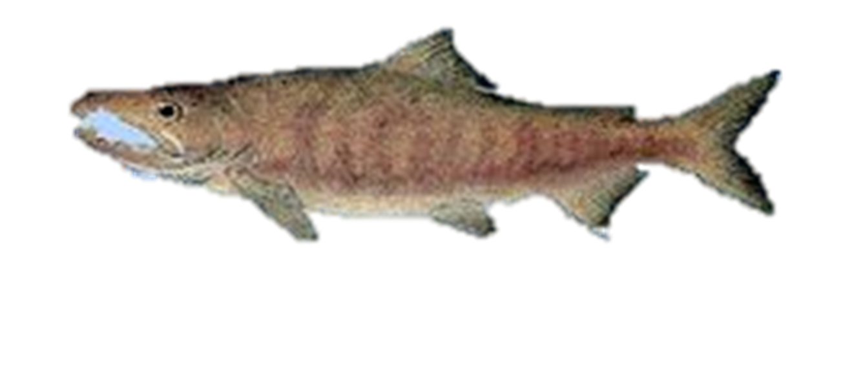
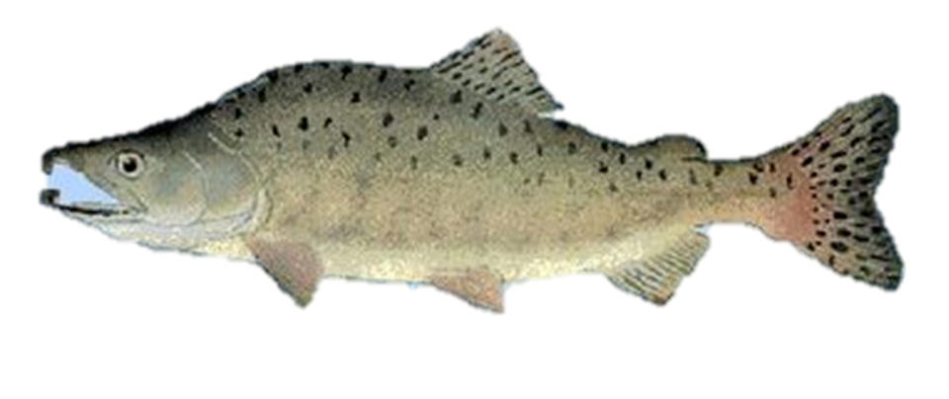
Five Types of Salmon Common to Oregon
Coho/Silver
Chinook/King
Chum/Dog
Pink
Sockeye
Notes:
Source: https://www.dfw.state.or.us/species/fish/index.asp
“There are five species of salmon found in the Pacific Northwest, of which three are common to Oregon: the chinook or king, the coho or silver, and the chum or dog salmon.& Neither sockeye nor pink salmon return to Oregon streams in significant numbers, although a major commercial offshore harvest of pinks occurs during alternate years as they spawn. Sockeyes migrate by the thousands up the Columbia each summer but all spawn in Washington waters. Landlocked versions of sockeye, called kokanee, thrive in many Oregon mountain lakes. With minor differences, the three Oregon inhabitants share similar life and reproductive cycles, which divide neatly into three distinct periods, freshwater, saltwater and spawning phases.”

Slide 20
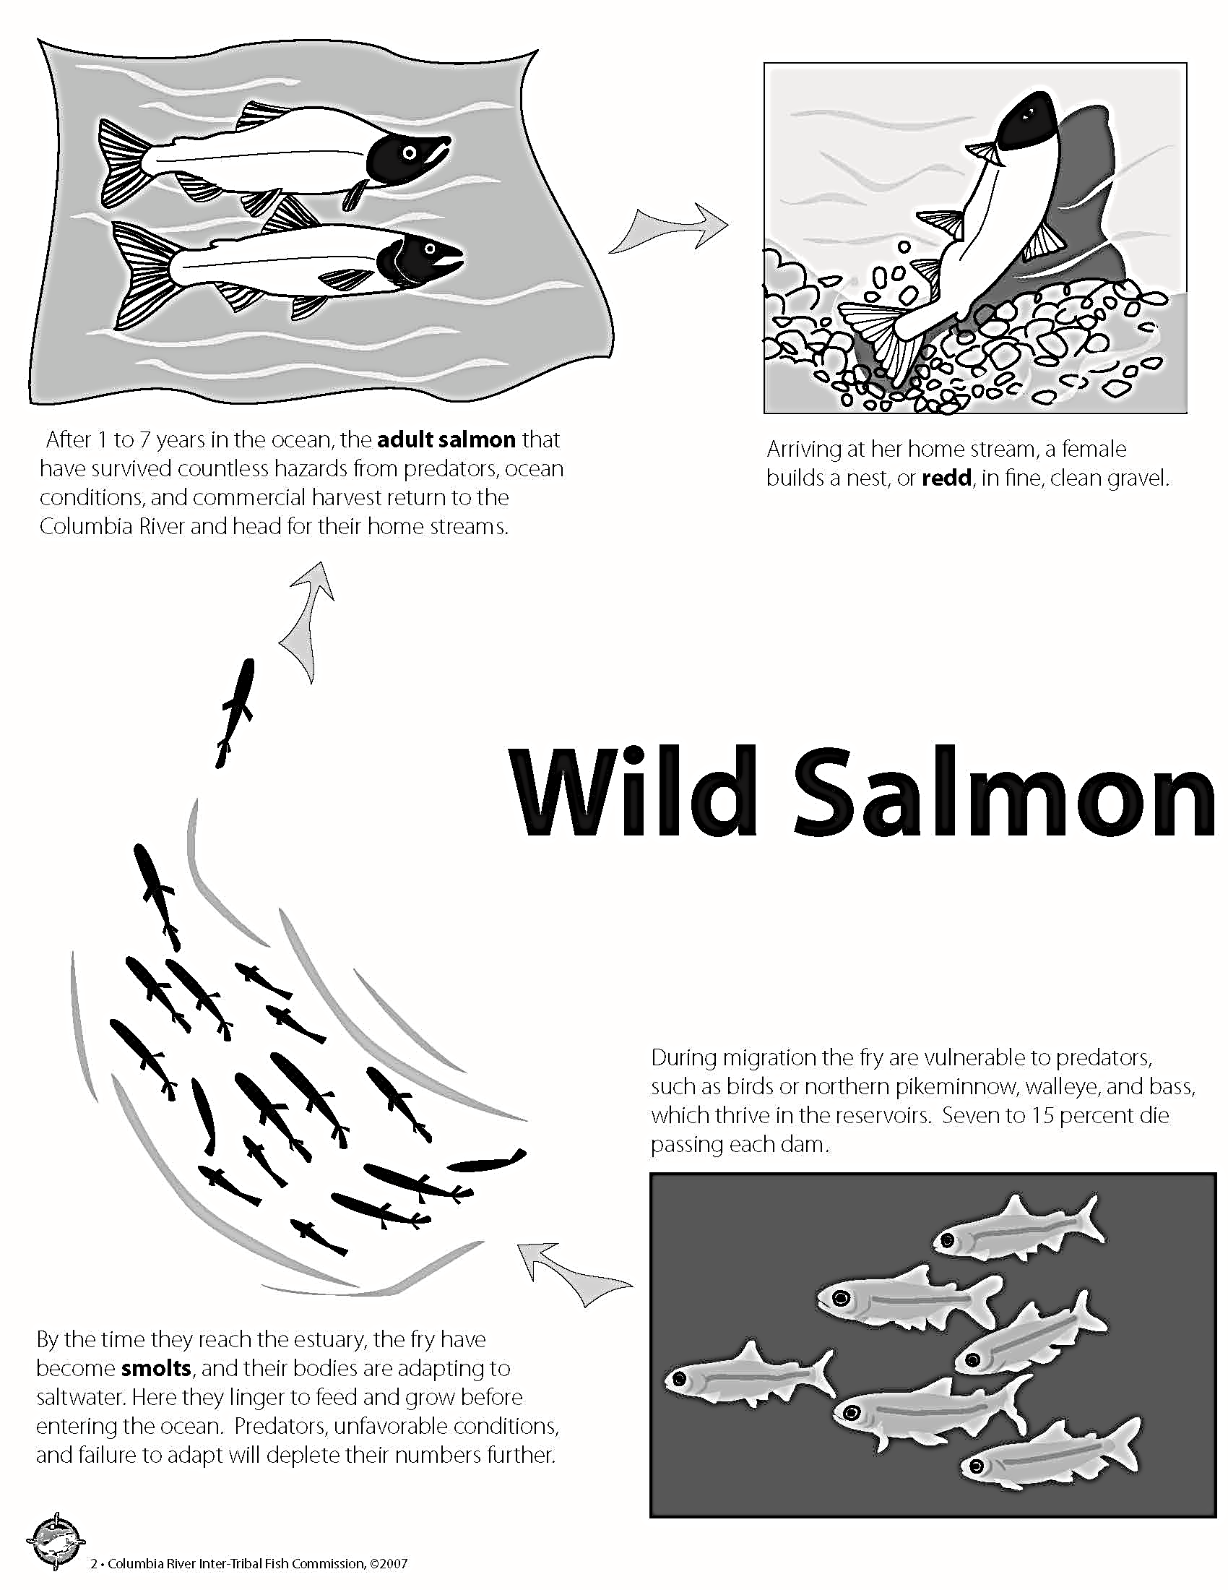
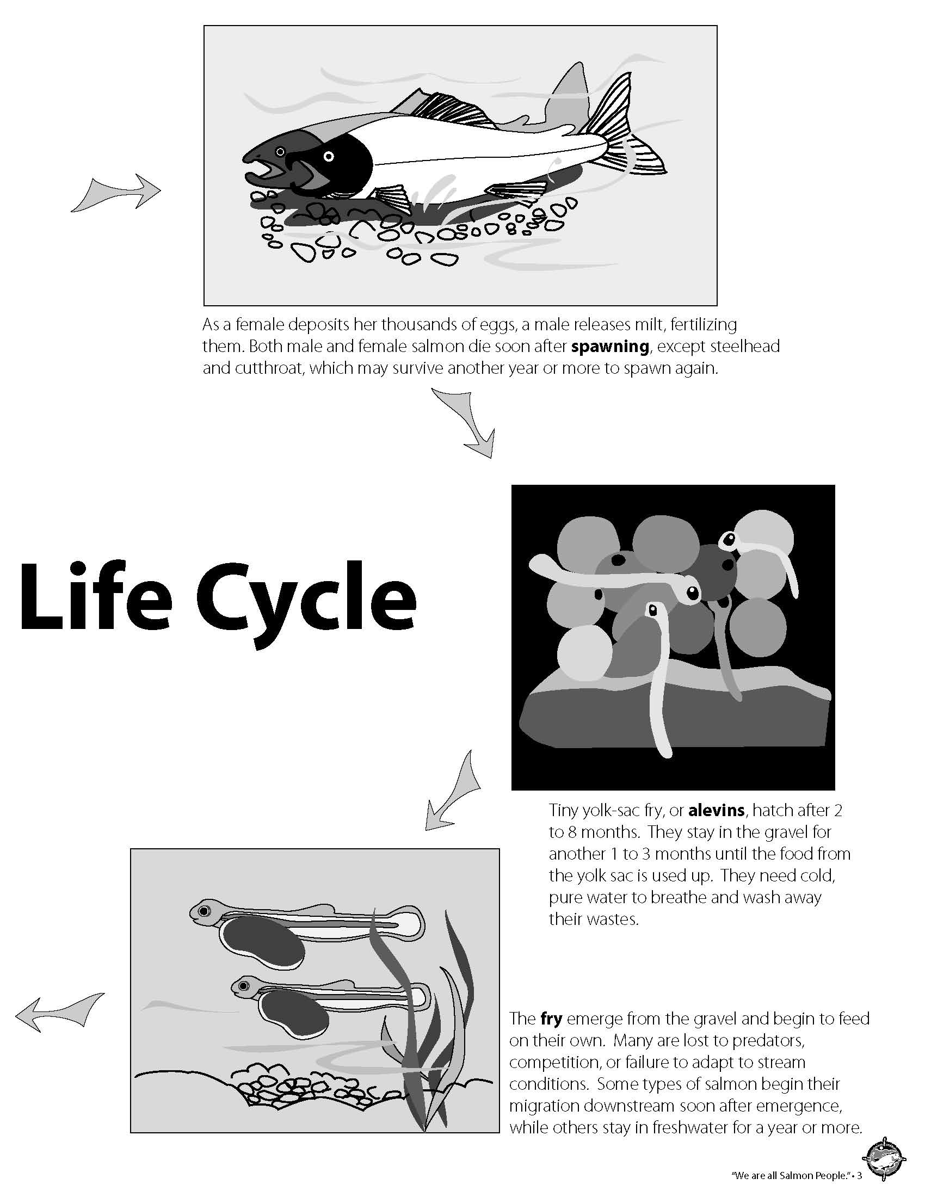
Wild Salmon Life Cycle in pictures

Slide 21
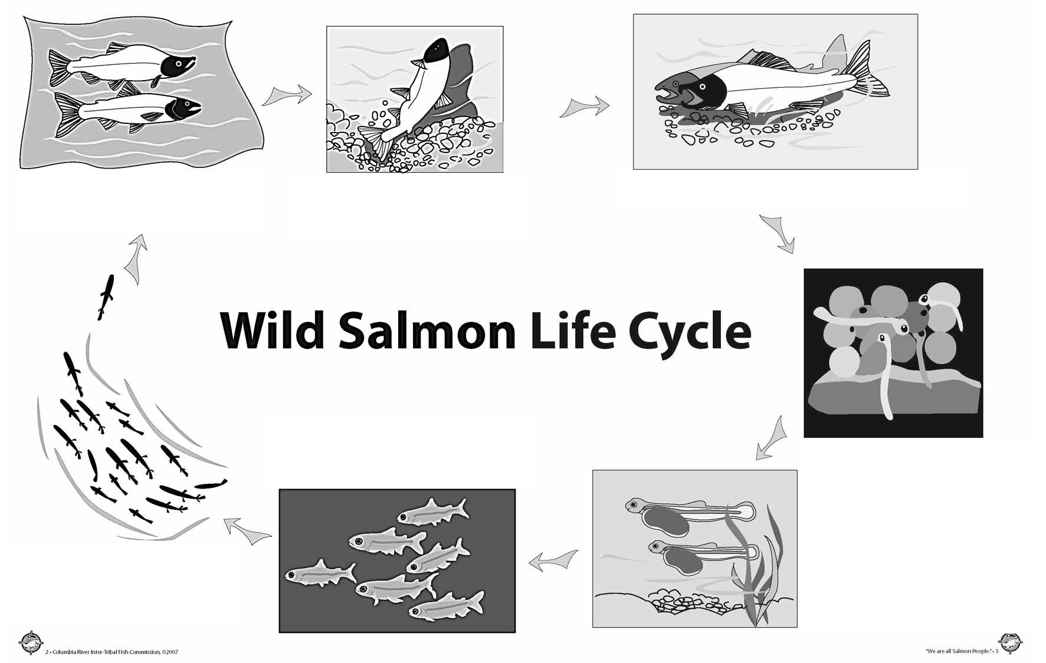
Wild Salmon Life Cycle
Key Terms:
Adult salmon
Alevins
Fry
Redd
Smolts
Spawning

Slide 22
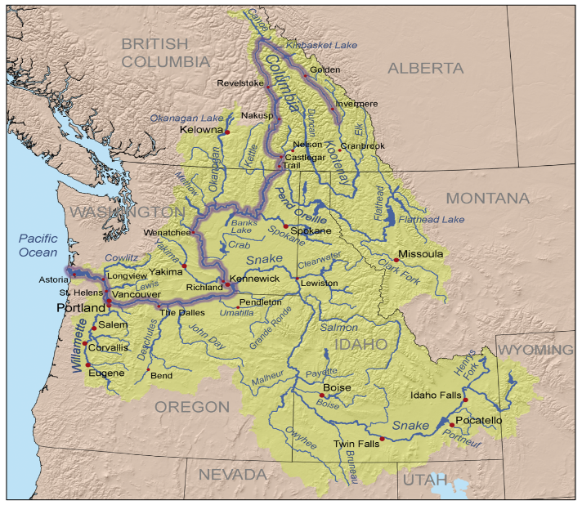
The Columbia River Basin
The Columbia River and its tributaries. This Photo by Unknown Author is licensed under CC BY-SA.

Slide 23
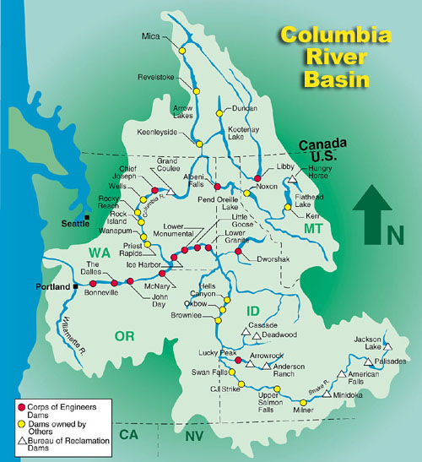
Dams in the Columbia Basin
This Photo by Unknown Author is licensed under CC BY-NC

Slide 24
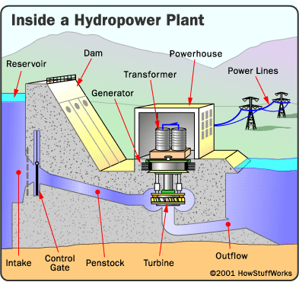
Dams Provide Electrical Power
This Photo by Unknown Author is licensed under CC BY-SA

Slide 25
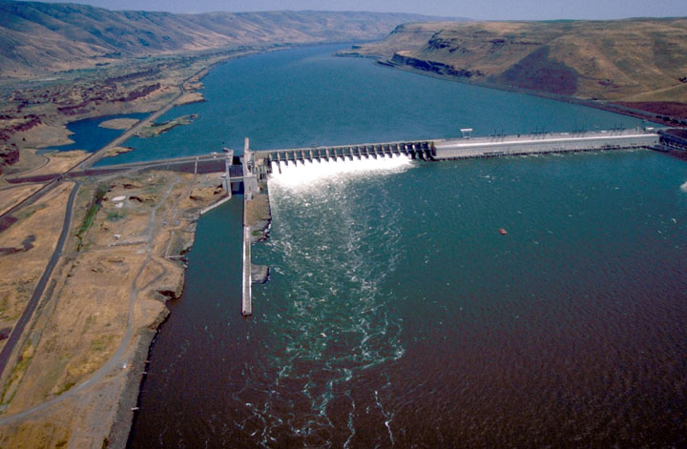
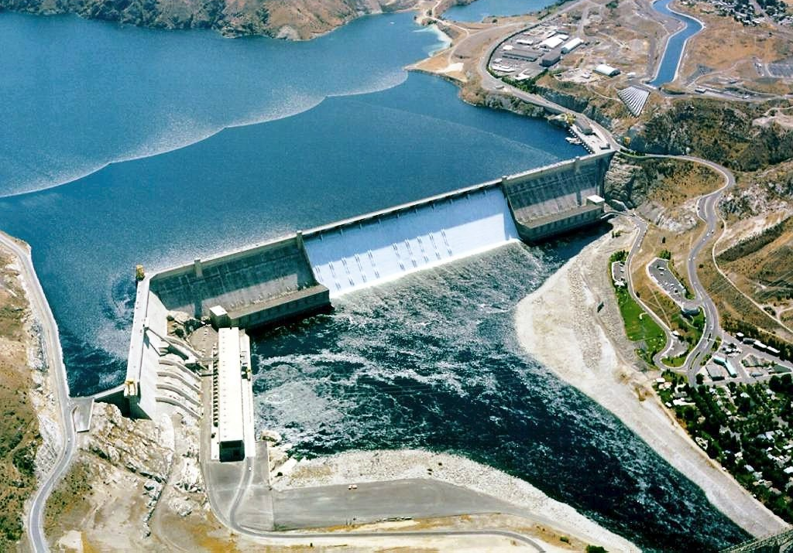
John Day Dam (passable)
This Photo by Unknown Author is licensed under CC BY-SA
This Photo by Unknown Author is licensed under CC BY-SA
Grand Coulee Dam (not passable)

Slide 26
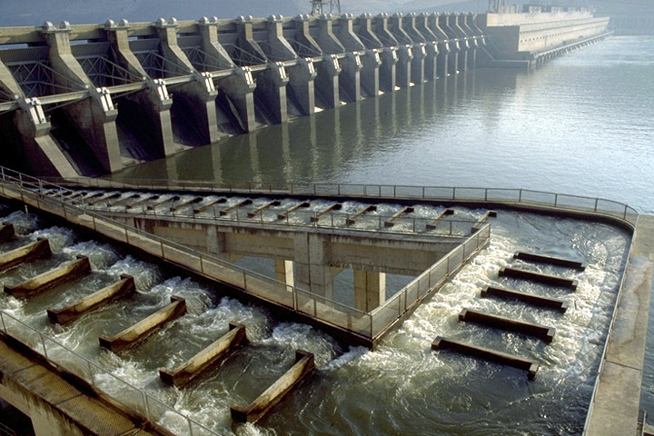
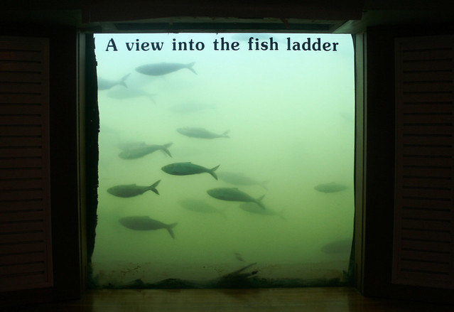
Fish Ladders – A Way Through
This Photo by Unknown Author is licensed under CC BY-SA
This Photo by Unknown Author is licensed under CC BY

Slide 27
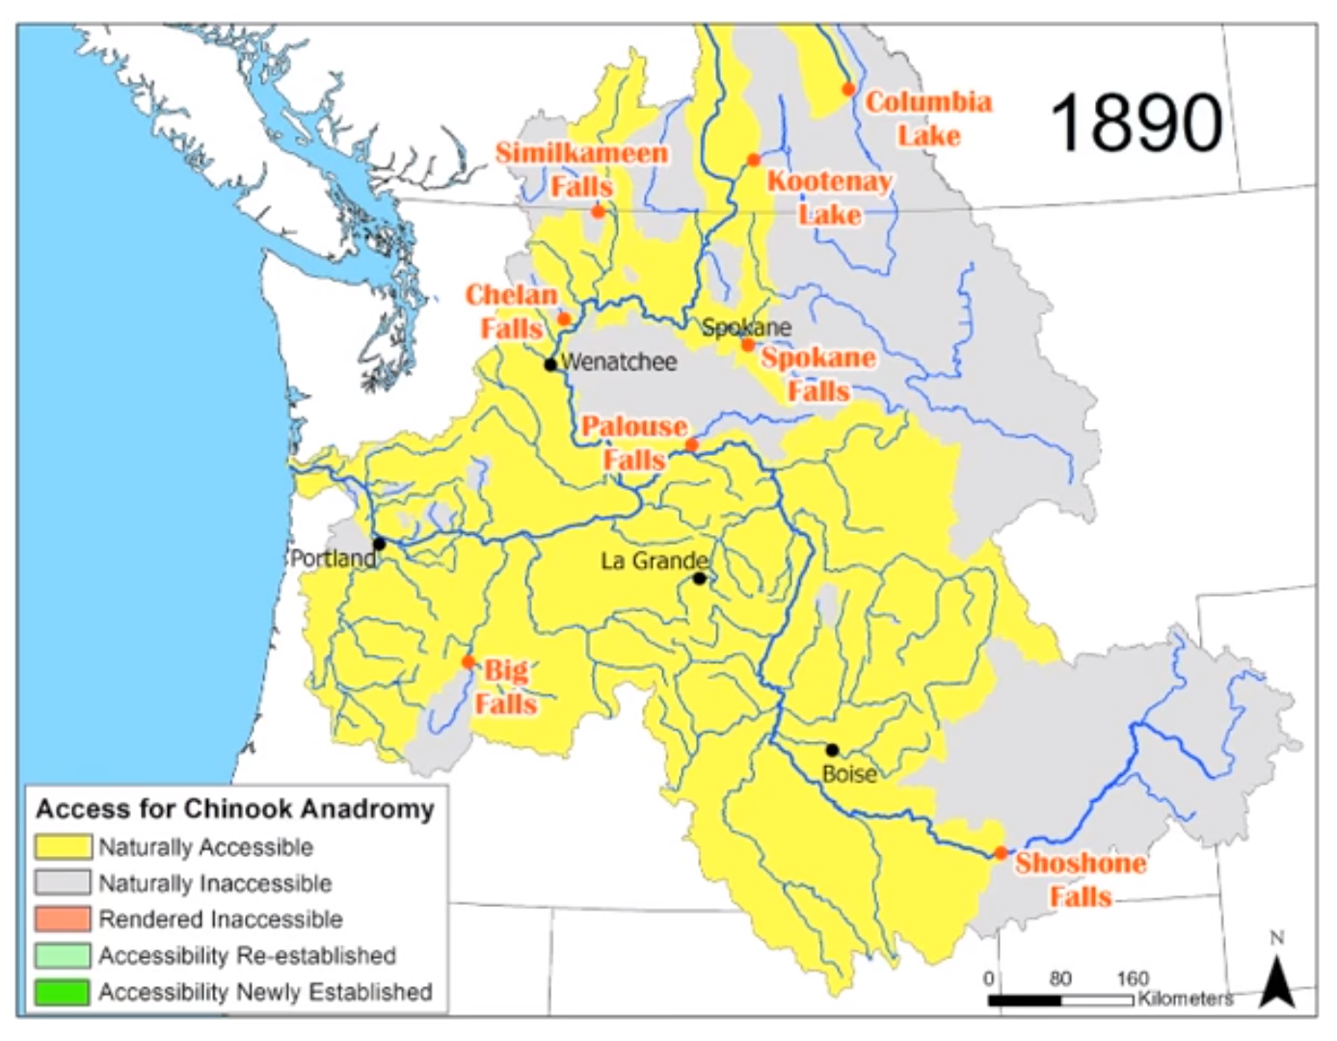
Accessibility for Salmon Before Dams (1890)
Notes:
Photo Credit: https://www.critfc.org/fish-and-watersheds/columbia-river-fish-species/columbia-river-salmon/

Slide 28
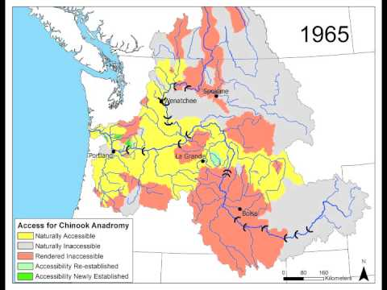
Accessibility for Salmon After Dams (1965)
Notes:
Photo Credit: https://www.critfc.org/fish-and-watersheds/columbia-river-fish-species/columbia-river-salmon/

Slide 29
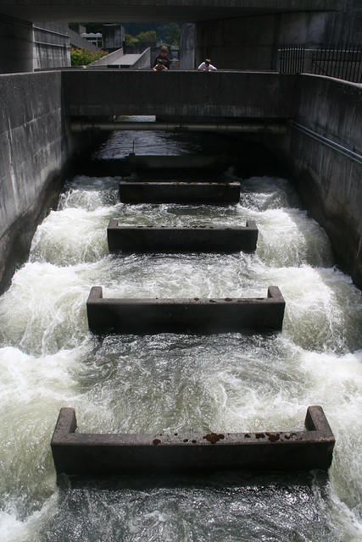
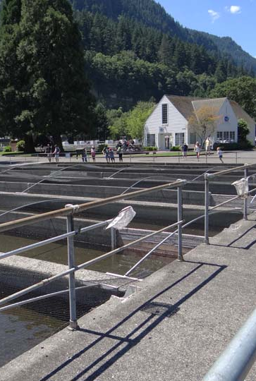
Stream Access
This Photo by Unknown Author is licensed under CC BY
This Photo by Unknown Author is licensed under CC BY-NC-ND
This Photo by Unknown Author is licensed under CC BY-SA
Fish Hatcheries
Stream Restoration

