Slide 1
Processing/Diversion in the USDA Foods Program
Notes:
Welcome to an introductory training on basics in the USDA Foods Processing/Diversion program.

Slide 2
What is Processing/Diversion?
Pounds available to be ordered that are sent to a processor to be made into an end product.
Notes:
What is Processing/Diversion? Pounds available to be ordered that are sent to a processor to be made into a end product. What is a end product?
End Products are USDA bulk foods converted into a more convenient, less labor intensive menu item at a processor.

Slide 3
Converting bulk USDA Foods into more convenient forms
Examples:
Raw chilled chicken into chicken pieces
Raw coarse ground beef into cooked patties
Cheese into pizza
Frozen fruit into applesauce cups
Notes:
So we just explained what processing/diversion is. What are some examples of end products?
Raw chilled chicken into chicken pieces
Raw coarse ground beef into cooked patties
Cheese into pizza
Frozen fruit into applesauce cups

Slide 4
Why Process/Divert?
Notes:
So the question remains, why would you want to process/divert?

Slide 5
Possible Benefits
Increase Participation?
More Variety
High Quality
Save Money?
Easy/Fast Preparation
Donated Food Value
Notes:
Here are some possible benefits to processing/diverting to processors:
Increase participation by offering more variety and high quality products. An example could be processing chicken to be made into whole muscle chicken strips, something you might not be able to afford commercially but the diverted cost makes it affordable.
Save money by using product already assembled that requires minimal labor and the food is more affordable because the USDA Foods donated value is subtracted from the price of the product.

Slide 6
Subtracting USDA Donated Food Value
Example: Fully Cooked Beef Patty
DF Inventory Draw
Down per Case
Value per lb of
DF
Value of DF per Case
(entitlement used)
Case Price
Undiscounted Case Price
40.57 lbs.
X
$1.4087
=
$57.15
+
$41.75
=
$98.90
Your Savings!
Notes:
What do we mean by subtracting USDA donated food value? This page illustrates that every case of diverted/processed end product has a certain amount of USDA Foods diverted food value subtracted from the commercial price. In some cases this makes food products more affordable.

Slide 7
What does value-pass-thru method mean?
Notes:
So how do you get your USDA Foods donated food value credit subtracted from the price of the case? There are several different ways which are called value-pass-thru methods.

Slide 8
FEE FOR SERVICE (FFS)
Other ingredients + labor + packaging + overhead + other costs = YOUR PRICE
Donated food value credit included in final price
Notes:
The most common value pass thru method is fee for service. A processor’s cost of ingredients (other than DF), labor, packaging, overhead, and other costs from the actual conversion of the DF into the desired end product. It primarily applies to meat & poultry, or other non-substitutable donated foods. The donated food value credit is included in the final price.

Slide 9
Net-Off-Invoice (NOI)
Other ingredients + labor + packaging + overhead + other costs = YOUR PRICE
Donated food value credit included in final price
Notes:
The indirect discount system is also know as net-off-invoice. In this system end products are sold to a distributor at a commercial price. The product becomes a USDA Foods case when an eligible participant buys the commercial product reduced by the donated food (net price). The reduction in price should be reflected off the final invoice to the customer.

Slide 10
Rebate
A refund equal to the value of DF contained in the end product
Your Price= commercial price
Refund (rebate) is sent after verification of purchase.
Notes:
The indirect discount system is also know as net-off-invoice. In this system end products are sold to a distributor at a commercial price. The product becomes a USDA Foods case when an eligible participant buys the commercial product reduced by the donated food (net price). The reduction in price should be reflected off the final invoice to the customer.

Slide 11
How do I Process?
Notes:
So now that we have talked about the concept of processing, how do I actually go about the process?

Slide 12
Processing Timeline
Attend food shows/network
Menu items/Forecasting
Procurement
Processing catalog
Complete calculations
Complete order
Contact broker/processor
Track orders
Notes:
All processed end products must be properly procured in accordance with State and Federal regulations. You will want to:
Attend Food shows and tasting events
Choose what items to menu
Complete competitive procurement
Use annual processing catalog to determine what product to divert to the processor in WBSCM
Complete calculations for what you will need
Complete order in WBSCM for what you will need
Contact broker/processor to arrange for ordering and delivery of end product
Keep track of your pound balances and orders
Let’s discuss these in more detail…

Slide 13
Food Shows/Networking
OSNA Conferences
SNA National Conferences
ACDA (American Commodity Distribution Association)
Network w/schools who process
Meet processor/broker company representatives
Product testing
Notes:
Here are some examples of food shows and networking. It is best to attend in the Fall or Spring before procurement process starts, here are some examples:
Oregon School Nutrition Association Conferences
SNA National Conferences
ACDA (American Commodity Distribution Association)
Network w/schools who process
Meet processor/broker company representatives
Product testing

Slide 14
Menu Items/Forecasting
Tentative menu plan for the following school year
Determine approximate usage –
Servings per day x Number of days on menu
100 students x 45 days = 4,500 total servings
Notes:
While attending food shows and networking will definitely help you choose food products, you need to also tentatively plan your menu for the next school year and plan for usage, this is called forecasting. You will need this information before you complete a procurement.

Slide 15
Procurement
Federal/state/local procurement regulations apply to processed commodities
You must use the strictest of Federal, State or local thresholds and rules
Competitive quotes required if you spend below $150,000
Formal bid required for amounts you spend above $150,000
Oregon State agreements link:
Oregon Processing Agreements
Notes:
All USDA Foods processed end products have to be procured in compliance with all Federal/State/Local regulations prior to diverting the pounds to the processor in WBSCM. You must always use the strictest of Federal, State, or local thresholds and rules. You can use your co-ops processing bid, complete your own or use the State agreements on the web at http://www.oregon.gov/ode/students-and-family/childnutrition/USDAFoods/Pages/StatewideProcessingAgreements.aspx. The benefit of using the state agreements is that most of the work is done for you, you just need to divert the pounds to the processor in WBSCM and arrange for ordering and delivery of the product. Delivery minimums vary.

Slide 16
Processing web page w/ SEPDS
Processing contact information
Products available
Quantity of diverted food needed for product
Pricing information
Oregon diversion/processing web page link:
Oregon Diversion/Processing
Notes:
Once you have completed a procurement, you will need to reference the processing web page to look at what’s known as the processors Summary End Product Data Schedule (SEPDS). You will need data from this schedule to figure out how much food you need to order/divert in WBSCM to the processor to receive a finished end product case. Let’s take a look at one.

Slide 17
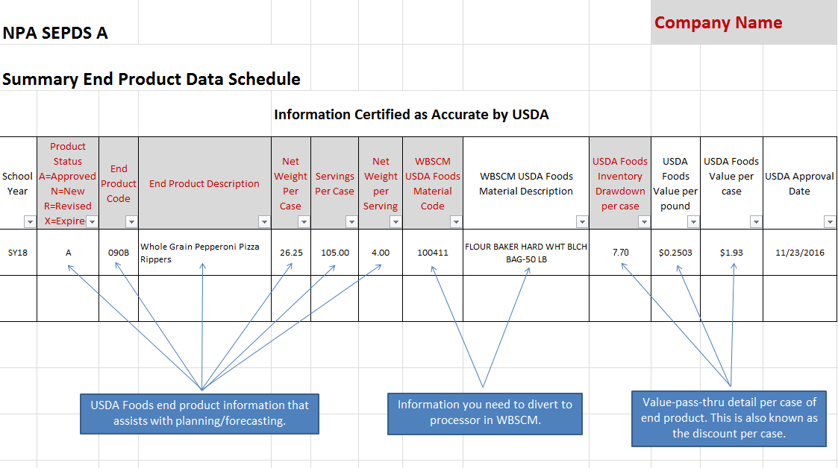
Example SEPDS
Notes:
Here is an example of a SEPDS. There are two very important columns, the USDA Foods inventory drawdown per case and the USDA Foods value per case. The WBSCM material code and description is what you order in WBSCM to send to that processor.

Slide 18
Complete Calculations
How much donated food needed
-Approximate usage ÷ servings per case =
# of cases needed
How many pounds needed for processing
-Quantity of diverted food (DF) needed per case × the # of cases needed
Notes:
Once you reference the processor SEPDS, you can calculate the amount of diverted food (DF) that will be necessary to be ordered in WBSCM to that processor.

Slide 19
Hold on! Is the USDA Food item a better deal than Commercial? You need to check!
Cost + Value-Pass-Thru + State Service Fees= Total Case Price
Notes:
Before you get too far into the process, please remember to always check whether the USDA processed/diverted product is actually cheaper than what you can buy it at commercially. Usually it will be but not always so you need to check! Only you will know the answer to this question. You need to make sure to include the procured processing cost, value-pass-thru amount, and state service fees.

Slide 20
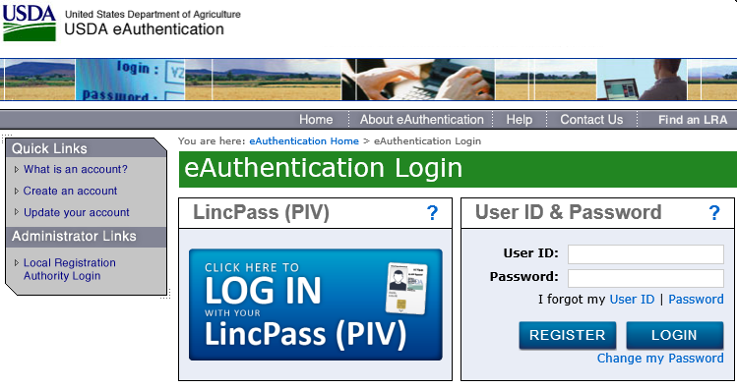
WBSCM Ordering
Enter orders in USDA WBSCM system
Usually ends March
ODE consolidates order information
ODE orders from USDA
Notes:
After you have completed calculations for what you will need, it will be time to enter the orders in the USDA’s WBSCM system. Ordering usually cuts off in March. ODE then compiles and consolidates the data and orders the pound with USDA. Pounds are then sent to the processor and will be available at the start of the next school year so you can receive whatever value-pass-thru method that the processor has agreed to use with you. There are additional trainings on the ODE website that go into the specific ordering procedures in WBSCM.

Slide 21
Contact Broker/Processor
After receiving confirmation:
Identify what product(s) & how many cases of each product
Identify delivery schedule & locations
Place orders
Notes:
After you have diverted the pounds and received confirmation that they were actually ordered in WBSCM (WBSCM will tell you status of all foods), then you can go ahead and place orders with the processor/broker that you completed a procurement with.

Slide 22
Track Orders
Make sure you are using proper value-pass-thru method and are receiving correct DF credit
Monitor balances with processor(s) monthly (K12, Processor Link, WBSCM)
Plan to use all of your diverted pounds in the year
Notes:
As a recipient agency of USDA Foods, it is your responsibility to track your pound usage and ensure you are receiving the proper value-pass-thru credit. Make sure you using free online tracking tools like K12 and Processor Link. WBSCM will not have pound usage but it will have the number of pounds sent to the processor. Plan to use all of your diverted pounds in the year. ODE will allow carryover into the next year for 6 months and then the pounds are taken back into the state account.

Slide 23
Non-Discrimination Statement
In accordance with Federal civil rights law and U.S. Department of Agriculture (USDA) civil rights regulations and policies, the USDA, its Agencies, offices, and employees, and institutions participating in or administering USDA programs are prohibited from discriminating based on race, color, national origin, sex, disability, age, or reprisal or retaliation for prior civil rights activity in any program or activity conducted or funded by USDA. Persons with disabilities who require alternative means of communication for program information (e.g. Braille, large print, audiotape, American Sign Language, etc.), should contact the Agency (State or local) where they applied for benefits. Individuals who are deaf, hard of hearing or have speech disabilities may contact USDA through the Federal Relay Service at (800) 877-8339. Additionally, program information may be made available in languages other than English. To file a program complaint of discrimination, complete the USDA Program Discrimination Complaint Form, (AD-3027) found online at: USDA Link, and at any USDA office, or write a letter addressed to USDA and provide in the letter all of the information requested in the form. To request a copy of the complaint form, call (866) 632-9992. Submit your completed form or letter to USDA by: (1) mail: U.S. Department of Agriculture Office of the Assistant Secretary for Civil Rights 1400 Independence Avenue, SW Washington, D.C. 20250-9410; (2) fax: (202) 690-7442; or (3) email: program.intake@usda.gov This institution is an equal opportunity provider.

