Slide 1
Planning and Forecasting USDA Foods

Slide 2
In this Training
The importance of forecasting to the supply chain and cost effective procurement
Existing tools for forecasting
Promoting good supply chain management, procurement and forecasting
Notes:
In this training we will discuss:
The importance of forecasting to the supply chain and cost effective procurement
Existing tools for forecasting
Promoting good supply chain management, procurement and forecasting

Slide 3
What is Forecasting?
Forecasting is the process of analyzing current and historical data to determine future trends.
Predicting and estimating for the coming year
Assessing needs by reviewing current procurement activities.
Notes:
So what exactly is forecasting?
Forecasting is the process of analyzing current and historical data to determine future trends.
Forecasting involves predicting and estimating the goods, products, and/or services needed in specified areas for the coming year.
Assessing needs by reviewing current procurement activities.
Forecasting allows for procurement plans to evolve each fiscal year.

Slide 4
Procurement Guidance
Notes:
The ICN State Agency Guidance on Procurement lists accurate forecasting as one of the five key areas for a good procurement.

Slide 5
What are the benefits of forecasting?
Cost savings are realized
Ensures steady supply
Just in time inventory
No excess inventory
Cost of capital decreases
Notes:
What are the benefits of forecasting?
Cost savings are realized - bids become more desirable and competitive
Ensures steady supply – however be realistic in your expectations. You should forecast a minimum of six weeks in advance. It is unrealistic to expect the awarded distributor or manufacturer to have products and quantities specific to your district readily available in their inventory.
Just in time inventory carried at manufacturer and distributor
No excess inventory
Cost of capital decreases thus resulting in better pricing for the end user

Slide 6
What are the benefits of forecasting cont.?
Notes:
Here is a graphical representation of why forecasting is important. The black lines represent actual demand, the blue forecasting line more closely follows along with the peaks and valleys and would give vendors better information than the red line which is a guestimate.

Slide 7
“Procurement in the 21st Century” manual- forecasting best practices
Utilize cycle menus
Forecast items accurately
Review data
ADP
Production records
Distributor velocity reports
Record of the current inventory
Conduct surveys or taste panels
Notes:
Utilize cycle menus- monthly is the most common but you could also do biweekly, quarterly, etc.
Forecast items accurately- only by doing the math and planning will you be successful
Review data- look at the following records for both current and past
ADP- This is looking at the actual meal participation, using enrollment or free/reduced application information does not necessarily represent who will actually participate with you and could lead to inaccurate forecasting. Also think about new buildings, remodeled kitchens, lunchtime scheduling, etc. for the next year when looking at ADP.
Production records- Knowing which items are being selected out of offerings will help you forecast better for the future.
Distributor velocity reports- This information should back-up the production records, or if production record information is not handy or in a useful format knowing the volume of ordering with help with future forecasting.
Record of the current inventory-Knowing what you have on hand can lead to more efficient forecasting for the next year. For example, if you had 100 cases of something left in stock, you might not even have to order anything for the next year. But if you don’t check you could really hurt yourself.
Conduct surveys or taste panels to determine customer satisfaction- This is one of the most essential parts of forecasting. Only by knowing what your customers want/prefer can you adequately plan for future menu items and get rid of the unpopular items.

Slide 8
Forecasting best practices cont.
Which USDA Foods are good for me?
Direct Delivery?
Diversion/Processing?
DoD Fresh?
Notes:
When you are planning for your commercial purchases, decide which direct delivery USDA Foods are a better deal for you and are a stable supply from USDA. Be sure to include state service fees which cover delivery and warehousing of your product. Commercial food prices usually already include these fees in the cost depending on how it was bid, you just don’t see the separate charges because they build it into the price charged.
Some sponsors may benefit from ready-to-use end products from diversion/processing. In some cases, diversion/processing can be a cost savings to the sponsor for high quality products. Just like Direct Delivery, do your homework for diversion/processing and see what is the better deal. Sometimes diversion/processing can be more expensive than purchasing commercially if you factor in the processing charge, service fees, and any delivery charges.
The DoD Fresh Fruit and Vegetable program is another great option to supplement your produce ordering. Just remember that USDA foods have to be 100% domestically produced or grown, so produce through this program is seasonal. For example, don’t expect grapes to be available during the winter. During the summer and fall they are available from California but during the winter they are more than likely coming from Central or South America and wouldn’t be offered. This would fit into your forecasting planning.

Slide 9
Forecasting good practices continued…do the math!!!
Calculate the amount of product to purchases and number of servings prepared
Food Buying Guide for a calculator
Complete a electronic monthly grid with estimates
Notes:
Calculate the amount of product to purchases and number of servings prepared
http://fbg.nfsmi.org for a calculator
Complete a electronic monthly grid with estimates

Slide 10
Food Buying Guide calculator
Notes:
Here is a sample of the ICN Food Buying Calculator. You can figure out the quantity needed line by line or you can add entire lists or even quantity recipes.

Slide 11
Sample forecast grid
Notes:
Here is a sample of a forecasting grid. Could be simple or complex depending on your forecasting needs.

Slide 12
USDA Foods calculator
Direct Delivery Comparison to Commercial:
Processing Comparison to Commercial:
Available on ODE & USDA websites
Notes:
USDA Foods has a wonderful calculator available on the web that allows you to quickly compare the cost difference between direct delivery and commercial and processing/diversion and commercial. They are available on the ODE and USDA websites.

Slide 13
Forecasting flowchart example
Notes:
Here is a example flowchart highlighting some of the things we have discussed put into a logical flow.
Notice that all forecasting is similar. There are extra steps with processing.

Slide 14
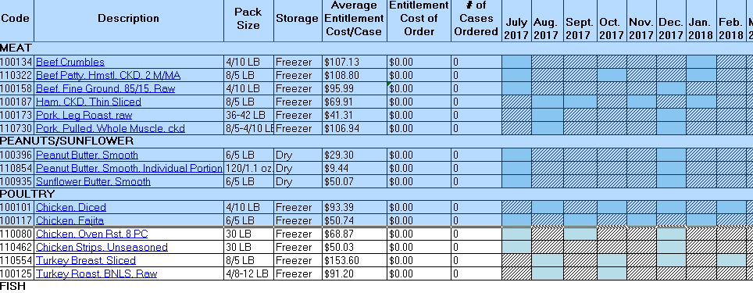
Order planners
Notes:
After determining which USDA Foods Direct Delivery and Bulk Diversion/Processing foods are the best for your organization and the amounts needed, planning your orders is the next step.
ODE updates our planners each year with the products, estimated costs and delivery options to create for a smoother ordering experience.
The direct delivery worksheet allows you to see what dates to expect items to be available for delivery to the state warehouse the following year. The order planner contains the product code, description and other pertinent information. The Description is a hyperlink to the food fact sheets to gather crediting and nutritional information. After entering the number of cases for each available month, the estimated cost will calculate.
The processing worksheet calculates order values as well but just as importantly it provides the destination code for each product to use when ordering processed food in WBSCM.
These worksheets are not required to be used but are highly recommended to save time and frustration during the ordering process. We will discuss the ordering process further in the next training.

Slide 15
Monitoring & adjust
Continuously analyze sales vs. forecast
Change in cycle menu
Monitor pounds at the processor
Notes:
Continuously analyze sales vs. forecast
If adjustments need to be made, let ALL parties (including distributors) know
Change in cycle menu
If a district must modify their cycle menu, ensure they give enough lead time to adjust the quantities.
Realistically takes 6 weeks before production can increase inventory
Could lead to shortages
Monitor pounds at the processor and verify proper drawdown

Slide 16
Monitoring USDA foods @ Processors
Free helpful tracking tools (use varies by manufacturer):
K12 Foodservice
Processorlink
Notes:
If you are wondering how to track your pounds at the processors, there are two free online tools available to use, K12 and Processorlink. Each processer decides whether to use K12 or Processorlink. ODE is also required to track processor pound usage, however there is a delay in processors reporting to us but you can contact us for the most recent information we have on file. It is important to occasionally check on usage because you want to ensure that you are receiving your USDA Foods pass through value.

Slide 17
Forecasting helps other areas
Prevents waste
Reduces customer dissatisfaction
Identifies potential customers
Helps set revenue goals
Notes:
Forecasting helps in many other areas than aren’t necessarily obvious:
Prevents waste in excess labor hours and overproduction of food
Reduces customer dissatisfaction because of inadequate staff and too little food prepared for the number served
Identifies potential customers who are not participating
Helps set revenue goals

Slide 18
Questions?

Slide 19
Non-Discrimination Statement
In accordance with Federal civil rights law and U.S. Department of Agriculture (USDA) civil rights regulations and policies, the USDA, its Agencies, offices, and employees, and institutions participating in or administering USDA programs are prohibited from discriminating based on race, color, national origin, sex, disability, age, or reprisal or retaliation for prior civil rights activity in any program or activity conducted or funded by USDA. Persons with disabilities who require alternative means of communication for program information (e.g. Braille, large print, audiotape, American Sign Language, etc.), should contact the Agency (State or local) where they applied for benefits. Individuals who are deaf, hard of hearing or have speech disabilities may contact USDA through the Federal Relay Service at (800) 877-8339. Additionally, program information may be made available in languages other than English. To file a program complaint of discrimination, complete the USDA Program Discrimination Complaint Form, (AD-3027) found online at: http://www.ascr.usda.gov/complaint_filing_cust.html, and at any USDA office, or write a letter addressed to USDA and provide in the letter all of the information requested in the form. To request a copy of the complaint form, call (866) 632-9992. Submit your completed form or letter to USDA by: (1) mail: U.S. Department of Agriculture Office of the Assistant Secretary for Civil Rights 1400 Independence Avenue, SW Washington, D.C. 20250-9410; (2) fax: (202) 690-7442; or (3) email: program.intake@usda.gov This institution is an equal opportunity provider.

