Slide 1
USDA Food Distribution Program WBSCM RA User Set-Up
This Recipient Agency (RA) Training Guide has been developed to assist our recipients (schools and other organizations) in utilizing USDA’s online ordering program – known as Web-Based Supply Chain Management, or WBSCM.
Notes:
Welcome to the Oregon Dept. of Education training on how to set-up your Web-Based-Supply-Chain-Management (WBSCM) user account for access to the USDA Foods ordering system.

Slide 2
Index
Important Contacts…Slide 3
When the State Sets Up Your WBSCM Account…Slide 4
The WBSCM Home Page…Slide 18
Navigating WBSCM…Slide 19
Review and Update your User Profile…Slide 24
Create Favorites…Slide 25
Setup WBSCM Accounts For Your Staff…Slide 26
Notes:
If you want to skip slides or go back here is an index of slides for topics.

Slide 3
Oregon WBSCM Help: Oregon USDA Foods Website E-mail: ode.fooddistribution@ode.state.or.us This e-mail address is continuously monitored M-F (except Holidays) Contact ODE first for assistance with WBSCM issues. USDA WBSCM Help Desk: Help Desk Hours: 8:00 AM to 6:00 PM EST M-F Phone: 877-WBSCM-4U or 877-927-2648 E-mail: WBSCM.servicedesk@CACI.com Contact the WBSCM Help Desk for any trouble you have only if ODE staff do not get back to you within 2-3 business days.
Important Contacts
Notes:
Here is a list of contacts for help with WBSCM. Please try to follow the steps in this training prior to contacting ODE or WBSCM.

Slide 4
New WBSCM Account Creation
WHEN THE STATE SETS UP YOUR WBSCM ACCOUNT
Notes:
When the State sets up your account, there is a sequence of events that must be followed exactly to set-up your account.

Slide 5
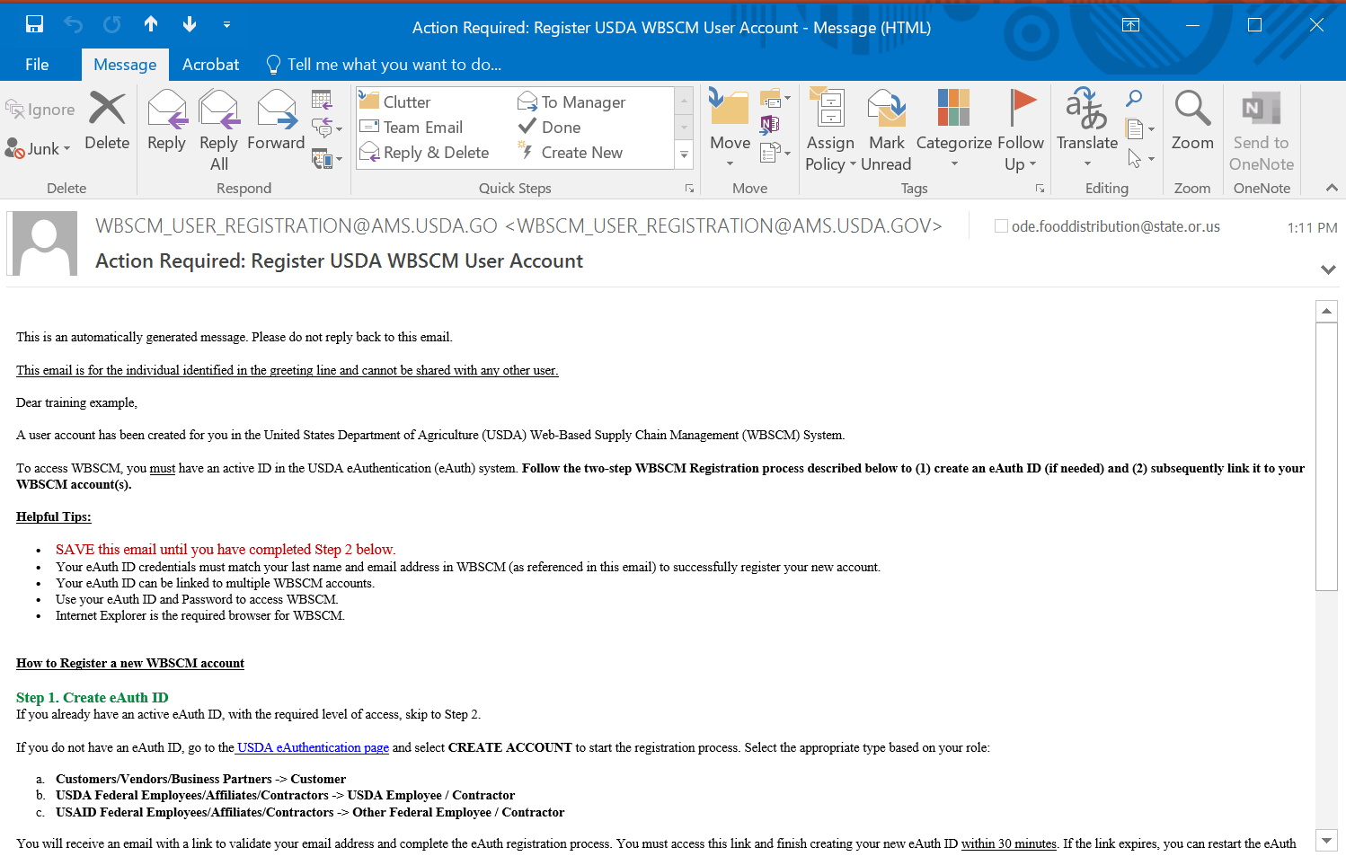
You will receive this e-mail
Didn’t Receive the Email? Check Spam or Contact Your IT Dept and ask them to make sure this email address is allowed
Notes:
You will first receive an e-mail from WBSCM_USER_REGISTRATION@AMS.USDA.GOV similar to this. If you didn’t receive the e-mail it may be caught in your district spam filter. Please contact your IT dept. for assistance.

Slide 6
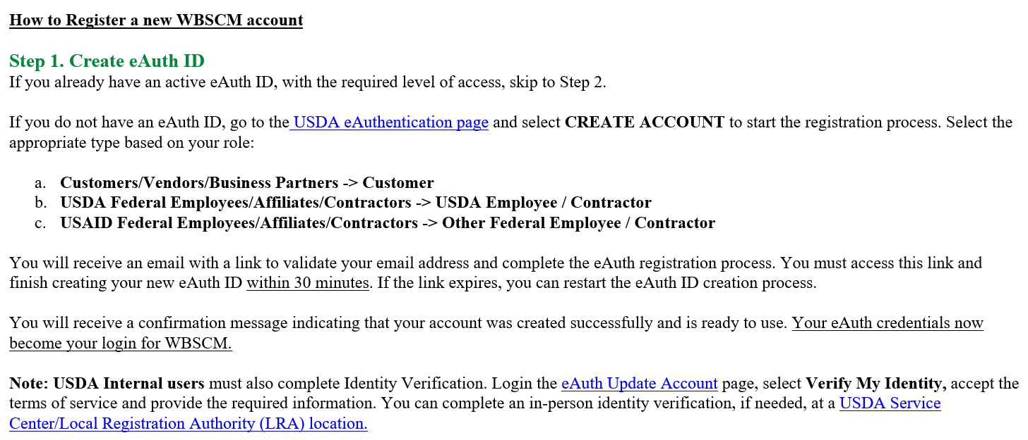
Step 1
Click on this link first
Notes:
The first step will be to click the step #1 link to create an eAuthentication account. If you already have an eAuthentication account because you are a DoD Fresh participant, you can skip to step #2, on slide 14 and complete your WBSCM registration.

Slide 7
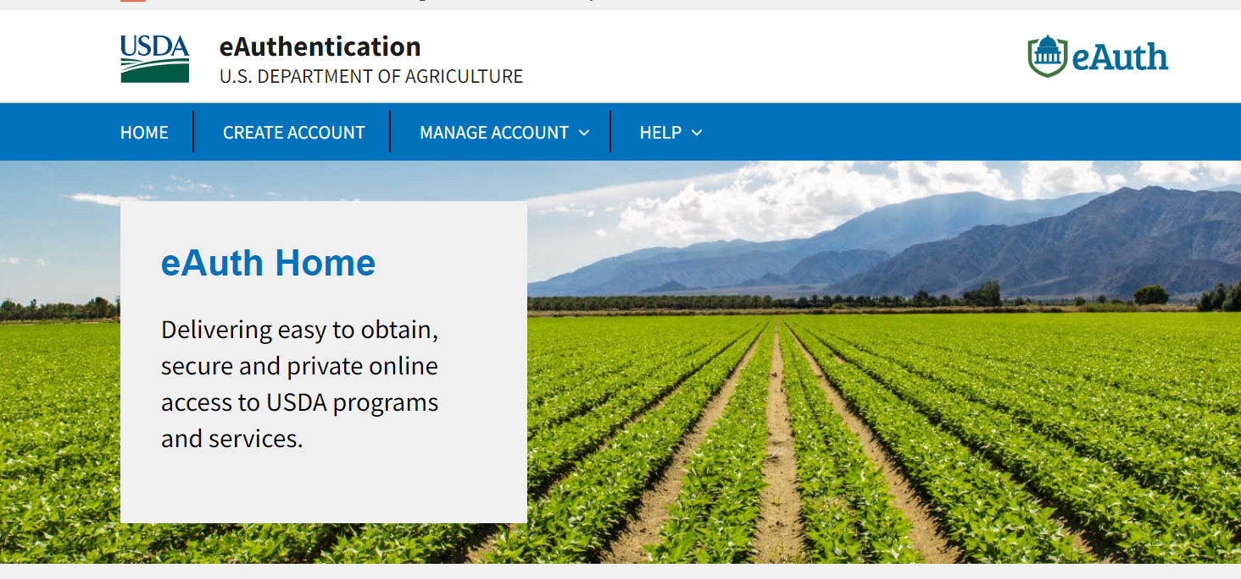
Click on “Create Account”
Notes:
After clicking on the eAuthentication link, you will be taken to this web page. Click on “Create Account.”

Slide 8
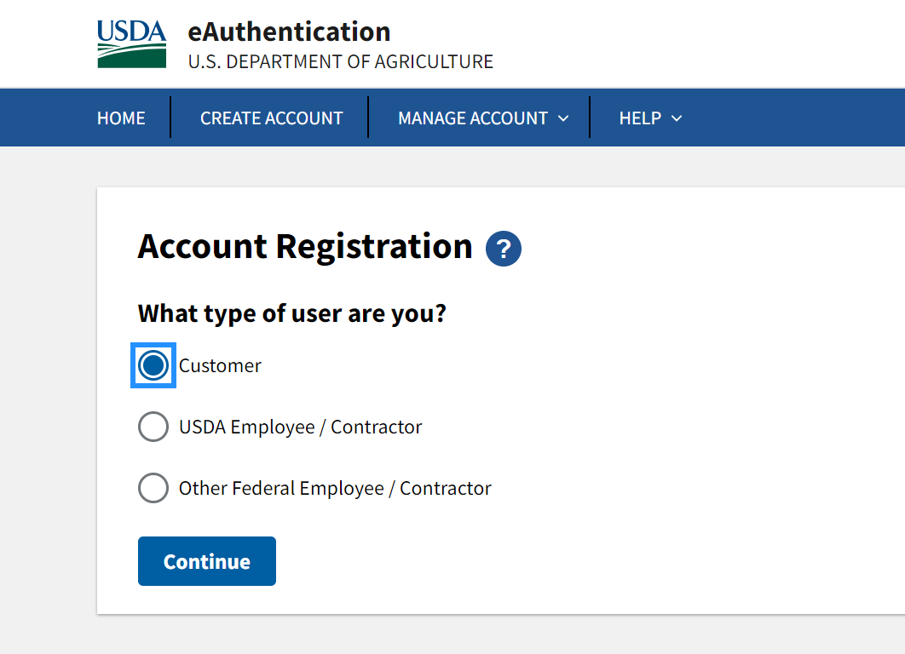
Click on “Customer”
Notes:
Next, select Customer and click continue

Slide 9
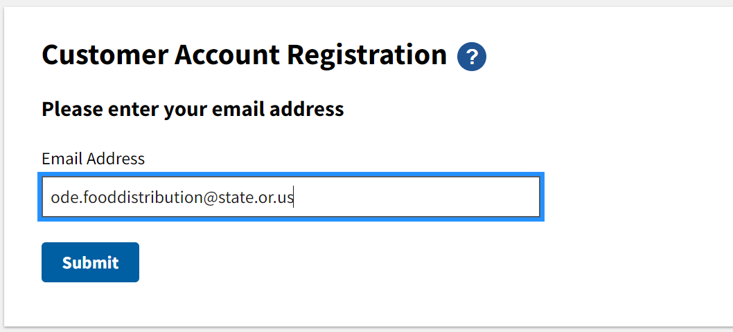
Enter Email
Notes:
Type in the email address you received the WBSCM email in and press Submit. You will get a page letting you know that you have been sent another email.

Slide 10
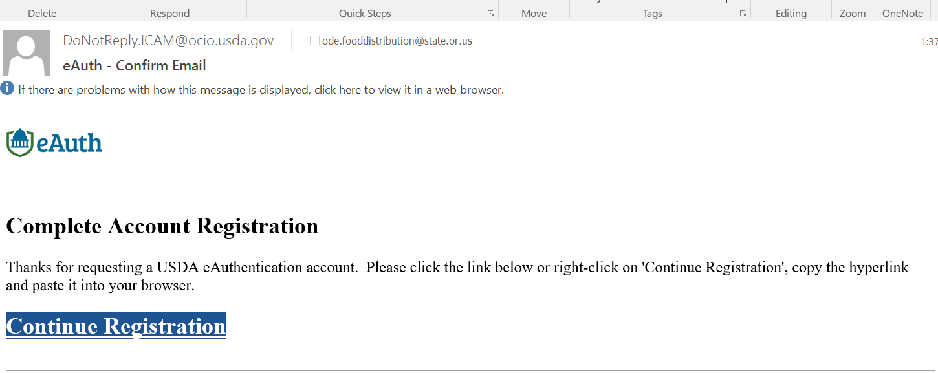
Second Email
Notes:
Your second email is going from DoNotReply.iCAM@ocio.usda.gov and have another link to continue your registration. Click continue registration.

Slide 11
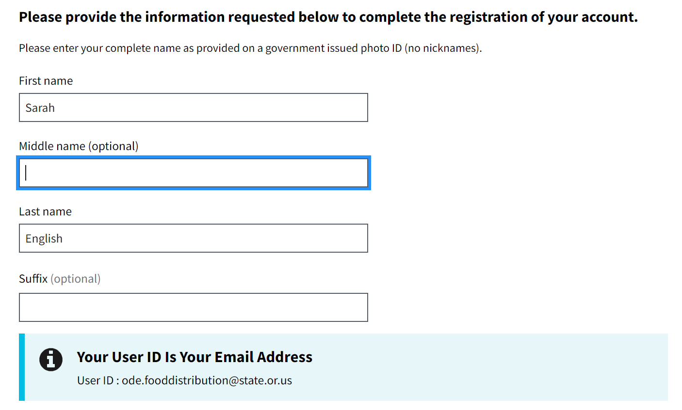
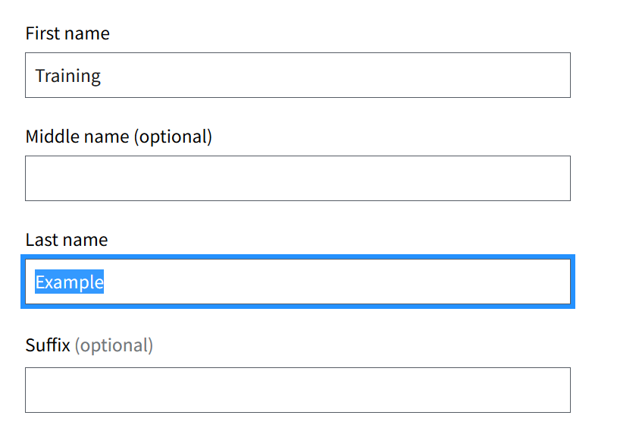
Set up account
Notes:
Enter your name and it will tell you your User ID is your email address.

Slide 12
Create your Password
Required Password Requirements:
12 - 24 characters long
At least one uppercase
At least one lowercase
At least one number (1 – 9)
At least one special character
Passwords cannot be dictionary words
Important: ODE FDP will provide first 7 characters, sponsors must come up with remaining minimum 5 characters.
The first 7 characters must be Oreg0n*
The first character is the capital letter O, followed by lower case letters reg, followed by the digit 0, followed by lower case letter n, followed by an asterisk.
You must then add at least 5 characters of your own choosing.
Notes:
Before we proceed to create level 1 customer account link, there are password requirements you must be aware of before creating your new password. The bullets on this slide outline the password requirements. The Oregon Dept. of Education has made the requirements easier for you by providing the first 7 characters of this password. You then can add at least 5 characters of your own choosing.
12

Slide 13
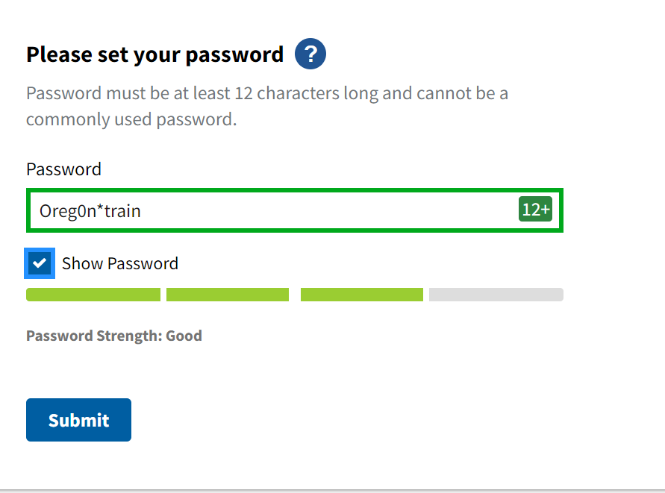
Entering Password
Notes:
If you use the beginning of the password from the slide below, you can add anything to be the last 5 digits. Submit and you will get a message telling you about a confirmation email coming.

Slide 14
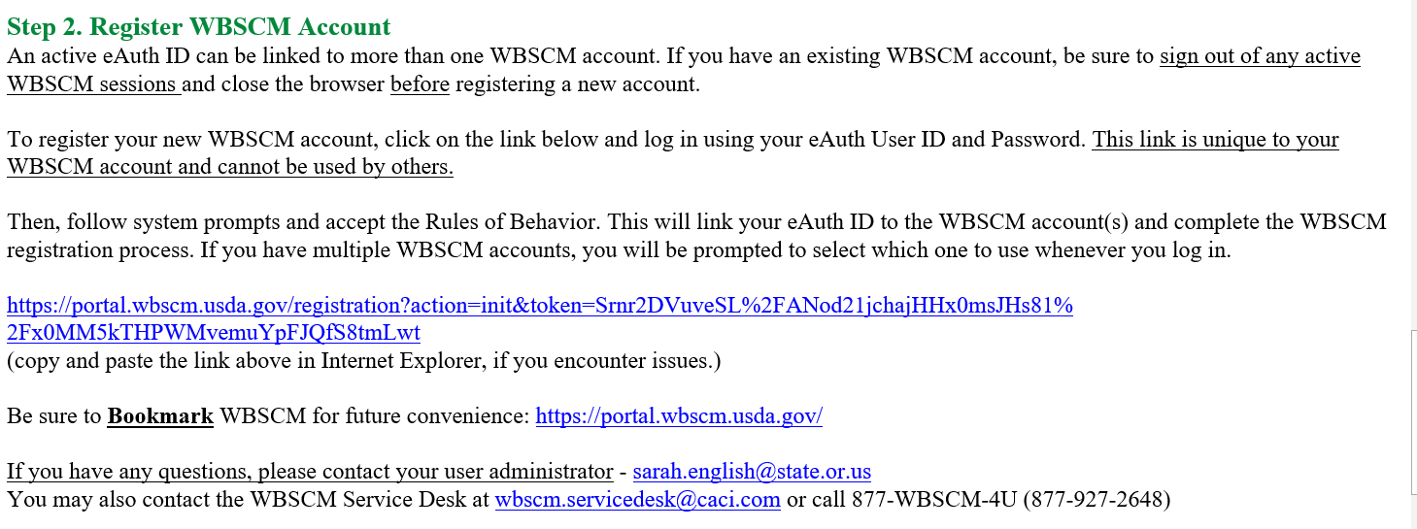
Step 2 – Go Back To The First Email
Now, click on the link in Step 2.
Notes:
Go back to the original WBSCM e-mail and this time click on the link in step #2.

Slide 15
Enter the eAuth User ID and Password You Just Created
Notes:
Use the user ID (email address) and password that you set-up when creating your eAuthentication account. They must be the same or it won’t work.

Slide 16
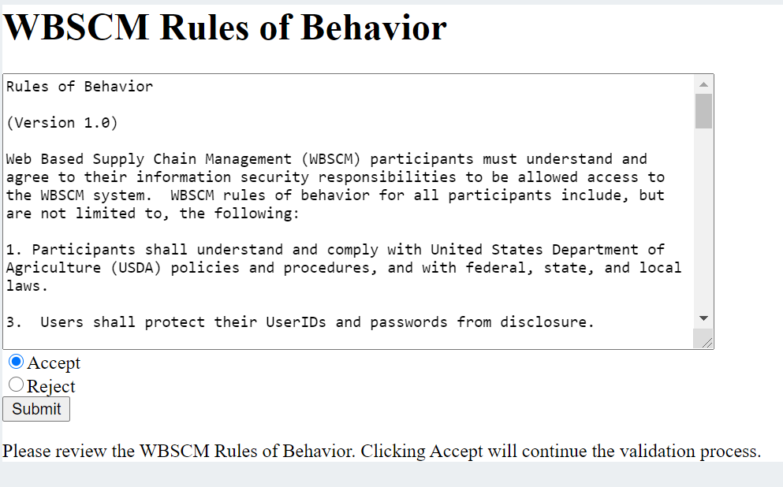
Click – “Accept”
Notes:
This is an official U.S. government system so read the bullets and then click “Accept” then submit.

Slide 17
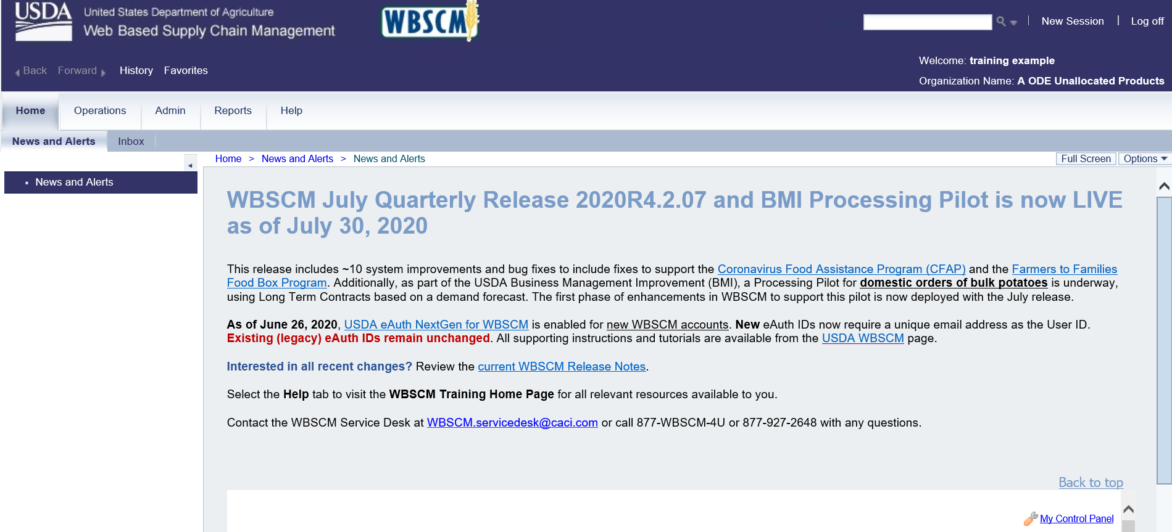
Congratulations! You’ve made it into WBSCM!
Notes:
Congratulations! You made it into WBSCM. You should see a screen similar to the one displayed.

Slide 18
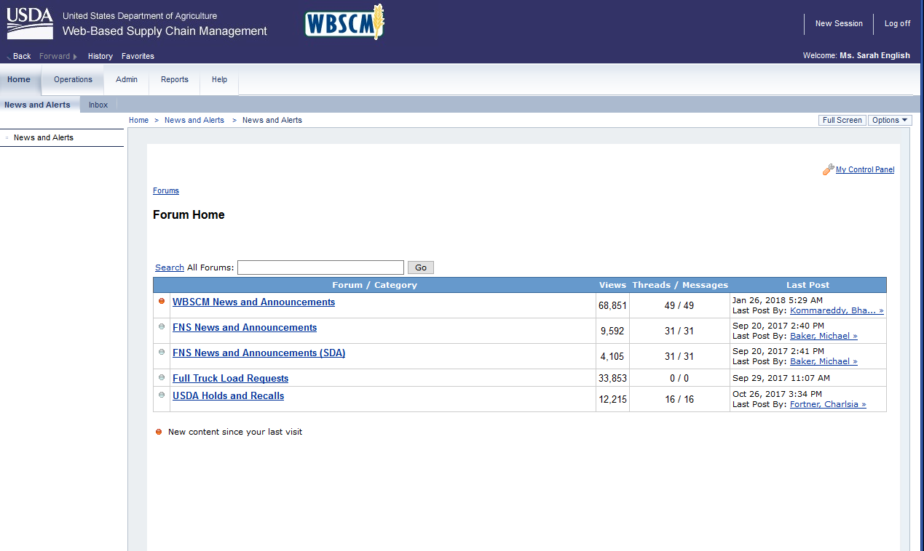
The WBSCM Home Page
Click here when you’re done to Log Off
Your name will appear here
News and Announcements from USDA –If dot is orange there’s new info
Notes:
This is the WBSCM home page. You will see your name, announcements and a log off link for when you are done.

Slide 19
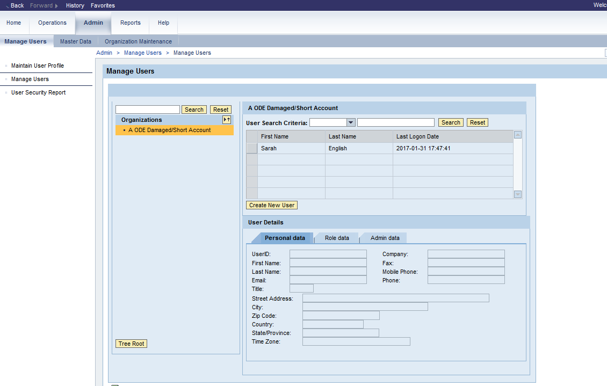
Navigating WBSCM
There are 5 tabs at the top of the WBSCM page – Home, Operations, Admin, Reports, and Help.
When you click on one of these tabs, different options will appear in the left column. When you click on the options under the left column, you will get to different areas, such as “Manage Users” or “Domestic Order Entry”.
Notes:
There are 5 tabs at the top of the WBSCM page – Home, Operations, Admin, Reports, and Help.
When you click on one of these tabs, different options will appear in the left column.
When you click on the options under the left column, you will get to different areas, such as “Manage Users” or “Domestic Order Entry”.

Slide 20
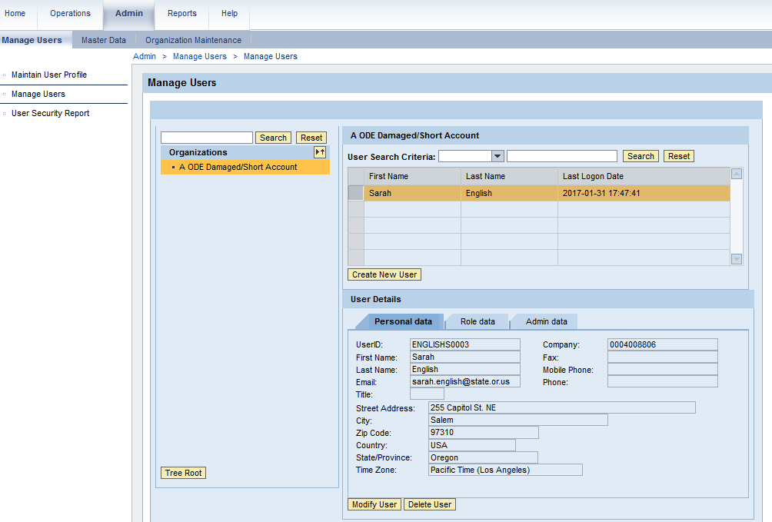
What to do if you can’t see all the tabs at the top of the page:
If you only see Home, Admin and Help at the top of the page, you’ll need to change your current roles. To do this, go to “Admin”, “Manage Users “ and follow these steps.
Click on the box next to the person’s name and their information will appear below
Note: if you change your email and last name on this page, it must match the email and last name on your eAuth account or you will be locked out – if you want to do this, call the WBSCM help desk to walk you through the steps.
Notes:
If you don’t have all of the tabs at the top of the page, it is because your “role” needs to be modified. Click on “admin” then “manage users”. Click on the box next to the person’s name and their information will appear under user details.

Slide 21
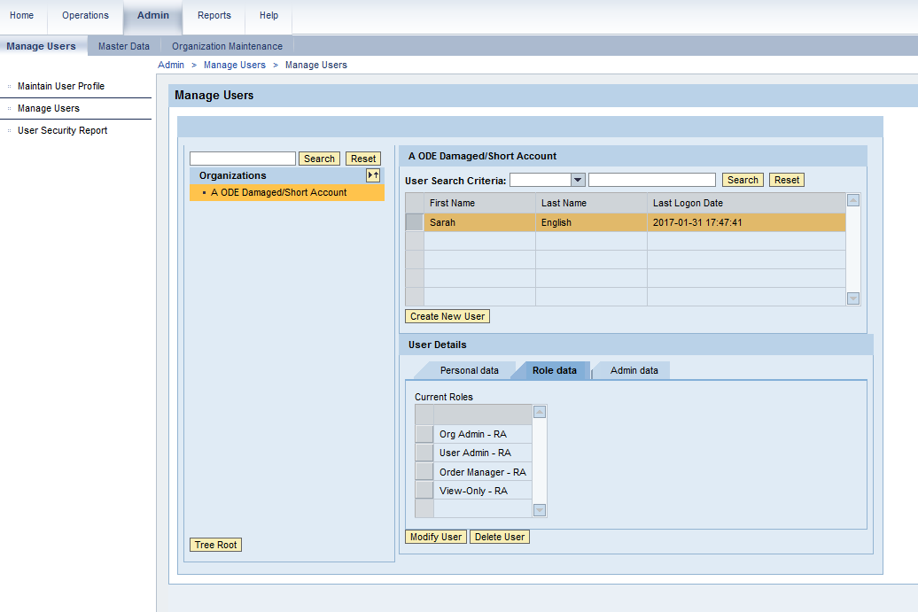
Modify Users
Notes:
Click on “role data” then “modify user”.

Slide 22
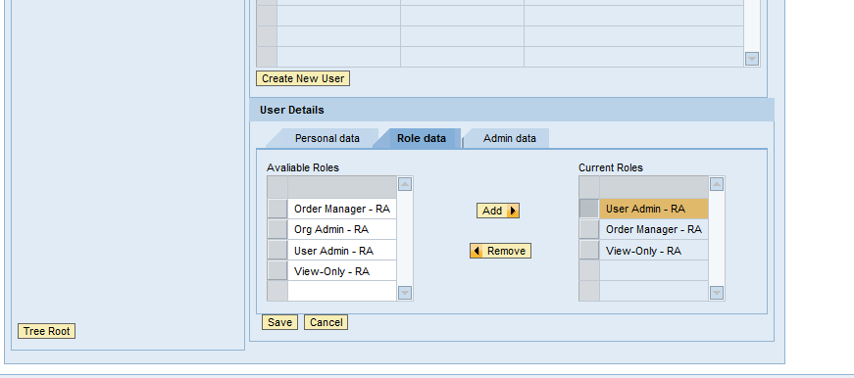
Modify Users
“User Updated Successfully” will appear after “Save” button is clicked. All the tabs should now be visible at the top of the page.
Notes:
Make sure that order manager-RA is selected for those that plan to place orders. Make sure that Org Admin-RA and User Admin-RA is selected for those that plan to create/modify access for other employees. Anyone who wants to view reports, including the order manager, needs “view only – RA” access. Click next to that role, click add, then click save.

Slide 23
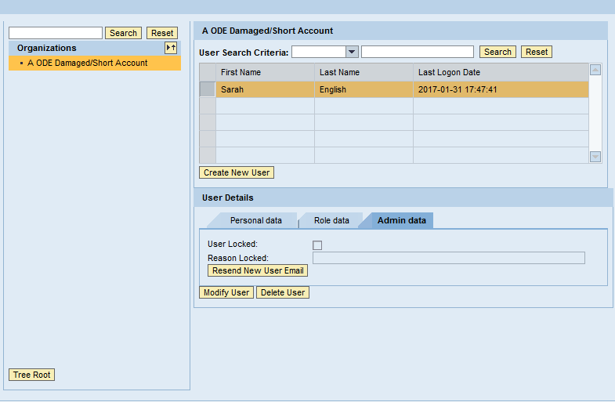
Admin Data Tab
NEVER LOCK USER
Notes:
Never click on lock user on admin data tab.

Slide 24
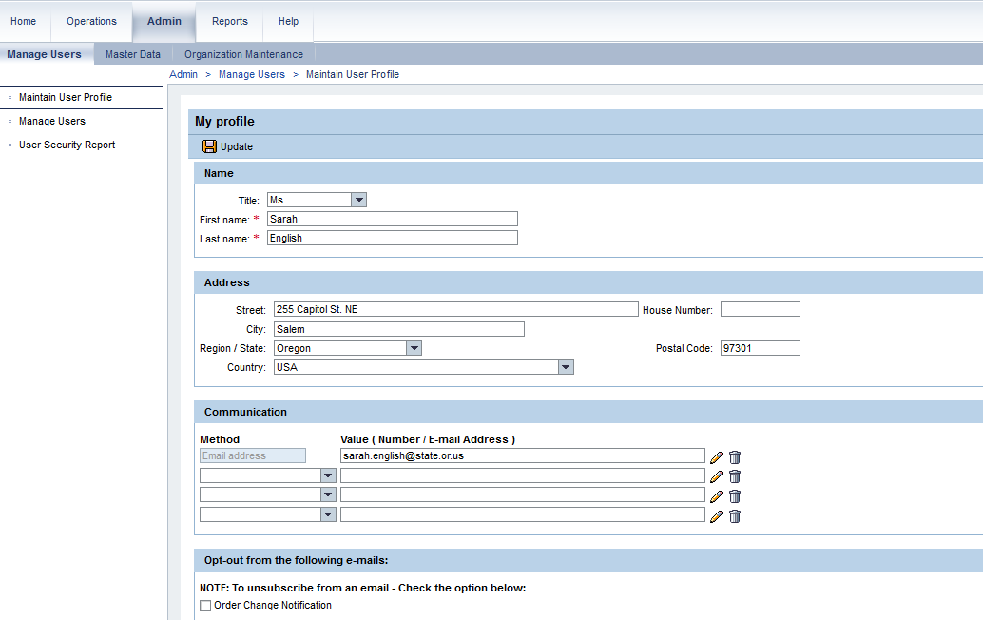
Review and Update Your User Profile
This message will appear after you click “Update”
Important – Complete this section to receive Hold/Recall announcements, then click “Update”
If you don’t want to receive WBSCM update emails, check this box and click “update”
Notes:
The first thing you should do is review and update your user profile. Click on admin, maintain user profile. Once you have made changes, make sure you click “update” in the top left of the screen. It will say “Data was saved successfully”. If you want to opt out of order notification e-mails from WBSCM click the box “opt out from order change notification emails”. It is recommended that at least one contact from each sponsor makes sure to leave this box unchecked so they receive order change notification emails.

Slide 25
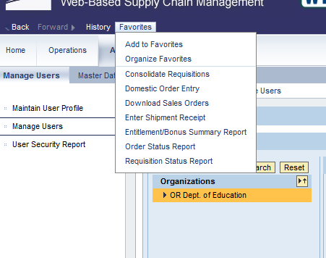
Create WBSCM Favorites
Notes:
To create WBSCM favorites (which is optional), click on Favorites above the WBSCM tabs. This creates a dropdown, click “add to Favorites”. The link will now be in the favorites drop down. No need to click multiple screens to get there.

Slide 26
Setup WBSCM Accounts for your Staff
You only need to follow these steps if you need to set up accounts for other staff at your school or organization.
Notes:
Please proceed on to the following slides only if you need to set-up accounts for other staff in your organization. If you are the only person that will be accessing WBSCM your existing account is adequate.

Slide 27
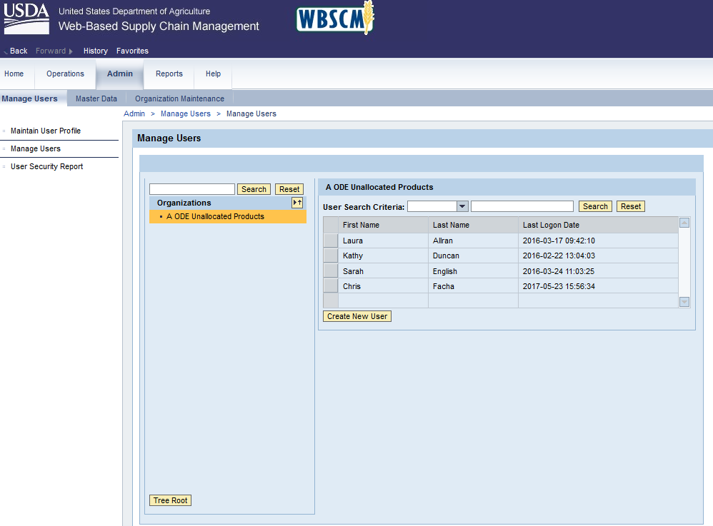
Manage Users Displays all WBSCM users in your Organization
Notes:
Click on “admin”, then “manage users”. Click on “Create New User”

Slide 28
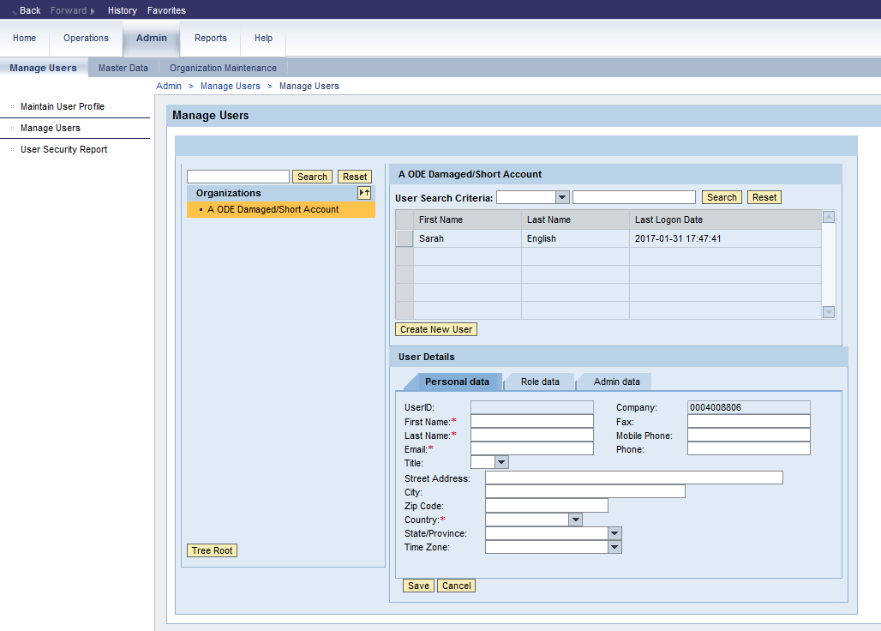
Creating a New User – Personal Data Tab
Notes:
Click on personal data tab.

Slide 29
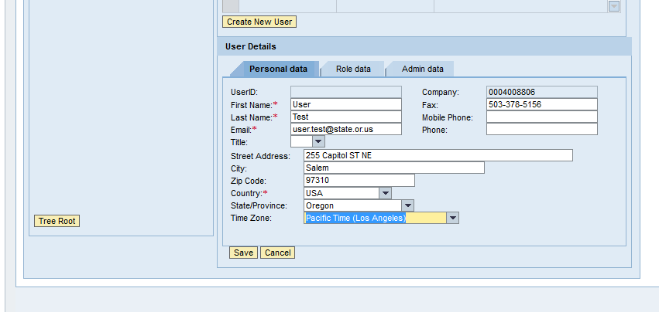
Creating a New User – Personal Data Tab Filled
Email & last name must match eAuth account
Notes:
Fill in information. Please note that the last name and e-mail will be the same ones the employee uses when creating their eAuthentication account.

Slide 30
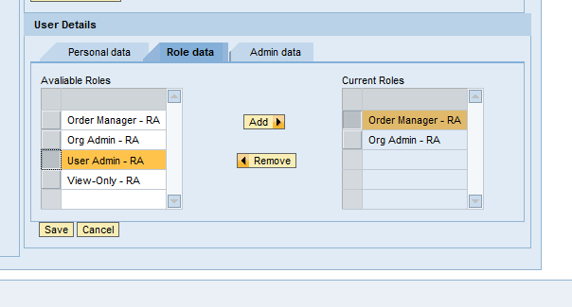
Creating a New User – Role Data Tab
Make sure to add appropriate roles
Notes:
Make sure to add appropriate roles for that employee. Click add one at a time.

Slide 31
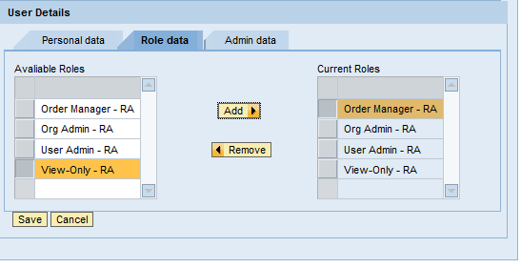
Creating a New User - Save
When you click “Save” the new user email will automatically be sent to the new user
Notes:
When you click “Save” the new user email will automatically be sent to the new user.

Slide 32
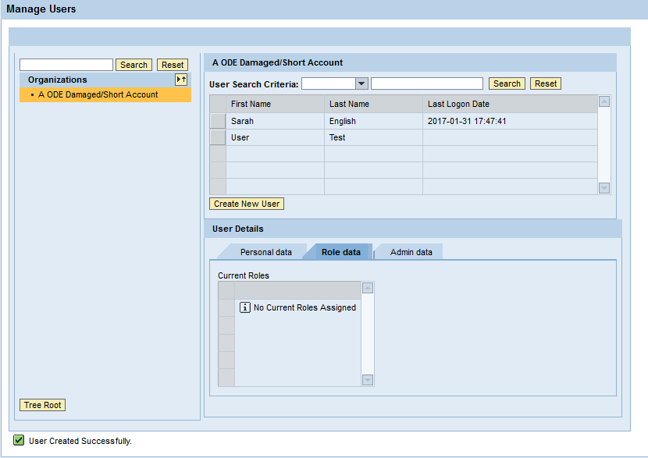
User Created Successfully
This message will appear
Notes:
If successful this message will appear.

Slide 33
NEW USER WILL RECEIVE EMAIL
THE NEW USER INSTRUCTIONS ARE ON SLIDES 5 TO 25
Notes:
The new employee will need to start at the beginning by creating an eAuthentication account, go back to slide 5.

Slide 34
Civil Rights
In accordance with Federal civil rights law and U.S. Department of Agriculture (USDA) civil rights regulations and policies, the USDA, its Agencies, offices, and employees, and institutions participating in or administering USDA programs are prohibited from discriminating based on race, color, national origin, sex, disability, age, or reprisal or retaliation for prior civil rights activity in any program or activity conducted or funded by USDA. Persons with disabilities who require alternative means of communication for program information (e.g. Braille, large print, audiotape, American Sign Language, etc.), should contact the Agency (State or local) where they applied for benefits. Individuals who are deaf, hard of hearing or have speech disabilities may contact USDA through the Federal Relay Service at (800) 877-8339. Additionally, program information may be made available in languages other than English. To file a program complaint of discrimination, complete the USDA Program Discrimination Complaint Form, (AD-3027) found online at: http://www.ascr.usda.gov/complaint_filing_cust.html, and at any USDA office, or write a letter addressed to USDA and provide in the letter all of the information requested in the form. To request a copy of the complaint form, call (866) 632-9992. Submit your completed form or letter to USDA by: (1) mail: U.S. Department of Agriculture Office of the Assistant Secretary for Civil Rights 1400 Independence Avenue, SW Washington, D.C. 20250-9410; (2) fax: (202) 690-7442; or (3) email: program.intake@usda.gov This institution is an equal opportunity provider

