Slide 1
Deaf or Hard of Hearing: What You Need to Know to Implement the Revised OAR 581-015-2150
Linda Brown
Educational Specialist
Oregon Department of Education

Slide 2
OAR 581-015-2150 Deaf or Hard of Hearing revised in March 2020
Changes:
Terminology changed from Hearing Impairment to Deaf or Hard of Hearing
Criteria changed for D/HH eligibility at both the ECSE and SASE levels.
The same criteria is now used at the EI, ECSE, and SASE levels.
OAR now contains two sections:
Early Intervention
Early Childhood Special Education/School Age Special Education

Slide 3
Early Intervention Definition
(1) Early Intervention (birth through two in accordance with OAR 581-015-2700(10)); "Deaf or hard of hearing" means an impairment in hearing, whether permanent or fluctuating, that is so severe that the infant or toddler is impaired in processing linguistic information through hearing, with or without amplification, currently affecting or has the potential to significantly affect an infant or toddler’s developmental progress The infant or toddler's hearing level does not need to be presently affecting their development for the infant or toddler to be eligible for Early Intervention services.

Slide 4
ECSE & SASE Definition
(5) Early Childhood Special Education (age 3 through 5) and School Age (age 5 through 21); "Deaf or hard of hearing" means an impairment in hearing, whether permanent or fluctuating, that is so severe that the child is impaired in processing linguistic information through hearing, with or without amplification, that adversely affects a child's developmental progress (age 3 through 5) or educational performance (age 5 through 21).

Slide 5
Comprehensive Evaluation Components #1
(2)(a) or (6)(a) An audiological assessment given by an audiologist licensed under ORS chapter 681 or by the appropriate authority in another state.

Slide 6
Comprehensive Evaluation Components #2
(2)(a) or (6)(b) For conductive hearing loss, a medical examination indicating the hearing loss identified by an audiologist licensed under ORS chapter 681 or by the appropriate authority in another state and determined to be untreatable by:
(A) A physician licensed under ORS chapter 677 or by the appropriate authority in another state;
(B) A nurse practitioner licensed under ORS 678.375 to 678.390 or by the appropriate authority in another state;
(C) A physician assistant licensed under ORS 677.505 to 677.525 or by the appropriate authority in another state; or
(D) A naturopathic physician licensed under ORS chapter 685 or by the appropriate authority in another state;

Slide 7
Comprehensive Evaluation Components #3
(2)(c) or (6)(c) For sensorineural hearing loss, documentation indicating the hearing loss identified by an audiologist licensed by an appropriate state authority under ORS chapter 681 or by the appropriate authority in another state is determined to be sensorineural; and

Slide 8
Comprehensive Evaluation Components #4
(2)(d) Any additional evaluations or assessments necessary to identify the infant or toddler’s needs.
(6)(d) Other:
(A) Any additional assessments necessary to determine the impact of the suspected disability:
(i) On the child's developmental progress for a preschool child(age 3-5); or
(ii) On the child's educational performance for a school-age child (age 5-21); and
(B) Any additional evaluations or assessments necessary to identify the child's developmental or educational needs.

Slide 9
Early Intervention D/HH Criteria
(3)(a)The infant or toddler must have hearing thresholds in at least one ear of 25 dBHL or greater at two or more consecutive frequencies at 500 HZ, 1000 HZ, 2000 HZ, 4000 HZ, 6000 HZ and 8000 HZ; or
(3)(b) The hearing loss is due to auditory neuropathy spectrum disorder (ANSD) or aural microtia/atresia, as determined by:…an audiological assessment… a physician… a nurse practitioner… a physician assistant…. or naturopathic physician.

Slide 10
ECSE & SASE Old D/HH Criteria
The child has a pure tone average loss of 25 dbHL or greater in the better ear for frequencies of 500 Hz, 1000 Hz, and 2000 Hz, or a pure tone average loss of 35 dbHL or greater in the better ear for frequencies of 3000 Hz, 4000 Hz, and 6000 Hz; or
The child has a unilateral hearing impairment with a pure tone average loss of 50 dbHL or greater in the affected ear for the frequencies 500 Hz to 4000 Hz; and (c) The loss is either sensorineural or conductive if the conductive loss has been determined to be currently untreatable by a physician.

Slide 11
ECSE & SASE New D/HH Criteria
(7)(a)The child must have hearing thresholds in at least one ear of 25 dBHL or greater at two or more consecutive frequencies at 500 HZ, 1000 HZ, 2000 HZ, 4000 HZ, 6000 HZ and 8000 HZ; or
(7)(b) The hearing loss is due to auditory neuropathy spectrum disorder (ANSD) or aural microtia/atresia, as determined by:…an audiological assessment… a physician… a nurse practitioner… a physician assistant…. or naturopathic physician.

Slide 12
EI Eligibility Team Must Determine
(4) Early Intervention: For an infant or toddler to be eligible for Early Intervention services as an infant or toddler who is deaf or hard of hearing, the eligibility team must determine that:
(a) The infant or toddler is deaf or hard of hearing as defined in this rule; and
(b) The infant or toddler is eligible for Early Intervention services in accordance with OAR 581-015-2780.

Slide 13
ECSE & SASE Eligibility Team Must Determine
(7) Early Childhood Special Education and School Age: To be eligible as a child who is deaf or hard of hearing, the child must meet one of the following criteria:
(a)The child is deaf or hard of hearing as defined in this rule; and
(b) The child is eligible for special education services in accordance with OAR 581-015-2795 and/or OAR 581-015-2120.

Slide 14
New Deaf or Hard of Hearing Eligibility forms
D/HH Early Intervention form
D/HH Early Childhood Special Education /School Age Special Education Eligibility form

Slide 15
Early Intervention Demographics

Slide 16
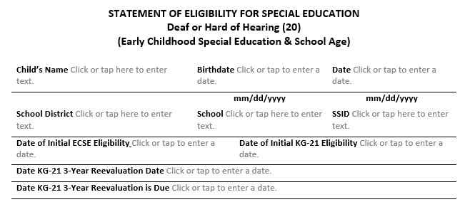
ECSE & SASE Demographics

Slide 17
ECSE & SASE Definition

Slide 18
Evaluation Process Documented

Slide 19
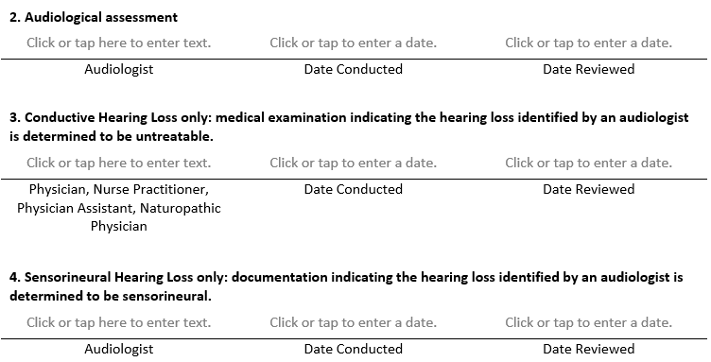
Evaluation Components Documented

Slide 20
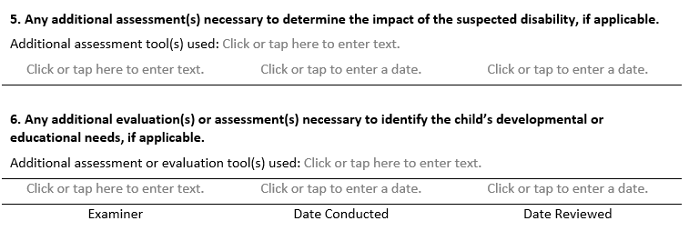
Evaluation Components Documented

Slide 21
Early Intervention Eligibility Team Determinations

Slide 22
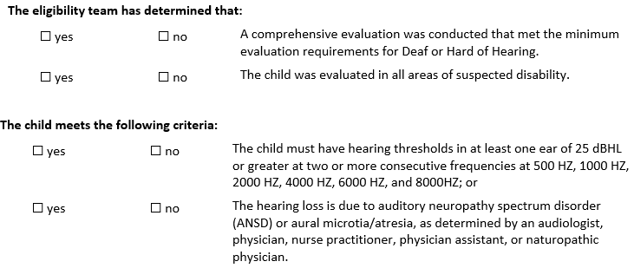
ECSE & SASE Eligibility Team Determinations

Slide 23
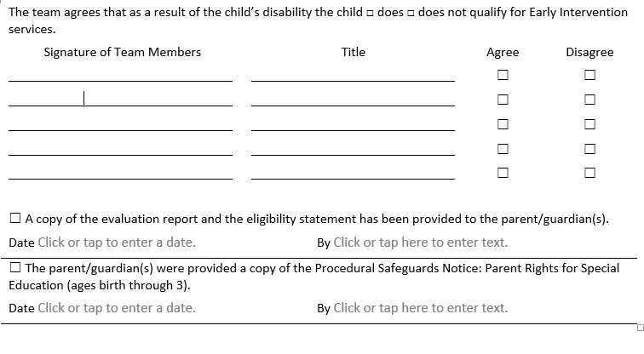
Early Intervention Team Agrees

Slide 24
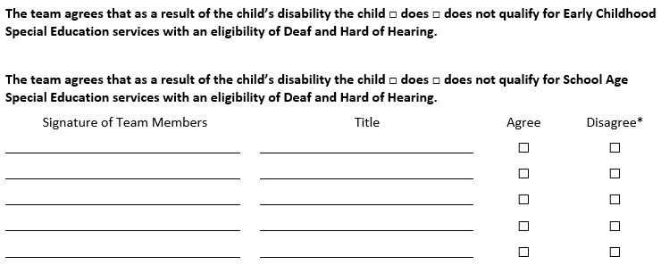
ECSE & SASE Team Agrees

Slide 25
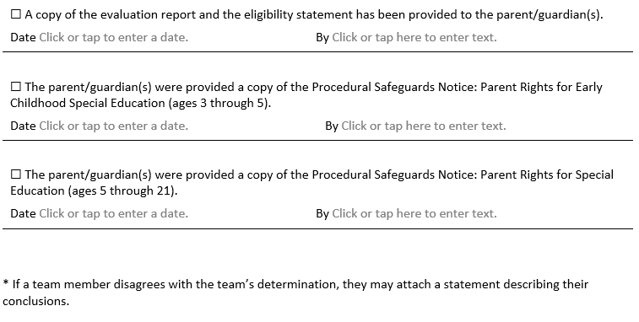
ECSE & SASE Evaluation Report and Procedural Safe Guard Documentation

Slide 26
Sample Eligibility Forms
All special education special education data systems used by EI/ECSE programs and school districts have been given the sample EI, ECSE/SASE Deaf or Hard of Hearing eligibility forms developed by ODE.
While EI/ECSE programs and school districts are not required to use the D/HH eligibility forms developed by ODE, EI/ECSE programs and school districts are required to use an eligibility form that are in compliance with the revisions made to OAR 581-015-2150.

Slide 27
Resources… Questions….
ODE Webpage--- Deaf or Hard of Hearing Information
Linda Brown
503-947-5825
linda.brown@state.or.us

