Slide 1
Ready Schools Safe Learners
June 30, 2020
1.5.8
Major
Minor
Patch
No Major changes to any key design parameters in this
iteration of guidance
There are a number of minor, while still substantial changes. All changes are in the Release Notes at the front of the document
We found a number of corrections and places to clarify or make the guidance more consistent

Slide 2
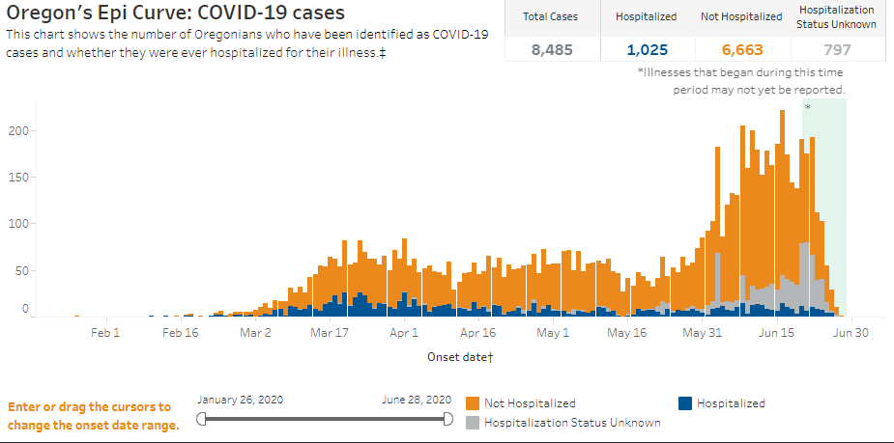
General Updates
General Updates

Slide 3
More General Updates
General Updates
Shared responsibility
It is what we know today…
Updates scheduled for July 21, August 11, and in the fall
July 1: Oregonians statewide will be required to wear face coverings in indoor public spaces
Governor’s Healthy Schools Reopening Council
What we are reading:
The survey - 6,000+ respondents
AAP - “The AAP strongly advocates that all policy considerations for the coming school year should start with a goal of having students physically present in school,” according to the guidance. These coordinated interventions intend “to mitigate, not eliminate, risk” of SARS-CoV-2.
Rural Cases on the Rise - This is true in Oregon and across the country
REL Mid-Atlantic - Where transmissions are likely and hybrid models that significantly delay transmission
EAB - What K-12 “Return to Learn” Plans are Getting Wrong

Slide 4
Athletics Updates
General Updates
Athletics
ODE and OSAA checking-in regularly
At this time…
Summer athletics are under the Governor’s guidance phased guidance for counties:
Phase I Counties follow Gym/Fitness Guidance
Phase II Counties follow Recreational Sports Guidance
Watch for updates in July
OSAA Guidance is aligned and is a more complete source of information for schools and planning for the fall

Slide 5
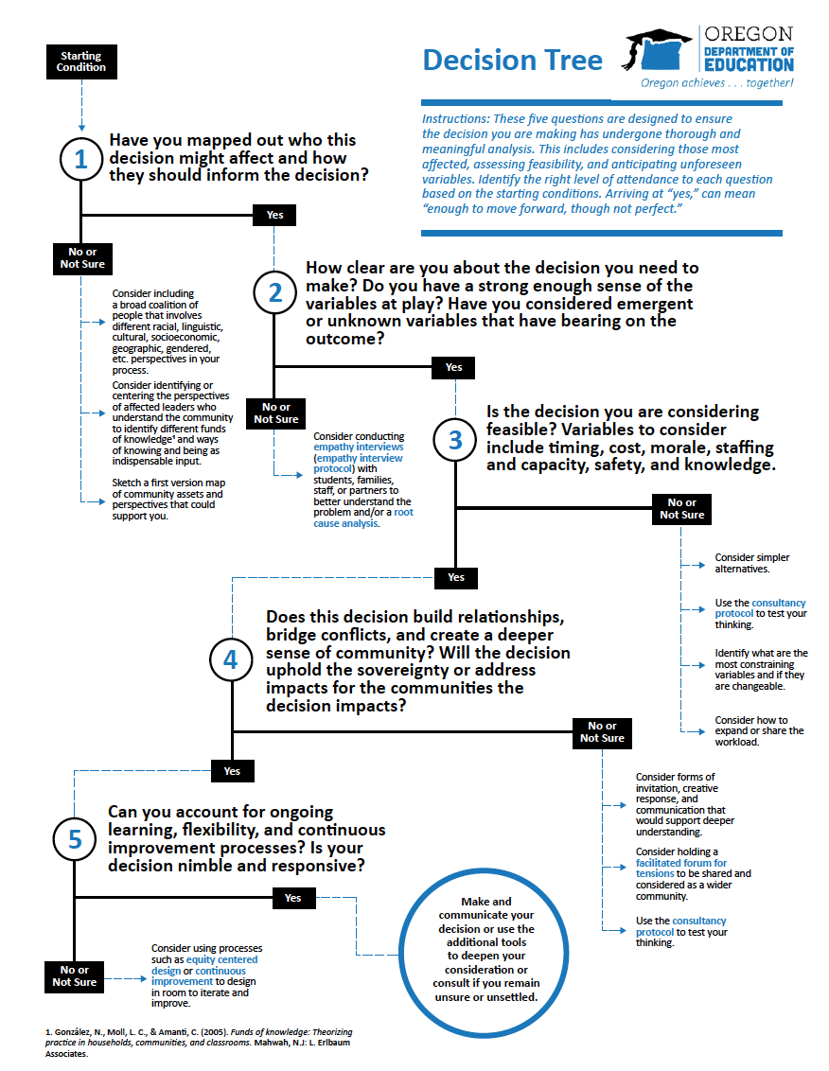
Release notes and Resources
Review Release Notes & Resources
Resources:
Decision Tools
Resource Library
Blueprint Template
Sample Plans
Communication Toolkit

Slide 6
Inclusive Guidance
Inclusive Guidance
This guidance applies to public schools which include schools within a school district, education service district, or public charter, as defined by ORS 330.003(3), ORS 330.005(2), ORS 334.003(2), and ORS 338.005(2). Public schools also include Juvenile Detention Education Programs (JDEP) and Youth Correction Education Programs (YCEP), as defined by ORS 326.695; the Oregon School for the Deaf, as defined by ORS 346.010; and Long Term Care and Treatment Programs (LTCT), as defined by ORS 343.961. This guidance also applies to private schools which include private or parochial schools providing courses of study usually taught in kindergarten through grade 12 in the public schools and in attendance for a period equivalent to that required of children attending public schools, as defined in ORS 339.030(1)(a).
Note: Private schools are required to comply with only sections 1-3 of this guidance.

Slide 7
Executive Order 20-29
Executive Order 20-29
Goes into effect July 1
Includes YCEP, JDEP, OSD, and LTCT
Directs schools/districts to operate in compliance with ODE/OHA guidance
Makes SSF payments contingent on compliance with guidance and compliance with ORS 659.850
Allows SBE and TSPC to create rules as needed
Allows SSF Transportation Grant for nutrition and distance learning supports
“Public school employees shall fulfill duties as may be assigned by their public school employers, consistent with the provisions of this Executive Order and guidance from ODE and OHA.”
Consider the goals of the Educator Equity Act

Slide 8
Public Health Review
Public Health Review
Your Local Public Health Authority will attest to receiving the blueprint, naming that the LPHA will be reviewing sections 1-3, and that the LPHA stands ready to work together with the school to mitigate impacts from COVID-19.
As schools will be partnering with LPHAs on an ongoing basis, once they receive the letter from the LPHA confirming receipt and have ensured posting of the Operational Blueprint to their website and submission to their local board and ODE, they can operate within the plan they’ve set forth.
LPHAs may reach out to ask for adjustments to their Operational Blueprints at any point they think necessary during the school year.

Slide 9
Section 1
Section 1
Public Health Protocols

Slide 10
Section 1 Highlights
Highlights
Students should not be placed into full-time cohort groups based on any demographic or disability criteria (e.g., students with complex medical needs, students with IEPs, students receiving language services, etc). Schools can create small groups within cohorts around skills and instructional needs. For example, a small instructional Math group can be organized that is diverse by demographics, any disability criteria, speech/language services, or English language development.
Updated description and recommendations regarding high-risk populations
Maintain 6 feet to the “maximum extent possible.”
Increased clarity on the use of face shields, facial coverings, and plastic barriers

Slide 11
Face Coverings
Face Coverings
What’s in the Guidance: Key Concepts to Highlight
Critical Step – Plan Development

Slide 12
Section 2
Section 2
Facilities & School Operations

Slide 13
Section 2 Highlights
Highlights
New recommendation on community use of school or district facilities.
Student hand hygiene clarifications:
After using the restroom students must wash hands with soap and water for 20 seconds
Wash hands or hand sanitizer before and after using playground equipment
Wash hands or hand sanitizer before meals and highly encouraged after meals
Transportation recommendations
Cleaning products that reduce the risk of asthma
Note: Sections 2a and 2b don’t apply to private schools.

Slide 14
Section 3
Section 3
Response to Outbreak
No changes in this update

Slide 15
Section 4
Section 4
Equity

Slide 16
Section 4 Highlights
Highlights
Recognize the disproportionate impact of COVID-19 on Black, American Indian/Alaska Native, and Latino/a/x, Pacific Islander communities; students experiencing disabilities; and students and families navigating poverty. It is appropriate and necessary to offer more heightened and focused support to students and staff from these communities. It matters to learn the differential impacts of COVID-19 in particular communities. For example, the workplaces with the largest outbreaks are the prison system and food/agricultural sites which deeply impacts particular communities, including students.

Slide 17
Section 5
Section 5
Instructional Models

Slide 18
Instructional Models
Instructional Models
Critical Step – Plan Development

Slide 19
Section 5 Highlights
Highlights
Clarified that all schools still need to follow Division 22 under all instructional models
Requirements and recommendations previously listed only in Figure 5 have been directly added to the main body of the document as well
Comprehensive Distance Learning Guidance cross-linked
Clarified Short-Term Distance Learning
Added recommendation to use the interim assessment system and Tools for Teachers (formerly known as the Digital Library) to support classroom instruction, accessible through the Oregon Statewide Assessment System (OSAS).
Added considerations for high-risk activities

Slide 20
Short Term Distance Learning

Slide 21
Section 6
Section 6
Family & Community Engagement

Slide 22
Section 6 Highlights
Highlights
New additional requirement
Include early learning programs and child care providers in the planning process. Schools with preschool classrooms operating as a part of the school will include plans for these classrooms in the school Operational Blueprint. Additional considerations specific to early learning environments is forthcoming.

Slide 23
Section 7
Section 7
Mental, Social & Emotional Health
No changes in this update

Slide 24
Section 8
Section 8
Staffing & Personnel

Slide 25
Section 8 Highlights
Highlights
It is important that staff are supported through reentry. Provide ongoing professional learning and communication so staff have the most-up-to date understanding of all ODE and OHA guidance. To the extent any modifications or reductions in a public school workforce are necessary, any such actions should consider the goals of the Educator Equity Act, ORS 342.437.

Slide 26
Final Steps of Plan Submission
Final Steps of Plan Submission
Post the Operational Blueprint for Reentry on your school and district websites. If there is no school or district website, it can be posted to the ESD website.
Submit final plan for each school to the Oregon Department of Education.

Slide 27
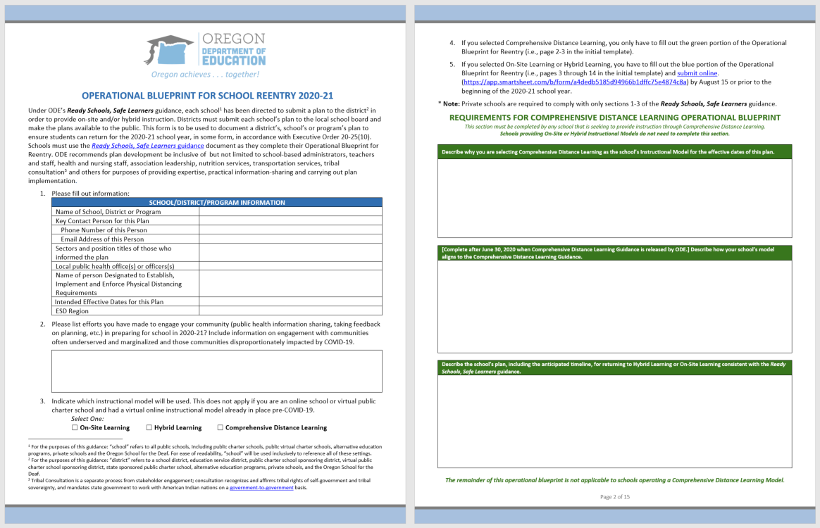
Operational Blueprint
Operational Blueprint
Updated to match changes in 6/30 RSSL and CDL Guidance Guidance

Slide 28
Send Your Link to ODE
Send your link to ODE

Slide 29
Communications Toolkit

Slide 30
Update to Ready Schools
Ready Schools, Safe Learners
8 sections
Graphics and tools
Operational Blueprint template
Sample plans
Resources and research
Communications tools
Updates schedule and process
+Comprehensive Distance Learning Guidance (6/30)

Slide 31
Comprehensive Distance Learning
Comprehensive Distance Learning

Slide 32
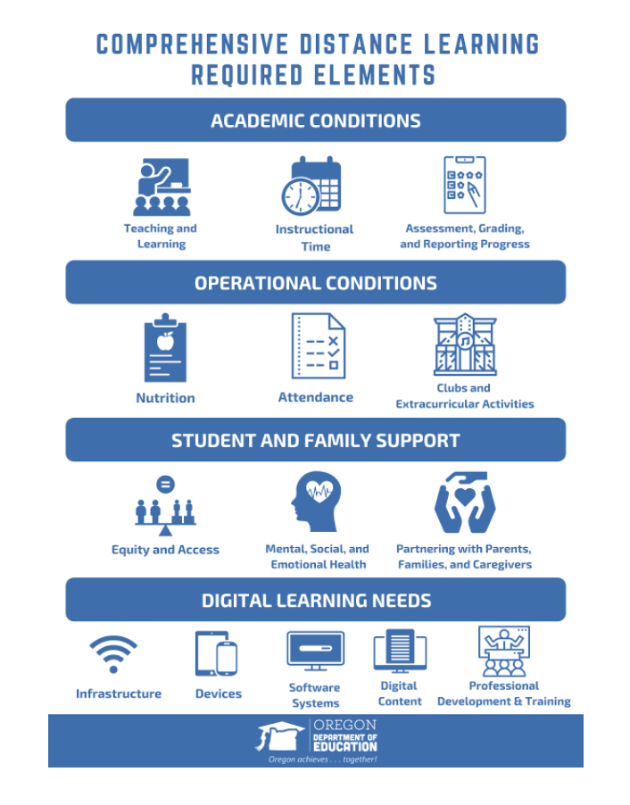
More on Comprehensive Distance Learning

Slide 33
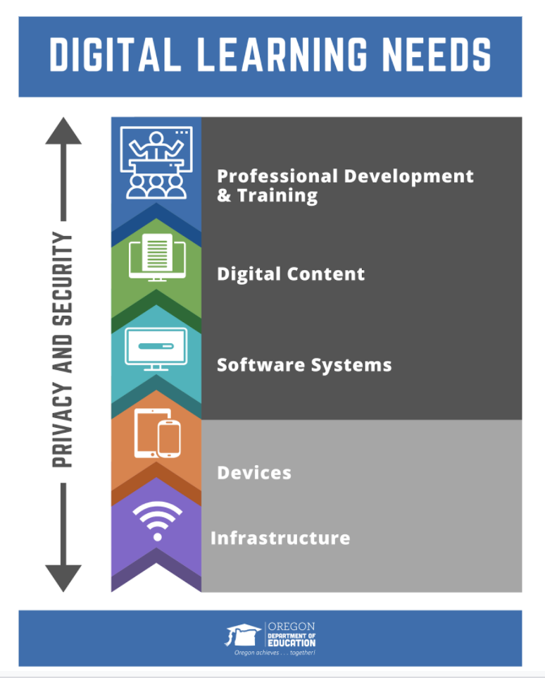
Digital learning Needs

Slide 34
Questions?
Questions...

