Slide 1
ML/EL Office Hours
January 8, 2024

Slide 2
Who We Serve
553,012 Students
“My vision is to make sure every child in Oregon is successful and has a safe place to receive a high-quality public education. I’ve seen firsthand how a positive student-teacher relationship can set a child on a successful path for the rest of their life. When we collaborate and build partnerships with students, educators and families we can advance equity and lead all students toward success.”
- Dr. Charlene Williams
More than 300 languages spoken
81,826 Educators
Staff of Color
12.2% of Teachers
12.8% of Administrators
17.5% of Counselors
22.3% of Educational Assistants
197 Districts
1,270 Schools
131 Charter Schools
19 Education Service Districts

Slide 3
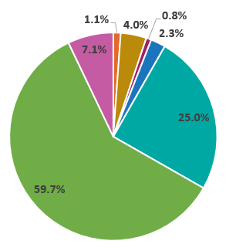
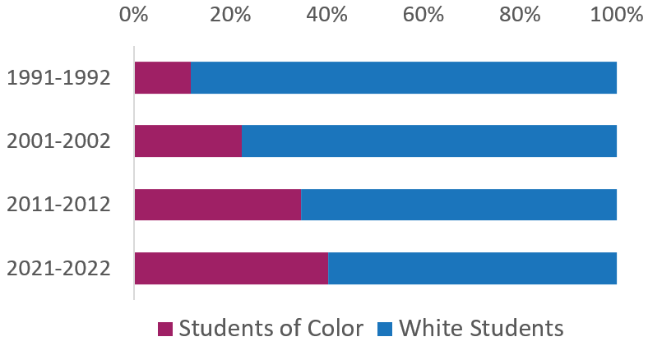
Demographic
Race and Ethnicity†
American Indian/ Alaska Native: 1.1%
Asian: 4.0%
Native Hawaiian/ Pacific Islander: 0.8%
Black/African American: 2.3%
Hispanic/Latino: 25.0%
White: 59.7%
Multi-Racial: 7.1%
Student Demographics
Economically Disadvantaged: 74%
Ever English Learners: 18%
Unhoused/homeless: 3%
Mobile Students: 13.9%
Students with Disabilities: 15%
Lesbian, gay, bisexual, something else, or questioning*: 31.5%
Transgender, gender expansive, or questioning*: 8%
Oregon's Increasing Diversity
Notes:
Please note:
* Sexual Orientation and Gender Identity demographic data comes from the 2020 Oregon Student Health Survey, voluntarily taken by 6th, 8th, and 11th grade students in Oregon.
† “Student demographic data reported using the federally defined race/ethnicity groups. Federal reporting guidelines require states to report students who identify as Hispanic or Latino/a/x as such, even if the student also holds other racial identities. Similarly, if a student does not identify as Hispanic or Latino/a/x and holds more than one racial identity, under federal reporting guidelines, that student is categorized as Multiracial.” (ODE Report Card 2021-22, pg. 17)

Slide 4
Equity
Education equity is the equitable implementation of policy, practices, procedures, and legislation that translates into resource allocation, education rigor, and opportunities for historically and currently marginalized youth, students, and families including civil rights protected classes. This means the restructuring and dismantling of systems and institutions that create the dichotomy of beneficiaries and the oppressed and marginalized.

Slide 5
Annual ELPA Assessment

Slide 6
Assessment
Future K ELPA Screener
Scoring resources for Alt ELPA
Alt ELPA User Guide
Timeline for ELPA assessments in 2023-24 school year

Slide 7
Resources
Test Administration Manual (updated 11/16/23)
Oregon Accessibility Manual (updated 10/19/23)
Future K and Grade K Screener
The Future K and Grade K window will vary slightly from that described in 2023 Future K and Grade K Screener Updates.
The Future K Screener remains open through January 8, 2024.
The Grade K Screener opens January 9, 2024 (along with the ELPA Summative).
Alt ELPA User Guide
To support conversations regarding exiting and score interpretation, the English Language Proficiency Assessment page has been updated with Alt ELPA Proficiency Descriptors, to be used in tandem with the previously published Alt ELPA Performance Standards (cut scores) and Alt ELPA Performance Level Descriptors. All three resources can be found in the Alt ELPA Assessment accordion

Slide 8
ELPA and EL Data Collection Timeline 2024
9th – ELPA in person summative opens
30th – Alt ELPA summative opens
3rd – February ELPA score delivery
10th – February HS score
11th – Spring EL data collection open
6th – Spring EL data collection review window opens
7th – April HS scores
21st – Spring EL data collection close
January
April
June
March
May
5th – Remote ELPA summative opens
12th – January ELPA score delivery
19th – January HS scores (Honoring HS proficiency)
7th – March ELPA score delivery
10th – March HS scores
24th Spring EL data collection close
31st – April ELPA score delivery and Alt ELPA score delivery

Slide 9
Budget Narrative

Slide 10
2023-24 Immigrant Grant
Dissemination
Per student allocation increased due to districts qualifying for the grant, opting out of this funding opportunity.
25 districts participating in the 23-24 Immigrant sub grants
Budget Narrative Requirements
Timeline
EGMS loaded 1/3/2024
Budget narrative applications open 1/8/2024
Budget narrative applications due 1/30/2024
Not approved Budget narratives by 6/1/24 will have funds liquidated

Slide 11
Reminders
2023-24 Title III Regular School Year Budget Narrative
February 1 – Any budget narrative not submitted will have grant on hold in EGMS
June 1 – Any budget narrative not approved will be liquidated
2023-24 Title III Immigrant
January 30 – budget narrative applications due
April 1 – Any budget narrative not submitted will have grant on hold in EGMS
June 1 – Any budget narrative not approved will be liquidated
Carryover Budget narratives (22-23 funds) – Regular School Year and Immigrant
Opened in mid-November – Due
January 27 – budget narrative applications due
https://content.govdelivery.com/accounts/ORED/bulletins/37d0df2

Slide 12
2023-24 Monitoring

Slide 13
Fall 23-24 Submissions
27 districts/ESD included in the Fall monitoring submissions
6 timeline extensions granted
ODE staff are completing responses to districts/ESDs
Any required resubmissions will have at least 45 calendar days to respond.

Slide 14
Winter 23-24 Submissions
22 districts/ESDs selected for February 15, 2024 submission
ODE staff have provided training and support
Once ODE staff have completed reviewing submissions any required responses will have 45 calendar days (this timeline will not include spring break days)

Slide 15
2024-25 Monitoring List
ODE staff will begin discussions on which districts will be included in the 2024-25 Monitoring in April 2024.
ODE staff will coordinate with other monitoring teams prior to notifying districts/ESD that they have been selected for TIII monitoring.
Monitoring in 2024-25 may include both in-person and desk, depending on internal review and discussions.
Once decisions are finalized, ODE staff will notify districts accordingly.

Slide 16
Upcoming Events

Slide 17
Upcoming Events for your calendar
January 22
Office Hours 12-1pm – Feedback opportunity with ODE staff
February 1
Data Collection Committee meeting – ODE staff will share with district data staff changes for the 2024-25 school year
February 7-10
National Association of ESSA Program Administrators Conference, Portland
https://www.eseanetwork.org/conference
February 15
Winter Monitoring Due
March 6-8
ML/EL Alliance Conference, Eugene
https://www.cosa.k12.or.us/events/2024-MEL
April 21-24
National Association of State Director of Migrant Education, Portland
https://www.nasdme.org/the-national-conference-1
April 30
Title III Grant Intent disseminated

Slide 18
Questions?

Slide 19
Contact Us
Kim Miller – kim.a.miller@ode.Oregon.gov
Tiffany Palaniuk – tiffany.palaniuk@ode.Oregon.gov

