Slide 1
Preparing for ESEA Monitoring: Tier 1
Titles I-A, I-D, II-A, IV-A, V-B, Equitable Services,
McKinney-Vento, and Foster Care
Notes:
Welcome!
Today's presentation is designed for districts that have been selected for Tier 1 monitoring for federal programs under the Elementary and Secondary Education Act, or ESEA, which was reauthorized in 2015 as the Every Student Succeeds Act or ESSA.
The purpose of this presentation is to provide information on what must be submitted by Tier 1 districts, how to submit it, and when.

Slide 2
Why and How We Monitor
Purpose
Buidling relationships: We're in this together
Technical assistance: We're here to help
Compliance: It's the law
Notes:
While accountability to federal requirements is important, the ultimate goal of monitoring is to support districts in the examination and refinement of their systems around federal programs.
We want to Build Relationships –The main objective for the Oregon Department of Education (ODE) is to raise student achievement for all of Oregon’s school aged children. Through cooperative assessment of the federal programs between the State and Oregon school districts the quality of services to students will be strengthened and improved.
We also want to provide Technical Assistance –State monitoring team members provide technical assistance during the review and beyond. It is not the State's intent to tell the district how to run its title programs, but rather to answer questions, facilitate dialogue, and exchange ideas and information for program improvement while, at the same time, meeting all federal requirements.
And last of all, we want to ensure Compliance – ESSA is a Civil Rights Law that requires supports to students and fiscal responsibility. Monitoring federal programs helps ensure that all children have a fair, equal, and significant opportunity to obtain a high-quality education. Monitoring is intended to be a collaborative partnership between ODE and districts to ensure compliance with ESSA.

Slide 3
Tiers of Monitoring for 2024-2025
Tier 1
Self-Assessment
Tier 2
Self-Assessment
Submission of materials for desk review
Tier 3
Self-Assessment
Submission of materials for desk review
Follow-up onsite visit
Notes:
The ODE is in the process of examining its monitoring processes across the agency. For the 2024-2025 cycle, districts being monitored for formula grant programs, Equitable Services, Foster Care and McKinney-Vento, have been identified as either Tier 1, Tier 2 or Tier 3 districts.
As I’m sure you’ve noticed, the submissions and participation needed changes based on the tier. A total of 58 districts have been selected for monitoring during the 2024-2025 school year.

Slide 4
Risk Assessment
Last Monitoring Cycle
Student Achievement
District Specific Metrics
Unresolved Findings
Notes:
The U.S. Department of Education requires districts to be monitored based on a risk assessment that examines the following categories:
Student Achievement – which includes data on 1) the percentage of schools identified for Comprehensive Supports & Interventions (CSI) and/or Targeted Supports & Interventions (TSI); and 2) the percentage of those schools that are Title I-A funded.
Last Monitoring Cycle – the length of time since the district was last monitored impacts the likelihood of being selected.
Unresolved Findings - Districts who are still working on resolving concerns raised in previous monitoring cycles will receive additional support.
District Specific Metrics - The final category consists of data from smaller items that include: 1) total allocation of federal funds, 2) percentage of funds carried over, 3) timely submission of budget narrative applications, 4) the percentage of Title I-A allocation set aside for district activities, 5) individual district needs or requests, as well as 6) other relevant factors.
Data for these categories is compiled from a variety of agency resources. Statewide risk scores are analyzed and a determination is made as to the districts to be monitored in the upcoming cycle. The number of districts monitored each year is based on risk level.

Slide 5
Tier 1 Monitoring
Notes:
Now that we have provided an overview of the monitoring process, we'll examine the requirements for Tier 1 monitoring.

Slide 6
What does Tier 1 Monitoring mean?
This is the lowest tier of monitoring for the 24-25 cycle
Submission of a Self-Assessment via Smartsheet
Receive feedback from ODE program specialists
Notes:
As described earlier, districts were selected for monitoring because they demonstrated some level of risk. Tier 1 is the lowest level in the 2024-2025 monitoring process.
Tier 1 districts should work with their district teams to complete the self-assessment. Each district will decide the appropriate staff to involve, but participants should include those who have the most knowledge of and/or responsibility for the programs included.
Program specialists at ODE will review the district's submission and provide feedback in the Spring.

Slide 7
What is the purpose of the Self-Assessment?
Helps districts examine their practices around federal programs
Facilitates shared understanding of the district's current practices relative to ESSA requirements
Identifies both strengths and where technical assistance or support may be needed
Notes:
The purpose of the Self-Assessment is to:
Help districts examine their practices around federal programs.
It will also facilitate a shared understanding of the district’s current practices relative to ESSA requirements.
And finally, it will identify both strengths and where technical assistance or support may be needed.
The district will NOT receive punitive action for any of their responses. The goal of the self-assessment is to help the ODE learn more about how to support and elevate district practices.

Slide 8
Tier 1 Monitoring Timeline
ODE conducts internal Risk Assessment to select districts
Districts view recorded training and complete Self-Assessment
ODE staff reviews Self-Assessment submissions
July 2024
September- October
December-February
August 19th
December 2nd
March 2025
ODE notifies districts of selection for Tier 1 monitoring
Districts submit Self-Assessment via Smartsheet
Districts receive feedback on Self-Assessment
Notes:
The monitoring process for Tier 1 districts takes place between August and March. The key date for districts is December 2nd which is the date by which the Self-Assessment must be submitted.

Slide 9
Using the Smartsheet
Notes:
We will now go over how to use the Self-Assessment Smartsheet

Slide 10
Why we chose Smartsheet
Familiar platform for districts
Allows for data tracking, analysis and feedback
Self-Assessment can be customized by district
Recommendations for using Smartsheet:
1) Fill out the Word template as a district team
2) Transfer responses into Smartsheet and submit
Notes:
Our team considered several options for the self-assessment, and ultimately settled on Smartsheets. We understand that some districts may be frustrated with the Smartsheet format, namely that you cannot save as you go. However, we felt that, in this case, the benefits outweighed the challenges.
First of all, this is a platform familiar to most districts. It will also better allow the ODE to track data, analyze responses and provide personalized feedback.
But most importantly, Smartsheets has the ability to customize the self-assessment to reflect only those programs for which districts receive funds. Therefore the Smartsheet Self-Assessment will include only the sections relevant to each district.
To assist districts, we have created a Word template of the Self-Assessment to use in discussions with the full team. We recommend that you fill out the Word template and then cut and paste your responses into the Smartsheet when you are ready to submit.

Slide 11
Types of Prompts and Responses
Rubric Selections
1 – Emerging
2 – Developing
3 – Proficient
4 – Exceptional
Narrative Response
Type your response to the question prompt
Yes or No
Equitable Services, Foster Care and McKinney-Vento only
Notes:
There are 3 types of prompts on the self assessment.
In the Rubric style prompt, the district will self-evaluate a statement of practice by rating themselves as:
1 is Emerging – indicating the district needs to develop or revise policies and practices in this area
2 is Developing – indicating the district has policies/practices aligned to some elements, but still needs support.
3 is Proficient – indicating the district has policies/practices aligned to all elements
And 4 is Exceptional – indicating the district is so well aligned they could serve as a model.
The second type of response is the Narrative response. Here districts briefly respond in writing to a question.
Finally, there are some Yes/No checkboxes. These prompts are a statement where the district indicates their participation with a Yes or a No. These types of questions are only in the Equitable Services, Foster Care and McKinney-Vento sections. After selecting a response, districts may be asked to contact the state program liaison to schedule a meeting.
Again, a district's responses will NOT result in punitive action. Please be honest so that the ODE can effectively support you and your students.

Slide 12
Smartsheet Tutorial
Notes:
Let's take a look at what you'll see when you access the Smartsheet.
First, you will want to select your district from the dropdown menu at the top
This will generate a list of programs for which you will answer prompts
The boxes must remain checked for a district to submit – so even if you don't think you should answer the questions for a specific program, please leave the box checked and answer the questions anyway.
You will also see there is a place for contact information. This is the person the ODE will contact, if needed, with any questions or clarifications
You will see that as you scroll down the Smartsheet, each program area is labeled. The red asterisk means that a response is required for submission.
You may choose to “Send me a copy of my responses” by checking this box.
Finally, click Submit

Slide 13
Universal Program Submissions
Even districts that decline funds must complete prompts
Foster Care
Mc-Kinney-Vento
All districts who accept funds must at least one Equitable Services prompt
Due December 2nd, 2024
Notes:
All Oregon districts must address the challenges that students experiencing houselessness and students navigating foster care have faced in enrolling, attending, and succeeding in school, and to ensure that these students have access to the educational and related services they need to enable them to meet the same challenging State academic standards to which all students are held.
Therefore, all districts, even districts that decline federal funds, must complete the prompts for Foster Care and McKinney-Vento.
All districts that accept Title funds must complete at least one Self-Assessment question about equitable services. This is to help the ODE and districts collaborate on determining what private schools exist within the state since private schools do not register with the ODE.
Finally one last reminder that the Self-Assessment must be submitted through Smartsheet by close of business on December 2nd.

Slide 14
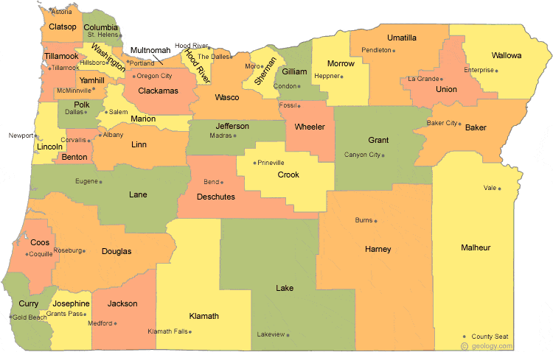
Monitoring Contacts
Formula Grants & Common Compliance
Jen Engberg, (971) 208-0207
jennifer.engberg@ode.oregon.gov
Sarah Martin, (971) 208-0333
sarah.martin@ode.oregon.gov
Lisa Plumb, (971) 208-0384
lisa.plumb@ode.oregon.gov
Amy Tidwell, (503) 580-0078
amy.tidwell@ode.oregon.gov
Equitable Services
Janette Newton, (503) 551-9405
janette.newton@ode.oregon.gov
Foster Care
Marlie Magill, (503) 580-4857
marlie.magill@ode.oregon.gov
McKinney-Vento
Lexi Neemann, (971) 208-1777
lexi.neemann@ode.oregon.gov
Notes:
Have questions? Please reach out!
For Formula Grants and common compliance questions, call or email Jen, Sarah, Lisa or Amy.
For Equitable services, please contact Janette
For Foster Care, please reach out to Marlie
And for McKinney-Vento, please contact Lexi
Thank you for watching this training. Have a wonderful day!

