Slide 1
Title I, Part A: School-Level Planning
Targeted Assistance Plans

Slide 2
Today’s Agenda
Targeted Assistance vs. Schoolwide Programs
Digging Deeper into Targeted Assistance Plans
Assessing Needs
Program Design
Engaging Families
Student Progress Monitoring

Slide 3
Purpose of Title I-A
The purpose of Title I, Part A is to “provide all children significant opportunity to receive a fair, equitable, and high-quality education, and to close educational achievement gaps.”
Oregon Department of Education
Notes:
As outlined in the Every Student Succeeds Act (ESSA) Title I-A funded schools may implement one of two approaches: 1) a School-wide Program or 2) a Targeted Assistance Program.

Slide 4
Targeted Assistance vs. Schoolwide Programs
Category | Targeted Assistance | Schoolwide
School Eligibility | Any school with a poverty level of 35% or the district’s poverty average (whichever is lower). | Any school with a poverty level of at least 40%.* *A school with less than 40% poverty may request to conduct a schoolwide program.
Student Participation | Resources are directed to students meeting the established targeting criteria. | All students in the school have access to activities under a schoolwide plan.
Professional Development | Professional development with Title I funds focuses on staff that provide direct support to students identified for Title I services. | Title I funds can be used to provide professional development for all staff.
Planning & Evaluation | Plan includes a general description of targeted assistance program activities to support students identified as eligible for services. | The schoolwide plan must be developed for reforming the total instructional program in the school.

Slide 5
Common Ground: TAS and SWP
Both Targeted Assistance (TAS) and Schoolwide (SWP) plans must:
be based on identified needs,
include specific goals and strategies, and
be developed and reviewed annually, with the input of families.
Schoolwide Program Brief
Targeted Assistance Program Brief
Notes:
Per ESSA Sections 1114 and 1115
TAS plans are needs inform targeting criteria, SWP needs are based on a comprehensive needs assessment

Slide 6
Targeted Assistance Programs
Targeted Assistance programs focus on the needs of specifically identified students
Supports must be supplemental (in addition to core instruction), e.g.:
Support in core academic subjects
High dose tutoring
Extended day/year/summer programs
Mental health, SEL, and counseling supports
Only identified students and staff can benefit
Notes:
Any Title I-A school that does not operate a schoolwide program must operate a targeted assistance program. When implementing a targeted assistance program, the school uses Title I-A funds to provide additional supports to specifically identified students most at risk of failing to meet state standards. Targeted assistance schools must determine which students they will serve by identifying the students with the greatest need. As a result, only the students identified are eligible to receive the services.
Examples of Title I-A funded activities for eligible students in a targeted assistance program include: • Provide support in core academic subjects including English, reading or language arts, mathematics, science, foreign languages, civics and government, economics, arts, history and geography • High dose tutoring • Extended day/year/summer programs • Professional learning for school personnel who work with eligible children • Mental health, social-emotional learning and counseling supports

Slide 7
Who is eligible?
Students identified as failing, or most at risk of failing, to meet state standards;
Students who participated in Head Start or attended a Title I preschool program in the prior two years;
Students who qualify for migrant services;
Students impacted by the justice system; and
Students experiencing houselessness or housing insecurity.
Notes:
Targeted assistance schools must determine which students they will serve by identifying the students with the greatest need for assistance from among the following eligible groups:
Students identified as failing, or most at risk of failing, to meet state standards;
Students who participated in Head Start or attended a Title I preschool program in the prior two years;
Migrant students;
Neglected and delinquent students; and
Students experiencing houselessness.

Slide 8
Targeted Assistance Plan Criteria

Slide 9
Criteria & Continuous Improvement
Criteria are organized under four categories
Needs Assessment
Program Design
Family Engagement
Student Progress Monitoring
Criteria for Title I-A Targeted Assistance Plans
Notes:
The continuous improvement process lends itself well to school-level planning, and districts have a great deal of autonomy in determining the format of their plans. ODE has created an optional template that schools can use, or they can design their own. Regardless of the format used, the following components must be included in all targeted assistance plans: Needs Assessment Summary, Program Design, Family Engagement, and Student Progress Monitoring.

Slide 10
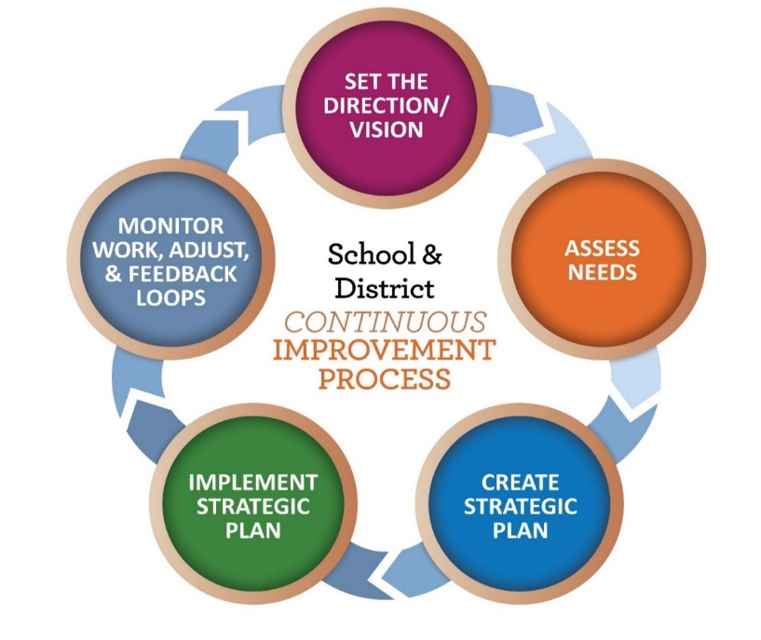
Assess School Needs
Who are our students?
What data did we look at?
Why are we choosing a Targeted Assistance Plan?
Who was at the table?
Community Engagement Toolkit
Notes:
Completing a needs assessment helps schools identify the goals and strategies that they will take to address the underlying inequities and challenges facing their students. A needs assessment should include review of multiple sources of data from at least three categories - Student Data, Perception Data, and Systems Data - and should be informed by robust community engagement.
Who are our students - Describe the students you serve. How have your student demographics changed over time? What trends are you seeing? How is your school serving students who have been historically underserved by the system?
What data did we look at - Articulate the multiple measures of data reviewed during the needs assessments. This can include student outcome data (academic, behavioral, programmatic), systems data (e.g. ORIS indicators) and perception data. Did this provide a comprehensive view of the school and community as well as the opportunities and challenges that should be addressed in a school wide plan?
Why are we choosing a Targeted Assistance Plan? Describe how the school determined that a Targeted Assistance Plan is the best approach for supporting students.
Who was at the table - Following the results of the needs assessment, describe who was engaged in the development of the plan. Which community members (e.g.; students, staff, families, tribal leaders, and tribal organizations) were included?

Slide 11
Program Design
Targeting Criteria – What criteria do we use to determine student eligibility?
Targeted Services
What interventions or services do eligible students receive?
How are services coordinated with the regular classroom schedule?
Professional Learning – How are staff being supported?
Notes:
Targeting Criteria – What criteria do we use to determine student eligibility? Describe the process used to identify the students most at risk of failing, including consideration for homeless, migrant, and neglected students. Include the multiple, educationally related, objective criteria used.
Targeted Services – What interventions or services do eligible students receive? The plan should include a description of the specific services targeted students receive and how the services are supplemental for students (in addition to the regular core classroom instruction).
Professional Learning – How are we supporting staff? Describe the professional learning opportunities provided to staff in implementing services to eligible students.

Slide 12
Targeting Criteria
Determination of students failing, or at risk of failing, must be made using multiple, educationally related, objective criteria
Multiple (more than one)
Educationally related (must include an academic component to the criteria)
Objective (criteria cannot be based on teacher judgement or other subjective means)
Notes:
LEAs must determine a threshold or percentile of students that will qualify for the targeted assistance program because they are failing or at risk of failing. The scores from each assessment can be assigned a numeric value in order to evaluate student need. In this example, students scoring more total points have the most need for targeted assistance, and low total scores indicate students are not eligible for targeted assistance.

Slide 13
Family Engagement
How are families involved in developing the plan and providing feedback?
What steps do we take to remove barriers to participation by ALL families?
How do we communicate about opportunities for family involvement in school activities?
What are the strategies we use to help families support their student's learning?
Notes:
Family Engagement is a powerful strategy that has significant impacts on students and teachers and is a key practice in helping schools build trusting relationships with families as co-creators in their children’s learning. Family Engagement is any way that a child’s adult caretaker (biological parents, foster parents, siblings, grandparents, etc.) at home, at school and in the community, effectively support learning and healthy development. It is a full, equal, and equitable partnership among families, educators, and community partners to promote children’s learning and development from birth through college and career. Intentionality in methods of engagement supports families’ involvement in the school and ensures they are welcomed.
Title I, Part A provides for substantive parental involvement at every level of the program. In order to receive funds, a district must conduct outreach with parents and families, develop policies and procedures for the involvement of parents and family members and plan and implement programs and activities with meaningful consultation with parents of participating children. Each Title I-A funded school within the district must collaborate with parents and families to develop and implement:
a plan to engage parents and families;
structures for parents and families to provide input and feedback on school plan and processes; and
compacts of shared responsibility for student achievement between students, families and teachers.

Slide 14
Student Progress Monitoring
Plan Review
What is our process for reviewing the progress of eligible students?
How often is data reviewed and who is involved?
Exit Criteria
How do we know when students no longer need services?
Notes:
Plan Review - What is our process for reviewing the progress of eligible students? Describe the process (including frequency) for reviewing student progress and making adjustments to the program when needed.
Exit Criteria – How do we know when students no longer need services? Describe performance criteria that will indicate a student is no longer eligible for services.

Slide 15
Moving from Targeted to Schoolwide
Conduct a comprehensive needs assessment
Determine priorities
Develop and submit a Schoolwide Plan to ODE
Maintain documentation of:
Title I-A Annual Meeting
Family Engagement Plan
Family-School Compact
Building Family Capacity
Verification of staff qualifications
Paraprofessional qualifications
Notes:
A school’s population and circumstance may change over time in ways that makes a shifting to a schoolwide model more appropriate. Schools that wish to transition to schoolwide will need to take the following steps:
1. Conduct a comprehensive needs assessment. Through the needs assessment, a school must consult with a broad range of community members, including parents, school staff, and others, and examine relevant academic achievement data to understand students’ most pressing needs and their root causes. While the school must consider student performance on the state assessment, school leaders should also consider other data including enrollment counts, dropout rates, graduation rates, school demographics, classroom observations and/or surveys of students, teachers, parents and community attitudes and perceptions.
2. Determine priorities. Based on the needs assessment results, the school must identify at least 3 priorities for their Title I-A schoolwide plan.
3. Complete the Schoolwide Plan Template and submit it to ODE. Each Title I-A funded school conducting a Schoolwide program must describe the components of its Title I-A plan including: o How the school will improve academic achievement throughout the school; 13 o How the strategies the school will employ provide opportunities and address the learning needs of all students in the school 14; and o How the methods and instructional strategies that the school intends to use will 12 ESEA Section 1114(b)(6) 13 ESEA Section 1114(b)(7) 14 ESEA Section 1114(b)(7)(A)(i), (iii) ESSA Quick Reference Brief: Title I-A Plans for Targeted Assistance Programs 5 Updated May 2023 ▪ strengthen the academic program in the school, ▪ increase the amount and quality of learning time, and ▪ help provide an enriched and accelerated curriculum, including programs and activities necessary to provide a well-rounded education.15

Slide 16
Resources
Targeted Assistance Plan Criteria
Targeted Assistance Planning Template
ESSA Quick Reference Brief: Targeted Assistance Programs
ORIS Needs Assessment Tool for Schools
Community Engagement Toolkit
Tribal Consultation Toolkit

Slide 17
Regional Contacts by ESD
Amy Tidwell
Grant, Harney, High Desert, InterMountain, Jefferson, North Central and Region 18
Jen Engberg
Clackamas, Columbia Gorge, Multnomah and Northwest Regional
Lisa Plumb
Lane, Linn Benton Lincoln and Willamette
Sarah Martin
Douglas, Lake, Malheur, South Coast and Southern Oregon
Notes:
We have divided up the state into four sections. Each of us serves as the primary contact for the districts in these ESDs

Slide 18
Please reach out!
Jen Engberg Jennifer.Engberg@ode.oregon.gov
Sarah Martin Sarah.Martin@ode.oregon.gov
Lisa Plumb Lisa.Plumb@ode.oregon.gov
Amy Tidwell Amy.Tidwell@ode.oregon.gov
Notes:
Our team has moved from a programmatic model to a regional support model. Each of us has taken a section of the state to support across Titles IA, IIA, IVA and VB.

