Slide 1
Child Find, June Exit and
Post School Outcomes
2023-2024
Spring Special Education Collections
May 2, 2024
Notes:
Jackie
Good afternoon everyone. Welcome to this spring training webinar covering Child Find, June Exit and Post School Outcomes.
My name is Jackie McKim. I am a Research Analyst with the Oregon Department of Education, Office of Enhancing Student Opportunities. Presenting with me today is Cherisse Gordon, Shava Feinstein and Charlotte Alverson. Running technology is Amanda Claycomb and monitoring chat is Maxwell Swope. Other ODE staff here are Cynthia Garton and Cara McMurry.
This training is for you. If you have questions please raise your hand or type it in the chat. We will not be recording this session. The PowerPoint with presenter notes will be posted to the website later.

Slide 2
Today’s Agenda
Welcome!
Special Education Child Find
June Special Education Exit
Post School Outcomes
Notes:
Jackie
The collections that we are going to cover are Child Find, June Exit and Post School Outcomes.

Slide 3
Special Education Child Find
Notes:
Jackie
The first collection we’ll cover is Special Education Child Find. And now I’ll pass it over to Cherisse.

Slide 4
Special Education Child Find Dates
Collection
Opens: 5/16/2024
Closes: 7/8/2024
Review Window
Opens: 8/15/2024
Closes: 9/16/2024
Data Owner: Cherisse Gordon
Notes:
Cherisse
The collection opens May 16 and closes July 8.
Review Window will open August 15 and close September 16.
Cherisse Gordon is the data owner.

Slide 5
What is Child Find?
The process of identifying, locating and evaluating all children with disabilities who are in need of early intervention, early childhood special education, or special education services.
OAR 581-015-2110(5) 60 SCHOOL DAYS from the date parent signs consent for Special Education evaluation for School Age (K to age 21).
OAR 581-015-2790(10) 60 SCHOOL DAYS from the date parent signs consent for Special Education evaluation for Early Childhood Special Education (3 to age 5).
OAR 581-015-2775(6) 45 CALENDAR DAYS from the referral for Early Intervention (birth to age 3).
Notes:
Cherisse
The requirement of a state to identify students with disabilities and evaluate for special education services.
Child Find relates directly to the evaluation timeline for schools.
The Child Find Data Collection is how ODE reports the information to the Federal government.
All referrals to determine initial eligibility are included in the collection.

Slide 6
Why Do We Collect Data on Child Find?
Ensure that students with disabilities are identified and evaluated within a reasonable amount of time and without any undue delays.
Improve outcomes for students through identification of needed services.
Identify any systemic issues and assist with improving practices and procedures.
Guide meaningful improvement planning by examining what’s working, what isn’t, and why.
Establish Federally mandated 100% compliance.
Notes:
Cherisse
ODE collects data to ensure that students are being evaluated in a timely manner across the state.
We collect data to determine if systemic issues are occurring in the State of Oregon. The goal of Child Find is to improve outcomes for students by determining if students with disabilities are eligible for special education, and to make sure that if they do qualify, they are found eligible in a timely manner. When we delay evaluations, students are not able to receive the services and supports they need to be successful.
The data collected informs districts on the specific causes of non-compliance.
The student-level and school-level data, in combination with the proper use of the “Reason Timeline Not Met” codes, allow districts to pinpoint any areas of non-compliance or areas needing improvement in their evaluation process.

Slide 7
Part B Child Find Requirements
Districts/programs are required to collect and report data for:
Children currently receiving Early Intervention Services who are being evaluated to determine eligibility for Early Childhood Special Education Services
Students being evaluated for IDEA Part B initial special education eligibility (ECSE or School Age)
Notes:
Cherisse
When students are receiving EI services and are initially evaluated for ECSE at age 3, they are reported in this collection.
When students in ECSE are evaluated or when school age students K-12 are evaluated for initial services, they are reported in this collection.
All other evaluations would be considered re-evaluations, even when transitioning from ECSE to school age (including DD).

Slide 8
Part B Child Find Requirements (Cont.)
Students being evaluated and considered for eligibility who were previously eligible under the IDEA, but whose eligibility was terminated by an IEP team (or parent revocation of consent).
Students who have moved to Oregon with an eligibility from a different state (This includes previous Oregon students who moved out of state with a current Oregon eligibility, attended school out of state, and returned to Oregon with an out of state eligibility).
Notes:
Cherisse
The first step of the evaluation process is a review of existing records.
Remember, a review of existing records does not require written consent.
This is part of the evaluation planning meeting.
We review records to determine if additional information is needed to determine eligibility.
If no additional information is needed to determine eligibility, no consent for evaluation is needed.
For students who have been exited and are being “reevaluated” for an initial evaluation, you may not need additional evaluation data to find the student eligible for special education services.
The team may determine that the file contains sufficient information to determine eligibility.
If this is the case, you would not need signed consent, no evaluation timeline would commence, and you would have no record to report.
Remember, the Child Find Data Collection is the 60 school day evaluation timeline which starts with signed consent (day 1).
For students moving into the state with an out of state eligibility, the same conditions apply.
Review the record, determine if additional assessment information is needed.
If so, signed consent is required and starts the 60 school day evaluation timeline.
If not, no consent is needed and no record needs to be reported on The Child Find data collection.

Slide 9
Child Find Reporting Period
Data is collected beginning on the date the parent signs consent for a special education evaluation and continues until an initial special education eligibility determination has been complete.
For EI, the timeline begins with the date of the referral to the EI program.
Report all students for whom initial eligibility determination was completed between July 1, 2023 and June 30, 2024.
Notes:
Cherisse
“The date of signed consent” means the date the parent signed the written consent—not the date the district received it.

Slide 10
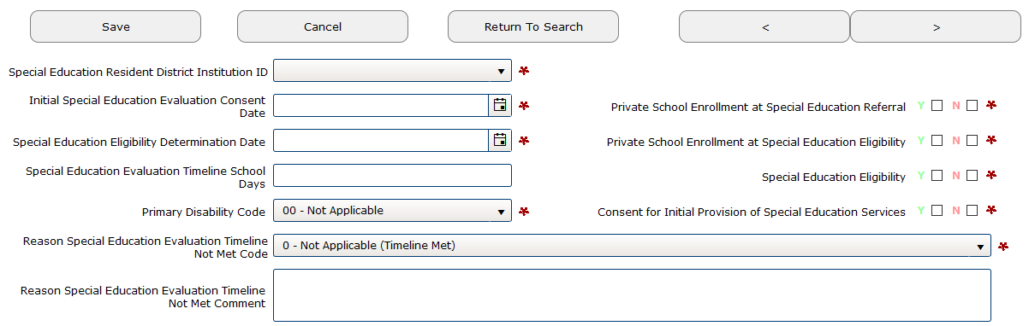
Initial Evaluation Consent Date
Enter date of consent for INITIAL evaluation by month, day and year. This is the date the parent/guardian signed the consent form, not the date the district/program received it.
The value entered should be in the format of 'MMDDYYYY'
Notes:
Cherisse
Even if parent dated it in February and didn’t turn into district until March, the date the consent was signed in February begins the 60 school day timeline countdown. The value should be entered as MMDDYYYY with no slashes.
(Notice that there are no slashes or hyphens between the month, day, or year).

Slide 11
Initial Eligibility Determination Date
Enter the date the eligibility determination was made. This date must be between 7/1/23 and 6/30/24.
This date should coincide with the eligibility team meeting date. If more than one meeting was held to complete the eligibility determination, fill in the most recent date.
Notes:
Cherisse
Leave yourself enough “wiggle” room in case the eligibility cannot be determined at the first meeting.

Slide 12
Was the Child Found Eligible?
If the student was found eligible, click the Y box (Yes flag) next to Special Education Eligible.
If the student was not found eligible, click the N box (No flag) next to Special Education Eligible.
Notes:
Cherisse
Again, all students need to be reported, even those who are not found eligible.
A district or agency could report a student on Child Find multiple times.
Examples:
Situation 1. The student was referred three times and each determination was made between July 1 and June 30, but was not found eligible the first two times and then found eligible the third. Three records would be reported.
Situation 2. The student was referred three times and each determination was made between July 1 and June 30. The student was not found eligible the first time, found eligible the second time and not found eligible the third time. Two records will be reported, the first referral where the student was not found eligible and the second referral where the student was found eligible. The third referral would not be reported.
Warning: Be careful when entering more than one record for a student. If a student was found not eligible and later found eligible, and you accidentally enter the same consent date for both records, the first record will be overwritten by the second record when using Web Submission. However, when using File Upload, the second record will throw an error.

Slide 13
Number of School Days
If the evaluation takes place in 60 business days or less, the “Special Education Evaluation Timeline School Days” field can be 0 (zero).
If it takes more than 60 business days, the actual number of school days will need to be entered.
Any number that is higher than 60 will be interpreted as an evaluation that exceeded the 60 school day timeline, so it is important to enter the actual number of school days (not weekdays) needed to complete the evaluation.
Notes:
Cherisse
School days are days that school was in session at least half of the day. School days do not include holidays, vacation/breaks, staff development days, grading days, snow days, orientation days, etc. Remember to have your school calendar available for reporting.

Slide 14
Reason Timeline Not Met Codes 0-4
0 - Not applicable (Timeline Met)
2 - Parent/guardian did not present child/student for testing (comment required)
3 - Parent/guardian did not attend eligibility meeting
4 - Initial testing results indicated need for additional testing not identified through initial evaluation planning
Notes:
Cherisse
If the number of school days exceeds 60 then Reason Timeline Not Met Code is entered.
Codes 2, 5, and 6 require a comment.
Codes 2, 7 and 8 are exceptions.
Code 2 --- Parent/guardian did not present child/student for testing/evaluation & eligibility processes impacted by COVID mandates (comment required)
This is not an automatic exemption, ODE will determine the exemption after reading the comment. The comment should be specific and thorough so an accurate determination can be made.
Examples-
Use Code 2 with a comment:
Student absent more than 45 of school days
Student absent more than 85% of school days
Code 3 --- Parent/guardian did not attend eligibility meeting
OAR 581-015-2190(5) Conducting a meeting without a parent in attendance: A meeting may be conducted without a parent in attendance if the school district has given the parent notice under subsection (2), or, for IEP or placement meetings, in accordance with OAR 581-015-2195
OAR 581-015-2195(3) (3) Conducting an IEP/Placement Meeting without a Parent in Attendance: An IEP or placement meeting may be conducted without a parent in attendance if the school district is unable to convince the parents that they should attend.
(a) If the school district proceeds with an IEP meeting without a parent, the district must have a record of its attempts to arrange a mutually agreed on time and place such as:
(A) Detailed records of telephone calls made or attempted and the results of those calls;
(B) Copies of correspondence sent to the parents and any responses received; and
(C) Detailed records of visits made to the parent's home or place of employment and the results of those visits.
(b) The Department considers school district attempts to convince parents to attend sufficient if the school district:
(A) Communicates directly with the parent and arranges a mutually agreeable time and place, and sends written notice required under OAR 581-015-2190(2) to confirm this arrangement; or
(B) Sends written notice required under OAR 581-015-2190(2) proposing a time and place for the meeting and states in the notice that the parent may request a different time and place, and confirms that the parent received the notice.
(c) "Sufficient attempts" may all occur before the scheduled IEP or placement meeting, and do not require the scheduling of multiple agreed-upon meetings unless the team believes this would be in the best interest of the child.
Code 4 --- Initial testing results indicated need for additional testing not identified through initial evaluation planning

Slide 15
Reason Timeline Not Met Codes 5-8
5 - Delay by doctor/medical personnel (comment required)
6 - Delay by district/program evaluation staff (comment required)
7 - Within extended timeline by written agreement for a transfer student
8 - Within extended timeline by written agreement to determine if a student has a specific learning disability
Notes:
Cherisse
Please provide specific information when leaving a comment to assist with the assessment of the noncompliance. ODE will review all comments to determine appropriate coding.
Code 5 --- Delay by doctor/medical personnel (comment required)
Require a comment. Be Specific.
Code 6--- Delay by district/program evaluation staff (comment required)
Require a comment. Be Specific. Comment should not be a variation of “delay by staff.”
Code 7--- Within extended timeline by written agreement for a transfer student
If a comment is provided, it must be about a student transferring from another school district.
Code 8--- Within extended timeline by written agreement to determine if a student has a specific learning disability
If a comment is provided, it must be about evaluating student for SLD.

Slide 16
What Code Would You Use?
Doctor’s appointment could not be scheduled in time
ESD required case history which took time to complete
Student was absent 9 days
Guardian could not attend meeting
Meeting needed to be rescheduled
Notes:
Cherisse
It is important that districts properly code issues of non-compliance.
The information can be used to inform districts WHAT the barriers to compliance are (what issues). The student and school-level data inform the district where the barriers to compliance are (at what levels).
Data can be used for staff development—know who to train and what to train on.
1. Code 6 --- Delay by district – must be scheduled and attended in 60 school days.
2. Code 6 --- Delay by district – must occur within 60 school days.
3. Code 6 --- Delay by district – 9 days is not sufficient to warrant a delay.
4. Code 6 --- Delay by district – reschedule.
5. Code 6 --- Delay by district – schedule earlier in process to allow for rescheduling requests.

Slide 17
Steps to Submit Data
Import or enter records into the IDEA Data Manager
Validate records in the IDEA Data Manager
Correct any errors
Create a submission file
Log onto the district website and submit the submission file
Correct any errors that appear
Approve the verification report
Notes:
Cherisse
Data must be submitted by 11:59 p.m. on July 8, 2024. We recommend it is done before 5 p.m., after that there will be no one to help you if there are problems.
We will cover correcting errors during the June Exit portion of this webinar, as the steps are the same.

Slide 18
Child Find – What’s New for 2023-2024
No changes!
Notes:
Cherisse
There are no changes to Child Find this year. Now I’ll pass it over to Jackie to talk about Problem Areas.

Slide 19

Child Find – Problem Areas
Miscounting Days
  Counting business or calendar days rather than school days
  Counting holidays, winter or spring break
  Relying on SIS to calculate days (spot check to ensure accuracy)
  Timeline days not aligning with Consent and Determination dates
Consent or Determination Date didn’t align with comment
Eligibility date on Child Find differs from Child Count
Re-evaluations submitted as Child Find records
Duplicate records
Notes:
Jackie
For Child Find, some things to look out for:
Counting non-school days can impact the timeline not being met within 60 days.
Be sure to count days when school is in session not business or calendar days.
Do no count holidays, winter or spring break.
Some Student Information Systems (SIS) miscounted school days in the past, so we recommend that you spot check records by hand counting.
Be careful when counting your school days. There have been submissions where the school days did not align with the reported Consent and Determination Dates.
In 2022-2023, there were some instances where the Consent or Determination date did not align with what was written in the comment.
We also had quite a few records where the eligibility date was different than December Child Count. Some were just a few days apart.
Be careful when submitting Child Find records. If a student is already eligible and team is doing the re-evaluation, then it’s not a Child Find record.
There were a lot of students who had eligibilities from the last few years reported and many students who were reported on the Child Find in 2020-2021 and/or 2021-2022 were reported again in 2022-2023.
There were 60 duplicate records submitted in 2022-2023. Some were reported by two separate districts, but many were reported by a single district. Of the records submitted by a single district, the Consent or Determination date (or both) were the same or similar, which is why they received an audit during the Review Window.
Most duplicated records were Yes Eligible. There were some that were a Yes and then a No, and a couple where both records were No.
2022-2023: Some kept their duplicate records and confirmed the audit. Be sure to delete the duplicate record before confirming the audit. If you get an audit for duplicate record submitted by another agency, please work with that other agency to determine who should report the record.
We had to reach out to 12 districts for duplicate record corrections. There were some instances where both records were either kept by both districts or both records were deleted.

Slide 20
Child Find – Problem Areas Coding
Records with Code 8 with a comment not about SLD
Records with Code 2 but comment not sufficient
  “Delay due to calendar issues”
  “The parents agreed to the meeting date”
  Illness/absences without number of days
Reported Birthdate not matching Fall ADM or Child Count
English Learner Flag not matching Fall ADM
Failure to recode or change comment
Notes:
Jackie
There were records with Timeline Not Met Code 8, but the comment was not about needing an extension for evaluating students with specific learning disability. Example comments were about the meeting date, absences, etc. Code 8 should be reserved for needing an extension for evaluating students with specific learning disability.
There were many records with Timeline Not Met Code 2 with comments that were insufficient to justify a Code 2, which is based on not having access to the student. Example comments were about absences/illness without number of days, meeting date changes, calendar issues etc.
Birthdate reported in the Child Find record not matching either Fall ADM or the Child Count.
English Learner Flag not matching what was reported in Fall ADM.
Failure to change the Reason Timeline Not Met Code or change the comment.
Be sure to read the full message and respond to the entire audit. We have an example in a few slides regarding this.

Slide 21
Child Find – Comment Guidance
If asked to change the Timeline Not Met Code or Comment, the comment change should have sufficient details to substantiate the exemption
Do not change the comment by one word
Do not reword the comment, but say the same thing
Be careful when using Code 2
Comments Required for Codes 2, 5 and 6
Include an explanatory comment
Must be based on not having access to the student to test
Notes:
Jackie
If Reason Timeline Not Met Code is codes 2, 5 or 6, then a comment is required.
Be careful when using Code 2. Be sure to explain the reasons evaluations could not be completed due to not having access to the student. If absent, the number of days out must be greater than the number of days over the timeline of 60 days. For example, if Timeline Days is 90, but the student was absent for 40 days, that would be allowable to use Code 2. But if the student is absent for 15 days, then another applicable code must be used.
Some records submitted in 2021-2022 and 2022-2023 contained the code description. Please add a detailed comment as this helps the team determine if record should be re-coded or not. We do find records that meet exemptions – aka could be a Code 2 or even Meets Timeline.
Reminder that if you are asked to change the Timeline Not Met Code or the Comment, then the comment change should have sufficient details to substantiate the exemptions. ODE cannot accept a comment that is changed by one word, or a comment that is reworded, but says the same thing.

Slide 22
Child Find Resources
Child Find (Indicator 11) Collection
Manual
Q & A
User Guides
Past Trainings
Notes:
Jackie
The Child Find page contains the Child Find Manual, Q & A, User Guides and Past Training PowerPoint Presentations.

Slide 23
Child Find Contacts
Contact for content questions:
Cherisse Gordon 503-428-7080 cherisse.gordon@ode.oregon.gov
Contact for collection/submission questions:
Jackie McKim 971-240-0234 jackie.mckim@ode.oregon.gov
Cynthia Garton 503-508-7492 cynthia.garton@ode.oregon.gov
Maxwell Swope 971-208-0259 maxwell.swope@ode.oregon.gov
Amanda Claycomb 503-931-8003 amanda.claycomb@ode.oregon.gov
Cara McMurry 503-689-2783 cara.mcmurry@ode.oregon.gov
Notes:
Jackie
Here is the contact information for Child Find.
Cherisse Gordon is the compliance expert and data owner for Child Find, and the data team provides technical assistance for the collection.

Slide 24

Questions?
Notes:
Jackie
Are there any questions about Child Find or what we covered thus far?

Slide 25
June Special Education Exit
Notes:
Jackie
The next collection we’ll cover is June Special Education Exit.

Slide 26
June Special Education Exit Dates
Collection
Opens: 5/16/2024
Closes: 7/8/2024
Review Window
Opens: 8/15/2024
Closes: 9/16/2024
Data Owner: Jackie McKim
Notes:
Jackie
June Exit opens May 16 and closes July 8 (Same as Child Find).
Jackie McKim is the data owner.

Slide 27
June Exit
Report
Exit Records (E1, E2, E3) for students ages 0-21 who have exited Special Education
  Exception - PK and KG can’t report as dropped out
EI Students successfully transitioning to ECSE (A2)
Notes:
Jackie
The June Special Education Exit Collection is for students ages 0-21 who have exited special education between July 1, 2023 and June 30, 2024 with the exception that PK and KG students can’t be reported as dropped out.
When exiting a student, indicate the date that the student exited the Special Education program. Again, that date reported must fall between July 1, 2023 and June 30, 2024.
Do not confuse exiting special education with exiting school. Although for some students this occurs simultaneously, students who continue to receive Special Education services even after receipt of a certificate, extended or modified diploma have not yet officially exited Special Education.
This collection is also for students who successfully transitioning from Early Intervention to Early Childhood Special Education on their 3rd birthday. These records are reported as record type A2 in order to track that they exited EI and entered ECSE.
These Exit data are primarily used for federal reporting purposes, so accuracy and data validity is very important.

Slide 28
June Exit – Who to Report
Report:
EI children exiting Part C (E1)
EI children successfully transitioning to ECSE (A2)
ECSE children exiting special education or transitioning to School Age (E2)
School Age students exiting special education (E3)
Notes:
Jackie
For all exited records, you will report EI children (birth through 2), ECSE children (3 through 4), and School Age students (K through 21) with the date they exited Special Education.
The Record Type code for exited EI children is E1, for ECSE children is E2, and for School Age students is E3.
Additionally, for children transitioning from EI to ECSE, (EI students not exiting Special Education, just the EI program), these students are reported in the Exit collection as a Record Type of A2 (Active ECSE).
Finally, report ECSE children exiting special education or transitioning to School Age.

Slide 29
June Exit – What to Report
We are asking how the student left special education
If the student has moved and returned within the same year, you will not report an exited record
Notes:
Jackie
For exit records, we are asking how the student left special education.
Transient students are difficult to track because they may have multiple exits. If the student was there the last day of school, you will not report an exit record.

Slide 30

Exiting EI, ECSE and School Age
Counts must be unduplicated within a district
Do not exit if child has an active IFSP or IEP with the district or program at the end of reporting period (as of June 30, 2024)
Exit EI children for whom ECSE eligibility has not been made
Exit ECSE transitioning to Kindergarten, regardless of whether they are or are not eligible for school age services
Notes:
Jackie
Some other things to keep in mind:
Counts in the collection must be unduplicated within a district.
This means, if a child comes and goes in Special Education throughout the reporting year within a district or program and did not resume services by the end of the reporting period, report the most recent exit date.
Conversely, do not exit this student if they have an active IFSP or IEP with the district or program at the end of reporting period (as of June 30, 2024). So, if a student comes and goes in Special Education within a district throughout the year, but are back on or before June 30, 2024, they are not exited.
When exiting EI children (or exiting part C), exit all children for whom Part B eligibility has not been determined. This includes children who were referred for Part B evaluation, but for whom the eligibility determination was not made, or reported, by the child’s 3rd birthday, or whose parents did not consent to transition planning.
When exiting ECSE children, include all children who are no longer eligible for services, and all ECSE children transitioning to Kindergarten, regardless of whether they are or are not eligible for school age services.

Slide 31
Codes for Exiting EI
10 IFSP Completed Before Age 3
11 Part B Eligibility Not Determined
12 Not Eligible for Part B, Exited w/Referrals to other programs
13 Not Eligible for Part B, Exited w/No Referrals
15 Deceased
16 Moved within Oregon
17 Moved Out of State
18 Withdrawal by Parent (or guardian)
19 Contacts Unsuccessful
Please see the Process and Content Manual for details associated with the codes listed above.
Notes:
Jackie
The next three slides will show the codes used to describe how a student exited Special Education. The full descriptions for these can be found in the Process and Content Manual.
Exit Reason Codes 10-19 are for children exiting EI programs,
Codes 20-29 are for children exiting ECSE programs, and
Codes 30-39 are for students exiting School Age programs.
I am not going to go over all of them, but I do want to highlight a few.
These codes (10-19) are used for exiting EI children. The EI/ECSE programs report these data.
Code 11: These are children who have been referred for Part B services, but the determination has not been made by their 3rd birthday.
Also Report: As I mentioned earlier, children transitioning from EI to ECSE, (so EI students not exiting Special Education, just the EI program), these students are reported in the Exit collection as a Record Type of A2 (Active ECSE).

Slide 32
Codes for Exiting ECSE
20 School Age (5+) Part B Eligible
21 School Age Eligibility Not Determined
22 Not Eligible for School Age Services, Exited w/Referrals
23 Not Eligible for School Age Services, Exited w/No Referrals
24 No Longer Eligible for ECSE Prior to Kindergarten
25 Deceased
26 Moved Within Oregon
27 Moved out of State
28 Withdrawal by Parent (or guardian)
29 Contacts Unsuccessful
Please see the Process and Content Manual for details associated with the codes listed above.
Notes:
Jackie
These codes (20-29) are used for exiting ECSE children and are similar to the EI codes.
I want to point out Code 21: Like EI, these are children who have been referred for Part B services, but the determination has not been made.
But before we move on to school age, if you are with an EI/ECSE and have something else that needs to be discussed for EI/ECSE exit, raise your hand or let us know via the chat.

Slide 33
Codes for Exiting School Age
30 Graduation with Regular Diploma
31 Received a Modified Diploma
32 Received a Certificate
33 Returned to Regular Education
34 Reached Maximum Age
35 Deceased
36 Moved, Continuing in Education
37 Extended Diploma
39 Dropped Out
Please see the Process and Content Manual for details associated with the codes listed above.
Notes:
Jackie
These codes (30-39) are used to exit School Age students and are a little different than the EI and ECSE exit codes.
30: Graduation with a Regular Diploma is used for students who exited an educational program through receipt of a regular high school diploma. When a student receives a Regular Diploma, FAPE ends so you must report an exit record.
31, 32 and 37, If a student received a Modified or Extended diploma or Received Certificate, the student is still eligible for FAPE until age 21 and can return or continue to receive special education services, but if they exit and are not returning or continuing to receive services you will report them on your exit report.
33: Students who return to regular education have been evaluated and have been determined they are no longer eligible for Special Education services. This includes students who left to attend home school whose parents have revoked consent in writing for all special education services.
34: Students who have reached maximum age (21) without receiving a diploma or certificate should be coded as a 34. Remember that students who turn 21 during a school year may continue to receive services throughout the rest of that school year.
35: Codes 15, 25, and 35 are for students who are exited as deceased. This code does not need much explanation. However, every year we resurrect at least one student on the subsequent December Child Count that was coded as deceased. Oops!
39: A student is considered as a dropout if the student was enrolled and receiving services in the current school year, not known to be enrolled and receiving services at the end of the school year and did not exit special education through any of the other means. Note that the ADM 10 day drop rule does not apply to special education students and the June Exit collection – consider the medically fragile student who still requires FAPE. Just because they have been absent for 10 days does not mean they have exited special education.
Before coding a student as a dropout:
Check the SSID system to see if they showed up in another district. In that case, they are considered Moved, Continuing in Education (code 36).
If a student left school to enter either a GED or Job Corps program, they should be considered a drop out. In rare instances, students continue to be jointly enrolled in school and either the GED or Job Corp programs and continue to receive special education services. Assuming special education services continue, these latter students would be reported as receiving a certificate upon completion of their GED or Job Corps program (code 32).
Note that Kinders can’t be reported as dropout since they are not generally compulsory attendance age.
Please see the Process and Content manual for examples of what is considered and what is not considered a dropout.
Also, if the student will be turning age 21 and exiting between July 1 and September 1, in other words during Extended School Year, be sure to report as exited the preceding regular school year. For example, if the student will turn 21 and exits on July 3, 2024, be sure to report the exit record on the June Exit 2023-2024, using the last day of your school year or June 30, 2024.

Slide 34
More on Modified Diplomas
If student is under age 21:
  If expected back or uncertain if student will return, report as Active Record
  If not expected back, report as Exit Record, BUT if student returns in Fall, change back to Active Record during Review Window
Notes:
Jackie
Modified diploma tends to be the most confusing exit category so we wanted to point out a few more things.
A student who receives a Modified diploma is still eligible for FAPE until age 21.
If the student is expected back, do not report an exit record. But when school starts in the fall, and it turns out the student is not returning or expected to not return, add the exit record during the Review Window.
If the student is not expected back, and you are sure they are not returning - for example, you complete the SOP, they are set them up for post school employment or attending college, you will report as exiting with a modified diploma. But if the student shows up in the fall, during the Review Window, remove the record and do not exit the student.
Talk to the Special Education Director, if you are not sure how to report these students. This information is discussed during the annual IEP meeting.
There was a huge gap in Oregon as a significant number of post school surveys are not being completed for two years due to waiting more than one year after the student left to exit them.

Slide 35
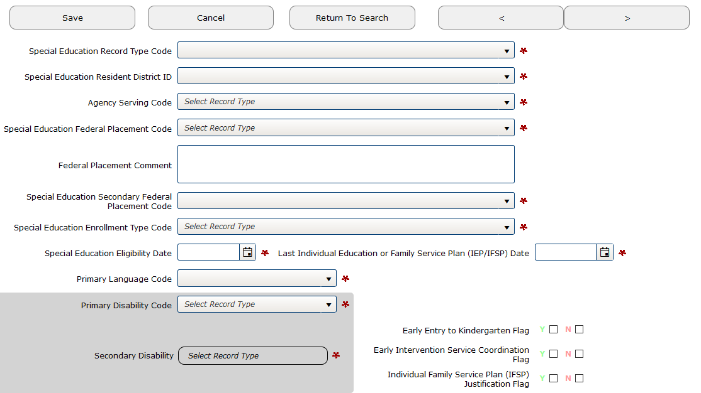
Entering June Exit Records
First step is entering the Special Education Record Type Code.
Selecting E1, E2 or E3 will then allow the application to display the correct Special Education Exit Reason Code.
Notes:
Jackie
First step is to enter the Special Education Record Type E1, E2 or E3.

Slide 36
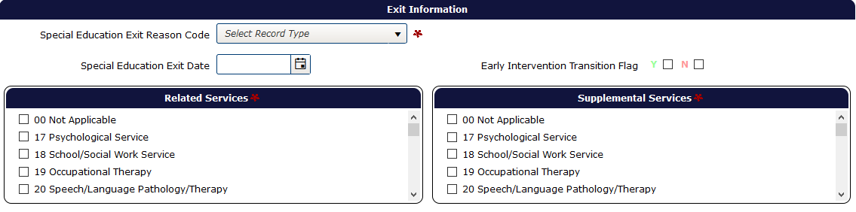
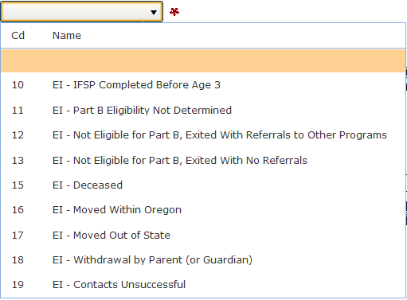
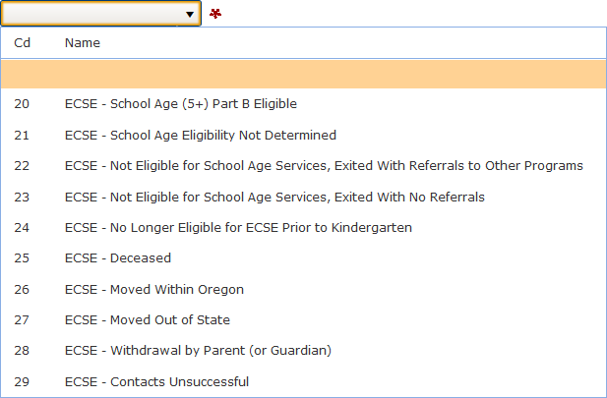
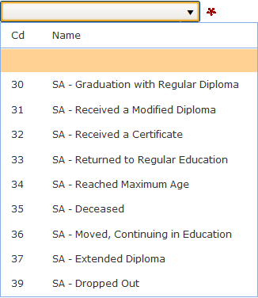
What Exit Code to Use
Depending on Record Type code, the application will display different Exit Reason Codes.
Notes:
Jackie
After selecting either E1, E2 or E3 the system will display the appropriate Special Education Exit Type.

Slide 37
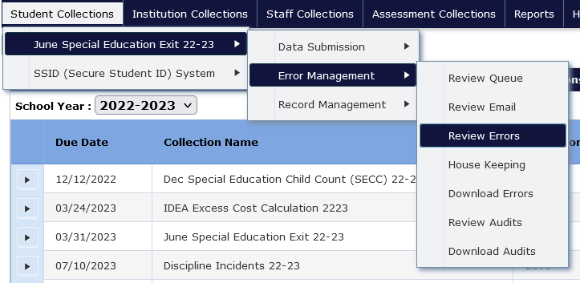
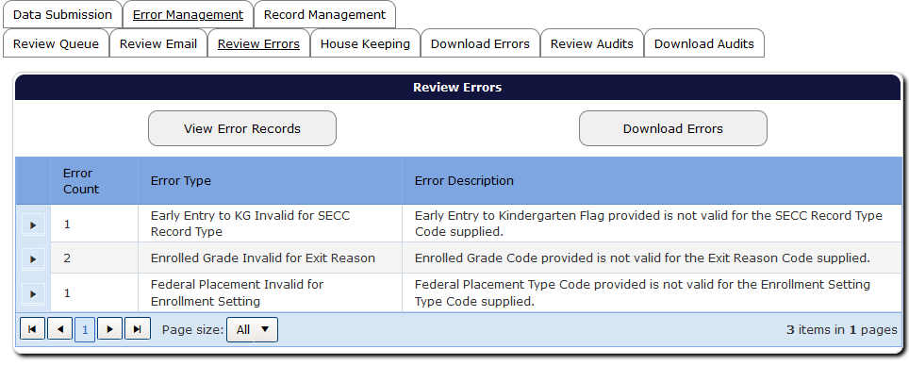
Reviewing Errors
Always verify submission for errors.
Click the expand triangle, which expands the page contents so users can fix errors.
Notes:
Jackie
After your submission file has uploaded, you need to verify your data submission for errors, even if you have already validated your records in the IDEA Data Manager.
To get to your errors in Consolidated Collections, hover your mouse over the Student Collections menu header, then over the June Special Education Exit collection, then Error Management, then click Review Errors. If errors were found in your data, they will be listed there.
To fix your errors record by record in Consolidated, click on the expand triangle to the left of the Error Count and Error Type columns (red circle). You may have multiple errors under each Error Type. After clicking the expand triangle, the screen will expand to show you the records associated with that error needing attention.

Slide 38
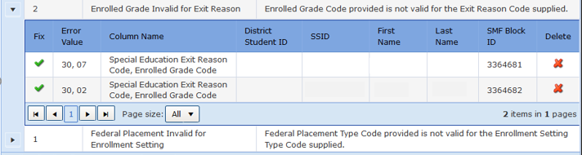
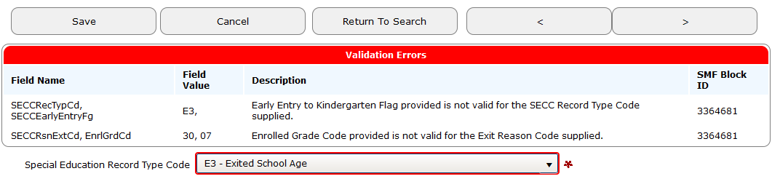
Fixing Errors in Consolidated
To fix each record error in Consolidated, select the green check mark to the left of each record.
Notes:
Jackie
This screen will show each record with an error under a particular Error Type. This error indicates that the record being submitted has an Early Entry to Kindergarten Flag is not valid for the SECC Record Type and that the Enrolled Grade Code is not Valid for the Exit Reason Code. For this record, neither the Yes or No box for the Early Entry to Kindergarten Flag was checked, and the Enrolled Grade Code is “7 – Seventh Grade,” which is not valid for Exit Reason Code of “30 – SA – Graduation with Regular Diploma.”
To fix each record error in Consolidated, select the green check mark to the left of the record. The record itself will then appear below the error. There are often multiple records with errors that need attention in this screen. To delete a record on this screen, click on the red X to the right of the record. This deletes the record from your submission.
Once you have fixed the error, click the Save button at the bottom or top of the record to save the record with the changes. “Record Saved” will appear at the top of the screen if your record is free of errors, and the record will leave the Review Errors screen. If the record still has errors after saving, the record will remain on this screen. Once you have fixed all errors, the Review Errors screen will have the message “No record to display.”

Slide 39
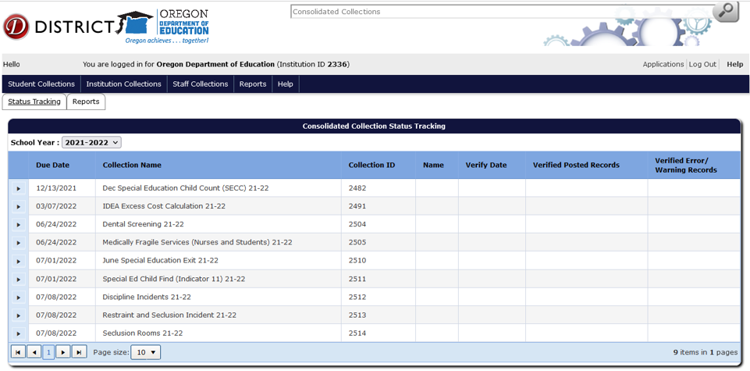
Verification on Status Tracking
After errors are resolved, verify submission counts by clicking arrow to the left of June Special Education Exit Collection.
Status Tracking tab
and School Year tab
Click on expand arrow to view reports
Notes:
Jackie
After all errors have been fixed you need to verify the number records you submitted and print the Final Submission Form. This is the easiest step to forget. Some districts upload their data early, but forget to complete this final step. Your submission is not complete until all reports in Status Tracking have been verified and approved.
To complete these final steps, click on the Status Tracking tab to view a list of the collections you have access to (like what you see on this slide). Also be sure to select the correct School Year which you see just below the Status Tracking tab. This is important, because you may be verifying exit records for the wrong school year.
To verify your exit reports, click on the tiny arrow to the left of the collection name and date (June Special Education Exit Collection 23-24). Four reports will be listed and will need to be viewed and approved.

Slide 40
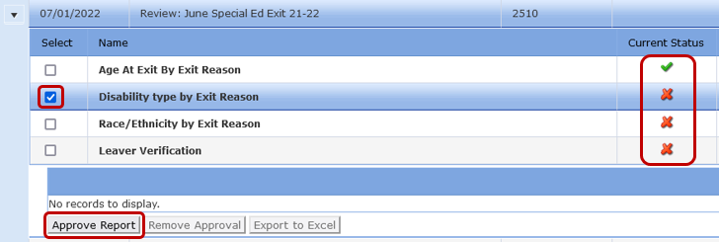
Verification Reports
Select the box to the left of the report name; review the data in the spreadsheet that appears below.
If the data are correct, click Approve Report button and the red X will become a green check mark.
Repeat for remaining reports until there are only green check marks in the current status column.
Notes:
Jackie
The four reports you need to approve are Age At Exit By Exit Reason, Disability Type By Exit Reason, Race/Ethnicity By Exit Reason, and Leaver Verification.
To approve a report, click on the small box to the left of the report name and verify the numbers in the table that appears.
If the counts are correct, click on the “Approve Report” button. The red X to the right of the report will change to a green check mark. Repeat for the remaining reports.

Slide 41
Final Submission Form
When all verification reports are approved, the Final Submission Form button will appear
Click on the Final Submission Form button
Open and print the Final Submission Form
Have the Special Education Director or Superintendent sign the form
Scan and email completed form to ODE.OSS-DataTeam@ode.state.or.us
You will receive a confirmation email within two weeks of receipt.
Schedule of Due Dates for collections materials: ODE District Website
Notes:
Jackie
After approving the four reports, and the red X’s have turned to green check marks, a Final Submission Form button will appear above the report names.
Click on the button and print out your submission form, sign it, and scan and email it to our office at the address on this slide.
If you are unable to scan and email it, you may mail it to the address on the bottom of the Final Submission Form. There is no need to send by registered or certified mail.
The schedule of due dates and pertinent collection materials for this and other collections can be found on the ODE District website.
Remember, the June Exit collection opens May 16, 2024 and closes July 8, 2024.
There will be a correction period for June Exit that will open August 15, 2024 and will close September 16, 2024. Look for the Listserv message reminders.

Slide 42
June Exit – What’s New for 2023-2024
SECC Primary Language Code Description updated
  Code indicating the student’s primary language. This primary language is the language and/or dialect most often used by the student. In the case of a child who has not yet developed language, indicate the language most often used by the parents.
Notes:
Jackie
The SECC Primary Language Code Description updated for better clarity.

Slide 43
June Exit – Problem Areas
10-day drop rule
Turning Age 21 During Summer (July 1 to September 1)
Inter-district Transfers
Dropped out – Check SSID system
Received Certificate if student has a GED when exit
Missing records
Resubmit your Final Submission Form if changes were made to your submission
Notes:
For June Exit, here are some things to keep an eye on:
10-day drop rule – must be in seat/attending for ADM. However, this does not apply to June Exit, e.g., medically fragile student still requires FAPE.
If the student will be turning age 21 and exiting between July 1 and September 1, in other words during the summer or Extended School Year, be sure to report as exited the preceding regular school year. For example, if the student will turn 21 and exits on July 3, 2024, be sure to report the exit record on the June Exit 2023-2024, using the last day of your school year or June 30, 2024 as the exit date.
Inter-district transfers – for new school age inter-district transfers, we expect an exit record from the resident district since the responsibility for FAPE transfers to the attending district. Exit as moved, known to be continuing.
Dropped out - Always check SSID system to see if showed up somewhere else before reporting as drop out.
If a student has a GED then the exit reason is Received Certificate, not dropped out. There seems to have been a bit of confusion concerning this. If incorrectly reported as dropped out, it will impact your drop out rate.
Missing records for students:
Quite a few records were not reported in 2021-2022 June Exit, so they had to be added to the PSO Survey for the 2022-2023 collection year. When gathering your data to submit for June Exit this spring, make sure you have all the records you need to report.
Students who come and go affect the survey by not being added, or excluded as they were on it the year before.
Modified diploma are often missed so be sure to add them to your exit submission if they are not returning even if they are under age 21
If records need to be added to PSO, then the district will be considered inaccurate for their June Exit submission.
Same as December Child Count, be sure to resubmit your Final Submission Form if you make changes to your submission.

Slide 44
June Exit – Problem Areas Coding
Race/Ethnicity flag not matching SECC or ADM
English Learner flag not matching ADM
JDEP students:
  Attending District and SECC Resident District
  should be reported as 3476
YCEP students:
  Attending District and SECC Resident District
  should be reported as 3477
LTCT students:
  Attending District and SECC Resident District
  should be reported as 3559
Notes:
Some other things to keep your eye on for June Exit:
Race/Ethnicity or English Leaner flag not matching Child Count or Fall ADM.
For JDEP students both the Attending District ID and the SECC Resident District ID should be reported as 3476.
For YCEP students both the Attending District ID and the SECC Resident District ID should be reported as 3477.
For LTCT students both the Attending District ID and the SECC Resident District ID should be reported as 3559.

Slide 45
June Exit Contacts
Contact for collection/submission questions:
Jackie McKim 971-240-0234 jackie.mckim@ode.oregon.gov
Cynthia Garton 503-508-7492 cynthia.garton@ode.oregon.gov
Maxwell Swope 971-208-0259 maxwell.swope@ode.oregon.gov
Amanda Claycomb 503-931-8003 amanda.claycomb@ode.oregon.gov
Cara McMurry 503-689-2783 cara.mcmurry@ode.oregon.gov
Notes:
Jackie
If you have Questions about the Exit collection, or anything else for that matter, please do not hesitate to give us a call.

Slide 46

Questions?
Notes:
Jackie
Are there any questions about June Exit or what we covered thus far?

Slide 47
Post-School Outcomes
Notes:
Shava

Slide 48
2 Types of Post School Outcomes Interviews
Exit Interview
Follow Up Interview
Notes:
Shava

Slide 49

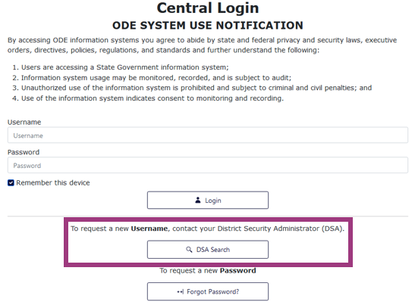
Access to Central Login
Access to the PSO 2.0 App needed for both Exit and Follow-Up Interviews
On the Central Login Website,
Click Locate your District Security Administrator to get access to the PSO 2.0 App
  District decides who has access
  PSO App designed for interviewers to enter data online as interviews are conducted.
Notes:
Shava

Slide 50
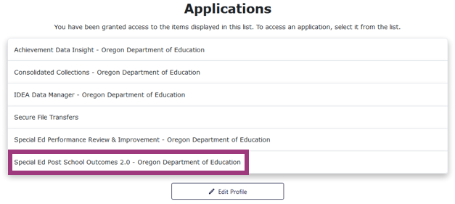
Central Login
Once you have access
  Click on Special Ed Post-School Outcomes 2.0
Notes:
Shava

Slide 51
2 Types of Post School Outcomes Interviews
Exit Interview
Notes:
Shava

Slide 52
Exit Interview
Students ages 16-21 leaving high school with a regular, modified, or extended diploma, a certificate, reaching maximum age, or who are dropping out of school; and have an IEP in effect when they leave school.
Collection open year-round.
Optional, but critical for documenting contact information.
Opportunity to tell student and family about the PSO Follow-Up Interview.
Signed Agreement to Participate required from parent or adult student for the Exit Interview.
https://transitionoregon.org/post-school-outcomes
Notes:
Shava

Slide 53
Prior to the Exit Interview
Review student file information for demographic and contact information
Enter demographic and contact information at any time before the interview
Obtain a signed Agreement to Participate
Familiarize yourself with the PSO 2.0 App
Set up an interview time - best would be within one month of student’s anticipated exit
https://transitionoregon.org/post-school-outcomes
Notes:
Shava
The exit interview is conducted while the student is still attending school and during what would be their final year of school.
The Exit Interview portion of the PSO application is open year round. Exit Interview data can be submitted All year long in the PSO App – downtime may occur on occasion for the PSO App to update
The Exit interview is not a required portion of the PSO collection, but it is important for documenting contact information.
By conducting the Exit interview, you are also given the opportunity to tell students and families about the PSO follow up interview. This will help them to know what to expect. the Exit interview is that it has been found to increase response rates for the required Follow-Up Interview.
Unlike the follow up interview, you must first have a signed agreement for participation in the exit interview . This signed agreement is required from parent or legal guardian. Or if the student is 18 and acting as their own guardian, you must have them sign the agreement to participate.
Other important facts about
Provides an opportunity to engage the student and family in the PSO process.
Encourages a discussion with students about their future plans and allows time to share resources for their future use.
Allows time to connect with student to explain the Follow-Up Interview that’s conducted one year after exit.
Lets students identify a preferred staff member they prefer to do the Follow-Up interview with.

Slide 54
During and After the Exit Interview
Complete the interview using the PSO App
Have student complete the address portion of the PSO Postcard in person
Collect multiple forms of contact information for Follow-Up Interview
Explain the upcoming Follow-Up Interview and answer any questions
Update the interview if new information emerges
Confirm ALL interviews complete with no need for further edits by clicking Mark Collection Complete
https://transitionoregon.org/post-school-outcomes
Notes:
Shava
Complete the interview electronically while using the PSO App
Have student complete the address portion of the PSO Postcard in person
Collect multiple forms of contact information for Follow-Up Interview and enter them into Exit Interview on PSO App; these contacts will pre-populate the Follow-Up Interview
Explain the upcoming Follow-Up Interview and answer any questions ; give the PSO Interview Guide for Student and Family as a resource
Update the interview if new information emerges (contact info, new goals, etc.)
Confirm ALL interviews complete with no need for further edits by clicking Mark Collection Complete

Slide 55
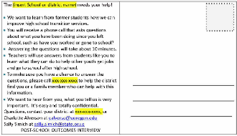
Exit Interview Tips
Ask the student to address the postcard to themselves.
Ask the student to identify a person they would like to have contact them for the follow up interview.
Notes:
Shava
Ask the student
to address the postcard to themselves.
to identify one person they would like to talk to for the Follow-Up Interview.
Record that person’s name along with the contact information in the Exit Interview

Slide 56
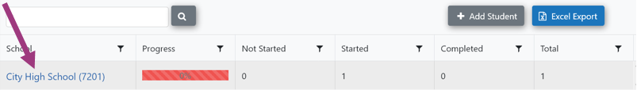
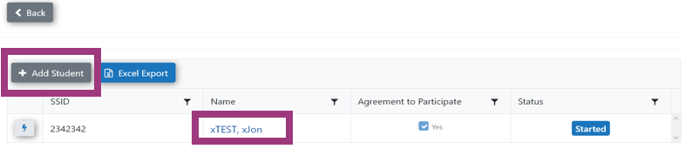
Exit Interview: Students
Click on the School’s name to view students
Click Add Student (Exit interview ONLY)
Click on student name to complete the Exit Interview.
Notes:
Charlotte

Slide 57
2 Types of Post School Outcomes Interviews
Follow Up Interview
Notes:
Shava

Slide 58
Follow-Up Interview Collection
Mandatory Data Collection
All leavers who exited IDEA services during the 2022-2023 school year
  Graduated, dropped out, aged-out, were expected to return
  Must be out of school for 365 days
  List of students eligible for the Follow-Up Interview is provided within the PSO 2.0 App
  Able to check the student list within the PSO 2.0 App until May 31.
Notes:
Shava

Slide 59
Data Collection Process
General Process for Follow-Up Interviews:
Download instructions, script, & agency supports
Print call logs (individually or in a batch)
Send postcard informing student/family of interview
Assign calls to someone who is familiar with the student or to the person the student requested to talk to
  Make sure this person has access to the PSO application
Complete interview with student/family member using online data entry
Paper copies should only be used when the application is unavailable.
Notes:
Shava

Slide 60
Reaching Students
Multiple Attempts on Multiple Days at Multiple Times
Students employed or enrolled in postsecondary education may not be available during normal working hours
Interviewers may need to call in the evenings or on weekends.
Confidentiality must be a priority!
Notes:
Shava

Slide 61
Post-School Outcomes Dates
Follow Up Interview Opens: Thursday, 6/6/2024
Follow Up Interview Closes: Friday, 9/30/2024
Data Owner: Shava Feinstein
Notes:
Shava
Reference dates

Slide 62

Data Collection 2024
Two Targets:
  Attempt to contact: 100% of students on the student list
  Completed interview: 85% of students on the student list
PSO 2.0 App automatically records each attempt electronically
Notes:
Shava

Slide 63
Updates
Exit Interview Updates - None
Follow-Up Interview Content Updates – None
Follow-Up Interview Processes – Minor Adjustments
  Identifying Students Placed Out- of-District
Application Reminder
  Districts cannot add students to the Follow-Up Student List
    For changes in the Student List, contact ODE Data Team at ode.oss-datateam@ode.state.or.us; they will verify need for addition/deletion
Notes:
Charlotte

Slide 64
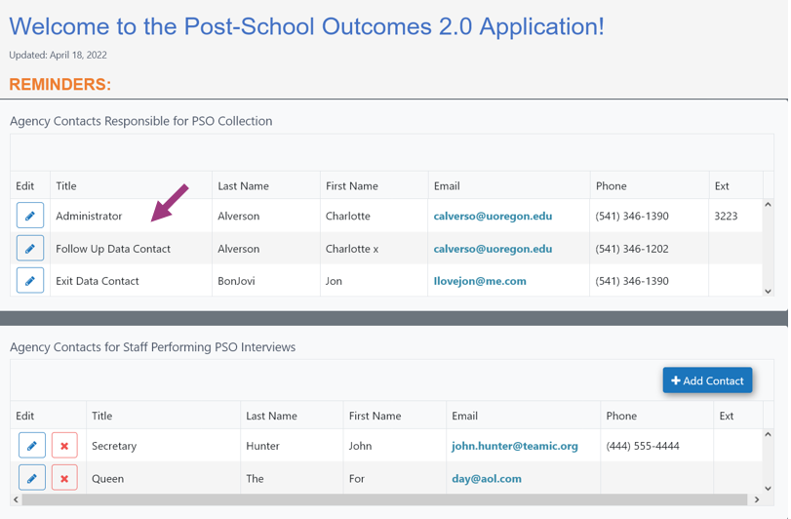
District Contacts Information: Identifying a PSO Team
Must enter agency contact information to proceed in PSO App.
Include contacts for:
Administrator
Follow-Up Data Contact
Exit Data Contact
Staff Collecting or Entering Data
Update your contact list yearly.
Why: Gives PSO Team at UO a point of contact.
Notes:
Charlotte
This information is required before the first interview can be accessed.
Asked to update contact information yearly. This information will link to your sign-on.
Why: Gives PSO Team at UO a point of contact.
To identify who to contact should a problem arise with the collection.
• To disseminate targeted information to those in varying roles (e.g., administrators, data collectors).
• To solicit targeted feedback from the people responsible for specific aspects of PSO data collection (e.g., administrators, data collectors).
Administrator: This is the person at the district office who is ultimately responsible for submitting the completed interviews to ODE. This person will be contacted if there is a question/problem with the submission.
• Follow-Up Data Contact: This is a point of contact for the Follow-Up Interview data collection. Notices pertaining to the Follow-Up Interviews will be sent to this person.
• Exit Data Contact: This is a point of contact for the Exit data collection. Notices pertaining to the Exit Interviews will be sent to this person.
• Agency Contacts for Staff Performing PSO Interviews: This is a list of all people who conduct interviews with former students or their designee. These people will be contacted for training opportunities or if there is a question with a specific student record. There is no limit to the number of contacts who can be added to the PSO interviewers’ list. Any one in any role can be listed here (e.g., case manager, transition specialist, attendance clerk, administrative assistant). Include those who only enter data into the system.

Slide 65
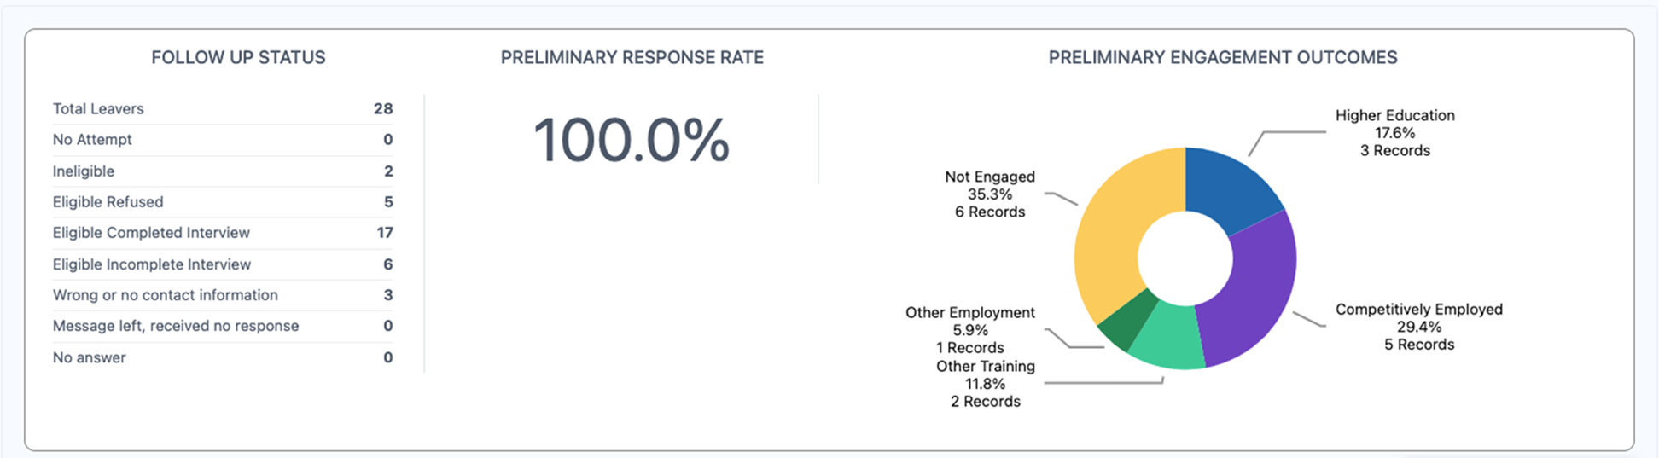
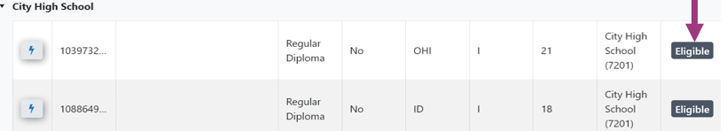
Follow-Up Dashboard
Student Status
Notes:
Charlotte
Review of List contains Current progress of review and Current List with student status.

Slide 66

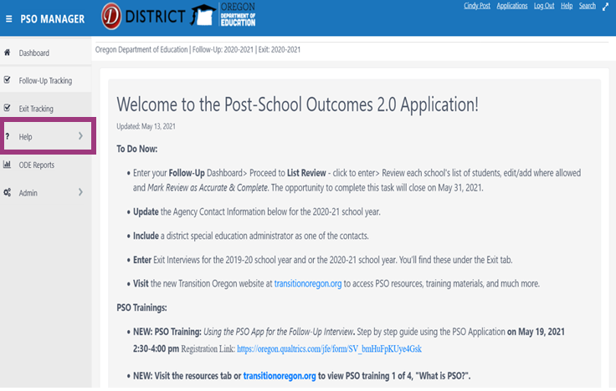
Help Resources
PSO 2.0 App
Dashboards & Help Tab
The transitionoregon.org website
PSO Resources Tab
Notes:
Charlotte

Slide 67
Save the Dates: 2024 Trainings
Date/Time | Audience |  | Objective | Mode
February 16, Posted The Results are In: PSO Results from 2023 | All Interested Parties |  | To share results from the 2023 data collection efforts | Recorded only
March – OSTC -PSO Processes | Anyone responsible for postschool outcome (PSO) data collection or reporting Check the OSTC materials for the time and location for any PSO presentation/s |  |  | Live
April 12th, Ready, Set, Go for PSO: What veteran data collectors need to know for 2024 | Data collectors & administrators experienced in collecting and reporting PSO data |  | To provide an overview of PSO processes, timeline, and resources for 2024 | Recorded
May 2 @ 2:00 pm ODE Spring Webinar | By ODE invitation – Watch for notifications |  |  | Live
May 16th & May 23rd @ 3:00 – 4:30 (PT) Two-part sequence introducing PSO data collection & use #1: Why does it matter: What, why, when, & who of Oregon PSO #2: Oregon PSO: How to collect PSO Data for New Data Collectors | Required for all administrators and data collectors new to PSO collection and reporting and anyone who did not collect and report data in 2023 Registration required; watch for notice | #1: To provide an overview of PSO processes, timeline, and resources for 2024 #2: To provide detailed guidance on step-by-step processes |  | #1: Recorded #2: Live only
May 30, @ 3:00 – 4:00 pm (PT) Open Mic: Q & A August 29, @ 3:00 – 4:00 (PT) Open Mic Q & A | Anyone affiliated with PSO Registration required; watch for notice |  | To respond to questions from the field regarding postschool outcomes | Live and Recorded
Up-to-date training information will be posted on the ODE PSO 2.0 App Main Dashboard Links to recorded sessions and PSO Resources are located under the PSO Resources tab on transtitionoregon.org
Notes:
Charlotte

Slide 68

Announcements and Upcoming Events
Districts can access PSO data through the SPR&I system
Student List Review available until May 31
PSO App 2.0 opens June 6, 2024 – closes September 30, 2024
Conduct Exit Interviews Anytime
Notes:
Charlotte

Slide 69
SpEd Post-School Outcomes Data
Collection Contacts
Data Owner Contact:
  Shava Feinstein
  Shava.Feinstein@ode.oregon.gov
Data Support Contact:
ODE Data Team
ode.oss-datateam@ode.state.or.us
PSO Support Team:
pso@uoregon.edu
Charlotte Alverson calverso@uoregon.edu
Cindy Post
cpost3@uoregon.edu
PSO Resources on Website: TransitionOregon.org
Notes:
Shava

Slide 70

Questions?
Notes:
Shava
Are there any questions about Post School Outcomes or what we covered thus far?

Slide 71
Thanks for all your hard work!
We appreciate you!
We can’t produce accurate reports without all that great data you submit!

