Slide 1
2023-25 CTE Revitalization Grant
Grant Recipient Orientation
February 7, 2024
Note: This session will be recorded and archived.

Slide 2
CTE Revitalization Grants | 2023-25
31 grants
74 schools
36,000 students
Supporting Programs of Study in:
Agriculture
Automotive Technology
Building Trades
Computer Science
Cosmetology
Digital Media & Broadcasting
Engineering
Firefighting/EMT
Health Sciences
Hospitality & Tourism
Manufacturing
Notes:
Art, Dan, and Linda
Show: Revit map
Do: Add name, school to the chat
Tell: History and Purpose of CTE Revitalization
64 Grants (applications)
$8,698,825 in grant funds requested
23 counties
2021-23 Revit: $7.321 million
Grant review period: January 13-24
33 reviewers (18 Education, 15 Business/Industry)
Each grant was reviewed by three reviewers
Each reviewer team included Education and B/I

Slide 3
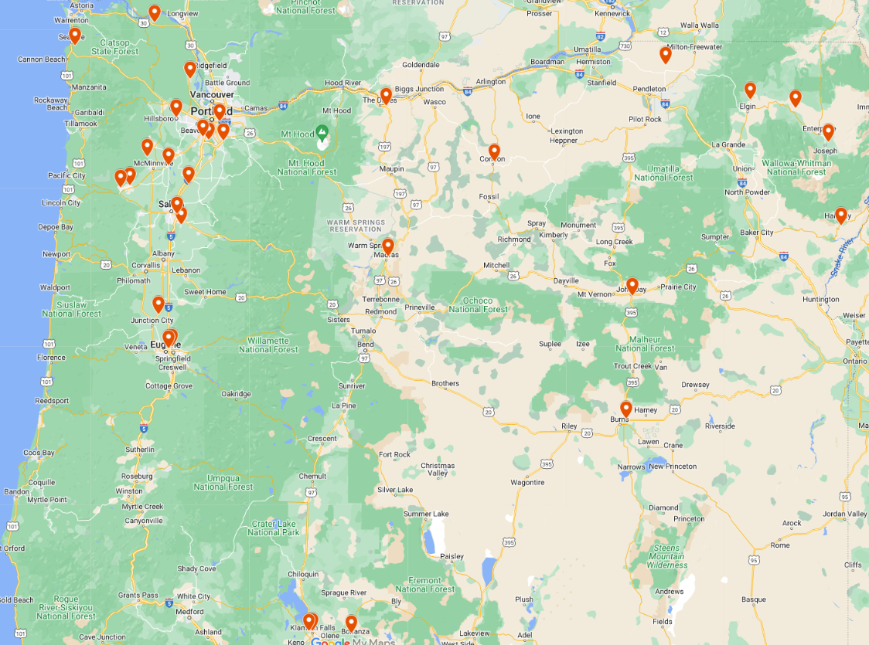
CTE Revitalization Grants 2023-25 |Geography
2023-25 Revit Grants
across Oregon
Notes:
Art, Dan, and Linda
Show: Revit map
Do: Add name, school to the chat
Tell: History and Purpose of CTE Revitalization
The CTE Revitalization Grant is a program established in 2011 through HB 3362, then reaffirmed each following biennium. The grants enhance collaboration among education providers and employers to create new or revitalize existing CTE Programs of Study.
One intention of the grant is to provide funding for large and small schools–urban and rural–across the state. (Schools range in size from approximately 20 students to several thousand.)

Slide 4
The Details
Vision: Projects funded through a CTE Revitalization Grant should leverage the strengths of the community, especially those voices of historically and currently marginalized students and their families.
High Quality CTE Programs of Study leading to satisfying, well-compensated careers
The knowledge and skills to navigate the path to a career
Making sense of learning and connecting it to the future
Access to experts who can help the future happen
Flexible and relevant learning
Notes:
Dan
If we help everyone do well, we all do well.

Slide 5
The Details: Providing Equal Access to All Students
Identify the specific activities within this project that are intended to:
Recruit historically and currently marginalized students
Provide support of (for?) historically and currently marginalized students
Help retain historically and currently marginalized students
Notes:
Dan

Slide 6
The Details: Building Partnerships–Business, Community, Local Workforce Investment Boards
Developing and sustaining partnerships is a key priority of the CTE Revitalization Grant.
Community-based organizations
Businesses, industries, labor management organizations, trades, and educational institutions
Tribes
Local community colleges
Workforce Investment Boards
Economic development organizations
STEM Hubs
Professional organizations
Notes:
Art
The focus of the grant is to initiate or enhance a CTE Program of Study, which affects student success/opportunity, local/regional economic vitality.
Advisors, industry/labor/trades connections
Your economic development folks
Worksource folks
STEM Hubs
Community college (required that the program be aligned with a college), but programs and schools align with universities and other learning institutions to supplement and add value
Thought partnership is critical
Collaboration is critical

Slide 7
The Details: Communication and Advocacy
Each funded CTE Revit project is required to submit to ODE at least one communication to parents/community and/or industry/postsecondary partners during the life of the grant.
Community, regional, or state publicity about the project
Communication/marketing plan for recruitment of students at the middle AND secondary level
Joint communications with postsecondary partners
Sample communications to students, parents, school staff, and the community
Notes:
Art
Qualifiers: Items in your local newspaper, social media feed, news station, recruitment items used to attract students to the program and to emphasize the value and promise of CTE.
The purpose of a CTE Program of Study must be communicated to students, parents, school staff, and community in order to be effective.
Additionally, the messages students receive from their peers and adults should support sustained involvement in a career pathway. What’s really cool is if older learners help to captivate the younger learners and make the journey real.

Slide 8
The Details: Purchasing–Smart Use of Grant Funds
Important: We will notify you when funds are available in the E-Grant Management System (EGMS).
Follow your local/district/ESD purchasing guidelines.
Select and order items early.
All purchases MUST be completed, services delivered, and equipment received at your location by June 30, 2025.
Any commitments that extend beyond the timeline of this grant are part of your Sustainability Plan.
E-Grant Management System
Use this link to learn about the system, obtain an ID (if necessary).
Notes:
Dan
Grants management and reimbursement/disbursement are independent of our team at ODE…essentially a separate office.
This is a reimbursement grant; you submit a request for reimbursement when you purchase something
Spend regularly and draw down on an ongoing basis
Concerning EGMS and Revit: “Our procurement office is seeing a beyond-normal influx of contract and grant agreements. Compared to just four years ago, ODE is processing an increase of more than $4 billion in additional payments. These result in a broader array of contracts and grantees than is typical, even at our busiest times. ODE’s procurement office had several vacancies that we have recently filled and we are training up the team. We are hopeful that we will be able to get the grant agreements out shortly. That being said, we don’t know when “shortly” is. We’ll share when we know as we know it. So rather than throw an approximate date out and keep moving the chains, best we wait until we know something for sure.”

Slide 9
The Details: Grant Expectations
Strengthens the alignment of Career and Technical Education, workforce development, and economic development.
Supports learner retention, success, and migration to career and postsecondary learning experiences.
Drives sustainable growth in a variety of high-wage, in-demand areas.
Creates opportunities.
Notes:
Art
Think about all of your students as a possible audience
Non-trad is a consideration
“Historically and currently underrepresented” = Focus Students
Your program could be the tipping point issue for learners who don’t feel connected.
Getting everyone (to the greatest extent possible…) involved with a career area that’s fulfilling improves the life of our communities in measurable, significant ways. Getting learners to be hi-wage earners raises the average (per capita income) and reduces reliance on a variety of services.
Detective Harry Bosch: “Everybody counts, or nobody counts….”

Slide 10
The Details: Reporting
Online Reporting Schedule
5/24/2024 Spring 2024 Update due
9/27/2024 Summer 2024 Update due
12/18/2024 Fall 2024 Update due
3/31/2025 Spring 2025 Update due
10/10/2025 Final Update due
You will receive an announcement and periodic reminder email(s).
We will use a Web submission (online form) with the capabilities of uploading artifacts.
We will provide technical support during this phase as needed.
Notes:
Art and Dan

Slide 11
The Details: ACTE Spring Conference (optional)
April 10-12, 2024 – Portland, OR
What do we want to say here?
Notes:
Art and Dan

Slide 12
The Details: Questions
Contact for CTE Revit Grant Information/Questions:
ode.cterevitalization@ode.oregon.gov
CTE Revit Office Hours
Monthly for the life of the grant (summers excepted)
2nd Wednesday of the month beginning March 2024
3:30-4:30pm via Zoom
Connect with your Regional Coordinator (need new link)
Connect with the Education Specialist in the appropriate subject area (need new link)
Perkins Fiscal: Reynold Gardner
CTE Revitalization Grant web page
Frequently-Asked Questions (need new link)
Notes:
Dan and Linda
Need to do:
Monthly CTE Revit Office Hours option
Contact Information for CTE Revit (Grant email address)
Please advise ODE of any changes/additions to your grant team

Slide 13
The ODE CTE Revitalization Team
Dan Findley/Grant Manager
Liz Rain/Designation??
KC Andrew/Higher Education Coordinating Commission
Linda Catterall/Logistical Support
ODE.CTERevitalization@ode.oregon.gov
Notes:
Art and Dan

Slide 14
Questions
Notes:
Art and Dan

Slide 15
Wrapping It Up
Thank you!
Notes:
Art and Dan

