Slide 1
Access to Linguistic Inclusion
(HB 2056)
COSA Multilingual and English Learner Conference
March 9, 2023

Slide 2
Today’s Presentation
Access to Linguistic Inclusion: short review and overview
Updates
Frequently asked questions
Implementation
Course coding
Credit awarding
Teacher licensure
Notes:
We’re excited to be with you today. We will begin with a version of the Statewide Webinar shared last spring, then move on to new material. During the course of our time together, we will review the law Access to Linguistic Inclusion, what it is and what it does, and we’ll provide updates we’ve learned about as the law has been implemented. We will review common questions around implementation, course coding, credit awarding, and teacher licensure, and we will ask you to review scenarios that will help you develop schema around how to interpret and implement the law. We will address common concerns, and we will hold time for Q&A.

Slide 3
Overview
Notes:
To start things off, we’ll give a brief review of the new law, what it is, and what it does.

Slide 4
Access to Linguistic Inclusion
Passed in the 2021 legislative session
Introduced as HB 2056
Effect date January 1, 2022
flicker.com
Notes:
Access to Linguistic Inclusion was one of a number of equity-focused bills passed in the 2021 legislative session. The bill was introduced as HB 2056 and took effect on January 1, 2022. While the bill was sponsored by the Oregon Department of Education, communities of multilingual learners and advocates like you provided input and public testimony. We heard the need and worked with partners to help shape the bill.

Slide 5
Three Main Effects
English Language Arts → Language Arts
Language Arts definition expanded
World Language definition expanded
Repeals requirement that all instruction (with some exceptions) be delivered in English
freesvg.org
Notes:
Access to Linguistic Inclusion changed a number of Oregon Revised Statutes. These changes fall in three main categories:
Relabeling English Language Arts as Language Arts, and updating its definition.
Updating the definition of World Languages.
Repealing the statute that required nearly all instruction in Oregon to be delivered in English. This creates opportunities for districts to offer courses from all content areas in languages other than English.

Slide 6
Language Arts: Instruction
New definition: “Language Arts” includes reading, writing and other communications in any language, including English.
Creates opportunity for Language Arts classes in languages other than English
Applies in Grades K-12, even though the impact will be felt most in Grades 9-12.
pxhere.com
Notes:
The Language Arts label has been redefined to include any language. Note that this change is additive, not subtractive. English is not being removed from the Language Arts field; rather, other languages are joining it. Therefore, course titles such as “English Language Arts” should be retained where they accurately describe the course content (composition and literature via the English language).

Slide 7
World Language: Instruction
New definition: “World Language” includes sign language, heritage languages and any language other than a student’s primary language.
Definition based on student linguistic identity
“Heritage language” means a language that has cultural or familial significance to a student, going beyond personal preference. A student’s primary language cannot be a heritage language if it is also the language of the dominant culture in the student’s educational environment.
This means English is not a heritage language for most students.
Applies in Grades K-12; greatest impact in Grades 9-12
wikimedia.com
Notes:
Access to Linguistic Inclusion updates the definition for World Languages based on student linguistic identity. This means that the same course might qualify as a World Language course for one student, but not for another student.
The enrolled text of Access to Linguistic Inclusion does not define the term “heritage language”. Under the implementation definition, shown on this slide, a student’s primary language may also be a heritage language (as may be the case for many Spanish speakers). A language may also be a heritage language for certain students even if they have not yet begun learning that language (as may be the case for students with tribal heritage). Now, I’ll hand things over to Ben to share some additional impacts resulting from the passage of this law.

Slide 8
English Learners and Multilingual Students
Access to Linguistic Inclusion makes no direct changes to definitions or requirements regarding students with English learner status. However, new definitions of Language Arts and World Languages (and new credit earning options) will matter greatly to students with English learner status.
Students do not need current or former English learner status to benefit from this law.
pikrepo.com
Notes:
Access to Linguistic Inclusion did not modify any statutes regarding students with English learner status. Since students with English learner status are by definition multilingual, they are eligible to benefit from many of the expanded opportunities available under this law. However, neither current nor former English learner status is required to benefit from Access to Linguistic Inclusion.

Slide 9
Updates and New Developments

Slide 10
Licensure and Credentialing
Teacher Standards and Practices Commission (TSPC)
No planned changes to teacher preparation
Exercises authority over teacher preparation and licensure, not credit
Find information about connections between courses and teacher endorsements on the Teacher Licensure page.
Notes:
Access to Linguistic Inclusion made no changes to existing rules governing teacher credentialing and licensure. The Teacher Standards and Practices Commission has not yet found it necessary to make changes to teacher preparation programs or licensure procedures as a result of the law. The teacher licensure link on this slide leads to an ODE page with more information about courses and teacher credentialing.

Slide 11
Endorsement Requirements
Required endorsement based on credit district proposes to offer
If proposing to offer Language Arts credit, a teacher with a Language Arts endorsement must be involved
If proposing to offer World Language credit, a teacher with a World Language endorsement for the language in question must be involved
For the purposes of Access to Linguistic Inclusion:
An English for Speakers of Other Languages (ESOL) endorsement is appropriate for awarding World Language: English credit
An English Language Arts endorsement is appropriate for awarding Language Arts credit (even in languages other than English)
Notes:
This slide examines teacher endorsements through the lens of the new definitions for Language Arts and World Language. If the district is proposing to offer Language Arts credit, a teacher with a Language Arts endorsement must be involved in course development or delivery. Likewise, if the district is proposing to offer a World Language credit, a teacher endorsed in World Language—in the language in question—must be involved in course development or delivery. For Access to Linguistic Inclusion, an ESOL endorsement would be sufficient for awarding World Language: English credit, and an English Language Arts endorsement is needed for awarding Language Arts credit.

Slide 12
“Involving” Appropriately Endorsed Teachers
“Involving” a teacher with a given endorsement could mean one or more of the following:
Involved teacher delivers or helps deliver instruction
Involved teacher plans or helps plan course delivery and content
Involved teacher designs or helps design assessment, performance tasks, or other methods to gather data on student knowledge and skills
Involved teacher evaluates or helps evaluate student performance
Etc.
Notes:
“Involvement” means that a teacher with the appropriate endorsement ensures (whether through review or proactive design) that the course does indeed cover relevant and appropriate content standards, and that student performance does in fact demonstrate the necessary knowledge and skills to substantiate a claim that they have completed essentially the same work that would be required in any other course awarding the same type of credit.

Slide 13
Seal of Biliteracy
Available for students who demonstrate proficiency in multiple languages
To harmonize with Access to Linguistic Inclusion, updated from “English and another language” to “Any two or more languages”
Notes:
The Seal of Biliteracy is a state-sponsored recognition of academic achievement by students who demonstrate an ACTFL Intermediate High or higher proficiency in more than one language. Access to Linguistic Inclusion had a direct impact on the Seal of Biliteracy, causing a reexamination of its associated Oregon Administrative Rules. Formerly, the Seal required demonstration of proficiency in English and another language. With the rule revision, the Seal is now available to students who demonstrate proficiency in any two or more languages.
To our knowledge, Oregon is the first state to offer a Seal of Biliteracy without an English requirement, which is yet another demonstration of how the state is exploring innovative spaces in honoring and recognizing multilingualism.

Slide 14
University Admissions Requirements
Oregon State University updated admissions to account for Access to Linguistic Inclusion
University of Oregon and Southern Oregon University have a holistic review process
For many post secondary institutions, “English” may be used as a synonym for “Language Arts”
In collaboration with the Higher Education Coordinating Commission (HECC), ODE produced a Higher Education Admissions Q&A​ to help provide information to post-secondary admissions departments
Notes:
During public hearings on HB 2056, admissions representatives from University of Oregon, Eastern Oregon University, and Oregon State University all provided public testimony in support of the bill. All three universities noted that even if their admissions requirements indicated that students needed four years of English, “English” may be used as a synonym for “language arts”. Since the bill’s passage, Oregon State has updated their admissions requirements to indicate that students need four years of language arts, rather than four years of English. U of O, Southern Oregon University, and Eastern Oregon University all indicated that their holistic review process is robust enough to account for changes resulting from Access to Linguistic Inclusion. To further support a smooth throughline from secondary to post-secondary institutions, ODE collaborated with the Higher Education Coordinating Commission to produce a post-secondary-facing Q&A document regarding Access to Linguistic Inclusion.

Slide 15
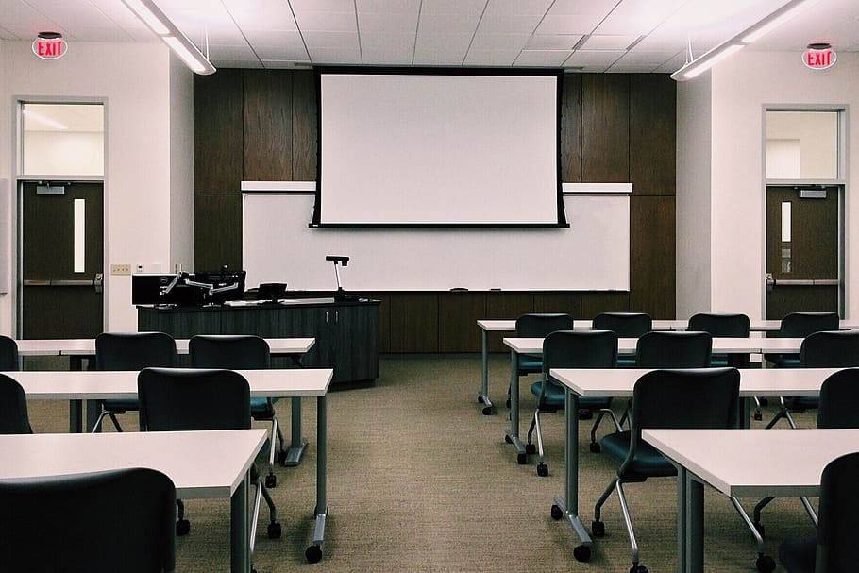
Reaching Clarity
There are more ways for schools and districts to recognize and honor student demonstrations of knowledge and skills. It’s easy to get lost in the options!
Asking the right questions should lead to a clear answer.
What are you currently doing?
What do you want to change?
What is your desired outcome?
pxfuel.com
Notes:
With the new flexibilities available under Access to Linguistic Inclusion, there are more ways to offer courses and more ways to recognize student achievement. This is great for students, but can lead to potential confusion for educators as they ask questions about course coverage, credits, teacher endorsements, and the role of the student..
Fortunately, with an organized approach, much of the confusion falls away. Today we hope to show you how to ask the right questions so that you get a clear answer.
In any district considering implementation of flexibilities available under Access to Linguistic Inclusion, we recommend first reaching a clear understanding of what you are doing now, followed by what you hope to change and the results you hope to see from that change. Based on the answers to these questions, required action for implementation should subsequently become clear. Don’t worry, we have some concrete examples later in the presentation to help illustrate what we mean.

Slide 16
Everything Turns on Content Standards
A course “is” the content standards it covers
Course credit should be awarded based on demonstrated mastery of content standards by students
Teacher endorsements authorized to teach a given course are outlined by the Course to Endorsement Catalogue (a tool that helps bridge from content standards)
pixnio.com
Notes:
When early astronomers tried to understand the movements of planets in the sky, their paths seemed very complicated. Things got much easier once people started thinking of everything as rotating around a central point–the Sun.
Likewise, you can significantly reduce the complication of questions regarding Access to Linguistic Inclusion if you begin with the content standards in mind.
Need to know what credit a course can award? Check the content standards against which student performance will be measured.
Thinking about recategorizing or retitling a course? Check the content standards that will be covered in that course.
Need to know what endorsement is required to teach a course? The Course to Endorsement Catalogue will help you draw a line from the content standards to be covered, through the description of the course in question, to endorsements authorized to teach that course.

Slide 17
Checking Your Center
Now that we’ve briefly summarized what can be done, and before moving to how it is done, be sure you ask yourself if it should be done.
Signs you may be on the right track | Warning signs
Honors student linguistic identity | Benefits adults or the system
Honors previously unrecognized demonstrations of student knowledge and skills | Imposes new requirements or creates new expectations for students
Based on what students know, show, and do | Based on what students lack or “need”
Prepares students for the next steps in their educational and life journeys (forward facing) | Checks off a requirement for an educational “to do” list (backward facing)
Notes:
At this point we want to issue the first several cautions. A famous film once mentioned that power comes with responsibility. In the case of Access to Linguistic Inclusion, we recommend checking your center early and often to guard against accidental misuse of these new flexibilities. It is important to remember that this law was designed to honor linguistic expertise and recognize demonstrations of knowledge and skill. The law was not written to correct a perceived problem with credit deficiencies or improve educational statistics for a particular student group. Therefore, when thinking through implementation, we encourage you to think about which areas of your implementation are student-centered and if there are any areas which are actually adult- or system-centered.

Slide 18
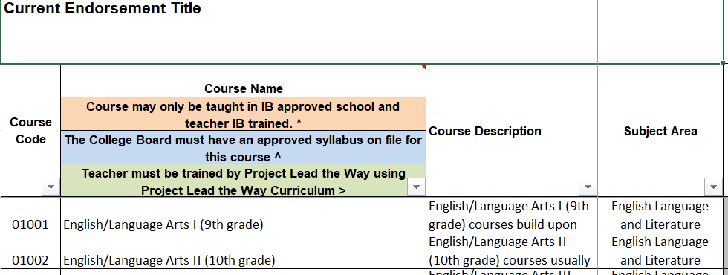
Course Coding
Use the Course to Endorsement Catalogue
Find the course description that most closely matches the content and standards covered in your course
Catalogue lists endorsements authorized to teach that course
Notes:
Two frequent questions that come up are how to code a particular course and what endorsement is needed to teach a particular course. In order to answer both of these questions, we can use the Course to Endorsement Catalog. In order to determine the appropriate course code, find the course description that most accurately describes the course content and the standards covered in the course. That will tell you the appropriate course code. Then, you can look across the table to find what endorsements are required to teach that course.

Slide 19
Asking the Right Questions
The intersections between credits, instruction, standards, and endorsements can be confusing. However, a clear answer will become apparent if you ask the right question.
What is the current practice?
What do you want to change?
What is your desired outcome?
Notes:
As we’ve worked with districts on implementing this law, we’ve learned that it is important to make sure you’re asking the right questions to satisfy your end goal. The intersection between credits, instruction, standards, and educator endorsements can be confusing. However, you’ll arrive at a clear answer, if you ask the right questions. You can see here, those questions are:
What is your current practice?
What do you want to change?
What is your desired outcome?
Let’s take a look at some scenarios to further illustrate this point. What we’re going to do is give you some time to review three distinct scenarios and talk through these questions to determine the implementation strategy. For each scenario, you’ll have five minutes to discuss at your tables. We recognize that this will not be enough time; however, it’ll get you started on the discussion, and then we’ll come back together, and we will share with you our ideas about how to respond to these scenarios under the flexibilities allowed in Access to Linguistic Inclusion.

Slide 20
Course Coding and Credits
Notes:
The next few slides discuss implementation scenarios for Access to Linguistic Inclusion. The purpose of this exercise is to help build your schema around the flexibilities this law affords.

Slide 21
Scenario A: Spanish Algebra I
“We have an Algebra I class taught in Spanish. Does the teacher need a World Languages: Spanish endorsement? What other credits can we award for this class?”
To discuss at your table group:
Which parts of this question reveal a student-centered approach? Which parts of this question reveal an adult- or system-centered approach?
What does this question indicate about current practice?
What does it seem like this district wants to change? What seems to be their desired outcome?
If time remains: How could or should the district implement these changes?
Notes:
Here’s Scenario A. It’s about an algebra 1 class that is taught in Spanish.

Slide 22
Scenario A: What Is Current Practice?
What is current practice?
District offers an Algebra I course, which happens to be taught in Spanish.
Content standards covered: Math
Credit awarded: Math
Endorsement required: Math (with Spanish bilingual specialization)
Notes:
So, we want to ask our key questions to help elicit the appropriate answers.
What is current practice?
The district offers an Algebra 1 course, which happens to be taught in Spanish.
The course covers math academic content standards.
The endorsements required: math with a Spanish bilingual specialization
So, the questions about world languages and additional credits stem from a mistaken focus on a non-essential component of the course (the fact that material is delivered in Spanish). What we know is that math standards are covered and math credit is awarded and that is the key information we need to take into the next set of questions.

Slide 23
Scenario A: What Do You Want to Change?
What do you want to change? What is your desired outcome?
If you want to offer a different kind of credit (not Math)...
…then change instruction to cover the new content area
If you want to offer additional credit (Math and something else)...
…then confirm that current instruction also covers other content standards, or expand instruction to cover more content standards
…and involve a teacher endorsed in the additional content area
Notes:
What do you want to change?
There are several possible answers to this question. Maybe the district wants to change very little–keep the math course the same, just make sure that they have the right teacher in place. Or maybe the district wants to transform the math course into a different course–like a science or economics course. Or maybe they want to do something extra, that is not only Math but also a math course combined with another content area like science or economics.
What is your desired outcome?
Once the district knows what they want to change, the outcome and necessary action steps should become clear. If the goal is to stick with Math, which is taught in Spanish, then no World Language endorsement is required–just Math and a bilingual specialization, exactly as before. If the course is going to cover new or different material, and/or offer new or different credits, then a teacher with a new or different endorsement may be required, depending on the planned coverage.

Slide 24
Scenario B: Spanish Language Arts
“We have middle and/or high school classes where students read novels in Spanish. Does the teacher need a World Languages: Spanish endorsement? What other credits can we award for this class?”
To discuss at your table group:
Which parts of this question reveal a student-centered approach? Which parts of this question reveal an adult- or system-centered approach?
What does this question indicate about current practice?
What does it seem like this district wants to change? What seems to be their desired outcome?
If time remains: How could or should the district implement these changes?
Notes:
This second scenario concerns a class where students read novels in Spanish.

Slide 25
Scenario B: What Is Current Practice?
What is current practice?
District offers elective courses where students read novels in Spanish. Course is taught in Spanish.
Content standards covered: unclear
Credit awarded: elective
Endorsement required: unclear
Notes:
So, we want to ask our key questions to help elicit the appropriate answers.
What is current practice?
The district offers a novel-based course, which happens to be taught in Spanish.
It is unclear from the description what content standards are covered in the course.
The credit awarded for this course is elective credit.
It is also unclear from the description what teaching endorsement is required for this course.
The first step is needing to clearly define why this is the current practice. What is the purpose of this course? This must be answered before being able to move on to the next set of questions, in order to get a clear answer.

Slide 26
Scenario B: What Do You Want to Change?
What do you want to change? What is your desired outcome?
If you want to offer Language Arts credit for these courses…
…then confirm that current instruction covers applicable grade-level Language Arts standards
…and involve a teacher who is endorsed in Language Arts
If you want to offer World Language credit for these courses…
…then confirm that current instruction covers applicable grade-level World Language standards
…and involve a teacher who is endorsed in World Language: Spanish
Notes:
What do you want to change?
Again, there are several possible answers to this question. Maybe the district wants to change very little–keep the course as an elective, just make sure that they have the right teacher in place. Or maybe the district wants to transform the elective course into a different course–like a language arts course or a world language course. Or maybe they want to do something extra, that is not only an elective course but also an elective course combined with another content area like World Language: Spanish or Spanish Language Arts.
What is your desired outcome?
If the desired outcome is to be able to offer language arts credit for this course, the district must confirm that current instruction covers applicable grade-level language arts and literacy standards and make any necessary changes to instruction if it does not currently meet those standards. If the current teacher is not endorsed in language arts, then the current teacher must involve a language arts teacher in the creation and planning of the course.
Similarly, if the desired outcome is to be able to offer World Language credit for this course, the district must confirm that current instruction covers applicable grade-level world language standards or adapt instruction to meet those standards. And again, if the current teacher is not endorsed in World Language: Spanish, then the current teacher must involve a World Language: Spanish teacher in the creation and planning of the course.

Slide 27
Scenario C: Credit by Proficiency
“Many students with English learner status arrive in our district needing more Language Arts credits than they can earn in the time left before graduation. What tests, work samples, or portfolio options are permissible under Access to Linguistic Inclusion to help these students earn the credits they need?”
To discuss at your table group:
Which parts of this question reveal a student-centered approach? Which parts of this question reveal an adult- or system-centered approach?
What does this question indicate about current practice?
What does it seem like this district wants to change? What seems to be their desired outcome?
If time remains: How could or should the district implement these changes?
Notes:
And finally, here’s Scenario C. Take a look at the scenario and the questions.

Slide 28
Scenario C: What Is Current Practice?
What is current practice?
Unclear. Perhaps the district requires students to attend an additional year of high school, or requires students to “double enroll” in Language Arts courses, or transfers Language Arts credit from international transcripts.
Standards covered: Language Arts
Credit awarded: Language Arts
Endorsement needed: Language Arts
Notes:
So, we want to ask our key questions to help elicit the appropriate answers.
What is current practice?
In order to arrive at a clear answer, it’s important to start with a clear-eyed view of what current practice is, and in this scenario, current practice is unclear. Maybe the district requires students in this situation to attend an additional year of high school. Or, maybe they require students to “double enroll” in language arts courses. Or, maybe they evaluate the students’ international transcripts and transfer language arts credit from their previous educational experiences.
As we’ll ask again on the next slide, have students learned the content but the system doesn’t know how to recognize it? That’s one thing. Or, are students graduating from high school without the skills needed to earn an Oregon diploma?
According to the description in this scenario, language arts standards are (or should be) covered.
The desired credit to be awarded is language arts credit.
Based on that information, it is clear if any endorsement is needed, it would be a language arts endorsement.

Slide 29
Scenario C: What Do You Want to Change?
What do you want to change? What is your desired outcome?
If you want to more thoroughly evaluate international transcripts…
…then establish an evaluation committee per recommendations in Access to Linguistic Inclusion guidance
If you want to create new courses that offer Language Arts credit…
…then design a course that meets the Language Arts standards (regardless of the language of course delivery)
…and involve a teacher who is endorsed in Language Arts
If you want to award additional Language Arts credit for existing courses…
…then confirm that current instruction covers applicable grade-level Language Arts standards (and change instruction if necessary)
…and involve a teacher who is endorsed in Language Arts
Notes:
What do you want to change and what is your desired outcome? Are the students already demonstrating knowledge and skills that the system doesn’t currently recognize? Or do the students need supplemental instruction to be ready for their next steps in education and in life?
If you want to be able to transfer credits from an international transcript, the district would need to establish an evaluation committee per the recommendations in the Access to Linguistic Inclusion Guidance.
If the desired outcome is to create new courses that offer language arts credit, then the district would need to design a course that meets the language arts and literacy standards, regardless of the language of course delivery. One important note on the language arts standards: There are very few references to the English language in the standards. Most of the standards are language agnostic. If you’re thinking of developing a language arts course in a language other than English, you’d simply replace any reference to the English language in the standards with the language of instruction. And, if this were your desired outcome, you’d need to involve a teacher endorsed in language arts in the development and planning of the course.
If the desired outcome is to award additional language arts credit for existing course, you’d need to confirm that the current instruction covers applicable grade-level language arts and literacy standards and modify instruction accordingly if it does not, and again, involve a teacher who is endorsed in language arts.

Slide 30
Final Thoughts

Slide 31
“Finding” Credits
Think carefully about any course of action presented as “finding” or “getting” more credits for students.
Access to Linguistic Inclusion is about recognizing student achievement and demonstrations of knowledge and skills
Is this alternate credit activity truly an equivalent of other currently available methods to earn the same credit in the district?
If students who were not credit deficient completed the same or similar demonstrations of knowledge and skills, would you (or will you) award the same credits?
What is driving the decision? (The expertise that the student demonstrated? The credits that they need?)
Check your center!
Notes:
Now that we’ve worked through some concrete examples, we will make one more recommendation to check your center. In our work as implementation managers, the most problematic questions we’ve received from districts have been phrased as “finding” or “getting” credits for students. At first blush, this sounds student centered–after all, students are the ones getting the credits, right? However, there is a risk that these extra credits will give students false information about their readiness for next steps in education and life. For example, Language Arts is more than just two thirds of the old song, “reading, writing, and arithmetic”. It is an assurance that the student has developed the skills they need to assemble a cogent and convincing argument, organize and explain evidence, understand and create complex texts, and much more. Awarding a Language Arts credit is a signal that the student has demonstrated mastery of these skills, whether in English or in another language. If we are going to say this, let’s be sure we mean it.

Slide 32
Learn More About Access to Linguistic Inclusion
The following resources are also available in the Access to Linguistic Inclusion expandable on the English Language Arts page
Guidance and Explanation document
One-page summary
Overview and statewide webinar slides
HB 2056 Oregon Legislative Information System page: contains legislative history and enrolled text
pxhere.com
Notes:
Here are several resources available to help explain Access to Linguistic Inclusion. Consult the links on this slide to learn more!

Slide 33
Thank You!
Questions about Access to Linguistic Inclusion? Contact both Tina and Ben!
Tina Roberts
Language Arts Education Specialist
tina.roberts@ode.oregon.gov
Ben Wolcott
ELPA Specialist
ben.wolcott@ode.oregon.gov
pxfuel.com
Notes:
Thank you for your attention. We hope these slides have helped increase your understanding of Access to Linguistic Inclusion. Please contact Tina Roberts and Ben Wolcott at ODE to continue the conversation.

