Slide 1
Essential Skills
Reading Work Samples
Development, Scoring, and Calibration
Notes:
The session will provide participants with an in-depth training and calibration to the Official Reading Scoring Guide; including developing work samples, and scoring student work samples to meet the Essential Skills requirement. Discussion will include Essential Skills requirement and the procedures for work sample administration. Participants will have an opportunity to work collaboratively on applying feedback on scored samples. Participants are encouraged to bring student samples to score both independently and with colleagues as they apply new their understanding.

Slide 2

Workshop Goals
  Develop Reading Work Samples
  Build background and collaboratively score a reading performance task to build a common understanding of proficiency.
  Review the guidelines for administering Reading Work Samples for the purpose of Essential Skills.

Slide 3
Partners and Peers
  HS school ELA teacher
  HS school social studies teacher
  Special Education or Title I teacher
  Instructional coach
  Other
Notes:
Note: Teachers should be partnered at the beginning of greeting attendees and placed in tables or groups with like-peers. Depending upon group make-up, you may need to change categories. It is recommended when working with multiple grade level to group teachers by those bands to collaboratively work with peers on the writing scoring guides and work sample calibration activity. Allow SPED teachers flexibility in choosing the group they work most closely with in supporting students. Coaches should be placed with the grade level content band that caters to their strength to contribute to the accuracy of calibration

Slide 4
Collaborative Work Norms
Equity of voice
Active listening
Respect for all perspectives
Confidential and safe
Self-monitor use of electronics/distractions
Notes:
Opportunity to review collective group norms to ground the professional development. Facilitators can add specific language and norms adopted by the school district.

Slide 5
Workshop Goals
  Develop Reading Work Samples
  Build background and collaboratively score a reading performance task to build a common understanding of proficiency.
  Review the guidelines for administering Reading Work Samples for the purpose of Essential Skills.

Slide 6

Goal 1:
Developing Reading Work Samples
Notes:
During this portion, educators will build there background around developing reading work samples:
Understand Characteristics and purposes of work samples.
Identify topic/reading passage.
Analyze reading passage.
Draft reading task.
Format the reading task

Slide 7
Workshop Goals for Developing
Reading Work Sample
Understand characteristics and purposes of work samples.
Identify topic/reading passage.
Analyze reading passage.
Draft reading task.
Format the reading task

Slide 8
Characteristics of Work Samples
Require student-initiated planning, management of information and ideas, interaction with a variety of other materials.
Require production of extended responses, such as oral presentations, exhibitions, and other scorable products, including more extended writing responses which might be revised and edited.
Reflect a real-world task and/or scenario-based problem; tasks are multi-stepped and allow for reflection and revision.

Slide 9

Step 1: Identify
Topic/Reading Passage
Questions for Consideration:
Is the topic/reading passage:
  curriculum-embedded?
  part of a thematic unit?
  a stand alone assessment?
  of high interest to students?
  rich enough to support analysis?
  appropriate for the grade level?
Notes:
Work Sample prompts must align with the Common Core standards for the skill area being assessed.

Slide 10

Step 2: Analyze the Passage
Considerations:
Texts:
  May be drawn from a variety of resources (traditional text, audio, video, graphics).
  Should be of a suitable length and complexity (see the Guide for Developing Reading Tasks for more clarification). http://www.oregon.gov/ode/educator-resources/essentialskills/Documents/es_worksample_guidelines_developing_reading.pdf
  Complexity should be evaluated on Qualitative and Quantitative measures.
Notes:
Facilitator can provide educators with hard copies of the Guide for Developing Reading Tasks at this time and allow educators time to review the document in small groups. Many of the notes provided in the Reading Guide will be included in the presentation and facilitator notes.

Slide 11
Determining Text Complexity
Text Complexity is determined by:
  Quantitative measures- readability and other scores of text complexity often best measured by computer software.
  Qualitative measures – levels of meaning, structure, language conventionality and clarity, and knowledge demands often best measured by an attentive human reader.
  Reader and Task considerations – reader’s background knowledge, motivation, and interests.
Notes:
Educators should employ their professional judgement in selecting passages.
All passages used for reading work samples should be at high school level. Literary selections for reading work samples should be appropriate in length and complexity to allow for responses that can meet standard on all traits of the scoring guide.

Slide 12

Determining Text Complexity
Quantitative Measures:
  word length
  word frequency
  word difficulty
  sentence length
  text cohesion
Notes:
Though Lexile levels have been utilized in the past they are not necessarily an adequate measurement used to determine text complexity.

Slide 13
Determining Text Complexity
Qualitative Measures:
  levels of meaning
  levels of purpose
  structure
  organization
  language conventionality
  language clarity
  prior knowledge demands

Slide 14
Determining Text Complexity
Reader and Task Considerations:
Student motivation.
Students’ knowledge and prior experience.
Complexity of the task assigned.
Complexity of the questions asked.

Slide 15
Additional Guidance:
  Multiple tasks should be developed within a school to prevent students from sharing information.
  Student should be given choice among reading selections (e.g. topic choice, genre choice, etc.).
  All passages used for reading work samples should be at high school level and be appropriate in length and complexity to allow for responses that can meet standard on all traits of the scoring guide.

Slide 16
Step 3: Draft the Questions
Considerations:
  Compose at least 2 questions for each of the reading traits (Demonstrate Understanding, Develop and Interpretation, Analyze Text).
  Include graphic organizers for responses to questions, as appropriate.
  Ensure questions are clear, concise, and remind students to provide support for their answers.
Notes:
Prompts that include questions about texts must clearly provide students with opportunities to demonstrate proficiency in the relevant reading Common Core standards.
Students should respond to multiple prompts/questions per reading work sample to allow for responses that can meet standard on all traits of the scoring guide. More prompts/questions would be required if two related passages are used for a single reading work sample.

Slide 17
Step 4: Format the Task
Considerations:
  Craft the directions and a brief introduction.
  Select an appropriate font style and size.
  Use formatting to enhance comprehension (e.g., use bold or italics to emphasize key words).
  Allow space for note taking.
  Include graphic organizers for responses, if appropriate.
  Allow adequate space for responses.
Notes:
Reading work samples should allow for marginal notes, highlighting, graphic organizers, drawing, etc. in addition to written responses to questions. Scores on each trait take into account all student work.

Slide 18
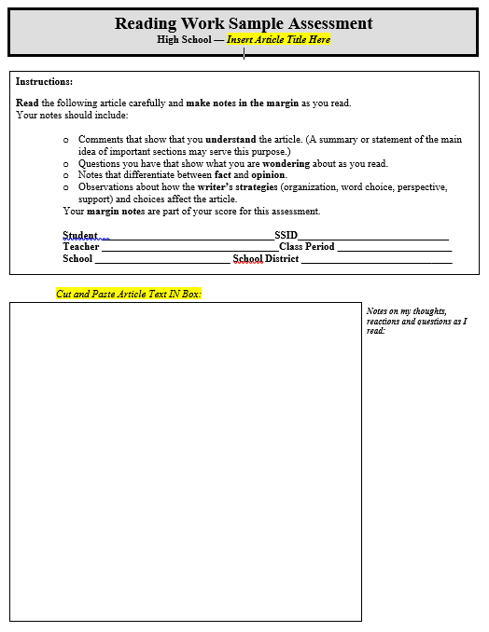
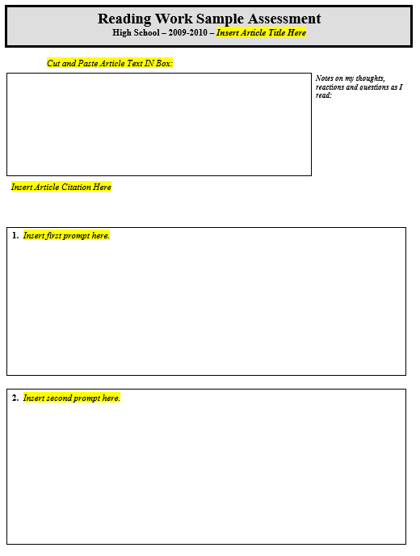
Reading Work Sample Template
Reading Work Sample Template
http://www.oregon.gov/ode/educator-resources/essentialskills/Documents/es_worksample_template-reading.docx
Notes:
Share with educators resources available on the ODE Essential Skills Reading Work Sample webpage. The template is a word document that can be edited once the educator has downloaded the doc.

Slide 19
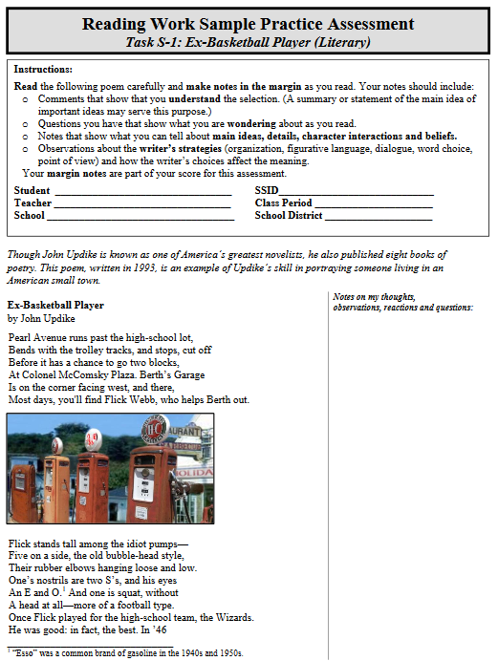
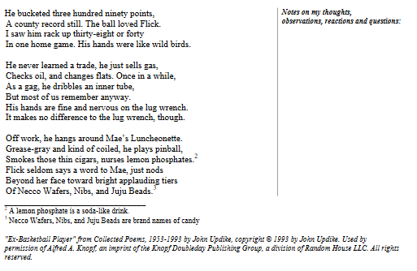
Reading Work Sample Example
Reading Work Sample Example
http://www.oregon.gov/ode/educator-resources/essentialskills/Pages/Reading-Performance-Asmt-Practice-Tasks.aspx
Notes:
Facilitator will pass out example reading work samples available on the ODE Essential Skills Reading Work Sample web page. This is a point in the presentation to extend activity to have groups discuss the quality of the reading work sample and modifications they would make to the work sample to make it either more engaging or accessible to students.

Slide 20


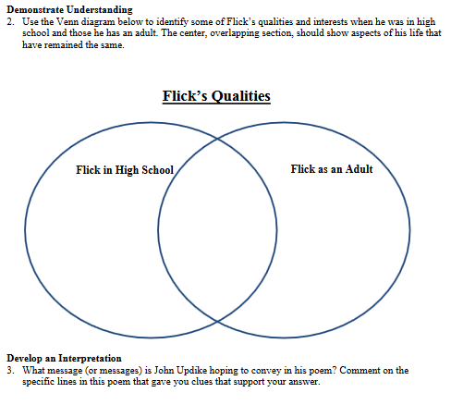

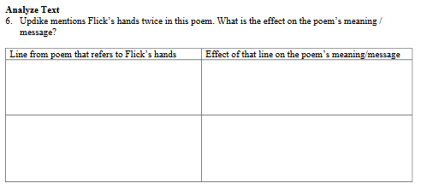

Reading Work Sample Example
Reading Work Sample Example
http://www.oregon.gov/ode/educator-resources/essentialskills/Pages/Reading-Performance-Asmt-Practice-Tasks.aspx
Notes:
Refer to notes on Slide 19

Slide 21

Questions or Clarifications?
Photo: Pixabay
Notes:
Respond to questions from the group, add further clarification, or create a parking lot area to clarify outstanding questions at a later time with more guidance.

Slide 22
Workshop Goals
  Develop Reading Work Samples
  Build background and collaboratively score a reading performance task to build a common understanding of proficiency.
  Review the guidelines for administering Reading Work Samples for the purpose of Essential Skills.

Slide 23

Goal 2:
Official Reading
Scoring Guide
& Calibration

Slide 24




Four Corners Activity
Notes:
4 Corners Activity:
Row boat – just beginning, lots of work, slow going
Motor boat – easier to get from place to place, moves faster
Speed boat – moves quickly
Yacht – can travel long distances with ease, amenities make it easy to handle various conditions

Slide 25
Guiding Questions
    Scoring guide structure?
    Scoring guide language?
    Score levels differences?
    Features of assessed reading responses?
Notes:
This should be a brief activity discussion. We will examine the scoring guide closely in moments.

Slide 26
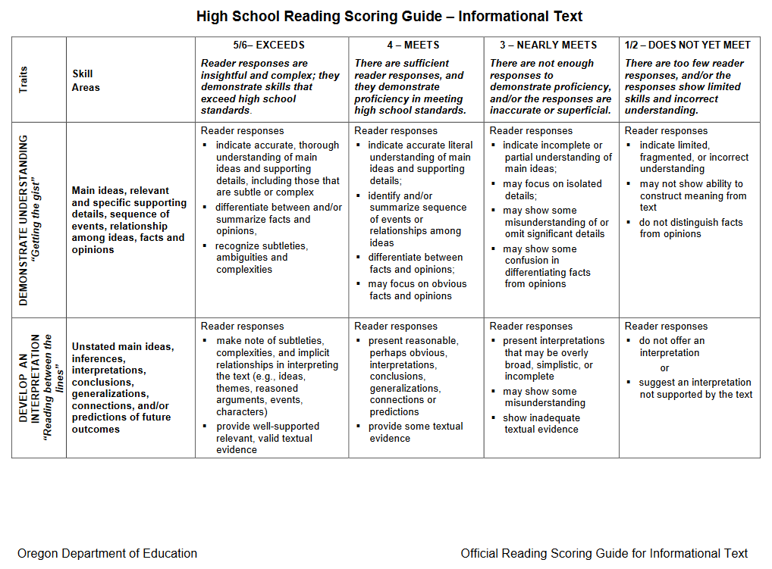
Oregon Official Reading Scoring Guide
Oregon’s Official Reading Scoring Guide
Notes:
Provide a brief overview of the scoring guide(s). We will take a deeper dive shortly. It is important to call attention to the two different Official Reading Scoring Guides: Literacy and Informational

Slide 27

Key Features:
Six-point scale
  Analytic – three traits
    Demonstrate Understanding
    Develop an Interpretation
    Analyze Text
      Literacy Text
      Informational Text

Slide 28

Demonstrate
Understanding
Main ideas
Relevant and specific supporting details
Sequence of events
Relationship among ideas
Facts and opinions

Slide 29

Develop an
Interpretation
Unstated main ideas, inferences,
interpretations, conclusions, generalizations, connections, and/or predictions of future outcomes

Slide 30

Analyze Text
Literary and Informational
Author’s purpose, ideas and reasoning, and writing strategies (e.g., organization, word choice, perspective, format, and, if used, literary devices*)

Slide 31
Highlighting Key Features
Examine the key language at achievement level “4” and highlight using the yellow highlighter.
Examine the key language at achievement level “3” and highlight using the pink highlighter.
Examine the key language at achievement level “5” and highlight using the orange highlighter.
Notes:
Activity: Highlighting Key Feature

Slide 32

Questions or Clarifications?
Photo: Pixabay
Notes:
Activity: Highlighting Key Feature

Slide 33

Anchor Papers
Examples of student work that exemplify the attributes of a certain score level and that serve as a standard against which other papers or performances can be judged.

Slide 34

Gathering Evidence and Scoring
Gathering Evidence
and Scoring
Photo: Pixabay
Notes:
Participants will start by looking at Literary anchor papers and then repeating the steps for Informational anchor papers.
Ideally educators will score three various levels from each genre type, however this could be streamlined to two anchor papers per genre type. The starting anchor paper is recommended to be a medium or on-level passing anchor paper with the other two being a slightly below (med-low) and slightly above (med-high) anchor paper. The purpose of choosing the on level is to firmly create a starting point for educator discussion when looking at the other two anchor papers.

Slide 35
Step 1: Individually
Read and Identify
Evidence
Demonstrate Understanding
Develop An Understanding
Analyzing Text
Identify evidence related to each trait while reading the student writing.
Notes:
This slide is a reminder of the 3 traits that count towards Essential Skills Scoring Traits.
Emphasize the fact that the more familiar a person is with the language of the scoring guide they are using, the quicker the scoring process. Tell participants that you will display this side again when they get ready to score a paper. It already appears in the slide deck again at the appropriate location.

Slide 36
Step 2: Record Key Features from the Scoring Guide
Look for a preponderance of evidence to determine a score.
After you identify pieces of evidence in student essays, record any key vocabulary in the scoring guide as evidence.
Notes:
As participants read the student anchor papers, they will use the highlighted key vocabulary from the Official Reading Scoring Guide to identify the preponderance of evidence - the greater weight of the evidence to decide in favor of one side or the other.

Slide 37

Step 3: Write
Your Scores on a Sticky Note
DU 4
DI 3
AT 3
Notes:
Once participants have read and identified evidence, they will record their score on a sticky note to share with the team during the collaboration and justification activity.

Slide 38
Step 4: Chart Your Scores and Justify in Collaborative Group
Trait | 6 | 5 | 4 | 3 | 2 | 1
Demonstrate Understanding |  | // | //// | /
Develop an Interpretation |  | /// | /// | /
Use of Sources |  | / | /// | ///
Notes:
Teams will share out their scores within their group and a designated recorder will chart the teams scores. Tell participants to focus on traits with discrepancies, try to come to consensus. Each participant should support scores using both language from the scoring guide and evidence from the student writing.
Consensus may not be 100% agreement. Sometimes it is okay to agree to disagree.

Slide 39

Step 5: Compare Your Results With Scores and Commentary
Notes:
Before you show this slide, encourage participants to only look at the scores and commentary for paper A. If they look ahead at other scores they will not get an accurate picture of their own accuracy.

Slide 40

Any Questions
Photo: Pixabay

Slide 41
Individually
Read and Identify
Evidence
Demonstrate Understanding
Develop An Understanding
Analyzing Text
Identify evidence related to each trait while reading the student writing.
Notes:
This slide is a reminder of the 3 traits that count towards Essential Skills Scoring Traits.
This is a time to remind participants that there are two separate scoring guides for Reading Essential Skills: Literary and Informational.

Slide 42
Repeat the Process for Sample B/C
Individually, Read and Identify Evidence
Record Key Features from the Scoring Guide
Write Your Scores on a Sticky Note
Chart Scores and Justify
Compare Your Results With Scores and Commentary
Wait for the next direction before you look at scores and commentary

Slide 43
Informational Calibration
Individually, Read and Identify Evidence
Record Key Features from the Scoring Guide
Write Your Scores on a Sticky Note
Chart Scores and Justify
Compare Your Results With Scores and Commentary
6. Repeat the Process for Sample D
Notes:
Participants will go through a similar activity utilizing the Informational Reading Scoring Guide

Slide 44

Questions or Clarifications?
Photo: Pixabay
Notes:
Respond to questions from the group.

Slide 45
Workshop Goals
  Develop Reading Work Samples
  Build background and collaboratively score a reading performance task to build a common understanding of proficiency.
  Review the guidelines for administering Reading Work Samples for the purpose of Essential Skills.

Slide 46

Goal 3:
Administering Reading Work Samples for Essential Skills

Slide 47
What about Essential Skills?
Work Samples are still one way students can demonstrate proficiency in reading for Essential Skills.
Students produce two passing samples; one must be Literacy / Informational.
The three trait scores add up to a total score of at least 12; with no individual trait score less than a “3”.
Revision is an allowable option.
Notes:
Prior to students completing Work Samples, students should have opportunities to become familiar with the scoring expectations and to discuss their performance in relation to these expectations. Rubrics can be incorporated into instructional experiences so that students receive formative feedback in relation to the rubrics throughout the course.

Slide 48
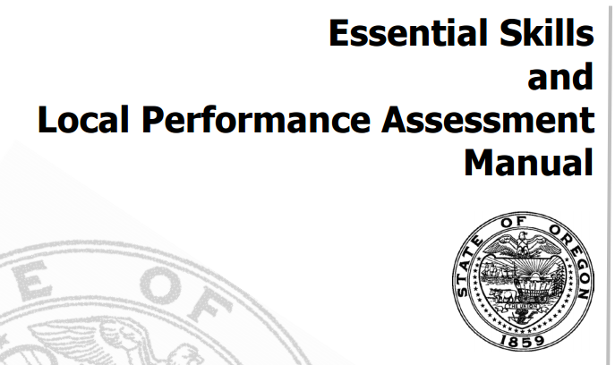
Work Sample Administration
Work Sample Administration
Notes:
Refer to ES manual for recommendations, requirements, and clarifications.

Slide 49
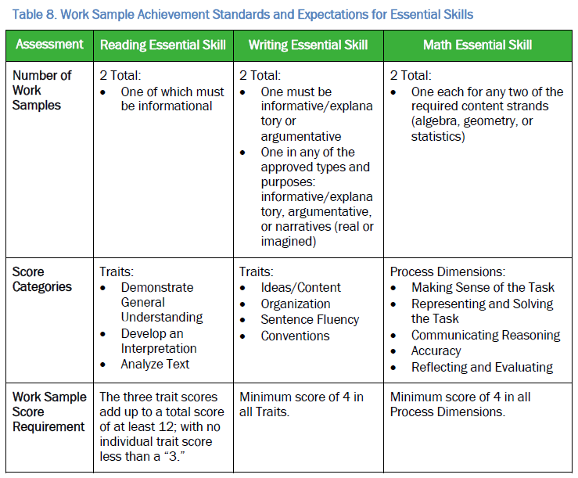

Work Sample Administration
Work Sample Administration
Notes:
Scores on each trait take into account all student work. This includes notes created in the margins and account for responses in other trait area that apply to additional trait categories.

Slide 50
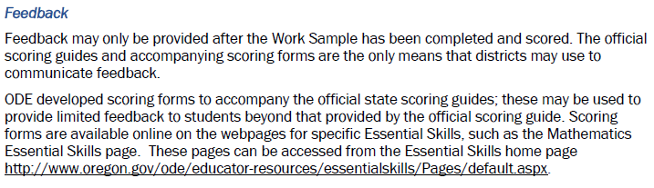
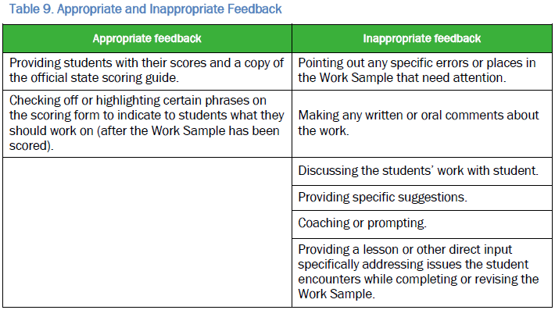
Work Sample Administration
Work Sample Administration
Appropriate Feedback
Notes:
Important to review and discuss appropriate and inappropriate feedback. Students must complete their Work Samples independently with no inappropriate feedback (see Table 9. Appropriate and Inappropriate Feedback) coaching, or editing from anyone, including educators, parents, or peers. Work Samples must reflect independent, individual student work only.

Slide 51
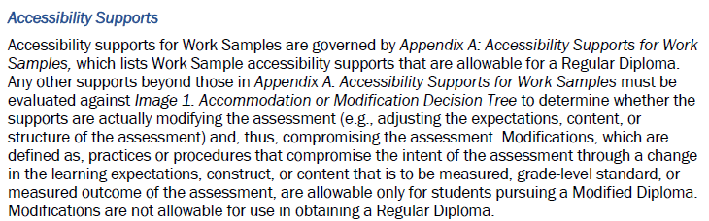
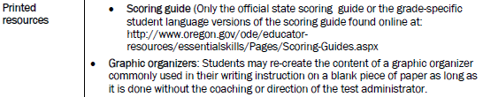
Work Sample Administration
Work Sample Administration

Slide 52
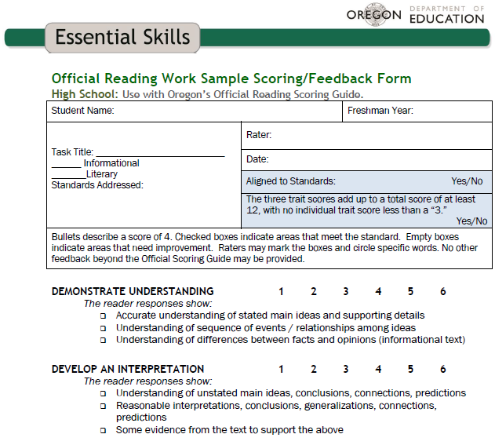
Work Sample Administration
Work Sample Administration
Appropriate Feedback (Essential Skills)
Notes:
Inform participants this is a portion of the Feedback Form.
Extended activity: Participants refer back to highlighting a blank Official Reading Scoring Guide as a feedback tool or complete the Essential Skills feedback form.

Slide 53

Work Sample Resources
Work Sample Resource
Task Bank and Scoring
Notes:
Remind educators that they may contact WESD to access ORSkills and other reading work samples that have already been developed.

Slide 54

Contact Information
Contact Information
Tony Bertrand
ELA & Social Sciences
Assessment Specialist
É503-947-5832
* tony.bertrand@state.or.us

