Slide 1
Oregon Statewide Assessment System Student Educational Equity Development Survey (SEED Survey)
Required for DTCs, STCs, TAs, and any educator who administers the SEED Survey
Notes:
Welcome to the Oregon Statewide Assessment System training module for the SEED Survey. This module is a required part of annual training for all district and school test coordinators, as well as test administrators and any other educators who will also administer the SEED Survey.

Slide 2
Topics
Overview of the Student Educational Equity Development Survey (SEED Survey)
Administration Features for the SEED Survey
Student Access to the SEED Survey
Accessibility Features for the SEED Survey
Notes:
This training module includes an:
Overview of the Student Educational Equity Development Survey (SEED Survey)
Administration Features for the SEED Survey
Student Access to the SEED Survey
Accessibility Features for the SEED Survey

Slide 3
Overview of the SEED Survey
Notes:
We’ll begin with an Overview of the SEED Survey

Slide 4
What is the SEED Survey?
The SEED Survey is a short student survey designed to gather information about the educational experiences of students in Oregon. It gives ODE, districts, and schools access to student voice, data regarding local investments, and additional insight into other state and local data.
Notes:
The Student Educational Equity Development Survey (SEED) will help the Oregon Department of Education gather information about the educational experiences of students in Oregon. This information will help ODE to develop appropriate resources and supports for districts in Oregon, and better target those resources and supports where they are most needed. The SEED Survey will also help ODE better interpret information we are already gathering through statewide testing.
SEED Survey information may also help districts develop a fuller picture of their local context and make strategic modifications to curriculum, instruction, and academic supports provided to students.

Slide 5
Purpose of SEED Survey
Data from the SEED Survey will be used to support the following purposes:
Hear directly from students about their experiences
Provide Oregon districts with actionable data regarding investments used to increase student group outcomes
Better interpret state and local test results
Expand reporting beyond test scores
Notes:
Data from the survey will be used to support the following purposes:
1. Honor the importance and necessity of incorporating student voices into the continuous improvement process for Oregon’s public education systems
2. Provide Oregon districts with actionable data regarding investments and quality pedagogy that can be used to increase student group outcomes such as academic achievement, graduation rates, and post-secondary success
3. Develop promising practices using the SEED Survey data independently and in combination with state and local data
4. Expand reporting to include information in addition to test scores that can help districts tell a more complete story about how they are serving students

Slide 6
ODE SEED Survey Administration
Per HB2656, the SEED Survey must be made available to students.
The SEED Survey is for Oregon students in Grades 3-11 and is administered through the Test Delivery System in-person or remotely.
The Alternate SEED Survey is for Oregon students in grades 3-11 who participate in alternate assessment. It is administered through the ORK12Test.com system.
SEED administration window: February 4 – June 13, 2025
The SEED Survey is projected to take 10-20 minutes.
More information about the Alt SEED Survey for students experiencing significant cognitive disabilities can be found on the ODE SEED Survey web page and the BRT Training and Proficiency Website.
Notes:
Overview of the ODE SEED Survey Administration
Per House Bill 2656, the (SEED) Survey must be made available to students starting in 2023-24.
The survey window is scheduled to run from February 4 to June 13, 2025 for students in grades 3-11
The SEED Survey will be administered through the OSAS Portal or a remote proctoring system.
The Alt SEED Survey will be administered through the ORK12Test.com System.
The SEED Survey is projected to take 10-20 minutes.
More information about the Alt SEED Survey for students experiencing significant cognitive disabilities can be found on the ODE SEED Survey webpage and the BRT Training and Proficiency Website.

Slide 7
Design of the SEED Survey
Core Topics
Access to Learning Resources
Opportunity to Learn
Self-Efficacy Beliefs
Sense of Belonging
Grades 3-5: Core Topics, plus:
Well-Rounded Education
Grades 6-11: Core Topics, plus:
Career/Technical Education
Extracurricular Engagement
Post-Graduation Planning (Grade 9-11 only)
Access to Learning Resources
Opportunity
to Learn
Student
Outcomes
Additional Grade Level Constructs
Sense of Belonging
Self-Efficacy Beliefs
Notes:
The topics addressed on the SEED Survey are informed by survey design approaches taken by several established national and international measures
The SEED Survey will measure student perceptions in four core topics:
Access to Learning Resources
Opportunity to Learn
Student Self-Efficacy Beliefs
Sense of Belonging
The Opportunity to Learn and Self-Efficacy topics focus on specific content areas in each grade level.

Slide 8
Topic Overview
Access to Learning Resources Grades: All Do students have the necessary resources to access instruction? | Sense of Belonging Grades: All Do students feel a unique sense of identity? Do they feel included and accepted as a member of their school community? | Opportunity to Learn Grades: All* Have students been exposed to classroom opportunities, activities, and specific content which facilitate learning? | Self-Efficacy Beliefs Grades: All* Do students believe themselves capable of performing tasks relating to a specific content area?
Well-Rounded Education Grades: 3-5, 7-11 Do students have access to classes from a wide variety of disciplines, including the arts, music, and physical education in addition to ELA, math, and science? | Career/Technical Education Grades: 6-11 Do students have resources and opportunities available in school to help them connect their learning to careers, develop technical skills and knowledge, and prepare for post-secondary goals? | Extracurricular Engagement Grades: 6-11 In what opportunities and activities do students participate within their schools and communities that foster meaningful connections to life, culture, and learning? | Post-Graduation Planning Grades: 9-11 What opportunities is a student considering in their first year after high school?
* ELA is included in Grades 3, 6, & 9. Math is included in Grades 4, 7, & 10. Science is included in Grades 5, 8, & 11.
Notes:
The following slide provides an overview of the different topics included in the SEED Survey

Slide 9
SEED Survey Topics by Grade
Grade | 3 | 4 | 5 | 6 | 7 | 8 | 9 | 10 | 11
Access to Learning Resources | X | X | X | X | X | X | X | X | X
Opportunity to Learn* | X | X | X | X | X | X | X | X | X
Self-Efficacy Beliefs* | X | X | X | X | X | X | X | X | X
Sense of Belonging | X | X | X | X | X | X | X | X | X
Well-Rounded Education | X | X | X |  | X | X | X | X | X
Career/Technical Education |  |  |  | X | X | X | X | X | X
Extracurricular Engagement |  |  |  | X | X | X | X | X | X
Post-Graduation Planning |  |  |  |  |  |  | X | X | X
* ELA is included in Grades 3, 6, & 9. Math is included in Grades 4, 7, & 10. Science is included in Grades 5, 8, & 11.
Notes:
The Opportunity To Learn and Self-Efficacy topics focus on specific content areas in each grade level. For instance…
Grade 3 reviews OTL and Self-Efficacy in English language arts, Grade 4 in mathematics, and Grade 5 in science.
That same cycle repeats in Grades 6, 7, and 8, and 9, 10, and 11 respectively.
Additional opportunity to learn items for Native American Culture/History are included for grades 4-11
The high school surveys includes all core constructs and additional constructs.
All grade levels will have survey questions specific to Sense of Belonging.
Grades 3-5 and 7-11 contains questions about Well-Rounded Education. Grades 6-8 and 11 includes questions pertaining to Career-Technical Education and Extra-curricular Engagement.
The last component, Post-Graduation Planning applies to grades 9-11.

Slide 10
Alt-SEED Survey Topics by Grade
Grade | 3 | 4 | 5 | 6 | 7 | 8 | 9 | 10 | 11
Access to Learning Resources | X | X | X | X | X | X | X | X | X
Opportunity to Learn | X | X | X | X | X | X | X | X | X
Independence | X | X | X | X | X | X | X | X | X
Sense of Belonging | X | X | X | X | X | X | X | X | X
Notes:
The Alt-SEED Survey includes questions on the four core topics, with self-efficacy replaced by independence.

Slide 11
Administration Features for the SEED Survey
Notes:
Administration Features for the (SEED Survey)

Slide 12
SEED Survey Administration Options
Assignment: Survey is delivered via a URL web address that is generated by an authorized user. Students access the survey through a web browser.
Secure Browser: Survey is delivered on site, via a test session, by a TA. Students access the survey via the Secure Browser with a test session ID.
Remote Test Session: Survey is delivered off site, via a test session, by a TA. Students access the survey via the Secure Browser or a web browser with a URL and a test session ID.
Alternate SEED Survey: The Alt SEED Survey is completed through the ORK12test.com system by an authorized user (QA or QT). The survey should be completed by an educator who is most familiar with the student’s education experience.
Notes:
The SEED Survey provides 3 administration options.
An ongoing open survey session may be created by an authorized user (DTC, STC, TA) using the assignment function.
The ‘assignment’ may be scheduled in advance and the authorized user can provide the URL address to students to log into the SEED Survey during the school hours provided for completion. Students may also access this URL later in case they were unable to finish or missed the survey opportunity at school.
Test administrators (TAs) will have the option to proctor the assessment ‘live’ via a test session and the secure browser.
Students would log into the SEED Survey using the OSAS Secure Browser, just as they would when taking a statewide summative assessment.
The remote administration option requires additional steps in addition to this Training 8 Module. A DTC or TA would need to complete Module 10: Remote Testing, and the Remote Proctoring Certification Course.
After completing the certification course educators will automatically be provided the remote proctoring option within their TA user account.
The remote proctoring option will allow the DTC or TA to create a remote URL address, which can be shared with students in lieu of using the OSAS Secure Browser.
The Alternate SEED Survey is completed in the ORK12Test.com system by an authorized user. The survey should be completed by an educator who is familiar with the student’s educational experience. If the educator completing the Alt SEED Survey is not an authorized user, they may complete the paper/pencil version of the Alt SEED Survey and have an authorized user input the data into the ORK12Test.com system.

Slide 13
Student Access to the SEED Survey
Notes:
Student access to the SEED Survey

Slide 14
Student Access to the SEED Survey
Students will take the SEED Survey through the OSAS Secure Browser or a web browser (Chrome or Firefox) when taking the survey remotely.
The “assignment” administration feature in the Test Delivery System will allow students to take the survey in a test window selected by a DTC or TA.
Notes:
As mentioned earlier a DTC or TA can administer the SEED Survey using one of three options. This means student will be able to access the SEED Survey via the OSAS Secure Browser or a URL address. Students will not need to download the secure browser to their device to access the SEED Survey for remote participation. It is recommended students use a Chrome browser.
The “assignment” feature in the test delivery system will allow students to take the survey in an test session within a test window selected by a DTC or TA.

Slide 15
Student Access to the SEED Survey
While the survey should be coordinated and conducted as an activity during the school day, students are expected to participate and respond independently given the nature of some of the questions.
DTCs or TAs should not read the questions aloud to the entire class and proceed as a group.
Students will need their SSID numbers to access the SEED Survey.
If students are accessing the SEED Survey remotely, please refer to the Test Administration Manual Section 2.5 Student Confidentiality for guidance in providing students their SSID numbers
Notes:
While an educator should provide coordinated class time complete the SEED Survey, educators should not read the survey aloud for the entire class to ensure students are allowed to independently respond to the questions.
If students need support reading the survey questions, please refer to the accessibility section of this training module.
Similar to the summative and interim assessments, students will need to either know or have access to their SSID numbers to access and participate in the SEED Survey. If students are currently in a distance learning or remote learning environment and educators can not physically provide students with their SSID numbers, refer to the Test Administration Manual Section 2.5 Student Confidentiality , which contains additional guidance on secure transmission of SSID numbers.
https://www.oregon.gov/ode/educator-resources/assessment/Documents/test_admin_manual.pdf

Slide 16
Accessibility Features for the SEED Survey
Notes:
Accessibility Features for the (SEED Survey)

Slide 17
Accessibility Supports for the SEED Survey
The 2024 survey is available in English, Spanish, Russian, Vietnamese, Ukrainian, Traditional Chinese, and Simplified Chinese.
The survey is administered in the same Test Delivery System as Oregon’s summative assessments. A list of available accessibility supports can be found in the Oregon Accessibility Manual.
When the survey is given as an assignment, student dependent accessibility supports need to be selected in TIDE before the web address (URL) is sent to the student.
Notes:
The 2024 survey is available in English, Spanish, Russian, Vietnamese, Ukrainian, Traditional Chinese and Simplified Chinese.
The survey is administered through the same test delivery system as Oregon’s summative assessments. A list of available accessibility and supporting guidance can be found in the Oregon Accessibility Manual.
As stated previously, the SEED Survey may be provided to students in-person using the secure browser, within a proctored remote administration using either the secure browser or a web browser, or as an ‘assignment’. Please note that when a survey is given as an ‘assignment’, student accessibility supports need to be selected in TIDE before the web address is sent to the student.

Slide 18
Additional SEED Survey Resources
Notes:
Additional SEED Survey Resources

Slide 19
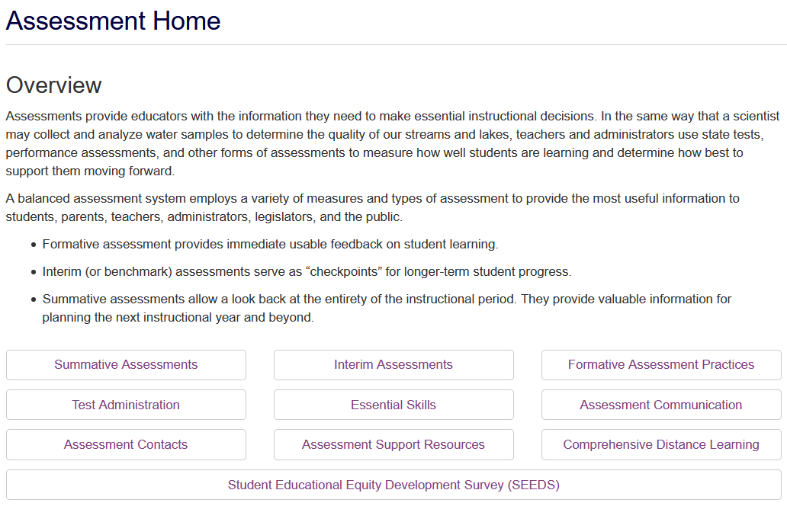
Seed Survey Resources
OSAS Portal
Notes:
For access to resources discussed in this training or for additional resources for the SEED Survey, please navigate to ODE Assessment homepage.
https://www.oregon.gov/ode/educator-resources/assessment/Pages/default.aspx

Slide 20
SEED Survey Resources
Resources available on ODE’s SEED Survey webpage include:
Parent notification and participation sample letters in 15 languages
The SEED Administration Manual
Communication toolkit designed to help districts communicate the purpose of the SEED Survey to staff, students, and families
SEED Survey items in 7 languages
A practice SEED Survey for students in grades 3-5
Previous SEED Survey results and Research Briefs
Notes:
The resources available on ODE’s SEED Survey webpage include
Parent notification and participation sample letters in 15 languages
The SEED Administration Manual
Communication toolkit designed to help districts communicate the purpose of the SEED Survey to staff, students, and families
SEED Survey items in 7 languages
A practice SEED Survey for students in grades 3-5
Previous SEED Survey results and Research Briefs
https://www.oregon.gov/ode/educator-resources/assessment/Documents/SEED%20Survey%20Communication%20Toolkit.pdf

Slide 21
Thank you!
Questions? Contact the ODE Assessment Team!
Notes:
This concludes the OSAS training module on the SEED Survey. Please don’t hesitate to reach out to ODE’s Assessment Team at the email address on this slide with questions.
Thank you for your time!

