Slide 1
Test Coordinator Training for Summative Assessments
Oregon Statewide Assessment System (OSAS)
Required for DTCs & STCs
Notes:
This is the test coordinator training module for Oregon’s statewide summative assessment system, required for all district and school test coordinators.
This is the first of a series of annually required training modules organized into the following topics:
Test Coordinators
Test Administrators
Accessibility Supports
Test Security
Summative assessment in English Language Arts (ELA) and Mathematics
Summative assessment in Science
Oregon’s Summative English Language Proficiency Assessment
Interim Assessment Remote Administration and Test Security
SEED Survey
Remote Test Administration

Slide 2
The Right Assessment for the Right Purpose
The Oregon Department of Education is committed to working with community partners to increase assessment literacy
The Right Assessment for the Right Purpose provides information in the following areas:
Shared understanding of a balanced approach to assessment
Common definitions for assessment types and purposes
Appropriate and inappropriate uses of assessment data
Critical considerations about testing time for our statewide summative assessments
Notes:
In 2019, ODE Assessment replaced its Best Practices Manual a guidance document called ”The Right Assessment for the Right Purpose”. The document provides definitions for critical terms in our Oregon Statewide assessment System (OSAS) and in other areas where Oregon students are assessed in terms of academic achievement, behavior, or other constructs as part of their instructional programs. The document also addresses current questions and appropriate uses and, perhaps just as importantly, misuses of statewide summative assessment data. It is critical that Oregon educators choose assessments that have sufficient technical adequacy documentation, and use those assessments according to the purposes for which they were designed.
This document addresses K-12 student assessment only. It will be revised periodically to reflect the ongoing assessment conversation in Oregon.

Slide 3
Required Training Format
Organized into short modules
Designed to be delivered to district and school staff
Focus on resource orientation
Built in Q&A discussion opportunities
Notes:
ODE has developed the annually required state test administration training to be provided in short, content-specific modules that can be delivered directly to district and school staff who will be serving as District Level Users (DLU), School Test Coordinators (STC), or Test Administrators (TA). These modules do not attempt to address every requirement, policy, or consideration that each of these roles need to understand and follow for successful testing. The focus of these modules is to provide an overview of major topics and serve as an orientation to the manuals and other resources available.
Each required module includes optional points to pause and discuss questions provided or to insert locally developed questions relevant to the topic. These slides are indicated by a blank slide layout with Q&A Discussion as the title and may be edited for local use. These discussions should connect testing requirements to local context as well as allow for clarification during training, thereby incorporating the Q&A requirement referenced in the TAM.
ODE has also developed optional one-page facilitation guides to accompany each module. These facilitation guides are intended to provide a high level summary of the topics included in each required module and connect these topics to additional, supplemental resources that support best practices for testing. Also, appropriate places to insert into the training modules references to local policies or procedures are indicated in the notes of the PowerPoint presentation version of each module as well as the facilitation guide.

Slide 4
Test Coordinator Training Topics
Roles & Responsibilities
Training
Scheduling
Student testing options
Student Participation
Resources
Notes:
The topics included in this presentation are test coordinator roles and responsibilities, training requirements for each role, scheduling testing, student testing options, participation, and additional resources.

Slide 5
Roles and Responsibilities
Clear expectations around roles and responsibilities creates an efficient and comprehensive student testing experience.
Notes:
The following slides address the roles of District and School Test Coordinators.

Slide 6
The Roles of a District Test Coordinator (DTC)
Test administration and security training
Coordinate access to OSAS System and testing data
Coordinate testing logistics and student testing options
Ensuring that Crisis Alerts are received by appropriate district personnel
Investigate and report test improprieties/irregularities to ODE
(Non-exhaustive list; see TAM and the Assessment and Accountability Checklist)
TAM, Section 1.4: User Roles and Responsibilities
Notes:
DTCs are responsible for ensuring:
- All district and school staff involved in state testing receive the annual required training in test administration and security.
- DTCs are expected to coordinate and monitor which staff have access to the testing system and secure testing materials and data, which involves setting up the Oregon Statewide Assessment System (OSAS) Portal user accounts with appropriate levels of access.
- Testing logistics handled by the DTC include tasks such as coordinating district- and school-imposed test windows, considering the maintenance of secure storage and distribution of paper test materials, and coordinating with the local network administrator or IT department to ensure technical requirements are met for testing.
- DTCs are expected to manage student testing options such as coordinating and monitoring student test settings in TIDE, ensuring students have access to the correct accessibility supports and test formats, such as extended or Braille, as well as ordering any paper testing materials including Large Print or Braille Extended tests.
- DTCs are encouraged to work with other district administrators and staff to develop and implement formal procedures for handling student Crisis Response papers in a timely manner. ODE can provide resources that can support districts in meeting this expectation upon request.
- It is the sole responsibility of DTCs to investigate and report testing improprieties and irregularities to ODE Test Security. Improprieties and irregularities will be covered in more depth in Module 4: Test Security.
The DTC is the official district point of contact with ODE but each DTC may appoint one or more District Level Users (DLUs) to assist with these duties.

Slide 7
The Roles of a School Test Coordinator (STC)
Ensure all TAs are trained
Ensure that all students participate in required assessments
Coordinate testing logistics and test schedules for your school
Coordinate student testing options for students in your school
Support DTCs in investigating test improprieties
TAM, Section 1.4: User Roles and Responsibilities
Notes:
STCs are responsible for the following activities at the school level in support to the DTC:
- STCs are expected to ensure that all school staff involved in state testing receive the required annual training in test administration and security, including folks other than teachers such as classroom aides, instructional support staff, substitutes, and classroom volunteers.
- As the primary point of contact for testing at each school, the STC is expected to monitor student progress during testing and to ensure adequate documentation is obtained from the parent or guardian choosing to opt their child(ren) out of required state testing.
- STCs are expected to coordinate school specific test schedules, ensure secure storage and distribution of all paper test materials, and collaborate with school network administrator or IT support to ensure technical requirements are met for testing.
- STCs are expected to coordinate and monitor student testing options such as test settings in TIDE, ensuring students have access to the correct accessibility supports and test formats, such as extended or Braille.
- It is necessary for STCs to support DTC investigation of any test improprieties or irregularities.
[DTC may reference or insert local policies or protocols that support the responsibilities and duties of the STC.]

Slide 8
Training
Ensure consistency in test administration and support equitable and secure testing environments for students across schools and districts.
Notes:
The following slides address training.

Slide 9
Staff Training
Ensure that all STCs and TAs:
Receive annual training
Read and understand the Test Administration Manual
Sign assurance of test security form
Ensure that all non-TAs with access to the secure test environment or materials:
Understand the importance of maintaining security
Sign assurance of test security form
TAM, Section 1.5: Training Requirements
Notes:
One of the most important roles of the DTC is to ensure that all STCs and TAs are trained annually. In addition to using the ODE-provided training modules, STCs and TAs must read the required sections of the current year’s TAM and OAM as well as submit the correct completed Assurance of Test Security form. Once trained, STCs can assist the DTC in training TAs within their school. Please note that any individual who will be interacting with students during administration of an Oregon Statewide Assessment is considered a TA and must complete the training.
To protect the security and validity of the assessments, DTCs are also responsible for ensuring that all non-TAs understand the importance of maintaining security and have submitted a signed Non-TA Assurance of Test Security form. This includes any person with access to the secure test environment or materials but who will not be interacting with students during administration of a test, such as front office or technology staff.

Slide 10
Test Administrator (TA) Training Considerations
Use ODE-provided modules
Incorporate discussion and check for comprehension in training
Coordinate to identify all staff who need training
Example: administration of the Alt ELPA will involve both English language development and Special Education personnel.
TAM, Section 1.5: Training Requirements
Notes:
To review the highlights that test coordinators must follow when planning their local STC and TA trainings, first use these ODE-provided modules.
Second, be sure to incorporate discussion, questions, and checks for comprehension into the trainings. Whether you are delivering the modules in-person or having staff review them in advance, it is essential to ensure that staff have an opportunity to discuss requirements and seek clarification. This is also a great opportunity to engage staff in applying the requirements to your local context. Optional pause points to incorporate discussion have been built into the training modules.
Third, coordinate with others in your district or school to identify all staff who need training. This may mean reaching out to the local EL coordinator to identify staff administering the ELPA or ELPA screener or the local Special Education coordinator to identify staff who will be administering the Oregon Extended Assessments or the online tests in Braille. This may also involve identifying substitute teachers who may be involved in testing to ensure they are trained. Some districts may benefit from coordinating regionally on this point.
[TCs may insert local policies/protocols for training at this point.]

Slide 11
Test Administrator (TA) Training Required Modules
Module 2: TA Training
Module 3: Accessibility Supports
Module 4: Test Security
Module 5: ELA and Mathematics
Module 6: Science
Module 7: ELPA
Module 8: Interim Assessment Remote Administration
Module 9: SEED Survey
Module 10: Remote Test Administration
Required for all TAs
Required for TAs based on the test(s) they will administer
Test Administration and Security Training Modules
Notes:
Here is a quick overview of the training modules that TAs are required to review. Modules 2, 3, and 4 are required for all TAs. Modules 5 through 9 are specific to the test the TA will administer, or, in the case of Module 8, the way that the interim assessment can be delivered remotely. Module 10 is for any TA who will be administering the summative assessment remotely. For example, a TA who is only administering ELPA in person is required to review Modules 2, 3, 4, and 7 but does not need to review Modules 5, 6, 8, 9, or 10.

Slide 12
Training Considerations
Trainings can incorporate independent study time for added flexibility
Track which staff have received training and signed an Assurance Form
Access to the OSAS System may be granted to staff only upon completion of training requirements
Develop a plan to provide “make-up” training to new hires or substitutes who will be involved in test administration
Provide a brief refresher training or supplemental resources before the start of each testing window
TA Training Promising Practices
Notes:
Although the minimal required components for the annual training are established in the TAM, facilitation of those components may be locally determined. Some DTCs have reported that incorporating independent study time for added flexibility has proven to be successful. Establishing a system to track which staff have received training and submitted a signed assurance form is useful, regardless of the number of staff. TCs may only grant OSAS Portal user accounts after staff have completed the training requirements. Anticipate how to handle make-up trainings to account for new hires, unanticipated substitutes, or volunteers. If the training is completed before Winter Break, provide a refresher or supplemental resources just before the start of each testing window. You can find these and other training facilitation tips in the TA Training promising practices document available at the link at the bottom of the slide.
[DTCs may insert local policies/protocols for STCs to use for training facilitation at this point.]

Slide 13
Supporting Staff in Test Administration
Disseminate ODE-issued testing updates and alerts to staff involved in state testing*
Weekly AA Update
DTC Alerts
Reminders about test windows and downtimes
Respond to questions from staff using Regional ESD Partners when necessary
* Monthly informal DTC webinars with ODE are another resource to get updates, ask questions, and share ideas with your peers
TAM, Section 1.5: Training Requirements
Notes:
In addition to ensuring that all staff receive their training before testing begins, test coordinators are also responsible for ensuring that all staff involved with testing receive any ODE-issued testing updates throughout the year. Examples include the weekly Assessment & Accountability Update sent out to DTCs and others who have signed up to receive it each Thursday, just-in-time alerts sent out to the DTC Listserv, and reminders about upcoming test windows, data submission deadlines, and scheduled downtimes. The Assessment & Accountability Checklist is a great resource for tracking upcoming events and due dates. Another communication resource available to DTCs to stay on top of the latest information is the monthly informal DTC webinars hosted by ODE. The schedule of webinars and links to join are included in the AA Updates.

Slide 14
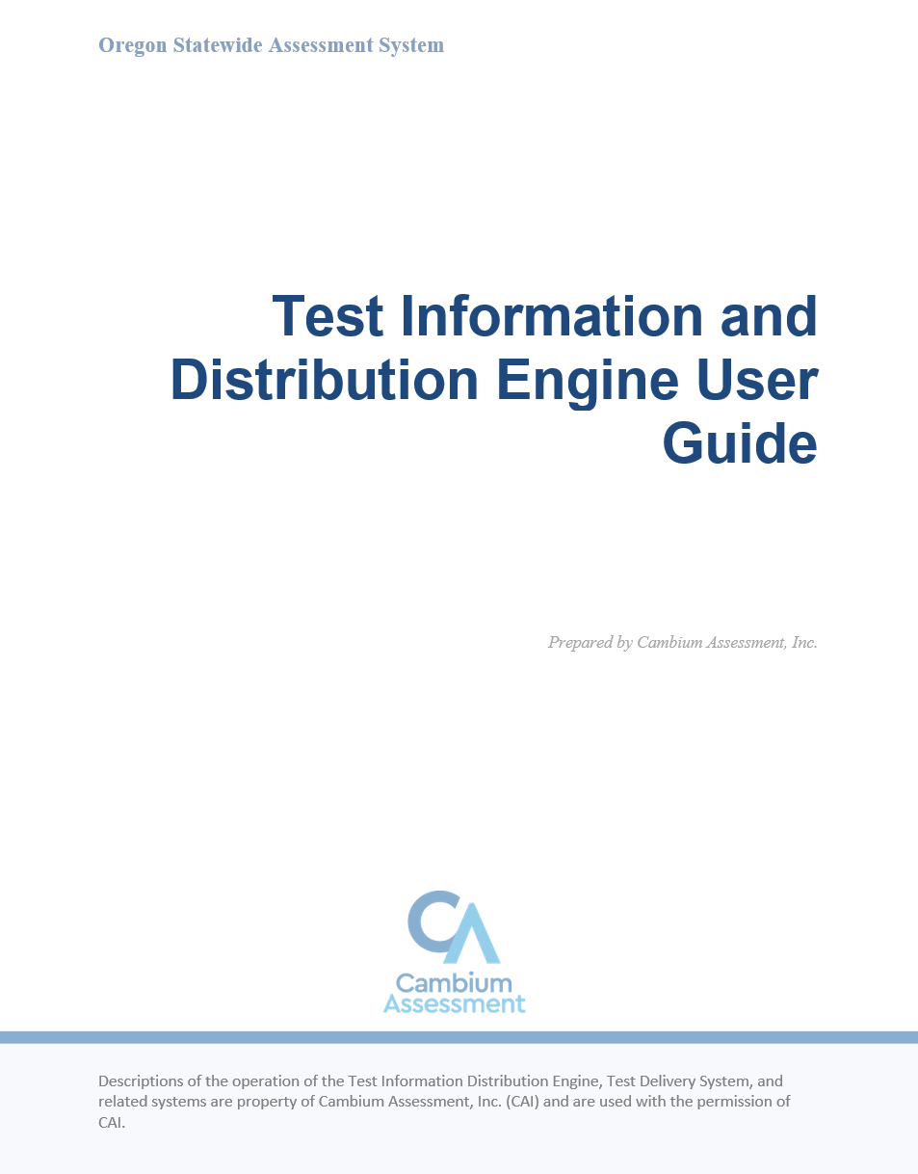
Creating User Accounts in TIDE
One “DTC” allowed per district; multiple “District Level User” roles permitted
DTC creates district- and school-level accounts:
District Level Users
District Report Viewers
School Test Coordinators
School Report Viewers
Test Administrators
Test Technicians
TIDE User Guide
Notes:
Once staff have been trained, DTCs are also responsible for creating accounts in the OSAS System. STCs can also create user accounts for SRVs, TAs, and TTs within their school. Step by step instructions for creating district- and school-level accounts as well as descriptions of each user type are included in the TIDE User Guide.
[DTCs may insert local policies/protocols for STCs for creating user accounts at this point in the training.]

Slide 15
Q & A Discussion
What are the local considerations and challenges around training within your school or district?
What are some effective approaches you could use to address these challenges?
Who within your school or district needs to be included when coordinating TA training?
What resources do you plan to use to assist you in planning and implementing TA training?
Notes:
This is an optional point in the required training to pause and discuss the questions provided or a locally developed set of relevant questions. If you would like to pause, please pause now.
Suggested activities:
-Small groups: use post-its to capture local considerations and challenges, one per sheet. Mount post-its.
-Large group: facilitate review/summary of considerations/challenges from across the large group
-Small groups: share effective approaches, look at artifacts
-Large group: facilitate share out, writing down approaches via chart pack
-Small group or individual: use note organizer to capture take-homes, next steps

Slide 16
Scheduling
Provide students adequate resources such as technology, space, and time to demonstrate what they know and can do on the test.
Notes:
The next few slides will cover scheduling.

Slide 17
Statewide Summative Test Schedule
Test | Window
ELPA Summative (in-person), Alt ELPA | January – April
ELPA Summative (remote) | March – April
ELA, Math, Science Summative Grade 11, including remote | February – June
ELA, Math, Science Summative Grades 3-8, including remote | March – June
For exact dates, see statewide test schedule in the TAM and on ODE’s Test Administration webpage.
TAM, Appendix A: Oregon Statewide Summative Test Schedule
Notes:
Here is a general overview of the Statewide Test Schedule. The complete statewide schedule for the current school year can be found in Appendix A of the TAM and is also linked from ODE’s Test Administration webpage. The SEED Survey is not a test, but has been included in this schedule, as it is linked to testing.
All district and school testing windows must fall within the statewide testing windows.

Slide 18
School-Level Test Windows: Scheduling Considerations
Tests are not timed
Test times vary by grade and subject
Use average test times in the TAM to guide scheduling
TAM, Section 5: Scheduling Test Administration
TAM, Section 6: Planning for Test Administration
Notes:
When setting your school-level test windows, keep in mind that the tests are not timed and students should be allowed to continue testing as long as they are making progress. While there is no set time limit, schools may find it helpful to set schedules using the estimated testing times table in Section 5.1 of the TAM. This shows times based on the 80th percentile, or the amount of time needed for 80% of students to complete the test. Many students will finish faster and some (approximately 20%) may require additional time.
When planning your test schedule, consider the options for breaking up the test across multiple test sessions or days. Section 6.4 of the TAM includes information about the pause rules and test expirations that apply by test.

Slide 19
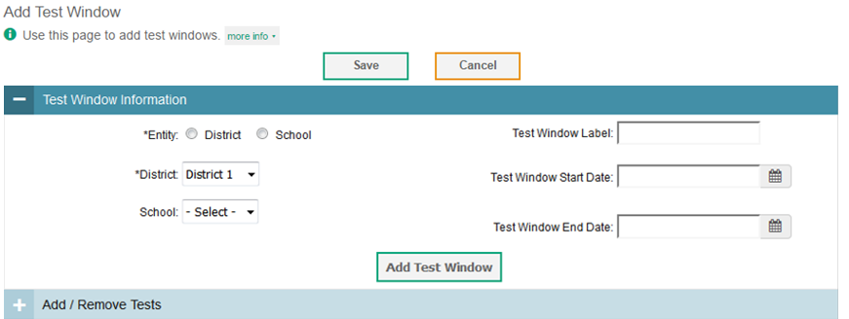
Managing School-Level Test Windows
District Test Coordinators, District-Level Users, and School Test Coordinators may set school-level test windows by grade and subject in TIDE
The TA interface will only list tests included in a test session during that test’s school-level test window
Recommended (but not required) to help districts ensure that the correct tests are administered at the right time
TIDE User Guide
Notes:
As an optional tool, TIDE will enable DTCs, DLUs, or STCs to set school-level test windows by grade and subject. Shown on the slide is a mock-up of the tool. This optional tool can be a helpful in preventing TAs from inadvertently including incorrect tests in testing sessions and approving students to start the wrong test.

Slide 20
Building a Testing Schedule
Inventory all potential locations and devices for testing
Identify students who will be taking each test
Determine non-negotiables:
Previously scheduled events during testing
Sequence of grade levels and tests considering recommendations
Days of week and what time of day for testing
Schedule Format
Plan for transition time (traveling to and from testing location, logging in and out, etc.)
Build in make-up sessions throughout testing
Plan for schedule adjustment processes
Plan staff, student, and parent communication
Notes:
Building a testing schedule at any school can become a very complex task. Here are some suggestions of considerations for building a testing schedule. First, take an inventory of all potential locations and devices that will be used for testing. Starting with a clear picture of the space and technology resources will help identify potential resource issues early in the planning process. Second, identify students who will be taking each test. Don’t forget to consider special accommodations such as Braille interface or students taking the extended versions of ELA, math, or science. Early identification of students who will be taking multiple tests can inform later decisions to mitigate student testing fatigue. Next, determine your non-negotiables. These are unique to each school or district and should be a reflection of your local values, school culture, and priorities. Examples of non-negotiables are previously scheduled events during testing that should be avoided, such as a field trip for an entire grade level. The preferred sequence of grade levels and tests, after taking into consideration the recommendations provided in the TAM, may differ depending upon the grade configuration of your school or district. The days of the week and time of day that testing will be held, such as avoiding Fridays or testing only in the mornings, should be decided up front. Schedule format could be scheduled to the minute or very flexible, and should align with established local practices. As the testing schedule begins to take shape, build in make-up sessions throughout testing. Waiting until the end of the testing window is not a best practice and may put completing performance tasks at risk. Anticipate and plan for schedule adjustment processes so that alterations can be made during testing when necessary with minimal disruption. Finally, don’t forget to include plans to communicate the testing schedule to staff, students, and the community. Remember that the testing schedule should ensure that adequate resources such as technology, space, and time are provided to students so that they are best able to demonstrate what they know and can do on the tests.

Slide 21
Q & A Discussion
What are the local considerations and challenges around scheduling within your school or district?
What are some effective approaches you could use to address these challenges?
Who within your school or district needs to be included when coordinating your school-level test windows and schedules?
What resources are available to assist you in planning and managing your school-level test windows and schedules?
Notes:
This is an optional point in the required training to pause and discuss the questions provided or a locally developed set of relevant questions. If you would like to pause, please pause now.
Suggested activities:
-Small groups: use post-its to capture local considerations and challenges, one per sheet. Mount post-its.
-Large group: facilitate review/summary of considerations/challenges from across the large group
-Small groups: share effective approaches, look at artifacts
-Large group: facilitate share out, writing down approaches via chart pack
-Small group or individual: use note organizer to capture take-homes, next steps

Slide 22
Student Testing Options
Adequate planning ensures that students have access to appropriate and necessary resources.
Notes:
Now we will cover student testing options.

Slide 23
Student Summative Assessment Options: Challenging Up to a Higher Grade Level Test
For the OSAS ELA & Math Tests, students in Grades 2 through 7 and 10* are allowed to challenge up one grade level
For the OSAS Science Test, students in Grade 10 may take the Grade 11 test
Challenging up is not allowed for the ORExt or ELPA
*Contact your ESD partner for assistance.
TAM, Appendix B: Student Inclusion
TIDE User Guide
Notes:
TCs are also responsible for identifying which students need to “challenge up” to a higher grade level. Your regional ESD partner is available to assist with the challenging up setting in TIDE. The rules for challenging up are unique to each test and only a high level summary is provided here for those rules. Consult Appendix B: Student Inclusion in the TAM for more detail.

Slide 24
Student Test Options: Supports & Restricted Access
Assign embedded designated supports and accommodations in TIDE
Online tests may be restricted for students expected to take the Oregon Extended Assessment
TAM, Section 5.3 Opt-Outs and Parent Requests for Exemption from State Testing TAM, Appendix B: Student Inclusion
OAM, Appendix A
TIDE User Guide
Notes:
TCs are responsible for ensuring that each student receives the appropriate tests with the appropriate accessibility supports. For the online tests, this includes ensuring that embedded supports (supports in the testing interface) are set in TIDE and that the resources and materials are available on hand for non-embedded supports (supports outside of the testing interface) before students test. The selection of supports and the different types of supports are addressed in more depth in Module 3:Accessiblity Supports.
TCs are responsible for managing test formats for students, such as which students need the Oregon Extended Assessment instead of the grade-level online tests. TIDE provides the option for DTCs and DLUs to restrict student access from specific online tests to help ensure students do not access the wrong test. Consult the TIDE User Guide for step by step instructions on restricting test access. TCs need to track which students require Braille formatting, which students require the translated Spanish test, which students need to retest, and which students are not testing due to being opted out by their parent or guardian. The restriction feature in TIDE may be helpful in managing access for students who will not be taking a test due to a parent opt out.

Slide 25
Student Participation
Ensure representation of all students in assessment results, as well as accurate interpretation and use of aggregated data.
Notes:
Next, we’ll cover student participation.

Slide 26
Participation Requirements
Participation calculations are based upon all students enrolled on the first instructional day in May.
ESEA requires:
95% student participation in ELA, Mathematics, and Science
100% of students identified as English Learners participate in the statewide summative ELPA or Alt ELPA
TAM, Section 5: Scheduling Test Administration
Notes:
All official participation calculations are based upon all students enrolled on the first instructional day in May, regardless of where or when the test was administered. The participation expectation remains 95% of all students in each tested grade for ELA, mathematics, and science, which includes either the general or extended assessment. For the English language proficiency assessment, participation of all eligible students is expected. These participation requirements are set by federal statute and have been upheld in the most recent reauthorization of ESEA, the Every Student Succeeds Act (ESSA). Participation requirements apply at the school, district, and state levels.

Slide 27
Managing Opt-Outs and Parent Requests for Exemption
ORS 329.479 governs opt-outs for ELA and Mathematics
District responsibilities:
Provide parents and adult students with
Annual Notice for Statewide Tests at the start of each year
combined 30-Day Notice and Opt-Out Form 30 days before start of statewide test window
Enter Admin Code X in Assessment Record Updating Application (ARUA)
OAR 581-021-0009 governs parent requests for exemption for Science and ELPA Summative
Eligibility tied to disability or religion
Parent must propose alternate learning activity
Subject to district review and approval
TAM, Section 5.3: Opt-Outs and
Parent Requests for Exemption from State Testing
Notices and Opt-Out Forms
Notes:
Specific to managing student participation and tracking parent requested opt-outs, TCs are responsible for tracking ELA and Math opt-out requests in accordance with ORS 329.479. Districts are responsible for providing parents, guardians, and adult students with the ODE-provided 30-day notice and opt-out form 30 days before the start of the statewide test window. Districts are also responsible for providing parents, guardians, and adult students with an annual notice at the start of each school year. Both the annual notice and the combined 30-day notice/opt-out form are posted on ODE’s website at the link shown at the bottom of the slide. Section 5.3 in the TAM includes guidance on appropriate communication protocols.
TCs are responsible for ensuring that all opt-out forms received are appropriately documented, implementing a process to ensure these students do not test accidentally (such as blocking students in TIDE), and entering Admin Code X in the Assessment Record Updating Application during validation. OAR 166-400-0010 governs the record retention requirements for school districts. Section 46 requires that test administration records (which includes related documentation such as opt-out forms) be retained for a minimum of 3 years after the school year in which the records were created.
As a reminder, parent requests for exemption from Science and ELPA Summative may only be approved on the basis of the student’s disability or religion consistent with OAR 581-021-0009. The state-developed opt-out form required by ORS 329.479 does not apply to these tests.
[DTCs may insert local policies/protocols for managing opt out forms at this point in the training.]

Slide 28
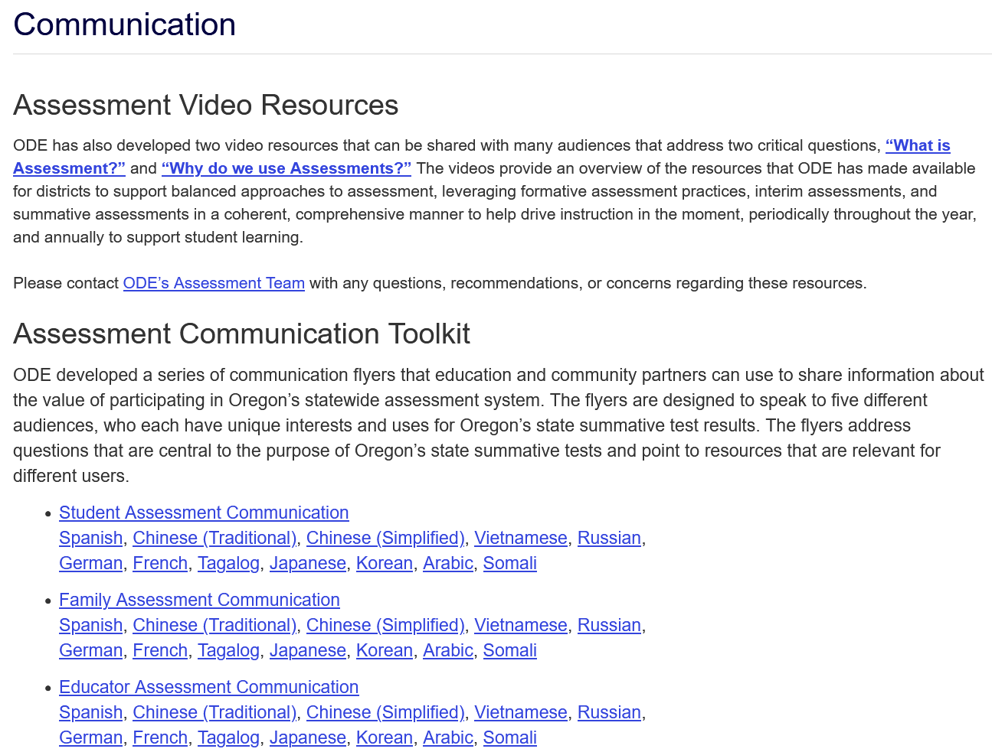
Student Participation: Communication Resources
Key Messages about Participation
Provides talking points administrators, counselors, teachers, or others can use when talking to parents about participation
Opt-out notices and forms available in the Forms accordion on the Test Administration page.
Assessment Communication page
Notes:
The specific approach to communicate with parents about state testing and the option to opt out is up to each district and their local communication protocols. ODE has posted a variety of resources to support districts in these conversations through a communications toolkit, available at the link provided at the bottom of this slide. All resources are available in multiple languages.
[DTCs may insert local policies/protocols for communicating opt out and test participation information at this point in the training.]

Slide 29
Q & A Discussion
What are the local considerations and challenges around managing student participation within your school or district?
What are some effective approaches you could use to address these challenges?
Who within your school or district needs to be included in tracking student participation and parent requested opt-outs?
What resources are available to assist you in tracking and managing student participation?
Notes:
This is an optional point in the required training to pause and discuss the questions provided or a locally developed set of relevant questions. If you would like to pause, please pause now.
Suggested activities:
-Small groups: use post-its to capture local considerations and challenges, one per sheet. Mount post-its.
-Large group: facilitate review/summary of considerations/challenges from across the large group
-Small groups: share effective approaches, look at artifacts
-Large group: facilitate share out, writing down approaches via chart pack
-Small group or individual: use note organizer to capture take-homes, next steps

Slide 30
Contacts and Resources
Notes:
We will conclude with a few helpful contacts and resources.

Slide 31
Regional Assessment Support
ODE will provide information through the DTC listserv and AA Update
Regional ESD Partners are the best source for assessment support
Notes:
Your regional ESD partner is available to provide hands-on support to answer questions and assist with processes such as setting student accessibility supports, targeting students up, and submitting assessment-related data collections. Contact information for the regional ESD partners for all three regions can be found using the link provided on this slide.

Slide 32
Related Reading Requirements by Role
District Test Coordinator (and District Level User)
Sections 1 – 12 and Appendices A – C of the Test Administration Manual (TAM)
The Oregon Accessibility Manual (OAM)
School Test Coordinator
Sections 1 – 11 and Appendices A – C of the TAM
The OAM
Notes:
This is a summary of the annual training reading requirements for TCs. This information can also be found in Section 1.5: Training Requirements in the TAM.

Slide 33
Online Resources
ODE staff contact information
Assessment home page
Regional ESD Helpdesk contacts
Test Administration (including TAM, OAM, DTC Roadmap, and test security forms)
Right Assessment for the Right Purpose
Oregon Extended Assessment
Assessment Resources (including Promising Practices)
Assessment Training Materials (including training modules)
Notes:
Finally, the links to the resources referenced on previous slides as well as others that will be helpful through the year are provided here. This concludes the test coordinator training module.

