Slide 1
Oregon Statewide Assessment System Session 6 – Connecting to Tools for Teachers and the Formative Assessment Process
Office of Teaching, Learning, and Assessment
Notes:
Welcome to the Oregon Department of Education’s Interim Assessment Professional Learning Series.
This is Session 6 of the series, and will focus specifically on using the Tools for Teachers platform and embedding formative assessment strategies into teaching and learning.

Slide 2
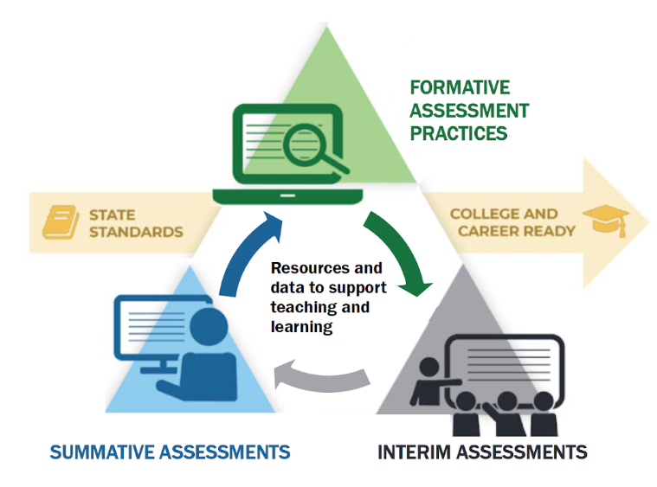
Purpose
The Oregon Statewide Assessment webinar series is designed to help teams of educators and administrators improve their teaching and learning systems using the tools and resources provided in a balanced assessment system.
Notes:
The purpose of this series is to help district- and school-based teams improve their systems of teaching and learning using a student-centered balanced assessment system and the many tools provided in Oregon’s Statewide Assessment System.

Slide 3
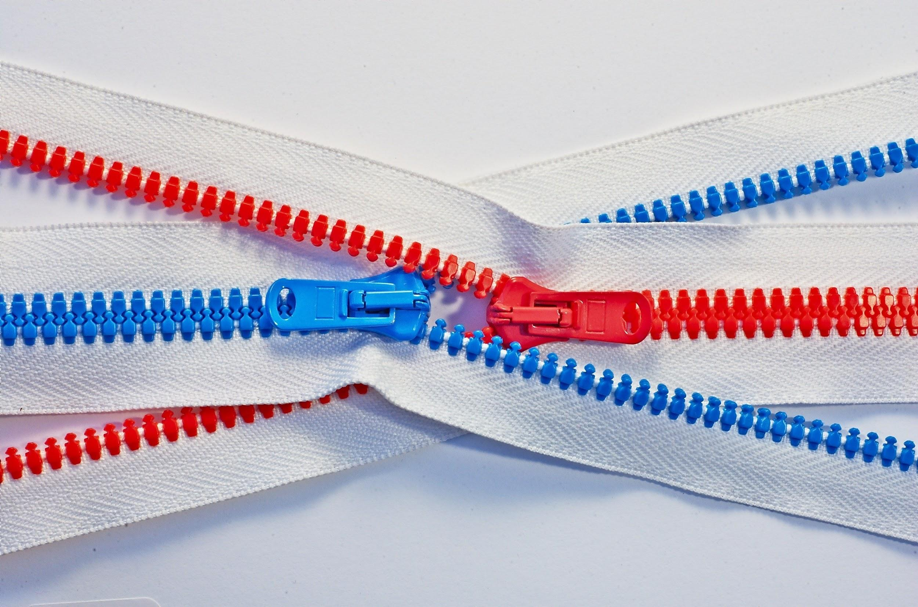
Series Outcome
Participants will build assessment literacy and improve practice by connecting formative assessment practices, interim assessments, and summative assessments to continually improve access and outcomes for each and every learner in their care.
Photo by Tomas Sobek on Unsplash
Notes:
By the end of the series, all participants will build assessment literacy and connect formative assessment practices, Oregon’s Statewide Interim Assessment System, and the Oregon Statewide Summative Assessments to continually improve access and outcomes for each and every learner in their classroom, school, and district.

Slide 4
Session Guide
1 | Understanding a Balanced Assessment System
2 | Overview of the OSAS Interim Assessment System
3 | Using Interim Assessments in the Context of Instructional Practices
4 | Interim Assessment Administration: Guidance and Support
5 | Accessing Interim Assessment Data to Inform Instructional Practices
6 | Exploring Tools for Teachers and Using Formative Assessment Practices
Notes:
Here is a session guide for the series. Again, resources for each of these sessions are posted on ODE’s Interim Assessments web page. The arc of the series begins in Session 1 by laying a common foundation of assessment literacy in a balanced assessment system; Sessions 2-5 move through each aspect of Oregon’s Interim Assessment System, and Session 6 finishes the series with a connection to Tools for Teachers and the formative assessment process.

Slide 5
Session Objectives
By the end of this session, educators will be able to:
Enhance their understanding of the formative assessment process.
Gain access and exposure to the features of Tools for Teachers.
Explore the components of a Tools for Teachers resource.
Connect interim assessments with instructional resources through “Connections Playlists”.
Notes:
By the end of this session, educators will be able to:
Enhance their understanding of the formative assessment process.
Gain access and exposure to the features of Tools for Teachers.
Explore the components of a Tools for Teachers resource.
Connect interim assessments with instructional resources through “Connections Playlists”.
We’ll put into the chat a Participant Guide that has links to each of the resources we talk about today. For those who may be facilitating this session in your district or school, you can find a Facilitator’s Guide and this slide deck on ODE’s Interim Assessment web page.
Links:
ODE Interim Assessment Web Page: https://www.oregon.gov/ode/educator-resources/assessment/Pages/Interim_Assessments.aspx
Session 6 Slides
Session 6 Facilitator Guide
[PASTE PARTICIPANT GUIDE INTO CHAT]

Slide 6
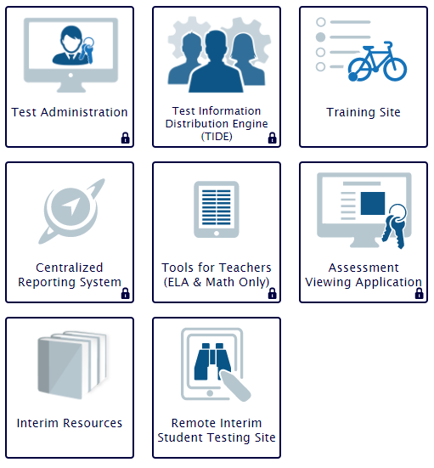
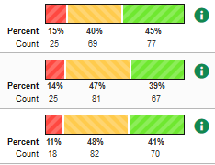
How We Got Here
Notes:
Before we dive into the specifics of today’s session, let’s quickly remind ourselves how we got here. In Session 1, we built some assessment literacy around why a balanced assessment system is so vital for equitable outcomes for learners. Session 2 provided an overview of the three types of interim assessments educators can use with students. Session 3 was broken out into content areas – 3A was facilitated by Tony Bertrand who showed participants how to connect ELA interim assessments with instruction; 3B was facilitated by Andy Byerley who did the same for math; and 3C was facilitated by Noelle Gorbett for districts that have purchased the science interim assessments. Session 4 walked through the details of administering interim assessments, both in a browser as well as within instruction, and we also discussed how to administer interims remotely. Session 5 will cover the Centralized Reporting System and how to access and use data from the interim assessment system. The arc of all of these sessions has brought us to integrating Tools for Teachers and formative assessment practices into instruction.
Each of the sessions in the series is available on ODE’s interim assessment web page – we’ve posted slides, the facilitator’s guide, slides with embedded audio of our lovely voices, and a video recording of the session. Please take full advantage of these resources with your professional learning teams.

Slide 7
Learning Objective #1
Educators can enhance their understanding of the formative assessment process.
Notes:
Learning Objective #1: Educators can enhance their understanding of the formative assessment process.

Slide 8
Assessment FOR Learning
Notes:
[[WATCH FIRST 2:00 OF VIDEO – BE SURE TO ENABLE SYSTEM AUDIO TO PLAY THROUGH VIRTUAL MEETING PLATFORM.]]
In Session 1, we talked at length about what makes an assessment system balanced, and the largest proportion of the “balance” is formative assessment, or assessment FOR learning. Because so much of the Smarter Balanced ecosystem is built around formative assessment and instructional supports, we thought it would be best to let them share their take on what formative assessment is.
Links:
Video on YouTube: https://www.youtube.com/watch?v=wpwZCqvt70U
Tools for Teachers playlist on YouTube: https://www.youtube.com/playlist?list=PLVed42c9y77aJs2dWCy9qRXXAlTA5xh6x
Smarter Balanced’s Formative Assessment Process: https://www.oregon.gov/ode/educator-resources/assessment/Documents/formative-assessment-process.pdf

Slide 9
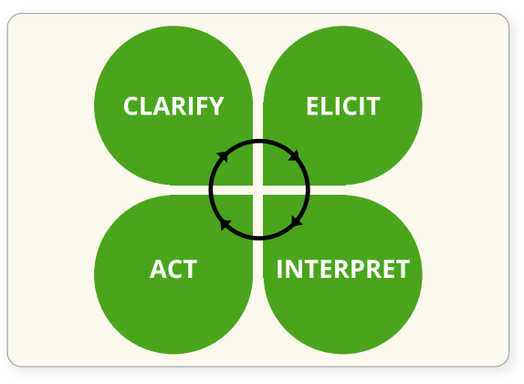
Assessment FOR Learning
Formative assessment is an active and intentional learning process that partners the teacher and the students to continuously and systematically gather evidence of learning with the express goal of improving student achievement. (Moss & Brookhart, 2018)
HIGH-QUALITY
INSTRUCTIONAL
PRACTICES
COLLABORATION
Notes:
We really like Connie Moss and Sue Brookhart’s definition of formative assessment: “Formative assessment is an active and intentional learning process that partners the teacher and the students to continuously and systematically gather evidence of learning with the express goal of improving student achievement”
Moss, C. M., & Brookhart, S. M. (2018). Advancing formative assessment in every classroom: A guide for instructional leaders. 2nd ed. Alexandria, VA: ASCD.
The four-leaf clover shows how Smarter Balanced frames this process.
Clarify learning goals and success criteria.
Elicit evidence from students in tasks, activities, discussions, and more.
Interpret that evidence and provide feedback.
Act on any changes to instruction.
Note that this process can really only happen effectively in a collaborative learning environment and when accompanied by high-quality instructional practices. You’ll see today how these four parts of the formative assessment process are highlighted in Tools for Teachers resources.

Slide 10
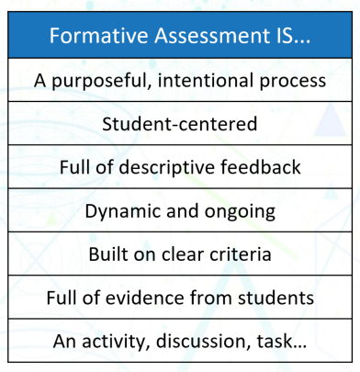
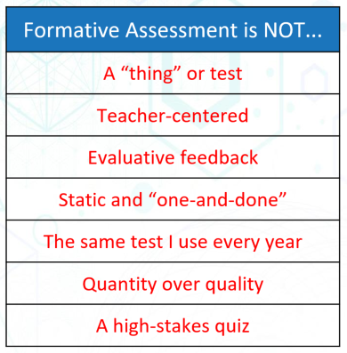
Assessment FOR Learning
Notes:
Our team continually hears dialog where formative assessment is reduced to simply a “fist to five” or an “exit ticket” a quiz. Each of these can be part of the process, but none of them defines the process. Formative assessment isn’t a “thing” – it is student-centered, intentional, designed around providing feedback on evidence from students, and dynamic in terms of adjustments to the teaching and learning process.
[Click animation]
Formative assessment is NOT simply a one-and-done test, a means to generate a grade, or the same test we use every year. Clarity on formative assessment is critical for educators, and the good news is that you will see some excellent formative assessment strategies within the Tools for Teachers platform that work remotely and in-person.

Slide 11
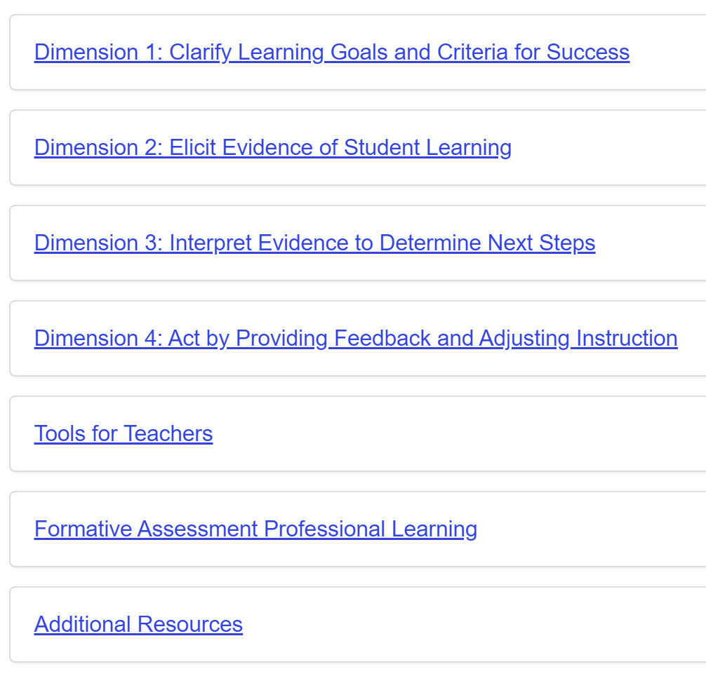
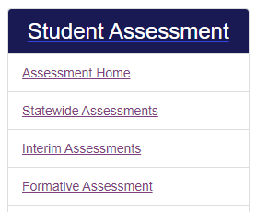
Formative Assessment Web Page
https://www.oregon.gov/ode/educator-resources/assessment/Pages/Formative_Assessment.aspx
Notes:
Before we leave this topic, we want to introduce you to ODE’s Formative Assessment Web Page. Just as with our Interim Assessment page, this breaks down the tools and resources available in the Oregon Statewide Assessment Portal and houses professional learning resources. We encourage you to bookmark this page for future access!
Link:
ODE’s Formative Assessment Web Page: https://www.oregon.gov/ode/educator-resources/assessment/Pages/Formative_Assessment.aspx

Slide 12
Learning Objective #2
Educators can gain access and exposure
to the features of Tools for Teachers.
Notes:
Learning Objective #2: Educators can gain access and exposure to the features of Tools for Teachers.

Slide 13
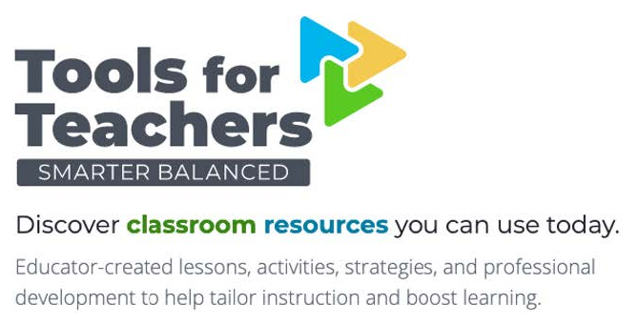
What is Tools for Teachers?
Tools for Teachers is a new, easy-to-use site from Smarter Balanced, featuring lessons and strategies that help educators plan lessons, enhance instruction, and support students.
Notes:
Alright, we’re several slides into this session and haven’t introduced the star of the show yet. What is Tools for Teachers?
(Core Statement) Tools for Teachers is a new, easy-to-use site from Smarter Balanced, featuring lessons and strategies that help educators plan lessons, enhance instruction, and prepare students to meet their postsecondary goals.
Smarter Balanced developed Tools for Teachers using the formative assessment process and a commitment to accessibility to support students.
Tools for Teachers was created in collaboration with hundreds of educators and is home to high-quality instructional supports. Each resource was created to meet rigorous quality criteria.
Tools for Teachers is at the center of the Smarter Balanced ecosystem, which supports educators, and links to additional Smarter Balanced websites and applications to facilitate seamless access to relevant content.
Tools for Teachers can be used for remote teaching and distance learning alongside other Smarter Balanced resources, such as interim assessments.
[Click animation]
Looking at our balanced assessment system, Tools for Teachers comprises one corner of the triangle, along with interim assessments and summative assessments.
Links:
remote.smartertoolsforteachers.org

Slide 14
Who Can Access Tools for Teachers?
Anyone with an active user account in the OSAS Portal: *
Test Administrators
Instructional Coaches & TOSAs
Interventionists
Paraeducators
Counselors & Graduation Coaches
Preservice Educators
District Leaders
Photo by Jen Theodore on Unsplash
* DTCs: use the “TFT_SC” role for users who do are not TAs
Notes:
Before we get into HOW to access Tools for Teachers, let’s talk about WHO can access. Anyone with an active user account in the OSAS Portal automatically has Tools for Teachers access. We want as many educators as can use these resources to have access to Tools for Teachers, so we have created a special user role in TIDE that allows access for educators who won’t be administering summative or interim assessments of any kind. That means instructional coaches, TOSAs, interventionists and specialists, paraeducators who provide direct student support, counselors and grad coaches, preservice educators, and district leaders.
If you have any issues logging in, please contact your District Testing Coordinator. For DTCs who are participating today, you will need to use the “TFT_SC” role for users who will not be TAs.

Slide 15
How Do I Access Tools for Teachers?
Three access pathways:
Direct link
OSAS Portal
Connections Playlist
Notes:
There are three primary ways to access Tools for Teachers. You can navigate directly through a URL, go through the OSAS Portal, or via a Connections Playlist. We’ll look at Connection Playlists in more detail later in this session.

Slide 16
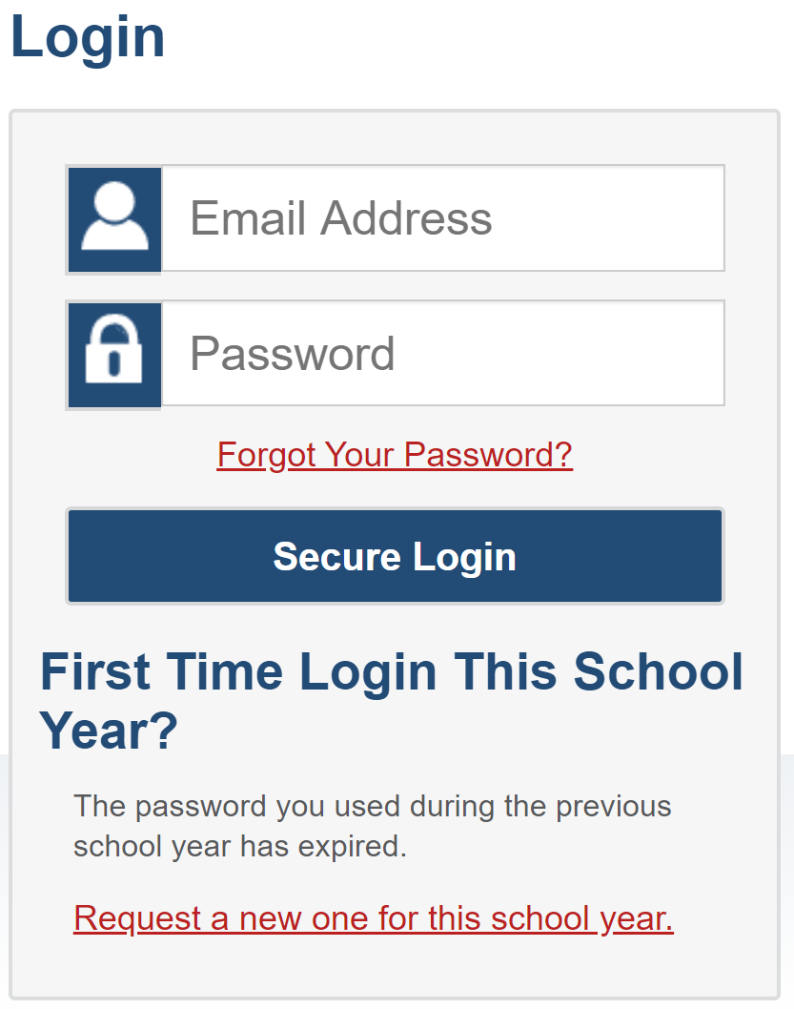
Access Pathway #1
https://smartertoolsforteachers.org/
Notes:
The first pathway is to navigate to smartertoolsforteachers.org in a supported web browser. You will need to select “Oregon” from the drop-down menu, and then you’ll see the familiar Cambium login. Smarter Balanced and Cambium now both support a single sign-on, so there’s no additional account information to remember.
Link:
Smarter Tools for Teachers: https://smartertoolsforteachers.org/

Slide 17
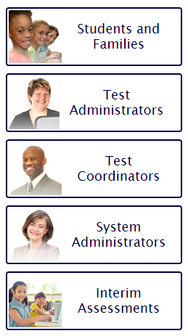
Access Pathway #2
https://osasportal.org/
Notes:
The second pathway is through the OSAS Portal. You’ll find Tools for Teachers in the center of the Interim Assessment Tiles, as well as in the right-hand shortcut menu on the portal homepage. Again, you’ll be prompted for your email address and password, then be redirected to Tools for Teachers.
Link:
OSAS Portal: https://osasportal.org/

Slide 18
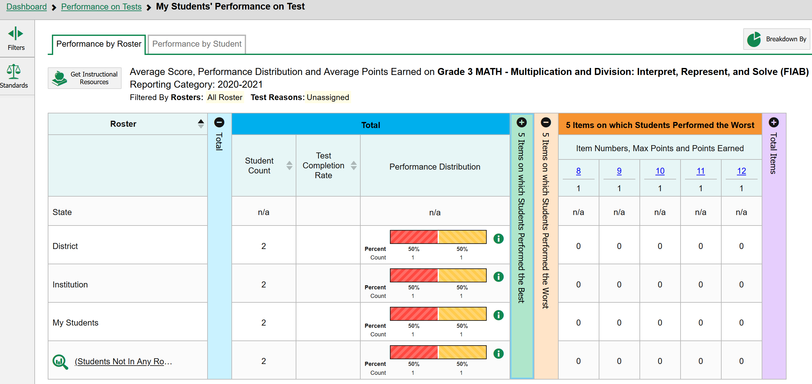
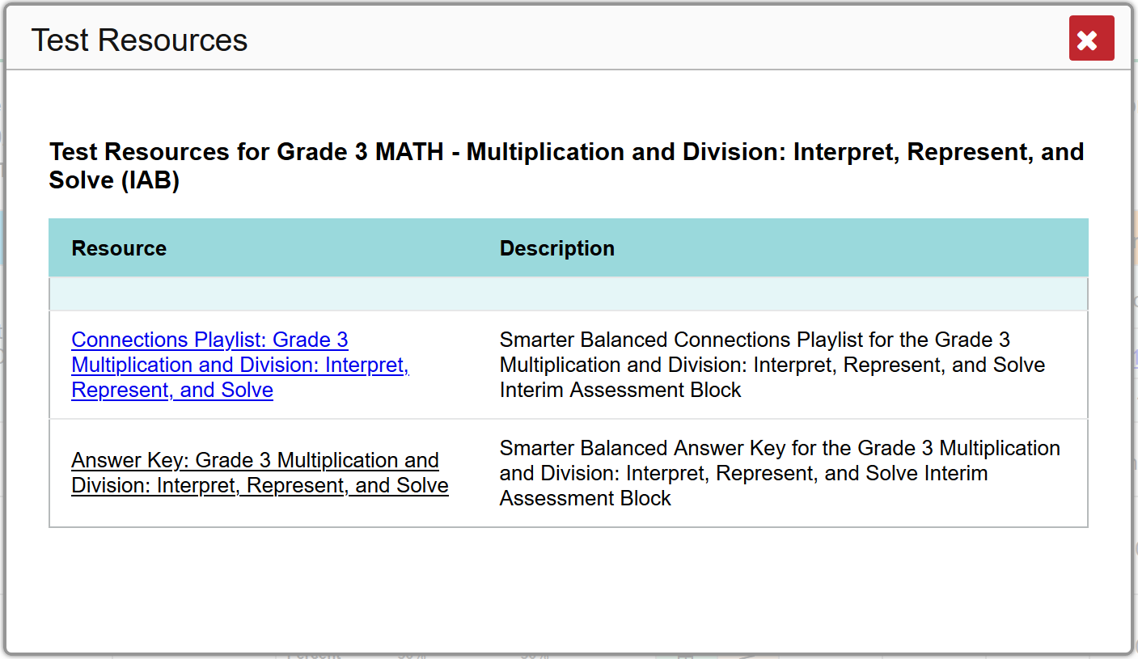
Access Pathway #3
Connection Playlist
Notes:
The third way to access Tools for Teachers is through a Connections Playlist in the Centralized Reporting System (or CRS). The Centralized Reporting System is where data from interim assessments can be displayed and analyzed. Each Interim Assessment Block or Focused Interim Assessment Block is connected to specific resources in Tools for Teachers via a Connections Playlist.
[Click animation]
At the top of the reporting screen, you will click the “Get Instructional Resources” button, then click the Connections Playlist that appears in the pop-up. We’ll take a look at a Connections Playlist in a few slides.

Slide 19
Potential Entry Points
“Window Shopping”
Browse instructional activities
“Add to Your Toolbox”
Implement new formative assessment & accessibility strategies
“Match Maker”
Interpret student evidence to determine instructional next steps
Notes:
It can be helpful to consider different entry points to Tools for Teachers.
[Click animation]
The first you might call “window shopping,” when you are simply browsing for instructional activities. There are hundreds of resources in Tools for Teachers, and we’ll look at how to filter these to hone in on what you need.
[Click animation]
The second would be to add some new formative assessment strategies or strategies to increase accessibility for students. You can browse for these, as well, and they can be embedded in your existing instructional materials pretty easily.
[Click animation]
A third entry point would be as a “Match Maker” when you are interpreting student evidence to determine instructional next steps. This is where the Connections Playlists are so handy to map directly to differentiated resources that can enhance instruction.

Slide 20
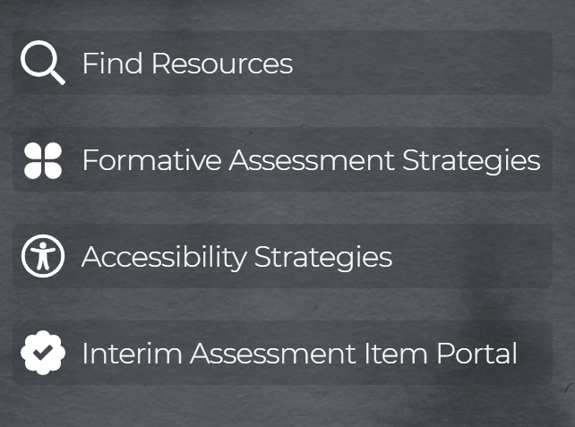
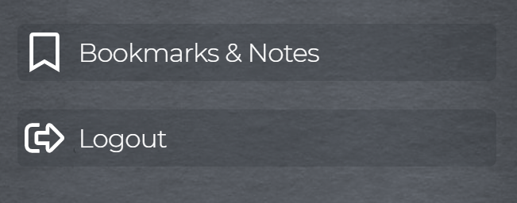
Tools for Teachers Interface
Notes:
Once you’ve logged into Tools for Teachers, you’ll see a navigation menu along the left-hand side of the screen.
[Click animation]
“Find Resources” leads to a search field that is oriented toward resources and Connections Playlists.
[Click animation]
“Formative Assessment Strategies” allows a quick search for embedded strategies.
[Click animation]
The same is true for Accessibility Strategies.
[Click animation]
The Interim Assessment Item Portal is another new part of the Smarter Balanced ecosystem that makes it easy to view and use interim assessment items in the teaching and learning process.
[Click animation]
Finally, Tools for Teachers allows users to capture notes and bookmark resources as they use them.
Coming up, we’ll take a deeper dive into these features of Tools for Teachers.

Slide 21
Learning Objective #3
Educators can explore the components of a
Tools for Teachers resource.
Notes:
Learning Objective #3: Educators can explore the components of a Tools for Teachers resource.

Slide 22
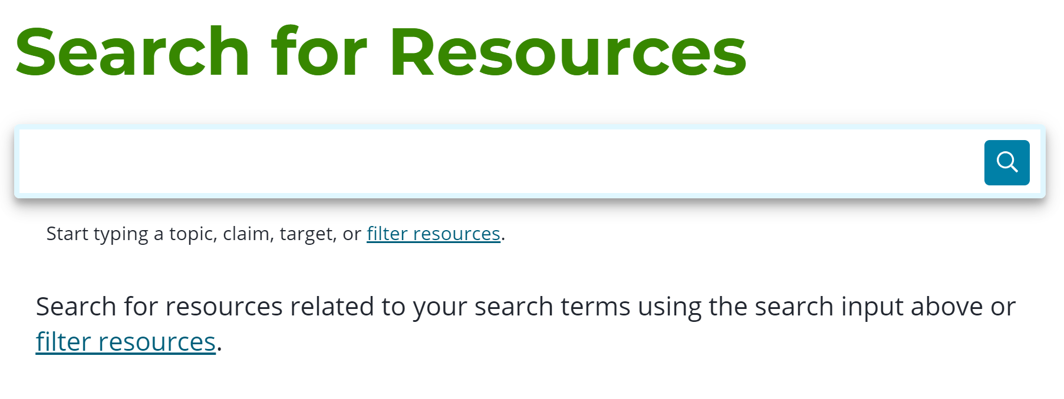
Find Resources
Notes:
One of the greatest strengths of Tools for Teachers is its ability to search for resources using filters.
[Click animation twice]
Simply type a keyword for a topic, a claim, or a specific target, and the system will go to work. There’s even a “smart text” feature that will attempt to autocorrect common misspellings.

Slide 23
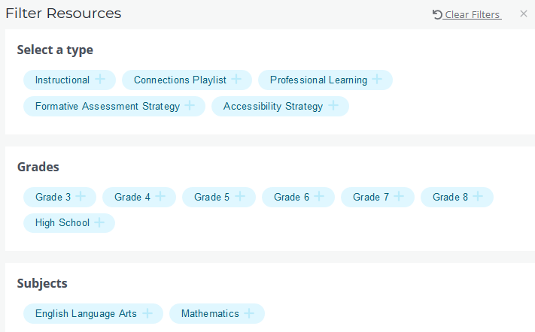
Search Filters
Notes:
When we expand the filters, we can see all the possible choices around resource types, grades, subjects, claims, targets, and even standards. Let’s take a look at this in action.

Slide 24
Using Filters
Notes:
In Session 3B on using math interim assessments, we profiled a 6th grade teacher working in a ratios and proportional relationships unit. Let’s suppose I want to find some resources to support these concepts.
[Click animation]
Initially, I get 218 resources which is not at all efficient.
[Click animation]
When I select that I’m looking for “Instructional” resources, the search narrows to 131 resources.
[Click animation]
When I select Grade 6, we’re down to 22, and…
[Click animation]
…when I specify Math, we’re down to 15. (I’m very interested to know what the 7 ELA resources are that we’ve filtered out…) Because I used the Content Explorer in my unit planning and to select an interim assessment block, I know that Target A is the one I want.
[Click animation]
When I select Target A, the results narrow to a much more manageable 4.

Slide 25
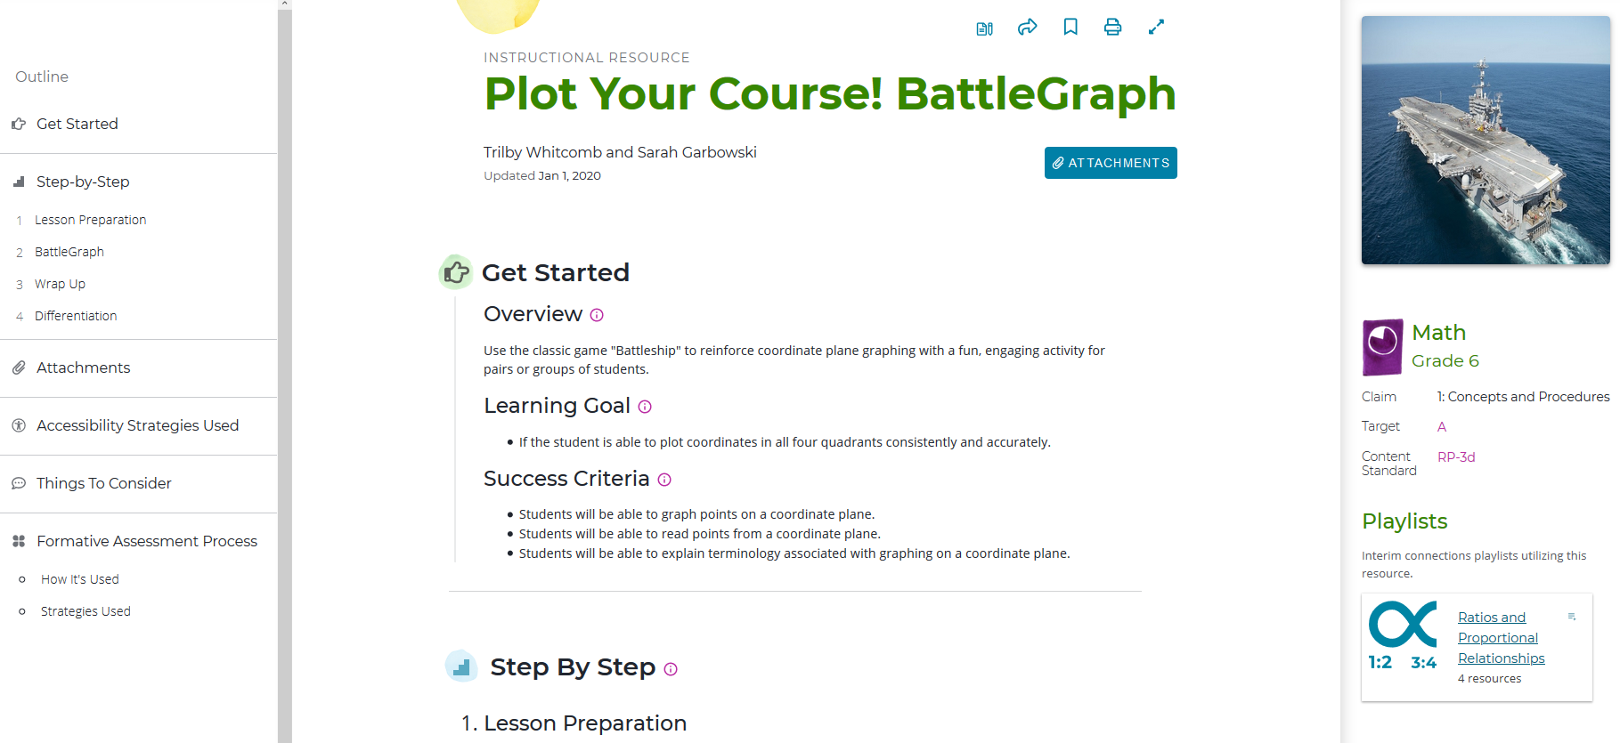
Resource Basics
Notes:
As I look through these four results, I see one that I think my students will enjoy and help support their learning of ratios. Plus, I loved playing Battleship as a kid, and I want to remember just how old I am when none of my students have heard of it.
[Click animation]
Here is what an Instructional Resource looks like in Tools for Teachers. There are three panes across the page: on the left is a navigation pane, the center pane contains the bulk of the resource’s content, and the right-hand pane shows standards alignment and which playlist(s) contain that particular resource.
Link:
Plot Your Course! BattleGraph

Slide 26
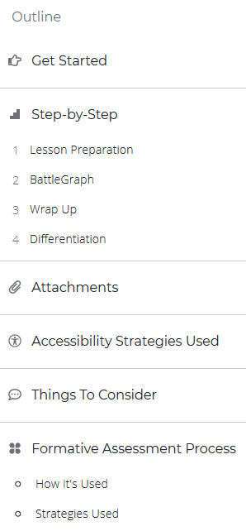
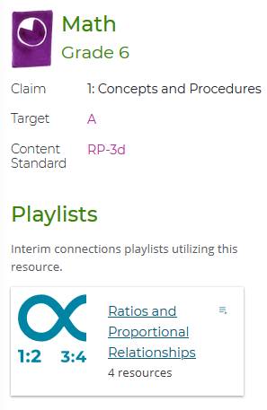
Resource Basics
Notes:
Looking more closely at each pane, we can see some of the interactive features of Tools for Teachers. In the header for the resource, you’ll find icons that allow you to take notes, share the resource, bookmark it, print it, and expand it on your screen. There’s also a quick link to any attachments such as slide decks or student handouts.
[Click animation]
The navigation pane gives quick links to different parts of the lesson sequence, as well as file attachments, any accessibility strategies used, things to consider (such as clarifications on standards or opportunities to differentiate for diverse learners), and specific alignment to the four-leaf clover formative assessment process.
[Click animation]
The right-hand pane of the resource shows which claim, target, and standard the resource aligns to, and also shows which Connection Playlist may contain the resource.
[Click animation]
Let’s take a closer look at how the formative assessment process is reflected in this resource.
Link:
Ratios and Proportional Relationships Playlist

Slide 27
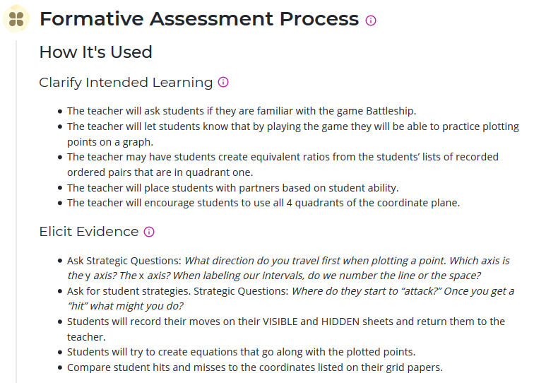
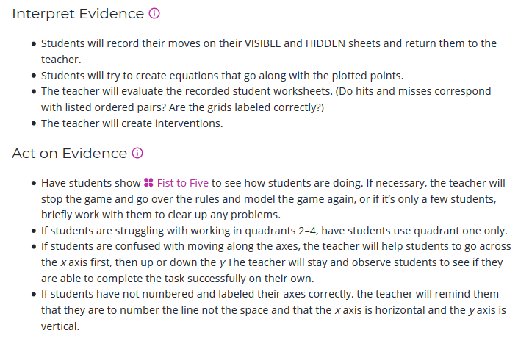
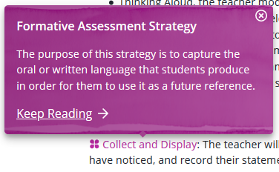
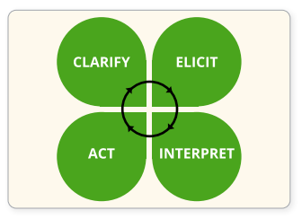
Built on Formative Assessment
Notes:
[Click animation]
Each instructional resource in Tools for Teachers is built around the formative assessment process.
[Click animation]
We can see specifically how the process is used within the resource. As you would assume, these points are not intended to be rigid and lock-step, but rather a guide that each individual educator will need to adapt to their style. We particularly like the “Elicit Evidence” section because there are helpful suggestions for questions to ask students to really focus their learning and, potentially, generate an engaging whole-class discussion.
[Click animation]
Looking at the final two “leaves” of the clover, you will notice the purple “Fist to Five” text in the “Act on Evidence” section. This indicates a callout that can be expanded on click to describe the specific formative strategy used. Accessibility resources are highlighted in the same manner. Remember, each of these formative assessment and accessibility strategies are searchable in Tools for Teachers, as well.

Slide 28
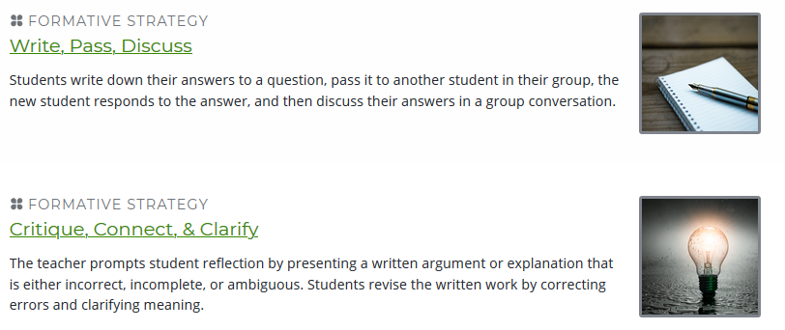
Formative Assessment Strategies
Notes:
Speaking of searching for Formative Assessment Strategies, here are two that are designed to help students produce and use content-specific academic language. Searching for these strategies is a very helpful way to add tools to your toolbox.

Slide 29
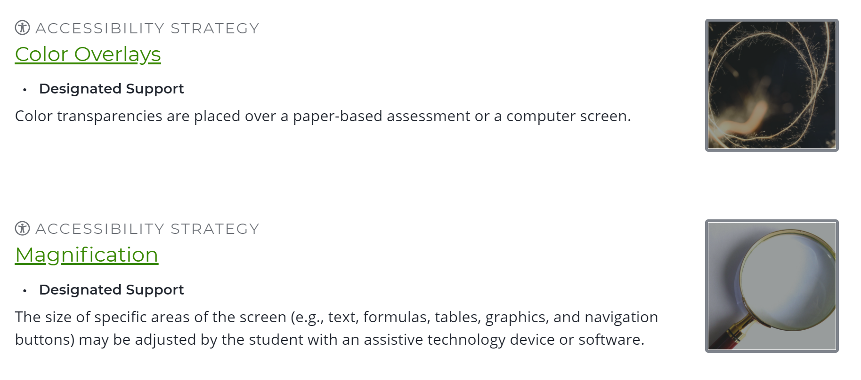
Accessibility Strategies
Notes:
Accessibility Strategies are searchable in the same way, and can be very helpful to indicate the embedded supports available to students in their interim and summative testing experiences in addition to being embedded in instruction.

Slide 30
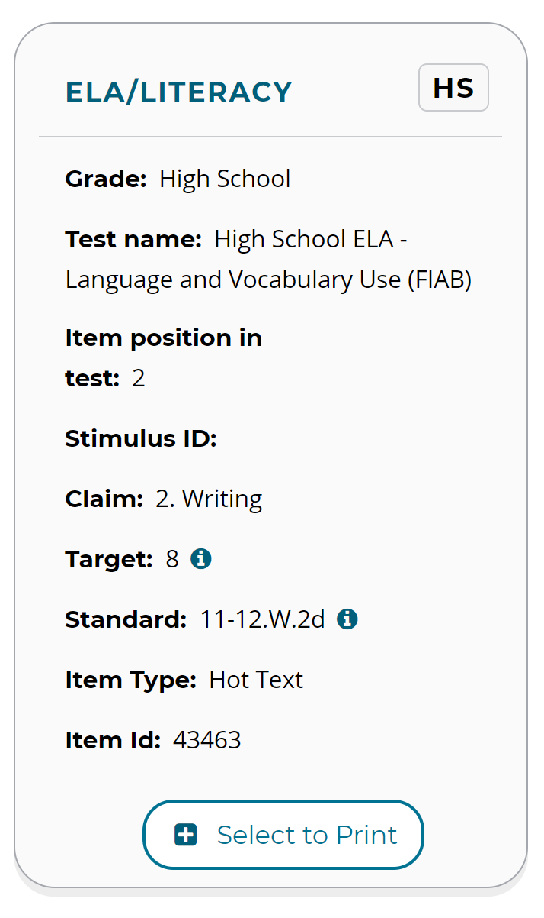
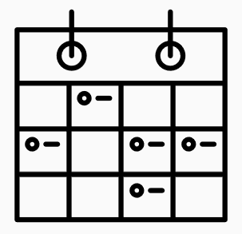
Interim Assessment Item Portal
COMING SOON!
ODE will be offering a follow-up session
on the Interim Assessment Item Portal
Notes:
The next tool in the main menu of Tools for Teachers is one that we’ll just tease you with today. The Interim Assessment Item Portal (or IAIP) is a new part of the Smarter Balanced ecosystem that helps educators find specific interim assessment tasks that align to a particular resource or Connections Playlist.
[Click animation]
Much like the Content Explorer and Sample Item database, filters allow you to search by grade, subject, test name, and claim to view items that can be used instructionally. The IAIP allows educators to use interim test items more flexibly than ever before to support the use of the formative assessment process. Educators can select and assemble questions to tailor content covered by an interim assessment so it better aligns with the sequence of their instruction. Items can be exported for use in both remote teaching and traditional classroom settings, and they can be printed for offline use when computers are not available.
[Click animation]
ODE will be offering a follow-up session soon on this platform, so stay tuned.

Slide 31
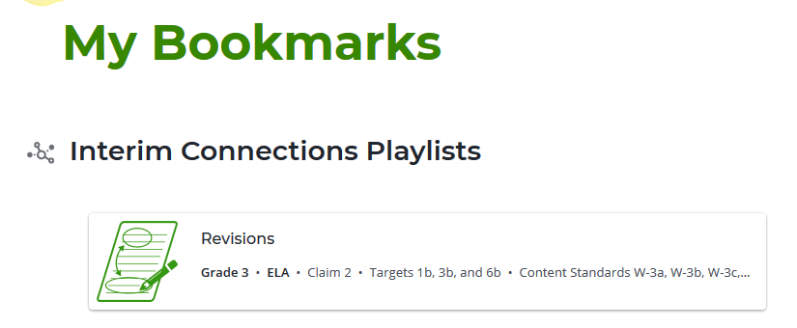
Bookmarks
Notes:
The final stop in our overview is saved bookmarks. Save yourself time by bookmarking resources you know you’ll use from year-to-year, and remember to capture notes about specific instructional moves or revisions.

Slide 32
Learning Objective #4
Educators can connect interim assessments with instructional resources through
“Connections Playlists”.
Notes:
Learning Objective #4: Educators can connect interim assessments with instructional resources through “Connections Playlists”.

Slide 33
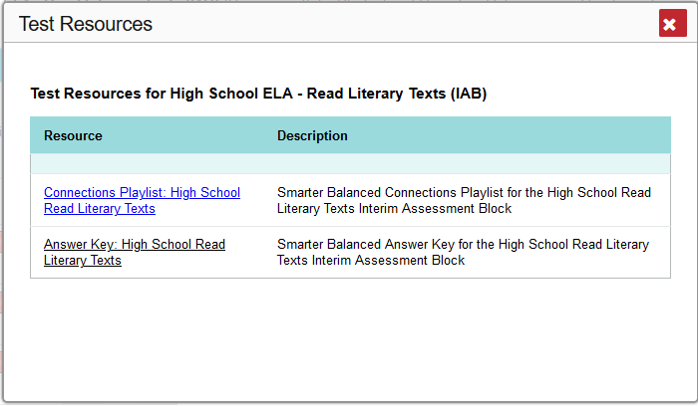
From Interim Assessments . . .
Notes:
The final component of this session is a deeper dive into Connections Playlists. As their name implies, they serve as a connection between interim assessments and Tools for Teachers. Recall from earlier how we can call these up from inside the Centralized Reporting System.
[Click through animations]
For this particular high school ELA interim assessment block, I can jump straight into the Tools for Teachers resources that will give me what I need.
Link:
Connections Playlist: High School Read Literary Texts

Slide 34
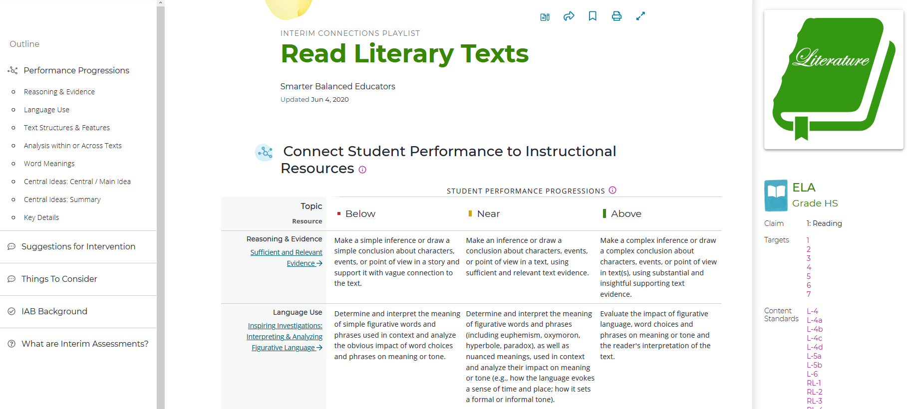
. . . To Tools for Teachers
Notes:
Here is an example of a Connections Playlist. Notice that the layout is similar with the three reading panes. We’ll look at each of these in more detail next, but…
[Click animation]
Educators don’t have to go into the reporting system to find Connections Playlists. They are searchable within Tools for Teachers, just like individual resources.

Slide 35
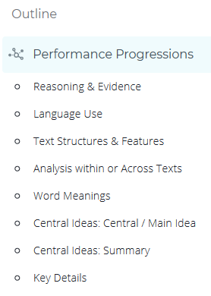
Connections Playlist Basics
Assessment
Targets
Range Achievement
Level Descriptors
Notes:
The left-hand pane contains links for quick navigation, and this is where some magic happens. Take a look at these Performance Progressions. Those of you who joined us for Session 3A on using ELA interim assessments may recognize these as…
[Click animation]
assessment targets. Targets are how standards are “bundled” within the Smarter Balanced ecosystem, and we were able to use the Content Explorer to look at several details on these targets to help prepare the right interim assessment. It’s no coincidence that these targets show up here in Tools for Teachers.
[Click animation]
Even more amazing are that each of these targets is linked to a detailed progression across achievement levels. These are the Range Achievement Level Descriptors that we also looked at in the Content Explorer.
[Click animation]
The Performance Progressions highlight two of the main uses of Connections Playlists:
These progressions can be used to better understand and interpret students’ interim assessment results; and
The specific descriptors within the progression can be used to inform and plan instructional next steps.

Slide 36
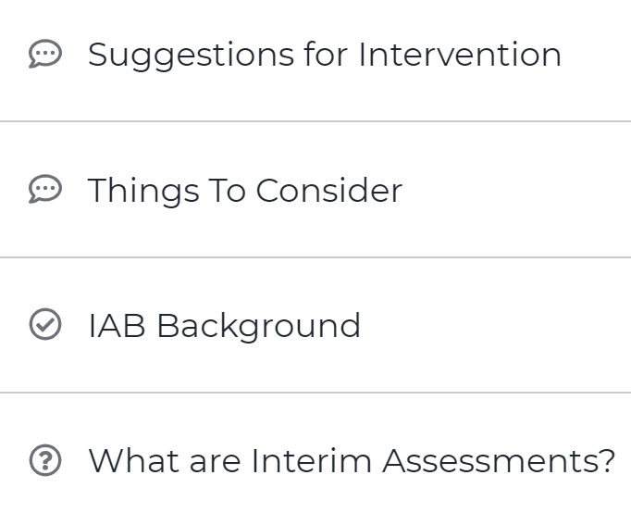
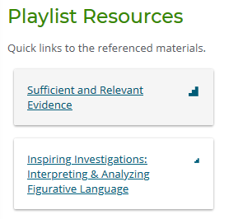
Instructional Resources & Supports
Notes:
Each Connections Playlist also contains suggestions and considerations on intervention and differentiation for a diverse range of learners.
[Click animation]
We talked a lot about the Content Explorer on the last slide – there actually is a link embedded within the Playlist to the specific target in the Content Explorer, as well as Sample Items that can also be used in instruction.
[Click animation]
Similarly to how Instructional Resources listed the Connections Playlists that contained them, each Connections Playlist has a list of resources that are embedded within the Playlist.
We recognize that we’ve just included a ton of new information in the past hour. Thank you for hanging in with us! While Tools for Teachers resources are specific to ELA and Math, the formative assessment process is not. Let’s take a look at how this process shows up in a science context.

Slide 37
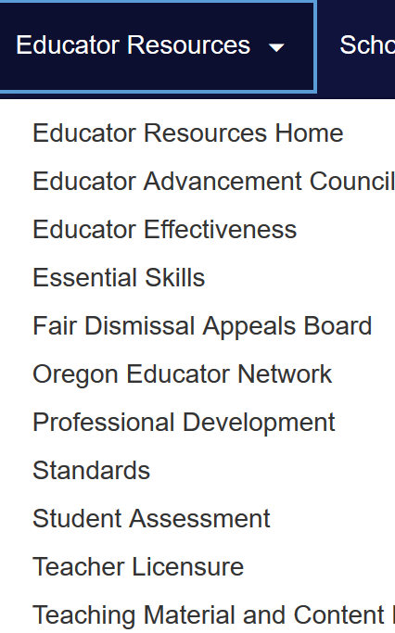
Contact Us!
www.oregon.gov/ode
Dan Farley: Director of Assessment
Tony Bertrand: ELA & Social Sciences Assessment
Andrew Byerley: Mathematics Assessment
Noelle Gorbett: Science Assessment
Ben Wolcott: English Language Proficiency Assessment
Photo by Volodymyr Hryshchenko on Unsplash
Notes:
We cannot thank you enough for joining today. Please don’t hesitate to reach out if our team can help in any way. Go to Oregon.gov/ode and navigate to Student Assessment. Dan Farley is our director, and any of us on the ODE Assessment Team can help you make sense of this vast system, answer questions, and support your implementation.
Link:
ODE Assessment Homepage

