Slide 1
Oregon Statewide Assessment System Session 3B – Using Math Interim Assessments in the Context of Instruction
Office of Teaching, Learning, and Assessment
Notes:
Welcome to the Oregon Department of Education’s Interim Assessment Professional Learning Series.
This is Session 3 of the series, and will focus specifically on using math interim assessments in the context of instruction. Session 3A focuses specifically on English Language Arts. Please see ODE’s Interim Assessment webpage for resources from each of the six sessions in the series.

Slide 2
Purpose
The Oregon Statewide Assessment webinar series is designed to help teams of educators and administrators improve their teaching and learning systems using the tools and resources provided in a balanced assessment system.
Photo by Bekir Dönmez on Unsplash
Notes:
The purpose of this series is to help district- and school-based teams improve their systems of teaching and learning using a student-centered balanced assessment system and the many tools provided in Oregon’s Statewide Assessment System.

Slide 3
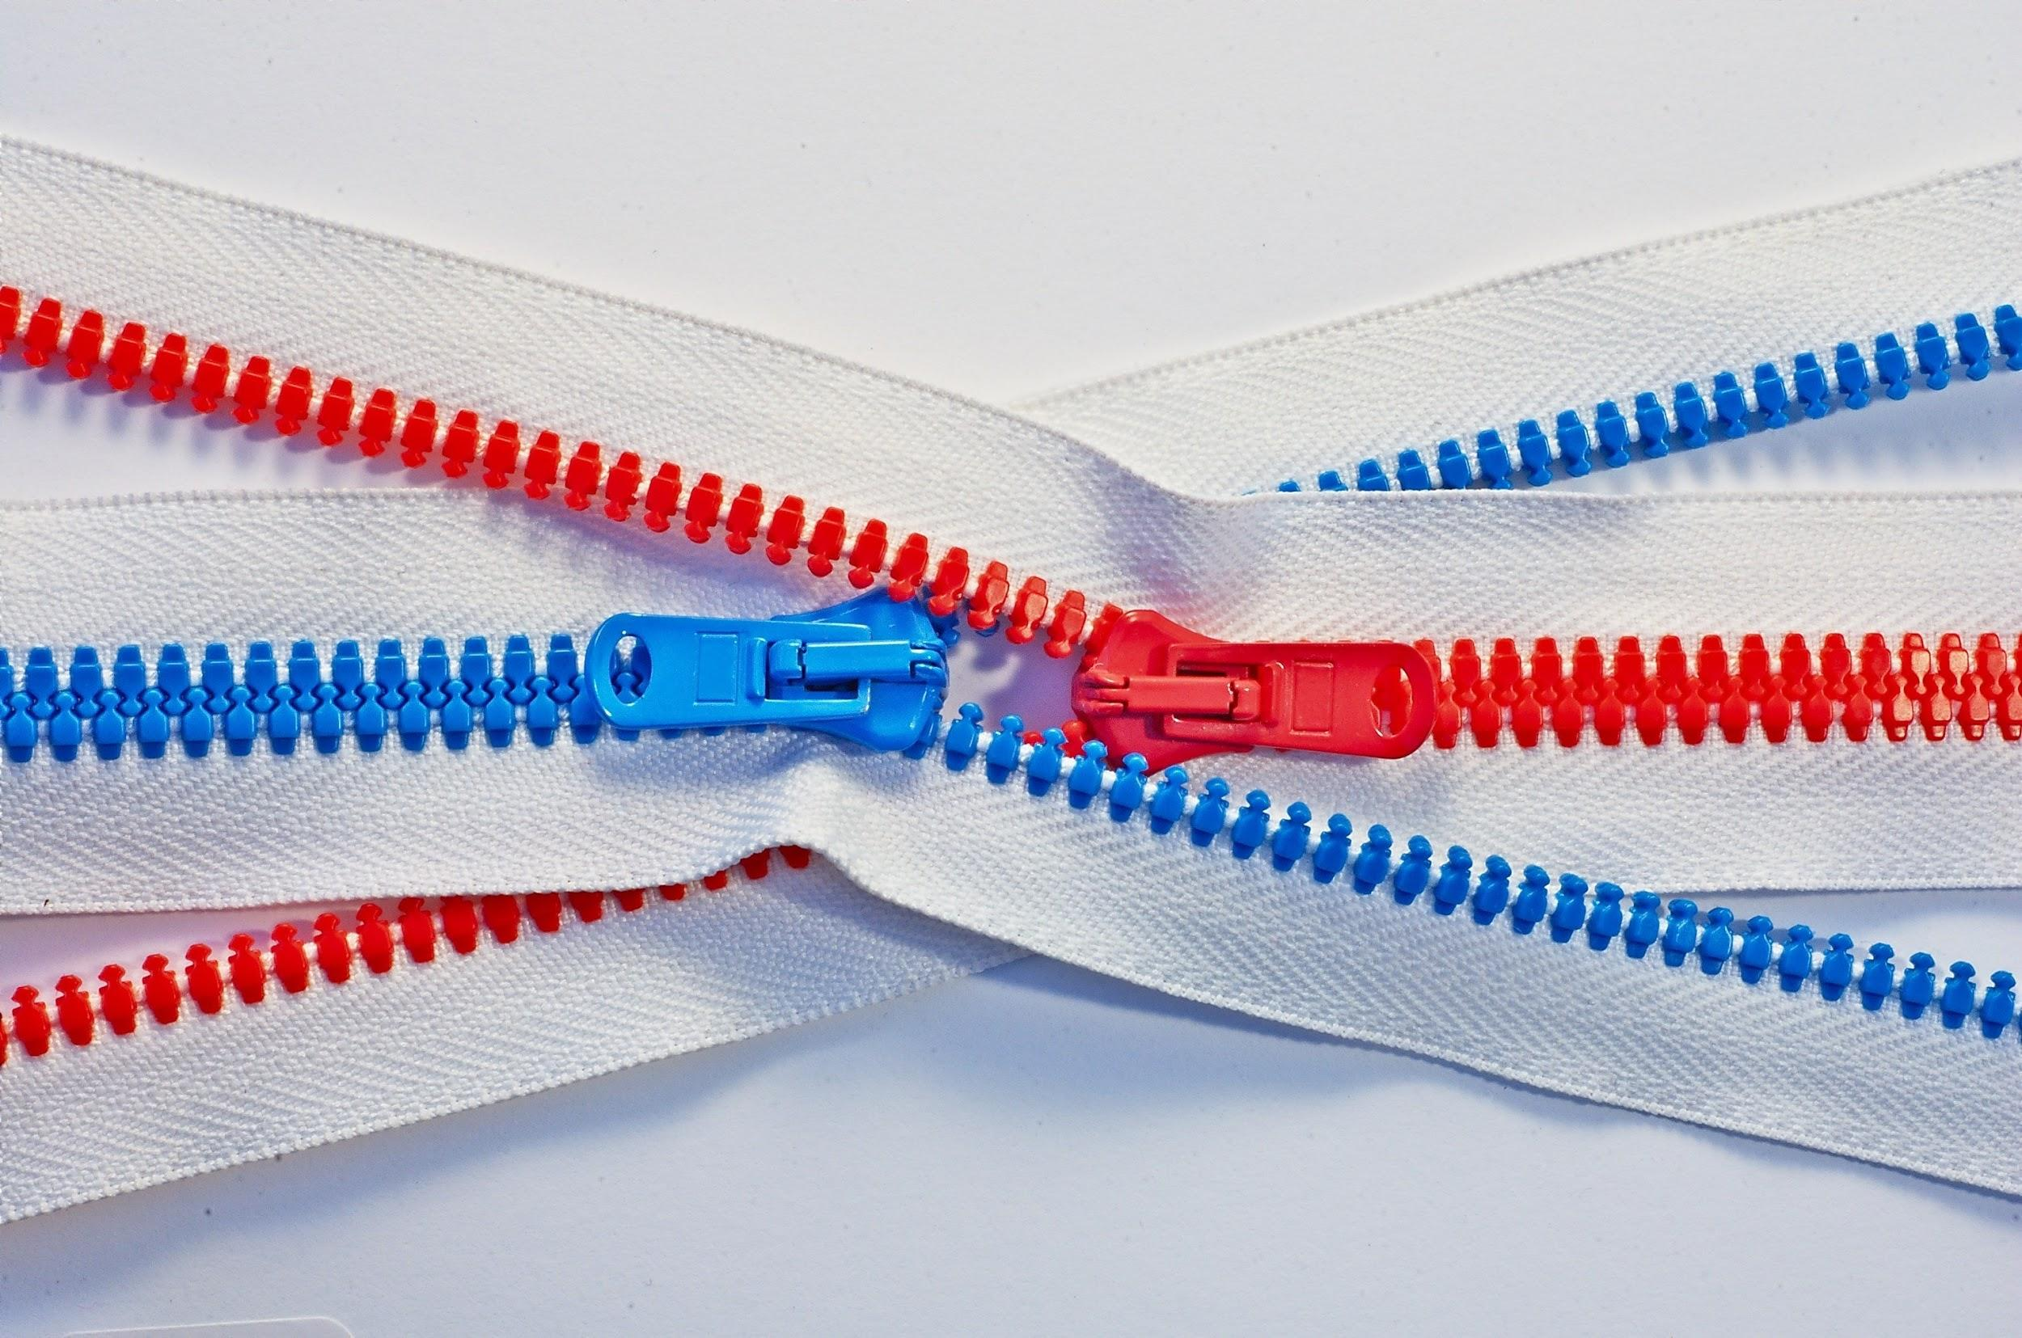
Series Outcome
Participants will build assessment literacy and improve practice by connecting formative assessment practices, interim assessments, and summative assessments to continually improve access and outcomes for each and every learner in their care.
Photo by Tomas Sobek on Unsplash
Notes:
By the end of the series, all participants will build assessment literacy and connect formative assessment practices, Oregon’s Statewide Interim Assessment System, and the Oregon Statewide Summative Assessments to continually improve access and outcomes for each and every learner in their classroom, school, and district.

Slide 4
Session Guide
1 | Understanding a Balanced Assessment System
2 | Overview of the OSAS Interim Assessment System
3 | Using Interim Assessments in the Context of Instructional Practices
4 | Interim Assessment Administration: Guidance and Support
5 | Accessing Interim Assessment Data to Inform Instructional Practices
6 | Exploring Tools for Teachers and Using Formative Assessment Practices
Notes:
Here is a session guide for the series. Again, resources for each of these sessions are posted on ODE’s Interim Assessments web page. The arc of the series begins in Session 1 by laying a common foundation of assessment literacy in a balanced assessment system; Sessions 2-5 move through each aspect of Oregon’s Interim Assessment System, and Session 6 finishes the series with a connection to Tools for Teachers and the formative assessment process.

Slide 5
Oregon Statewide Assessment System Guiding Principles
A balanced assessment system is vital to achieve an equitable,
high-quality education for all students.
Center Equity
Cultivate Connections & Relationships
Use the Right Assessment for the Right Purpose
Be Transparent
Notes:
We all know the extraordinary challenges families, students, and educators face this academic year, and we’re also aware that the families and students most affected by the COVID-19 pandemic are often those who are historically underserved by our systems. The ODE Assessment Team joins you in thinking deeply about how we can adapt to this year, and our statewide assessment system is guided by the same principles as ODE’s Ready Schools, Safe Learners guidance. First and foremost, we believe that a balanced assessment system is vital to achieve an equitable, high-quality education for all students.
To achieve this vision, we are centering in equity. We’ve worked hard to provide an interim assessment system across Oregon that guarantees access for both educators and students to tools that can pinpoint student learning.
Cultivating connections to and relationships with our students is vital for any learning environment, and these will happen very differently in two-dimensions than in our normal three. It’s also vital that we stay connected to our professional community and colleagues who can support and encourage us.
Our team’s tagline is “Use the Right Assessment for the Right Purpose,” and this principle drives our work and frames our conversations. We’ll talk more about this a bit later.
And finally, being transparent. We support an assessment system that is designed to provide evidence of student thinking all the way up to data on system-level indicators, and we also support a set of tools that can demystify the process of assessment and enhance student learning.

Slide 6
Session Objectives
By the end of this session, educators will be able to:
Determine the purpose of interim assessments within a grade-level course map.
Utilize the Content Explorer and Interim Assessments Overview to select the appropriate interim assessment.
Make connections to high-quality instructional practices.
Notes:
By the end of this session, educators will be able to:
Determine the purpose of interim assessments within a grade-level course map.
Utilize the Content Explorer and Interim Assessments Overview to select the appropriate interim assessment.
Make connections to high-quality instructional practices.
We’ll put into the chat a Participant Guide that has links to each of the resources we talk about today. You’ll notice at the top of that guide is a blank “Notes and Reflections” document – feel free to use this or not, but we’ll pause after each of these learning targets to give you a chance to reflect on your learning.
[PASTE PARTICIPANT GUIDE INTO CHAT]
Here we go!

Slide 7
Quick Series Recap…
Session 1:
Understanding a Balanced Assessment System
Session 2:
Overview of the OSAS Interim Assessment System
Notes:
Before we dive into the specifics of using math interim assessments in the context of instruction, let’s briefly review the first two sessions of the series.

Slide 8
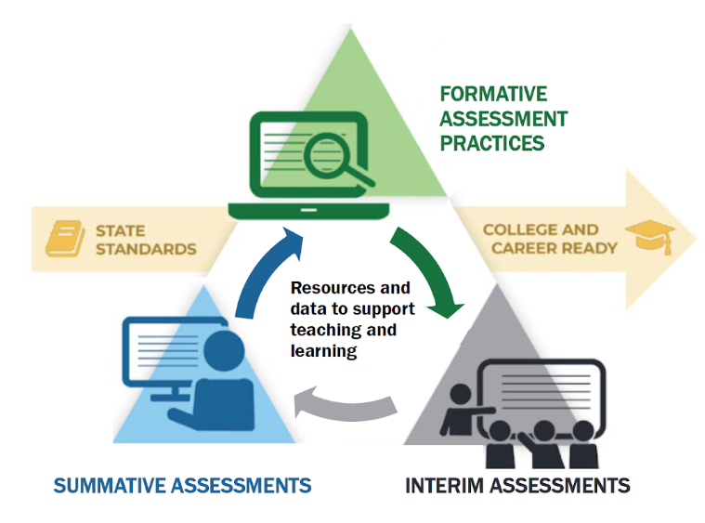
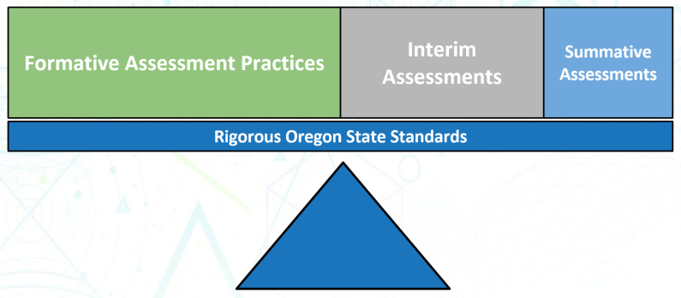
Session 1
Assessment FOR Learning
OF & FOR
Assessment OF Learning
Does this assessment best help us understand student learning or
system health?
Notes:
Session 1 focused on building assessment literacy around a balanced system. Oregon’s Statewide Assessment System is comprised of summative assessments, interim assessments, and formative assessment practices. Within the OSAS Portal, ODE’s assessment team supports many tools and resources that help support the teaching and learning process.
[Click for animation]
A truly student-centered assessment system, is achieved only through a balance of each of these types of assessments. Most important to students’ day-to-day learning are formative assessment practices, which serve as a microscope [click animation] to see the fine details of student thinking and to know how to adjust instruction as needed. Next are interim assessments, which support the teaching and learning process but “zoom out” a bit to see student performance over time or at a specific point in time. [Click animation] Binoculars are a good analogy for interim assessments because they don’t allow for as fine the detail as formative practices, but we can still focus on students’ overall learning. Finally, summative assessments are focused on evaluation and accountability. [Click animation] We use a telescope to represent these because they provide a view of a district or school’s system of teaching and learning.
[Click for animation]
Another way of framing formative practices are as assessment FOR learning. Summative assessments are assessments OF learning, because they look back over the arc of the full year. Interim assessments bridge the gap between the two, and can serve as both assessments OF and FOR learning, depending on their intended use.
[Click for animation]
One important guiding question as you determine the right assessment for the right purpose is, “Does this assessment better help understand student learning, or the overall health of our teaching and learning system?”

Slide 9
Session 2
Interim assessments are designed to support teaching and learning throughout the year by using periodic standards-based assessments that focus on specific units of content (called targets).
For 2020-21, there are a total of 149 IABs (67 in math)
Notes:
In Session 2, we went through an overview of the Interim Assessment System. First of all, interim assessments are designed to support teaching and learning. They are often designed to be embedded within a unit of instruction and align to a specific set of standards, which we call assessment targets. Educators across Oregon have long used interim and benchmark assessments they have designed or that their district has provided. For this year, ODE is proud to be able to provide a statewide interim assessment system for free to all Oregon districts.
[Click for transition]
Oregon’s interim assessment system is developed by educators throughout the Smarter Balanced Assessment Consortium. They are aligned to standards, both in terms of content as well as rigor. There are three types of interim assessments available for educators to use.
1. Interim Comprehensive Assessments (or ICAs) are built around a full test blueprint. They contain both computer-scored stand-alone items and a Performance Task, and are designed to assess the full range of targets for a grade level. They are appropriate for a mid-year progress check, when a student moves into your school from out-of-district or state, or to help identify specific additional instructional supports for a student.
2. Interim Assessment Blocks (or IABs) are aligned to 3-8 assessment targets and are much more “bite-sized” in that they often fit into the scope of existing units. They are designed to take around 60 minutes in a standard administration.
3. Focused Interim Assessment Blocks (or F-IABs) are even more bite-sized in that they align to 1-3 assessment targets and take between 45-60 minutes for students to complete. These offer educators the most flexibility instructionally.
One quick note here: all interim assessments are fixed form, meaning they are not adaptive. Each student takes the same assessment in the same order. Educators should be strategic about multiple administrations to avoid item over-exposure.
[Click for transition]
For 2020-21, there are a total of 149 interim assessment blocks across both ELA and math. 67 of those are in math, and more are created for each academic year.
[Click for transition]
Finally, each interim assessment connects to the Tools for Teachers platform. Tools for Teachers is a set of instructional resources that contain embedded formative assessment practices to best meet students’ needs. We’ll take a deeper dive into Tools for Teachers in Session 6. This is a brand new platform for the 2020-21 academic year, and all of the resources are written and curated by educators across the Smarter Balanced Assessment Consortium.
Finally, please refer to Session 2 of this series for how to gain access to the interim system, or talk with your District Testing Coordinator for more information.

Slide 10
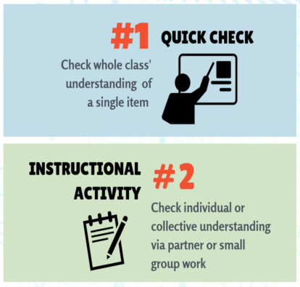
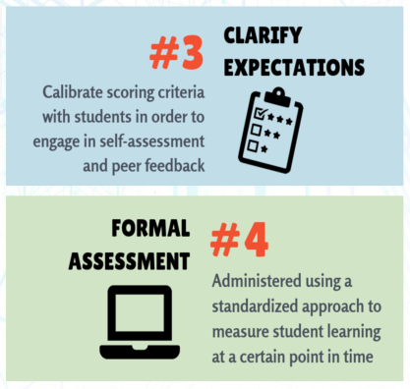
Quick Check
Determine whether each use of
Interim Assessments is an
example of
Assessment FOR Learning
-or-
Assessment OF Learning
(HINT: ignore the colors)
Notes:
Also in Session 2, we highlighted 4 main uses of interim assessments. [Summarize each use.] Interim assessments often bridge the gap between formative and summative assessment.
[Click for transition]
Whether you attended Session 2 or not, we’d like to do a quick check of whether you think these uses best map to “assessment FOR learning” or “assessment OF learning”. Take a moment to mentally sort these into the two categories – HINT: ignore the colors!
[Pause for think time.]
[Click for transition]
Here’s what we came up with. The first three uses best align to formative assessment practices, and the last use best aligns to summative. One of the biggest take-aways regarding interim assessments is that they serve a vital role of CONNECTING STUDENT PERFORMANCE TO INSTRUCTION.
[Click for transition]
That’s why a balanced assessment system includes such a high percentage of formative and interim assessment.

Slide 11
Learning Objective #1
Educators can determine the purpose of interim assessments within a grade-level course map.
Notes:
Our first objective is that you can determine the purpose of interim assessments within a grade-level course map.

Slide 12
Grade-Level Course Maps
Step 1: Prioritize essential content.
Step 2: Review and revise course maps to accelerate students in grade-level content.
Step 3: Identify the purpose of interim assessments within the course map.
Step 4: Understand interim assessment administration options.
Notes:
For each of our objectives, we’ll present a few steps to consider – not so much that it’s a template to reproduce, but really to “chunk” the massive amount of information we’re sharing with you today. These slides are available to you in the Participant Guide, so feel free to reference them often and use them with your professional learning team.
We’ll go into more detail on each of these, but briefly,
Step 1 is to prioritize essential content.
Step 2 is to review and revise your existing course maps to accelerate students into grade-level content.
Step 3 is to identify how you will use interim assessments within your course map; what is their purpose to best serve student learning?
And Step 4 is to understand the options to administer interim assessments.

Slide 13
Step #1: Prioritize Essential Content
bit.ly/ODEDL2021
Notes:
Over the summer, a team of specialists from ODE collaborated on content-specific considerations for Designing Learning in 2020-21. The purpose of these documents is to help educators face the daunting challenge of designing hybrid and distance learning experiences after months of emergency school closure last spring. These documents were designed from other national guidance, resources from other states, and input received from educators, and represent our best thinking at this time.
[Click for transition]
The Mathematics section includes prioritized content for all grades. In grades K-8, we drew from the guidance given by Student Achievement Partners. For grades 9-12, ODE released priority content based on a draft of the new mathematics standards that we hope will go before the State Board of Education in 2021. Our hope is that this “preview” release will help districts and schools begin to design learning around what will likely be very close to our eventual standards rather than having to repeat the process in the next two years. Step 1 is to become familiar with essential content, recognizing that proficiency in mathematics requires engagement with the math practices and opportunities for application. We simply cannot afford to fit “what we always do” into a new learning and teaching paradigm.
There is also a Formative Assessment supplement that will help address crucial practices to meet students’ needs during distance learning.

Slide 14
Step #2: Revise Course Map
Notes:
The second step is to review and revise course maps. An academic year may include several units of instruction around sets of grade-level standards. As these standards are prioritized for this year, district and school teams will be making decisions about how to restructure the year accordingly. Oregon’s interim assessment system makes it easy to align interim assessment blocks to individual units, particularly in math. We’ll go through an example here in a few minutes.

Slide 15
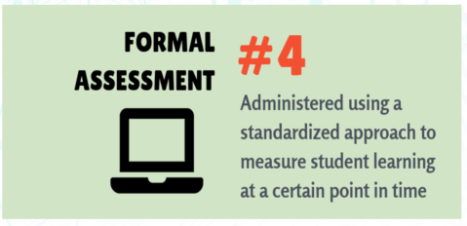
Step #3: Identify the Purpose of Interim Assessments
Notes:
After revising our course maps, we need to calibrate ourselves around the purpose of interim assessments. In some cases, teams of educators may decide that it makes the most sense to use an interim assessment block as a formal assessment at or near the end of a unit to assess what students should know. This is a very appropriate use of interim assessments, particularly if educators have time to adjust instruction to move all students toward proficiency. Again, in this way, interim assessments work very much like summative assessments.

Slide 16
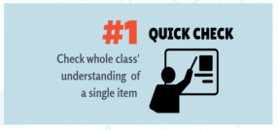
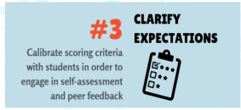
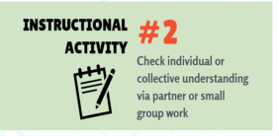
Step #3: Identify the Purpose of Interim Assessments
Notes:
It may also be that teams of educators choose to use the interim assessment blocks during the unit rather than at the end. Because interim assessments are flexible in how they can be administered, an educator can take even a single task out of the system and use it instructionally. In fact, educators can even use interim assessments from previous grade levels to assess prior knowledge and academic readiness. In this way, interim assessments are more connected to the process of learning and function more as formative assessment.

Slide 17
Step #4: Understand Administration Options
Standard Administration (Inside the OSAS Portal)
Individual & independent Single administration allows for a reliable “point-in-time” spot check of student knowledge Following summative policies and procedures, such as a secure test environment (e.g., no cell phones, guiding resources, etc.) Student data available immediately
Non-Standard Administration (Outside the OSAS Portal)
Non-secure, non-public Use within the arc of instruction Collaborative tasks Guided & independent practice Students use resources to help them answer questions Must be scored, analyzed, and interpreted
Notes:
After determining the purpose for interim assessments across our course map, step 4 is to understand administration options. Now, we cover this information and a lot more in Session 4, so please join us for that session for deeper learning on this topic. This slide is presented as an overview.
In a Standard Administration, students interact with assessment items inside the OSAS Portal, as they would a summative assessment. In this way, each student’s work is individual and independent, and administration should closely mirror a summative administration in terms of universal tools, designated supports, and test environment. This would be especially appropriate for a more formal use of interim assessment at the end of a unit where a single administration gives a reliable spot check of student knowledge. Interims *can* be administered remotely, and we’ll talk much more about that in Session 4. Any stand-alone items in math are automatically scored, so student performance data is available immediately. Performance Tasks will need to be hand-scored and entered before they will be visible in the reporting system. We’ll cover a lot more of how to access and use data from the Comprehensive Reporting System in Session 5.
[Click for animation]
Oregon’s interim assessment system offers a lot of flexibility in that interim assessments – even individual items – can be pulled outside of the OSAS Portal and administered in various semi-secure ways. Because of this, we say that interim items are both non-secure and non-public. An interim task could be used via an educator’s LMS, such as Canvas or Google Classroom, because students must login to access this system. Interim assessments may not be shared by email, on social media, or via a parent communication system. In a non-standard administration, interim tasks can be used collaboratively within groups of students, and for guided or independent practice. Students may have full access to their learning resources, as well. When used in this way, tasks will need to be scored, analyzed, and interpreted outside the system as well. Professional learning teams benefit greatly by collaboratively analyzing evidence of student learning.
There is so much to share about this system, and we recognize this is some heavy lifting for new users! Thank you for hanging in with us.

Slide 18
Reflect & Integrate
Educators can determine the purpose of interim assessments within a grade-level course map.
What is my key learning about this objective?
What is my next action step?
Notes:
We’ve reached the end of our first objective, and we want to give you a few moments to reflect and integrate.
What is your key learning about this objective?
What is your next action step?
Take a few moments to reflect in whatever way will be most productive for you.

Slide 19
Learning Objective #2
Educators can utilize the Content Explorer and Interim Assessments Overview to select the appropriate interim assessment.
Notes:
Our next learning objective introduces a couple of tools that are so incredibly helpful, even beyond the scope of interim assessments. We’ll share our time between slides and a demo of these tools in action.
By the end, you should be able to utilize the Content Explorer and Interim Assessments Overview to select the appropriate interim assessment. Let’s go!

Slide 20
Selecting an Interim Assessment
Step 1: Identify the essential standard(s) of your unit.
Step 2: Use the Smarter Content Explorer to identify the assessment target(s) addressed in your unit.
(Step 2a: Fill your toolbox!)
Step 3: Access the Interim Assessment System in the OSAS Portal.
Step 4: Use the Interim Assessment Overview resource document to identify which Interim Assessment Block to administer.
(Beyond: Administer, analyze evidence, determine next steps, etc.)
Notes:
As we did earlier, we’ll outline the process, then jump into each step.
In Step 1, we’ll need to identify the essential standard(s) of our unit. Because we’ve revisited our course map already, this is easy.
In Step 2, we’ll take these standards to the Content Explorer to identify assessment targets, as well as fill our toolboxes with evidence statements, achievement level descriptors, and more. These are invaluable instructional tools.
In Step 3, we’ll access the interim assessment system in the OSAS Portal.
Finally, in Step 4 we’ll reference the tables in the Interim Assessment Overview document to identify which interim assessment blocks to administer.
Certainly there is more to the arc of the process than this – you will need to administer the IABs, analyze evidence, determine next steps, and more. Join us in Sessions 4, 5, and 6 for a deeper dive into each of these areas.

Slide 21
Step 1: Identify Essential Standard(s)
Illustrative Mathematics, Grade 6
(Kendall Hunt)
6.RP.1
6.RP.3
5.NF.3
5.NBT.1
IM is licensed under a Creative Commons Attribution 4.0 International License.
Notes:
Most of my years as a classroom educator were at the middle school level. For this learning objective, I’ll take on the role of a 6th grade math teacher because what can I say? I just love middle school!
Let’s suppose that my school is using the Illustrative Mathematics instructional materials provided, in this case, through Kendall Hunt Publishing. We’ve used the Student Achievement Partners guidance to determine essential content, and done the work of revising our course map.
[Click for transition]
As such, we’ve decided to incorporate most of what is usually our Unit 1 into other units and prioritize the early proportional thinking concepts and skills. Unit 2 is now our Unit 1.
[Click to transition]
Within this unit, we know that these four standards, in particular, are key. Note that we’re in our sixth grade curriculum, yet we’ll prioritize some fifth grade standards as we review and incorporate learning we may have missed last school year. We used the Coherence Map tool, also from Student Achievement Partners, to connect these standards across grade levels.
We’re off to a great start!

Slide 22
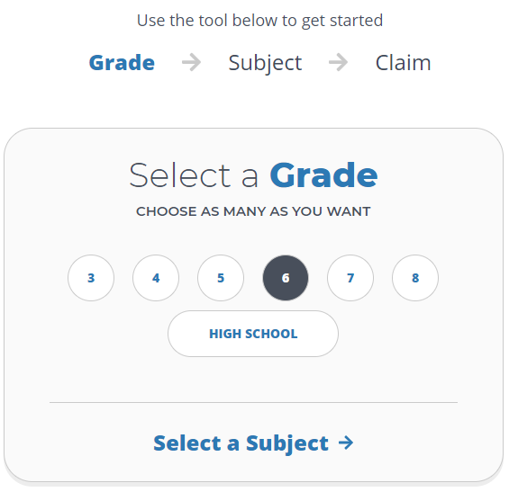
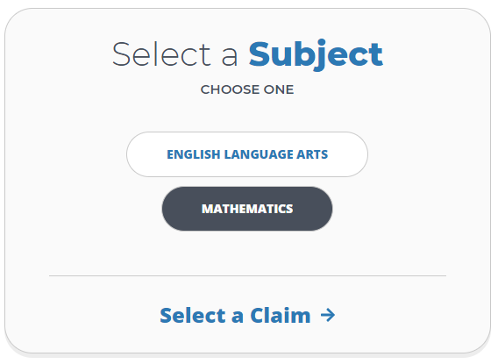
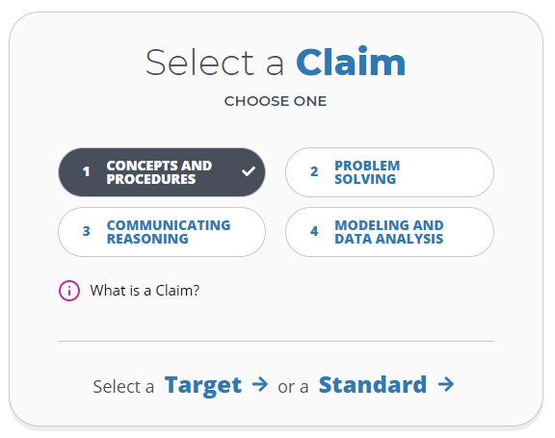
Step 2: Smarter Content Explorer
https://contentexplorer.smarterbalanced.org/
Notes:
Now, we’ll take those standards over to the Content Explorer tool, developed by Smarter Balanced. I’m serious – this is an amazing tool and you will want to shout it from the rooftops before we’re done. (Except I hear that shouting can increase the spread of COVID-19, so maybe don’t shout. Or shout with a mask on.)
When we navigate to the Content Explorer, we’ll first select a grade, then …
[Click to transition]
A subject, then …
[Click to transition]
A claim. Note that this tool works for ELA as well, and if you haven’t joined Tony Bertrand for Session 3A on using interim assessments in English Language Arts, you’re in for a treat.
In this case, I selected grade 6, mathematics, and Claim 1: Concepts and Procedures. We’re now prompted to select a Target or a Standard. Now, “targets” in math are really just what the Common Core State Standards refer to as “clusters”. You may already know the cluster (or target) of your unit. In this case, I’ll select standard because I’m generally more familiar with standards than targets. Targets tend to be more “assessment-ese”, but we’ll need this information to determine which interim assessment block to select.

Slide 23
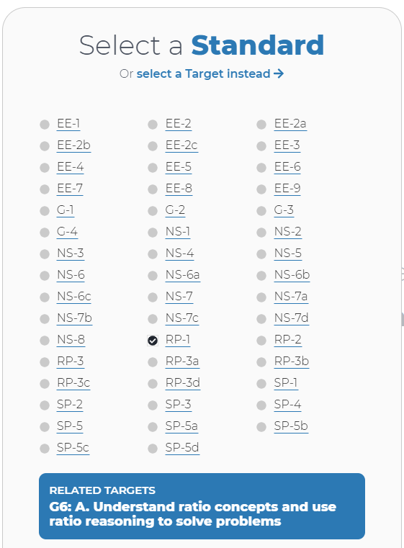
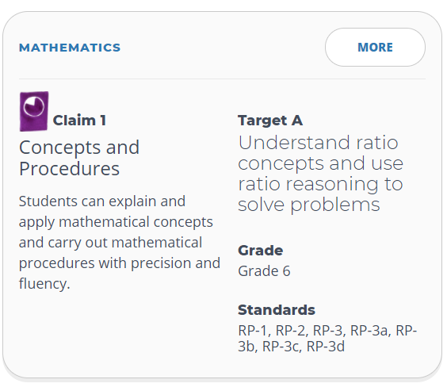
Step 2: Smarter Content Explorer
https://contentexplorer.smarterbalanced.org/
Notes:
Next, we select our standard or standards. I know I need RP.1, and when I click that, the tool brings up a window that shows me, specifically, which Target contains this standard. [Click for transition, twice]
It’s worth noting the text of both the claim and the target, and we see in one quick reference how claim, target, and standard all connect. This is where the term “Smarter” came from in “Smarter Balanced”, by the way.

Slide 24
Step 2: Smarter Content Explorer
https://contentexplorer.smarterbalanced.org/
What proficiency looks like!
Notes:
There are a couple of other key elements to the Content Explorer that we need while we’re here. First, “Range Achievement Level Descriptors” is a fancy term for “What proficiency looks like”. Our instruction should be designed around Level 3, which defines end-of-grade proficiency for this target.
At this point, let’s head over to the Content Explorer to see this in action. We’ll also find sample items aligned to our target, evidence statements, and a list of Tier 3 vocabulary.
[Go to browser tab]

Slide 25
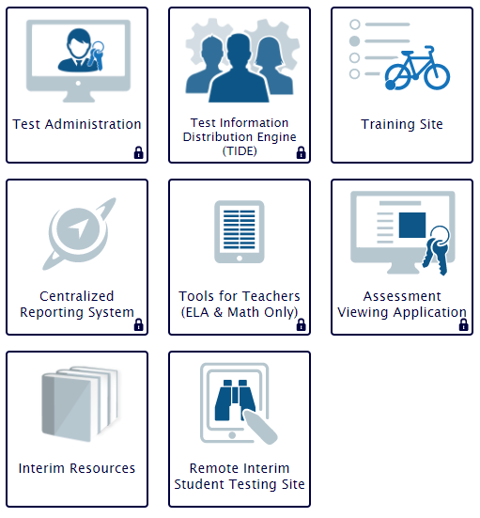
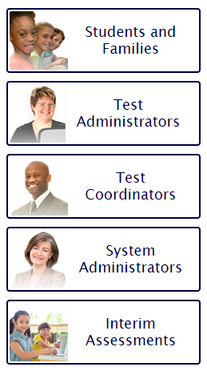
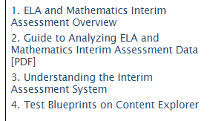
Step 3: Navigate to the OSAS Portal
https://osasportal.org/
Notes:
Now that we’ve filled up our toolbox a bit, let’s move to Step 3. We’re going to navigate to the OSAS Portal and [Click to transition] click on Interim Assessments. That will load a set of tiles for the interim system, many of which will look familiar. Standard administration works just like summative assessment administration – Test Administrators create a test session for students to access. You’ll also find TIDE, training tests, the data platform (called the Centralized Reporting System), Tools for Teachers access, the Assessment Viewing Application (which is used by educators to actually preview and interact with assessment items), a set of resources, and the remote administration testing site.
[Click for animation]
We want the Interim Resources, and, specifically, the “ELA and Mathematics Interim Assessment Overview”. We highly recommend you bookmark this document for ease of access.

Slide 26
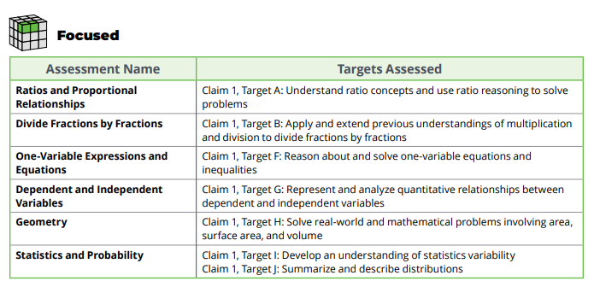
Step 4: Interim Assessment Overview
Notes:
Once we’re in this overview document, we’ll see tables for both ELA and Math that reference assessment names by targets. Remember that our unit covers Target A, so we want [Click for transition] the Focused Interim Assessment Block called “Ratios and Proportional Relationships”.
At this point, I could go back into the OSAS Portal to the Assessment Viewing Application and preview each item. Let’s take a look.
[Go back to browser to show OSAS Portal resources, then Interim Assessment Overview, then AVA; do NOT show items]

Slide 27
Reflect & Integrate
Educators can utilize the Content Explorer and Interim Assessments Overview to select the appropriate interim assessment.
What is my key learning about this objective?
What is my next action step?
Notes:
Alright, we’ve reached the end of our second objective. Take another moment to reflect and integrate your learning.
What is your key learning about this objective?
What is your next action step?
I’ll pause for a moment before we move to our last objective.

Slide 28
Learning Objective #3
Educators can make connections to high-quality instructional practices.
Notes:
Our final learning objective is all about making connections to high-quality instructional practices.

Slide 29
Take Only What You Need…
6.RP.1
6.RP.2
6.RP.3
Notes:
We’ll lace this section with some “pro tips”, and one of these is to take only what you need. When we look more closely at [Click for transition] the Ratios and Proportional Relationships Focused IAB, we note that *all* standards from Target A are assessed.
[Click to transition] Our unit did not get into RP.2, which is on unit rates. That’s our next unit. So I need to be strategic in how I use this assessment because some of the items apply to my current unit, while some will be more appropriate in the next unit.
This is a strong case for a non-standard administration, where I can pull a few items out of the OSAS Portal to use throughout instruction.

Slide 30
Look Backwards
6.RP.1
6.RP.3
5.NF.3
5.NBT.1
Notes:
The next pro tip is to look backward and use interim assessments from previous years. This works especially during 2020-21 because only a few districts used the Smarter Balanced interim assessments last year. Remember that my unit contained a few 5th grade standards, which I’ve also looked up on the Content Explorer.
[Click for transition]
5.NF.3 is in Target F – good to know.
[Click for transition]
Now I look in the Interim Assessment Overview tables for Grade 5 and see that there is an IAB called “Number and Operations – Fractions” that assesses Targets E and F. [Click to transition]
I can use assessment items from previous grade levels, but we do not recommend that you use interim assessment items from future grade levels. Instead, use sample items either from the Content Explorer or by browsing the Sample Items database directly.

Slide 31
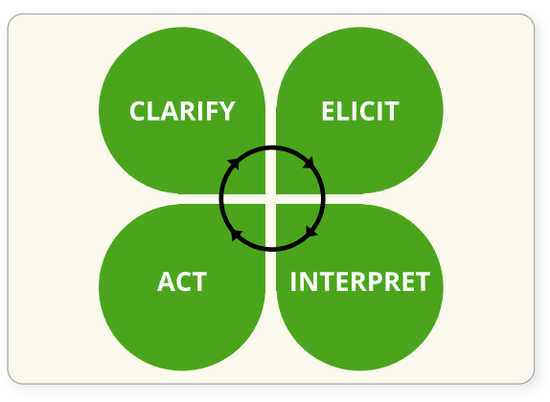
Assessment FOR Learning
Formative assessment is an active and intentional learning process that partners the teacher and the students to continuously and systematically gather evidence of learning with the express goal of improving student achievement.
HIGH-QUALITY
INSTRUCTIONAL
PRACTICES
COLLABORATION
Notes:
We’ll make a deliberate connection to the formative assessment process before we head into some specific use cases. If you joined us for Session 1, you’ll recall that formative assessment is active and intentional; it’s a process, not a “thing”; it is shared by educators and students; and is centered on evidence of student learning.
The clover image is a helpful visual anchor – this represents the four phases of formative assessment that can happen most effectively amidst high-quality instructional practices and a strong sense of collaboration among educators and students.
Also, remember the three “assessment FOR learning” use cases we outlined in Session 2. Let’s see a few of these in action.

Slide 32
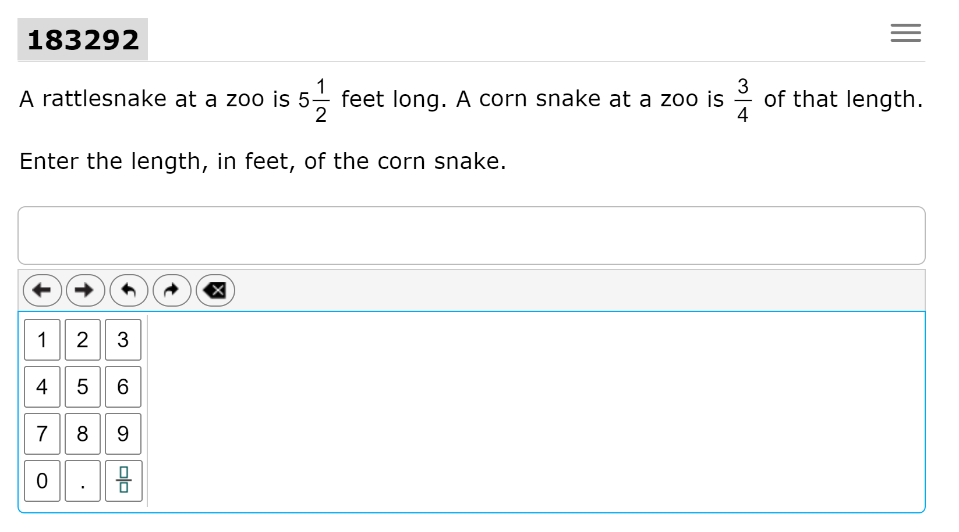
Daily Warmup
6.RP.1
6.RP.3
5.NF.3
5.NBT.1
Notes:
One idea is to use an interim task as a daily warmup. In this case, I’d like to better understand how my students work with fractions, which they would have done in more depth in 5th grade.
[Click for transition, twice]
This is a quick check formative task, and I could predict some possible student responses that could even help differentiate my instruction for that day’s lesson.
[Note that I’m only using sample items here]

Slide 33
Assessment Probes
Statement | True? Y or N | Evidence (How do you know?)
The ratio of total questions to history questions is 5 : 4.
The ratio of history questions to geography questions is 4 : 1.
There is 1 more history question than geography questions.
Notes:
Another example, and one of my favorites, is to transform an interim task into a formative probe by quickly putting response options in a table and asking students to provide evidence of their thinking.
[Click for transition]
This gives me more information than simply whether the student got it “right” or “wrong” in a standard administration, and requires students to produce language and engage in the math practices.
[Click for transition]
Creating a probe like this is an example of an instructional activity, and works best with multiple choice or multiple select items.

Slide 34
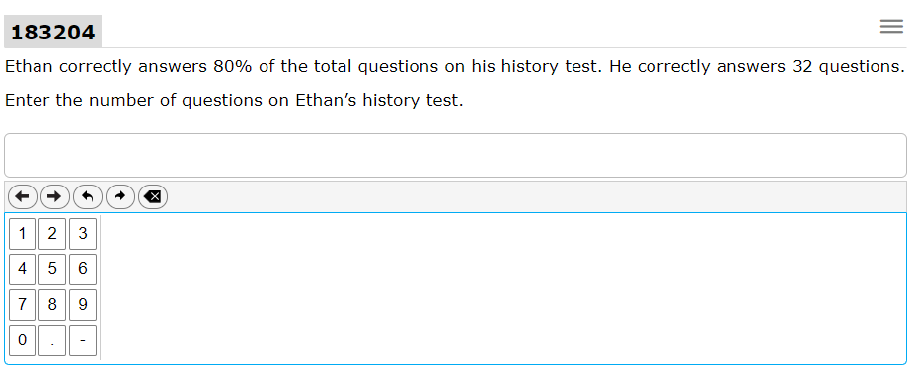
Discussion Prompts
D’Neisha thinks there were 36 questions on Ethan’s test.
Is she correct? How do you know?
Notes:
Another one of my favorite instructional adaptations is to take an interim assessment task and reframe it to force students to critique the reasoning of others.
[Click to transition]
In this example, students see another possible response and have to justify their answer with evidence. This could work on any number of distance learning platforms, including on Flipgrid, where students could even critique their classmates’ thinking (respectfully, of course).
[Click to transition]
Discussion prompts are another example of an instructional activity use case.

Slide 35
Extensions
What’s the rule?
Can you add a new row that includes a decimal?
Can you add a new row that includes a fraction?
Have you ever made a drink from a mix? What did you make?
Notes:
Yet another example is to extend an existing task to stretch students’ thinking. In this task, students are asked to complete a table interaction. No sweat!
[Click to transition twice]
I might tweak this task slightly to give students more language practice and some agency to create their own combinations. By asking “what’s the rule?” students have to describe what’s happening mathematically, and having students come up with their own examples gives them voice and choice in this activity. It could also be a great way to continue getting to know your students, their cultures, and hobbies.

Slide 36
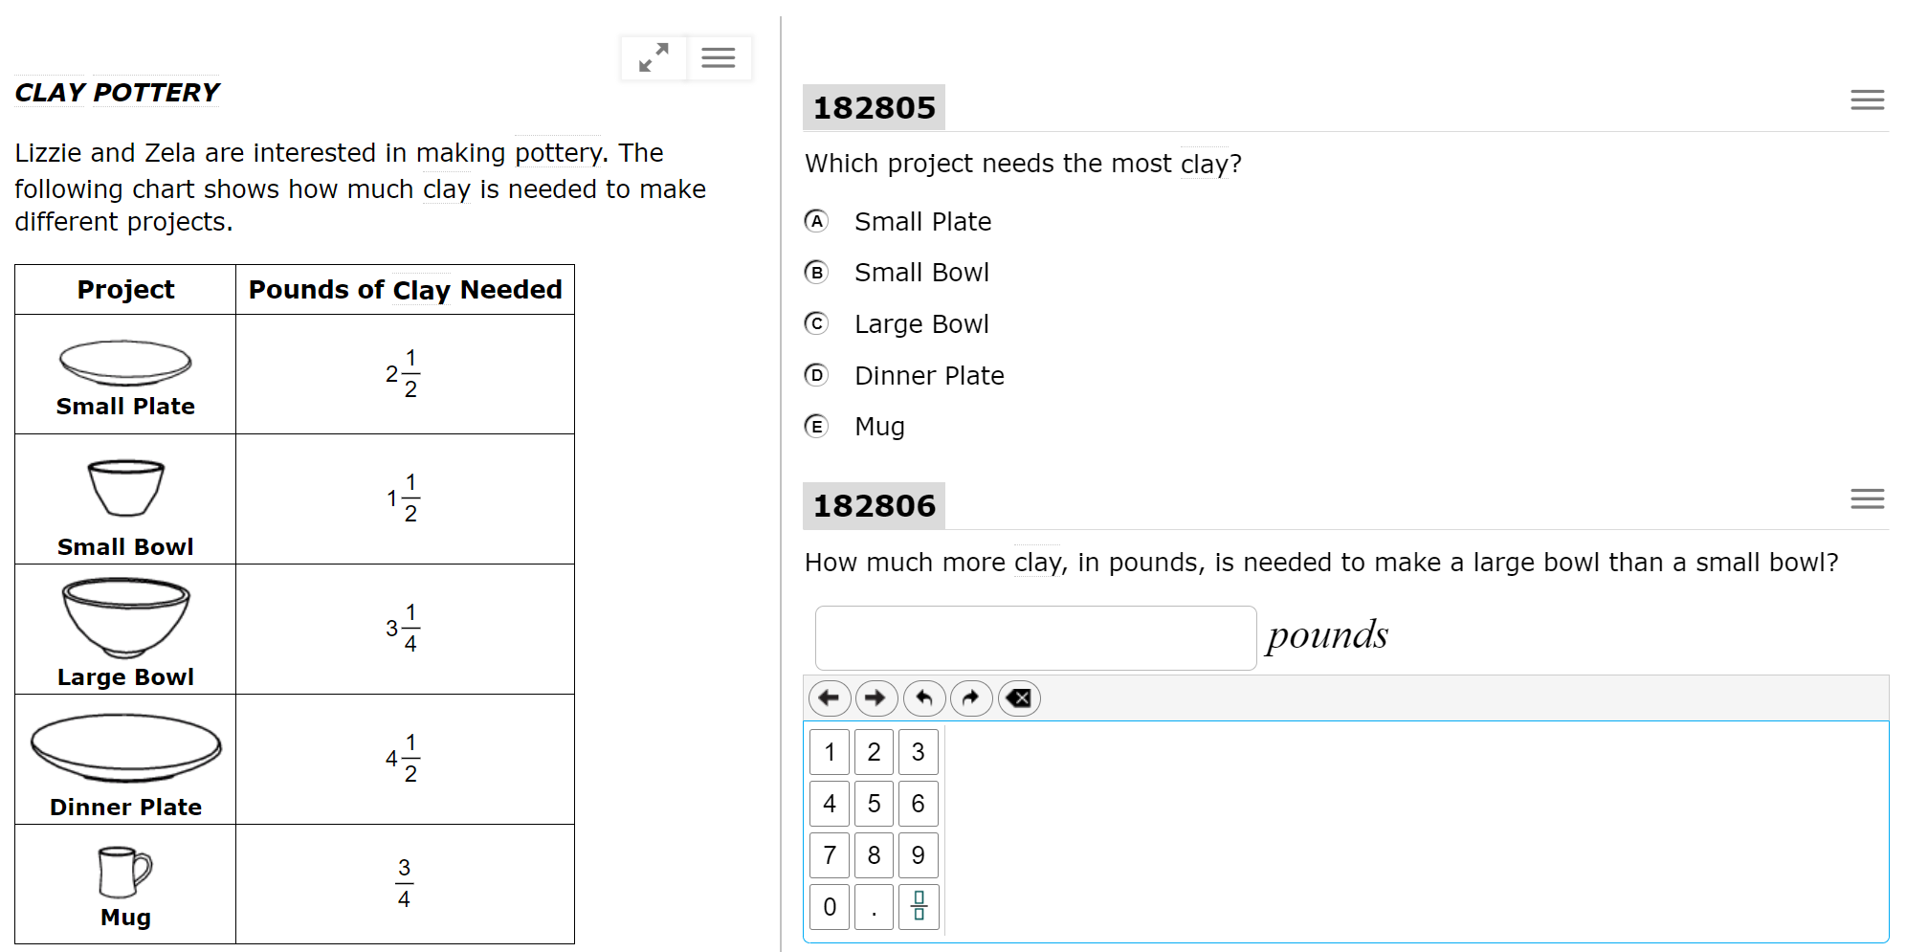
Math Practices
Notes:
Finally, now more than ever, we must keep our students engaged in the mathematical practices. Because the interim assessment system includes [Click to transition] Performance Tasks, I can [Click to transition] clarify expectations around what quality evidence of learning looks like. This could be a great way to clarify expectations around language use, expected vocabulary, even how to interact with certain items.
Each of these previous examples is connected to student learning, and illustrates how important interim assessments are in our overall formative assessment process.

Slide 37
Connections Playlists
Notes:
One last topic for today: Each interim assessment includes a Connections Playlist that links to Tools for Teachers. We’ll dive into this in Session 6, but please keep this in mind – there are several high-quality resources waiting for you, developed by educators for educators, that also include formative assessment instructional practices that work well for both in-person and distance learning.

Slide 38
Points to Ponder
Photo by Glen Carrie on Unsplash
Interim assessment blocks are flexible.
Take the time to align interim assessments with your course map.
Know and use the Content Explorer. (Even buy the t-shirt.)
Evidence is much more important than data.
Think about the role of feedback in equitable grading practices.
Notes:
We’ll wrap up today with a few big points to ponder.
First, interim assessment blocks are flexible. From how we administer them, to using them across grade levels, they are designed to meet instructional needs.
[Click to transition]
Next, take the time in your professional learning teams to align interim assessments with your course map. Maybe you’re doing this a quarter at a time right now. No problem, but at least be intentional about how interim assessments support student learning throughout the unit.
[Click to transition]
Third, know and use the Content Explorer. Buy the t-shirt. There is so much goodness to be found there!
[Click to transition]
This year, more than ever, evidence is more important than data. We’re not after a number; we’re after student thinking.
[Click to transition]
Finally, and we didn’t touch much on this today, think about the role of feedback as part of your equitable grading practices. Feedback could be given to students in each of the examples we just shared. Consider how your planning time can support providing students with feedback in a distance learning paradigm.

Slide 39
Reflect & Integrate
Educators can make connections to high-quality instructional practices.
What is my key learning about this objective?
What is my next action step?
Notes:
As has been our practice, we’ll give you just a few moments to reflect and integrate your learning.
What is your key learning about this objective?
What is your next action step?

Slide 40
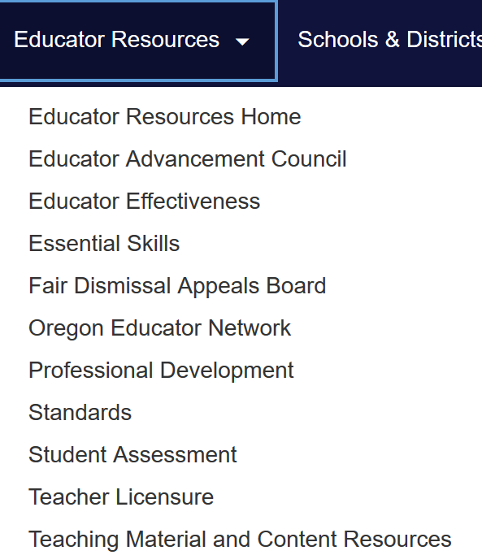
Contact Us! www.oregon.gov/ode
Dan Farley: Director of Assessment
Andrew Byerley: Mathematics Assessment
Mark Freed: Mathematics Education Specialist
Tom Thompson: STEM Education Specialist
Photo by Volodymyr Hryshchenko on Unsplash
Notes:
I cannot thank you enough for joining today. Please don’t hesitate to reach out if our team can help in any way. Go to Oregon.gov/ode and navigate to Student Assessment. Dan Farley is our director, and any of us on the ODE Math team can help you make sense of this vast system, answer questions, and support your implementation.

