Slide 1
TAG: Identification of Underrepresented Populations
Angela Allen

Slide 2
The data … our current reality

Slide 3
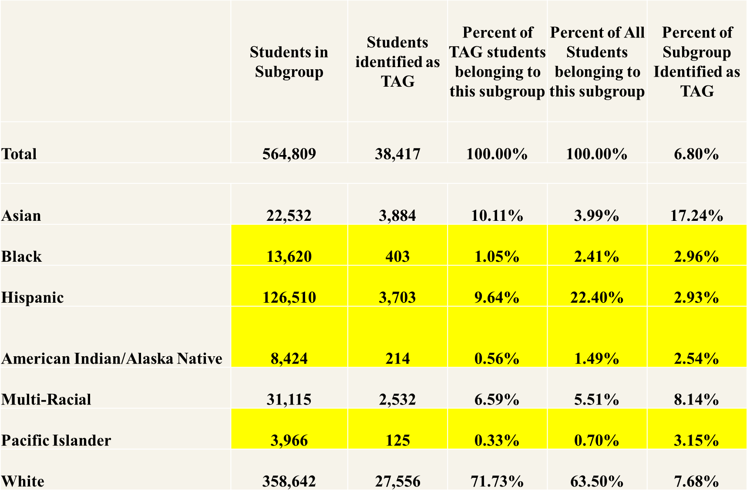

Slide 4
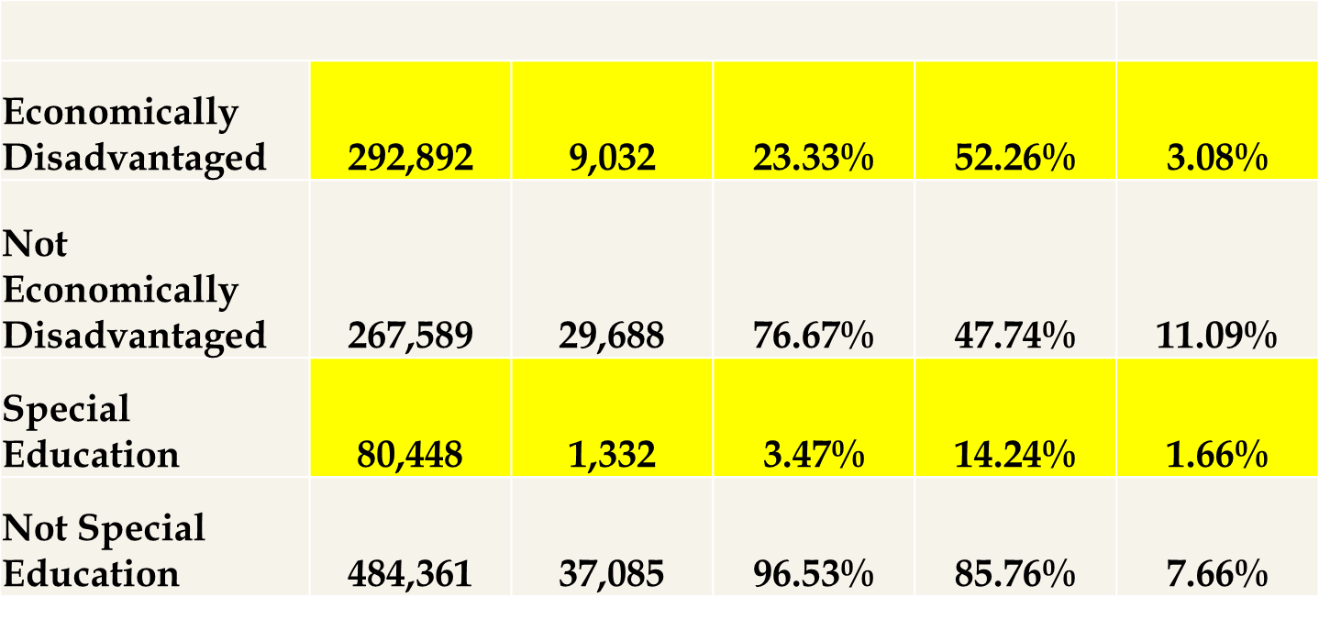

Slide 5
A snapshot of EL/TAG data
3273 | 10
13 | 0
1078 | 1
1358 | 4
5304 | 21
116 | 1
14 | 0
0 | 0
0 | 0
0 | 0
21 | 0
21 | 0
125 | 0
325 | 0
1 | 0
952 | 0
17 | 0
4 | 0
87 | 1
9 | 0
16 | 0
3 | 0
24 | 0
438 | 0
Each line represents an individual district
Fall Membership
EL Count = number of students in the district identified EL
EL TAG Count = number of EL students identified as TAG

Slide 7
Concerns regarding identification
Deficit lens vs. Asset lens
Inequities (belief, opportunity, achievement, and excellence gap)
“Poster child” of TAG does not reflect our diversity
Lack of cultural competency
Lack of understanding regarding Potential to Perform

Slide 8
OAR 581-022-1310
Adopted March 3, 2016
(2) The policies and procedures must meet the following requirements:
(a) Districts shall use research based best practices to identify students from under-represented populations including: ethnic minorities, students with disabilities, students who are culturally and/or linguistically diverse, or economically disadvantaged.

Slide 9
Potential to Perform
Students who demonstrate the potential to perform at the 97th percentile or higher.

Slide 10
Potential to Perform
Oregon Administrative Rule: 581-022-1310
Required to collect behavioral, learning, and performance information
(e)Despite a student’s failure to qualify under paragraph (d) (A) and (B) of this subsection, districts by local policies and procedures, shall identify students who demonstrate the Potential to Perform at the 97th Percentile.
Potential to Perform threshold is set by the district.
These students are considered Talented and Gifted once identified as Potential to Perform and must receive services.

Slide 11
Best Practices
Prior to the revised OAR, research based best practices were not generally utilized in the identification process for underrepresented populations
Examples of research based best practices include:
Universal Screening (examples): Kingore Observational Inventory, CogAT, and Naglieri Nonverbal Ability Test
Multidimensional data points/No cut scores
Normed Scales: SIGS (Scales for Identifying Gifted Students), Gifted Rating Scale/Gifted Evaluation Scale
Assessments in native languages
Using local norms when available
Educate and engage parents (via registration process)
Progress monitoring for ALL students in academically diverse classrooms
Talent pool

Slide 12
Perspective on Talented and Gifted
Giftedness is often a label and fixed quality
The goal should be inclusion, rather than exclusion
Both objective and subjective data should be collected
Professionals and non-professionals with various levels of expertise should provide information on behavioral indicators
Special attention should be given to the different ways in which children of various cultures manifest behavioral indicators of giftedness
Identification should occur early, consist of specific steps, and should be on-going
Decisions on identification should be delayed until all relevant data on the student is reviewed
Working with Gifted English Language Learners, M. Mathews, Prufrock Press, 2006.

Slide 13
Traits that mask giftedness
Asynchronous development
Perfectionism
Overexcitabilities (intellectual, psychomotor, emotional, imaginational, sensual)
Underachievement
Negative behaviors
Introvert
Fixed mindset

Slide 14
Educate! Create! Build!
Build capacity: district leaders – focusing on equitable practices
Demonstration sites
Professional Development (statewide)
TAG Networks/Hubs
Sharing materials (inter-district)– universal screening
ESSA allowances (Title I and IIa) to expand TAG professional development

