Slide 1
Review of the 2016 TELL Oregon Survey Results State Board of Education May 19, 2016
Lindsey Capps, Chief Education Officer
Dawn Shephard, New Teacher Center
Hilda Rosselli, Chief Education Office
Dawne Huckaby, Oregon Department of Education
Hanna Vandering, Oregon Education Association
Notes:
Lindsey—introduce panelists

Slide 2
Today’s Objectives
Review TELL survey design
Explore 2016 survey results
Identify key changes in perception since 2014
Consider State level policy and ways to inform use of the TELL results
Notes:
Lindsey-review objectives

Slide 3
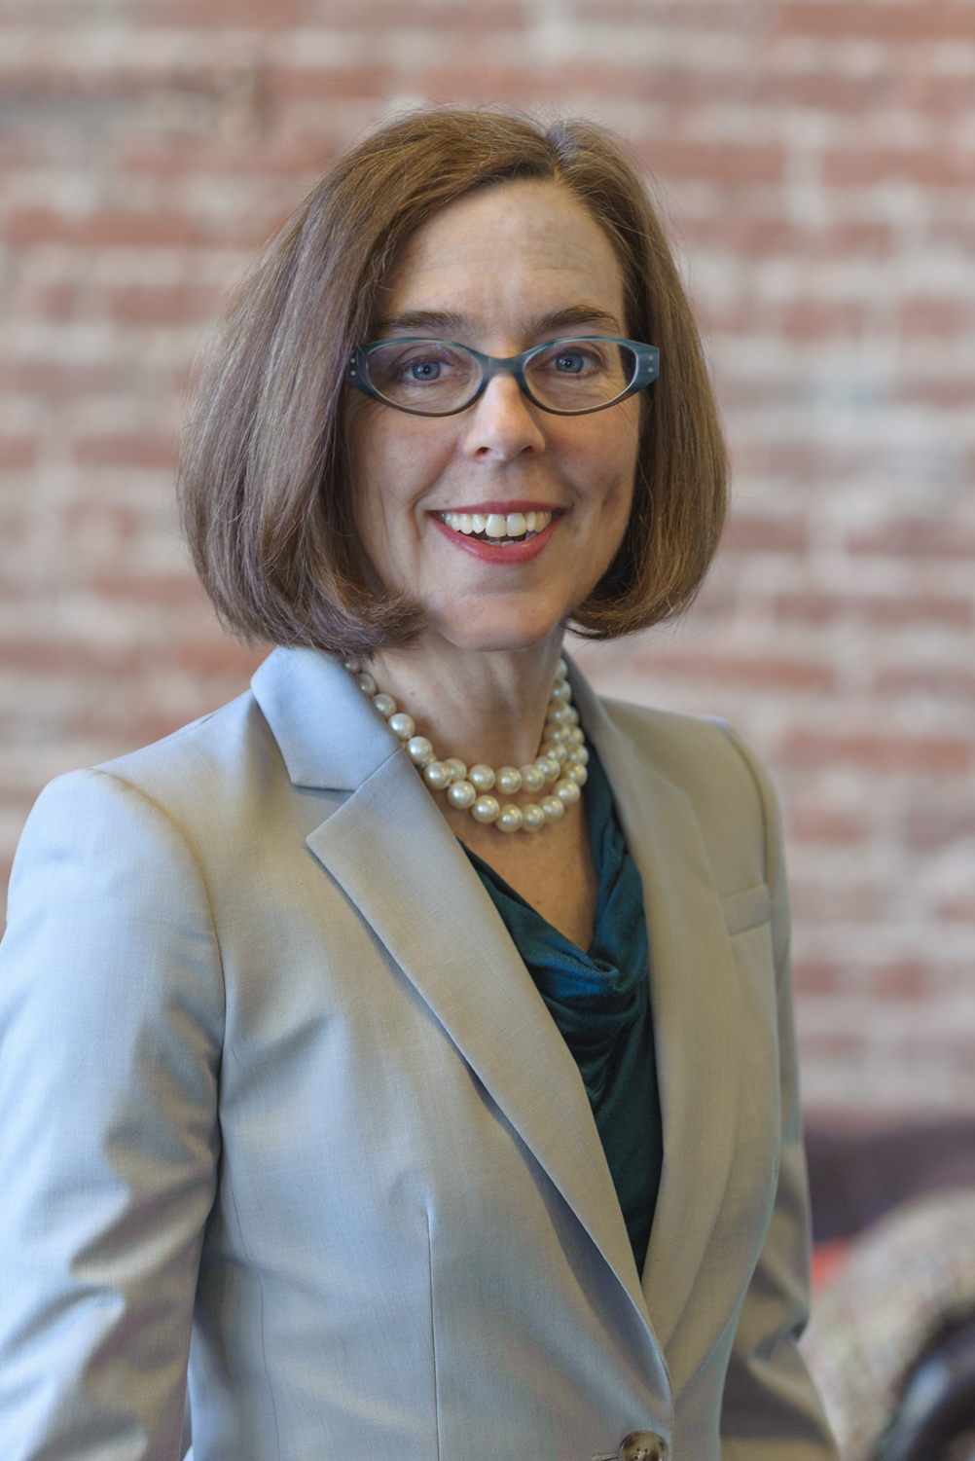
“We want to hear from you. As an educator, you are the most critical link to student success. Your feedback is essential to our ability to monitor and improve teaching and learning conditions.” Governor Kate Brown
Notes:
Lindsey—why important to the Governor

Slide 4
TELL Survey Background
Notes:
Dawn

Slide 5
The TELL survey is a voluntary, anonymous, online survey taken by teachers and building level licensed administrators and staff.
The acronym TELL stands for:
Teaching,
Empowering,
Leading, and
Learning.
Notes:
Dawn

Slide 6
TELL Survey Origin
Governor's Teacher Working Conditions Initiative in North Carolina (2002)
North Carolina Professional Teaching Standards Commission (NCPTSC) used the National Center for Education Statistics’ School and Staffing Survey to better understand factors contributing to teacher satisfaction and employment trajectories.
Since 2008, NTC has heard from over one million educators across twenty states
Notes:
Dawn

Slide 7
TELL Survey Purpose
The main intent of the TELL Survey is to provide additional data on teaching and learning conditions for the purposes of school and district improvements.
Results are also expected to inform state level policy.
Notes:
Dawn

Slide 8
What the TELL Oregon Survey IS:
A statistically valid and reliable instrument to assess whether educators have working conditions in their school that support effective teaching.
What the TELL Oregon Survey Is NOT:
An assessment of the morale of teachers or their happiness with specific policies. The survey does not provide information as to why teachers perceive conditions as they do, which is best ascertained through data-driven dialogue as part of the school improvement planning process.
Notes:
Dawn

Slide 9
Teaching and Learning Conditions Matter
Retention
Conditions that matter most in deciding to stay include the school’s culture, the principal’s leadership and relationships among peers Johnson, Kraft and Papay (2011)
Teaching and learning conditions predict plans to leave a school, independent of school demographics Ladd (2009)
Notes:
Dawn

Slide 10
Teaching and Learning Conditions Matter
Student Learning
Teaching and learning conditions predict student achievement in mathematics, and to a lesser degree, in reading (Ladd, 2009)
Student conduct management, demands on time, professional autonomy and professional development — are significant predictors of student learning gains and student perceptions of rigor and support (Ferguson & Hirsch, 2014)
Notes:
Dawn

Slide 11
TELL measures 8 constructs linked to teacher retention and student achievement:
Use of Time
Facilities and Resources
Community Support and Involvement
Managing Student Conduct
Teacher Leadership
School Leadership
Professional Development
Instructional Practices and Support
Notes:
Dawn

Slide 12
TELL Constructs Defined
Use of Time | Available time to plan, to collaborate, to provide instruction, and to eliminate barriers in order to maximize instructional time during the school day
Facilities and Resources | Availability of instructional, technology, office, communication, and school resources to teachers
Community Support & Involvement | Community and parent/guardian communication and influence in the school
Managing Student Conduct | Policies and practices to address student conduct issues and ensure a safe school environment
Teacher Leadership | Teacher involvement in decisions that impact classroom and school practices
School Leadership | The ability of school leadership to create trusting, supportive environments and address teacher concerns
Professional Development | Availability and quality of learning opportunities for educators to enhance their teaching
Instructional Practices & Support | Data and support available to teachers to improve instruction and student learning
Notes:
Dawn

Slide 13
TELL Oregon Survey Participation
Notes:
Hilda

Slide 14
TELL Oregon 2016 Statistics
Survey open-- 5 wks.
18,266 responses (54.3%)
16,651 Teachers
353 Principals
192 Assistant Principals
1,070 Other staff
93 schools w/100% response rate
Notes:
Hilda
201 Stats as reference only
Survey open-- 6 wks.
19,373 responses (59.4%)
17,418 Teachers
588 Principals
236 Assistant Principals
1,131 Other staff
117 schools w/100% response rate
In 2014 784 of 1,265 schools (62%) met or exceeded 50% participation threshold w/at least 5 respondents
In 2016 XXX of XXXX schools (XX%) met or exceeded XX% participation threshold w/at least X respondents

Slide 15
Other States’ TELL Survey Response Rates
North Carolina 2016 (85.46%) response rate
Kentucky 2015 (89.32%) response rate
Colorado 2015 (51.08%) response rate
Tennessee 2013 (82.14%) response rate
Notes:
Hilda

Slide 16
Survey Results by Construct
Notes:
Hilda
All calculations are done at the respondent level and then aggregated to school, district, and state level
At the Item Level:
Percentage of respondents indicating ‘Agree’ or ‘Strongly Agree’ for the given survey question
At the Construct Level:
Average rate of agreement across items within the given construct
Ex. Respondent indicates ‘Agree’ or ‘Strongly Agree’ for 4 out of 8 items within a construct, their Rate of Agreement (RA) for the given construct is 50%

Slide 17
2016 TELL Construct Averages
Use of Time
Community Support & Involvement
Facilities & Resources
Managing Student Conduct
Teacher Leadership
School Leadership
Professional Development
Instructional Practices & Support
Notes:
Hilda
Construct Average= Average Rate of Agreement on the items that measure that construct

Slide 18
TELL Construct Averages, 2014 & 2016
 | 2014 | 2016 |  | 2014 | 2016
Use of Time |  |  | Teacher Leadership
Community Support & Involvement |  |  | School Leadership
Facilities & Resources |  |  | Professional Development
Managing Student Conduct |  |  | Instructional Practices & Support
+4
+11
+3
+3
+5
+7
-2
+3
Notes:
Hilda
Now able to look at comparisons between 2014 and 2016 results

Slide 19
Which aspect of your teaching conditions most affects your willingness to keep teaching at your school?
Notes:
Hilda
Critical to our overall goal of recruiting and retaining an effective education workforce

Slide 20
Survey Results for Selected Items
Notes:
Hilda

Slide 21
Use of Time
2014 | 2016
Teachers have sufficient instructional time to meet the needs of all students.
Class sizes are reasonable such that teachers have the time available to meet the needs of all students.
The non-instructional time provided for teachers in my school is sufficient.
Efforts are made to minimize the amount of routine paperwork teachers are required to do.
Notes:
Hilda

Slide 22
Professional Development
2014 | 2016
An appropriate amount of time is provided for professional development.*
Sufficient resources are available for professional development in my school.
Professional development is differentiated to meet the needs of individual teachers.
*Item with greatest growth from 2014 to 2016
Notes:
Hilda

Slide 23
Additional Item-Level Changes
2014 | 2016
State data assessment data are available in time to impact instructional practices.*
The curriculum taught at this school is aligned with state-based standards.
Teachers have sufficient access to a broad range of professional support personnel.
Teachers have time available to collaborate with colleagues.
Teachers are allowed to focus on educating students with minimal interruptions.
*Item that decreased the most from 2014 to 2016; Lowest rated item 2016;
Notes:
Hilda
Only 2 other items decreased in rate of agreement from 2014 to 2016.
The faculty work in a school environment that is safe. (-1.3%)
The physical environment of classrooms in this school supports teaching and learning. (-1.0%)

Slide 24
“Overall, my school is a good place to work and learn.” by Grade Level
Notes:
Hilda

Slide 25
Responses for educators plan to stay were higher than for those who plan to move to a different school:
Notes:
Hilda

Slide 26
Accessing and Using the TELL Results
Notes:
Dawne

Slide 27
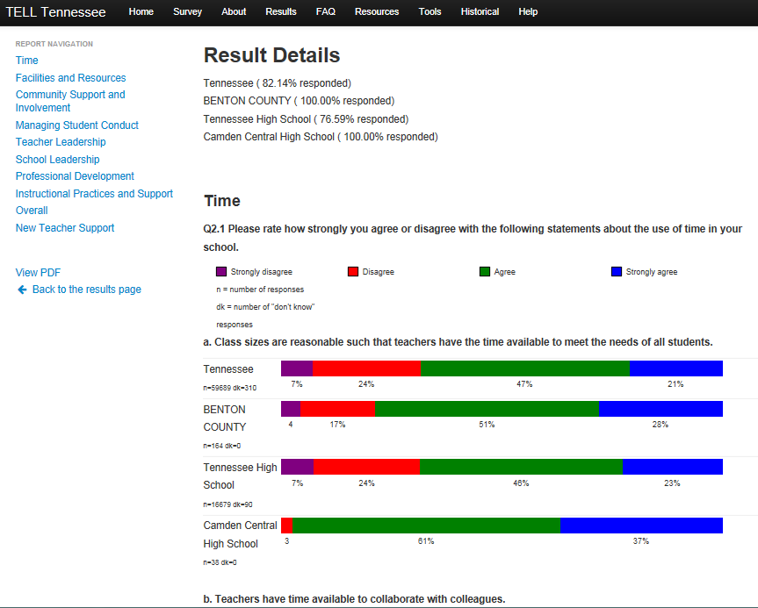
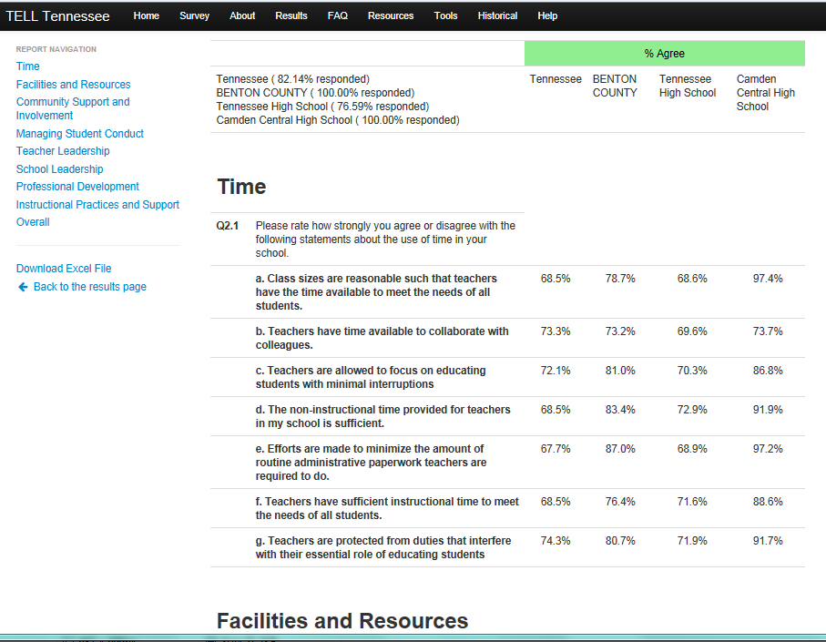
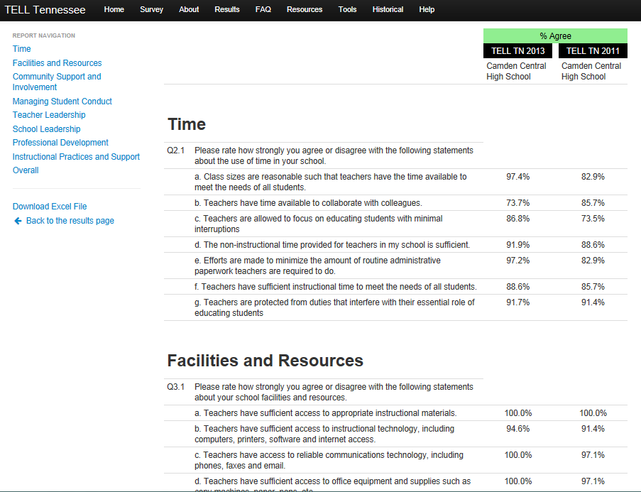
Reports Available on TELL Oregon Website
Detailed
Summary
Comparison to 2014
Notes:
Dawne

Slide 28
OEA Center for Great Public Schools TELL Guide
1) Reflect on the overall status of teaching conditions as identified by educators;
2) Use the TELL data to review differences within and across schools in their district;
3) Consider potential strategies and solutions to improve conditions; and
4) Collaboratively work with fellow teachers, principals, district administrators and community members to support continuous improvement teaching and learning conditions in each and every Oregon school and district
Notes:
Hanna discuss intent and design of the toolkit.

Slide 29
Use of the TELL Data at the State Level
Council for Education Advancement—Developing recommendations for Governor Brown that improve teaching and learning conditions
ODE & Chief Education Office—Tracking impact of strategic investments
ODE & Chief Education Office—Prioritizing state resources and improving practices
ODE & Chief Education Office—Monitoring change over time related to goals and improvement plans
Notes:
Dawne

Slide 30
State Board Considerations
Are the TELL data another evidence source indicating school and district effectiveness?
Should districts be encouraged to use the TELL data to inform their plans for use of Title II-A funding?
Should an item be added to the next TELL survey to specifically assess impact of state-offered PD?
Would the State Board like to learn more about how other states have used the TELL results? e.g. policy, teaching condition standards, etc.
How can we ensure that funding for the TELL survey is secure for the next biennium?
Notes:
Dawne facilitate board discussion

Slide 31
Appendix Item-Level Results by Construct
Notes:
For board members reference only
This section contains item level results for all constructs.
This information shows variation within the constructs to help you identify specific areas of strength and opportunities for continued improvement.

Slide 32
Use of Time
Class sizes are reasonable such that teachers have the time available to meet the needs of all students. | 37
Teachers have time available to collaborate with colleagues. | 62
Teachers are allowed to focus on educating students with minimal interruptions. | 60
The non-instructional time provided for teachers in my school is sufficient. | 48
Efforts are made to minimize the amount of routine paperwork teachers are required to do. | 57
Teachers have sufficient instructional time to meet the needs of all students. | 46
Teachers are protected from duties that interfere with their essential role of educating students. | 71
Notes:
For board members reference only

Slide 33
Facilities and Resources
Teachers have sufficient access to appropriate instructional materials. | 67
Teachers have sufficient access to instructional technology, including computers, printers, software and internet access. | 68
Teachers have access to reliable communication technology, including phones, faxes and email. | 92
Teachers have sufficient access to office equipment and supplies such as copy machines, paper, pens, etc. | 82
Teachers have sufficient access to a broad range of professional support personnel. | 64
The school environment is clean and well maintained. | 79
Teachers have adequate space to work productively. | 79
The physical environment of classrooms in this school supports teaching and learning. | 76
The reliability and speed of Internet connections in this school are sufficient to support instructional practices. | 77
Notes:
For board members reference only

Slide 34
Community Support and Involvement
Parents/guardians are influential decision makers in this school. | 64
This school maintains clear, two-way communication with the community. | 84
This school does a good job of encouraging parent/guardian involvement. | 84
Teachers provide parents/guardians with useful information about student learning. | 91
Parents/guardians know what is going on in this school. | 78
Parents/guardians support teachers, contributing to their success with students. | 72
Community members support teachers, contributing to their success with students. | 78
The community we serve is supportive of this school. | 85
Notes:
For board members reference only

Slide 35
Managing Student Conduct
Students at this school understand expectations for their conduct. | 85
Students at this school follow rules of conduct. | 71
Policies and procedures about student conduct are clearly understood by the faculty. | 75
School administrators consistently enforce rules for student conduct. | 70
School administrators support teachers' efforts to maintain discipline in the classroom. | 80
Teachers consistently enforce rules for student conduct. | 75
The faculty work in a school environment that is safe. | 89
Notes:
For board members reference only

Slide 36
Teacher Leadership
Teachers are recognized as educational experts. | 83
Teachers are trusted to make sound professional decisions about instruction. | 83
Teachers are relied upon to make decisions about educational issues. | 80
Teachers are encouraged to participate in school leadership roles. | 88
The faculty has an effective process for making group decisions to solve problems. | 65
In this school we take steps to solve problems. | 80
Teachers are effective leaders in this school. | 84
Teachers have an appropriate level of influence on decision making in this school. | 64
For board members reference only
Notes:
For board members reference only

Slide 37
School Leadership
The faculty and leadership have a shared vision. | 75
There is an atmosphere of trust and mutual respect in this school. | 73
Teachers feel comfortable raising issues and concerns that are important to them. | 73
The school leadership consistently supports teachers. | 78
Teachers are held to high professional standards for delivering instruction. | 92
The school leadership facilitates using data to improve student learning. | 89
Teacher performance is assessed objectively. | 86
Teachers receive feedback that can help them improve teaching. | 79
Teachers in this school receive feedback about their teaching on an ongoing basis. | 68
The procedures for teacher evaluation are consistent. | 81
Teachers in this school are evaluated by someone who is well prepared to use the district’s evaluation tool. | 85
The school improvement team provides effective leadership at this school. | 74
The faculty are recognized for accomplishments. | 76
Notes:
For board members reference only

Slide 38
Professional Development
Sufficient resources are available for professional development in my school. | 71
An appropriate amount of time is provided for professional development. | 69
Professional development offerings are data driven. | 72
Professional learning opportunities are aligned with the school’s improvement plan. | 86
Professional development is differentiated to meet the needs of individual teachers. | 51
Professional development deepens teachers' content knowledge. | 62
Teachers are encouraged to reflect on their own practice. | 89
In this school, follow up is provided from professional development. | 60
Professional development provides ongoing opportunities for teachers to work with colleagues to refine teaching practices. | 70
Notes:
For board members reference only

Slide 39
Professional Development (cont.)
Professional development is evaluated and results are communicated to teachers. | 46
Professional development enhances teachers' ability to implement instructional strategies that meet diverse student learning needs. | 75
Professional development enhances teachers' abilities to improve student learning. | 80
Professional development in this school supports teachers in developing formative assessments aligned to standards. | 66
Notes:
For board members reference only

Slide 40
Instructional Practices and Support
State assessment data are available in time to impact instructional practices. | 31
Local assessment data are available in time to impact instructional practices. | 75
Teachers use assessment data to inform their instruction. | 87
The curriculum taught in this school is aligned with state-based standards. | 92
Teachers work in professional learning communities or cluster groups to develop and align instructional practices. | 87
Provided supports (i.e. instructional coaching, professional learning communities, etc.) translate to improvements in instructional practices by teachers. | 79
Teachers are encouraged to try new things to improve instruction. | 90
Notes:
For board members reference only

Slide 41
Instructional Practices and Support (cont.)
Teachers are assigned classes that maximize their likelihood of success with students. | 63
Teachers have autonomy to make decisions about instructional delivery (i.e. pacing, materials and pedagogy). | 80
Teachers believe almost every student has the potential to do well on assignments. | 90
Teachers believe what is taught will make a difference in students’ lives. | 94
Teachers require students to work hard. | 93
Teachers collaborate to achieve consistency on how student work is assessed. | 80
Teachers know what students learn in each of their classes. | 75
Teachers have knowledge of the content covered and instructional methods used by other teachers at this school. | 68

