Slide 1
Writing Scoring Guide

Slide 2
Draft and Official Writing Scoring Guide
Study included 594 writing samples that were double scored using both the Draft and Official Writing Scoring rubrics.

Slide 3
Draft and Official Writing Scoring Guide
Notes:
Sentence Fluency (S) showed largest computed difference of 0.09.
Note: All trait scores range from 1 to 6

Slide 4
Edit to Sentence Fluency

Slide 5
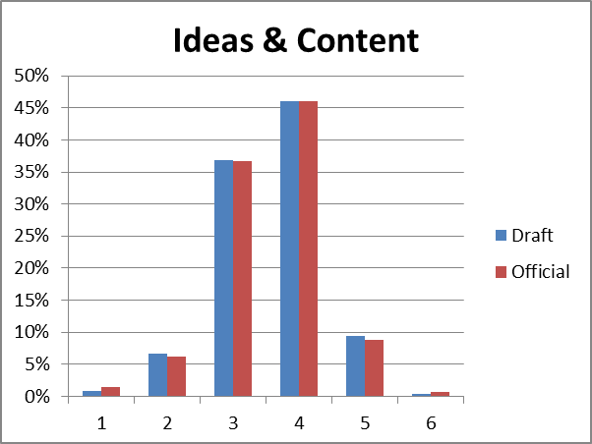

Slide 6
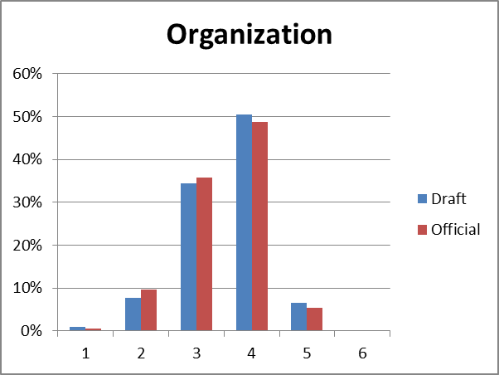

Slide 7
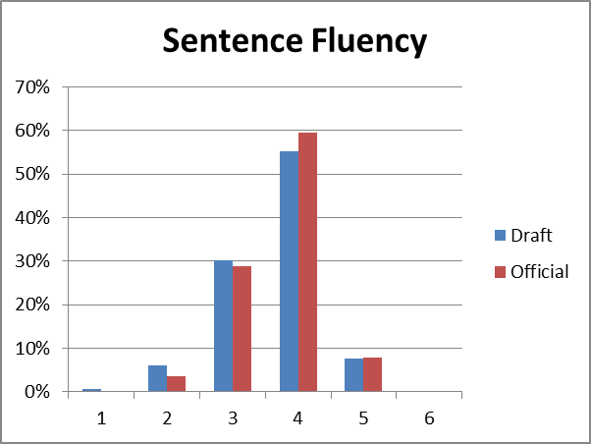

Slide 8
