Slide 1
Update to State Board of Education
January 2015

Slide 2
Mission & Vision
To provide a creative learning environment where students develop a sense of place and become stewards of the natural world and active citizens within our community.
Our vision is to look beyond classroom walls. We believe that healthy communities are created by engaged, informed & compassionate citizens. Through service, integrated curriculum and experiential learning, we provide opportunities for our students to actively build relationships locally, inspiring them to become catalysts of change in a global community.

Slide 3
Educational Philosophy
Place-based learning
Connects kids to the community
Uses the social and natural environment as an additional classroom
Integrated learning experiences
Authentic, hands-on, real world learning experiences
Science, Art & Civics are the primary lenses
Small class and school size

Slide 4
Why Southwest Charter School?
Fewer educational options in SW Portland
28 public options on the east side of Portland
6 public options on the west side of Portland
Small class size & small school size
Community involvement
Authentic, place-based learning

Slide 5
History of Southwest Charter
Opened in 2007
Grown from 29 students to 200+
Over 275 applied last year
Waiting list grown to 200+ students
Operated in 7 different locations
Renewed in 2010 for 3 years
Renewed in 2013 for 5 years

Slide 6
Significant Accomplishments in 2013-2014
Large improvement in our overall reading, math and science scores on the OAKS.
Implementation of new math curriculum, Singapore Math.
Successful fundraising with over $80,000 raised to support programming at SWCS.
Second year as a level 4 school on the newly revised Oregon School Report Card.

Slide 7
Significant Accomplishments in 2013-2014
Maintenance of both enrollment and waiting lists.
Largest 7/8 classes yet.
Implemented three new artists-in-residence.
Continued to identify needs and implement more professional development for teachers including full staff training in Singapore Math and joint training with Eagle Charter School in Education for the Future’s school improvement techniques.
Fourth year win for our 7th/8th grade students of the statewide Project Citizen project.

Slide 8
Field Work
An integral part of the learning at SWCS
Authentic experiences for students
Broadens their concept of where learning happens
Connects classroom learning with real world application

Slide 9
Field Work
Over 150 field work experiences this year
Weekly trips to neighborhood resources (e.g. Community Garden, Cottonwood Bay)
Library trips at grade levels 1-8 (monthly)
Art experiences
Portland Art Museum
Theater & Music performances
Science experiences
Bull Run Reservoir
Outdoor school – multi-day trips for grades 5/6
Pond studies at Oaks Bottom for grades K-2
Civics experiences
Project Citizen in Salem – follow-up with City Council
Metro Cemetery project
Seattle Trip for grades 7/8
Portland connections – Oregon Food Bank, Zidell Marine Corporation

Slide 10
Community Partnerships
Waterfront Foursquare Church – offered a secular, healthy relationship seminar open to parents and the community
Communities for Safe Kids – Bullying & child abuse workshops for teachers, parents and students
Wind & Oar Boat School – hosted a subset of 7/8 students to build a wooden, oar-driven boat
Mirabella Portland – hosted 7/8 interns, 1/2 students visited elderly residents on multiple visits
Zidell Marine Corporation
Rock & Roll Camp for Girls – hosted 3 sessions of their rock camp for girls in the Summer of 2012 and 2013
South Portland Business Association – SWCS is a member
Oregon Food Bank – hosted 5/6 students for 4 community service projects
Portland Parks & Recreation – SWCS has a stewardship agreement with PPR with regard to Cottonwood Bay, a nearby natural area owned by the Parks.

Slide 11
Community Partnerships
Metro Heritage Cemeteries – Worked with 7/8 students on Civil War Veteran Cemetery Quests
City Hall – Worked with 7/8 students on Project Citizen project
7/8 Internship Partners
Mirabella
Park Place – Senior Living
Free Geek
Johnson Creek Watershed Council
The Dog House
Gray’s Landing – REACH
Courtyard at Mt. Tabor – Park
Tryon Creek State Park
Neighborhood House
American Red Cross
Additionally, over 280 vendors donated to our annual auction in support of SWCS

Slide 12
Student Assessment
State tests - 100% participation
Percent meeting/exceeding standards this year improved in:
Reading – 3rd, 4th, 5th, 7th & 8th
Math – 3rd, 5th, 7th & 8th
Science – 5th & 8th

Slide 13
Student Assessment

Slide 14
Areas Where SWCS Scores Were Higher than PPS | Areas where SWCS Scores Were Higher than State
3rd reading | 3rd reading
5th reading | 3rd math
5th math | 4th reading
5th science | 5th reading
6th reading | 5th math
7th reading | 5th science
7th math | 6th reading
8th reading | 6th math
8th math | 7th reading
8th science | 7th math
Overall reading | 8th reading
Overall math | 8th math
Overall science | 8th science
 | Overall reading
 | Overall math
 | Overall science

Slide 15
Student Assessment
Project-based rubrics
Individualized student goals
Create portfolios of student work
Use pre/post tests in many subjects
Standards-based report cards
EasyCBM

Slide 16
Student Demographics
Gender
60.5% Boys
39.5% Girls
Race/ethnicity
4.4% Hispanic/Latino
2.2% American Indian
1.3% Asian/Pacific Islander
2.2% African American
6.4% Multi-racial
87% White (non-Hispanic)

Slide 17
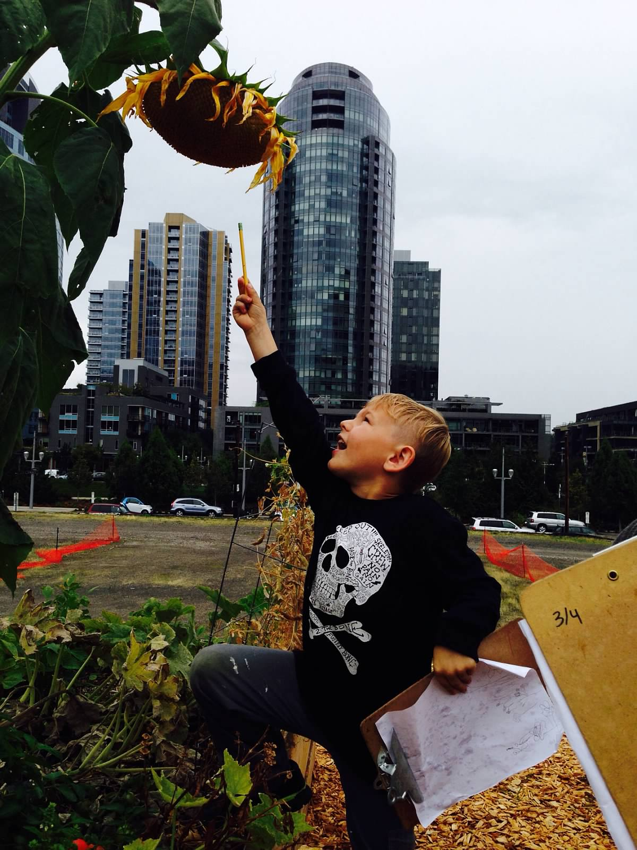
Student Demographics
10% qualify for free/reduced lunch program
Students represent 9 different school districts
88% from Portland Public Schools

Slide 18
Students with Disabilities
18.7% of our students had IEPs
14.3% in 2012-2013
7 have 504 plans
9 students with IEPs left because of insufficient services at SWCS

Slide 19
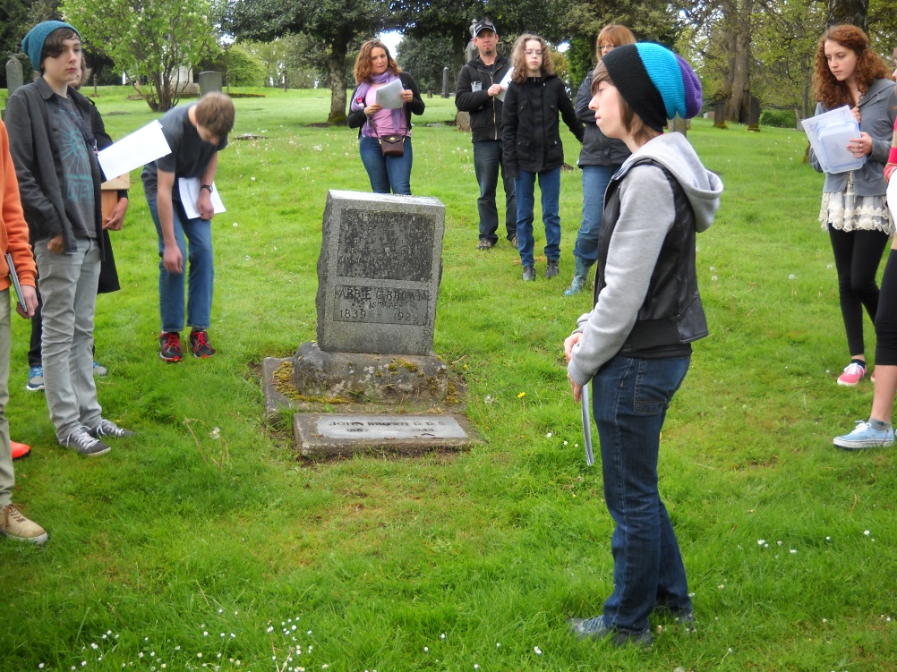
Grades 7 & 8 at SWCS
4 Project Citizen statewide wins
Policy-based solutions to community problems
Last year: No Smoking in Portland Parks
Metro Cemetery Project
More intensive field work
8-week internships
Career internships

Slide 20
Reaching Out
Foreign Visitors
Matt Little – UK - Real Ideas Organisation
Pre-service Teachers (6) from JeJu National University – Seoul, South Korea

Slide 21
Reaching Out
Place-based Learning
Participate/present with Lewis & Clark’s PBE Consortium
School Visit Day
Lowrie Elementary, West Linn
Jane Goodall Environmental Middle School, Salem
Emerson Charter School, Portland
Portland Waldorf School, Portland

Slide 22
Goals for 2014-2015
Math Performance Goals
From 69% to 70% meeting/exceeding
Reading Performance Goal
From 83% to 84% meeting/exceeding
Increased rigor & parent communication about student progress
Field work & community partner improvements
Stronger scope/sequence for language arts
Teacher retention & continued prof. development
Telling our story!

Slide 23
Final Thoughts
From the comment book at the Grand Army of the Republic Cemetery
August 1, 2014
I just moved from New York (city and metro area) where I grew up and Williamsburg, Virginia , to West Linn, Oregon. We lived in Virginia for about five years and during that time, I visited many Civil War battle sites and GAR cemeteries all over the state. My wife and I became Civil War addicts, you might say. I went to many, many Civil War sites -- Virginia, Petersburg, Williamsburg, Cold Harbor, Seven Acres, Appomattox to name a few -- nothing moved me more than this remarkable 8th grade project. This humanized the soldiers and the war like nothing I have seen.
I intended to spend a few minutes here, I spent most of the afternoon. I came across this project after walking the cemetery and recognized the names in the Cemetery Quest booklet and went around again and looked at the grave sites with deeper knowledge and appreciation for what these men and women did to preserve the Union and free the slaves because now I really knew about them as individuals.
Congratulations to the SWCS class of 2014 8th graders and your teachers. This is a great project, and it must have been terrific working on it.

