Slide 1
EL Strategic Plan Status and Update
Taffy Carlisle – Education Specialist, Equity & English Learners
Oregon Department of Education
Office of the Deputy Superintendent

Slide 2
A look at the beginning

Slide 3
Steering Committee Members
David Bautista
Yvonne Curtis
Miriam Fox
Karen Gray
Sandy Husk
Steve Larsen
Doris McEwen
Salam Noor
Chuck Ransom
Bill Rhoades
Hilda Rosselli
Jada Rupley
Oregon English Learner Strategic Plan 2013-2016

Slide 4
Charge ~
Focus educators across the P-20 system using research informed practices and models to:
Eliminate the achievement gap
Increase English learner high school graduation rates
Provide for English learners to complete college

Slide 5
Overview of the Strategic Planning Process
Steering Committee
Governor & Legislature
State-wide Vision
40/40/20 & P-20System
Vision, Mission, Values, and Goals
OEIB
Objectives & Initiatives
Participation 465 Educators and
150 Superintendents
ODE
Goals, Objectives, Strategies
Strategic Plan to OEIB April 9,2013
ELL Collaborative
Blue Print and Policy Recommendations
Strategic Plan to ODE April 10, 2013

Slide 6
Statewide Vision for English Learners
English learners achieve their dreams and remain in Oregon to contribute to building our world-class public education system.
The nation’s best educators flock to Oregon to serve students in a seamless public education system, from cradle to career.
Businesses move to Oregon to hire multilingual English learners to fill top positions.
Oregon contributes to world-wide efforts to improve.

Slide 7
MISSION
Prepare all English learner students to be ready with the language and academic skills necessary to access and achieve success in college and multiple career pathways by 2015.

Slide 8
Value Statements:
It is important to demonstrate acceptance and appreciation for all cultures and languages.
All English Learner students should have access to a rigorous curriculum and engaging learning opportunities.
By providing exemplary educational programs for all of our ELs, they will exit our school systems as graduates sought after.
A variety of effective, research information models can be sued to educate English learners.

Slide 9
Value Statements cont’d:
Training and professional development are essential to the implementation of effective instructional programs.
Multilingualism will strengthen our educational programs, and prepare our students to compete in a 21st Century global school.
Parent education and the partnerships are essential components of education.

Slide 10
Current work in progress

Slide 11
A Picture of ELs in Oregon
Category | Description | #
Current English learner student counts | Total number of English Learners | 57,158
 | English learners receiving service | 54,876
 | English learners waiving service | 2,282
 | Elementary English learners (K-5) | 43,710
 | Middle School English learners (6-8) | 7,780
 | High School English learners (9-12) | 5,668
2014-2015 LEP collection and Oregon State Report Card

Slide 12
Oregon English Learner Statistics
Monitored English learner student counts | Total number of Former ELs in Oregon
 | Number of Monitor year 1 ELs (exited 14-15) | 9,397
 | Number of Monitor year 2 ELs (exited 13-14) | 7,868
English learners with IEP’s | Number of ELs on an IEP (ELSWD)
 | Number of Elementary School ELs on an IEP | 6,376
 | Number of Middle School ELs on an IEP | 2,680
 | Number of High School ELs on an IEP | 1,553
Top five (5) languages spoken by English learners | Number of ELs by language of origin
 | Spanish speaking ELs | 44,413
 | Russian speaking ELs | 1,895
 | Vietnamese speaking ELs | 1,453
 | Chinese speaking ELs | 993
 | Arabic speaking ELs | 967

Slide 13
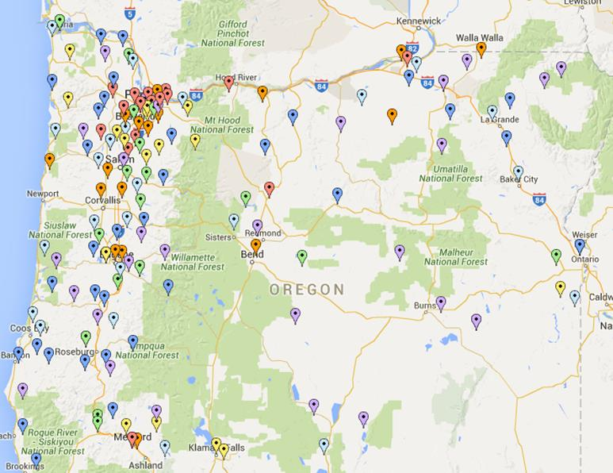
Map of Oregon’s Districts with English Learners

Slide 14
Oregon English Learner Statistics (2014-2015)
Top ten districts with largest English learner population by student count |  | Salem-Keizer |  | 8,297
 |  | Beaverton |  | 5,684
 |  | Portland |  | 4,176
 |  | Hillsboro |  | 3,407
 |  | Reynolds |  | 3,270
 |  | David Douglas |  | 2,386
 |  | Woodburn |  | 2,220
 |  | North Clackamas |  | 1,796
 |  | Tigard-Tualatin |  | 1,456
 |  | Gresham-Barlow |  | 1,445
Top 10 districts with largest percentage of English learners to total district enrollment |  | Woodburn |  | 38.56%
 |  | Umatilla |  | 34.15%
 |  | Jefferson Co. |  | 28.82%
 |  | Nyssa |  | 27.97%
 |  | Reynolds |  | 27.87%
 |  | Gervais |  | 26.94%
 |  | Milton-Freewater |  | 23.42%
 |  | Morrow |  | 22.89%
 |  | David Douglas |  | 21.61%
 |  | Salem-Keizer |  | 20.38%

Slide 15
Goal #1: Develop tools and resources in order to support implementation, benchmarking, and continuous improvement of instructional programs for English learners.
Method Of Online Communication (MOOCs) through Stanford and OSU
Biliteracy Pathways Grant
Dual Language Community of Practice meetings
HB 3499
EL Strategic Plan
ODE/OSU Collaboration on Reclassification methods of EL students

Slide 16
Goal #2: Systemic approaches to “capacity building” for all stakeholders will occur and will positively impact academic achievement for all English learners.
COSA EL Alliance Conference – yearly format for ODE staff to present
Best practices from districts who met all three AMAO
Reclassification – using multiple measures (ODE/OSU)
How, when, and why - parent communication
Collaboration with Indian Ed on culturally appropriate communication between districts and communities/ families
Biliteracy Seal opportunity for dual credit
Monthly Title III new and general Director webinars

Slide 17
Goal #3: School districts engage and involve families and communities as equal partners in order to support and enhance programs designed for English learners.
Migrant Education – Active district/statewide parent meetings
EL Plans – Heightened engagement and accountability for parent involvement and communication
Indian Ed discussions on culturally appropriate communication
Dual Language Grant commitment to parent understanding and communication

Slide 18
Goal #4: Develop a team of expert practitioners and researchers to guide the development, improvement, and accountability for English learner program models and practices.
ODE/OSU collaboration – multiple measures for reclassification
ODE staff part of workgroups
A national discussion on a common definition for an EL and a long-term EL student
Common program models and data collection requirements
Benefit from national leaders and experts in the field
HB 3499 workgroups on coding and outcomes

Slide 19
Goal #5: Develop a process for replicating exemplar programs across the state.
COSA EL Alliance Annual Conference
Exemplar programs meeting all 3 AMAO targets
Districts piloting
Common Home Language Use Survey
Multiple Measures for Reclassification
Biliteracy Seal districts sharing best practices
SB 1564 best practices in reporting data
Dual Language/K-12 Biliteracy Pathways grantees to share exemplar practices

Slide 20
Goal #6: Create and align assessment systems to support all English learner program models that include the performance of both current and former English learners.
Oregon is lead state in:
The multi-state ELPA21 consortium aligning the ELPA21 assessment to the new English Language Proficiency standards
ODE/OSU partnership first to propose a flag to track former EL students in the state data collection system
Oregon was the lead state to create training modules for the ELP standards and the ELPA21 assessment

Slide 21
Goal #7: Oregon provides support to provide all educators the knowledge and skills they need in their positions to better serve English learners.
Title I-C and Title III technical assistance onsite and remotely
Monthly Title III Directors’ webinars
COSA EL Alliance Annual Conference open to all educators
Dual Language and K-12 Biliteracy Pathway support
ODE staff presentations at multiple forums

Slide 22
Goal #8: The Universal Preschool Program will ensure that English learners receive a quality early learning experience that provides a powerful foundation for their education.
Migrant Education Parent Meetings
Activities for parents and children to do
Pre-Kindergarten checklist
Collaboration with Early Learning
Preschool Incentive Grant Consortium
Ten states looking at best practices and materials for migrant students

Slide 23
Next Steps…
HB 3499 – task with the EL Strategic Plan
OEIB stakeholder group has sunset
Create a subgroup to analyze the plan to continue the work as outlined, for revisions, and for updates
Create workgroups to develop each goal, training materials, and seek opportunities to disseminate information
SB 1564 – work with districts to collect data
ODE consolidates and reports back to districts
Assists districts in communicating information

Slide 24
Thank you

