Slide 1
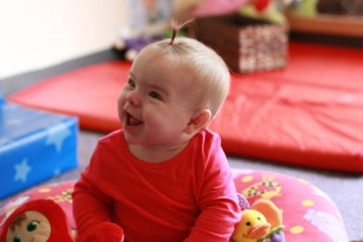
Preschool Promise Early Learning Update
April 14, 2016
David Mandell, Early Learning Division

Slide 2
Vision of HB3380
The Need:
In Oregon only 15,000 children, out of 96,000 3 & 4 year olds, have access to publicly funded preschool.
Currently access to publicly funded preschool is restricted to children who are living at or below 100% of the federal poverty level.
The Plan:
Provide high quality preschool, in a variety of settings, to children from a higher threshold of the federal poverty level.
The Outcome:
Children who attend high quality preschool are more likely to arrive at kindergarten ready to learn and are more likely to sustain an academic growth trajectory.
High quality preschool is one of the most effective strategies for closing opportunity and learning gaps.

Slide 3
What’s in a name? Mixed Delivery vs. Preschool Promise
Eligible for Mixed Delivery Funding
Head Start/OPK
Relief Nursery
Public Charter School
Childcare Provider
Private Preschool
Education Service District
Public School
Commmunity Based Organization

Slide 4
Roles & Responsibilities
Early Learning Council Policy Body | Early Learning Division State Agency | Early Learning Hubs Local Contractors | Preschool Providers
Establish criteria and process for selecting Early Learning Hubs who will sub-contract with local preschool providers. Identify resources necessary for the ELD to develop, support and sustain the implementation of a high quality preschool program. Ensure that professional development pathways and supports are available to teachers and assistants. Establish minimum salary and target salary requirements for lead preschool teachers. Develop strategies that strive to increase the mean salary for lead preschool teachers in this state. Administer waivers. | Set program standards, teacher qualifications, and compensation scales. Support professional development of workforce (state system alignment). Develop Technical and Training Assistance supports for both contractors and providers. Monitor local contractors for proper execution of sub-contracts with providers, including quality improvement plans associated with waivers. Build data system to support program objectives and reporting requirements. | Identify community priorities. Create an Implementation Plan that addresses priorities. Identify a set of providers that would actualize the Implementation Plan. Subcontract with selected providers to implement preschool program. Monitor program providers. Make investments in providers in order to meet program standards. Support community collaboration to meet the needs of children and families enrolled in the preschool program. | Recruit and determine child eligibility. Implement preschool model according to program standards. Recruitment of staff that meet requirements. Participate in continuous quality improvement plans to meet standards. Collect and report data on child outcomes and other identified program goals.

Slide 5
Budget
Categories | Amount (millions)
Per Child Program Allocation | $14.3M
Preschool Provider Start-Up & Capacity Building | $1.5M
Hub Coordination, Support and Administrative Activities | $1.1M
Total for Hub Contract | $16.9M
Training & Technical Assistance | $.4M
Department of Administrative Services (DAS) Cost for RFA process | $.2M
TOTAL ALLOCATION | $17.5M

Slide 6
Budget: Major Cost Drivers
Maximum classroom size of 20 children
Lead teacher and teacher’s assistant in every classroom (adult: child ratio of 1:10)
Transportation funding included
Lead teacher with a bachelor’s degree in early childhood or related field
Salaries for lead teacher commensurate with kindergarten teachers (with salary floor to be set by Early Learning Council)
Full-day schedule
Instructional hours equivalent to full day Kindergarten

Slide 7
Hubs selected for an Award
Selected 6 Applications, that include 9 Hubs, to serve approximately 1300 children in year one of implementation.
Marion & Polk Early Learning Hub, Inc.
South-Central Oregon Early Learning Hub
Lane Early Learning Alliance
Southern Oregon Early Learning Hub
Eastern Oregon Early Learning Hub
NW Regional joint application
NW Regional Early Learning Hub
Early Learning Washington County
Early Learning Multnomah
Clackamas Early Learning Hub

