Slide 1
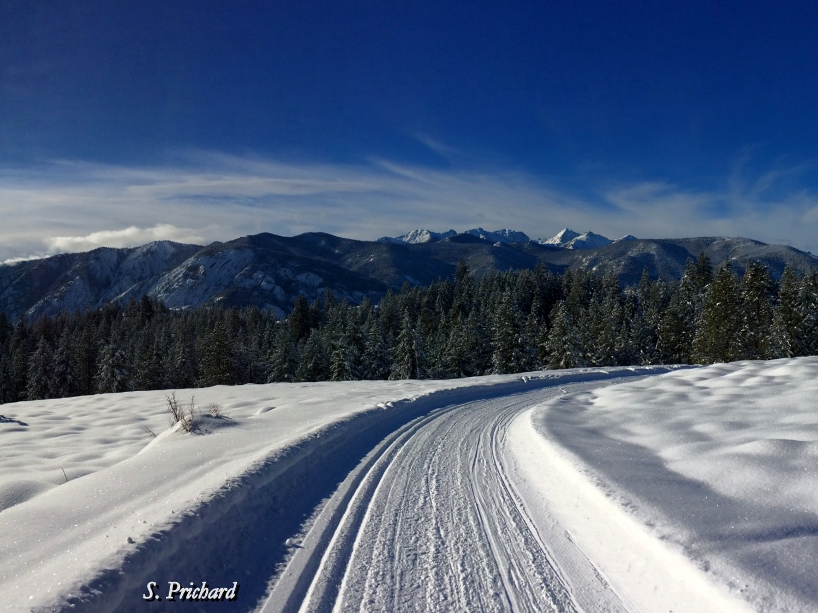
Seasonal Climate Forecast Dec. 2024 – Feb. 2025 Issued: November 21, 2024
Contact: ODF Lead Meteorologist Pete Parsons
503-945-7448 or peter.gj.parsons@odf.oregon.gov
ODA Team: Diana Walker; Andy Zimmerman; Jenn Ambrose; Taylor Harding ODF Team: Julie Vondrachek; Kristin Cody

Slide 2
El Niño vs La Niña (SST Patterns in the Tropical Pacific Ocean)
Courtesy: https://www.cpc.ncep.noaa.gov/products/analysis_monitoring/ensocycle/ensocycle.shtml

Slide 3
Sea Surface Temperatures (SSTs) Animated (PowerPoint only) SSTs (top) / Anomalies (bottom)
ENSO-neutral conditions are present
Courtesy: https://www.cpc.ncep.noaa.gov/products/analysis_monitoring/enso_update/gsstanim.shtml
Notes:
Image available at: https://www.cpc.ncep.noaa.gov/products/analysis_monitoring/enso_update/gsstanim.shtml

Slide 4
El Niño Southern Oscillation (ENSO) Current Status and Forecast
The October Southern Oscillation Index (SOI) of 0.5 reflected an increase in easterly trade wind strength in the equatorial Pacific Ocean.
The August – October Oceanic Niño Index (ONI) remained -0.2°C, reflecting near-to-below average sea surface temperatures (“SSTs”) in the central equatorial Pacific Ocean (within the cold ENSO-neutral range).
NOAA’s Climate Prediction Center (CPC) expects a transition from cold ENSO-neutral to weak La Niña during the October – December period, with weak La Niña persisting through January-March 2025.
Note: This “analog” forecast does not consider NOAA’s ENSO forecast. It uses only historical and current ENSO conditions to find “analog years” that most-closely match the recent evolution of the ENSO state.
https://www.cpc.ncep.noaa.gov/products/analysis_monitoring/lanina/enso_evolution-status-fcsts-web.pdf
Notes:
Weekly ENSO update: https://www.cpc.ncep.noaa.gov/products/analysis_monitoring/lanina/enso_evolution-status-fcsts-web.pdf

Slide 5
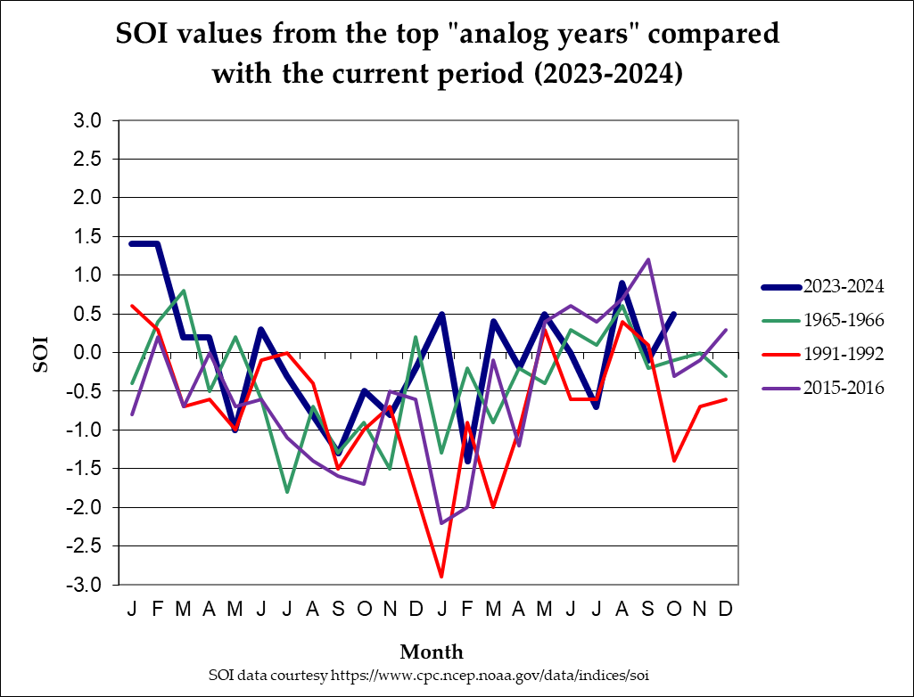
Southern Oscillation Index (SOI)
(1965-1966; 1991-1992; 2015-2016)
Oct 2024 SOI (0.5) reflects ENSO-neutral conditions
La Niña
ENSO-neutral
Top Oct SOI analogs
ranged from ENSO-neutral
to El Niño
El Niño
Notes:
SOI data from: https://www.cpc.ncep.noaa.gov/data/indices/soi

Slide 6
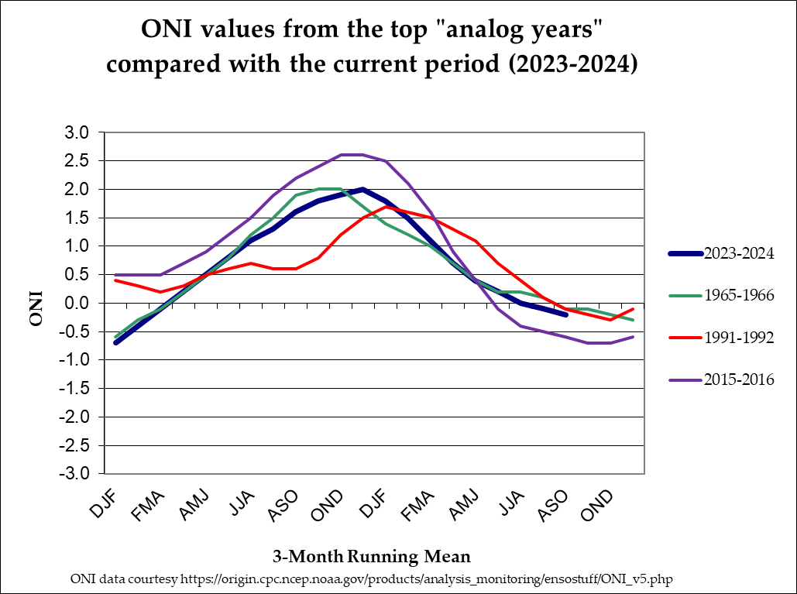
Oceanic Niño Index (ONI)
Aug – Oct 2024 ONI (-0.2°C) was in cold ENSO-neutral
(1965-1966; 1991-1992; 2015-2016)
Strong
Moderate
El Niño
Weak
ENSO-neutral
Weak
Moderate
La Niña
Strong
Aug – Oct ONI analogs ranged from ENSO-neutral to weak La Niña
Notes:
ONI data from: https://origin.cpc.ncep.noaa.gov/products/analysis_monitoring/ensostuff/ONI_v5.php

Slide 7
The Pacific Decadal Oscillation (PDO) (Reflects SST “Phase” in the North Pacific Ocean )
Positive (Warm)
“Phase”
Negative (Cool)
“Phase”
SST Anomalies
Courtesy: http://research.jisao.washington.edu/pdo/img/pdo_warm_cool.jpg

Slide 8
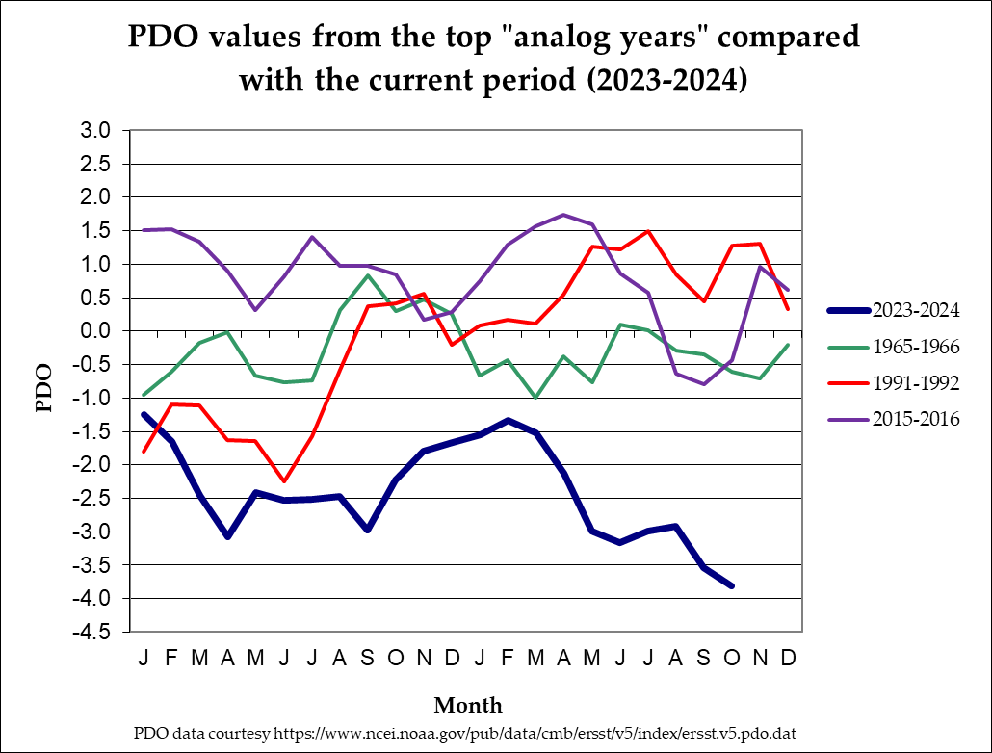
North Pacific Ocean (Poleward of 20°N Latitude)
(1965-1966; 1991-1992; 2015-2016)
Top Oct PDO analogs were in “Neutral” Phase
Warm Phase
Neutral Phase
Oct 2024 PDO (-3.81) was deeply in the “Cool” Phase
Cool Phase
Notes:
PDO data from: https://oceanview.pfeg.noaa.gov/erddap/tabledap/cciea_OC_PDO.htmlTable?time,PDO

Slide 9
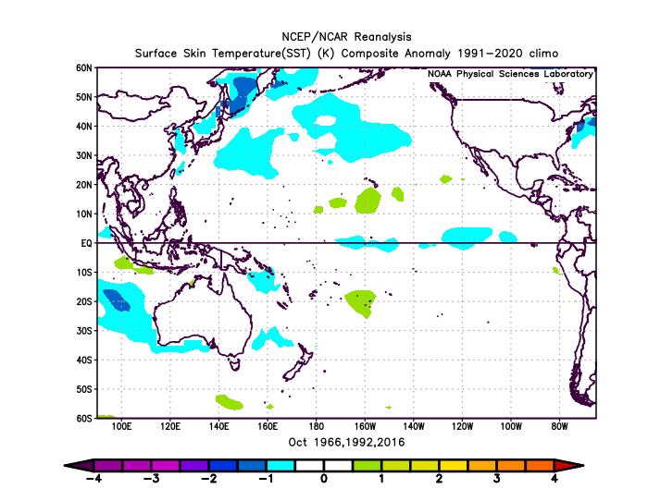
SST Anomalies Comparison
October Analogs
October 2024
The SST anomalies of both the October analog composite (left) and October 2024 (right) reflected ENSO-neutral conditions, with the latter having stronger negative temperature anomalies in the central & eastern equatorial Pacific Ocean. 2016 is the best match of the analogs…
Notes:
Charts generated at: https://www.esrl.noaa.gov/psd/cgi-bin/data/composites/printpage.pl

Slide 10
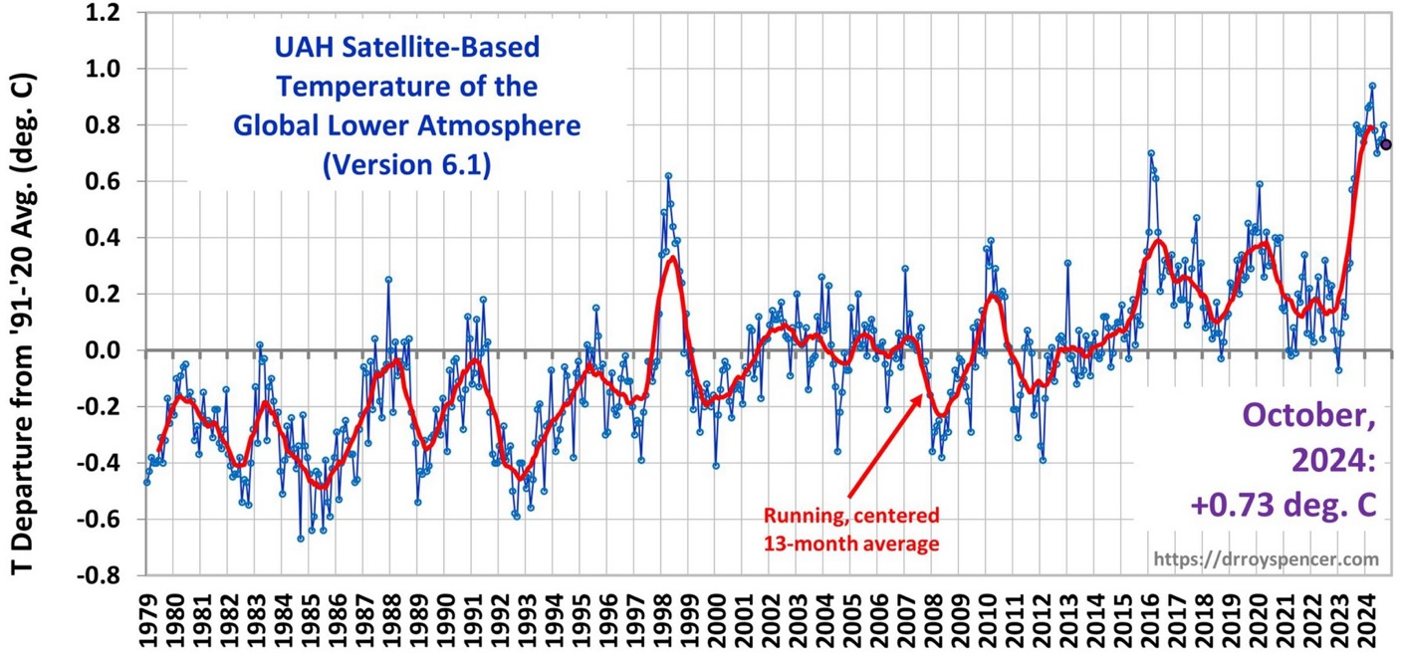
El Niño & La Niña Impact Global Temperatures...
El Niño
La Niña
Courtesy: http://www.drroyspencer.com/latest-global-temperatures/
Notes:
Charts generated at: https://www.esrl.noaa.gov/psd/cgi-bin/data/composites/printpage.pl

Slide 11
Global Temperature Trends Increase Error in Analog Forecasts!
October 2024
Warming of ≈0.15°C / Decade Since 1979
Current Analogs
are 1966; 1992; 2016
Courtesy: http://www.drroyspencer.com/latest-global-temperatures/
Notes:
Charts generated at: https://www.esrl.noaa.gov/psd/cgi-bin/data/composites/printpage.pl

Slide 12
Notes:
Map created by ODA. Shape file from Oregon Climate Service (George Taylor)

Slide 13
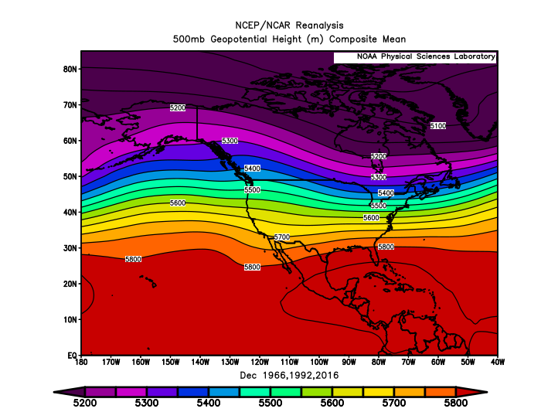
December 2024 Forecast
Mean Upper-Air Pattern
Upper-Air Anomalies
Analogs had anomalous troughing centered just offshore (1966), over Oregon (1992), or just east of the Pacific Northwest (2016).
The analog blend (above) puts highly anomalous ridging in the Gulf of Alaska with corresponding troughing over the Pacific Northwest.
Notes:
Charts generated at: https://www.esrl.noaa.gov/psd/cgi-bin/data/composites/printpage.pl

Slide 14
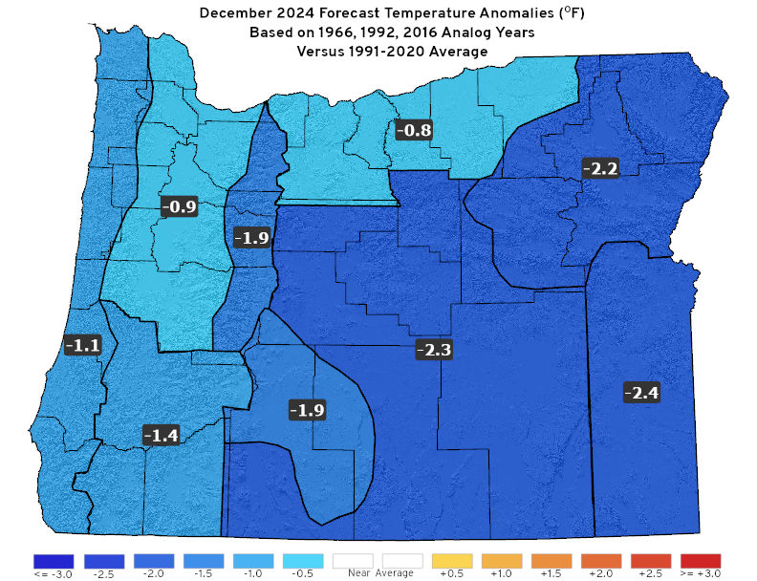
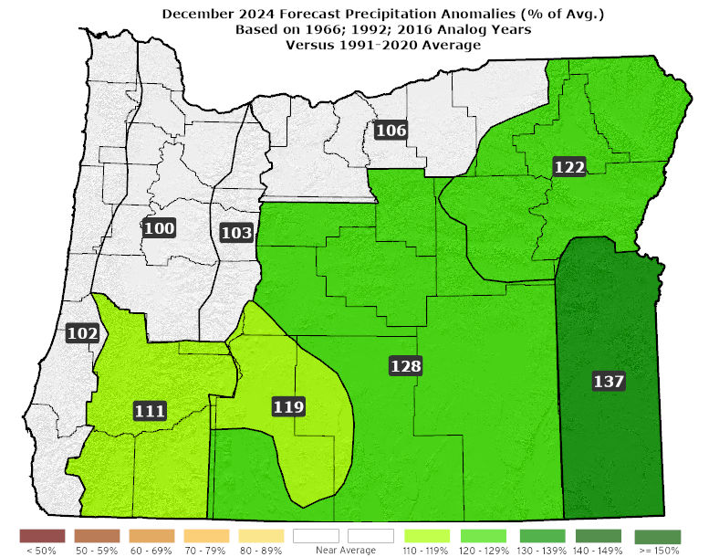
December 2024 Forecast
Temperatures
Precipitation
A slightly mild 1966 is offset (above) by progressively colder 1992 and 2016 analogs, which included arctic air and lowland snow/ice events.
Analogs were more consistent on precipitation with near or above-average rain and mountain snow.
Notes:
Data from NCEI: https://www.ncdc.noaa.gov/ & Charts generated locally by ODA

Slide 15
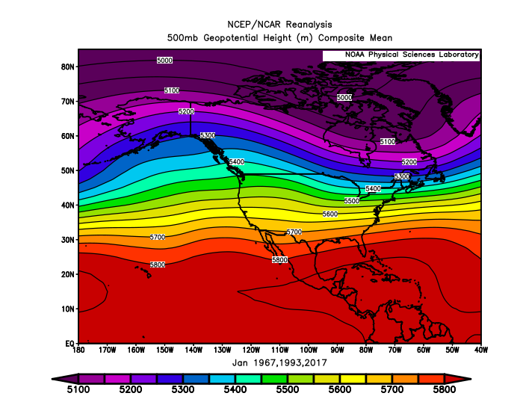
January 2025 Forecast
Mean Upper-Air Pattern
Upper-Air Anomalies
Analogs all had anomalous mean ridging in the Gulf of Alaska with subsequent downstream troughing over the Pacific Northwest.
The composite (above) shows anomalous troughing centered on NW Oregon, but analogs had significant variation in its location.
Notes:
Charts generated at: https://www.esrl.noaa.gov/psd/cgi-bin/data/composites/printpage.pl

Slide 16
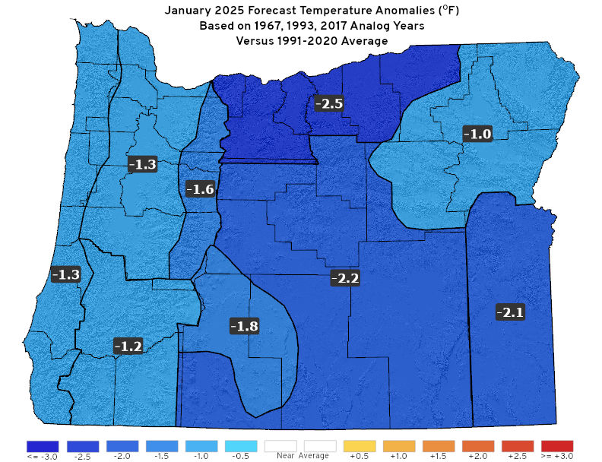
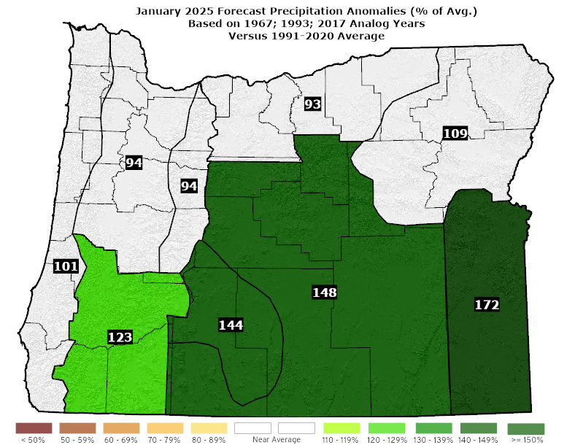
January 2025 Forecast
Temperatures
Precipitation
1967 centered anomalous troughing offshore. Strong storms produced high winds & heavy mountain snow, especially south…lowlands stayed mild. 1993 & 2017 had troughing centered over Oregon, bringing less precipitation but much colder temperatures and lowland snow.
Notes:
Data from NCEI: https://www.ncdc.noaa.gov/ & Charts generated locally by ODA

Slide 17
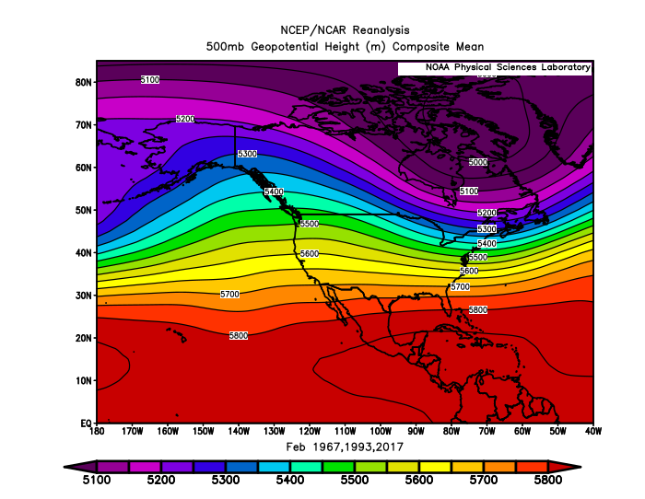
February 2025 Forecast
Mean Upper-Air Pattern
Upper-Air Anomalies
Huge variation among analogs... 1967 had anomalous ridging over Oregon, while 1993 & 2017 maintained anomalous troughing.
A blend of the analog years (shown above) favors more upper-level troughing than normal.
Notes:
Charts generated at: https://www.esrl.noaa.gov/psd/cgi-bin/data/composites/printpage.pl

Slide 18
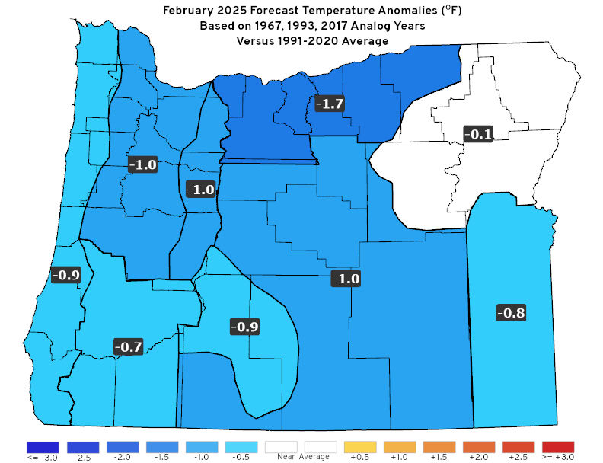
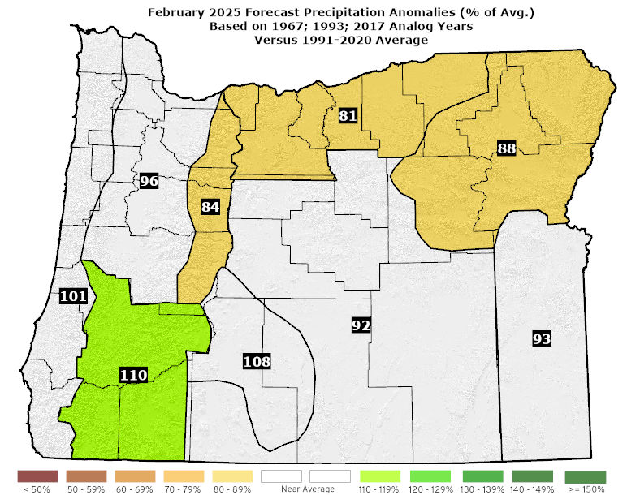
February 2025 Forecast
Temperatures
Precipitation
Huge variation among the analog years, ranging from a warm & dry 1967 to a cool & very wet 2017.
Current analog “blend” favors slightly cooler than average with near-normal precipitation, but an analog update is likely prior to February…
Notes:
Data from NCEI: https://www.ncdc.noaa.gov/ & Charts generated locally by ODA

Slide 19
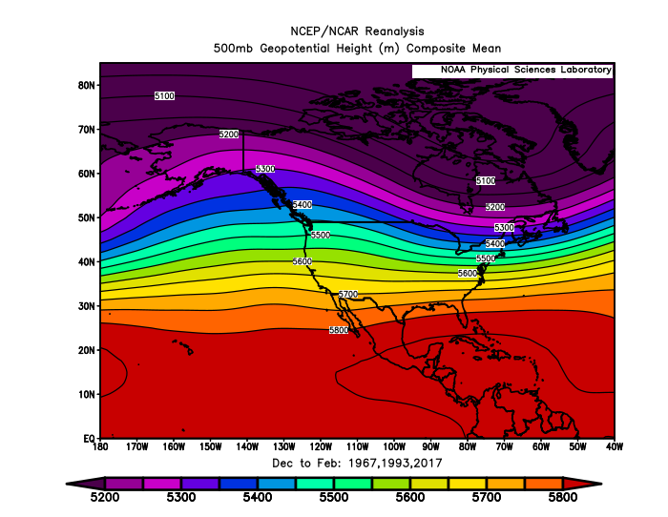
Dec. 2024 – Feb. 2025 Forecast
Mean Upper-Air Pattern
Upper-Air Anomalies
Analogs all had anomalous ridging in the western Gulf of Alaska and downstream troughing centered near the Pacific Northwest.
December & January should bring some degree of anomalous troughing over Oregon with the analogs diverging by February.
Notes:
Charts generated at: https://www.esrl.noaa.gov/psd/cgi-bin/data/composites/printpage.pl

Slide 20
Dec. 2024 – Feb. 2025 Forecast
Temperatures
Precipitation
Volatile weather likely in December & January (mild/stormy or cold/snowy at times). Lower confidence in the February forecast.
Near-to-above average precipitation with above-average snowfall in the mountains. Increased chances for lowland snow and coastal storms.
Notes:
Data from NCEI: https://www.ncdc.noaa.gov/ & Charts generated locally by ODA

Slide 21
Forecast Highlights
This forecast is based on weather that occurred during the (1966-67; 1992-93; 2016-17) analog years (unchanged from last month).
Expect the 2024-25 winter to behave markedly different from last winter, which was influenced by a strong El Niño.
Cold ENSO-neutral conditions are present and may transition to weak La Niña during this forecast period. 1966-67 and 1992-93 remained in ENSO-neutral, while 2016-17 transitioned into weak La Niña.
Increased chances for stormy or cold/snowy periods in December and January with above-average mountain snow. Forecast confidence drops in February (analog diverge). Analog update likely before then…
Disclaimer: This forecast is not associated with NOAA’s CPC (see “Forecasting Methods…” at: https://oda.direct/Weather) nor the official CPC “Three-Month Outlooks,” which are available at:
https://www.cpc.ncep.noaa.gov/products/predictions/long_range/seasonal.php?lead=1

Slide 22
Forecast Resources
ODA Seasonal Climate Forecast Home:
https://www.oregon.gov/ODA/programs/NaturalResources/Pages/Weather.aspx
CPC Official US Three-Month Forecasts (Graphics):
https://www.cpc.ncep.noaa.gov/products/predictions/long_range/seasonal.php?lead=01
CPC US 30-Day & 90-Day Forecasts (Discussions):
https://www.cpc.ncep.noaa.gov/products/predictions/long_range/fxus07.html
CPC Weekly & Monthly ENSO Discussions: https://www.cpc.ncep.noaa.gov/products/analysis_monitoring/enso_advisory
Australian Government Climate Model Summary:
http://www.bom.gov.au/climate/model-summary/#region=NINO34&tabs=Overview
Australian Government ENSO Wrap-Up:
http://www.bom.gov.au/climate/enso
IRI ENSO Quick Look:
https://iri.columbia.edu/our-expertise/climate/forecasts/enso/current/

Slide 23
Water Supply / Fire-Potential Outlook
CPC U.S. Seasonal Drought Outlook:
https://www.cpc.ncep.noaa.gov/products/expert_assessment/season_drought.png
NRCS Snow Water Equivalent Oregon Map:
https://www.wcc.nrcs.usda.gov/ftpref/data/water/wcs/gis/maps/or_swepctnormal_update.pdf
NRCS/USDA Snow Water Equivalent Products:
https://www.nrcs.usda.gov/wps/portal/wcc/home/snowClimateMonitoring/snowpack/
NDMC U.S. Drought Monitor:
https://droughtmonitor.unl.edu/
NIDIS North American Drought Portal:
https://www.drought.gov/nadm/content/percent-average-precipitation
WRCC WestWideDroughtTracker:
https://www.wrcc.dri.edu/wwdt/
NWCC Northwest Interagency Coordination Center (video)
https://gacc.nifc.gov/nwcc/predict/outlook.aspx

Slide 24
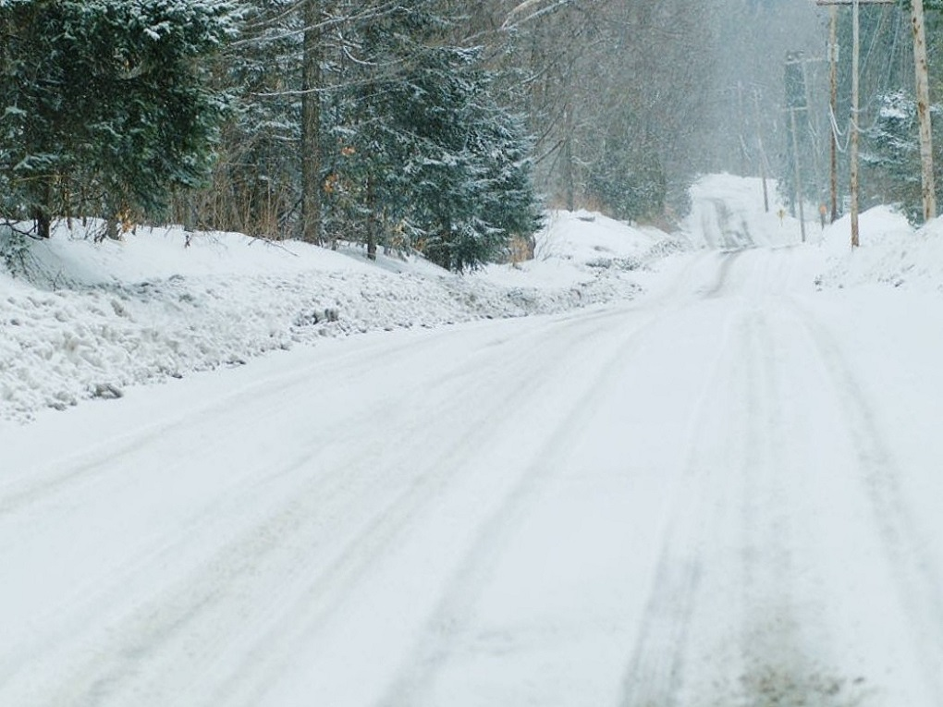
Updated Monthly
Your Feedback is Welcome!
Sign-up for Email Notification of Updates at:
https://oda.fyi/SubscribeSCF
Contact: Pete Parsons, ODF Lead Meteorologist
at 503-945-7448 or peter.gj.parsons@odf.oregon.gov

