Slide 1
Title Slide
TEACHING SKILLS THAT MATTER (TSTM)
IN ADULT EDUCATION
A BRIEF INTRODUCTION TO TSTM
Created May 2022

Slide 2
Overview
Why is TSTM valuable for teachers?
What is the goal of TSTM?
What are the core elements of TSTM?
How do students benefit?
Where can we find additional resources?

Slide 3

Why TSTM?
TSTM Brings Together:
OACCRS Learning Standards
Employability skills
Workforce training
WIOA compliance
Access to professionally prepared lessons and resources

Slide 4
Why is this Important?
Targets topic areas highly relevant to adult learners
Engages learners in workforce preparation activities that develop employability skills
Provides easy-to-access lesson plans and resources useful to both new and experienced ABS instructors
Seamlessly incorporates into learning standards materials and resources

Slide 5
What is the Goal?
To target the skills that matter in the areas of civic education, digital literacy, health literacy, and workforce preparation using approaches that work

Slide 6
Core Elements
SKILLS
9 Central Skills
APPROACHES
3 Proven Approaches
AREAS
5 Critical Topic Areas
AREAS

Slide 7
9 Skills
Adaptability & willingness to learn
Communication
Critical thinking
Interpersonal Skills
Navigating systems
Problem-Solving
Processing & analyzing information
Respecting difference and diversity
Self-awareness
What are the transferable skills that are necessary for an adult learner to function effectively within the workforce and civic and community life?

Slide 8
3 Approaches
Project-based learning
Problem-based learning
Integrated & contextualized learning
What teaching approaches have been proven to be best practices?

Slide 9
5 Areas
Civic education
Digital literacy
Financial literacy
Health literacy
Workforce preparation
Which topic areas have the biggest impact on adult learners?

Slide 10
Benefit to Students
Lisa, a student at Umpqua Community College, shares her thoughts on the benefits of TSTM- based lessons.

Slide 11
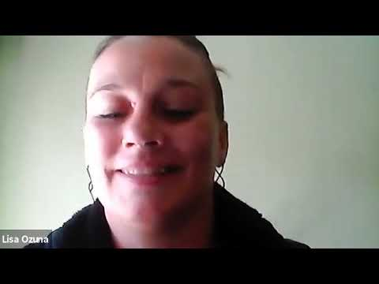
Video of Lisa

Slide 12

TSTM Resource Links
Additional
Resources
Defining: The Skills that Matter
Defining: The Approaches
Defining: The Topic Areas
OACCRS/TSTM
Lesson Planning Tool
Tools:
Lesson Index Organized by Skill
Central Skills Integration Analysis Tool
Videos:
Project- Based Learning
Problem- Based Learning
Integrated and Contextualized Instructions
Lesson Plans and Videos:
Civics
Digital Literacy
Financial Literacy
Health Literacy
Workforce Preparation

Slide 13

What’s Next?
Watch for the integration of TSTM topics, skills and approaches into learning standards trainings
Connect with local lead to join a Professional Learning Community (PLC)
Join the Community of Practice on Basecamp (Coming Summer ‘22)
Visit the ABS Professional Development webpage

Slide 14
Questions or Comments?
Oregon Higher Education Coordinating Commission (HECC)
Community College & Workforce Development (CCWD)
HECC ABE State Leadership Coordinator: Ashley Garrigan
EMAIL: ashley.garrigan@hecc.oregon.gov
PHONE: 503-979-5453

Slide 15
Appendix A - Printable Resource Links
Defining the Skills that Matter: https://lincs.ed.gov/sites/default/files/DefineSkillsThatMatter-508.pdf
Lessons Organized by Skills: https://lincs.ed.gov/sites/default/files/Toolkit-Index-508.pdf
Central Skills Integration Analysis Tool: https://lincs.ed.gov/sites/default/files/CentSkillIntegrAnalTool-508.pdf
Defining the Approaches: https://lincs.ed.gov/sites/default/files/DefineApproachesThatWork-508.pdf
Video - Project-Based Approach: https://youtu.be/Q26ME7PGHmQ
Video - Problem-Based Approach: https://youtu.be/pYdIgwiVA8M
Video - Integrated and Contextualized Approach: https://youtu.be/UV3FGkTNQnU
Defining the Topic Areas: https://lincs.ed.gov/sites/default/files/DefineTopicFocusAreas-508.pdf
Civics Lesson Plans & Video: https://lincs.ed.gov/state-resources/federal-initiatives/teaching-skills-matter-adult-education/civics-education
Digital Literacy Lesson Plans & Video:
https://lincs.ed.gov/state-resources/federal-initiatives/teaching-skills-matter-adult-education/digital-literacy
Financial Literacy Lesson Plans & Video:
https://lincs.ed.gov/state-resources/federal-initiatives/teaching-skills-matter-adult-education/financial-literacy
Health Literacy Lesson Plans & Video:
https://lincs.ed.gov/state-resources/federal-initiatives/teaching-skills-matter-adult-education/health-literacy
Workforce Preparation Lesson Plans & Video
https://lincs.ed.gov/state-resources/federal-initiatives/teaching-skills-matter-adult-education/workforce-preparation
Lesson Planning Tool: https://docs.google.com/document/d/1_lQ2f1HYn4tCdmvl7CQbT-JpZV-GElNZ/view

