Slide 1
STATE OF OREGON STATISTICAL TRANSPARENCY OF POLICING (STOP)
DATA COLLECTION BRIEFING FOR OFFICERS
OCTOBER 2023
https://oregon.gov/cjc/stop

Slide 2
OREGON STOP PROGRAM OVERVIEW
Established by the Oregon Legislature in 2017 (HB 2355)
Requires every law enforcement agency to annually submit data on officer-initiated traffic and pedestrian stops to the Oregon Criminal Justice Commission (CJC) for analysis
Directs the Department of Public Safety Standards and Training (DPSST) to offer related technical assistance and training
Notes:
The Statistical Transparency of Policing (STOP) Program was created by the Oregon Legislature in 2017 to ensure fair and impartial policing practices statewide.
The current collection of statutes outlining this program are ORS 131.930 – 131.945.

Slide 3
OREGON STOP PROGRAM PRESENTATION OBJECTIVES
Provide police officers with basic information to help ensure compliance with reporting requirements
Answer frequently asked questions about reporting and the STOP Program
Provide agencies with an opportunity to discuss local policies and procedures related to stop data collection
Notes:
CJC and DPSST recognize stops, searches, etc. can involve a great deal of complexity, so it is important to note these materials are NOT intended to answer every possible question. This information is designed to provide some additional clarity and guidelines around what the STOP Program requires to help ensure accuracy and compliance in reporting.
Law enforcement agencies are encouraged to review and discuss their own policies and procedures to help their officers work through the myriad of “what ifs.”

Slide 4
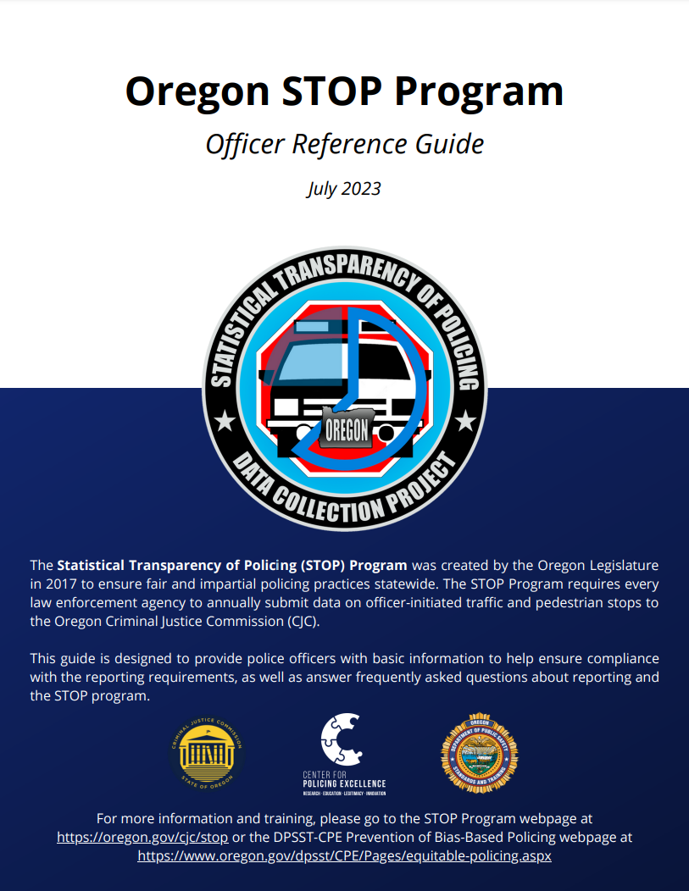
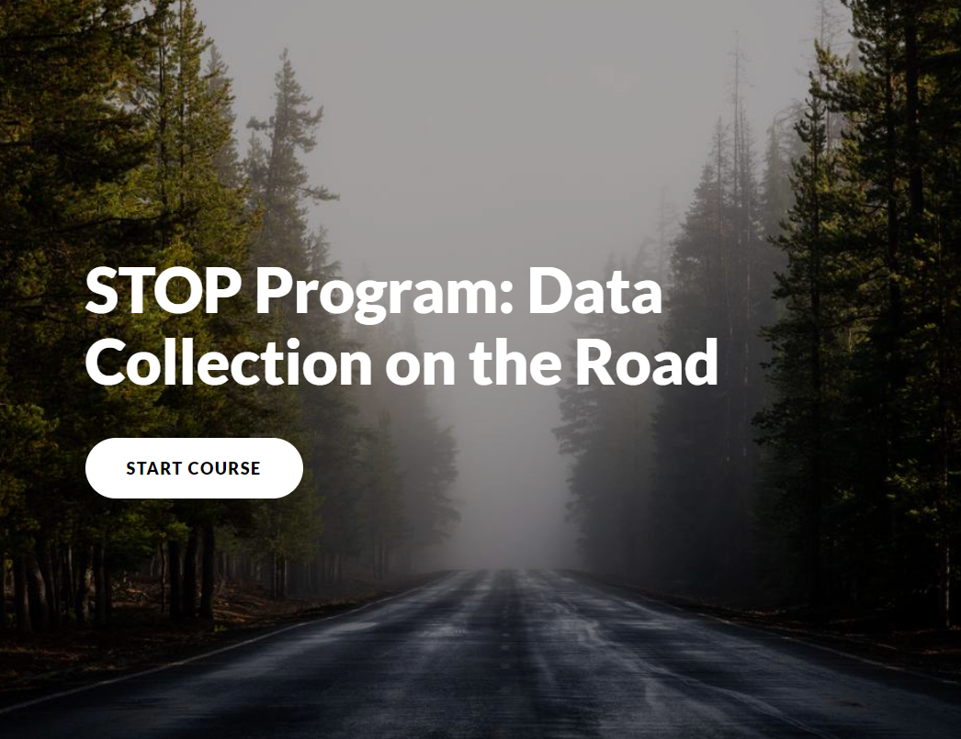
OREGON STOP PROGRAM SUPPLEMENTAL MATERIALS
Officer Reference Guide
Online Training
Notes:
Additional training resources are available on DPSST’s Prevention of Bias-Based Policing webpage.
https://www.oregon.gov/dpsst/CPE/Pages/prevention-of-bias-based-policing.aspx

Slide 5
OREGON STOP PROGRAM OFFICER-INITIATED TRAFFIC STOPS
Requirement: Report all officer-initiated traffic stops.
Definition: The detention of a motor vehicle, NOT associated with a call for service, for the purpose of investigating a suspected violation of the Oregon Vehicle Code.
Key Point: For the purposes of the STOP program, a "call for service" is defined as:
information obtained by an officer that results in a detention by the officer but
was not initiated by the officer. It also includes activity based on a warrant,
persons wanted for questioning or reported suspect/vehicle descriptions.
SEE NEXT SLIDE FOR EXAMPLES
Notes:
The reporting requirements for the STOP Program are limited to officer-initiated stops (i.e. a detention NOT associated with a call for service).
For the purposes of the STOP program, a "call for service" is defined as: information obtained by an officer that results in a detention by the officer but was not initiated by the officer. It also includes activity based on a warrant, persons wanted for questioning, or reported suspect/vehicle descriptions.
Frequently Asked Questions:
Does any information about passengers need to be reported to the STOP Program?
* No; only driver information should be reported on a traffic stop.
What if I stop a bicyclist based on an observed violation?
* Report it, because the purpose of the stop is a suspected violation of the Oregon Vehicle Code.
What if I stop a watercraft based on an observed violation?
* Do not report it, because the vehicle code does not apply.

Slide 6
OREGON STOP PROGRAM OFFICER-INITIATED TRAFFIC STOPS
SITUATION | REPORT IT?
A stop based on an observed violation. I stopped a car for speeding in a school zone. | Yes; not a call for service
A stop based on reported information. I stopped an SUV matching the description of a vehicle reported stolen. | No; considered a call for service
Notes:
Training Idea:
Ask one officer to describe a recent traffic stop. Then ask other officers to discuss whether it should be reported under the STOP Program and why.
Additional Examples:
I stopped a truck for an equipment violation.
* Report it; this stop was officer-initiated, not a call for service.
I stopped a car associated with an Amber Alert.
* Do NOT report it; this stop would be considered a call for service.

Slide 7
OREGON STOP PROGRAM OFFICER-INITIATED PEDESTRIAN STOPS
Requirement: Report all officer-initiated pedestrian stops.
Definition: The detention of a pedestrian, NOT associated with a call for service.
Key Points: Detentions for routine searches performed at the point of entry to or exit from a controlled area are NOT reported.
SEE NEXT SLIDE FOR EXAMPLES
Notes:
Again, the reporting requirements for the STOP Program are limited to officer-initiated stops (i.e. a detention NOT associated with a call for service).
Frequently Asked Questions:
If a group of pedestrians is stopped, how should it be reported?
* Each individual that is DETAINED based on unlawful activity, or responsible suspicion of such, should be reported separately.

Slide 8
OREGON STOP PROGRAM OFFICER-INITIATED PEDESTRIAN STOPS
SITUATION | REPORT IT?
A self-initiated mere conversation or field interview. I asked a woman walking on the sidewalk for information about a series of thefts in the area. | No; not detained
A self-initiated detention due to unlawful activity, or a reasonable suspicion of such. I detained a man I observed damaging public property. | Yes; detained, no call for service
A self-initiated detention based on reported information. I detained a woman I recognized as having a warrant. | No; detained, but associated with a call for service
Notes:
Training Idea:
Ask one officer to describe a recent pedestrian stop. Then ask other officers to discuss whether it should be reported under the STOP Program and why.
Additional Examples:
I asked a man for information about a person he had recent contact with.
* Do NOT report it. This was a mere conversation; the man was not detained.
I observed a woman on private property, developed a reasonable suspicion that she may be trespassing, and detained her for further investigation.
* Report it; the woman was detained and the stop was not associated with a call for service.
I detained a man matching the reported description of a burglary suspect.
* Do NOT report it. Despite the man being detained, the stop was associated with a call for service.

Slide 9
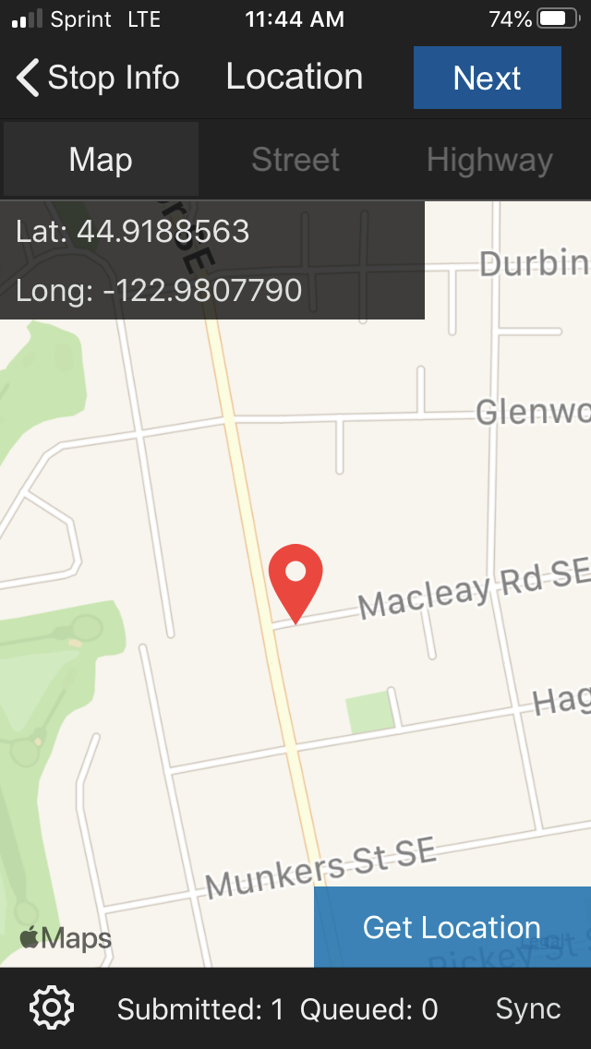
OREGON STOP PROGRAM LOCATION DATA
Accurate location data can often help evaluate the relationships between stop rates or post-stop outcomes with calls for service, accident rates, crime rates, and/or traffic patterns.
When possible, X-Y coordinates are preferred
Do not use this option if you have moved a significant distance from the stop location to enter the information for the STOP program.
NOTE: In the STOP App, click “Get Location”
Notes:
Accurate location data will help your agency understand and address any potential disparities.

Slide 10
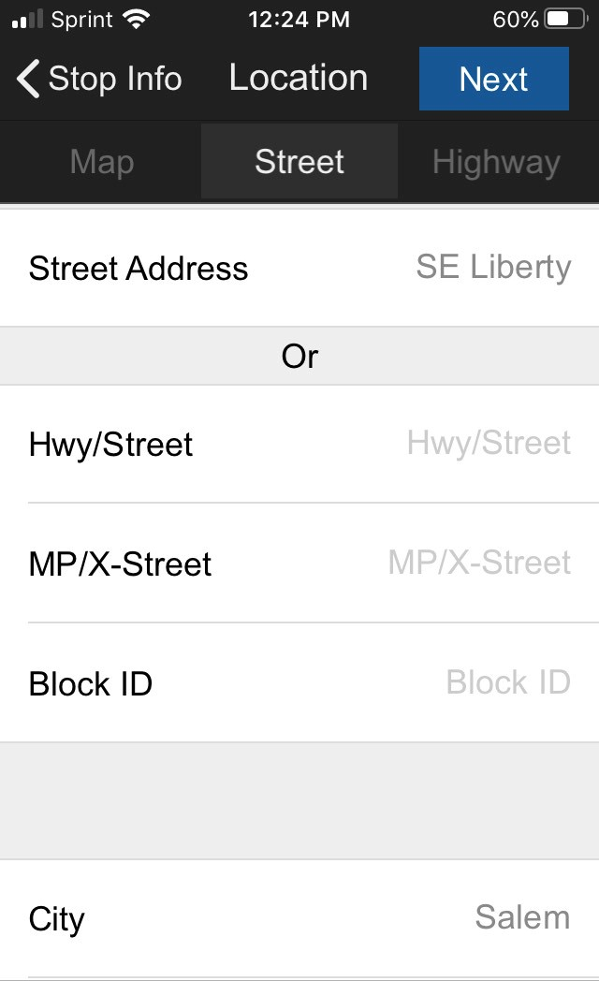
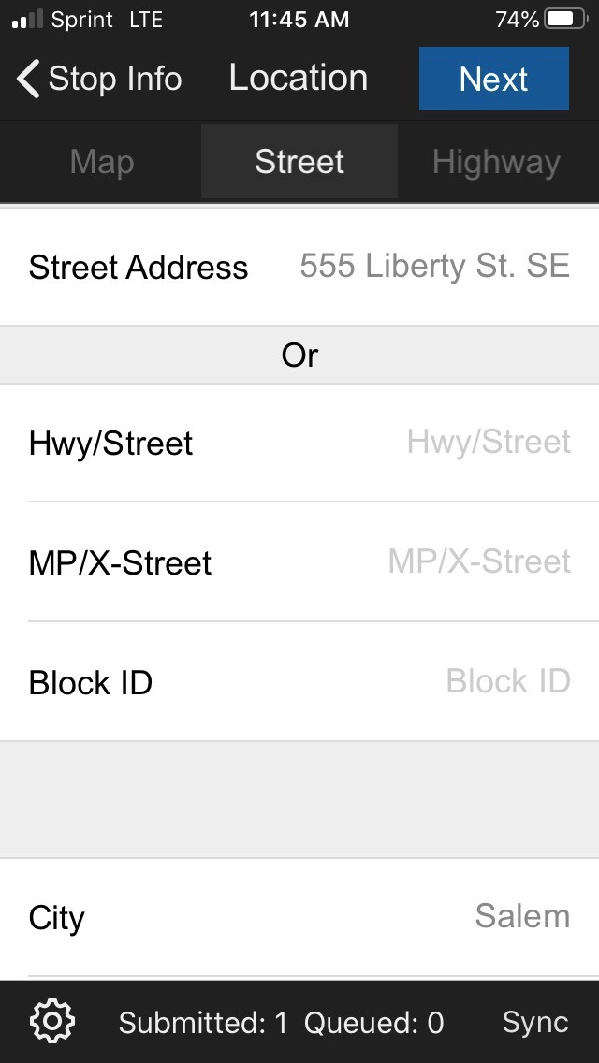
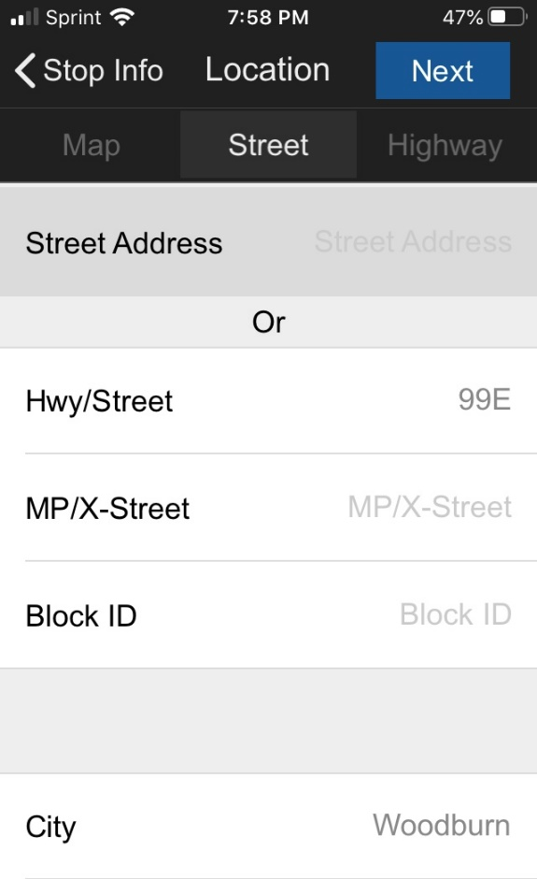
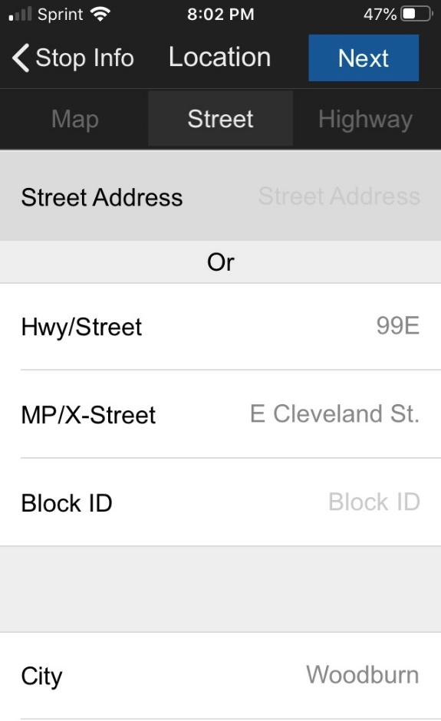
OREGON STOP PROGRAM LOCATION DATA
If reporting location using a street address, roadway designation, etc. please ensure your entry is accurate and complete.
Insufficient info. to determine location
Sufficient info. to determine location
Insufficient info. to determine location
Sufficient info. to determine location
Notes:
Training Idea:
Provide officers with a list of problematic location entries (pulled from your system or made-up). Ask them to evaluate what information is missing or how the entry could be improved.

Slide 11
OREGON STOP PROGRAM RACE, GENDER AND AGE
The race, gender and age of the person stopped should be reported based on your earliest observation of the person.
There are no “wrong” answers in reporting your perception of each characteristic based on your observations and experience.
NOTE: It is acceptable to report a person’s actual gender or age if you are using a reporting system that automatically populates that data based on a driver’s license/identification.
DO report your own perception of a person’s race, gender and age.
DO NOT ask a person to identify their race, gender or age.

Slide 12
OREGON STOP PROGRAM RACE, GENDER AND AGE
In some cases it may not be possible to observe a person’s race, gender or age at the time you initiated the stop.
In these instances, be sure to report your observations from the earliest moment you were able to perceive these characteristics, such as during your approach or upon initial contact.
DO report your initial perception of a person’s characteristics from the earliest moment it was possible to do so.
DO NOT report any changes in perception that may occur over the course of the stop

Slide 13
OREGON STOP PROGRAM RACE, GENDER AND AGE
In the STOP App there is an option to indicate whether you were able to perceive a person’s characteristics before your initial contact with them.
Notes:
This information helps researches identify stops where bias is not likely a factor.

Slide 14
OREGON STOP PROGRAM REASON FOR THE STOP
The reported reason for a stop should be the observed violation or crime that caused you to make the stop.
Regardless of whether you reasonably suspect other unlawful activity, the reported reason for the stop should be the actual violation or crime you initially observed.
SEE NEXT SLIDE FOR EXAMPLES
Notes:
If you are using the STOP web form or mobile application and are unable to find a specific statute or category, please choose the closest option.

Slide 15
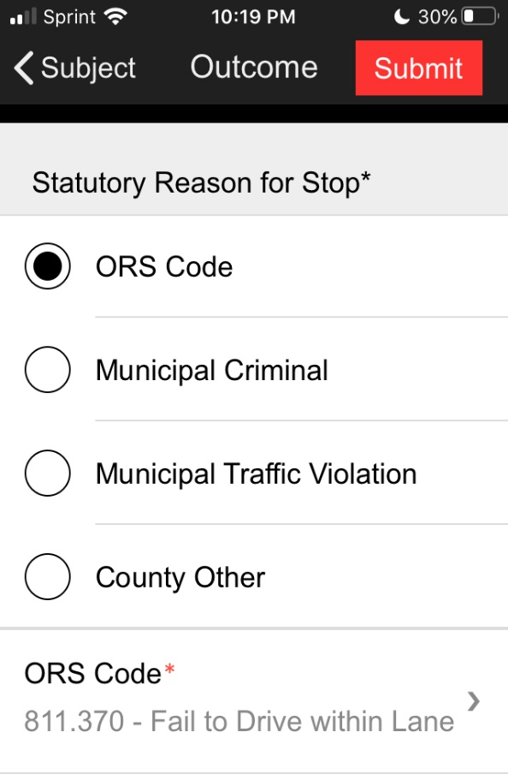
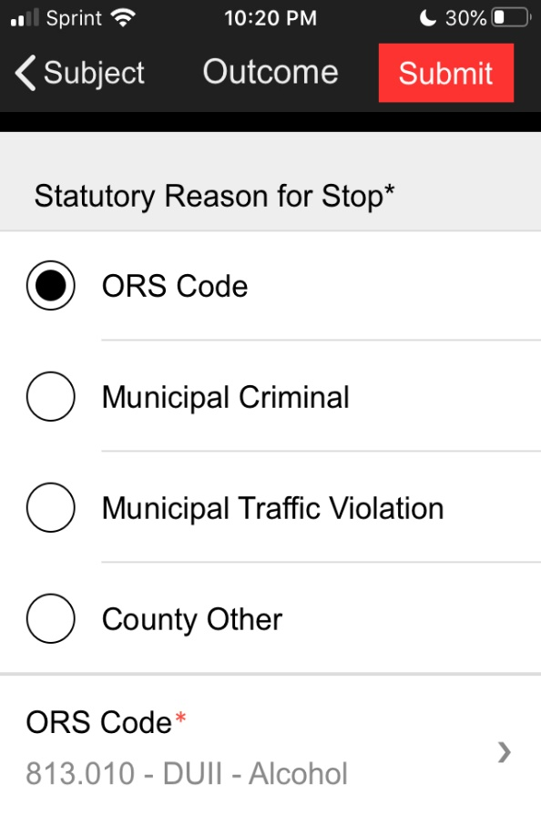
OREGON STOP PROGRAM REASON FOR THE STOP
Example:
You observe a vehicle swerving in and out of its traffic lane for a number of miles.
You suspect the driver may be impaired and initiate a traffic stop.
DO report the failure to drive within a lane
DO NOT report your suspicion of driving under the influence
Notes:
Example #2:
This time your observe a vehicle swerving within its traffic lane and traveling significantly under the speed limit for a number of miles. No actual violation is observed, but you suspect the driver may be impaired and initiate a traffic stop based on reasonable suspicion alone.
DO report your suspicion of driving under the influence as the reason for the stop.

Slide 16
OREGON STOP PROGRAM DISPOSITION OF THE STOP
The reported disposition of a stop should be the most serious outcome of the stop.
Report the most serious disposition regardless if it is associated with the initial reason you made the stop.
Example: You observe a vehicle speeding and initiate a stop. Upon contact you determine the driver has a warrant. You provide the driver with a warning for the moving violation, but take them into custody for the warrant.
DO report the physical arrest for the warrant as the disposition of the stop.
DO NOT report the warning for speeding as the disposition of the stop.
Notes:
There may be multiple violations or crimes, and associated dispositions, identified at the conclusion of a stop. The STOP Program requires that only the most serious disposition is reported.
Training Idea:
Ask one officer to describe a recent traffic or pedestrian stop from start to finish. Then ask other officers to evaluate and explain the following in accordance with the STOP Program:
1. Does the stop need to reported? (reference: slides 5-8)
2. What violation or crime should be reported as the reason for the stop? (reference: slides 14-15)
3. What action should be reported as the most serious disposition of the stop?
4. What violation or crime should be reported as the reason for the most serious disposition? (reference: slide 17)

Slide 17
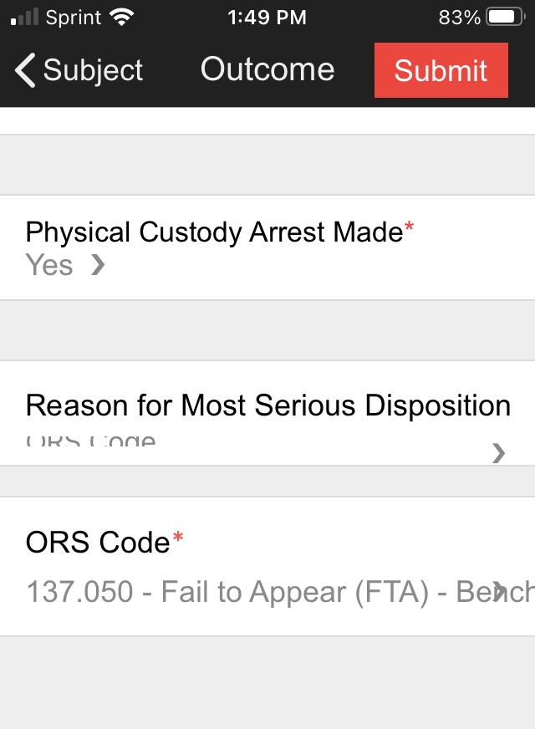
OREGON STOP PROGRAM DISPOSITION OF THE STOP
The reason for the most serious disposition of a stop can often help evaluate factors impacting arrest or citation rates.
Fields for the reason for the most serious disposition were added to the STOP App in 2021.
Notes:
Additional information about the reason for the most serious disposition of a stop will help your agency understand and address any potential disparities.
Example:
An initial analysis of data from the Oregon State Police in 2019 identified a disparity in citation rates. However, further evaluation of the reasons for the citations determined that agency policy accounted for a portion of the disparity. In this specific case, the additional data demonstrated that disparities cannot and should not always be attributed to bias on the part of officers, as other factors can lead to disparate outcomes.

Slide 18
OREGON STOP PROGRAM SEARCHES
Reporting whether a search was conducted only applies to stops already determined to be reportable under the STOP Program (i.e. a detention not associated with a call for service).
Only discretionary searches should be reported.
Searches specifically determined NOT to be reportable in the STOP Program:
Field Sobriety Tests
Weapons pat-downs
Searches incident to arrest
Agency policy-directed inventory searches of a vehicle being towed
In the STOP App “Other Search” refers to searches conducted without consent.
Notes:
Remember, the reporting requirements for the STOP Program are limited to officer-initiated stops (i.e. a detention NOT associated with a call for service).
Frequently Asked Questions:
Do I report an inventory search of a vehicle prior to towing?
* No; only discretionary searches conducted based on reasonable suspicion or probable cause should be reported.
What if another officer or K-9 conducted the search?
* Regardless if another officer conducted the search, if you are the officer who initiated the stop, you should report whether a discretionary search was conducted, the type of search, and whether or not anything was found.

Slide 19
OREGON STOP PROGRAM FACTS ABOUT DATA ANALYSIS
CJC uses multiple, evidence-based methods of analysis to identify if any agencies have statistically significant indications of racial disparities in their stop rates and/or post-stop outcomes.
NOTE: A brief summary of the types of analyses conducted can be found on the Oregon Knowledge Bank.
Agencies found to have a statistically significant disparity in two of the three analytical tests conducted by CJC are referred to DPSST for technical assistance.
An annual report on the result of CJC’s analyses is published every December.
Notes:
The annual reports, and an interactive data dashboard, are available on CJC’s STOP Program webpage.
https://www.oregon.gov/cjc/stop/Pages/default.aspx

Slide 20
OREGON STOP PROGRAM FACTS ABOUT DATA ANALYSIS
The STOP Program does NOT single out individual officers.
By law, all data submitted to CJC may not contain information that reveals
the identity of any officer, or any stopped individual.
The STOP Program does NOT assume that police officers engage in bias-based profiling.
The STOP Program DOES examine whether statistically significant disparities exist in an agency’s stop rates and/or post-stop outcomes.
Disparities identified by the STOP Program DO provide evidence of factors that warrant further analysis and discussion.
Disparities identified by the STOP Program do NOT themselves provide conclusive evidence of bias-based profiling.

Slide 21
STOP Program
Contact
Information
503-378-4830
CJC.stop@oregon.gov

