Slide 1
Social Media Recruiting
Developing, Implementing, and Maintaining Your Strategy
Molly Anderson and Kyle Weraky
Notes:
Introductory statements
Q: How many agencies have already began or built a social media strategy?
Q (Follow-up): What sites social media sites are you already using?

Slide 2
Benefits
Open avenue for information
Easily adaptable
Influences personal connection
Accesses target audiences
Builds an agency brand
Free
Notes:
Open avenue for information: Share and access useful content, promote events, news and updates, helpful articles and videos, etc. It is more than a just a job board. Both an employer and a job seeker can benefit from the information shared.
Easily adaptable: You are never locked in to your strategy- there is plenty of room for trying new content and stategies, i.e. you can try posting at different times of day, post different kinds of articles, and target different kinds of people.
Influences personal connection: It is more than the transactional flow of a job board. Sharing in conversations via social media gives an interested job seeker a deeper look into your work culture, and gives the recruiter a better look at what a job seeker brings to the table
Accesses target audiences: It is easy to find people, accounts, and organizations that may fit the needs of your agency, i.e. if you are looking for more IT professionals to become interested in your agency, you can search key words to find the accounts of people who may be experienced in that profession.
Builds an agency brand: It not only creates an interest in your agency at the moment, it builds a pipeline for down the road. Even people who are not currently searching for a job will either consider working for you right then, or keep you in mind down the road if they are ever searching for a job. It creates a long term awareness about the possibilities available at your agency. It builds a deeper, more insightful perception of your agency outside of just being “state government”. It showcases the culture and mission, rather than just MQ’s, salaries, and benefits
6. Free: leveraging content and investing time

Slide 3
Developing a Social Media Strategy
Getting Buy-In
Building a Plan
Maintaining Momentum
Notes:
Getting Buy-In: Starting the conversation about the effectiveness of using social media and how the strategy will be rolled out
Building Your Plan: Building a meaningful and sustainable plan for committing to a social media strategy long term
Maintaining Momentum: Strategizing how the work will get done and what daily, weekly, and monthly steps need to take place for the plan to become a core recruiting avenue

Slide 4
Getting Buy-In

Slide 5
Key Players
Your Team
Executive Management
Communications
IT
Notes:
This must be a much larger strategic conversation than just deciding to utilize social media for recruiting. This conversation will be different for every agency.
The first conversation must be a team conversation about what your goals for social media are, and how the responsibility will be divided and resources used to implement your strategy
Gaining approval from executive management and promoting social media as an effective recruitment tool. Using data to demonstrate the cost vs. benefit.
Determine what units may already have social media, and whether your accounts will be for the entire agency, or specific to your unit. If it is an agency-wide social media strategy, you must determine how other units will fit into the bigger picture.
Making sure Communications is on board and adhering to any policies they have for agency communications via social media.
You also need to partner with IT to determine what resources they can get you connected with

Slide 6
Building a Plan

Slide 7
80%
20%
Agency advertising and job postings
Original content: blog posts, updates, videos, photos, news, events, etc.

Slide 8
Choosing Social Media Networks
Questions to Ask:
What are our goals for social media?
How much time do we have to commit?
What kinds of content can we produce?
What resources do we have available?
Notes:
What are our goals? You must determine what kind of audience you want to target, what news and updates you want to share, and how you will measure if your strategy is being implemented effectively.
How much time do we have to commit? You must assess the workload of you and your team to determine how the workload can be divided and builT into your responsibilities. You have to take into consideration daily postings, content production, and data collection.
What kinds of content can we produce? Do you go to many events, have good blogging material, or have the resources to make videos? These will be key factors in selecting what types of social media networks to pursue.
What resources do we have available? If you plan to make videos, you will need to determine what types of software and equipment you need. If you post live from events or use photos, you have to determine whether you will bring a laptop or use social media from a phone or tablet.

Slide 9
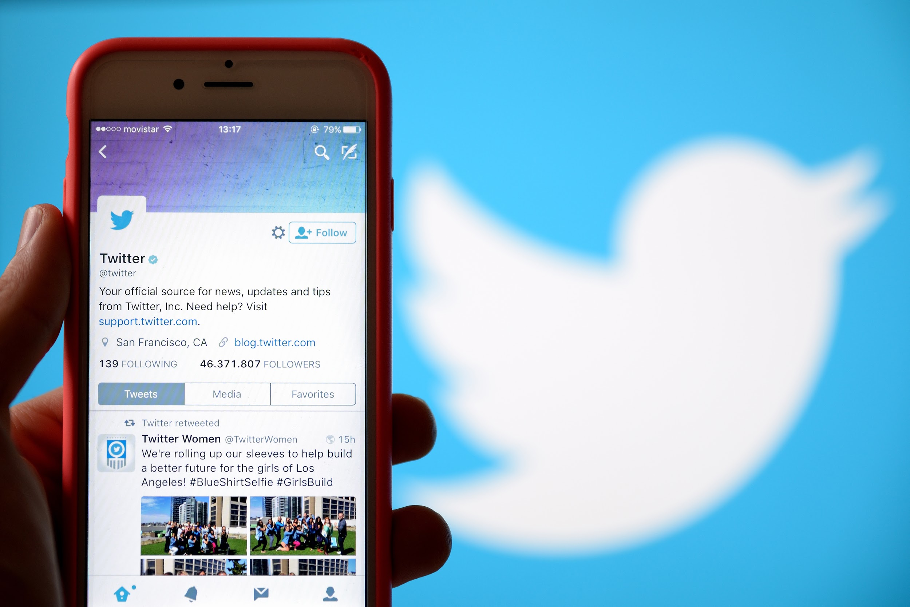
Twitter
Short “text” updates- 140 characters (tweets)
Tweet photos, videos, and links
Share (retweet) others’ content
Chat discussions
#Hashtags- searchable tags that group similar tweets together
Notes:
Twitter is easy to maintain in the sense that the content is short, 140 character updates as opposed to full blog posts.
In order to gain the highest engagement you should be posting at least once per day.
This network works really well down the road when you have a few different social media sites, because it is a great way to give a first look into a website, blog post, or video. It forms the “introduction” to your company.
It is a great place for sharing quick updates or introducing a new concept or idea.
You must be actively involved on Twitter, participating in chats and engaging with other users in order to have an impact.

Slide 11
LinkedIn
Post company updates, articles, photos, videos, and job announcements
Connections can like, comment, and share your content
Network with jobseekers through private messages
Form LinkedIn Groups
Notes:
LinkedIn is a huge benefit because it specifically targets a more professional audience and you can search for people based on industry.
It is basically an online resume
This site is great for directly contacted potential candidates, but it can be difficult to engage LinkedIn users on the company page
In order to have higher engagement, it is recommended that you post once per day on LinkedIn, but since the updates are usually longer content, it can be difficult to build ahead of time to maintain that posting frequency
You can join groups and follow different field interests to make connections with people who may be interested in working for you.

Slide 13
Youtube
Recruiting or training videos
Share links to videos across all social media handles
Include information in video descriptions with links to websites and other social media
Users can comment and like your videos or subscribe to your channel
Notes:
Twitter is a great resource because you can easily share your Youtube videos across your social media profiles and on your website. As a social media site itself, there is very little interaction except comments and likes on your video
Social media users will respond to photos and videos more than articles and written text, so posting videos on Youtube is a great way to drive engagement.
You can also gain traction on Youtube because if someone watches a video on your channel, they are directed to your channel where they can watch more of your content
The downside to Youtube is that it requires technology and resources to produce professional looking videos

Slide 15
Facebook
Post status updates, links, photos, and videos
Facebook users can “follow” your page to see your content on their news feed
Users can like, comment and share your content
Advertise events and form Facebook groups
Notes:
Facebook is the most widely used social media site, and those who use it engage with content more than any other site
Although it is more of a personal network, it can be great place to highlight agency updates and share personal stories
Facebook users can easily share content and/or open jobs with their friends that may be interested

Slide 16
Maintaining Momentum

Slide 17
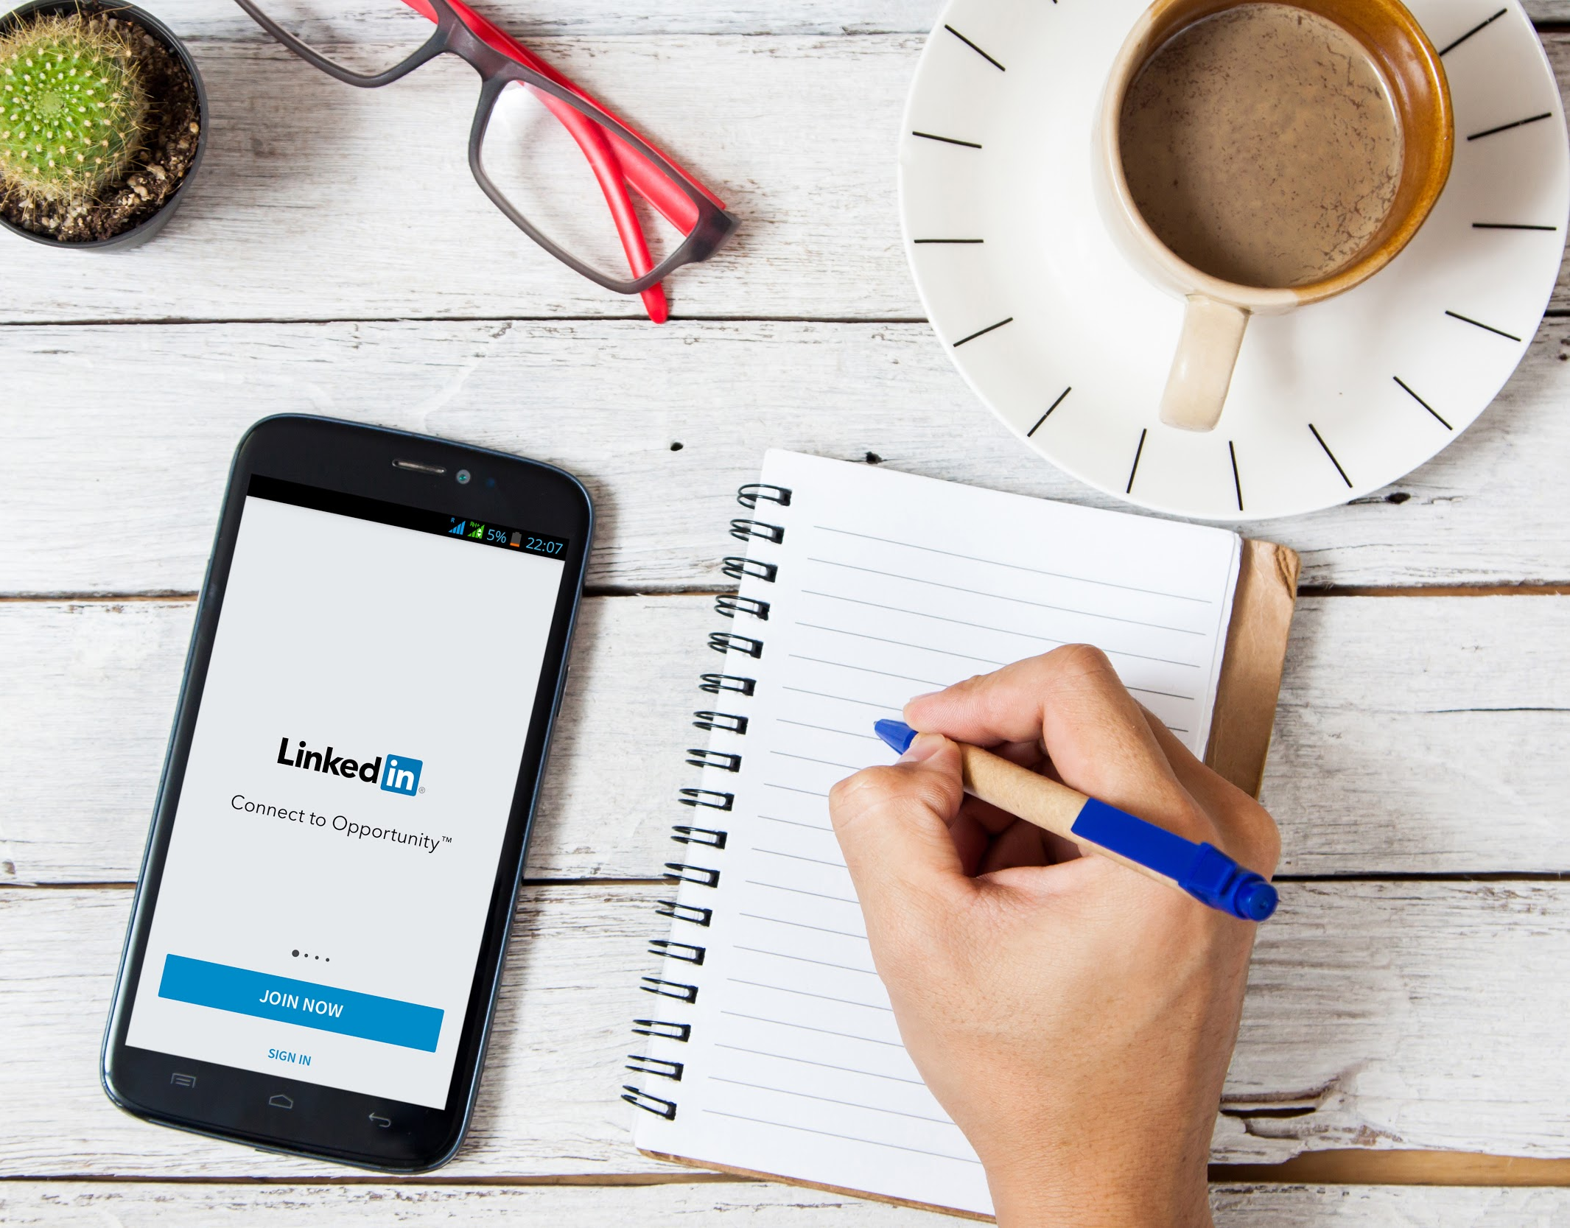
Tips for Maintaining Your Strategy
Start small (Quality vs. Quantity)
Develop relevant and realistic social media goals
Create a social media schedule
Assess your progress
Notes:
Start small: it is recommended that you begin with one social media site and work on leveraging it to build a high quality profile, rather than pursue several strategies and not have the time to frequently engage
Once you decide what kind of strategy to pursue, it is important to determine how often you plan to post and who will post. There are tools that allow you to schedule updates ahead of time so you can spend a few hours every week digging in and producing content and then maintain in shorter periods of time throughout the week by sharing content and connecting
Posting about events is a great way to drive people to go to the event or show social media users what your agency is involved with or has to offer
Creating a social media calendar makes it easier for different members of your team to collaborate on projects and plan campaigns for events in advance
If you produce your content ahead of time it will take a

Slide 18
Q&A
More Questions?
Molly Anderson: Molly.Anderson@state.or.us
Kyle Weraky: Kyle.Weraky@state.or.us
Notes:
7-8 minutes

