Slide 1
HRIS Data Integrity
Tools agencies can use to audit
and ensure accuracy in
Worker Data and Pay Impacting
Business Processes

Slide 2
The Data Integrity Team
Libbie Saunders
Ryan Englund

Slide 3
Data Points
Worker Data
Position Data
Compensation & Benefit Data
Future Dated items
Service Related Data

Slide 4
Position Data vs Worker Data

Slide 5
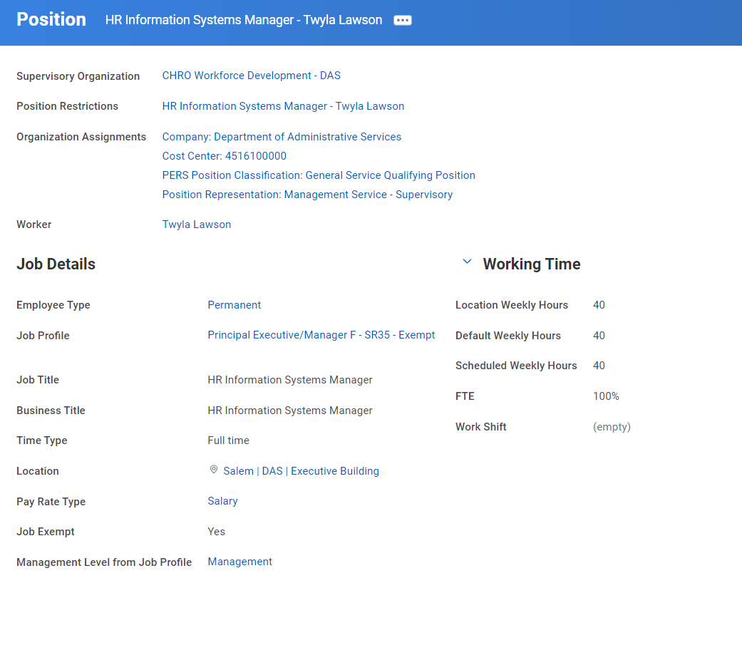
Position Data
Organization Assignments
1. Company (aka Agency)
2.Cost Center - Default
3. Position Representation
3. PERS Class
4. Employee Type
5. Job Profile
6. Location

Slide 6
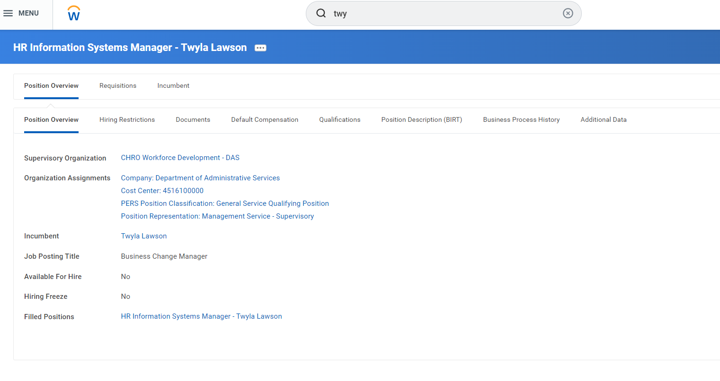
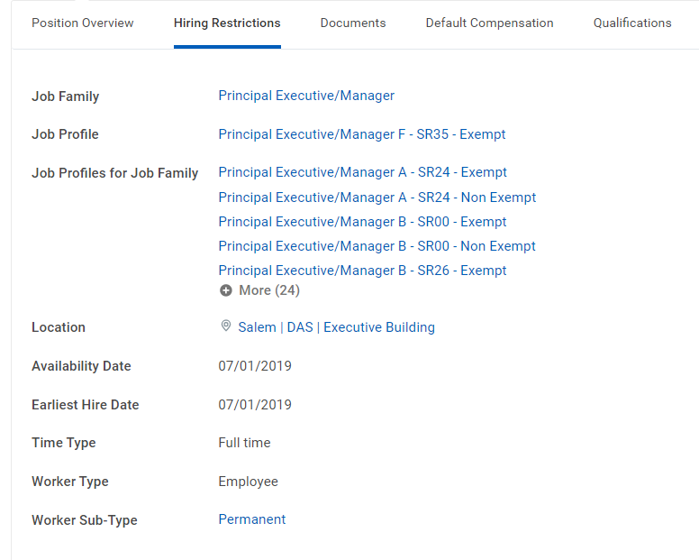
Position Restrictions
Hire Restrictions
Job Profile, Availability Dates, Worker Sub Type
Default Comp
Position Description

Slide 7
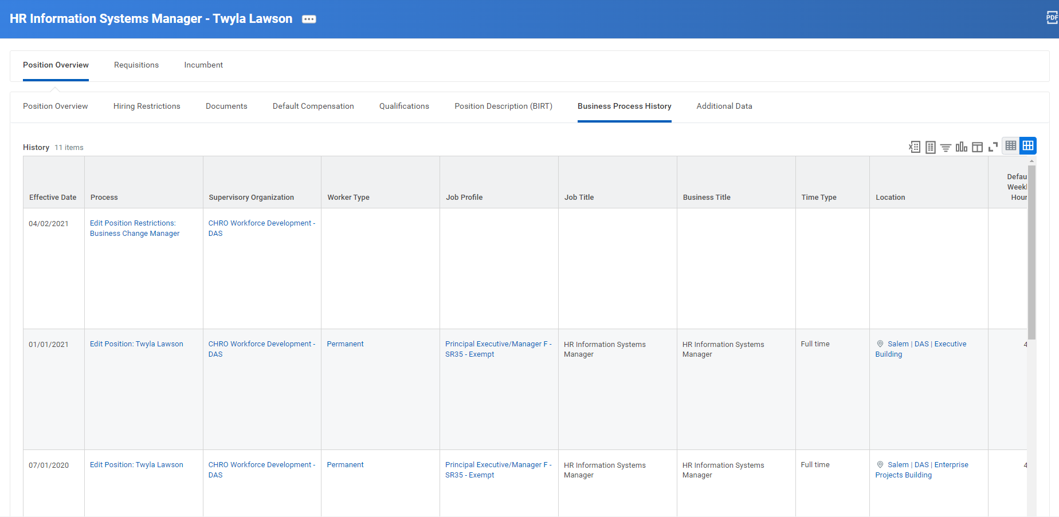

Slide 8
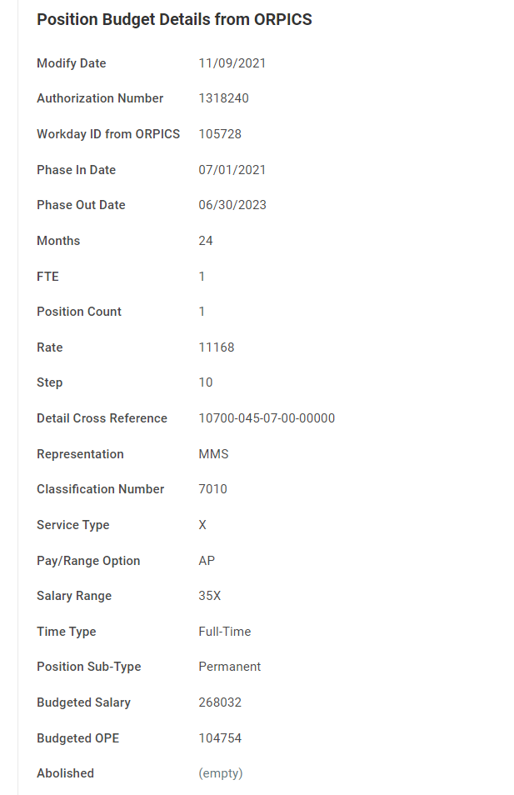
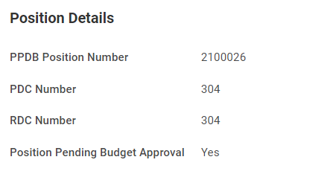

Slide 9
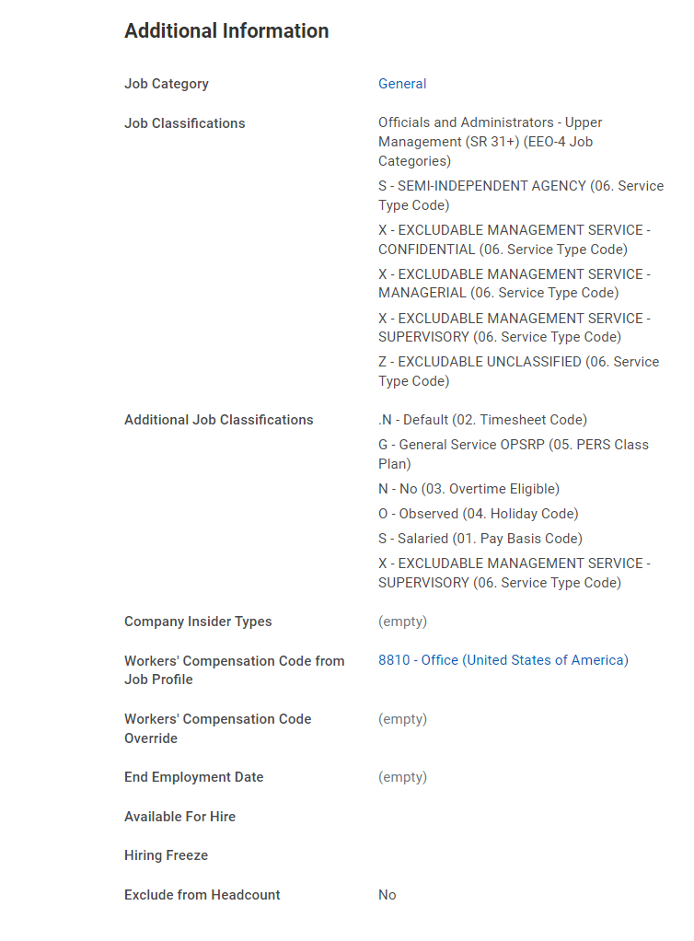
Job Class Codes It’s worker Data…on the position page!
Required 6
Pay basis
Timesheet
Overtime
Holiday
PERS Class Plan
Service Type
Optional Codes
Concurrent job
Job Share
Underfill
Internship

Slide 10
Position Reports
HR Reports>Exception Reports>Audit for multiple job classifications in same group
HCM | Current Worker Detail Report
HCM | Non-Budgeted Positions
HCM | Budgeted, Non-Budgeted, Salaried and No Pay Positions Report
HCM | Vacant Non-Budgeted Position Report
AUD | Additional Jobs Where FTE not Zero
HCM | Employee Missing Uploaded Position Description Document
HCM | Position Freeze with Comments
HCM Employees in Seasonal Positions
HCM | Edit Position Field Changes for Worker

