Slide 1
HRIS Data Integrity
Tools agencies can use to audit
and ensure accuracy in
Worker Data and Pay Impacting
Business Processes

Slide 2
The Data Integrity Team
Libbie Saunders
Ryan Englund

Slide 3
We ensure proper entry into Workday
We help information in Workday flow to Payroll
We assist in large scale changes such as COLA administration, bargained changes, and allowance updates
We help educate Agencies on the correct business process for making changes, and corrections.
We work with multiple divisions on data integrity such as PERS, Payroll, Budget, and Position management.
We troubleshoot errors in Workday and OSPS (Payroll)

Slide 4
What do we do?
Workday
Enter business processes and information
Payroll
Accurate worker pay
+
Feed to additional systems & integrations

Slide 5
Data Points
Worker Data
Position & Benefit Data
Compensation Data
Future Dated items
Service Related Data

Slide 6
Worker Data
Name
Address
Email
DOB
SSN
PERS Status Check
ACA Eligibility for Temps
I9 Process, corrections if needed
Working Remotely

Slide 7
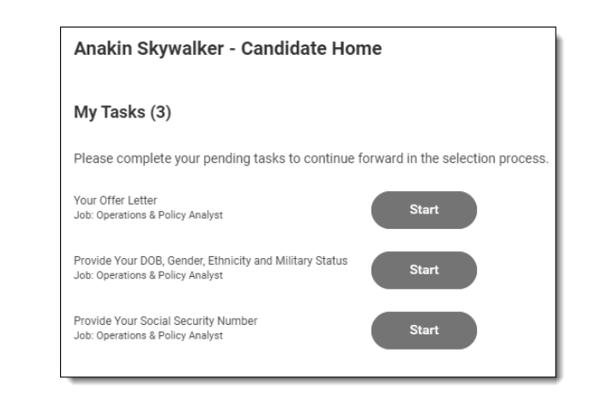
Worker Data Entry – Offer process
Using the offer process ensure the data comes from the worker directly giving a much less chance for errors.
1st round for SSN entry by the worker is during the offer process, the I9 is the 2nd defense against inaccuracy.

Slide 8
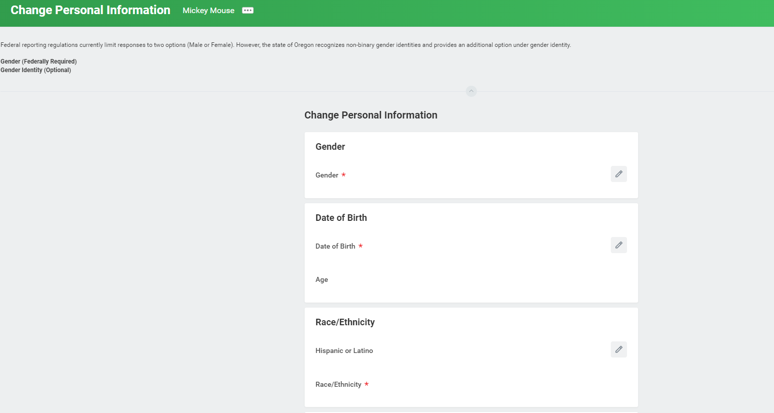
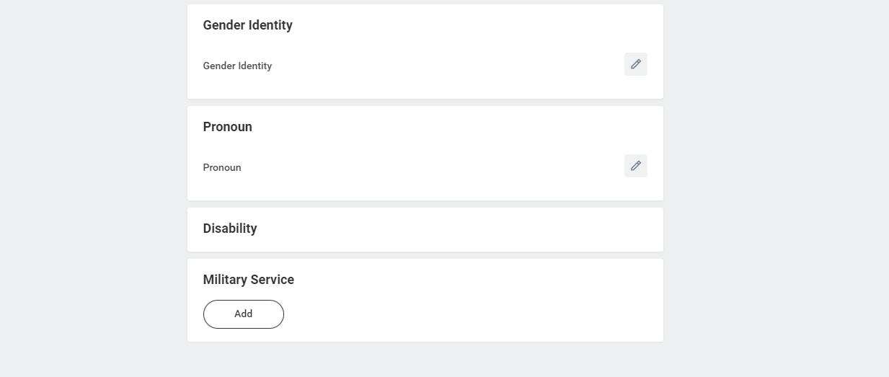
Adding Worker Data - Manually

Slide 9
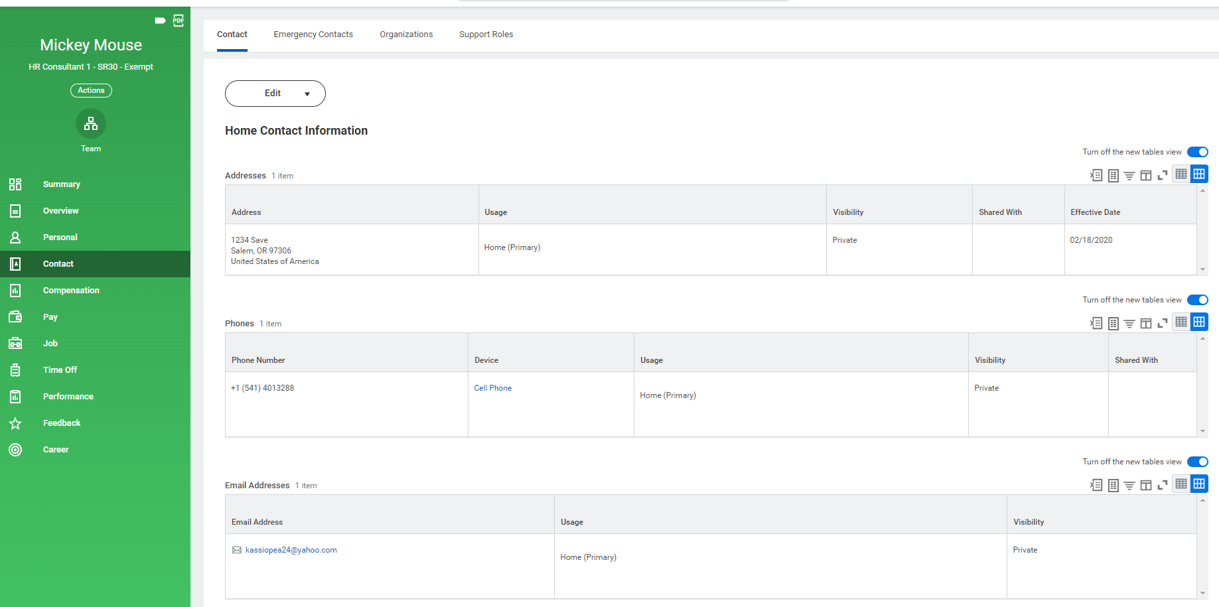

Slide 10
Worker Data
Name
Address
Email
DOB
SSN
PERS Status Check
ACA Eligibility for Temps
I9 Process, corrections if needed
Working Remotely

Slide 11
PERS Status Checks
Need SSN prior to hire to complete the check
When using the offer process, SSN is provided and available for a status check
Work with Payroll to ensure only one Status check is requested by Agency.
Establish process for either Payroll or HR to obtain and share information.

Slide 12
I9 Process and SSN Entry + Changes
Worker I9 – Onboarding
Worker completes section 1 on 1st day of employment, but no later than the 3rd day of employment.
HR completes section 2 by physically or virtually reviewing documents as acceptable
Verify SSN match with I9 and SSN provided by worker
SSN Correction @ I9 (or anywhere when discovered)
Update SSN at correct payroll cycle junction (not between run 1 and run 2)
Final approval by system admins
If SSN is found to be incorrect, PERS status check needs to be completed again.

Slide 13
Worker Reports Human Resources Reports
Worker Reports > Home Contact
Worker Reports > Work Address
Worker Reports > Workers without email addresses
HCM | Date of Birth Change Report
PAY | Social Security Number Change Report
HCM | Home Address Changes by Date Range
HCM | Working Remotely | Awaiting Action
HCM | Working Remotely | Completed Requests
HCM | Current Worker Detail Report
HCM | Current Worker Detail Report

