Slide 1
Microaggressions

Slide 2
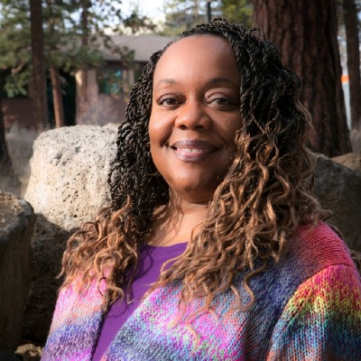
About the trainer
Erika McCalpine is the Senior Director of Equity, People and Culture at Espousal Strategies, LLC. Prior to joining Espousal, Erika was the Chief Equity Officer for the Oregon Department of Transportation. Erika has also served as faculty at Oregon State University-Cascades, and her beloved alma mater, the University of Alabama (Roll Tide!). Erika earned her bachelor's degree from the University of Alabama in Business Management, and her master's in Management with concentrations in Organizational Behavior and Human Resources from the same institution. Erika devoted almost ten years of her career to teaching in academia, but has transferred to the private sector. With that transition, Erika still has a strong desire to share her knowledge and experience so she teaches psychology courses online. Erika is a Society of Human Resource Management -Senior Certified Professional (SHRM-SCP). When Erika has spare time, she enjoys binge watching good television shows and spending time with her two children.

Slide 3
Macroaggression
Macroaggression
Large scale or overt aggression to those of a certain race, culture, gender, orientation, etc.
Aggression that is intended to harm others physically through pushing, kicking, punching or mentally through threats or verbal assault. (Click, 1997)
Example: Racial slurs, homophobic slurs, etc.
The act is clearly offensive and aggressive in nature.
No doubt that bias is present in the behavior

Slide 4
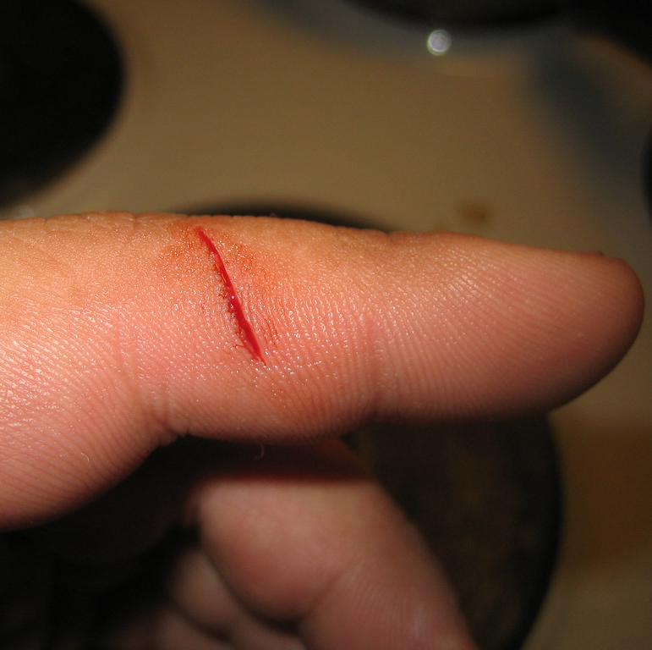
Microagression
Microagression
Brief, commonplace behavioral, verbal or environmental insensitivities by potentially well-meaning individuals that communicate hostile or negative attitudes and insults to individuals of marginalized groups (Sue, 2007).
Also called micro insults, exclusionary behaviors or verbal/nonverbal slights
Microaggressions in the Workplace - YouTube

Slide 5
Activity 1

Slide 6
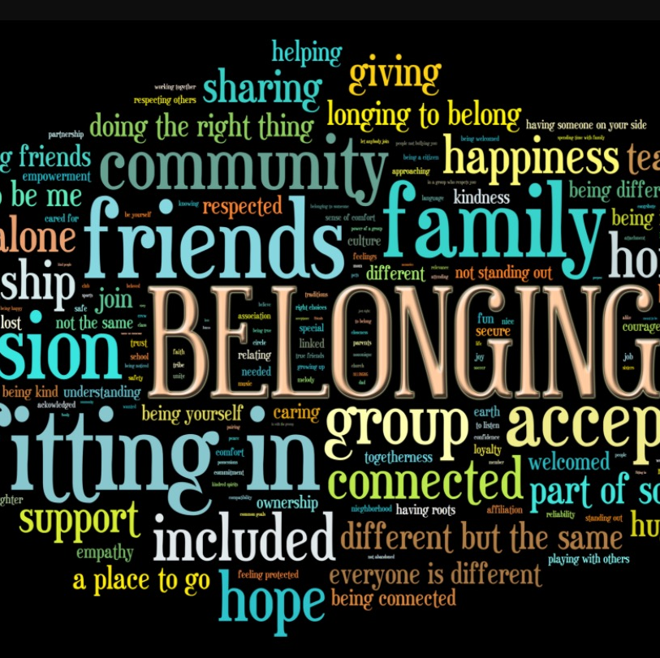
What can I say now?
If you are left wondering, what can I say that won’t harm someone? PLENTY!
Create a culture of belonging by making an honest effort to get to know people based on something other than what makes them different.
If is fine to be curious, but remember, use compassionate curiosity when asking about something that makes a person different.

Slide 7
Activity 2

Slide 8
Questions

