Slide 1
FLSA Report & Case Management Update

Slide 2
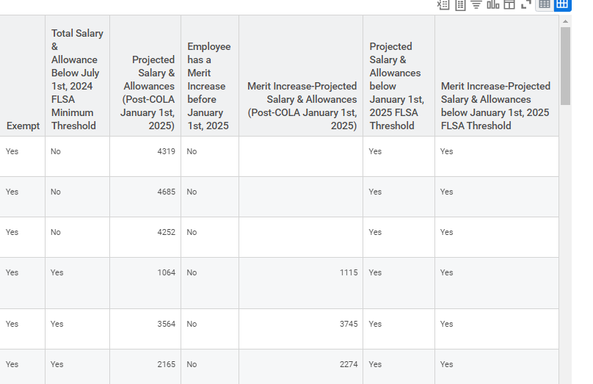
FLSA Validation
HCM | FLSA Validation Report (2024-2025)
Evaluates exempt staff for July 2024 and January 2025 FLSA threshold changes.
Accounts for upcoming COLA, allowances, FTE, and projected merit increases.
Prompt: Company or Sup Org, Effective date.

Slide 3
Workday Case Management Update
7 months remaining
Open Case Management to DAS HR Staff Q4 2023
CHRO Class and Comp Consultants assign and act on cases
Deliver Case Management Training at Class Comp Statewide + Workday Wednesday Q1 2024
Open Case Management to all Enterprise HR Staff
Requests no longer accepted outside of Workday after 12/31/2024
We are here

Slide 4
Workday Case Management Update
130 Cases successfully submitted so far.
Report available for use: CM | Class Comp Help Cases.
Please continue to send Pay Equity related cases to Pay Equity inbox.
Every agency has a Help Workspace already, submit requests to Workday Oregon for Case Solver role assignment.

Slide 5
Workday Case Management Submission Template
Title Line Naming Convention:
“Action Item Type, (WD/PPDB ID), (Incumbent or Classification if Vacant)”
Detailed Message Text Field Template:
Action Item Type:
Agency
Requested by/ Supervisor
Workday Position Number (“TBD” if unavailable)
PPDB Position Number (“TBD” if unavailable)
Current Classification
Proposed Classification
Case to be shared with:

Slide 6
Case Solver Resources
DAS - WD - Case Management Overview
Solver Perspective: Working with Your Cases
Who should be a Case Solver in Workday?
Solver Perspective: Getting to Know Case Management
Case Types for Workday Help/Case Management

Slide 7
Case Management
Contact information:
DAS CHRO Classification & Compensation Team
chro.cnc@das.oregon.gov
https://www.oregon.gov/das/HR/Pages/cc.aspx

