Slide 1
Presentation to stakeholders
October 13, 2015
Salem, OR
http://www.oregon.gov/ODF/Documents/WorkingForests/ReviewofMAMUResearchRelatedToNestingHabitatUseandNestSuccess.pdf

Slide 2
Outline
Scope of project
Systematic reviews
Questions
Study plan
Results
Utility of study

Slide 3
Scope
November 2013 -- State Forests Division RFP
“to employ methods similar to those used in ‘Systematic Evidence Reviews’, also known as Systematic Review (SR), to assess the amount, strength, and relevance of the science related to several central elements of the PSG protocol and to several other marbled murrelet related hypotheses.”

Slide 4
Purpose
The Division expects to use the results of the Marbled Murrelet review in the following ways:
1. to inform the ongoing development of and revisions to murrelet survey protocols;
2. to inform longer term Division policies, plans and strategies for murrelet protection;
3. to develop and refine research and monitoring questions;
4. to inform ODF interactions with other agencies, professional organizations, and other interested parties;
5. to further learn about the SR method, and if/how it may be applied to other topics.

Slide 5
Systematic evidence review
Historical context
1980’s Clinical medicine
2003 Centre for Evidence Based Conservation (CEBC) & Collaboration for Environmental Evidence (CEE)
ODF
2008 pilot project: Does instream wood placement affect salmonid abundance, growth, survival or habitat complexity? (Burnett et. al)
2013: For small & medium streams in the western Pacific Northwest, in or adjacent to forest harvest operations, what are the effects of near-stream forest management on stream temperature and/or riparian shade? (Czarnomski et. al)

Slide 6
Systematic evidence review
Elements described in a protocol for conducting a systematic review (Czarnomski and Hale 2013)
Elements | Brief explanation
Question | Focused, scientifically answerable question that guides search strategy and inclusion criteria
Search strategy | Methods (e.g., search terms and databases) to find studies pertinent to the question
Inclusion criteria | Filters used to determine relevance of studies to question
Study quality and relevance assessment | Criteria used to determine strength of study methodology, and the relevance of study findings to the review question
Data extraction | Tables used for consistently recording data and meta-data from studies and associated reviewer notes
Data synthesis | Methods (quantitative, qualitative) used for synthesizing data with respect to the review question
Transparent Objective Repeatable

Slide 7
Study plan
Overview:
Personnel
Questions development
Protocol development
Search strategy
Data extraction
Critical appraisal of studies
Synthesis

Slide 8
Study plan - Personnel
ODF
Terry Frueh, Rosemary Mannix, Nick Palazzotto
Primary Reviewers
Brian Cooper, Peter Sanzenbacher, Robert Day, Jonathan Plissner
External Reviewers
Martin Raphael, Alan Burger
Stakeholders
Support

Slide 9
Review Process
Stakeholders
Questions
Study Plan
Study Inclusion
Draft Synthesis
Co-authors
ODF

Slide 10
Questions
Development of questions
Narrow focus
4 questions pertain to elements of ISP
1 question informs management decisions
Discussion and review process

Slide 11
Question 1
How are individual behaviors (subcanopy flight, circling, landing, vocalizations) of Marbled Murrelets indicative of nesting in the forest stand where those behaviors occur?
Significance of various Marbled Murrelet behaviors as indicators of nesting.
Focus only upon measureable indicators of nesting (not prospecting for nest sites, pair-bonding, roosting, etc.).

Slide 12
Question 2
To what extent do Marbled Murrelets exhibit nest-site fidelity at various spatial scales (i.e., at the scale of a watershed, forest stand, tree, branch, and platform), and how does the spatial extent of continuous potential habitat affect nest-site fidelity?
Includes repeated use of a nest site within a year or between years by the same or different individuals.
Importance of habitat continuity.

Slide 13
Question 3
How does the spatial extent of continuous potential habitat relate to the co-occurrence (i.e., nesting by multiple pairs) of murrelets in a forest stand and at other spatial scales?
Known nest locations only.
Importance of habitat continuity.

Slide 14
Question 4
How is the occurrence of Marbled Murrelet nest sites related to the number and size of potential nest platforms and platform-tree density within stands of different age-classes (young, mature, and old growth)?
Determine whether platform characteristics of murrelet-occupied habitats vary among stands of different age-classes.

Slide 15
Question 5
How is Marbled Murrelet nesting success affected by habitat characteristics?
Inform management decisions in areas where occupied sites are identified.
Focuses only on habitat associations with nest success (not habitat associations with the presence of nests).
Patch-, stand-, and landscape-level habitat characteristics and abiotic factors describing location of nest in relation to topography and distances from landscape features.

Slide 16
Study plan – Protocol development
CEE guidelines
Available at: http://www.environmentalevidence.org/information-for-authors
Internal discussion
External review/input
Revisions

Slide 17
Study plan – Search strategy
Key papers
ISP(Evans Mack et al. 2003)
BNA account (Nelson 1997)
Reviews: Ralph et al. 1995, Burger 2002, Raphael et al. 2002, McShane et al. 2004, Piatt et al. 2007, Raphael et al. 2008, USFWS 2009, Raphael et al. 2011
Literature searches
Search engines, online databases, governmental and university websites
Study Inclusion criteria

Slide 18
Study Inclusion

Slide 19
Study exclusions
Superseded results
Non-MAMU
Results with insufficient information for appraisal
Raw data
Studies with uncertainty of nests

Slide 20
Study plan -Data extraction
Study citation
Primary focus of study
Focal species
Study location (region/state or province)
Study area habitat
Study design
Sampling design
Study methods
Study dates and study duration (# of years, days within a year)
Sampling intensity
Sample sizes
Statistical analysis of results
Statistical power
Document type
Behaviors recorded
Circling behavior definition
Distances of recorded behaviors from nest known?
Distances of recorded behaviors from potential nesting habitat?
How was nesting determined?
Pertinent results, including statistical significance values and measures of variation
Location of results within article (e.g., specific tables & figures, text)
Potential sources of bias or error
Effects modifiers
Additional notes

Slide 21
Study plan – Critical appraisal
Relevance Rating Factors:
Study objectives: Was the study designed to address specifically the primary review question?
Nest habitat: How similar is the nesting habitat (i.e., forest structure and composition) to that found in Oregon?
Continuous habitat: Are blocks of continuous habitat defined within the study area? (Questions 2 and 3 only).
Nests: Does the study include data on real or artificial Marbled Murrelet nests? (applies to Question 5 only).

Slide 22
Study plan – Critical appraisal
Confidence Rating Factors:
Study design
Sampling design
Study methods
Appropriate statistics
Statistical power
Study duration
Sample size
Spatial coverage
Document type

Slide 23
Study plan – Critical appraisal
Study evaluation scoring table
Study | Relevance |  |  |  | Confidence |  |  |  |  |  |  |  |  |  | Study Evaluation Score (% of maximum possible)
 | Study objectives | Nest habitat | Continuous habitat | Study design |  | Sampling design | Study methods | Statistically robust | Statistical power | Study duration (yrs) | Study duration (season) | Sample size | Spatial coverage | Document type
Burger 1994 | 0 | 1 | 2 | 0 |  | 0 | 4 | 1 | 1 | 3 | 1 | 1 | 2 | 0 | 16 (38%)
Carter and Sealy 1987 | 0 | 2 | 0 | 0 |  | 0 | 0 | 1 | 1 | 3 | 1 | 1 | 1 | 2 | 12 (29%)
Kuletz et al. 1995 | 0 | 1 | 0 | 0 |  | 1 | 4 | 1 | 1 | 0 | 2 | 1 | 1 | 2 | 14 (33%)
Manley 1999 | 2 | 1 | 2 | 3 |  | 1 | 4 | 1 | 1 | 3 | 2 | 5 | 1 | 2 | 28 (67%)
Naslund et al. 1995 | 2 | 1 | 3 | 3 |  | 1 | 4 | 1 | 1 | 1 | 2 | 3 | 1 | 2 | 25 (60%)
Nelson and Wilson 2002 | 2 | 2 | 0 | 3 |  | 3 | 4 | 1 | 1 | 3 | 2 | 5 | 2 | 0 | 28 (67%)
Suddjian 2003 | 0 | 1 | 0 | 0 |  | 1 | 4 | 1 | 1 | 3 | 2 | 3 | 1 | 0 | 17 (40%)
Waterhouse et al. 2011 | 0 | 1 | 2 | 0 |  | 0 | 4 | 1 | 1 | 1 | 2 | 3 | 3 | 2 | 20 (48%)
Maximum scores | 2 | 2 | 3 | 3 |  | 4 | 4 | 5 | 4 | 3 | 2 | 5 | 3 | 2 | 42

Slide 24
Study plan – Synthesis
Each narrative documents an organized, qualitative evaluation of the strength of the entire body of evidence based on the following criteria:
Quality: the aggregate quality of the entire body of evidence (based on an average of the Study Evaluation Scores of all the individual studies);
Quantity: the number of studies, sample sizes, power, and magnitudes of effect;
Consistency: the extent to which similar findings are reported when using similar and different study designs;
Coherence: do the findings of the body of evidence make sense as a whole?

Slide 25
Study plan – Synthesis
Summary of studies
Narrative synthesis of results
Variation among studies and Effects Modifiers
Comparisons with other reviews
Conclusions
Data gaps

Slide 26
Results – Summary of studies
864 papers reviewed
71 studies included
Question 1. 16 studies
Question 2. 23 studies
Question 3. 14 studies
Question 4. 25 studies
Question 5. 40 studies
20 additional studies excluded because superseded

Slide 27
Results
Question 1.
How are individual behaviors (subcanopy flight, circling, landing, vocalizations) of marbled murrelets indicative of nesting in the forest stand where those behaviors occur?

Slide 28
Question 1
Studies
16 studies with primary data or analyses.
15 studies at known nest locations
1 study at sites lacking potential nest habitat
0 studies at sites with potential habitat and confirmed absence of nests
Mean study evaluation score:
17.9/39 (46%)
Descriptive studies, small sample sizes

Slide 29
Question 1
Dechesne & Smith 1997
Hamer & Cummins 1990
Jones 2001
Lougheed et al. 1998
Manley & Kelson 1995
Manley 1999
Naslund 1993
Nelson & Hardin 1993
Nelson & Peck 1995
Nelson & Wilson 2002
Nelson et al. 1994
Singer et al. 1991
Singer et al. 1995
Suddjian 2003
Varoujean et al. 1989
Witt 1998

Slide 30
Question 1
Study Evaluation Scores

Slide 31
Question 1
Conclusions
Subcanopy flights, landings, stationary vocalizations, and circling regularly occur in the vicinity of known Marbled Murrelet nest sites.
Most occur at active and inactive nest sites.
No studies at sites with potential habitat and confirmed absence of nests.

Slide 32
Question 1
Data gaps
Information on behaviors at non-nesting sites, especially those with potential habitat.
Information on distance from nests at which behaviors occur.
Frequency of occurrence of occupied behaviors at known nest sites and their associations with past, current, and future nesting activity at the site.

Slide 33
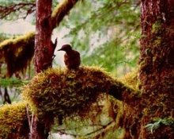
Results
Question 2.
To what extent do Marbled Murrelets exhibit nest-site fidelity at various spatial scales (i.e., at the scale of a watershed, forest stand, tree, branch, and platform), and how does the spatial extent of continuous potential habitat affect nest-site fidelity?
Photo by M. Hobson

Slide 34
Question 2
Studies
23 studies with primary data or analyses.
Mean study evaluation score:
16.6/42 (40%)
Descriptive or anecdotal studies, small sample sizes

Slide 35
Question 2
Barbaree et al. 2014
Bloxton & Raphael 2009
Burger 1994
Burger et al. 2000
Burger et al. 2009
Conroy et al. 2002
Divoky & Horton 1995
Drever et al. 1998
Golightly & Schneider 2011
Hébert & Golightly 2006
Hébert et al. 2003
Hirsch et al. 1981
Jones 2001
Lougheed et al. 1998
Manley 1999
Manley 2003
Meekins & Hamer 1999
Naslund et al. 1995
Nelson & Peck 1995
Nelson & Wilson 2002
Ryder et al. 2012
Singer et al. 1995
Spickler & Sillett 1998

Slide 36
Question 2
Study Evaluation Scores

Slide 37
Question 2
Conclusions
Marbled murrelets frequently re-occupy nesting sites (at a variety of scales) previously used by the same and/or other birds.
Fidelity at the scale of the tree and branch may be lower in areas with more continuous habitat, but data too limited to identify the spatial extent of fidelity for individual birds within contiguous habitat at larger spatial scales.

Slide 38
Question 2
Data gaps
Relationships between breeding fidelity and the extent of continuous habitat (size of stands/patches).
Information on marked individuals to determine individual fidelity and sex differences.

Slide 39
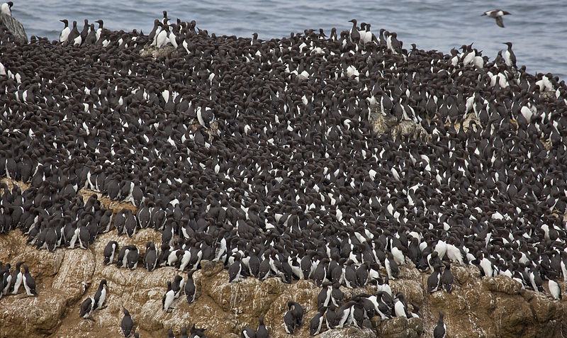
Results
Question 3.
How does the spatial extent of continuous potential habitat relate to the co-occurrence (i.e., nesting by multiple pairs) of murrelets in a forest stand and at other spatial scales?

Slide 40
Question 3
Studies
14 studies with primary data or analyses.
6 studies identified areas of continuous habitat around nest sites
1 study quantified the habitat area
Mean study evaluation score:
19.2/42 (46%)
Descriptive or anecdotal studies

Slide 41
Question 3
Bloxton & Raphael 2009
Burger 1994
Carter & Sealy 1987
Hamer & Cummins 1990
Hull et al. 2001
Kuletz et al. 1995
Manley 1999
Naslund et al. 1995
Nelson & Peck 1995
Nelson & Wilson 2002
Ryder et al. 2012
Suddjian 2003
Waterhouse et al. 2011
Zharikov et al. 2007

Slide 42
Question 3
Study Evaluation Scores

Slide 43
Question 3
Conclusions
Evidence for co-occurrence of nesting murrelets at the scale of the watershed and forest stand.
No studies comprehensively surveyed an entire stand or watershed for nests
minimal frequencies of co-occurrence
unknown relationship between the extent of habitat and the probability of co-occurrence/breeding density within stands or watersheds

Slide 44
Question 3
Data gaps
Intensive tree-climbing efforts to locate all active nests within large sampling areas of contiguous and non-contiguous habitat.
Density of concurrently active nests.
Quantification of the extent of continuous habitat at watershed and forest stand scales in areas with co-occurrence.
Relationship between nest density and habitat area.

Slide 45
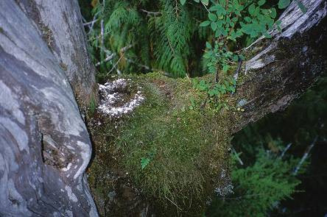
Results
Question 4.
How is the occurrence of Marbled Murrelet nest sites related to the number and size of potential nest platforms and platform-tree density within stands of different age-classes (young, mature, and old growth)?
Photo by K. Jordan

Slide 46
Question 4
Studies
25 studies with primary data or analyses.
11 studies omitted because information superseded by analyses of Hamer and Nelson (1995) or Baker et al. (2006)
0 studies provide information on stand age
Mean study evaluation score:
22.3/36 (62%)
Descriptive or anecdotal studies

Slide 47
Question 4
Baker et al. 2006
Bradley & Cooke 2001
Burger 1994
Burger & Bahn 2001
Burger et al. 2000
Conroy et al. 2002
Dechesne & Smith 1997
Ford & Brown 1995
Golightly & Schneider 2009
Golightly et al. 2009
Grenier & Nelson 1995
Hamer & Nelson 1995
Jordan et al. 1997
Manley 1999
Manley 2003
Manley et al. 2001
Meekins and Hamer 1999
Naslund et al. 1995
Nelson & Wilson 2002
Quinlan & Hughes 1990
Silvergieter & Lank 2011a
Silvergieter & Lank 2011b
Waterhouse et al. 2007
Waterhouse et al. 2009
Witt 1998

Slide 48
Question 4
Study Evaluation Scores

Slide 49
Question 4
Conclusions
Variability in methods and platform definitions limit comparability of platform characteristics across studies
Minimal and mean nest limb diameters across all studies were 7 and 26 cm (measured at the bole) and 10 and 28 cm (measured at the nest).
Most studies indicated that nest trees typically contained more potential nesting platforms than non-nest or randomly selected trees.
Evidence for the density of trees containing potential nest platforms as a predictor of nesting probability is equivocal.

Slide 50
Question 4
Data gaps
Data from nests found since 2003.
Variability associated with stand age-classes and elevation.

Slide 51
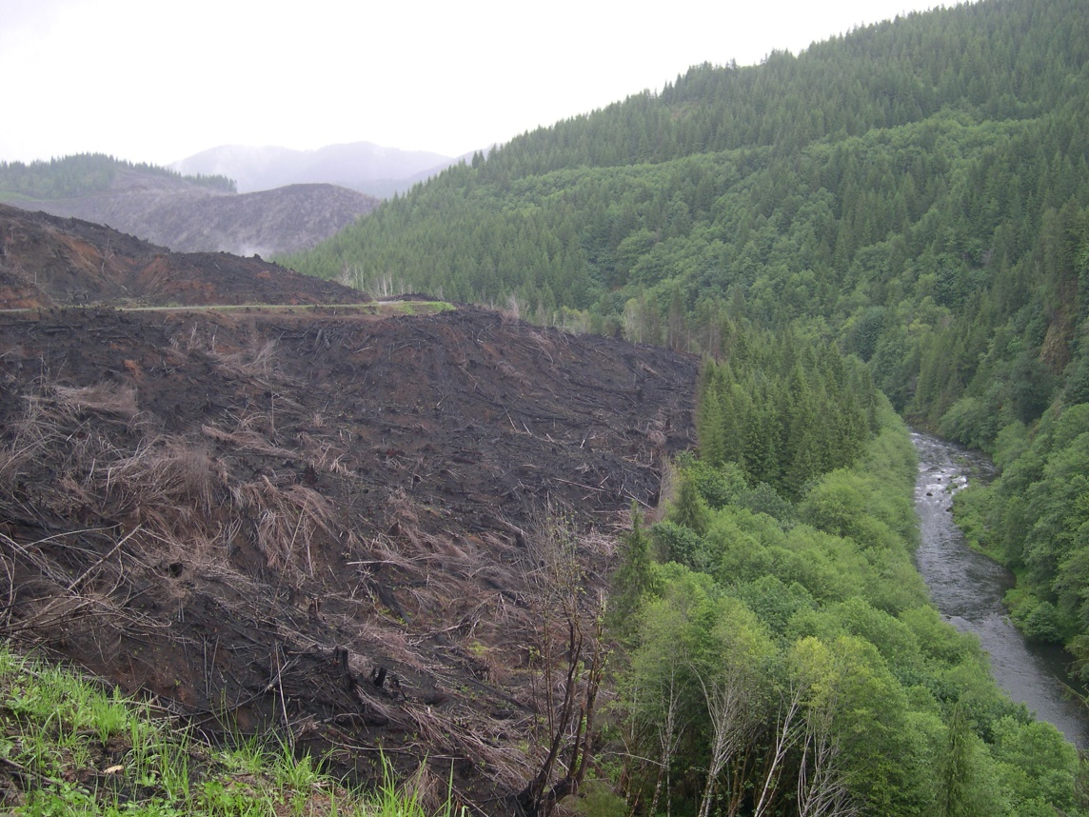
Results
Question 5.
How is Marbled Murrelet nesting success affected by habitat characteristics?

Slide 52
Question 5
Studies
40 studies with primary data or analyses.
3 studies omitted because information only on nests that failed as a result of human disturbance
16 studies analyzed habitat associations with nest fates
5 studies of artificial nests
1 study compared artificial and MAMU nests
Mean study evaluation score:
22.2/42 (53%)
Small sample sizes of descriptive studies

Slide 53
Question 5
Barbaree et al. 2014
Becking 1991
Bloxton & Raphael 2009
Bradley 2002
Bradley & Cooke 2001
Burger 1994
Burger et al. 2000
Burger et al. 2004
Drever et al. 1998
Ford & Brown 1995
Golightly et al. 2009
Hamer & Cummins 1991
Hirsch et al. 1981
Hull et al. 2001
Jones 2001
Kerns & Miller 1995
Kuletz et al. 1994
Luginbuhl et al. 2001
Malt & Lank 2007
Manley 1999
Manley 2003
Manley et al. 2001
Marks & Naslund 1994
Marzluff & Neatherlin 2006
Marzluff et al. 1999
Naslund et al. 1995
Nelson 1992
Nelson & Hamer 1995b
Nelson & Hardin 1993
Nelson & Peck 1995
Nelson & Wilson 2002
Raphael et al. 2002
Silvergieter 2009
Singer et al. 1991
Singer et al. 1995
Suddjian 2003
Waterhouse et al. 2008
Witt 1998
Zharikov et al. 2007
Zharikov et al. 2006

Slide 54
Question 5
Study Evaluation Scores

Slide 55
Question 5
Conclusions
Model selection analyses useful in identifying variables of interest and interactions; however variability in habitat variables considered limit comparability across studies.
Relationship between nest success and distance to the edge of the nesting stand varies with other factors.
Edge type
Predator densities
Numerous descriptive studies with information on habitat characteristics and nest success.

Slide 56
Question 5
Data gaps
Comparable studies in different regions.
Interactions between habitat variables and identification of critical variables among those that tend to co-vary within studies.

Slide 57
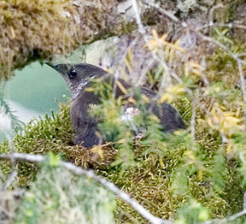
Overview of results
Extent of habitat
Age of stands
Controlled studies
Comparable results
Sample sizes
Unpublished data
Photo by N. Hatch

Slide 58
Website
http://www.oregon.gov/ODF/Documents/WorkingForests/
ReviewofMAMUResearchRelatedToNestingHabitatUseandNestSuccess.pdf

Slide 59
Systematic evidence review
Differences from traditional SR’s

