Slide 1
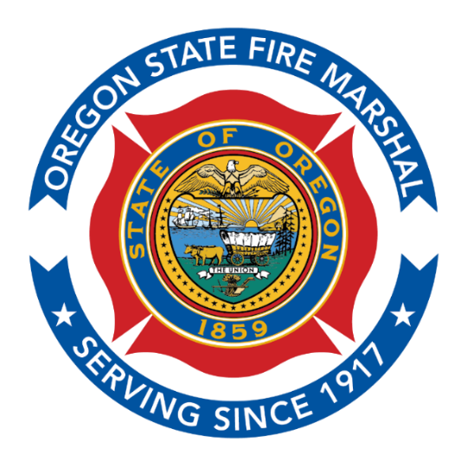
2023 Fire Season Outlook
Travis Medema, Chief Deputy State Fire Marshal

Slide 2
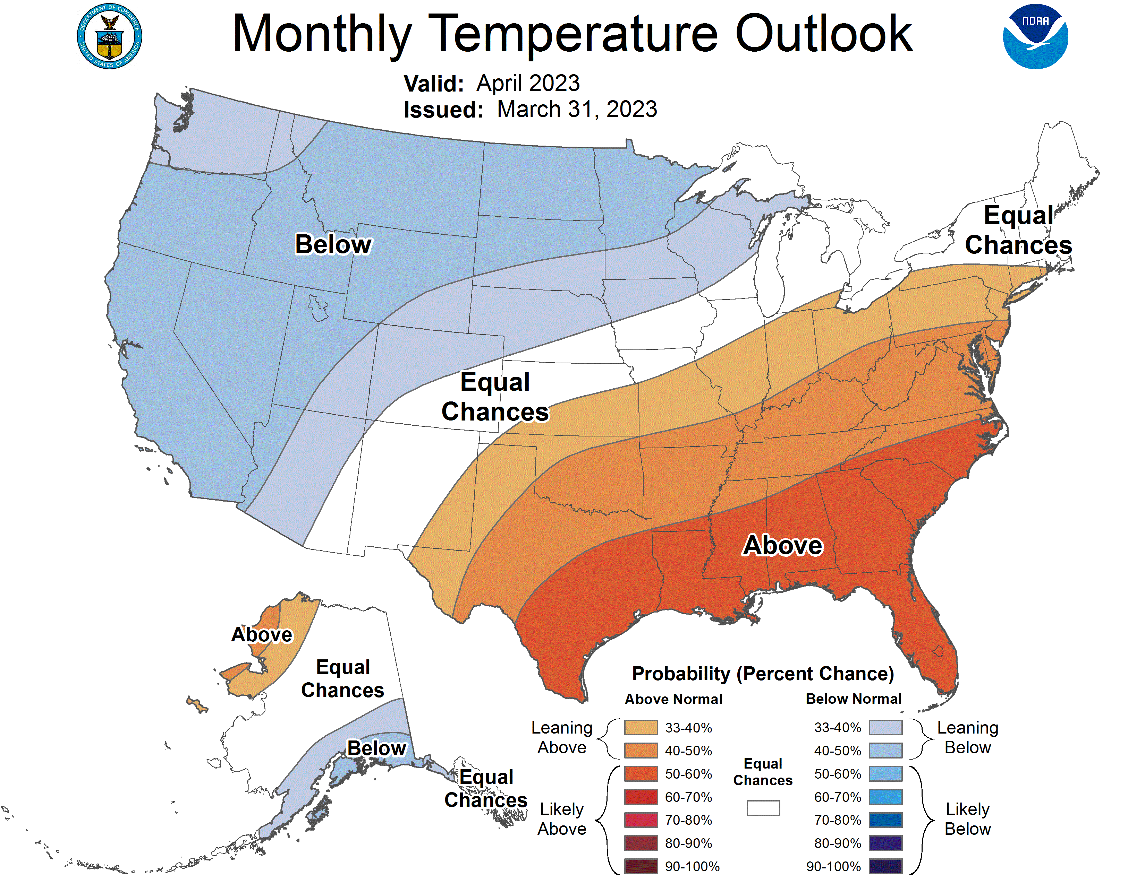
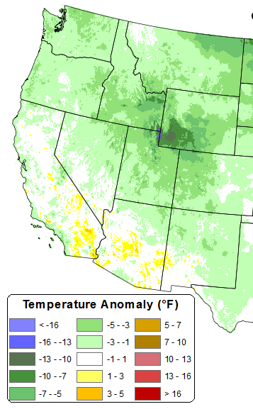
Temperature Forecast vs Observed: April 2023
Observed in April 2023
Temperature: April outlook
Characterization. Temperatures were cooler than average across much of the west in April.

Slide 3
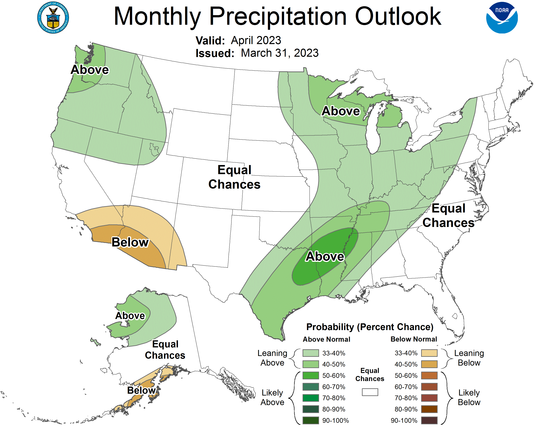
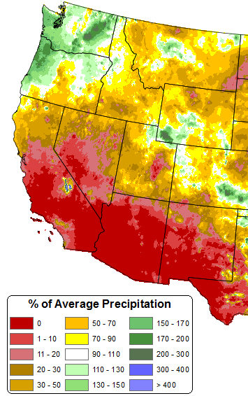
Precipitation Forecast vs Observed: April 2023
Observed in April 2023
Precip: April outlook
Characterization. Precipitation was above average for much of Washington and about half of Oregon.

Slide 4
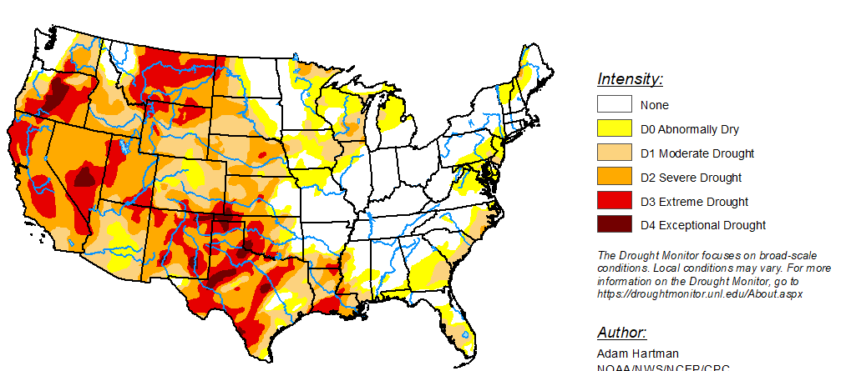
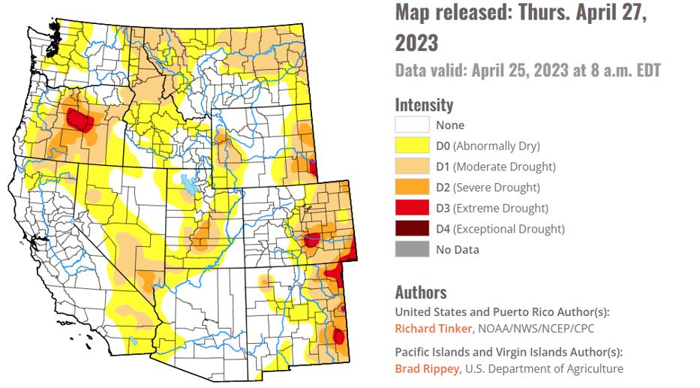
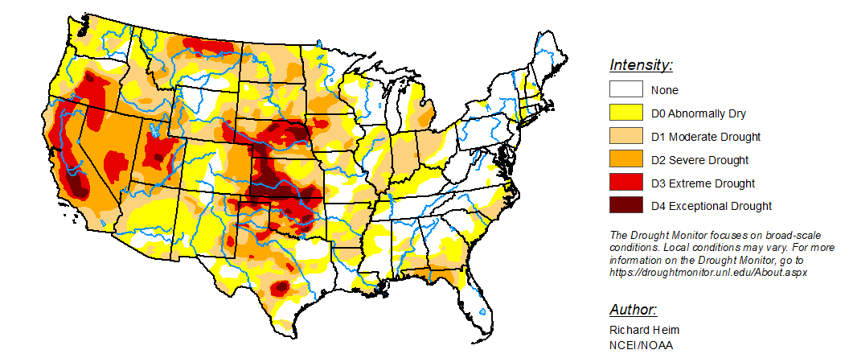
2022/2023 Drought Monitors
March 2022
April 2023
Dec 2022

Slide 5
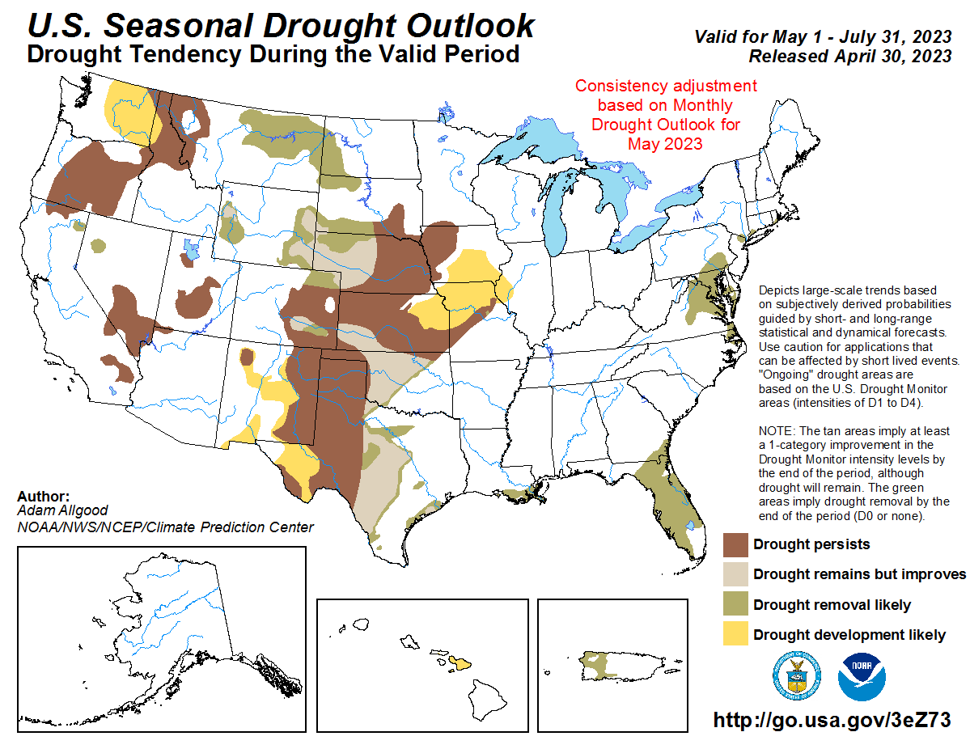

Slide 6
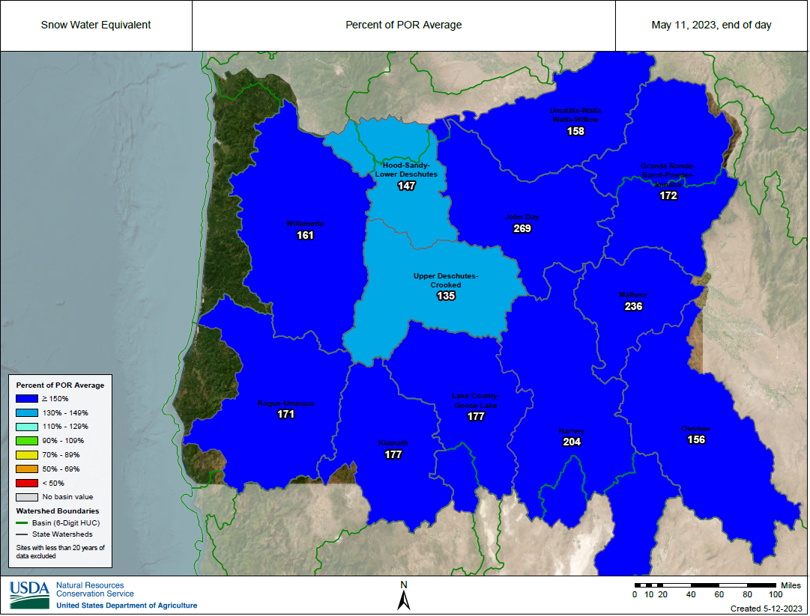
Characterization: Accumulation of new snow tracked well above normal for Oregon and elsewhere through much of April 2023. However meltoff intensified in the last few days of April.

Slide 7
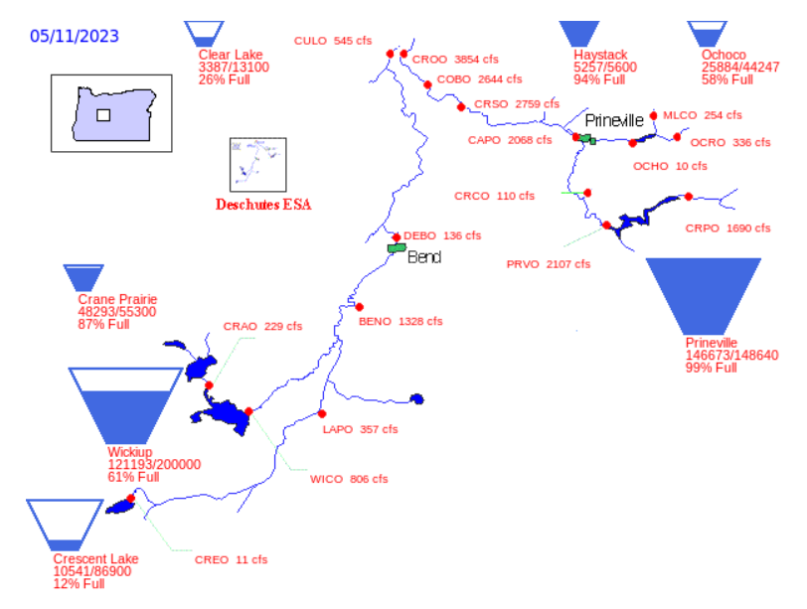
Deschutes River Basin Reservoirs Levels
2022
April 2023
May 2023

Slide 8
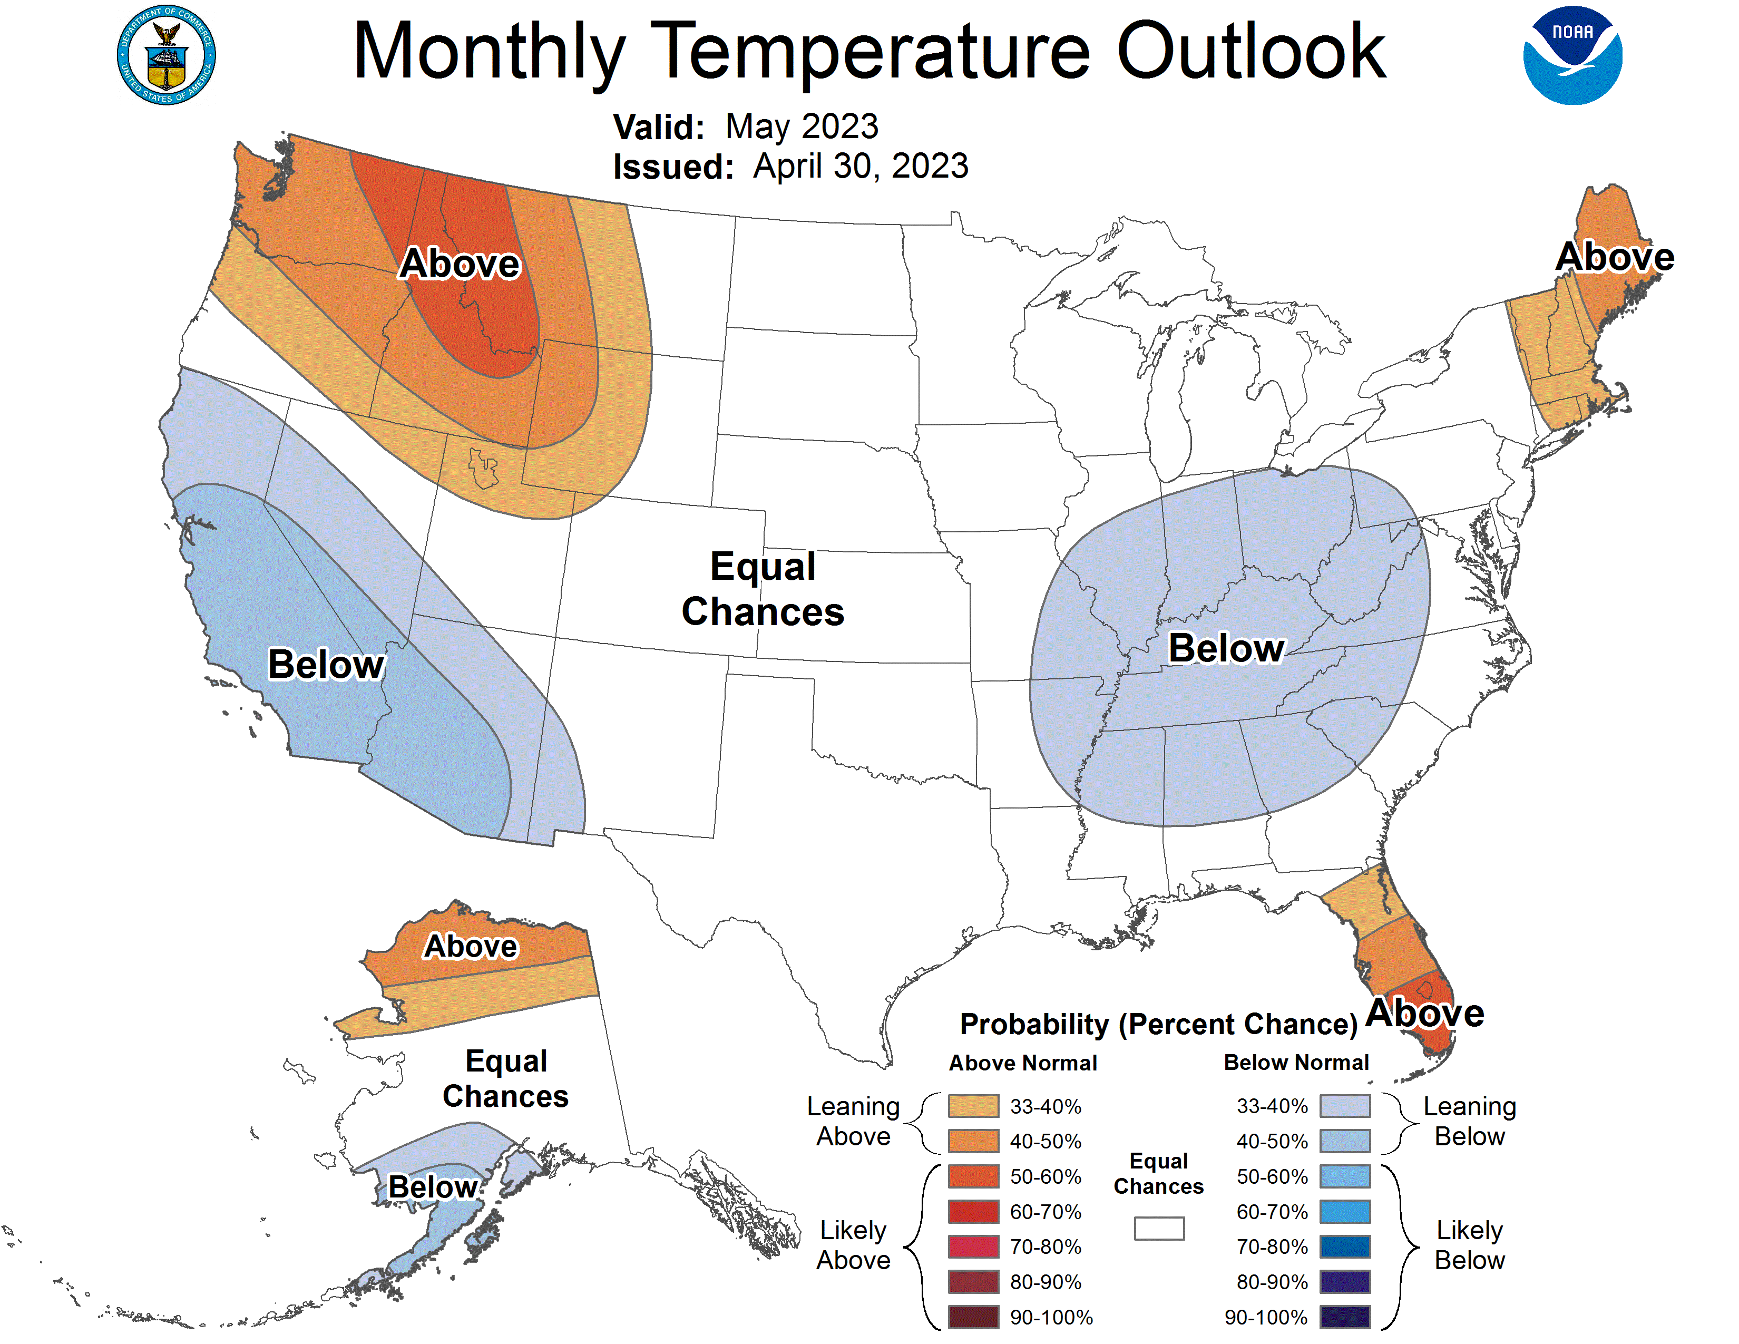
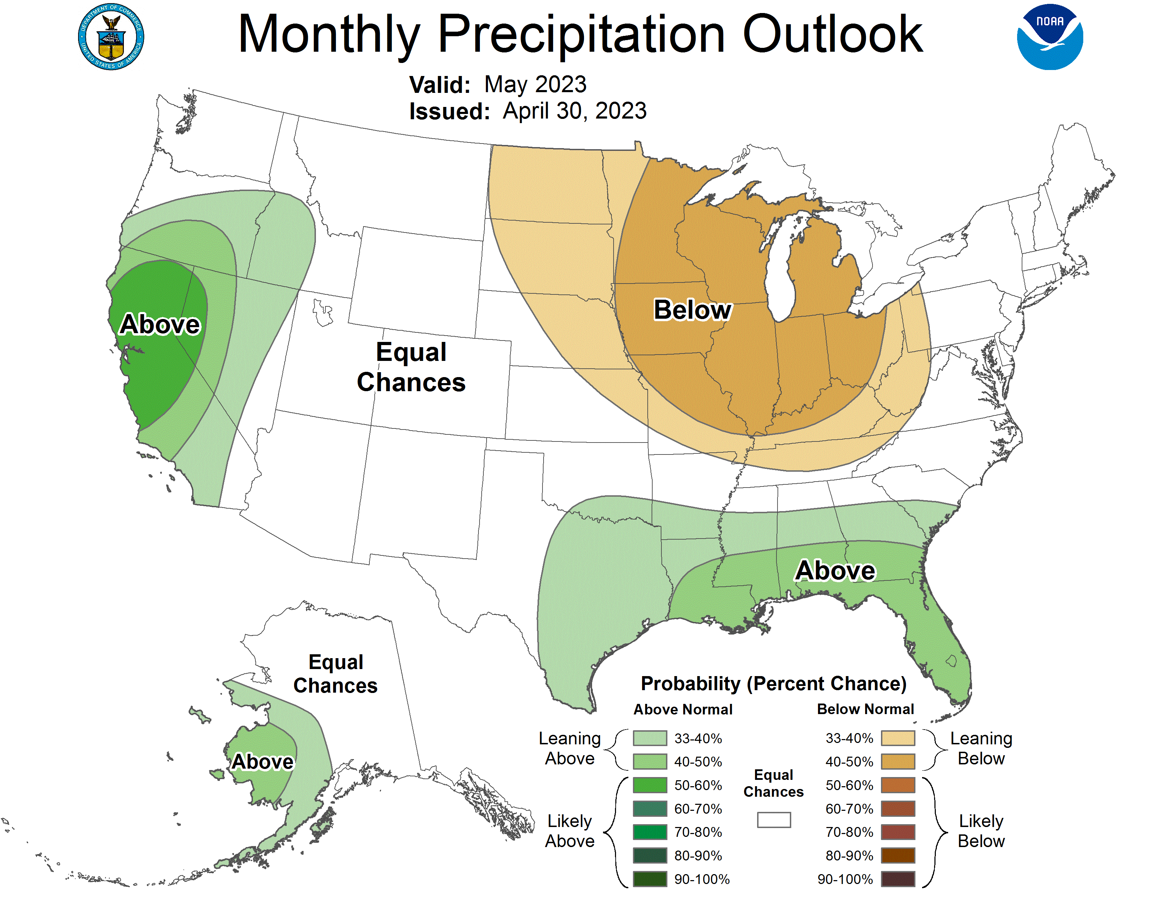
May 2023 Outlook
Temperature Outlook
Precipitation Outlook
Characterization. Warmer than typical is the most likely temperatures scenario for May 2023 for most of the Pacific Northwest except for southwest Oregon. Precipitation is most likely to be above normal over much of Oregon. No precipitation anomaly is foreseen for Washington.

Slide 9
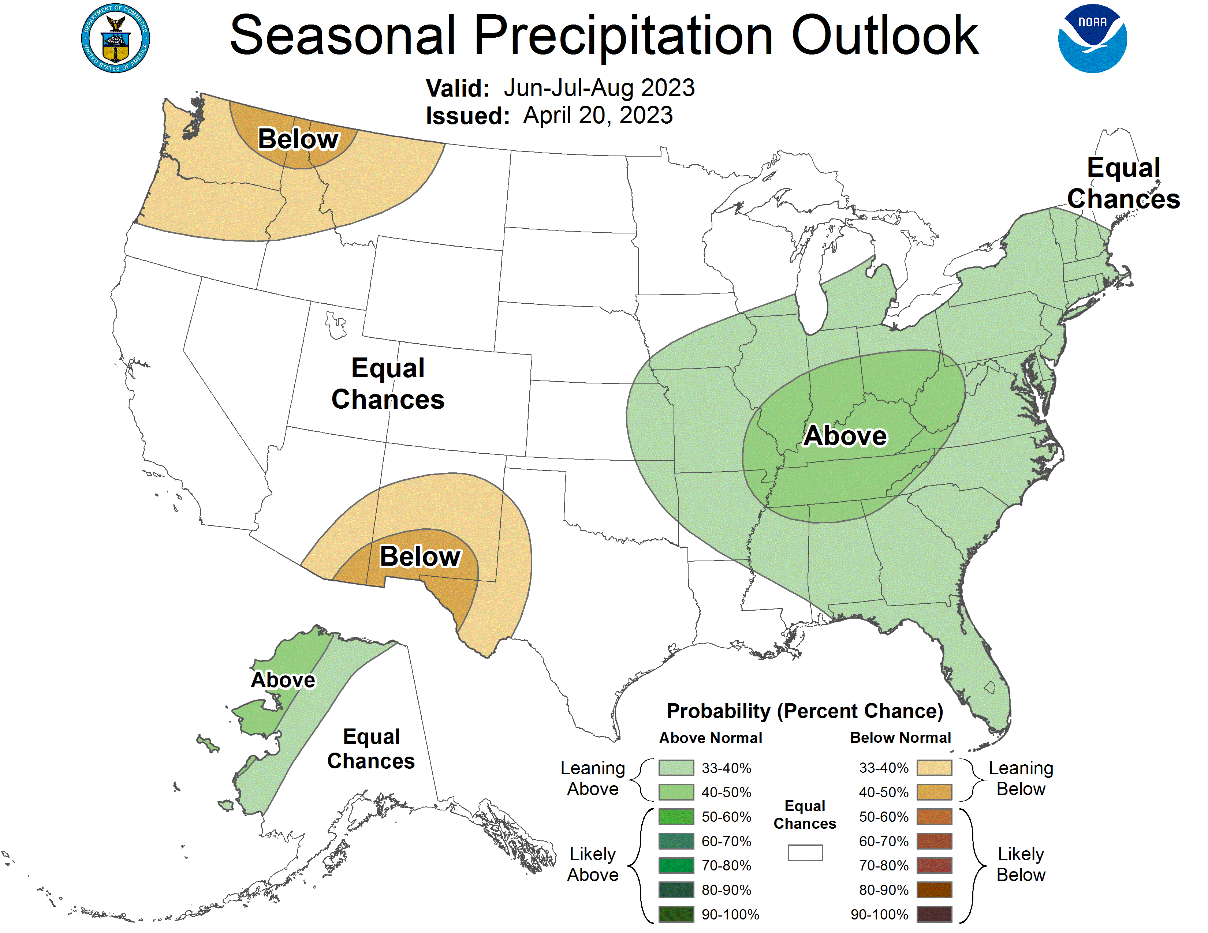
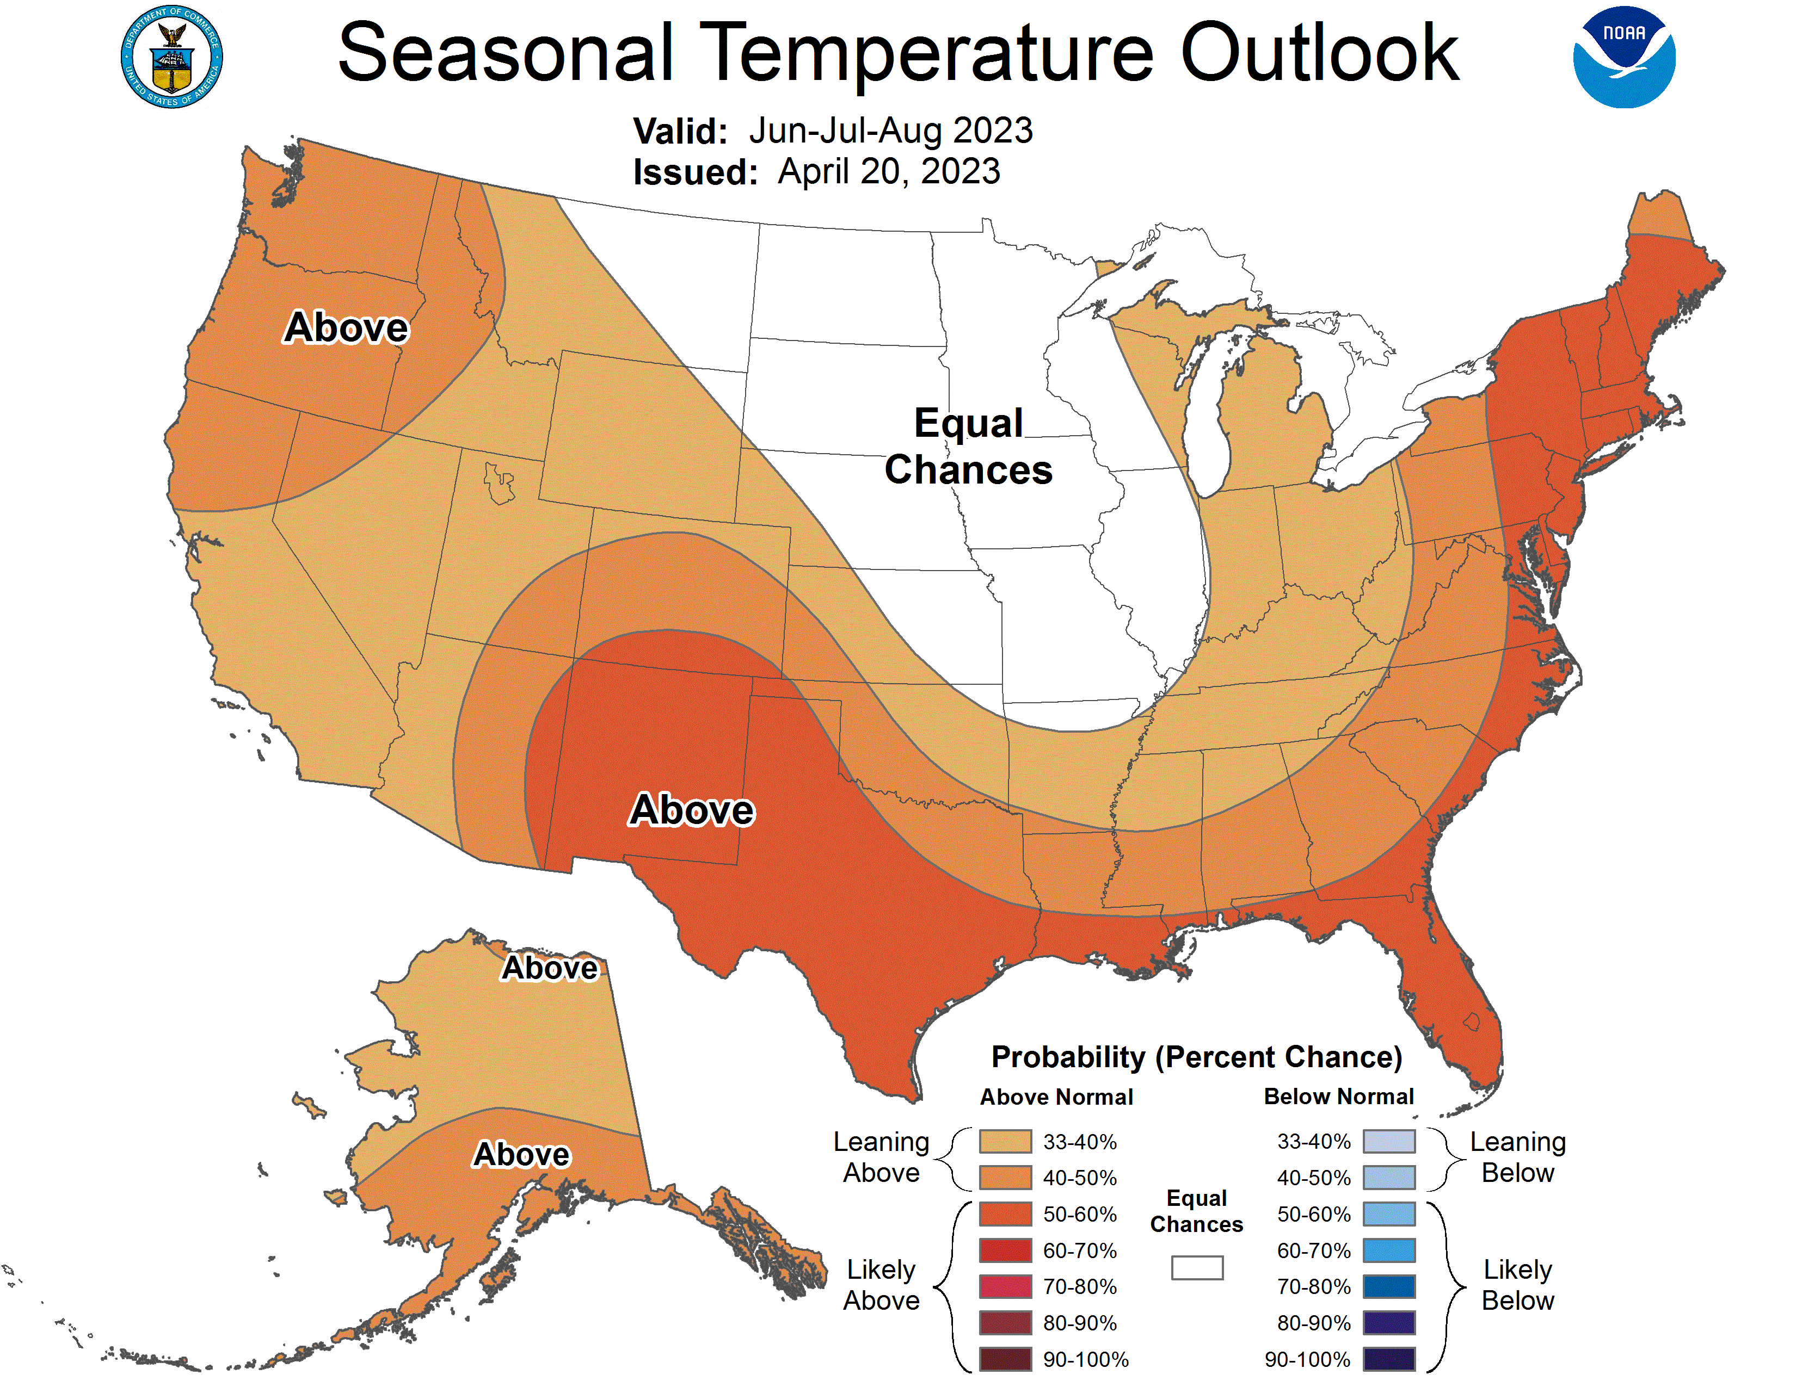
Jun-July-Aug 2023 Outlook
Temperature Outlook
Precipitation Outlook
Characterization Warmer-than-typical most likely for most of the USA. Drier than typical for much of the Pacific Northwest and sections of the southwest.

Slide 10
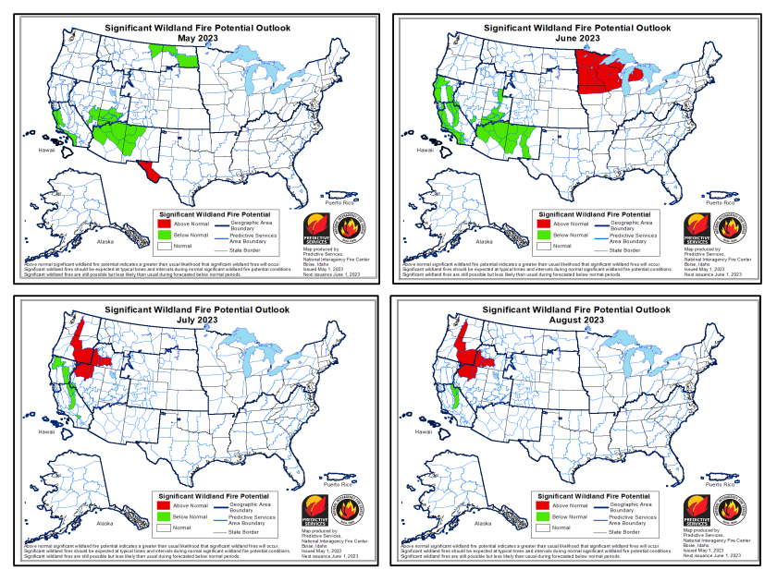

Slide 11
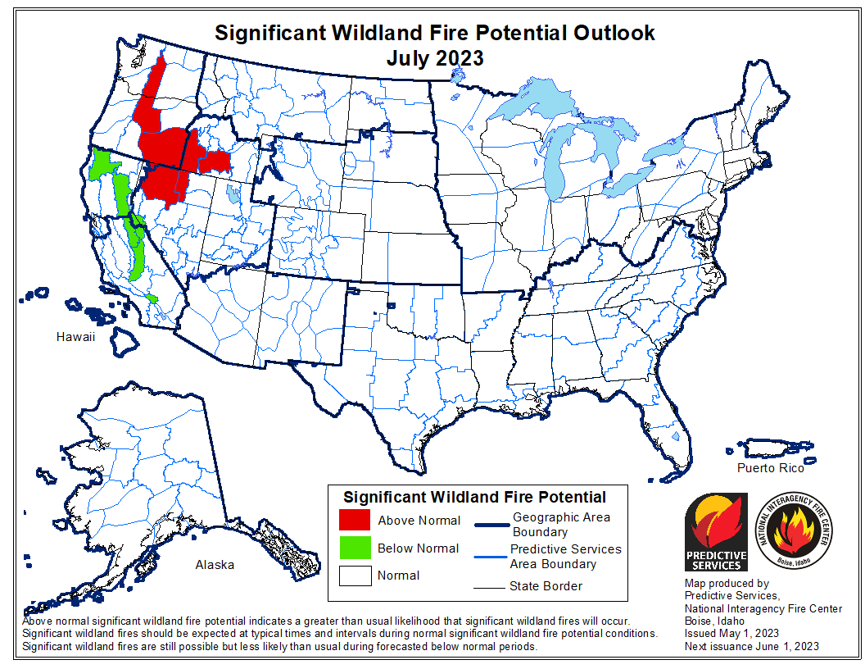
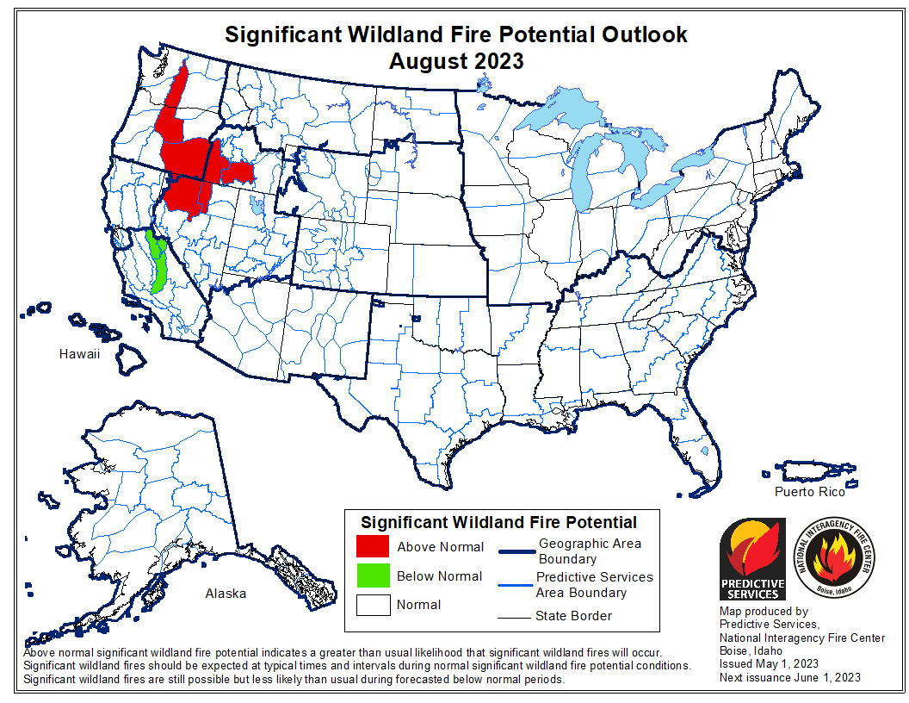
July and August 2023 Significant Fire Potential Outlooks
Risk of large, costly (significant) fires is exists for the east slopes of the Washington Cascades, central Oregon, and southeastern Oregon.
Concentrated lightning activity is the most critical factor during fire season over the Pacific Northwest and other areas in the western states.

Slide 12
Continue Response Readiness
OSFM – Forward leaning posture
Incident Management Teams
Regional Mob Coordinators
Pre-positioning resources
Severity resource and aircraft use
Grant Programs
Notes:
TSM
Continue this- last year very successful- early and proactive
Regional Mob coordinator key in this strategy- early and often connections plays into Prepo
Pre-position- huge last year used 6 times- key element in the strategy about keeping fires small and out of communities
Severity Aircraft partnership with ODF- again huge success we talked about a few times last year especially in the fires in wheat county saved additional conflagrations- will continue this approach and new tools.
TSM
Fire season prep- IMT training and added positions due to increasing severity and complexity, FDB state level may & weekly calls June, Mob Plan- completed in May, AOC readiness drills, IMT equipment ready and for the first time have radio caches across the state.
Wildfire partnerships- ODF, PNWCG, EMAC partners
Fire Service Capacity- more on this on the next slide
Huge thanks GKB and a Big success last year an early declaration led to EMAC early an often to staff taskforces---will need to likely do this again

Slide 13
Closing thoughts
Conditions point to a normal start to fire season
As we get into the heart of fire season, risk increases east slope of Cascades and SE Oregon
Notes:
Cal.

