Slide 1
OAHTC-New Rules and Processes
Oregon Opportunity Network
Spring Industry Support Conference- April 18, 2017
Presented by:
Teresa Pumala, OHCS
Jake Kirsch, NOAH
Jennifer Marchand, OHCS

Slide 2
Agenda
Welcome and Panel Introductions
Brief OAHTC Program Overview
HB 2315 and Need for Change
OHCS Information and Tips
NOAH Information and Tips
Compliance Information
Compliance FAQ’s
Audience Questions*
*Please feel free to ask questions during presentation

Slide 3
Program Overview
In 1989 the Oregon Legislature created the Oregon Affordable Housing Tax Credit (OAHTC) Program which enables a lending institution to claim Oregon Affordable Housing Tax Credits against Oregon taxes with respect to loans for the construction or acquisition, and rehabilitation of affordable housing projects. In exchange for this tax credit, project tenants get lower rents for each dollar of credit taken by the bank with 2 exceptions:
Preservation of Manufactured Home Parks
Preservation of projects at risk of losing existing federal rental subsidies

Slide 4
Rule Change
On March 24, 2015 OHCS announced adoption of temporary rule 813-110 Oregon Affordable Housing Tax Credits (OAHTC). This rule became permanent November, 1, 2015. The rule change impacted the way OAHTC pass-through can be calculated when being applied to units with tenant-based Section 8 or Housing Choice Vouchers.

Slide 5
HB 2315
OHCS is now proposing a revision to ORS 813-110 in order to remove existing language that conflicts with the new rule. Currently Section (5)(b)(ii) states, “full amount of savings from the reduced interest rate provided by the lending institution is or will be passed on to the tenants in the form of reduced housing payments, regardless of other subsidies provided to the housing project.”
If passed, HB 2315 will allow OHCS to remove the conflicting language within the current rule and get more specific on how to calculate pass-through including using tenant-based voucher units. OHCS compliance will institute a new uniform calculation sheet to aid management agents managing pass-through requirements.
Update: HB 2315 passed the Senate on 5-31-2017

Slide 6
NOFA Application

Slide 7
Pro forma – Income

Slide 8
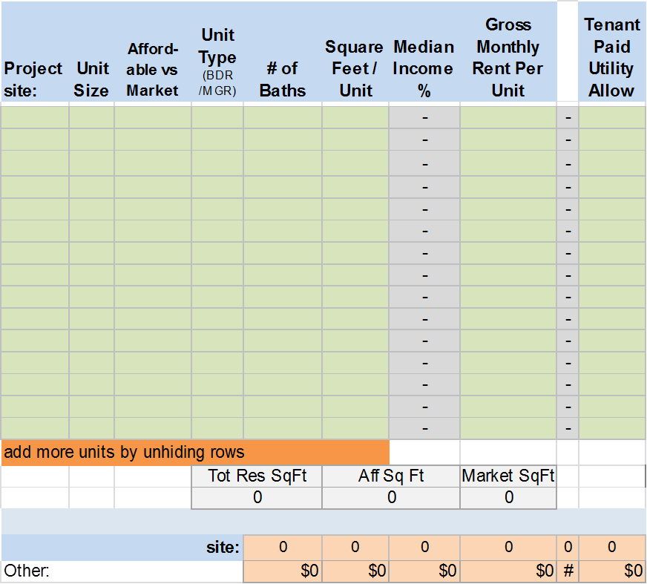
Pro forma – Income w/OAHTC

Slide 9
Pro forma – OAHTC Calculation

Slide 10
OAHTC Declaration Rent Limits. Owner will, throughout the Affordability Period described below, restrict rents for such Qualified Units to limits established herein, including applicable Program Requirements. Owner will further restrict rents in the Project beyond what is described in the table below reflecting other applicable OHCS subsidy restrictions and in a manner consistent with other applicable OHCS subsidy requirements, including federal low-income housing tax credit requirements. Further rent restrictions will be consistent with the Rent Pass-Through requirements found in section 3(d).

Slide 11
Mission-driven lender established in 1990
209 perm loans totaling approximately $253 million
Approximately 75% involved OAHTC’s
157 loans totaling approximately $188 million including $154 million in OAHTC
Represents large portion of OHCS non-bond OAHTC allocations

Slide 12
Can provide significant technical assistance
Help refine pro forma for application
Review OAHTC declaration
Review & accept OAHTC certification
Help troubleshoot compliance issues
Requires monthly escrow deposits for OAHTC compliance fee
Calculates & pays fee to OHCS annually

Slide 13
Avoiding pass-through pitfalls:
Use pre-OAHTC rent levels in the Preferences grid in the OHCS LIHTC Questionnaire
Section 4.1C of 2016 NOFA application
Project-based voucher units not eligible
Evenly spread rent reduction over eligible units or prepare partners for possible adjustments during compliance period

Slide 14
Avoiding pass-through pitfalls continued:
Know your starting point
Only rent restrictions from OHCS funds apply (LIHTC, GHAP, state funded HOME, etc.)
Locate your regulatory agreements & make a grid
Contact OHCS prior to adding project-based vouchers after funding

Slide 15
OHCS OAHTC Compliance
Goal of OHCS Compliance:
1) To determine if the tenants are receiving the benefit of the full amount of the rent reduction that was agreed to when the interest savings was received by Owner as indicated in the OAHTC declaration. 2) To educate partners on OAHTC requirements and rent reduction obligations.
Example taken from actual LURA:
SECTION 5 – RENT REDUCTION
The Owner represents, warrants and covenants that, throughout the term of this Declaration;
(a) The Owner shall be in compliance with the rent limitations established in the OAHTC
Administrative Rules (813-110) and, when applicable, the rent limitations established
pursuant to IRC Section 42 by ensuring that:
(b) Rents in the project will be reduced annually by a total of at least $37,597. This Rent
Reduction is calculated from the Rents Charged at the Market Interest Rate indicated in the
OAHTC application dated February 6, 1998. Such rents may be adjusted annually based on
the percentage increase in the area median gross income where the Project is located as
announced by the Department of Housing and Urban Development. In no event, shall rents
be required to decrease as a result of such adjustment below the rates shown in the
application.
(c) The Rent Pass Through per month per unit to the tenant, in order to accomplish the Rent
Reduction mandated in (b) above will be an average amount of $65.00, with the combination
of all monthly Rent Pass Through to the tenants in the project on an annual basis totaling not
less than $37,597.

Slide 16
Reporting Requirements
Certifications of Continuing Program Compliance (CCPC’s) must be submitted once annually by the end of February for the previous calendar year for every OHCS funding source. For example CCPC’s documenting compliance for the period of January 01 to December 31, 2016 were due by February 28, 2017. Each funding source certification is designed to request information or documentation to support compliance requirements.

Slide 17
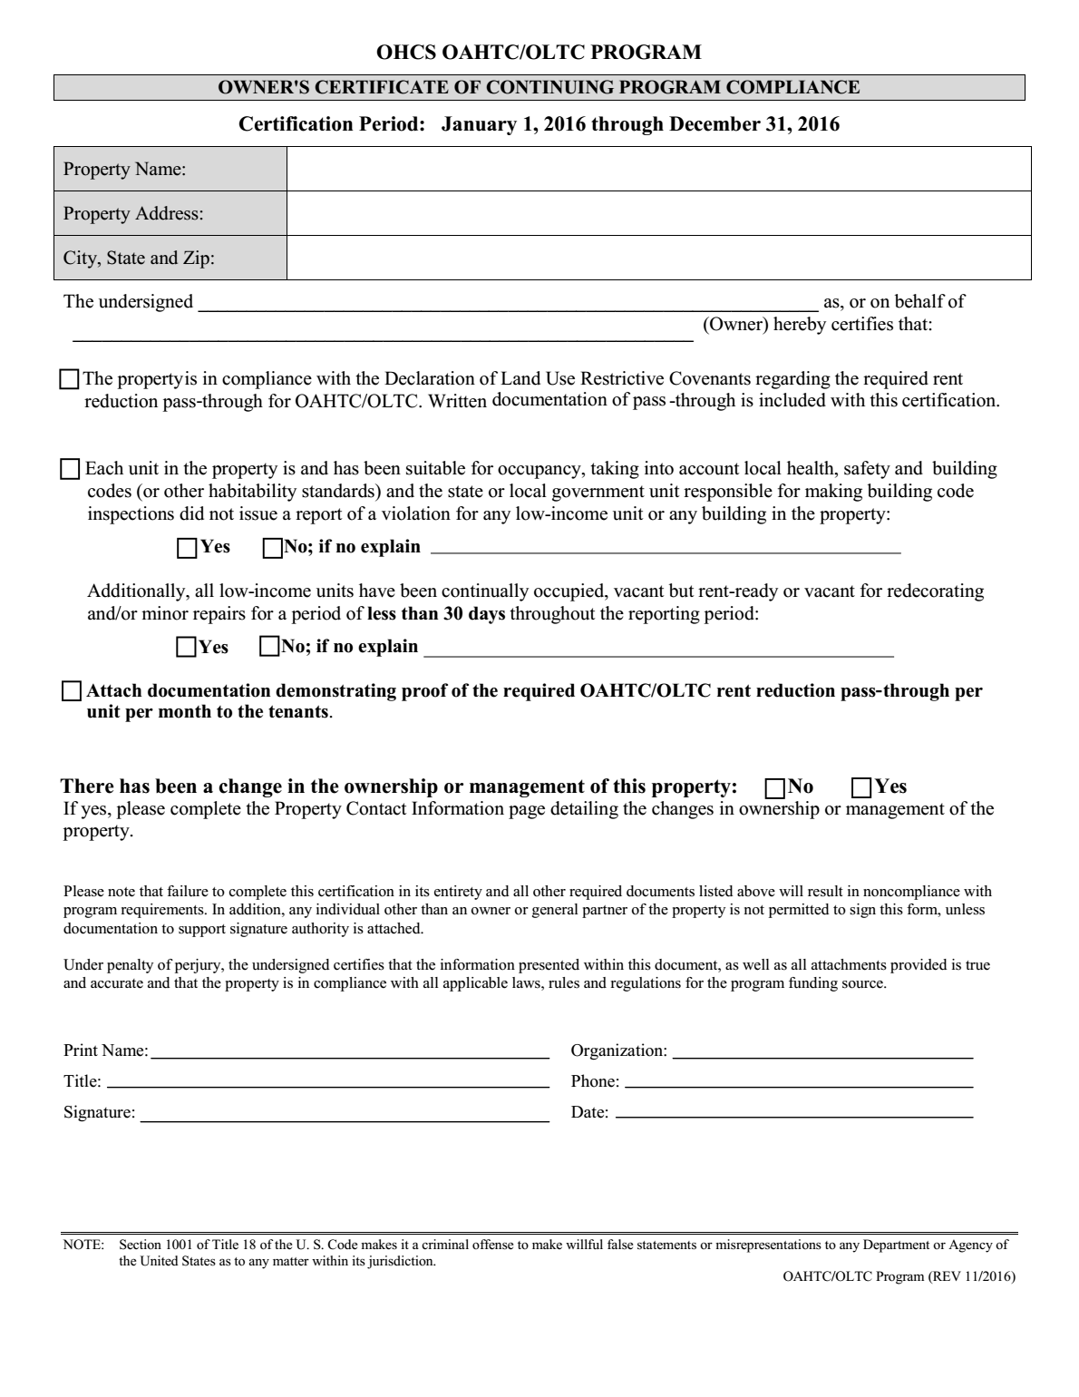
OAHTC CCPC

Slide 18
Reporting Continued
Demonstration of rent reduction pass through is also required to be submitted:
During the process of any OHCS scheduled compliance inspection (ideally once every three years-may be more)
When the property requests a rent increase
Any other time as requested by OHCS as needed

Slide 19
Exemptions
Certain properties are exempt from meeting OAHTC rent reduction pass through
Manufactured Dwelling parks
Preservation Projects
OAR 813-110-0015
(b) In the case of a preservation project or a manufactured dwelling park awarded after September 27, 2007, pass-through is not required for a certification produced on or after September 27, 2007.
“Preservation project” means housing that was previously developed as affordable housing with a contract for rental assistance from the United States Department of Housing and Urban Development or the United States Department of Agriculture and that is being acquired by a sponsoring entity. The contract for project-based rental assistance must cover at least 25 percent of all units in the project.

Slide 20
Calculating OAHTC
How to calculate: The estimated annual average per-unit pass through for the project is to be calculated by dividing the annual loan interest savings, divided by twelve months, and then by dividing the number of affordable units occupied or held vacant for occupancy by qualified tenants.
Where to start: The OAHTC program is intended to lower rents below the level that would be obtained after all other subsidies have been applied. When a project uses one or more other department (OHCS) programs the OAHTC reduction should be calculated by deducting the rent reduction from the other programs restricted rent obligation.
Funding from non-OHCS sources: Only rent restrictions from OHCS funds apply (LIHTC, GHAP, state funded HOME, etc.) when determining a start point for the reduction.

Slide 21
Calculating With Vouchers
Project Based Vouchers: Some projects that have PBV funding are exempt from passing on a rent reduction, however many are not.
813-110-0015
(4) Rental units covered by Section 8 project based assistance are not eligible to be used to demonstrate pass-through savings for the OAHTC program because the rent reductions related to the OAHTC subsidy typically would not be passed on to the tenants in the form of a rent reduction from what the tenants would otherwise pay, and therefore, would not achieve pass-through savings. Projects that are partially covered with project based assistance may qualify to use OAHTC on the remaining units by, inter alia, demonstrating pass-through interest savings that result in appropriate rent reductions to the OAHTC qualified tenants. To the degree this can be achieved in conjunction with tenant vouchers not targeted for pass through, it is encouraged to be targeted to non-voucher units in the Project.

Slide 22
Calculating With Vouchers
Important Tip:
To find out if the property you Own/Manage is exempt from pass through requirements ask the Owner first and then call the OHCS Compliance officer for more information.
Before adding Project based assistance to an existing property with OAHTC it is VERY IMPORTANT that you notify OHCS. OHCS staff can walk you through the property’s specific funding requirements and help you identify any barriers. For example how to meet rent reduction requirements and/or keep the HOME mix in compliance.

Slide 23
Calculating Vouchers Continued
Housing Choice or Tenant Based Vouchers: Pass through is limited for units occupied by a tenant with a tenant based Section 8 or Housing Choice Voucher, under 813-110-0013(2)(C).
“Project owners may only assign up to the maximum of the estimated annual average per-unit pass through to units whose qualified tenants are using a tenant based Section 8, or Housing Choice Voucher”.

Slide 24
HCV Calculation Example
Maria Smith is a long term tenant of The Spring Apts. The property was developed with LIHTC/OAHTC funding. The Maximum LIHTC rent for the unit that she resides in is $1,000.00 per month. The Owner pays all utilities. The Owner does not charge non-optional fees.
Maria recently received a HCV from the local public housing authority. The PHA calculated Maria’s tenant portion of rent based on her adjusted income to be $300.00 per month.
Per the OAHTC declaration for this property the Owner agreed to an OAHTC rent reduction of $12,000.00 per year averaging to $100.00 per unit per month.

Slide 25
HCV Calculation Continued
How would you calculate the annual pass through for Maria’s unit?
Choose One:
I cannot calculate pass through for this unit at all because it is not allowed. She has a voucher. The total is $0.
Deduct the total tenant payment of $300 from the max rent of $1,000 and times by 12 (700 X 12 = annual reduction of $8,400.00 for Maria’s unit)
Calculate the average unit reduction per the OAHTC declaration ($100 X 12 = $1,200.00)
Correct Answer: #3

Slide 26
OAHTC Calculation Worksheets
Previous version:
Lumped Unit types together and was not unit specific. Did not take into account voucher situations.
New Improved Version Excel Spreadsheet (provided as handout):
Can be found on the OHCS webpage: http://www.oregon.gov/ohcs/Pages/asset-management-resources.aspx
Includes unit specific information and area to include HCV

Slide 27
Consequences of Non-Compliance
Most non-compliance situations that come to the attention of OHCS appear to be 1) A misunderstanding of OAHTC requirements and/or 2) A lack of communication between Owner/Agent.
When non-compliance is discovered the main goal of OHCS Compliance is to 1) Help Owner/Agent get back into compliance and 2) Educate Owner/Agent about program requirements.
Most OAHTC non-compliance situations can be satisfied by:
Correcting calculations to properly represent the true annual rent reduction of the property
Adjust rents as needed
Fix the unit reduction mix as needed

Slide 28
Consequences Continued
Most Owners/Agents are very willing to address non-compliance situations right away. However, willful refusal to comply with the OAHTC requirements may result in:
Interest rate increase for property
Lender action as written in lender agreements between lender and Owner
General OHCS Consequences of Non-Compliance Examples Include (but are not limited to):
The status of Owners, managing agents, and or general partners may be designated as “not in good standing” with the agency
Future approvals for management companies may be denied portfolio wide
Required training of staff and/or Change in management or site staff may be required
A professional consultant may be required to be hired*
Required third party audits for compliance*
100% file and/or physical inspections by OHCS or third party* as required by OHCS
Additional OHCS monitoring and/or charging of non-compliance fees
Required training of staff*
Future applications for housing credits or other funding may be subject to automatic denial
*At Owners expense

Slide 29
FAQ’s
Does the rent reduction apply evenly to all units? The OAHTC subsidy must be applied to OAHTC qualified tenants or homeowners in its entirety although the pass-through need not be distributed evenly among the units.
Can I calculate a rent reduction for management units that are occupied by staff members? Only if the staff members are qualified low income tenants certified correctly for the program paying a reduced rent. The unit must be an eligible unit per the declaration.
The property I manage is 100% @60% but there are additional set-asides of 30%. Does that mean I have to reduce the 30% rents? In some cases, the owner may have agreed to further reduce allowable rents to be utilized for other programs or to meet pass through requirements (for example, 30% rents instead of 60% rents). If this was done, rents may already be lowered enough to accomplish the reduced rent requirements for OAHTC.

Slide 30
FAQ’s Continued
How do I know if the Owner agreed to the lower set-aside (30% units for example) with the intent of meeting the rent reduction requirements? The property pro forma spreadsheet showing rents before OAHTC and after OAHTC is a good resource to use for this purpose. If you need help obtaining documentation ask the Owner and then call your OHCS Compliance Officer.
If a resident in a 30% unit receives a voucher and I can no longer meet pass-through requirements what do I do?
You can float out the 30% designation or reduce the rents of other in place tenants.

Slide 31
FAQ’s Continued
How do I float out a set-aside designation or choose someone to give a larger reduction to if needed?
Maintaining the required number of set-aside units is important to comply with unit mix requirements. When re-designating units in order to maintain the required unit mix, Owners/Agents must substitute a comparable unit. You can choose to substitute a “larger” unit for a “smaller” unit. A “larger” unit is one that might be considered more preferable because of larger size, additional bedrooms, or amenities. This type of substitution is not required. However, Owners/Agents are never permitted to substitute a “smaller” unit for a “larger” unit.
The process utilized for re-designating set-aside units in order to maintain the correct unit mix must be outlined in the Tenant Selection Plan for the specific property. Be sure the Tenant Selection Plan provides for a consistent and fair method for the re-designation when needed and be sure to regularly follow the plan as outlined. It is recommended to keep supporting documentation to show the plan has been followed, and to keep an updated spreadsheet documenting the unit mix.

Slide 32
FAQ’s Continued
How do I float out a set-aside designation or choose someone to give a larger reduction to if needed (continued)? There are many ways that rents/set-asides can be re-assigned.
Examples include:
Assigning the lower rent /set-aside to the next household that moves in
Assigning the lower rent /set-aside to the existing household that qualifies and has been at the property longest
Assigning the lower rent or set-aside to the existing household that has the lowest income
Tips: Establish a clear written plan that is reasonable and applied consistently. Communicate and coordinate with the Owner regarding the plan and make sure that all staff members are aware of the plan.

Slide 33
FAQ’s Continued
What are the income and rent limits for OAHTC funding? The Owner is required to pass the benefit of the project's reduced loan interest rate to tenant or homeowner households whose earnings are less than 80 percent of area median income at the time of initial tenant or homeowner qualification (unless exempt). However when paired with other sources, the more restrictive income limit would apply (for example 60% for LIHTC). There are no rent limits established however the rent reduction must be applied to the most restrictive funding source utilized by OHCS and the tenants should not be rent burdened. For example if calculating a rent for an 80% income unit, the rent should be no more than the 80% MTSP Actual year limit as published by HUD for the county where the property is located.

Slide 34
FAQ’s Continued
How long is the compliance period?
OAR 813-110-0037
Use of Project; Transfer of Title
(1) The sponsoring entity and the owner of a project, including any successors, assigns or transferees shall maintain operate and maintain the project in a manner consistent with program requirements including, but not limited to its use for eligible occupants, for the term of the tax credits or twenty years, whichever is longer.
(2) If the title to a project transfers to the lending institution because of a foreclosure, a deed-in-lieu of foreclosure or an involuntary transfer under a bankruptcy proceeding, the lending institution may dispose of the property at its sole discretion.
Stat. Auth.: ORS 317.097

Slide 35
Thank you for Attending
Jennifer Marchand
OHCS Multifamily Program Compliance Technical Advisor
503-986-2031 Jennifer.C.Marchand@Oregon.gov
Teresa Pumala
OHCS Tax Credit Programs Manager
503-986-2112 Teresa.Pumala@oregon.gov
Jake Kirsch
NOAH Relationship Manager
503-501-5687 jakek@noah-housing.org

