Slide 1
Preparing for an OHCS inspection
What to Expect when OHCS inspects
Notes:
Purpose of the inspection is to objectively assess the physical condition of the property in order help you (our partners) maintain the property to Uniform Physical Condition Standards (UPCS). OHCS also has Supplemental Inspection Standards in addition to the UPCS standards.

Slide 2
Confirmation Letter-Information requested
June 6, 2017
Jeremiah Frogman
TEAMRO Property Management Company
123 Pond Avenue
Lake City, Oregon, 97000
Re: 2017 LIHTC Physical Inspection – Lilly Pad Landing
Dear Jeremiah:
This letter is confirmation that the above-referenced property is scheduled for a physical inspection. The review has been scheduled for June 29, 2017, beginning at approximately 9:00 am. Please provide the required written all day notification to all tenants. Your Inspector(s) will be … XXX
Please be aware that your representative must accompany the inspector at all times while in a unit. Your representative should be prepared to open all units (including all doors within each unit to turn on all ranges/stove tops for testing). The inspector will, on the day of the inspection, inform your property management agent which units will be inspected.
The Inspector will verify property profile data. Please submit the following information:
Rent roll to include total number of units (vacant and occupied), resident name, unit size, move-in date, and identify all HOME units if applicable
Total number of buildings and the number of units in each building (all buildings not just residential unit buildings)
The unique building identifier (address or other identifier)
All applicable certifications to include elevator, sprinkler systems, fire systems, and boilers
Site map
Please have the Administrative Notebook available for review during this physical inspection.
The inspection covers the following areas: site, building exterior, common areas, building systems, and units. OHCS appreciates that views may differ regarding observed deficiencies; however, the inspector must classify deficiencies in accordance with the inspection protocol.
The inspector is required to record all health and safety hazards identified during the inspection. There are certain health and safety deficiencies that require immediate repair or remediation. Before leaving the property, the inspector will provide management a written notice that lists specific instances where these items were observed.
The above-listed documentation must be submitted to my attention via email no later than June 15, 2017. Please contact me at 503-986-6772 or by e-mail at Allen.McCartt@oregon.gov if you have any questions.
Sincerely,
Inspector
Compliance Officer
Asset Management and Compliance Section
cc: Owner
Notes:
Inspector needs all this information 2 weeks prior to inspection to create a property profile in the tablet the inspectors are using to complete the inspection. Similar to REAC inspector must enter all information into device manually then inspector must visually verify information is accurate the day of inspection.

Slide 3
Preparing for the Inspection – Tips
Prior to the inspection date, the property should conduct a complete (100%) inspection of the property. It should include the site, all building exteriors, all building systems, all common areas and all units
For clarification purposes: all areas within a building that are not residential units are considered common areas for the inspection and you will need to provide access to each of these areas
While preparing for the inspection, keep in mind that if an inspectable item exists on your property it must function as designed by the manufacturer; i.e. Garbage Disposals, sink plug/pop-up, etc.
Ensure that all residents are provided appropriate notice and that the notice is for the entire day – 8:00 a.m. to 5:00 p.m. – to allow flexibility in the schedule.
Notes:
Walk the property prior to the inspection and look for items that might pose a hazard or that do not portray the property in the manner you want it to be portrayed.

Slide 4
Property should be aware of the following when preparing for the inspection:

Slide 5
Electrical:
All electrical boxes, electrical panel boxes, fuse boxes, disconnect boxes, timer boxes, etc., are subject to inspection by the inspector regardless of the location. These boxes will be inspected even if behind locked doors for any electrical deficiency that exists. Representatives should have access and keys available for entry.
All other electrical boxes, disconnects, timers, etc. will not be opened by the inspector and no deficiency cited if secured at the time of the inspection. By definition, a box is considered secured if it cannot be opened using only your hands. (No tools are allowed.)

Slide 6
Blocked Egress:
All individual living areas/rooms in a unit and all common area rooms must have 2 independent and unimpeded means of egress (escape) if so designed. The only exception is windows above the 3rd floor that do not serve as a means of access to a designed escape route.

Slide 7
Vegetation:
Ensure all vegetation is trimmed away from building surfaces
Walkways are free from overgrown vegetation

Slide 8
Market Appeal:
Ensure all litter is removed
Remove all graffiti
Curb appeal – mow grass, bark beds are weed free,
Dumpster appearance – clean area, not overflowing, enclosure well maintained
Entry sign is in good repair and visible from 20ft

Slide 9
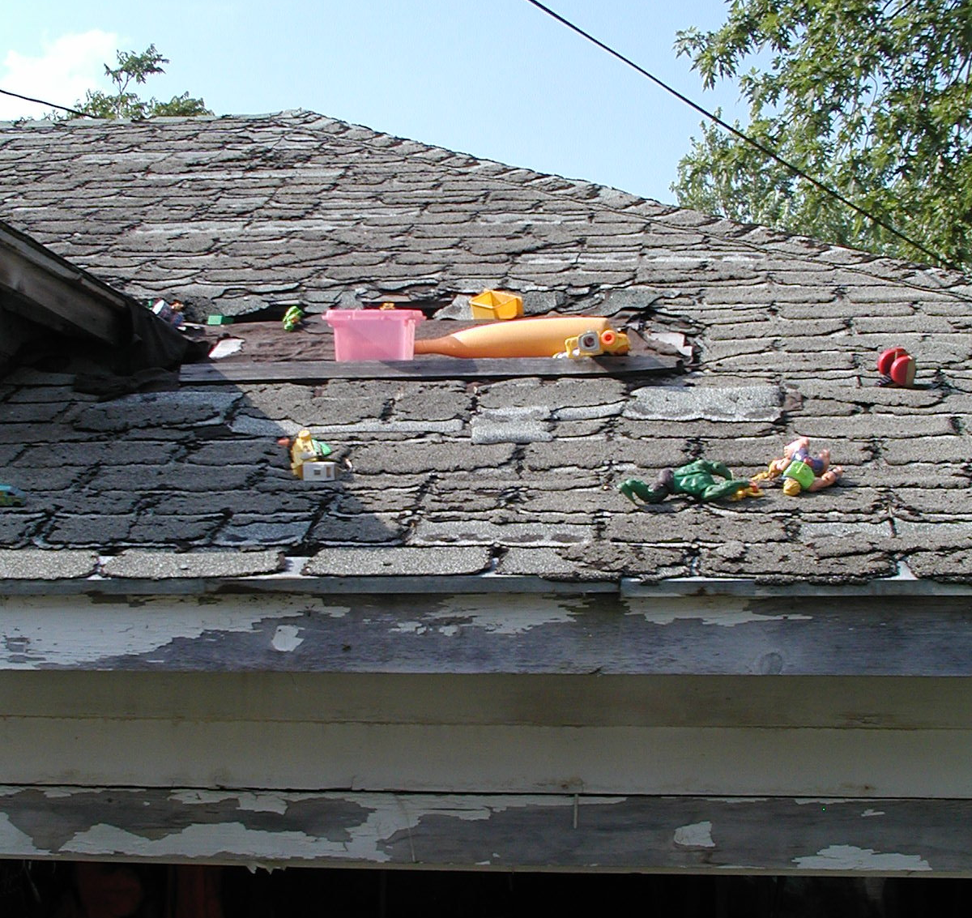
Building Exterior:
Roofs are free of moss and debris
Gutters are clean and not overflowing

Slide 10
Units:
Blocked heaters & electrical panels
Smoke & Carbon Monoxide detectors are present and in working order
Free of cable trip hazards
Test GFCI for proper operation
No flammables stored in the oven
Water heaters are accessible
No missing or burnt out light bulbs
No interior doors with keyed locks
Check for cracked or broken electrical covers
Notes:
Eliminating several of the most commonly discovered deficiencies will speed up the inspection and will improve the property’s chances at more appealing rating.

Slide 11
Preparation for the day of review:
Notes:
Inspector is going to verify the notification letter was sent to all residents, inform P/O/A Participant, Owner, Agent expectations.

Slide 12
Current Inspection Certificates :
Boilers, Fire Alarm, Building Sprinkler System, Elevator and Lead Based Paint Report and Resident Disclosure if the property has a building built prior to 1978

Slide 13
Rent roll:
Should be current for the day of inspection and must contain all occupied units, vacant units and non-revenue units. If the purpose of any of these dwelling units changes to a non-dwelling use you will need to inform the inspector and it must be removed from the unit count (e.g. Office, Police Substation, etc.)
Notes:
Units vacant longer than 30-days will be added to the units inspected

Slide 14
Site map:
This enables the inspector to navigate the property in a more efficient manner
The map should include all buildings and the building identifier (e.g. building A, building 1, etc.)

Slide 15
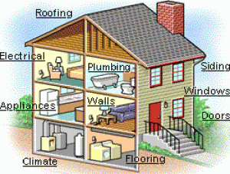
What to expect on the day of Inspection:

Slide 16
Inspectors will inspect all five inspectable areas:
Site
Building Exterior
Building Systems
Common Area
Unit
All components that exist on a property that are in place for active service must function as designed or they are evaluated as deficient under the UPCS protocol.
An example of an item that would be noted as deficient are trash chutes that the property reports as abandoned; however, one or more of the chute doors have not been permanently sealed shut.

Slide 17
Points to remember:

Slide 18
Remember:
A property representative must accompany the inspector at ALL TIMES throughout the inspection while in a unit
The property staff must enter the building/unit first, and accompany the inspector throughout the unit
While conducting an inspection an inspector is not to open closed doors within a unit. The property representative is required to provide the inspector with access to all inspectable areas within the sample units and sample building common areas
For inaccessible areas: Management will be asked to provide a certification indicating that they had accessed the unit and inspected it at a later date

Slide 19
Remember continued:
The property representative should carry a notepad and camera with them during the inspection to document the various findings when appropriate.
You should not schedule the maintenance/service of any inspectable items the day of the inspection
Pay attention while the inspection is being conducted. The inspector will call out all deficiencies discovered during the inspection. However, if property staff are argumentative the inspector is allowed to stop calling out deficiencies

Slide 20
EH&S Deficiencies:
Propane, natural, or methane gas leaks
Exposed wires or open electrical panels
Water leaks on or near electrical equipment
Blocked or unusable emergency or fire exits
Blocked fire escapes or ladders
Missing or misaligned chimney for gas-fired water heater or HVAC unit
Window security bars preventing exit
Expired fire extinguishers
Inoperative or missing smoke detectors

Slide 21
Immediate Action Items form:
Should the inspector find any EH&S items, a Oregon Annual Inspection Immediate Action Required Form will be left at the site. The items listed must be repaired immediately, but in no case, later than three (3) days after citation. Upon completion of the repairs, the owner or approved management agent must submit the completed form to OHCS.

Slide 22
Inspection response
Physical Inspection response is due 30-days from report sent date (Failure to submit response to the inspection report by due date will affect inspection rating)
Response should include documentation for all items noted in inspection report (Failure to respond to all items noted in inspection report may affect response being received after due date which will affect property rating)
Requesting Extension
Submit written request for extension to inspector(s) completing inspection at least 1 week prior to response due date (Requests for extension received the day the response is due may be approved but will result in failure to submit the response prior to the due date and subsequently will affect the inspection rating)

Slide 23
Ratings; Meets/Does not Meet OHCS Standards
PROPERTY MAINTENANCE OPERATIONS
CATEGORY: | MEETS OHCS Standards
Property Maintenance | The physical inspection indicates management has preventative maintenance practices in use that demonstrate NO apparent pattern of deferred maintenance.
 | Unit turn-over practices are in place to ensure units are prepared for occupancy within 15-30 days.
 | Units are consistently made ready for occupancy within 30 days or less.
 | No units required unplanned substantial rehab at turn-over.
 | No units were taken off-line due to deferred maintenance.
 | DOES NOT MEET OHCS Standards
 | The physical inspection indicates management does not have any preventative maintenance practices in use and/or a pattern of deferred maintenance is apparent.
 | Unit turn-over practices are NOT in place to ensure units are prepared for occupancy within 30 days or less.
 | Units consistently take longer than 30 days to make ready for occupancy.
 | Units required unplanned substantial rehab at turn-over.
 | Units were taken off-line due to deferred maintenance.
CATEGORY: | MEETS OHCS Standards
Physical Inspection- Preparation & Materials | All documentation requested by OHCS in preparation for the review was received by OHCS by the required due date.
 | All requested documentation was provided and the documentation was complete and accurate.
 | All Tenants were provided proper notice of the inspection and the inspection was NOT delayed due to management’s failure to issue the proper notice as required.
 | DOES NOT MEET OHCS Standards
 | Documentation requested by OHCS in preparation for the review was NOT received by OHCS by the required due date.
 | OHCS had to make requests and/or send reminders to obtain the requested documentation.
 | Documentation submitted/received was incomplete and/or inaccurate.
 | All tenants were NOT provided proper notice of the inspection and/or the inspection was delayed due to management’s failure to issue the proper notice as required.
CATEGORY: | MEETS OHCS Standards
Physical Inspection | The condition of the property meets industry standards and findings do not demonstrate a pattern of systemic issues/problems or lack of management oversight.
 | No repeat findings.

Slide 24
Continued
 | <5% of inspected areas had observable EH & S findings/problems.
 | </=25% of the inspected areas with findings or notes.
 | Responds to all REAC inspections in a timely manner and corrects all findings per the REAC inspection report.
 | Property appearance is attractive and inviting to the public with minimal detractive items observed (i.e. inspector notes a few pieces of garbage around the property during the inspection).
 | Maintenance practices appear to be more re-active than pro-active and all repairs made meet industry standards.
 | All common areas inviting, available for use by the general public and used for the intended purposes.
 | AFHMP and Administrative Notebook are both properly posted/maintained at the property as required.
 | All previous and current 8823s have been resolved.
 | DOES NOT MEET OHCS Standards
 | The condition of the property does NOT meet industry standards and/or EH& S findings/problems demonstrates a pattern of systemic issues/problems or lack of management oversight.
 | Findings/deficiencies demonstrate deferred maintenance issues; possible lack of management oversight and/or lack of response to maintenance requests.
 | Pattern of repeat findings.
 | · +5% of inspected areas had observable EH& S findings/problems.
 | · +25% of the inspected areas with findings or notes
 | Not responding to REAC inspections and/or not correcting all findings per the REAC inspection report.
 | Apparent or previously reported EH& S findings/problems exist and have not been addressed.
 | Property appearance is NOT attractive and inviting to the public. Overall impressions indicate property is NOT well taken care of on a regular basis or has been neglected.
 | Maintenance practices appear to be lacking and repairs made do NOT meet industry standards.
 | Common areas are NOT being used, are taken off-line and/or NOT used for the intended purposes.
 | AFHMP and Administrative Notebook are NOT property posted/maintained at the property as required.
 | Previously issued and/or current 8823s are unresolved.
CATEGORY: | MEETS OHCS Standards
Inspection Response | The inspection response was received by OHCS by the required due date.
 | An extension was requested at least ten (10) days prior to the required due date and was then received complete by OHCS by the extended due date as required.
 | All findings that require a delayed completion date due to type/size of work including large budgetary item/s for repair have been pre-approved by OHCS and a completion was been submitted to OHCS.
 | As requested by OHCS, all valid supporting documentation that shows findings have been corrected was submitted to OHCS.

Slide 25
Ratings; Continued
 | OHCS 72-Hour Immediate Action Items report was completed and submitted back to OHCS by the due date as required.
 | DOES NOT MEET OHCS Standards
 | The review response was not received by the required due date.
 | An extension was requested less than ten (10) prior to the required due date or no extension was requested.
 | Documentation submitted was incomplete and/or inaccurate.
 | All findings that require a delayed completion date due to type/size of work including large budgetary item/s for repair have NOT been pre-approved by OHCS and a completion plan has NOT been submitted to OHCS.
 | As requested by OHCS, all valid supporting documentation that shows findings have been corrected was NOT submitted to OHCS.
 | OHCS had to make requests/reminders to obtain the required documentation.
 | OHCS had to make requests/reminders to obtain complete and/or accurate documentation.
 | OHCS 72-Hour Immediate Action Items report was not completed and/or not submitted back to OHCS as required.
CATEGORY: | MEETS OHCS Standards
Communication | The Owner/Agent responds to all requests for information/documentation from OHCS by the required due date.
 | All requested information/documentation is accurate, complete and received by OHCS by the required due date.
 | Extension was requested prior to the required due date; information/documentation was then received by OHCS by the extended due date.
 | DOES NOT MEET OHCS Standards
 | The Owner/Agent does NOT respond or responds late to all requests for information/documentation from OHCS.
 | The requested information/documentation is inaccurate and/or incomplete and/or not received by OHCS by the required due date.
 | Extension was NOT requested.
CATEGORY: | MEETS OHCS Standards
Fair Housing & Equal Opportunity (FHEO) | Owner/Agent has demonstrated knowledge and practices that meet industry standards.
 | DOES NOT MEETS OHCS Standards
 | Owner/Agent does NOT have demonstrated knowledge and practices that meet industry standards.

Slide 26
Inspection Schedule; Risk-based System
After the Inspection is complete and the rating issued, OHCS staff will evaluate the inspection rating along with other property information and generate an overall number rating of the property. This number rating will determine OHCS’ risk regarding the property. As a result, the property’s inspection schedule may be more often or less frequent due to this rating.

Slide 27
The End

