Slide 1
State Data Validation
Validation for accuracy

Slide 2
What are the steps for
“State Data Validation”?
Steps
  Data entry by registrars
    Random pull by state data administrator
      Data validation by state data administrator
        Feedback to entry registrar
          Correction of error data
            Re-validation by state data administrator

Slide 3
What is Data Validation looking for?
ACCURACY
TIMELINESS
RELEVANCE
SYSTEM OPERABILITY
ERRORS
CORRECTIVE ACTIONS

Slide 4
Feedback
First feedback is directly to the registrar who entered data.
Second feedback is to the registrar and trauma coordinator/manager
Third feedback is to registrar, trauma coordinator/manager, and state survey team
Feedback is NOT to call anyone out!
Feedback is NOT a search for not doing a good job!
Feedback IS recorded and tracked.
Feedback is TWO way communication!

Slide 5
Error Corrections
Corrections MUST be done to trauma records within 30 days of notification of errors.
Re-validation on record errors is done at the end of the 30 day time period.
Re-education is done when needed, or requested by the registrar, trauma coordinator/manager, or state survey team.

Slide 6
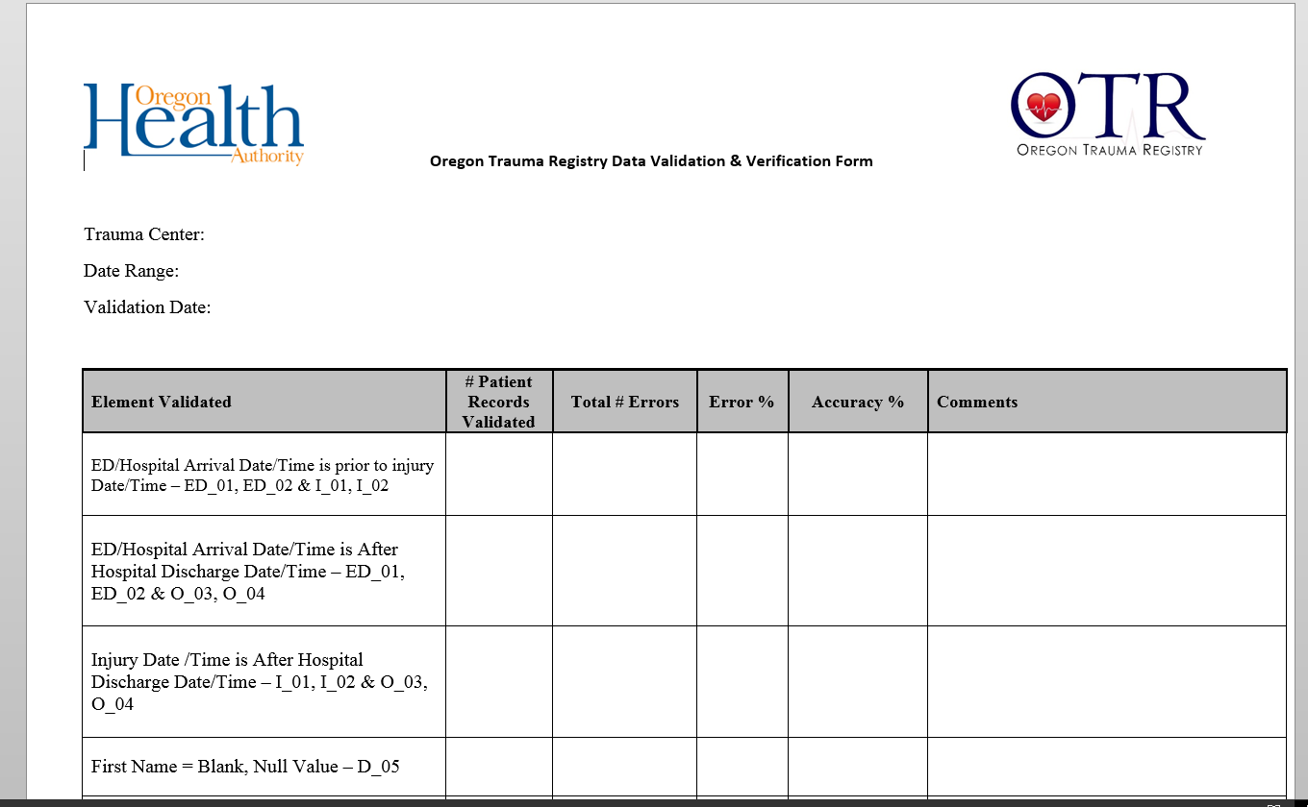
Data Validation Form

Slide 7
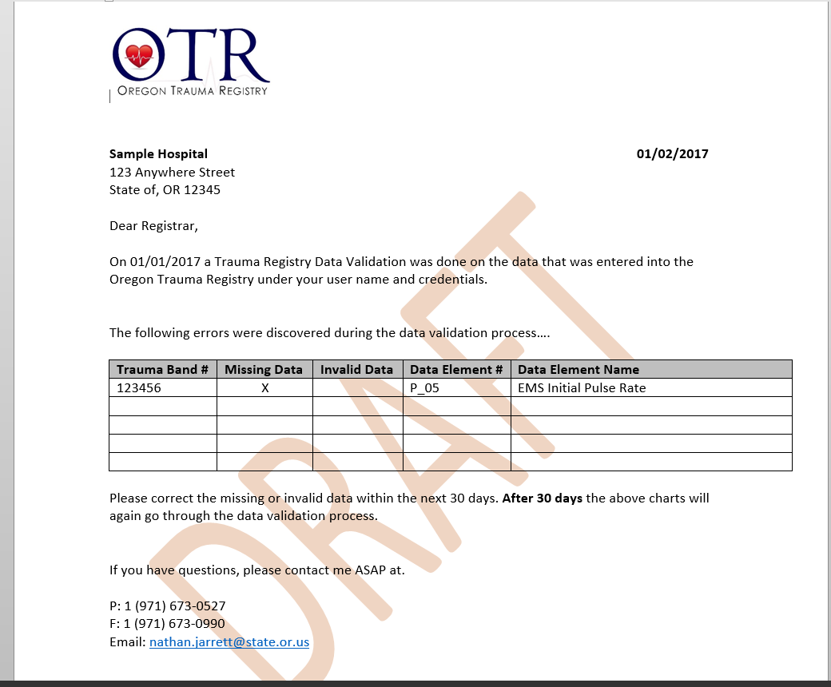
Feedback Letter

Slide 8
Questions?
Nathan C. Jarrett
State Data Administrator
800 NE Oregon Street
Suite 730 email: nathan.Jarrett@state.or.us
Portland, OR 97232
P (971) 673-0527
C (971) 334-2365

