Slide 1
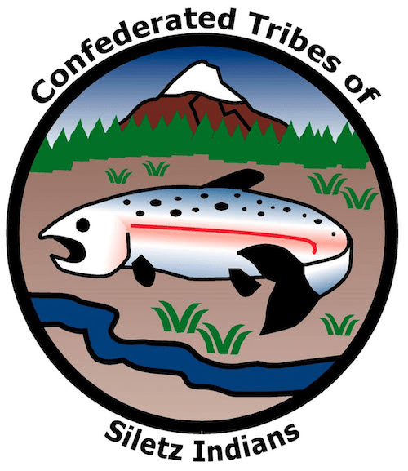
GRADE 6 Siletz Today: Caring for Our Lands

Slide 2
Discussion prompt
What responsibilities, if any, do humans have to care for and protect earth’s systems?
Notes:
What responsibilities, if any, do humans have to care for and protect earth’s systems?

Slide 3
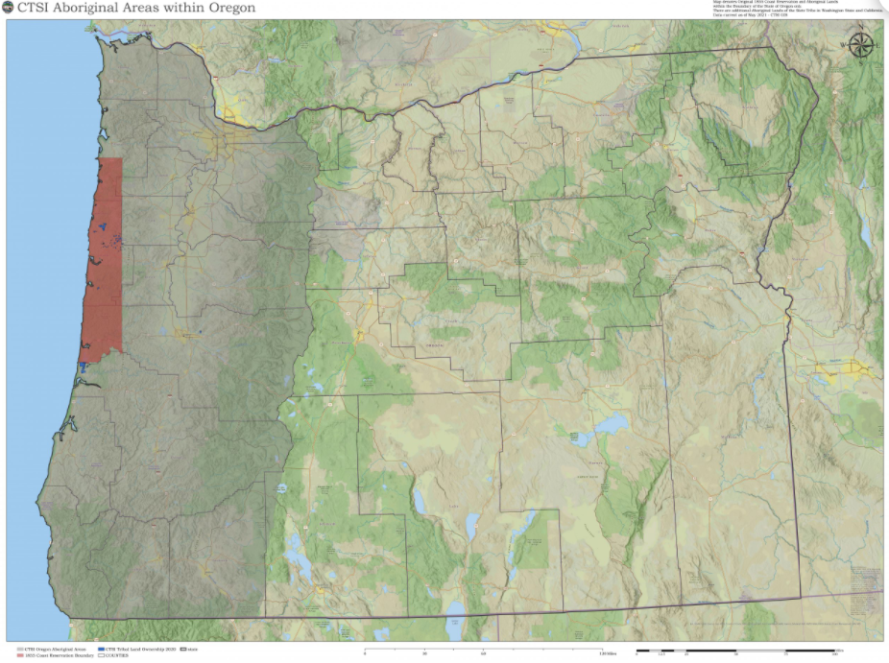
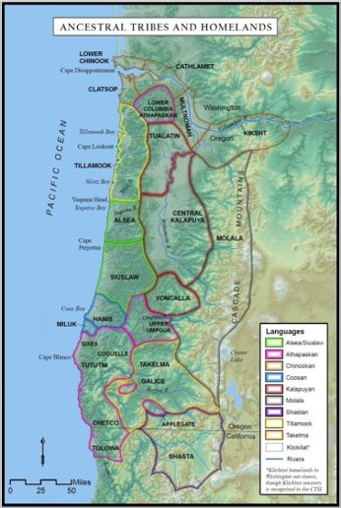
Siletz homelands
Image source: CTSI
Notes:
Ancestors of the Confederated Tribes of Siletz Indians come from many different Tribes and bands living in what is now western Oregon and parts of southwest Washington and northern California. These groups all developed land management practices best suited to the ecologies they lived in to support their lives and cultures.

Slide 4
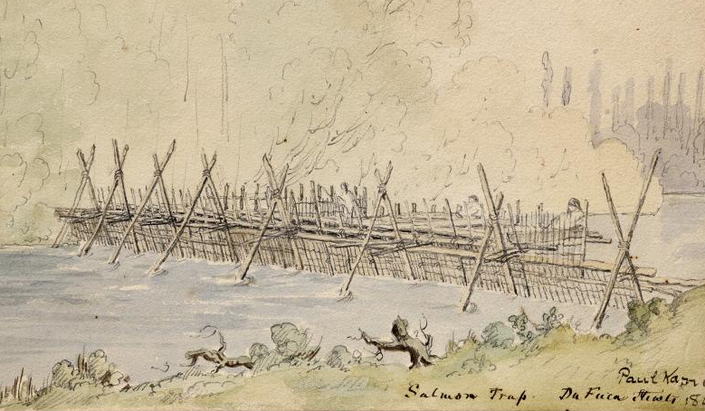
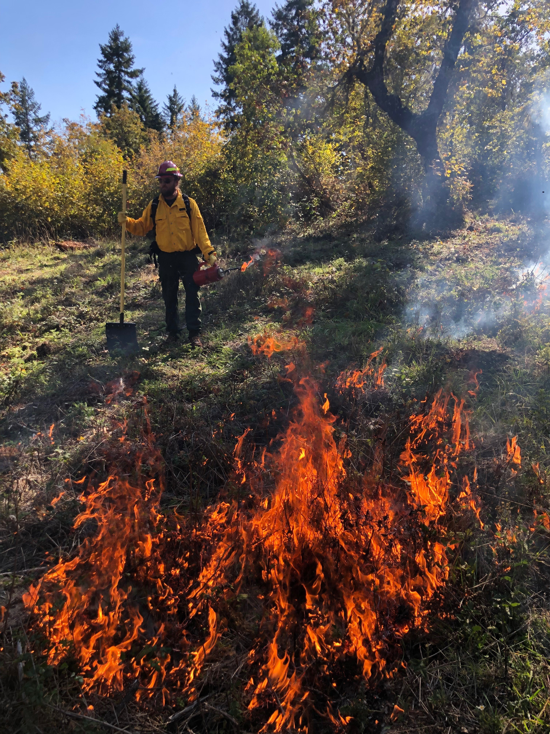
Siletz stewardship practices
Historic fish weir
Modern-day controlled burn
Images source: Weir: Stark Museum of Art
Notes:
Depending on their location, Siletz people built weirs and traps in rivers and estuaries to catch fish, practiced controlled burning of grasslands to control brush and improve hunting, and tended fields or beds of certain food and fiber plants to ensure a more predictable supply of food and useful materials. These practices often had a major impact on the environment. Fire especially played a major role in determining the plant and animal populations of the region. But while Native people had a large impact on the environment, their land-management strategies created healthy and resilient ecosystems.

Slide 5
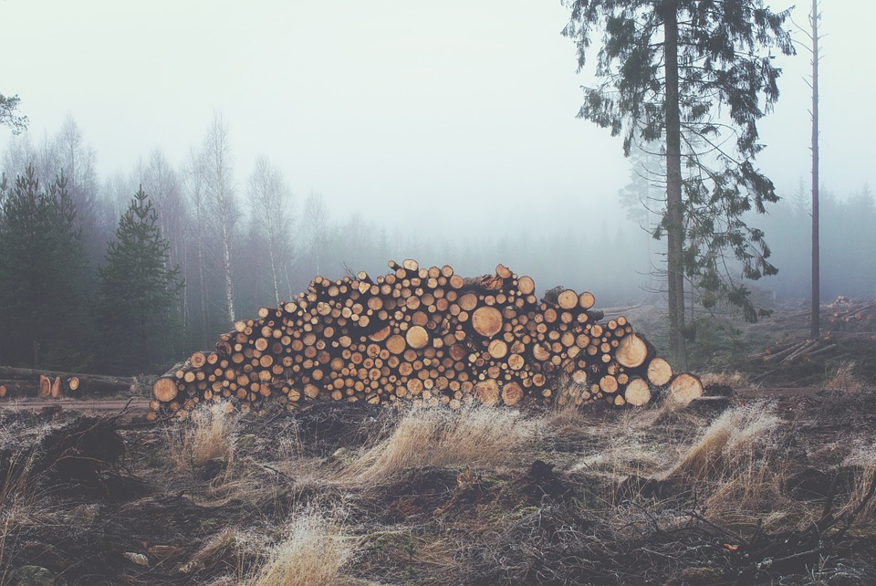
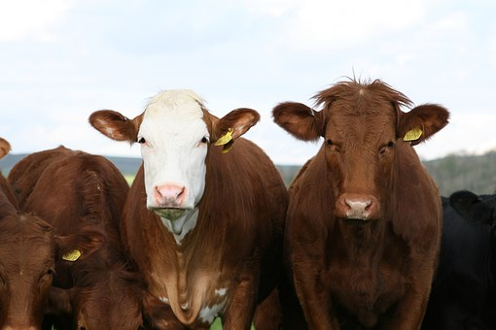
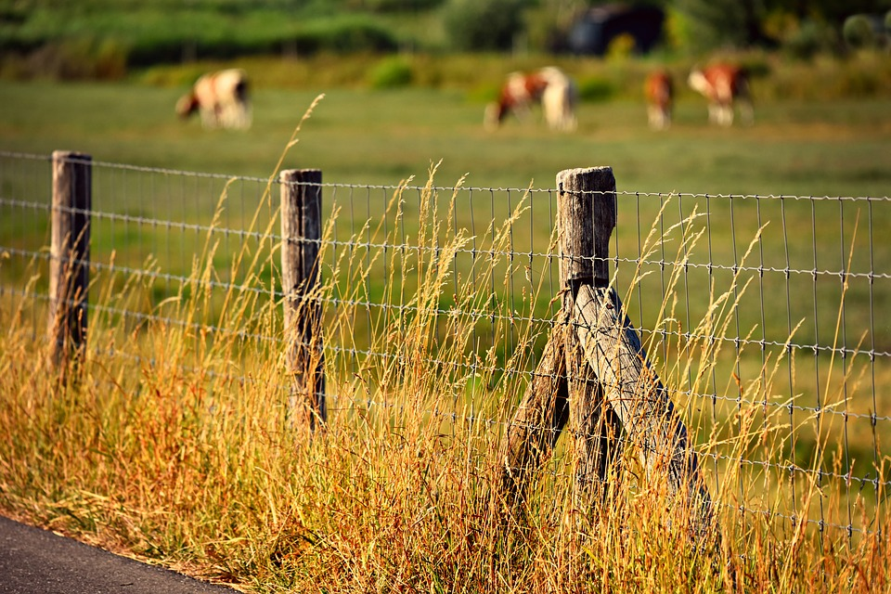
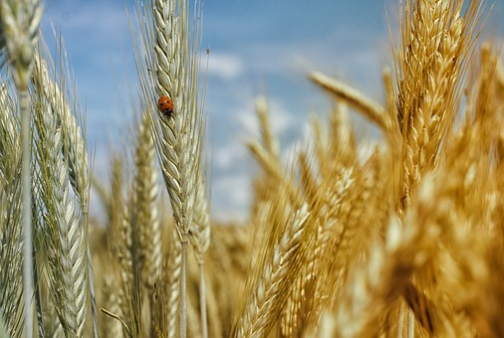
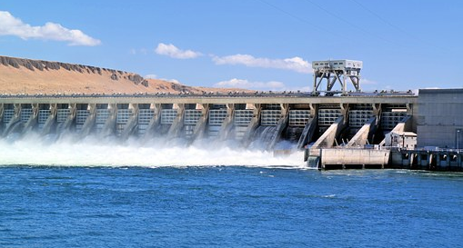
Impacts of settlement
Image source: Pixabay
Notes:
Several aspects of Euro-American settlement drastically changed the relationships between Oregon’s Indigenous peoples and their landscape. New diseases led to the death or disability of many Indigenous people. In some regions, like the Willamette Valley, more than 95 percent of the people who would have been tending the land died. From the early 1800s onward, fur traders trapped thousands of beavers and river otters to near extinction, which disrupted many waterways. Beginning in the mid-1850s, settlers coming to Oregon forced the different Tribes away from their lands onto a reservation at Siletz. Settlers brought cultural values and tools for interacting with the natural world that were different from those used by Indigenous people.

Slide 6
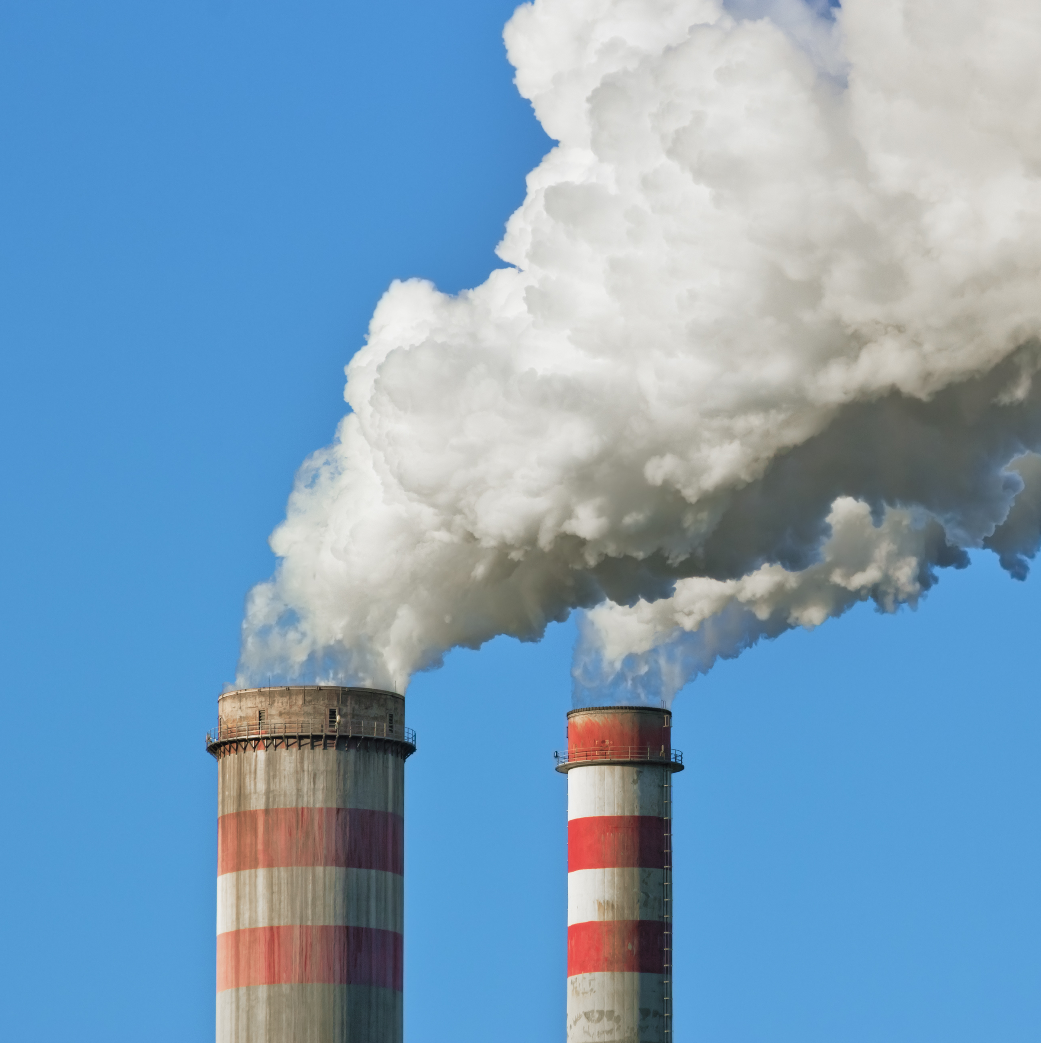
Conservation challenges
Fractured land ownership and uses
Pollution
Habitat loss
Native species extinction
Climate change
Image source: iStockPhoto
Notes:
These changes have been just as devastating for Siletz people, reducing access to much of their ancestral homelands as well as the ability to hunt, fish, and gather food in many of the places that have sustained them for generations. Even some of the sacred places that connected Siletz people to ancestral lifeways and cultural memories have been destroyed or are no longer accessible. The larger environmental disturbances that have reduced Oregon’s earth systems’ life-supporting capacities and compromised their natural resiliency are part of the same processes that removed Native people from their lands.

Slide 7
Siletz Tribal Natural Resources Department mission
It is the mission of the Siletz Tribal Natural Resources Department to care for, protect, enhance and provide for the wise use of all of the Tribe’s natural resources in a manner which will ensure that all generations to come will benefit from these resources. This philosophy applies to all lands to which the Tribe is historically tied, including its ancient, aboriginal, ancestral lands, its Coast Reservation, and its current and future land holdings.
Source: CTSI website
Notes:
Despite the oppression and assaults on their cultures and lands, the people of the Confederated Tribes of Siletz Indians have survived and persisted. Since restoration, the Tribes have worked to regain control or ownership of parcels of land within their peoples’ traditional homelands to help their members retain a connection to traditional lifeways and cultural practices, provide resources to support Tribal members, and steward resources for the benefit of future generations. In a moment, we’ll explore in detail how the Siletz Tribal Natural Resources Department (STNRD) supports the Tribes in carrying out this work.

Slide 8
Siletz stewardship practices
Natural resource management
Manage human use of land, water, and biological resources
Fish and wildlife management
Guide relationship between people and animals
Environmental protection
Control pollution; protect and restore natural resources
Research and education
Collect and share information about land, water, and biological resources and humans’ use of them
Notes:
The handout and slide identify different types of activities and services that states and Tribes use to manage the lands, waters, plants, and animals under their jurisdiction and how their citizens and others access and use them. Not every state or Tribe always offers all of them; for example, CTSI does not currently provide services for or enforce rules regarding the use of farmland.

